Slide 1
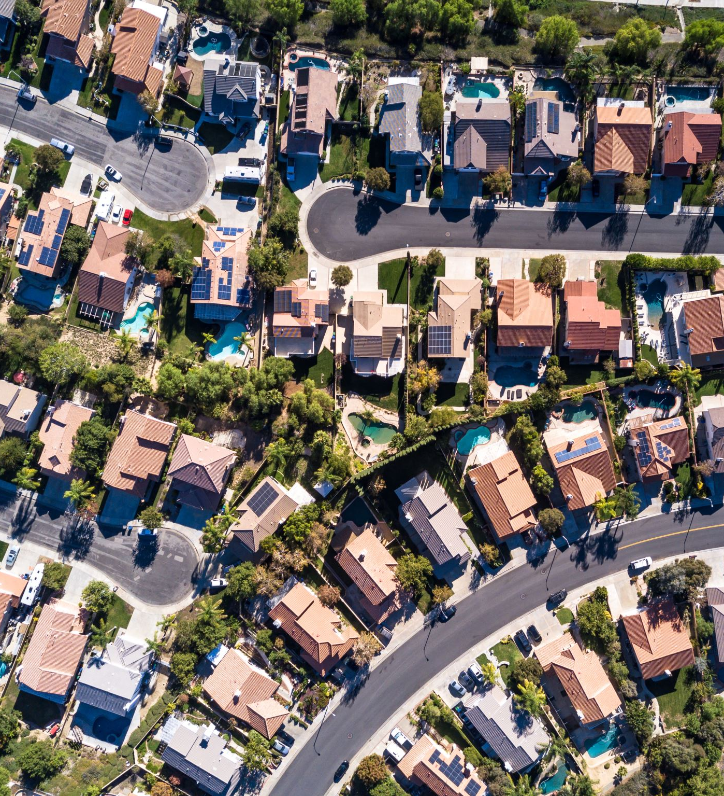
Analysis of San Francisco Housing Market
Exploration of displacement and gentrification phenomena
Pietro Bogani, Tomaso Castellani, Sara Tonazzi

Slide 2




Datasets
Main information:
Neighborhood
Price/mq
Date of the advertisement
# Beds, baths and rooms
Rent: it contains data about online rent advertisements in SF taken from Craiglist.
Address
Neighborhood
Date
Motivation of the eviction
Buyout amount
Evictions&Buyout: it contains the information of the eviction notices and buyout agreements emitted in SF during the period of study.
Construction: it contains all the permits of construction granted by the city of SF. We extracted the information regarding excusively housing buildings (with an increase of the units) in order to have an idea of the locations of the new houses built in the period of the study.
Address
Date (of emission)
Existing and proposed use
Existing and proposed units
Latitude and longitude of the vertices of the parcel
# houses for each parcel
Year of construction
Parcels: it contains the coordinates of the residential parcels units in SF.
All the dataset are referred to the period 2007-2018

Slide 3

Goals and research questions
How the housing market prices have changed? Are there differences between distinct neighborhoods? Can we observe a connection between prices, number of eviction notices/buyout agreements? Do they carry the same information?
How could the government act to fight the gentrification and displacement phenomena? Will the increasing of the housing supply mitigate rent increases or will it stimulate the demand for nearby housing by improving neighborhood quality?
Assuming that the number of eviction notices can be considered as a rough measure of the gentrification, how has it been during the past years and how can we expect it will evolve?

Slide 4


Goals and research questions
How the housing market prices have changed? Are there differences between distinct neighborhoods? Can we observe a connection between prices and number of eviction notices?
How could the government act to fight the gentrification and displacement phenomena? Will the construction of new houses produce an increase of the prices (because of an improvement of the quality of the neighborhood) or the opposite ( because of the increment of the offer )?
Assuming that the number of eviction notices can be considered as a rough measure of the gentrification, how has it been during the past years and how can we expect it will evolve?
Try to understand

Slide 5

Tentative analytical workflow
Exploratory analysis of the average prices and number of eviction notices for each neighborhood as functions of time
GAM model for : $rent price \sim neighborhood+\#new construction within 0.5 , 1 ,2.5 km+year$
GAM model for : $\#eviction notices \sim rent price+neighborhood +year+\#near new construction$
For point 2 we are planning to :
Compute the average price for each neighborhood for each year
Compute an «interpolated» price for each parcel as the average of the average prices of the neighborhood weighting on the distance (between centroids of parcel and neighborhood) for each year
Compute for each parcel the number of recent constructions for each parcel for each year within 0.5, 1 , 2.5 km
Build the GAM model and analyze the results
For point 3 we are planning to :

