Slide 1
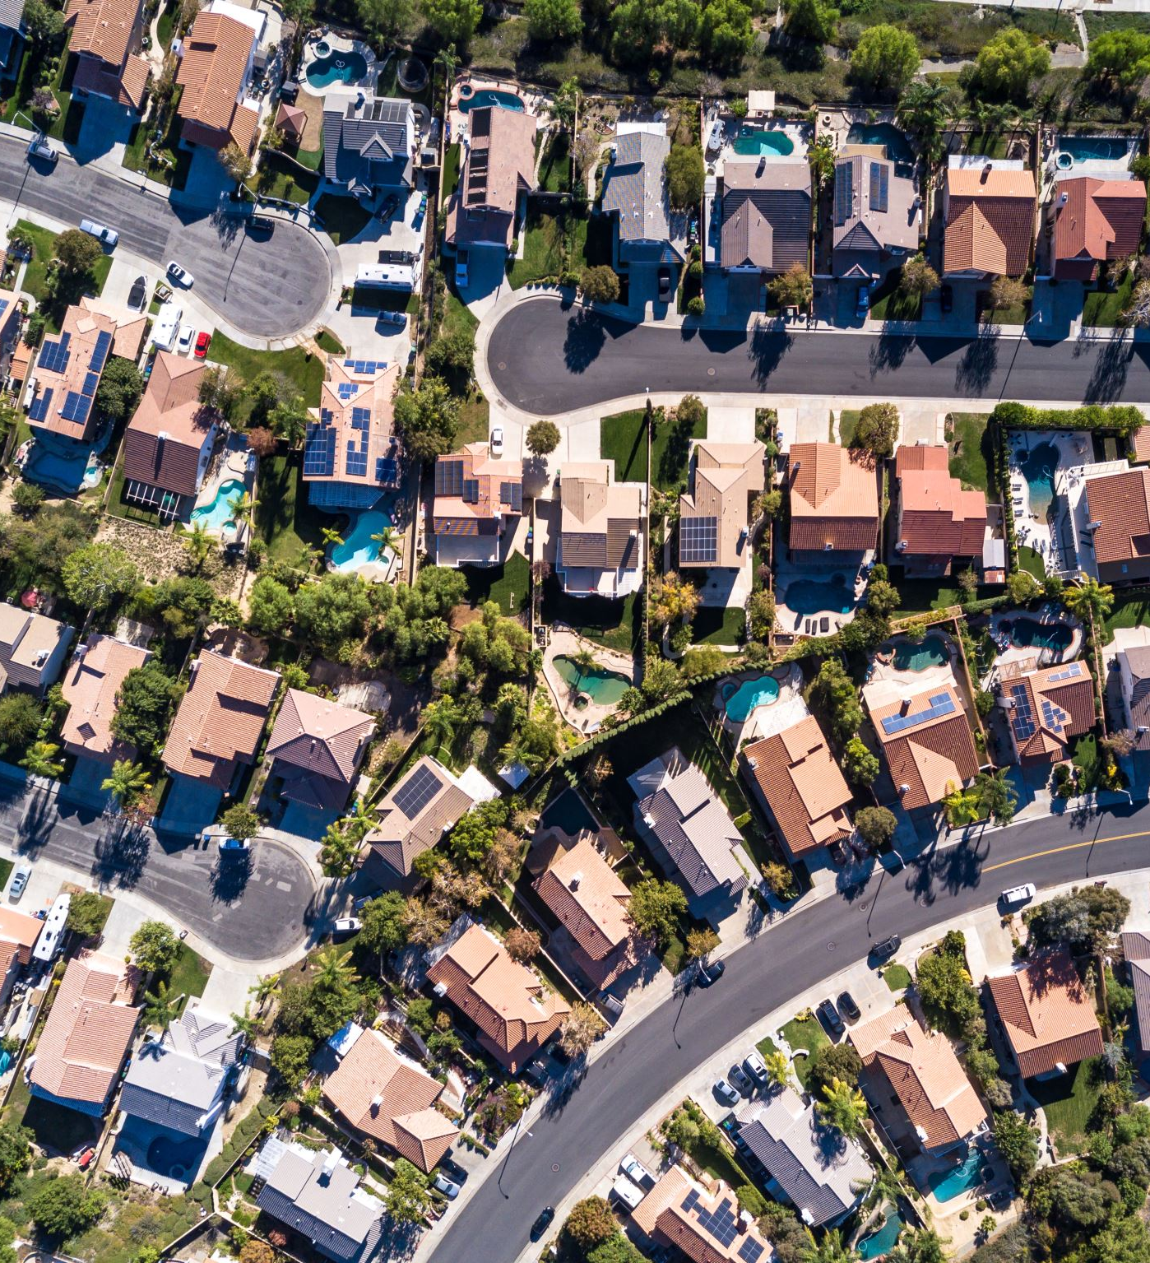
Analysis of San Francisco Housing Market
Exploration of Displacement and gentrification phenomena
Pietro Bogani, Sara Tonazzi , Tomaso Castellani

Slide 2




Datasets
Rent : it contains data about online rent advertisements in SF. In particular we are focusing on the information about neighborhood, rent/mq and time.
Evictions : it contains the information ( coordinates,neighborhood and time) of the eviction notices emitted in SF during the period of study.
Construction : it contains all the permits of construction granted by the city of SF. We extracted the information regarding excusively housing buildings in order to have an idea of the locations of the new houses built in the period of the study.
Parcels : it contains the coordinates of the parcels units in SF.
All the dataset are referred to the period 2008-2018

Slide 3

Goals and reasearch questions
How the prices of the housing market has changed? Are there differences between distinct neighborhoods?
How could the government act to fight the gentrification and displacement phenomena? Will the construction of new houses produce an increase of the prices (because of an improvement of the quality of the neighborhood) or the opposite ( because of the increment of the offer )?
Assuming that the number of eviction notices can be considered as a rough measure of the gentrification, how has it been during the past years and how can we expect it will evolve?

Slide 4

Tentative analytical workflow
Exploratory analysis of the average prices for each neighborhood as functions of time
GAM model for : $rent price \sim neighborhood+number of near constructions+ ….$
In order to construct this model we …..
GAM model for : $\#eviction notices \sim rent price+ ….$
In order to construct this model we ….

