Slide 1
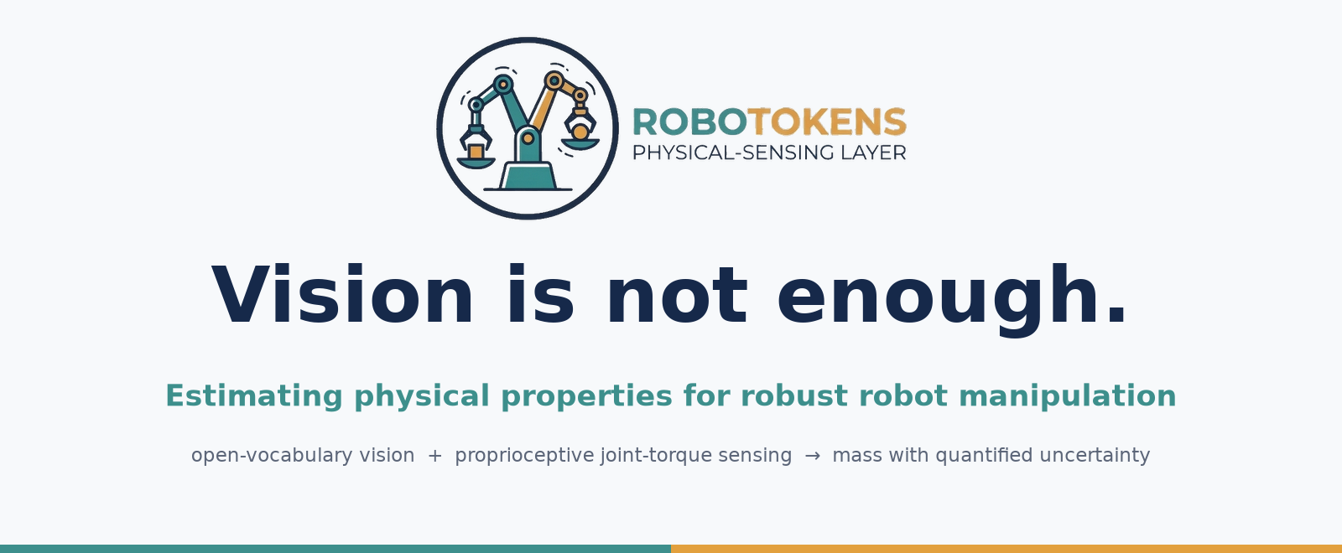
Real OpenArm v1 · MuJoCo digital twin · 3-minute pitch
Notes:
0:00-0:25 HOOK
Two cans. They look identical. One is full, one is empty. Any camera sees the same image twice. Vision is not enough. And that is exactly what robots rely on today.

Slide 2
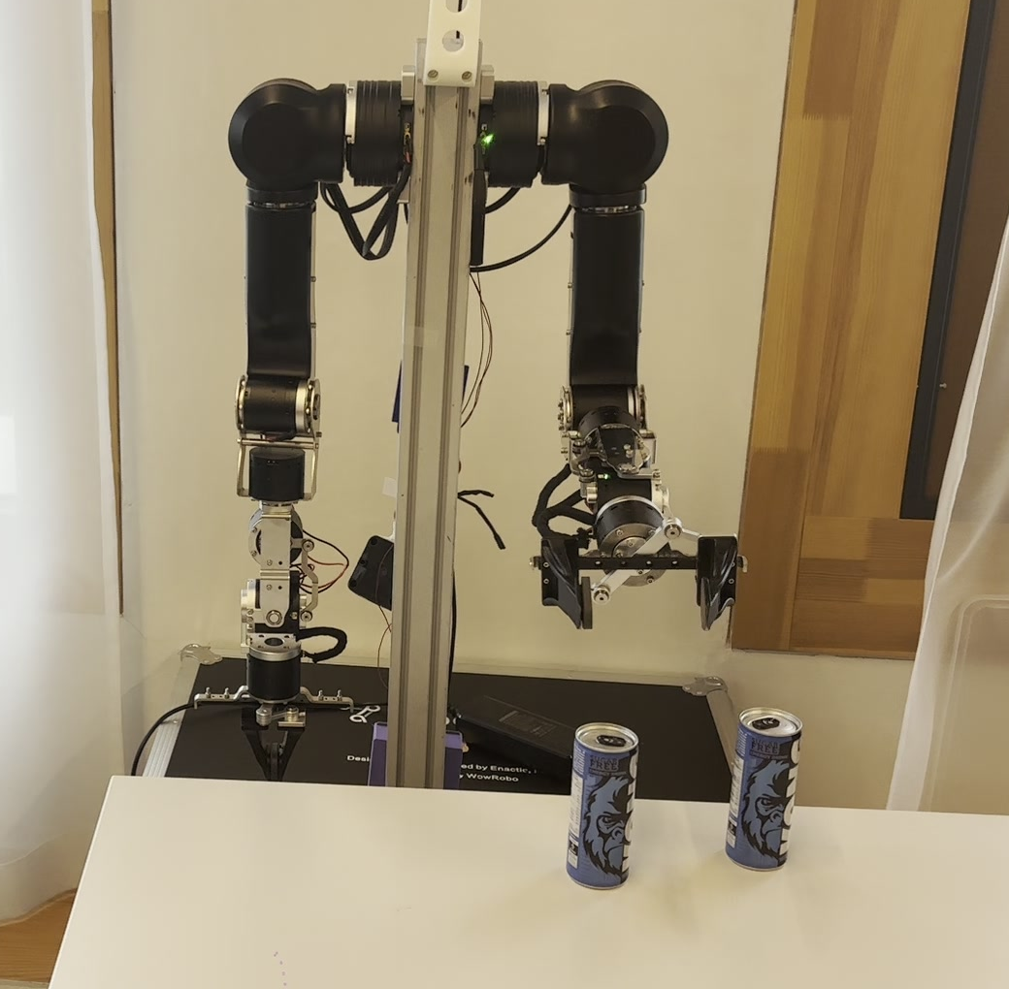
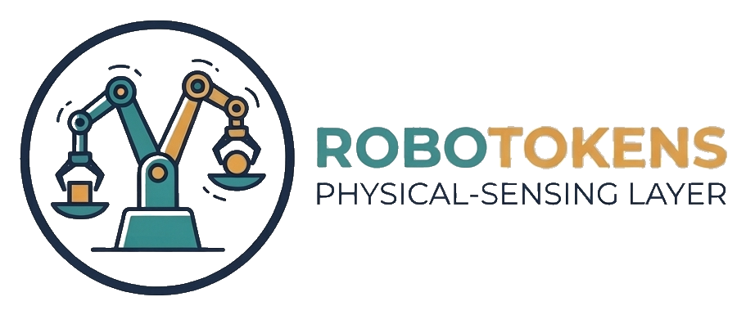
THE PROBLEM
Two cans. Same image.
Which one is full?
• A camera sees shape, colour and position.
• Mass, fill level and stiffness are invisible.
• Physical AI needs physics: these properties are revealed only by interaction.
Vision-only robots guess. Sorting, handover and lab handling fail when objects look alike.
Our OpenArm in front of two look-alike cans. One is full, one is empty.
RoboTokens · Vision is not enough
2
Notes:
0:25-0:55 PROBLEM
Physical AI has to deal with physics: mass, stiffness, fill level. You cannot see those. You only learn them by interacting with the object. A robot that sorts parcels, hands a tool to a person, or loads a lab rack makes wrong decisions the moment two objects look the same.

Slide 3
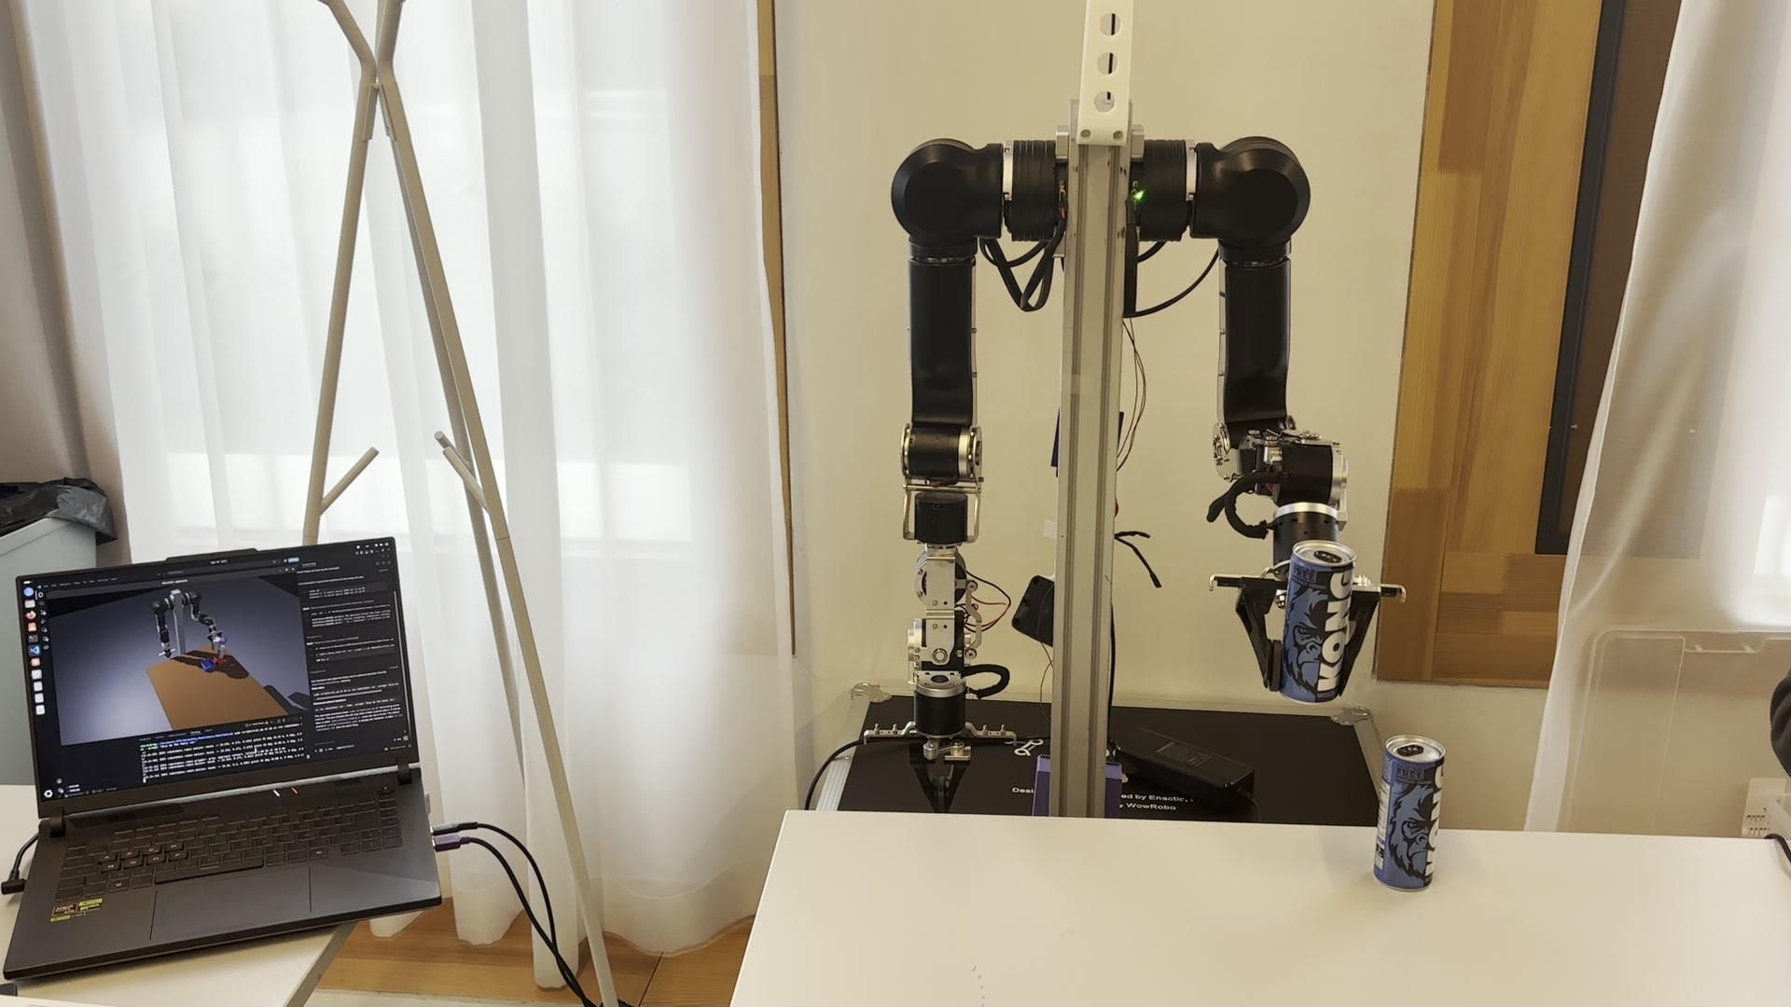
OUR IDEA
The arm is the sensor.
Lift
the object
Read
the joint torques
Estimate
mass ± uncertainty
How: a mass m at the hand adds Jz(q) · m · g to the joint torques. A 1° dither cancels friction; least squares gives m and its standard error.
No load cell
uses the torques the motors already report
No wrist sensor
no added hardware on the arm
Software only
a layer on top of the vision pipeline
RoboTokens · Vision is not enough
3
Notes:
0:55-1:30 OUR IDEA
RoboTokens adds a physical sensing layer. The arm already carries the sensor we need: every joint reports its torque. We lift the object, read the joints, and estimate its mass. No load cell, no extra hardware, just software. The result is a mass with an uncertainty, not a guess.

Slide 4
LIVE
Demo: “Give me the heavy can.”
1
See
GroundingDINO + SAM2 find the two cans from the sentence
2
Weigh
lift each can, mass from the joint torques
3
Decide
act only if z = Δm / SE ≥ 3; else re-measure, else refuse to guess
4
Hand over
carry the heavy can to the person
Real OpenArm v1: detecting, lifting and weighing two look-alike cans, with the MuJoCo twin on the laptop. Backup if the live run fails: click to play.
5
Release
open the gripper only when contact is felt
RoboTokens · Vision is not enough
4
Notes:
1:30-2:10 LIVE DEMO (run: robotokens run, default task 'Give me the heavy can.')
I say: give me the heavy can. Vision finds the two cans. The robot lifts each one, weighs it, and compares them statistically. Only when the difference is clear does it act. Then it carries the heavy can to me and holds it. It opens the gripper only when it feels me take it. If the evidence is weak, it re-measures, and if it is still unclear, it refuses to guess.
If the live run fails: say 'the robot refused to guess' and play the video on this slide.

Slide 5
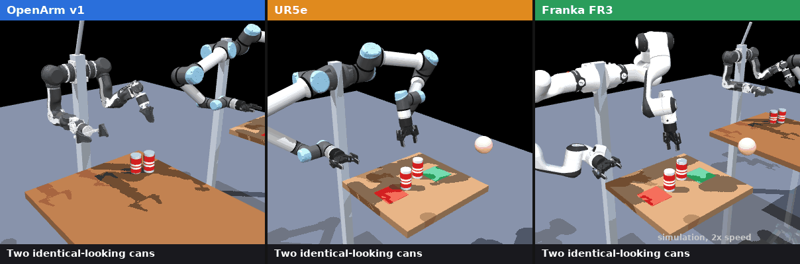
CROSS-EMBODIMENT SIMULATION
Same recipe, three different arms.
MuJoCo, 2x speed: each arm lifts two look-alike cans, wiggles its joints to weigh them, and puts them back. Simulation, not hardware data.
RoboTokens · Vision is not enough
5
Notes:
2:10-2:20 EVIDENCE (part 1)
We also simulated the same recipe on three different arms: OpenArm, UR5e and Franka. (Let the animation run for a few seconds.)

Slide 6
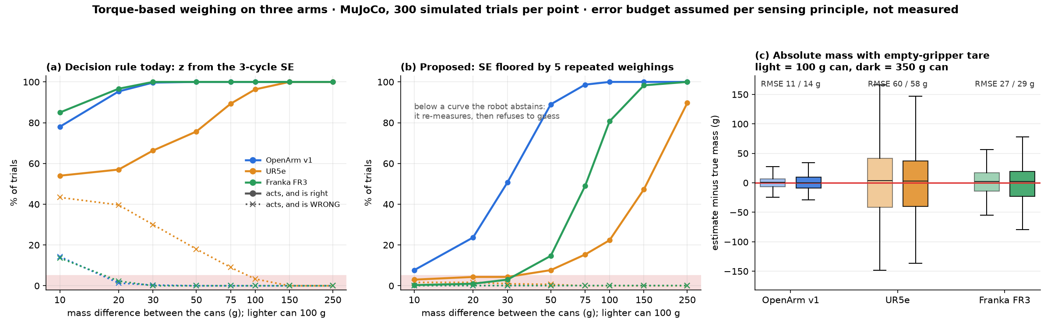
RESULTS
Evidence, stated honestly.
HARDWARE
Full pipeline end to end on the real OpenArm: see, weigh, decide, hand over.
SIMULATION
Realistic error budget. Full vs. empty: 300 / 300 on all arms. OpenArm resolves ~20–30 g.
TO FIX / NOT YET
Uncertainty is overconfident below ~20 g: add a repeatability floor. Real benchmarks next.
RoboTokens · Vision is not enough
6
Notes:
2:20-2:35 EVIDENCE (part 2), honestly
On the real OpenArm, the full pipeline runs end to end. In simulation we added realistic error sources: drift, friction, ripple, grasp position, model error. Full versus empty is resolved on all three arms every time; the OpenArm resolves about 20 to 30 grams. And the simulation showed us something to fix: today the robot is overconfident on tiny differences. With a floor from repeated weighings it stops acting wrongly and abstains instead. Real benchmarks on the robot are our first next step.

Slide 7
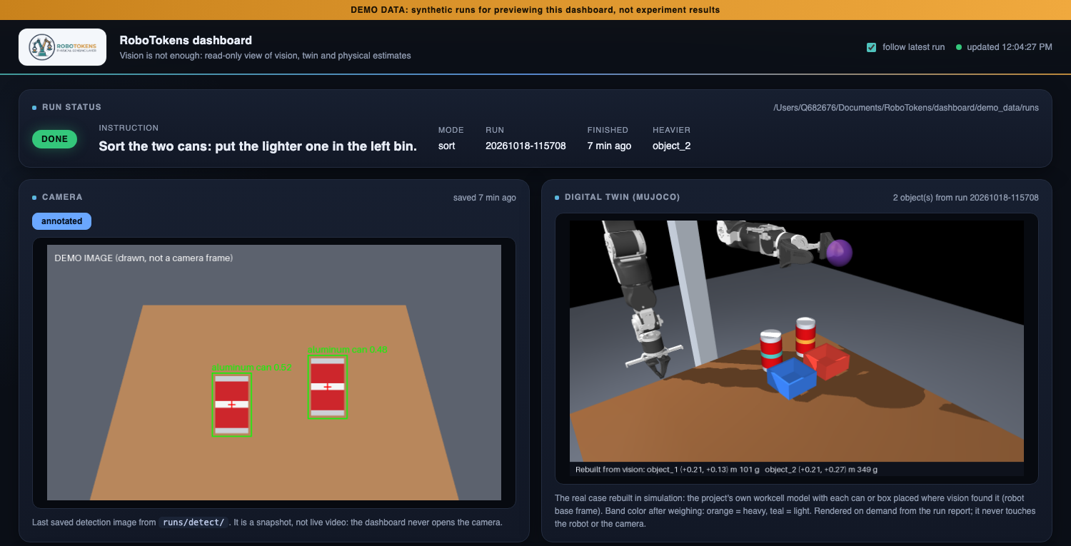
USE CASES
Why it matters.
Warehouse picking
Weight checks catch mis-picks, today with extra scales. We check inside the grasp.
Lab & pharma
Fills are verified by weight. A screening check in flexible cells.
Assistive robots
Hand-over must release at the right moment: on felt contact.
Robot learning
Measured physical labels instead of appearance-based guesses.
Every run is auditable. Dashboard: camera detections, MuJoCo twin rebuilt from vision, mass ± error, decision, live joint torques. (Shown with demo data.)
RoboTokens · Vision is not enough
7
Notes:
2:35-2:55 WHY IT MATTERS
Warehouses already check weight to catch mis-picks, but with extra scales. Labs verify fills by weight. Assistive robots must hand things over safely. We bring that check into the grasp itself. Every run produces an auditable report, and our dashboard shows the vision, the digital twin and the live torques.

Slide 8
WHO WE ARE
The team.
PD
Z
JY
?
Pietro Dardano
Ziad
Jiwon You
[Name]
[role]
[role]
[role]
[role]
RoboTokens · Vision is not enough
8
Notes:
TEAM
(Optional, a few seconds) Introduce the four of us, or let this slide stay up during questions.

Slide 9
Vision tells the robot what to pick.
Interaction tells it what it picked.
Vision is not enough.
Notes:
2:55-3:00 CLOSE
Vision tells the robot what to pick. Interaction tells it what it picked. RoboTokens: vision is not enough.

