Slide 1
Votestats
Simplify your voting
By:

Slide 2
Introduction:
Votestats is a Secure, Cloud based election ,proactive and easy-to-use with interface that’s run well on all internet enable devices
Elections are optimized for desktop and mobile devices. Voters can vote from a web browser or our iOS & Android apps.
Personalize your election with your organization's logo and colors.
Each voter has a unique "Voter ID" and "Voter Key" and can only vote once.
Votestate enables you to vote and view the results of contests in real time.
All the votes are secured can’t be manipulated and automatically calculated

Slide 3
Problem statement:
After realizing that there are so many problems in voting process, we have decided to develop this app to solve them.
Associated problems are:
Missing out their ids.
Inability for physical disable persons
Mixed Calculation of collection of Ballot papers
Time management

Slide 4
Solution:
Votestats is an electronic voting system which make voting Easy
It provide an id for every one
Reaching out all people both Disabilities persons
Accurate Calculation of collection of Ballot papers
It saves time

Slide 5
USERS
Segment using gender: We are targeting all gender . Mainly the female.
Segment using geographical model: our target are people with android /IOS phone and computers with internet.
Segment using : deals with personalities
Segment using users needs

Slide 6
Product differentiation:
Guidelines and Reviews are provided for voter
Deals with all people with internet
Makes life more easier

Slide 7
Cost effectiveness:
All Smart Devices (Android & IOS)
Internet charges
ID Creation
Advanced security

Slide 8
Objectives:
Making elections easy for everyone
Saving time and make people vote from everywhere
Making elections secured.

Slide 9
Votestats Reviews
Votestats works with all smartphones (Android or IOS) also as a desktop app with a supported browser the latest web standards.
Vote in your school/organization's elections that are powered by VoteStats. Votestats makes it easy for you to build and launch elections for your school/organization. If you'd like to run an election, visit https://drive.google.com/open?id=19ZwOqVFx398v-CID1a2YS0TLqbowJbLT to create an account and build your first election.

Slide 10
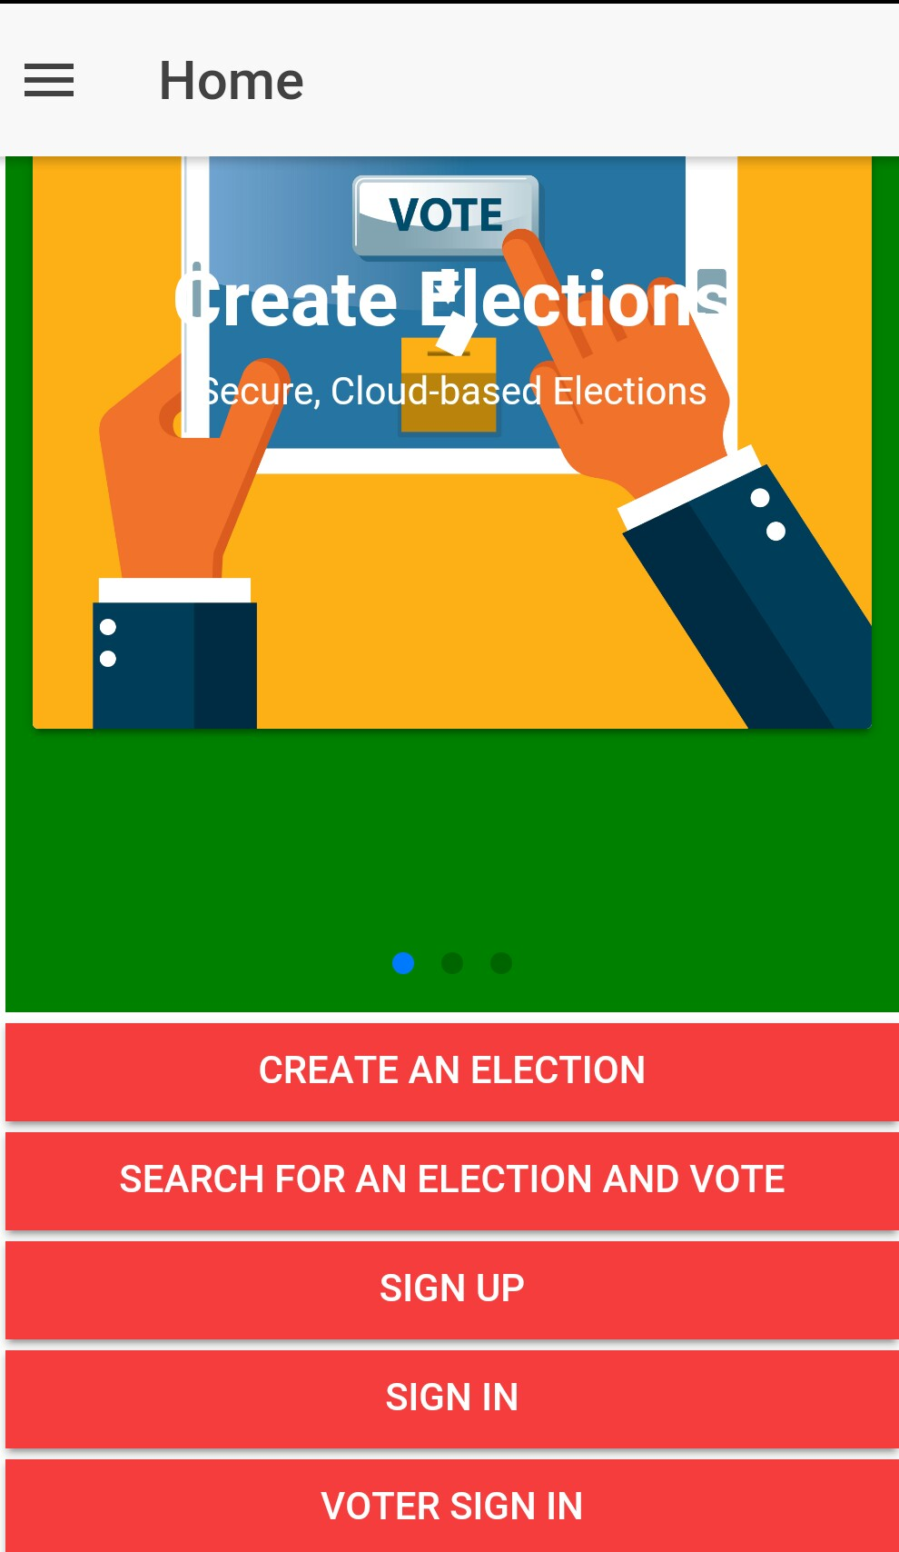
Interface 1

Slide 11
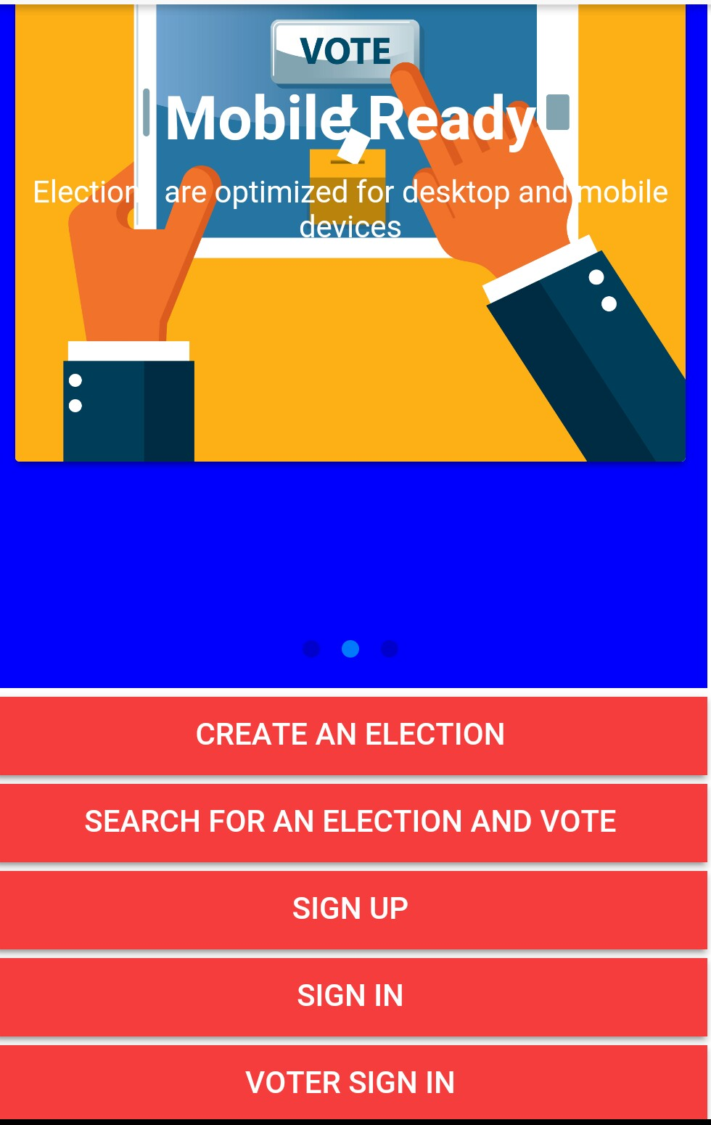
Interface 2

Slide 12
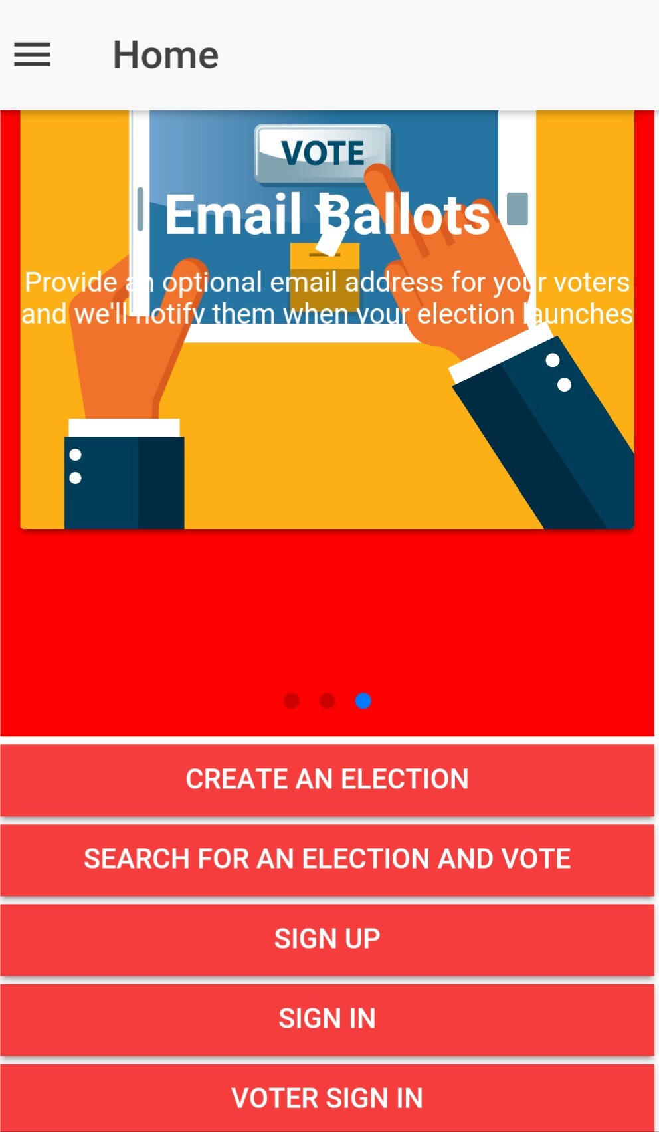
Interface 3

Slide 13
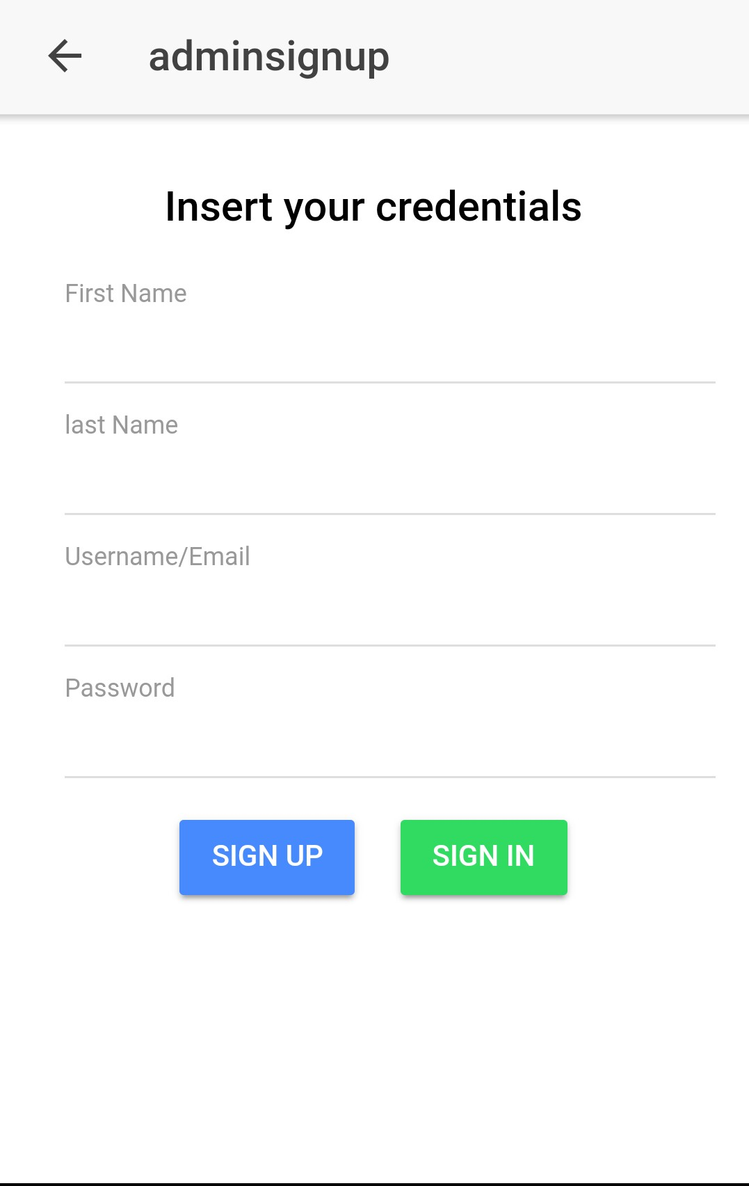
The log-in Interface for the Admin:

Slide 14
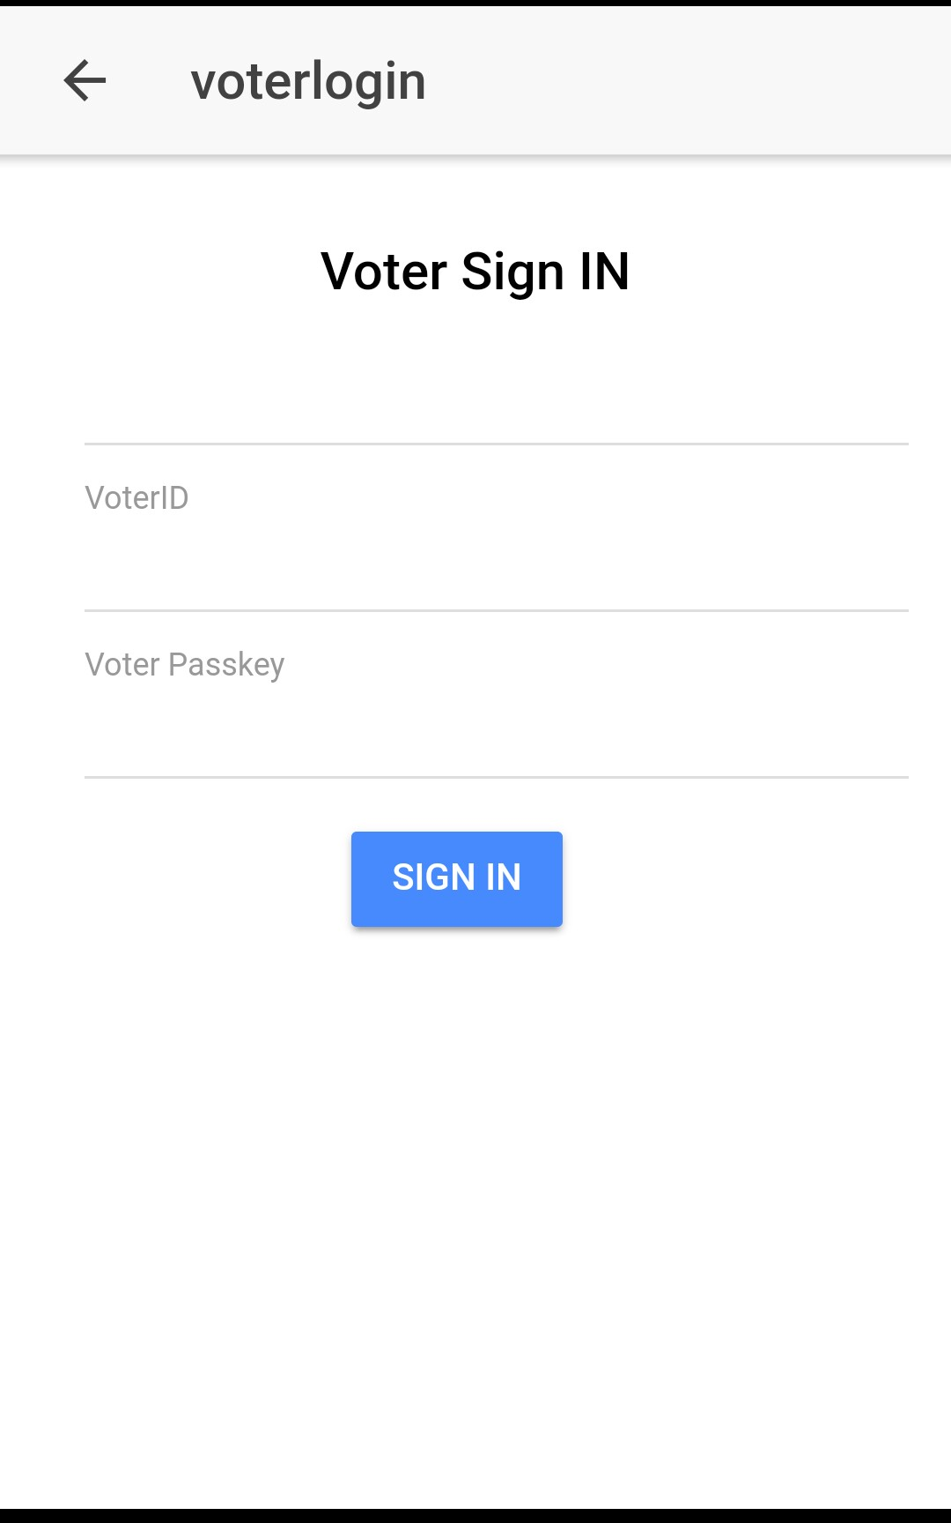
The log-in page for voters

Slide 15
Application Guidelines
Easy to use, As an admin Just sign-up for a free voting , Create election , Input candidates, Input the date and time of the Election
For voting , sign-in from voters log-in button, inter your info. Then vote.
voting is always free for your participants and no signup needed on their part.
Votestats Have a method of limiting people from voting multiple times. Disclosing our methods would only give potential multi-voters ideas on how to circumvent our process. To ensure people can only vote once, you can set up a contest to require authentication in order to vote.
You must have an active e-mail address and valid ID to enable you to vote
You can also search for election from search button

Slide 16
Sustainable Development Goals
Democracy: With Votestats everyone around the globe get to conduct a free and fair Election.
Student in the university or collages also practice the application of casting their vote and the right to be voted for.
The Government also get to select a delegate to hold any official position without any form of election rigging because all votes are rightly secured.

