Slide 1

Bike sharing forecasting through Bayesian networks

Slide 2
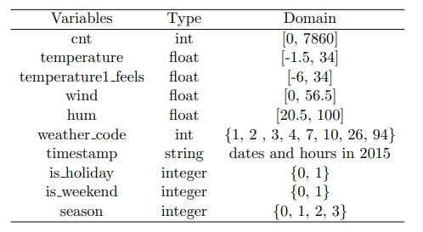
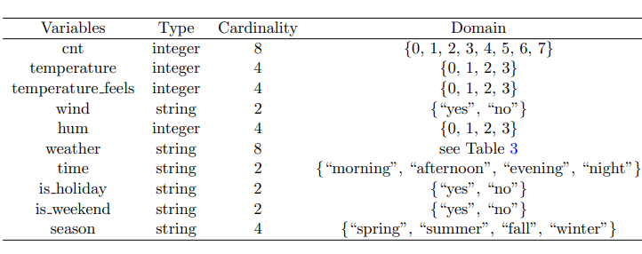
London bike sharing datasetdataset
BEFORE PREPROCESSING
AFTER PREPROCESSING

Slide 3
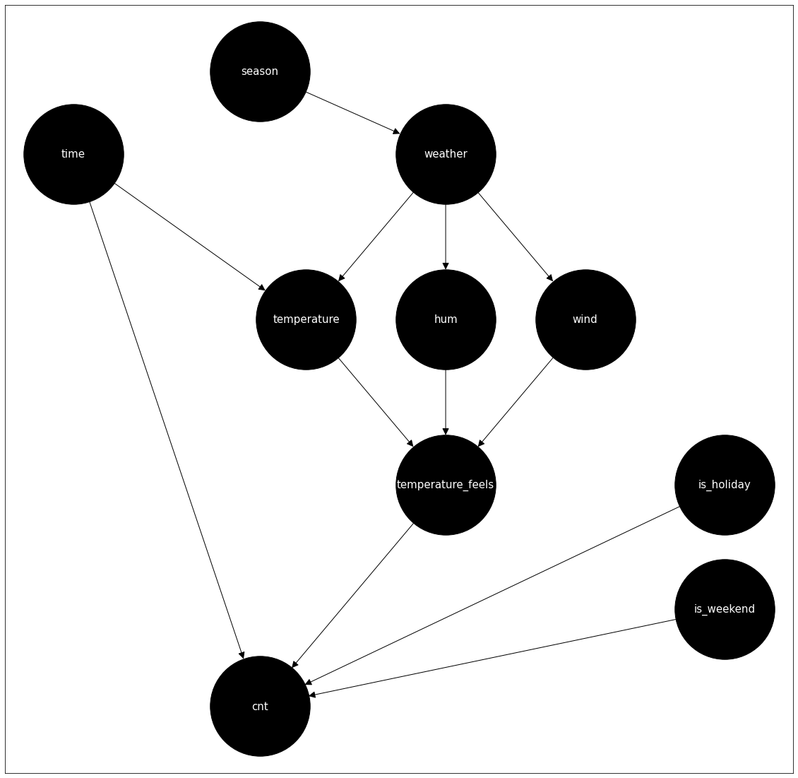
Construction of the Bayesian Network
network = BayesianNetwork()
network.add_nodes_from(["cnt", "temperature", "wind", "weather", "is_weekend", "season", "time", "temperature_feels", "hum", "is_holiday"])
network.add_edge("season", "weather")

Slide 4

Conditional probability tables
We developed a function devoted to generate the table of conditioned probabilities associated to a specific variable.
For each value of a variable X we computed the conditioned probabilities of the variable given all the possible combinations of values of parents P₁, …, P_{n} as follows:
$$\text{P}\text{ (}\text{X}\text{=}\text{xi}\text{ | }\text{P}\text{1}\text{= }\text{p}\text{1}\text{, …,}\text{P}\text{n}\text{= }\text{p}\text{n}\text{) }=\frac{\text{Nrows}\text{ (}\text{X}\text{=}\text{xi}\text{ , }\text{P}\text{1}\text{= }\text{p}\text{1}\text{, …,}\text{P}\text{n}\text{= }\text{p}\text{n}\text{) }}{\text{Nrows}\text{ (}\text{P}\text{1}\text{= }\text{p}\text{1}\text{, …,}\text{P}\text{n}\text{= }\text{p}\text{n}\text{) }}$$

Slide 5
Exact inference with variable elimination
Query 1
infer_non_adjust.query(variables=["cnt"], evidence = {"temperature": 0, "wind": 1, "weather": 4, "season": 3})
Query 2
infer_non_adjust.query(variables=["time"], evidence = {"cnt": 0})
Query 3
infer_non_adjust.query(variables=["temperature_feels"], evidence = {"wind": 0, "hum": 2})
Query 4
infer_non_adjust.query(variables=["cnt"], evidence = {"temperature": 2, "wind": 0, "weather": 1, "season": 1})
Query 5
infer_non_adjust.query(variables=["is_holiday"], evidence = {"cnt": 1, "temperature_feels": 3})

Slide 6
Query 1
cnt | p(cnt | E)
(47, 473] | 0.2583
(473, 753] | 0.1790
(753, 992] | 0.1720
(992, 1256] | 0.0925
(1256, 1595] | 0.0866
(1595, 2066] | 0.0881
(2066, 2762] | 0.0629
(2762, 7860] | 0.0605
E = {temperature = [−1, 7.75], wind = yes, weather = rain, season = winter}

Slide 7
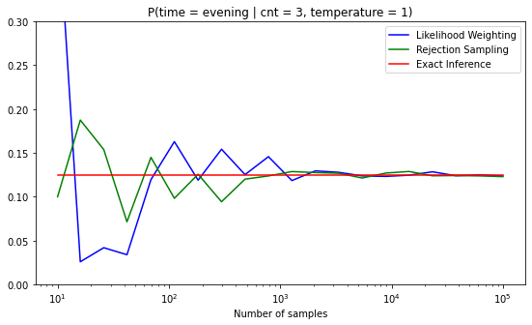
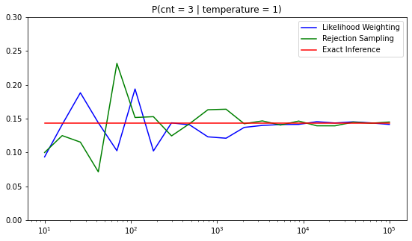
Approximate Inference
cnt = 3 => (992, 1256]
TEMPERATURE = 1 => (7.75; 16.5]

Slide 8
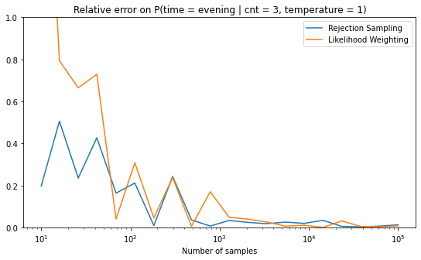
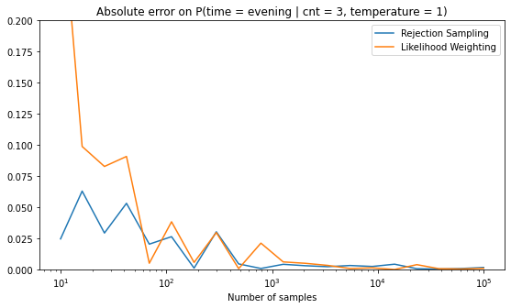
Errors using approximate inference

