Slide 1
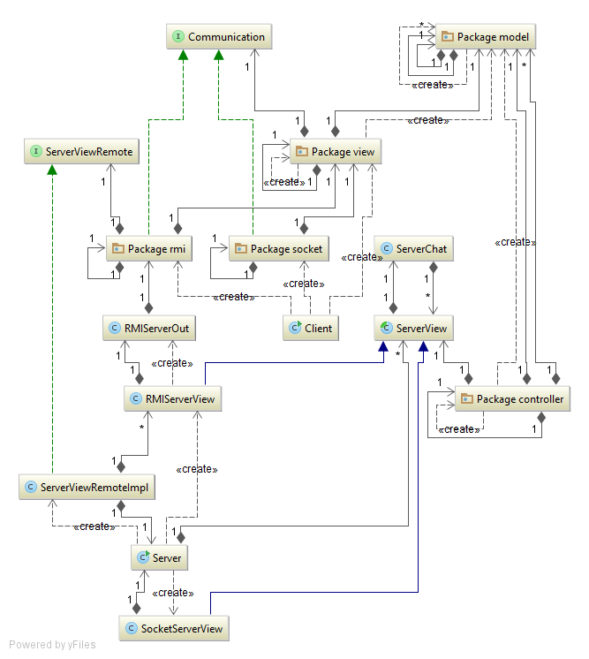
MVC Pattern
The whole architecture of the application follows the MVC pattern, the model contains all the information about the game and the controller manages it. The view is composed by two parts, one on the server side and the other on the client side, that communicate with each other.

Slide 2
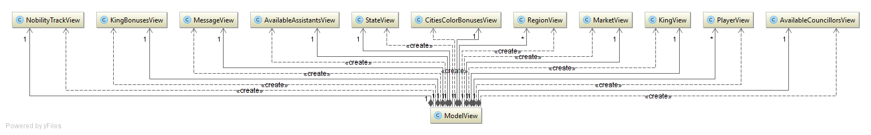
ModelView
We choose to implement a ModelView class which is an always updated deep copy of the game.
In this way the View hasn’t a reference to the proper model but it’s still able to refresh itself without communicate with the controller.
Every main component of the game is observed by a ComponentView class. Each of them updates itself when needed and notifies the ModelView class that sends the updates to the View.

Slide 3
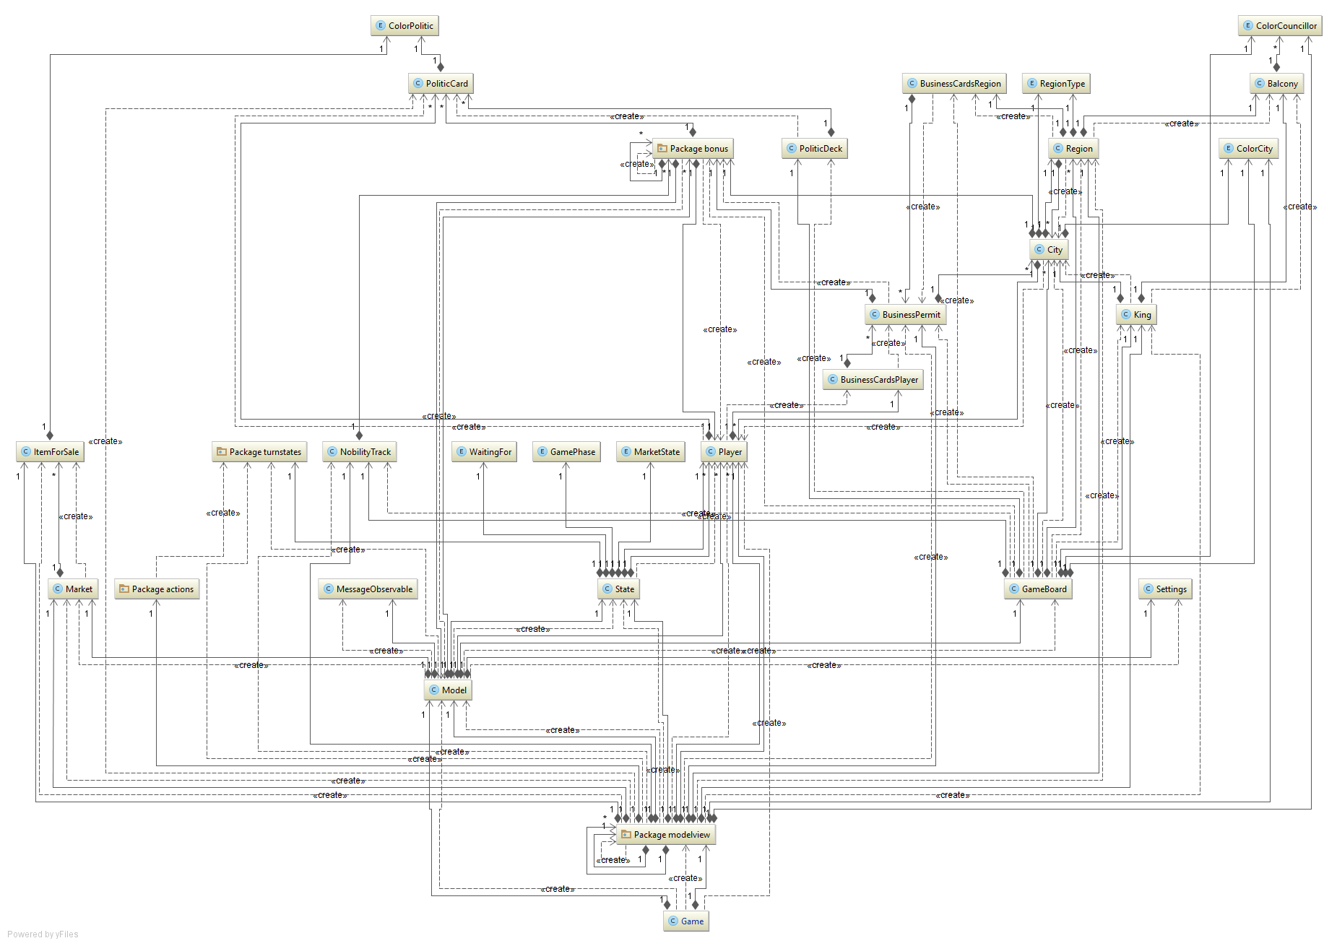
Model

Slide 4
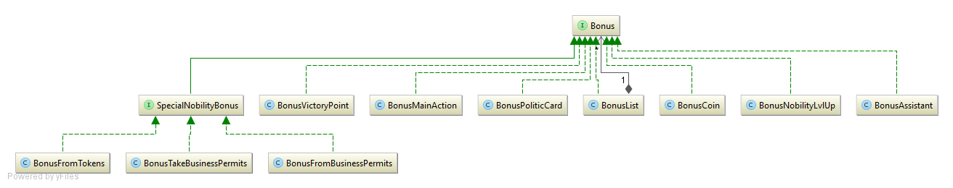
Bonus

Slide 5
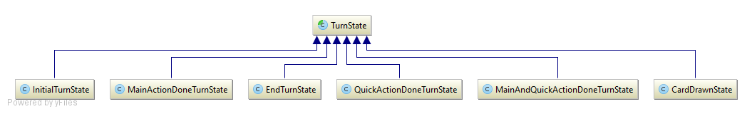
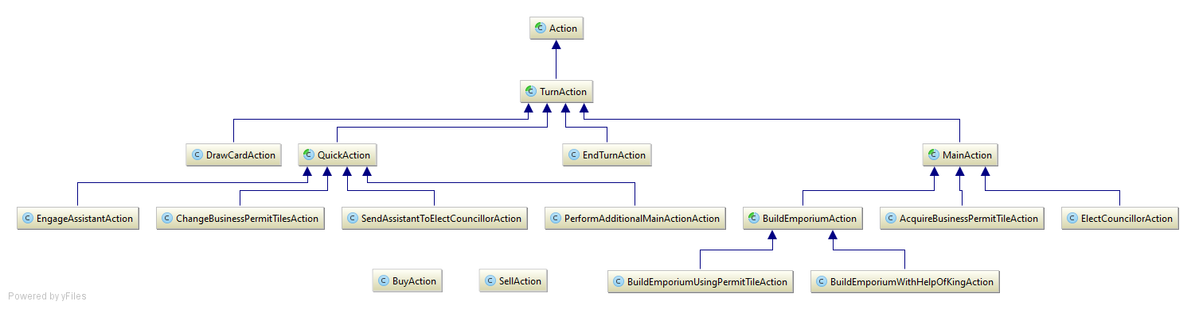
Turnstate & Action

Slide 6




Turn State Machine
J (if additionalMains==0)
B,C,D,E
I (=>additionalMains++)
B,C,D,E (if additionalMains>0)
A
F,G,H
J
I (=>additionalMains++)
B,C,D,E (if additionalMains>0)
ACTIONS
DrawCardAction
AcquireBusinessPermitTileAction
BuildEmporiumUsingPermitTileAction
BuildEmporiumWithHelpOfKingAction
ElectCouncillorAction
ChangeBusinessPermitTilesAction
EngageAssistantAction
SendAssistantToElectCouncillorAction
AdditionalMainAction
EndTurnAction
F,G,H
B,C,D,E
additionalMains is an attribute of MainActionDoneState, QuickActionDoneState and MainAndQuickActionDoneState used as counter for the remaining MainAction.

Slide 7
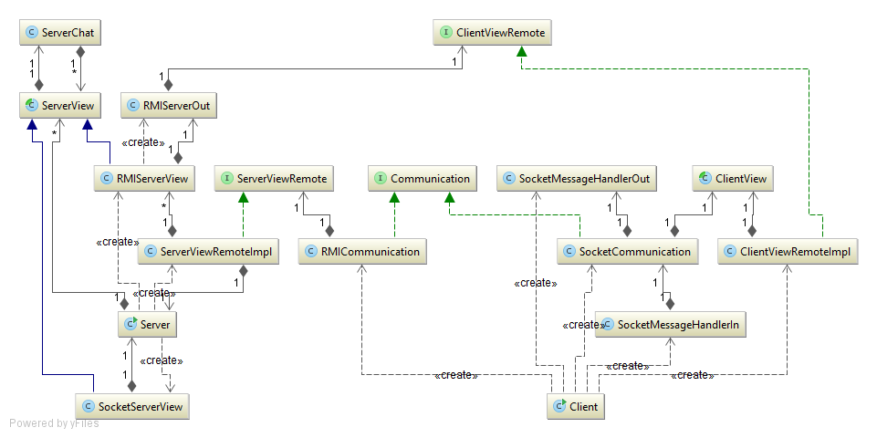
Implemented features: rmi/socket connection
Server and clients can communicate through RMI or Socket connections.
The exchange of information is developed between the ServerView and the ClientView classes which work as if they were just one View.

Slide 8
Implemented features: chat
Server and clients can communicate through RMI or Socket connections.
The exchange of information is developed between the ServerView and the ClientView classes which work as if they were just one View.
The ServerChat class is responsible for collecting message from a player and for forwading it to all players.

Slide 9
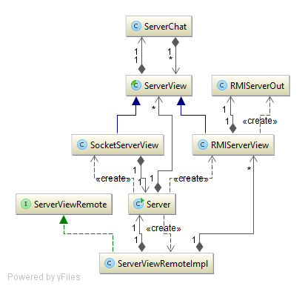
Server connection side
Any ModelView update is received by the ServerView which is responsible for forwarding it to the ClientView. This will result in CLI or GUI updates.
When 2 Clients are connected to the Server a 20 seconds timer is set. After this time the game starts. The number of players in a single game is set by default to 4 but it can be easily changed.
If there is no available game when a player connects to the server a new one is created.

Slide 10
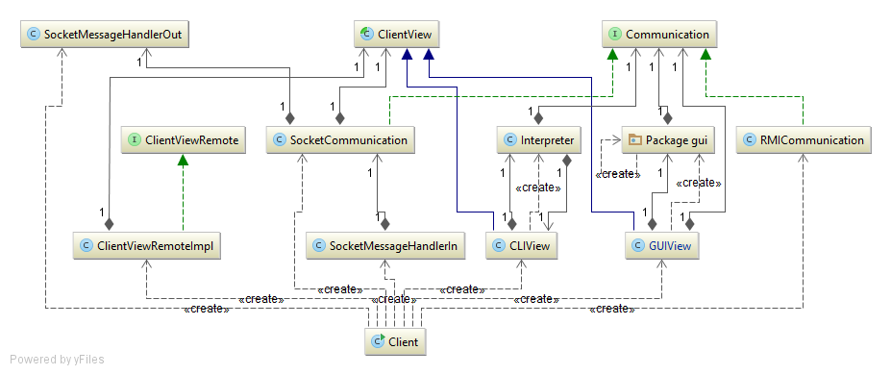
Client connection side
Any message from the Server is handled by the specific socket or RMI class, while the Communication class is responsible for forwarding any message from the ClientView (either CLI or GUI) to the Server using the proper RMI or Socket class.

Slide 11
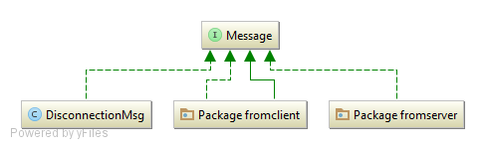
Message
In general Messages allow communication between Server an Clients.
DisconnectionsMsg is specifically used by the Server to inform the Controller class that a player is no longer connected.

Slide 12
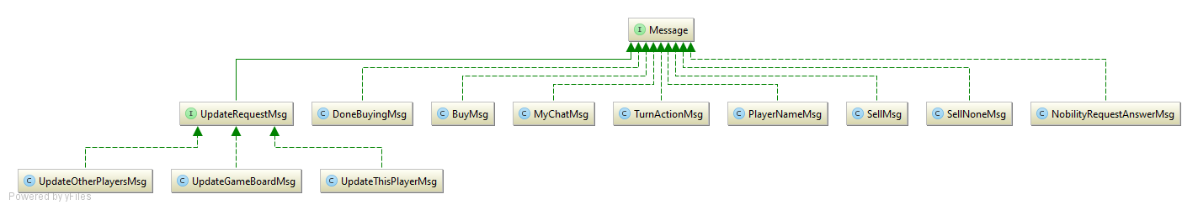
Client messages

Slide 13
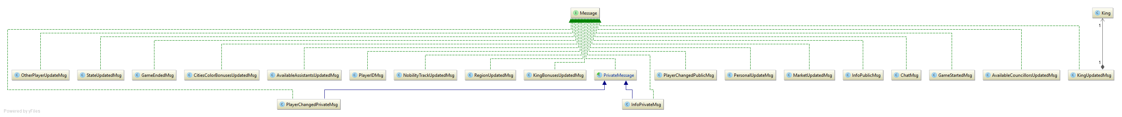
Server messages

Slide 14
Implemented features: GUI/CLI
CLIView and GUIView extends both the ClientView class allowing runtime instantiation of CLI or GUI (strategy pattern). Both register the player’s actions and deliver them to the ServerView through the Communication class.
The CLI used an Interpreter class that convert read String into callable Communication’s methods.

Slide 15
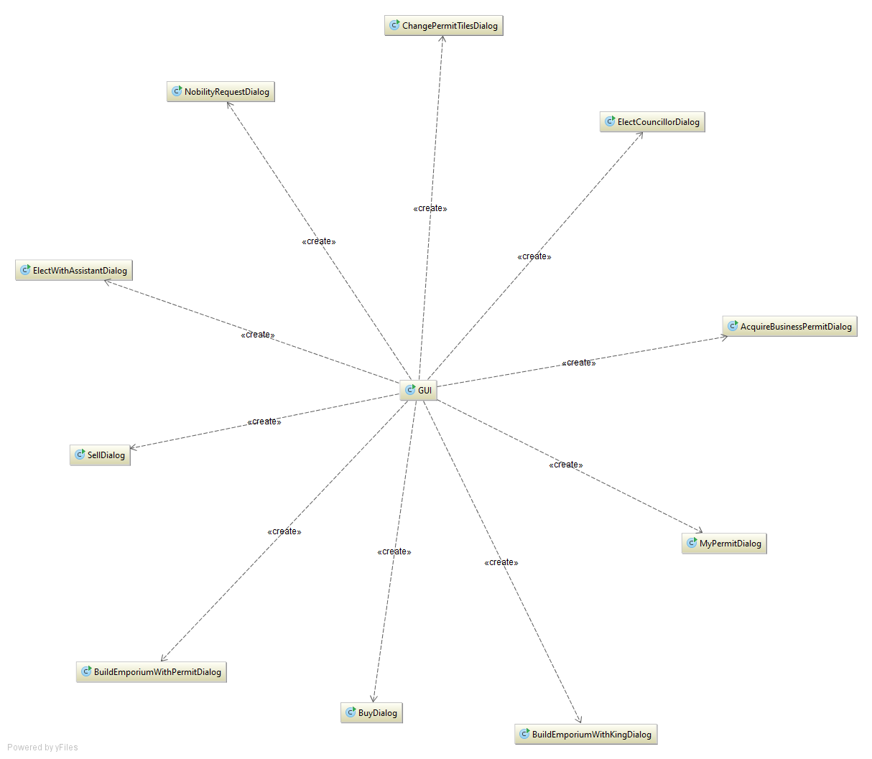
GUI
The GuiView class contains a reference to the GUI class which is the application main window.
When the game needs information from the player this window creates the proper jDialog.

