Slide 1
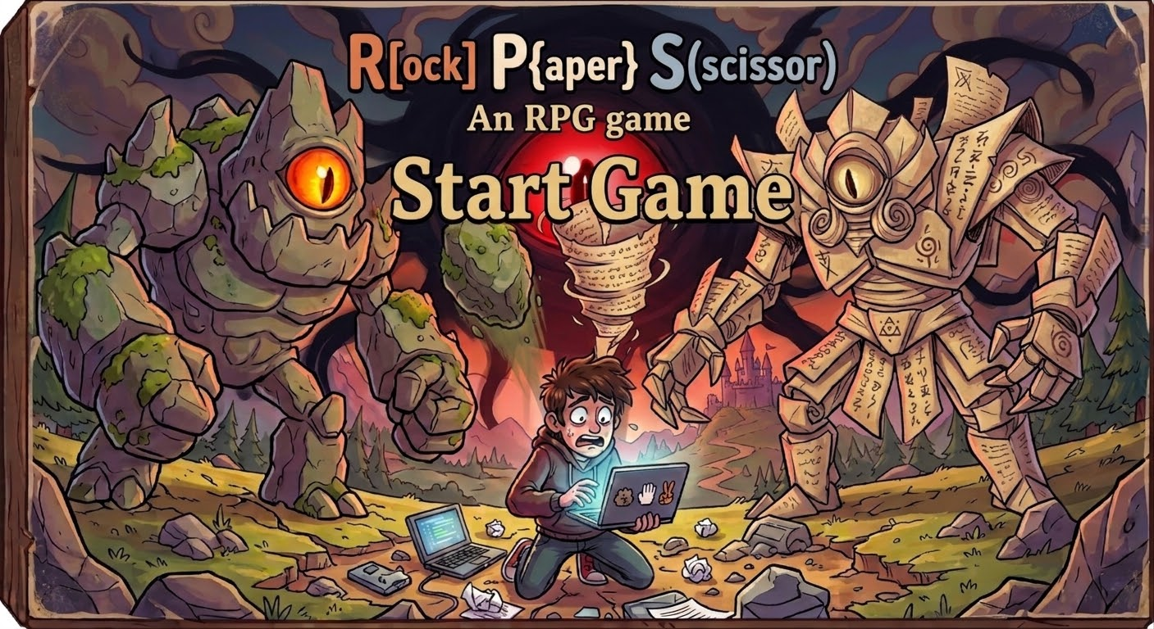

Slide 2
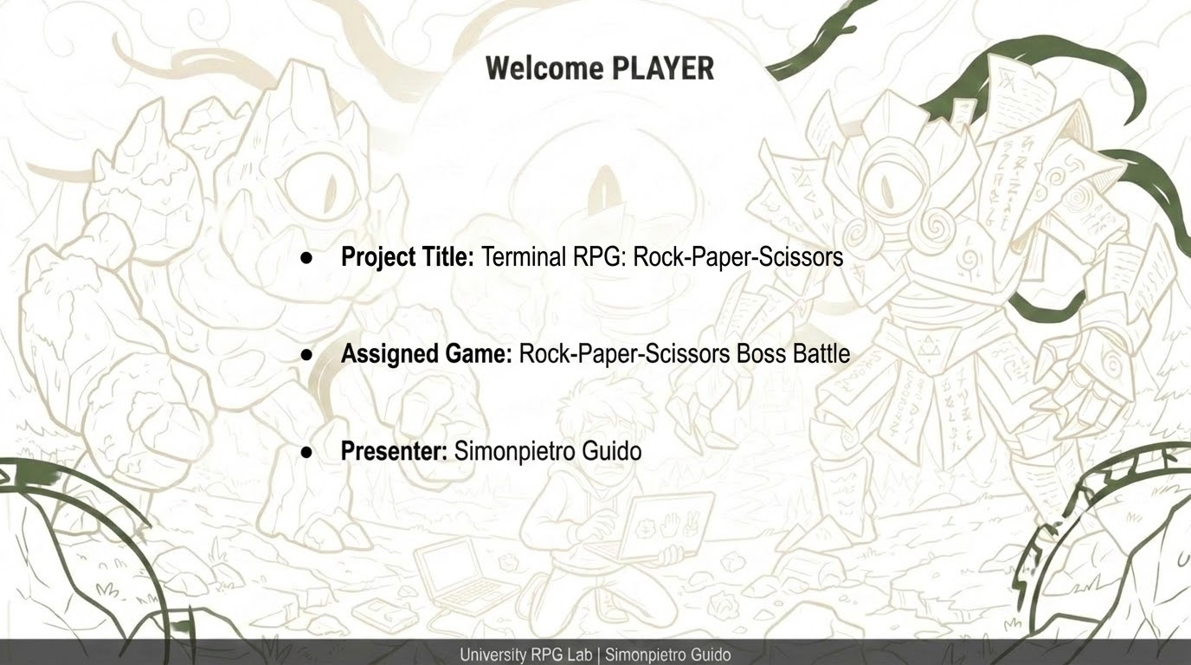

Slide 3
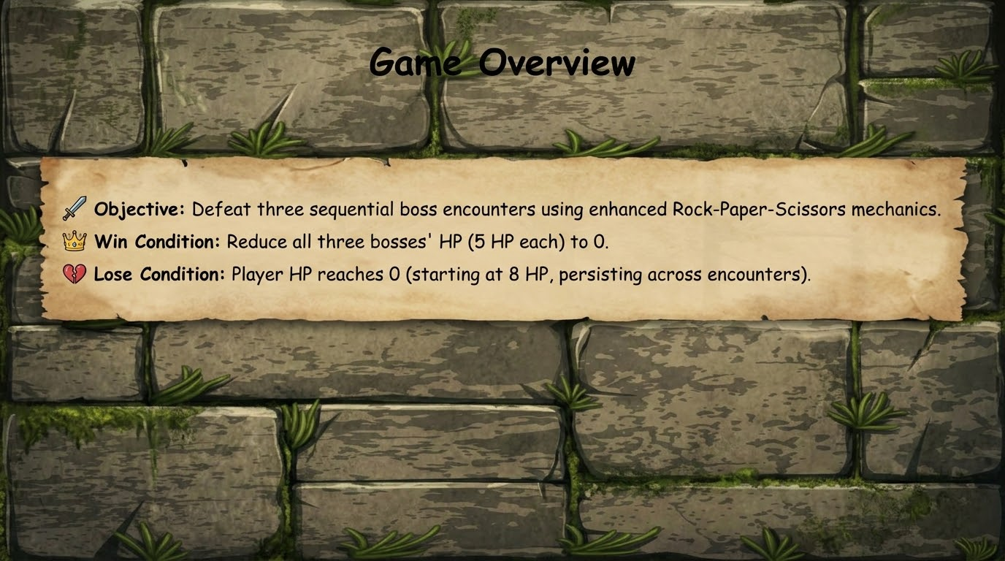

Slide 4
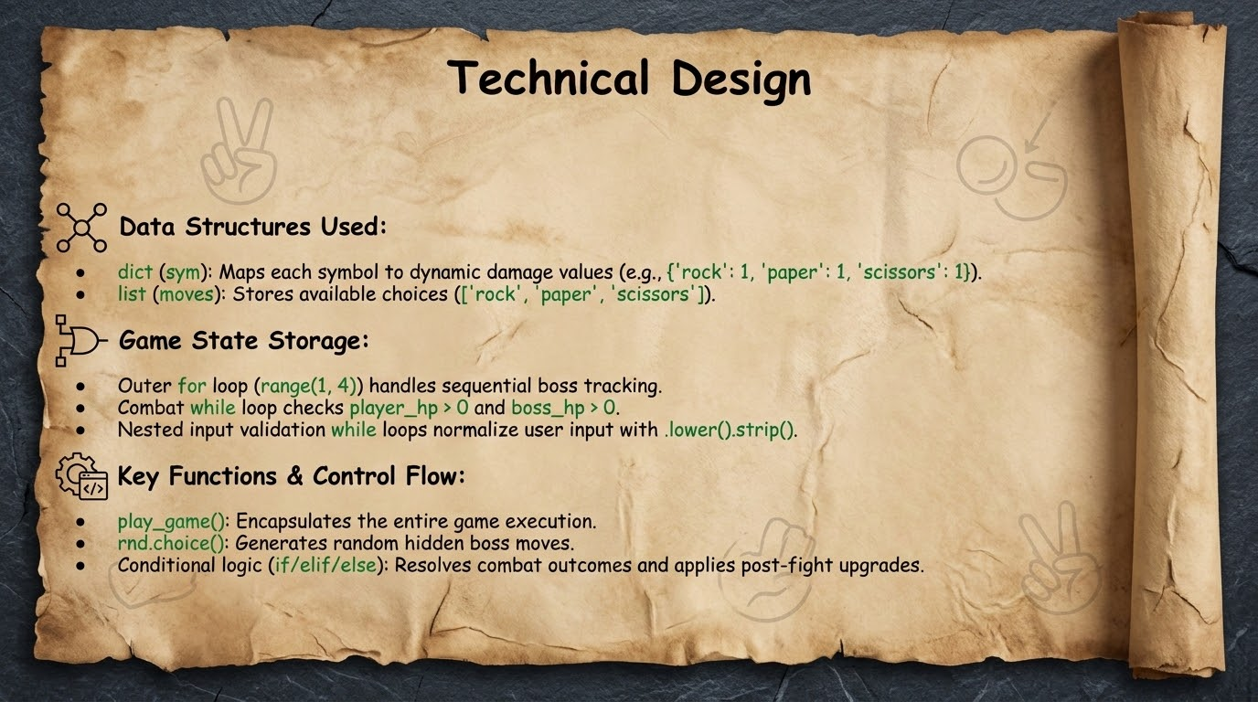

Slide 5
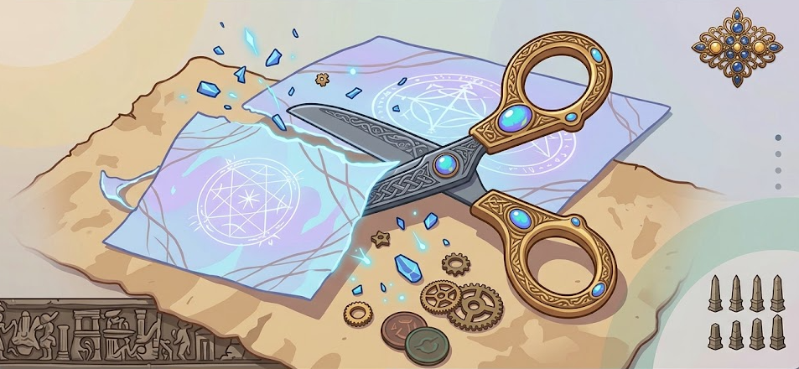
Biggest Challenge
The Difficult Part: Preventing invalid player inputs from crashing the program while managing seamless state transitions between round combat, boss encounters, and reward phases.
How It Was Solved:
  Implemented dedicated while True validation loops with string normalization to clean inputs (r/rock).
  Used nested loop control (break) to safely exit combat when player_hp <= 0 and route players directly to symbol upgrades after defeating Boss 1 and 2.

