Slide 1
COPERTINA XMASDEV 2024

Slide 2
RECIPE MaGIC
Building a Christmas Recipe Copilot with Qdrant, Llama, and RAG, from Local to Cloud

Slide 3
SPONSOR

Slide 4

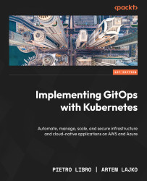
MySELF
I am passionate about technology and the world of software development and cloud architectures at 360°.
Author of “Implementing GitOps with Kubernetes” with Artem Lako
https://www.amazon.com/Implementing-GitOps-Kubernetes-infrastructure-cloud-native/dp/B0D7PZ7171
I now work as a Cloud Solution Architect for Swisscom in Zürich, Switzerland.
LinkedIn: https://www.linkedin.com/in/pietrolibro/

Slide 5
Agenda
Generative AI
SLM & LLM
Understanding SLM and LLM
Phi-3.x & Llama 3.x
Ollama
Microsoft Semantic Kernel
RAG
Vector Search and Text Search
Local to Cloud Transition
Q&A
Magic-Recipes-Copilot- Repository:
https://github.com/pietrolibro/magic-recipes-copilot

Slide 6
What is generative ai?
Generative AI refers to artificial intelligence systems that generate new content based on input data.
Examples include chatbots, recipe generators, and AI tools for enhancing creativity and automation.
Powered by Small Language Models (SLMs) and Large Language Models (LLMs)

Slide 7
Understanding Slm and llm
Small Language Models (SLMs):
Focus: Handle specific AI tasks with lower resource requirements.
Advantages:
Cost-Effective: Reduced computational needs.
Efficiency: Offer lower latency responses.
Domain Expertise: May provide deeper insights for specialized tasks.
Limitations: May be less accurate with broad or generalized queries.

Slide 8
Understanding Slm and llm
Large Language Models (LLMs):
Focus: Manage a wide range of tasks, including complex and generalized queries.
Advantages:
Versatility: Suitable for building custom enterprise agents and generative AI applications.
Comprehensive Understanding: Handle diverse and complex queries effectively.
Considerations: Require more resources and may involve higher costs.
<<Decision Factors>>
“Explore AI models: Key differences between small language models and large language models”, https://tinyurl.com/yb5yrwec

Slide 9
The phi-3.x model collection
Latest Small Language Models (SLMs) from Microsoft, excelling in language, reasoning, coding, and math.
Offering high-quality, cost-effective generative AI solutions.
New Phi-3.5 models:
Phi-3.5-mini: 128K context length with enhanced multi-lingual support.
Phi-3.5-vision: Improved multi-frame image understanding and reasoning.
Phi-3.5-MoE: Mixture-of-Experts model with 16 experts, excelling in performance, safety, and latency.
https://ai.azure.com/explore/models?selectedCollection=phi

Slide 10
Llama 3.x (meta)
The open-source AI model you can fine-tune, distill, and deploy anywhere.
Available versions: 1B, 3B, 11B, 90B, and continued support for Llama 3.1.Features of Llama 3.2:
Multilingual text-only models (1B, 3B).
Text-image models (11B, 90B).
Quantized versions of 1B and 3B:
Up to 56% smaller size.
2-3x speedup, ideal for on-device and edge deployments.
https://www.llama.com/

Slide 11

ollama
«Get up and running with large language models»
A platform (macOS, Windows, Linux, Docker) for running and deploying Small\Large Language Models locally
Focuses on privacy, efficiency, and cost-effectiveness.
Integrates seamlessly with tools like Qdrant or ChromaDB for embedding storage and retrieval
https://ollama.com/

Slide 12
Ollama: model library
Example of available models:
Minimal requirements: 8 GB of RAM available to run the 7B models, 16 GB to run the 13B models, and 32 GB to run the 33B models. Source: https://github.com/ollama/ollama
Model | Parameters | Size | Download
Llama 3.2 | 3B | 2.0GB | ollama run llama3.2
Llama 3.2 | 1B | 1.3GB | ollama run llama3.2:1b
Llama 3.2 Vision | 11B | 7.9GB | ollama run llama3.2-vision
Llama 3.2 Vision | 90B | 55GB | ollama run llama3.2-vision:90b
Llama 3.1 | 8B | 4.7GB | ollama run llama3.1
Llama 3.1 | 70B | 40GB | ollama run llama3.1:70b
Llama 3.1 | 405B | 231GB | ollama run llama3.1:405b
Phi 3 Mini | 3.8B | 2.3GB | ollama run phi3
Phi 3 Medium | 14B | 7.9GB | ollama run phi3:medium
…
Mistral | 7B | 4.1GB | ollama run mistral
Moondream 2 | 1.4B | 829MB | ollama run moondream
Neural Chat | 7B | 4.1GB | ollama run neural-chat
Starling | 7B | 4.1GB | ollama run starling-lm

Slide 13
how to interact (locally) ?
Open Web UI (https://github.com/open-webui/open-webui)
Ollama UI (https://github.com/ollama-ui/ollama-ui)
Lobe Chat (https://github.com/lobehub/lobe-chat)
Text Generation Web UI (https://github.com/oobabooga/text-generation-webui)
Lord of LLMs Web UI (https://github.com/ParisNeo/lollms-webui)
AnythingLLM (https://anythingllm.com)
And many more...

Slide 14
DEMO

Slide 15
Microsoft semantic kernel
Open-source development kit for integrating AI models into applications.
Supports C#, Python, and Java for cross-language flexibility.
Combines AI capabilities with APIs to automate business processes.
Modular and extensible, enabling integration of existing code as plugins.
Compatible with OpenAPI specifications.
Designed to adapt to evolving AI technologies with minimal code changes.
https://learn.microsoft.com/en-us/semantic-kernel/overview

Slide 16
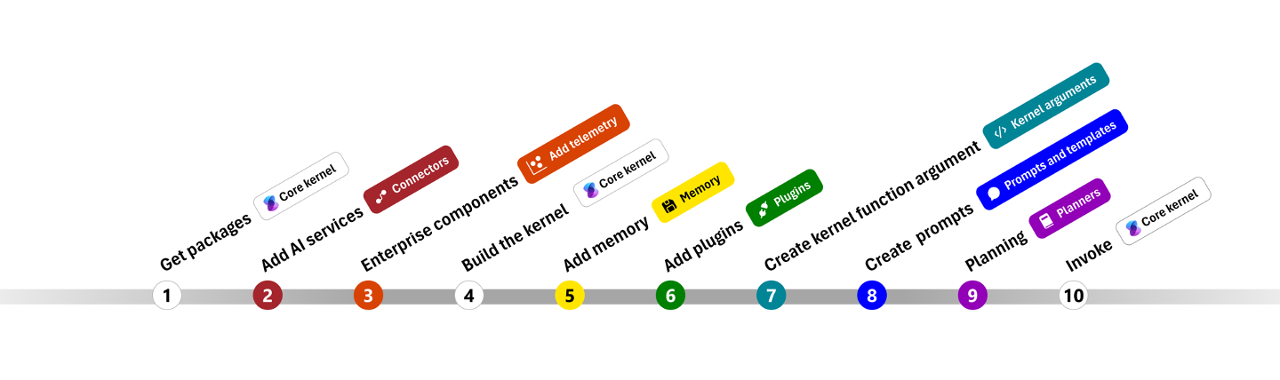
Microsoft semantic kernel
https://learn.microsoft.com/en-us/semantic-kernel/get-started/quick-start-guide?pivots=programming-language-csharp

Slide 17
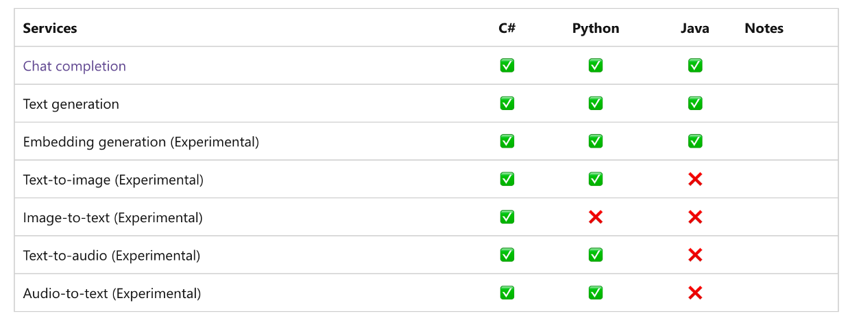
AI services
https://learn.microsoft.com/en-us/semantic-kernel/concepts/ai-services
=> Ollama Connectors for Local Models <=
https://devblogs.microsoft.com/semantic-kernel/introducing-new-ollama-connector-for-local-models

Slide 18
DEMO

Slide 19
Retrieval-Augmented Generation (RAG)
RAG combines language models (SLMs/LLMs) with external knowledge retrieval to provide accurate and contextually enriched responses.
Key Components:
Retrieval Phase:
Uses vector databases (e.g., Qdrant) to fetch relevant information.
Ensures the AI model has access to the most up-to-date and specific context.
Generation Phase:
AI model generates responses by integrating retrieved knowledge.
Results in factually accurate, detailed, and context-aware outputs.
Advantages:
Enhances response accuracy and relevance by augmenting static model knowledge.
Supports dynamic updates for real-time information access.
Notes:
RAG combina modelli linguistici con il recupero di conoscenze esterne per fornire risposte accurate e arricchite contestualmente.

Slide 20
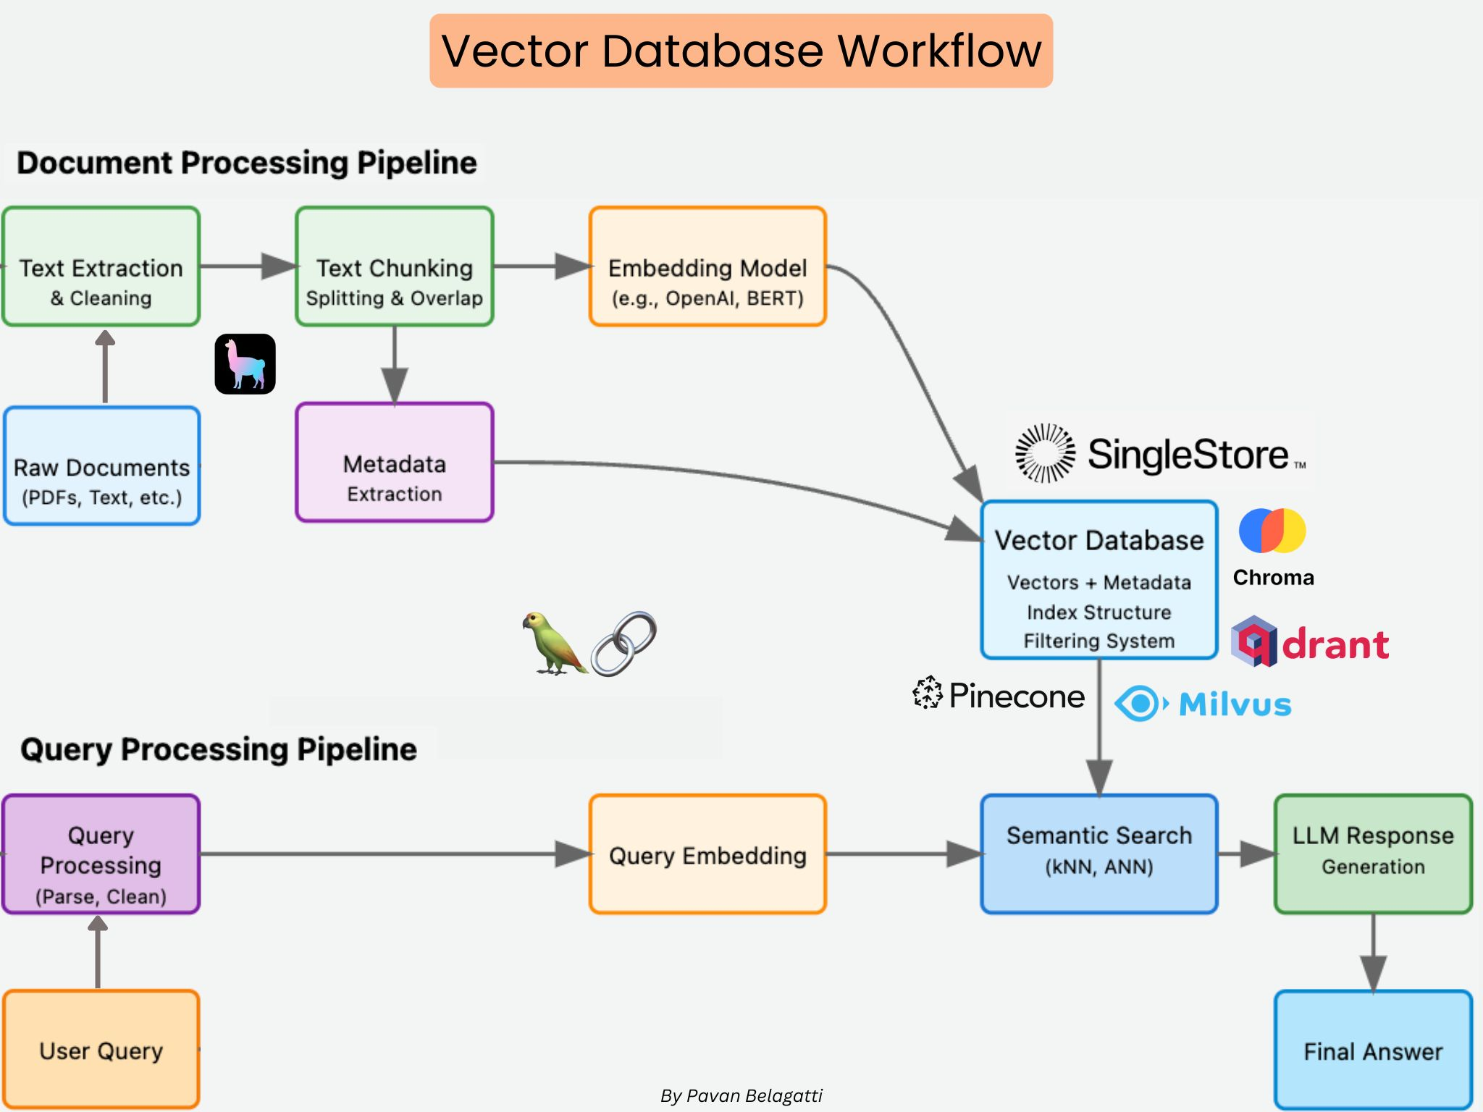
Retrieval-Augmented Generation (RAG)
Source: https://www.linkedin.com/posts/pavan-belagatti_how-do-vector-databases-work-lets-understand-activity-7271934798040842240-TO0r/

Slide 21

qdrant
Open-source vector database and similarity search engine designed to store, search, and manage high-dimensional vectors with associated payloads. It enables applications to perform efficient similarity searches, making it ideal for use cases like semantic search, recommendation systems, and machine learning model integration.
Key Features:
High-Performance Vector Search
Flexible Data Management
Scalability
User-Friendly API
https://qdrant.tech/documentation/overview

Slide 22

Vector store connectors
Microsoft Semantic Kernel Vector Store Connectors provide a standardized interface for integrating various vector databases into your applications. They enable efficient storage and retrieval of high-dimensional vectors, which are essential for tasks like similarity search and semantic understanding.
Key Features:
Model-First Approach: Define data models that map directly to your storage schema, simplifying data management.
Attribute Annotations: Utilize attributes to specify the function of each property in your data model
Abstraction Layer: Interact with different vector stores through a consistent API, allowing for easy experimentation and scalability.

Slide 23
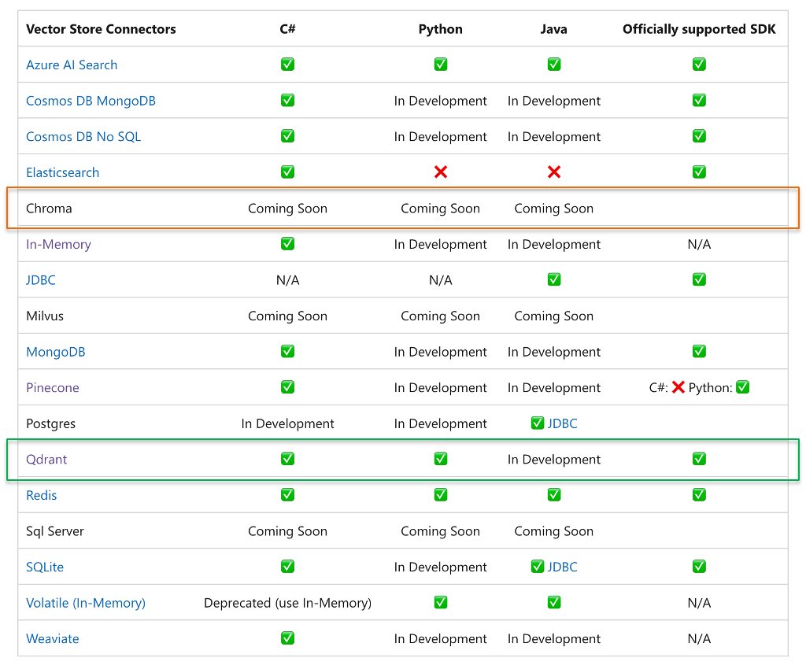
Out-of-the-box connectors

Slide 24
Text search
Microsoft Semantic Kernel's Text Search enables developers to enhance AI model responses by RAG with up-to-date and relevant data, ensuring more accurate and context-aware outputs.
Key Features:
High-Level Text Search Interface: Accepts text inputs with basic filtering, supporting various implementations such as web search engines and vector stores
Versatile Output Formats: Capable of returning results as simple strings or more structured data models, facilitating easy incorporation of search results into AI prompts.
Plugin Integration: Designed to function as a plugin within chat completion systems.

Slide 25
Text search vs. Vector search
Text Search: Operates at a higher abstraction level, handling text inputs and providing straightforward integration with various data sources.
Vector Search: Functions at a lower level, processing vector inputs and returning detailed data models.
Combining both methods allows for comprehensive data retrieval strategies, enhancing the effectiveness of RAG implementations.

Slide 26
DEMO

Slide 27
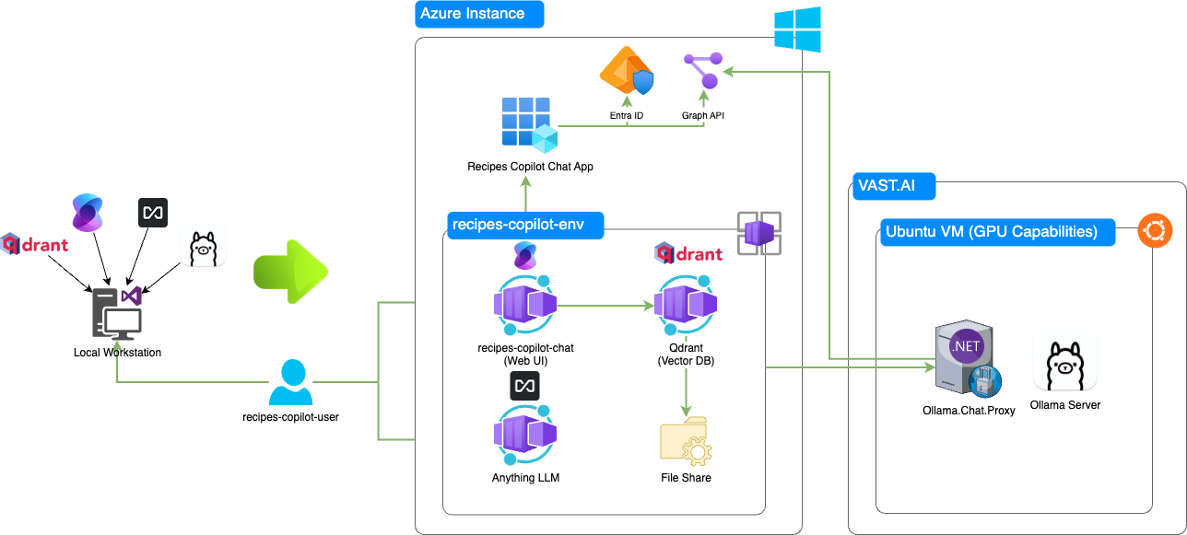
From local to cloud

Slide 28
DEMO

Slide 29
Q&A

