Slide 1


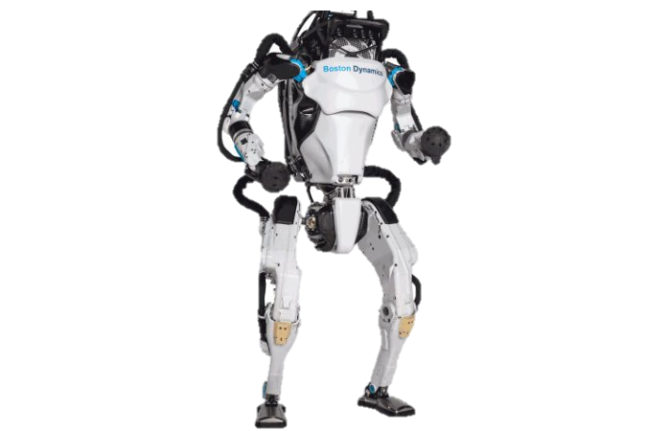
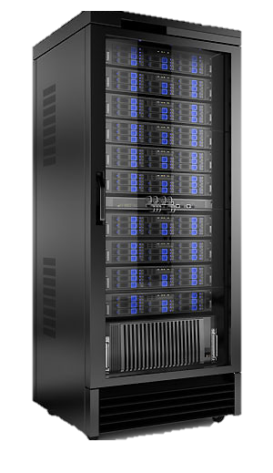
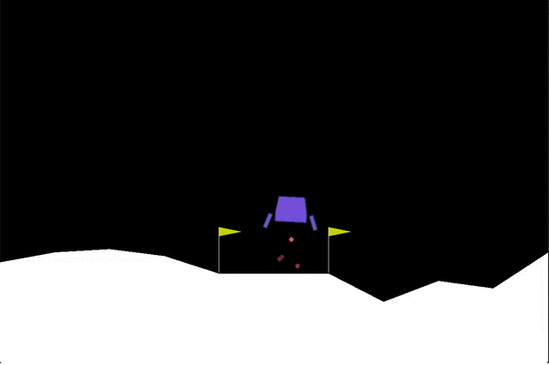
Agent Training Workflow
1
Task Distribution
Requestor
(Provider Orchestrator )
** In the first episode the Federated Agent is a newly initialized agent
Training
Task 1
Training
Task 2
Training
Task …
Training
Task n
Provider 1
(Worker)
Provider 2
(Worker)
Provider …
(Worker)
Provider n
(Worker)
4
Federated Learning
2
Agent Training
Requestor
(Provider Orchestrator )
1 Task Distribution
2 Agent Training
3 Agent Gathering
4 Federated Learning
Agent
Agent 1
Agent 2
Agent …
Agent n
Loop M episodes
Provider 1
(Worker)
Combine
Environment
3
Agent Gathering
Requestor
(Provider Orchestrator )
Federated Agent
Send Agent 1
Send Agent 2
Send Agent …
Send Agent n
Provider 1
(Worker)
Provider 2
(Worker)
Provider …
(Worker)
Provider n
(Worker)

Slide 2

Federated Reinforcement Learning
Agent 1
Agent 2
Agent …
Agent n
DNA 1
DNA 2
DNA …
DNA n
Federated Learning Agent
From Agent 1
From Agent 2
From Agent …
From Agent n
Mutation
Average
Weighted Average
Evolutionary

