Slide 1

Compustat Global in WRDS: The Basics
WHARTON RESEARCH DATA SERVICES
I. What is Compustat Global?
April 20, 2020

Slide 2

Compustat Global in WRDS: The Basics
Highlights
Types of Compustat Global data
How the Data looks
How to filter by country
Some Research Questions

Slide 3
Compustat Global in WRDS: The Basics
Highlights
Coverage Frequency Types of Identifiers
Types of Compustat Global data
Fundamental Index Securities
How the Data looks
How to filter by country
Some Research Questions

Slide 4
1. Highlights

Slide 5

More than 500 company-level fundamentals in one place
Covering publicly traded companies in global markets
More than 80 countries
US & Canada in not included
About 24,000 active companies and 10,000 inactive
No survivorship bias
Income Statement, Balance Sheet, Cash Flows and suppl. data items in local currency
Quarterly and Annual frequencies
Market data - daily freq.
Prices, Dividends, Trading Volume and Shares Outstanding

Slide 6
More than 500 company-level fundamentals in one place
Times series: since 1986 - annual data; since 2003 for quarterly data
Normalized according to the country accounting principles
Global Indices: Constituents and Prices on 90 local market indexes
Currency files with cross-translation tables for more than 110 currencies
Main identifier: GVKEY
In case of M&A, the GVKEY of acquiring company remains while the acquired is set to inactive. Including other id: ISIN, and SEDOL.

Slide 7
2. Types of Compustat Global Data

Slide 8
Types of Compustat Global data
1
Fundamentals – Annual and Quarterly
2
Index Constituents and Index Prices
3
Security Daily
Notes:
Other databases: CRSP Portfolios and Stock Indices database CRSP Treasuries Ziman REIT database

Slide 9
3. How the Data looks…

Slide 10
Annual Fundamentals Data for Canon Inc.

Slide 11
Index Monthly Prices Data for S&P Global 100

Slide 12
Index Constituents Data for S&P Global 100 (extract)

Slide 13
Security Daily data for Royal Dutch Shell PLC

Slide 14
4. How to Filter by Country

Slide 15
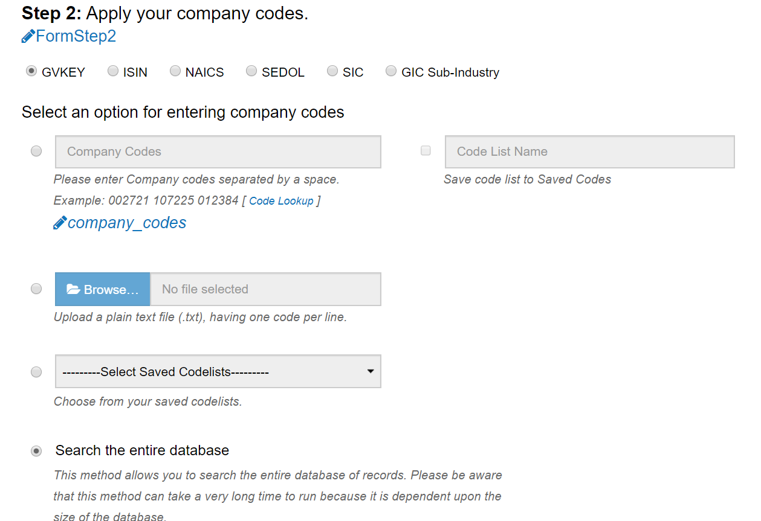
How to filter by Country
If you would like to download data for all covered companies in a specific country, you can use the Country Code filter in the Web Query. In step two, select search the entire database

Slide 16
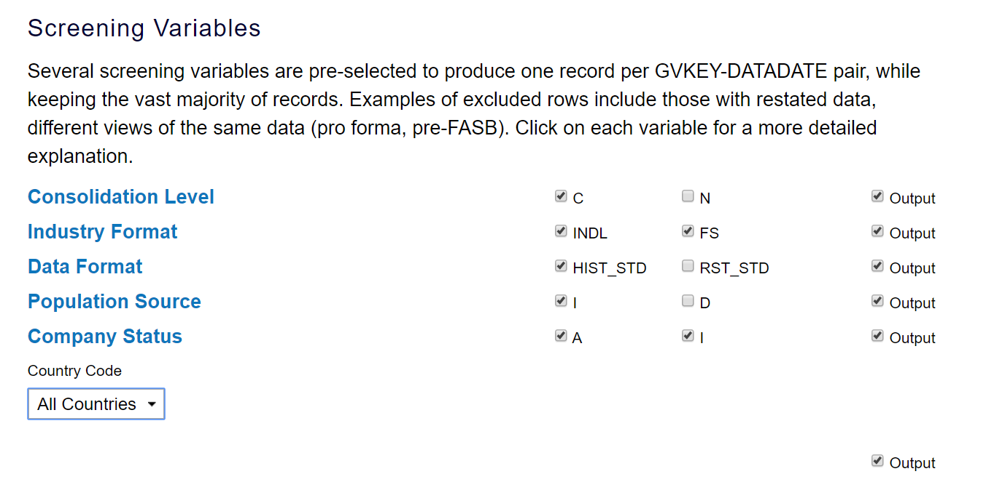
How to filter by Country
Below Step two, after the Screening Variables, you will see the Country code box. Select the code of your country of interest, then move on forward with the following steps of the query.

Slide 17
Show step 3 FAST & Step4 just for completion

Slide 18
5. Some Research Questions

Slide 19
Some Research Questions
A
Calculating the Market Value of a Firm
B
Adjusting the Daily Securities Prices for Stock Splits
C
Computing Returns
Notes:
Other databases: CRSP Portfolios and Stock Indices database CRSP Treasuries Ziman REIT database

Slide 20
A. Calculating the Market Value of a Firm

Slide 21
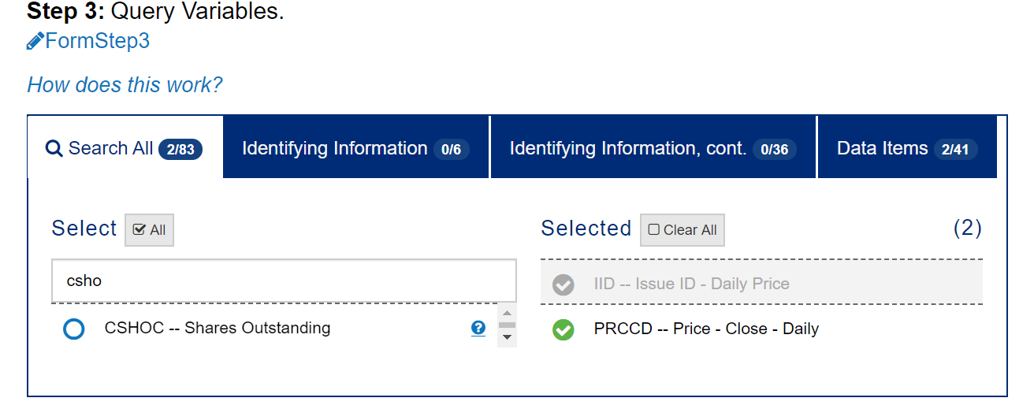
Calculating the Market Value of a Firm Market value of equity as of the December end of any given fiscal year can be obtained as a product of the close market price at the calendar year end (PRCCD variable in Compustat Global Security Daily) times the shares outstanding (CSHOC). CSHO represents the net number of all common shares outstanding at year-end, excluding treasury shares. Market Value = PRCCD x CSHOC.

Slide 22
B. Adjusting the Daily Securities Prices for Stock Splits

Slide 23
Adjusting the Daily Securities Prices for Stock Splits
You can use the variable AJEXDI (adjustment factor) to adjust the prices in Compustat.
Adjusted close price = PRCCD/AJEXDI

Slide 24
C. Computing Returns

Slide 25
Computing Returns
To compute returns, you will need to apply a DAILY RETURN FACTOR (variable TRFD) to the close price. That is, multiplying the current adjusted close price (PRCCD/AJEXDI) by the current total return factor (TRFD) and dividing the result by the product of the adjusted close price of the prior period multiplied by the Total Return Factor of the prior period.
IMPROVE THIS EXPRESSION
(((((PRCCD/AJEXDI)*TRFD)
/((PRCCD(PRIOR)/AJEXDI(PRIOR))*TRFD(PRIOR))) -1 )* 100).
TRFD includes Cash Equivalent Distributions + reinvestment of dividends and the compounding effect of dividends paid on reinvested dividends.
If you are looking for a price only return, do not use the total return factor. WHY??

Slide 26

Summary
Highlights
Types of Compustat Global data
How the Data looks
How to filter by country
Some research questions

Slide 27

https://wrds-www.wharton.upenn.edu/
Contact: wrds-support@wharton.upenn.edu

