Slide 1
188 specimens scanned, of which:
8 were omitted from landmarking,
180 specimens landmarked, of which:
6 were omitted from analysis because were juvenile
4 believed to be other species
170 specimens for analysis:
69 females, 91 males, 10 unknown
67 subtropicus, 40 south stuartii, 23 north stuartii, 40 dubious

Slide 2
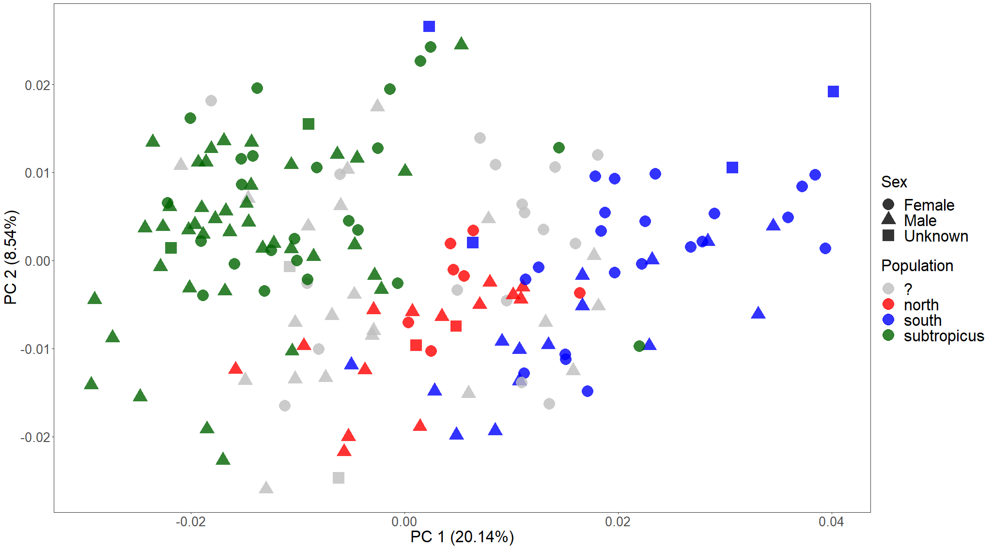
PCA on all specimens, including unknown sex and dubious population identity

Slide 3
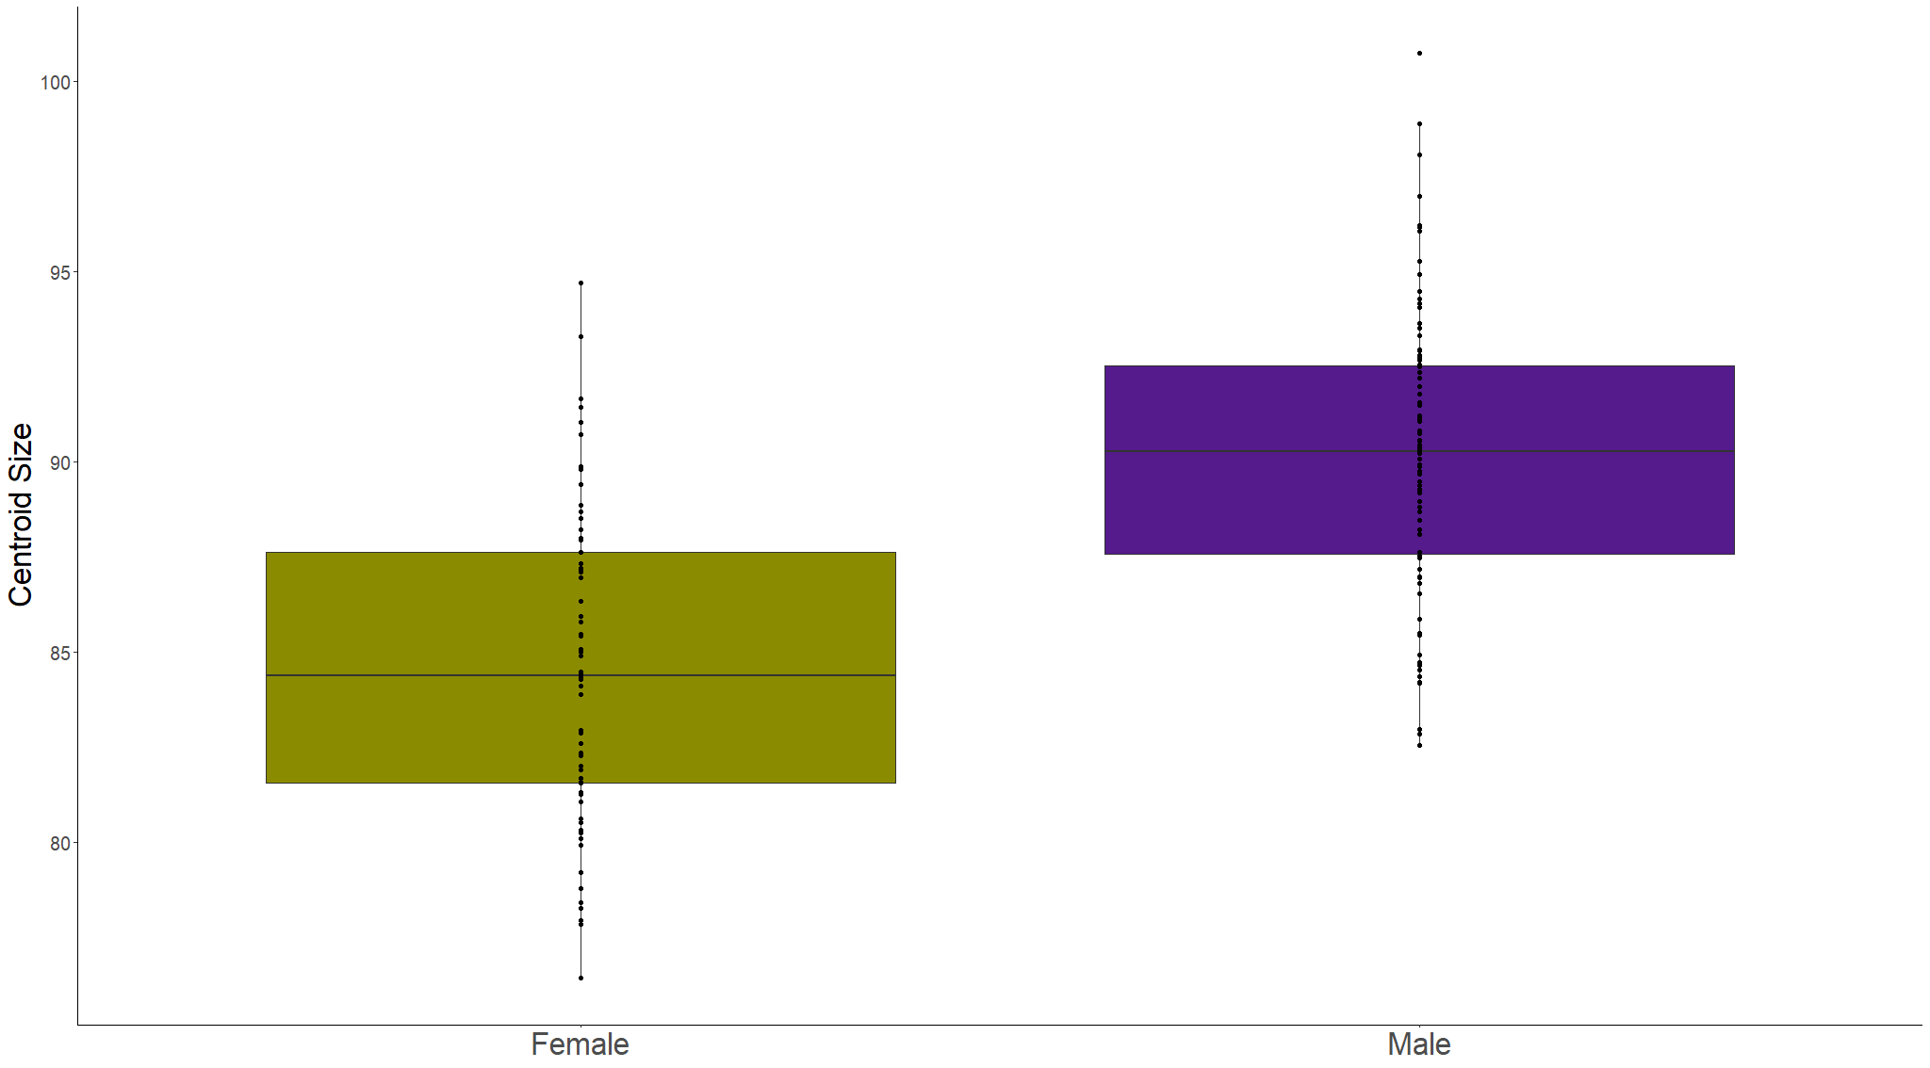
ANOVA on sex as a predictor of size variation
Adj. R² = 0.328
F_{1,158} = 78.68
p = 1.485e-15

Slide 4
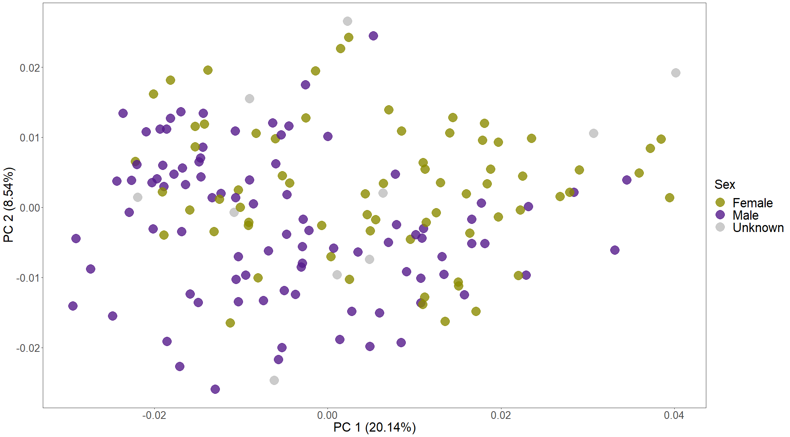
Procrustes ANOVAs
Are sexes different in shape?
(shape~sex)
R² = 0.036
F_{1,158} = 5.937
p = 0.001
Do they have unique allometries? (shape~size*sex)
R² = 0.004
F_{1,156} = 0.8
p = 0.774
Adjusting for size, are sexes different in shape? (shape~size+sex)
R² = 0.009
F_{1,157} = 1.647
p = 0.035
PCA on all specimens, labelling only sex

