Slide 1
Figure 1. Distribution map of the specimens used for this study. Labelled are A. stuartii south, A. stuartii north, A. subtropicus, specimens of unknown identity within the A. stuartii - A. subtropicus species complex, the holotype of A. subtropicus and the neotype of A. stuartii. All figures in this paper are labelled: A. stuartii south in blue, A. stuartii north in red and A. subtropicus in green. The phylogeny is adapted from Mutton et al. (2019).

Slide 2
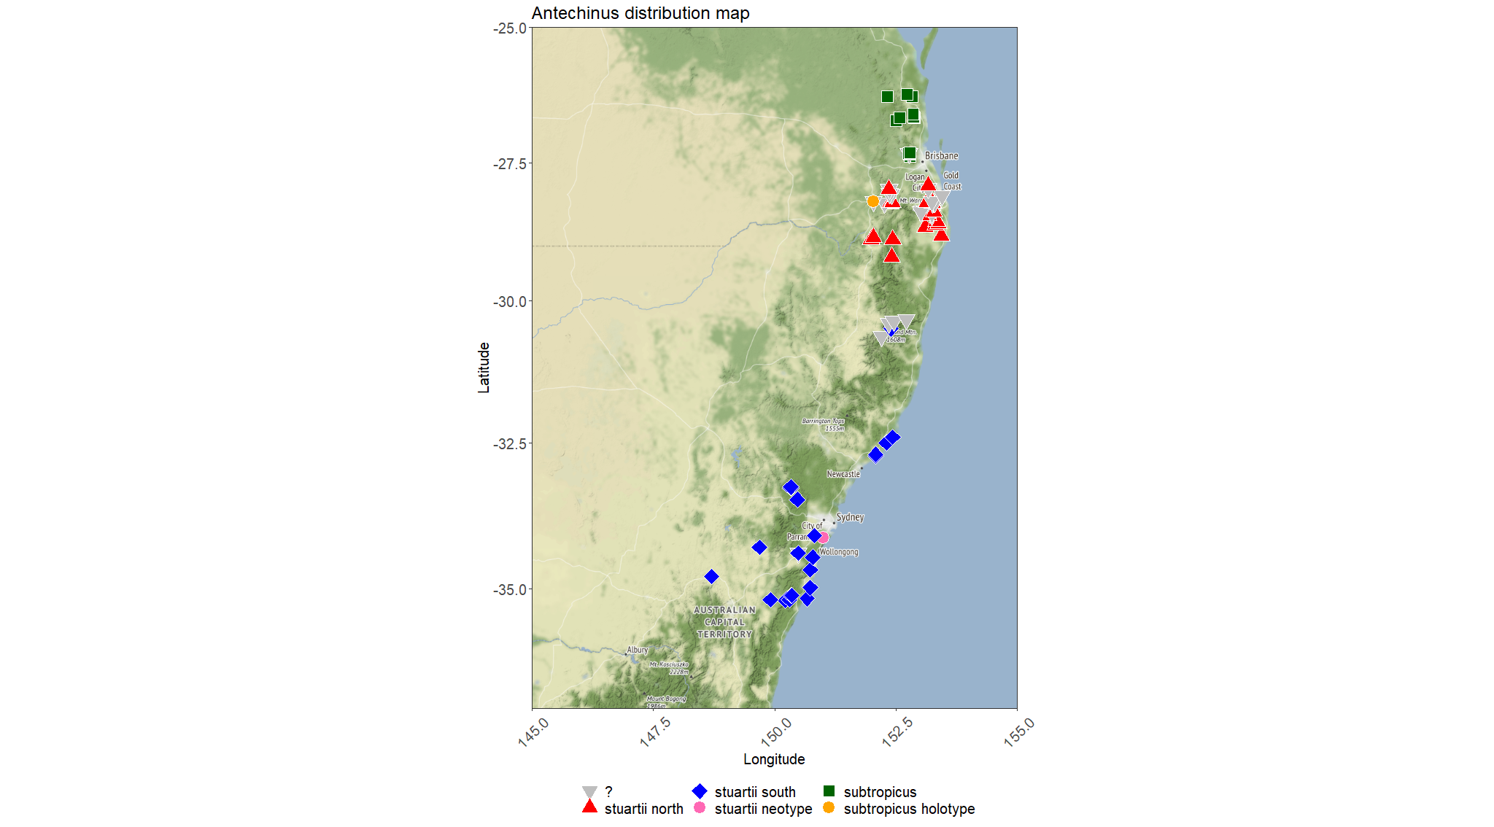
Pleistocene (2.6 Mya)

Slide 3
Figure 2. a) Box plot and dot plot of centroid size labelling each clade as per Figure 1. b) Allometry plot labelling each clade as per Figure 1, consisting of centroid sizes versus shape scores obtained from the regression of shape on size (Drake & Klingenberg, 2008).

Slide 4
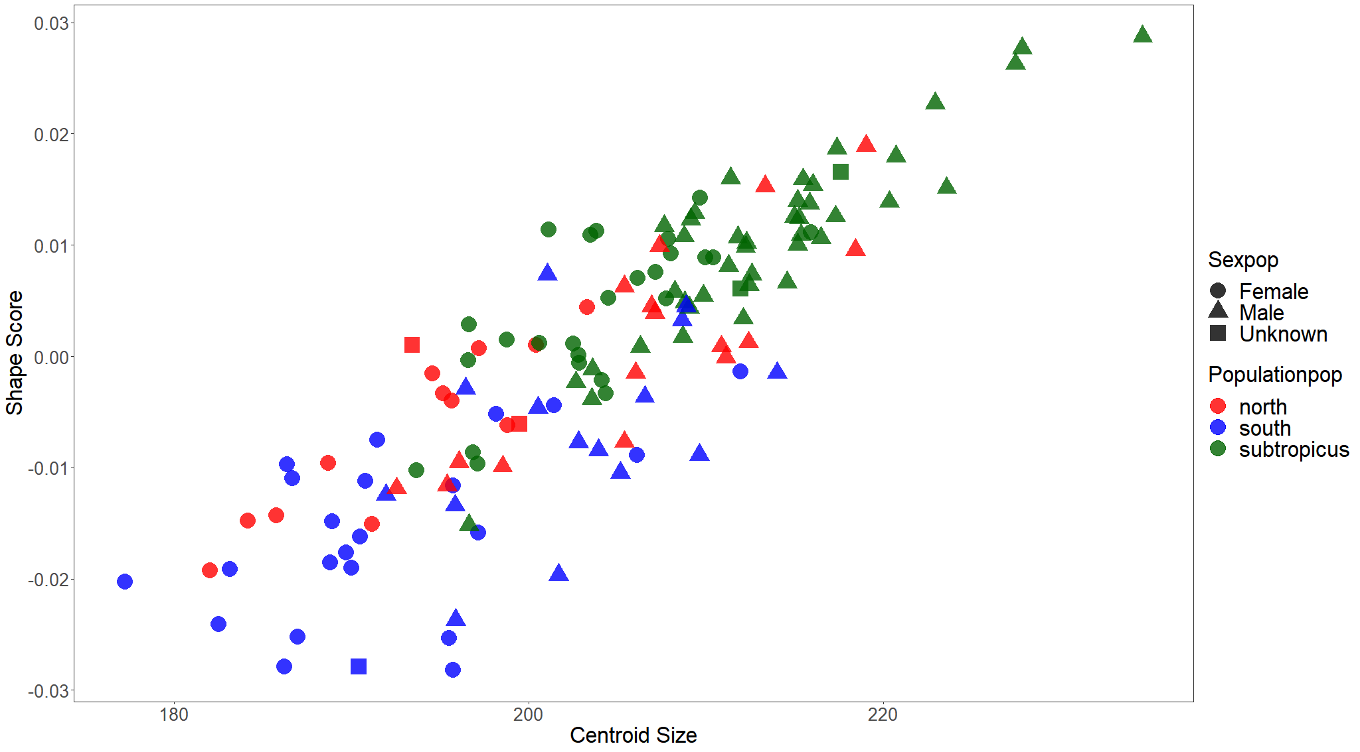
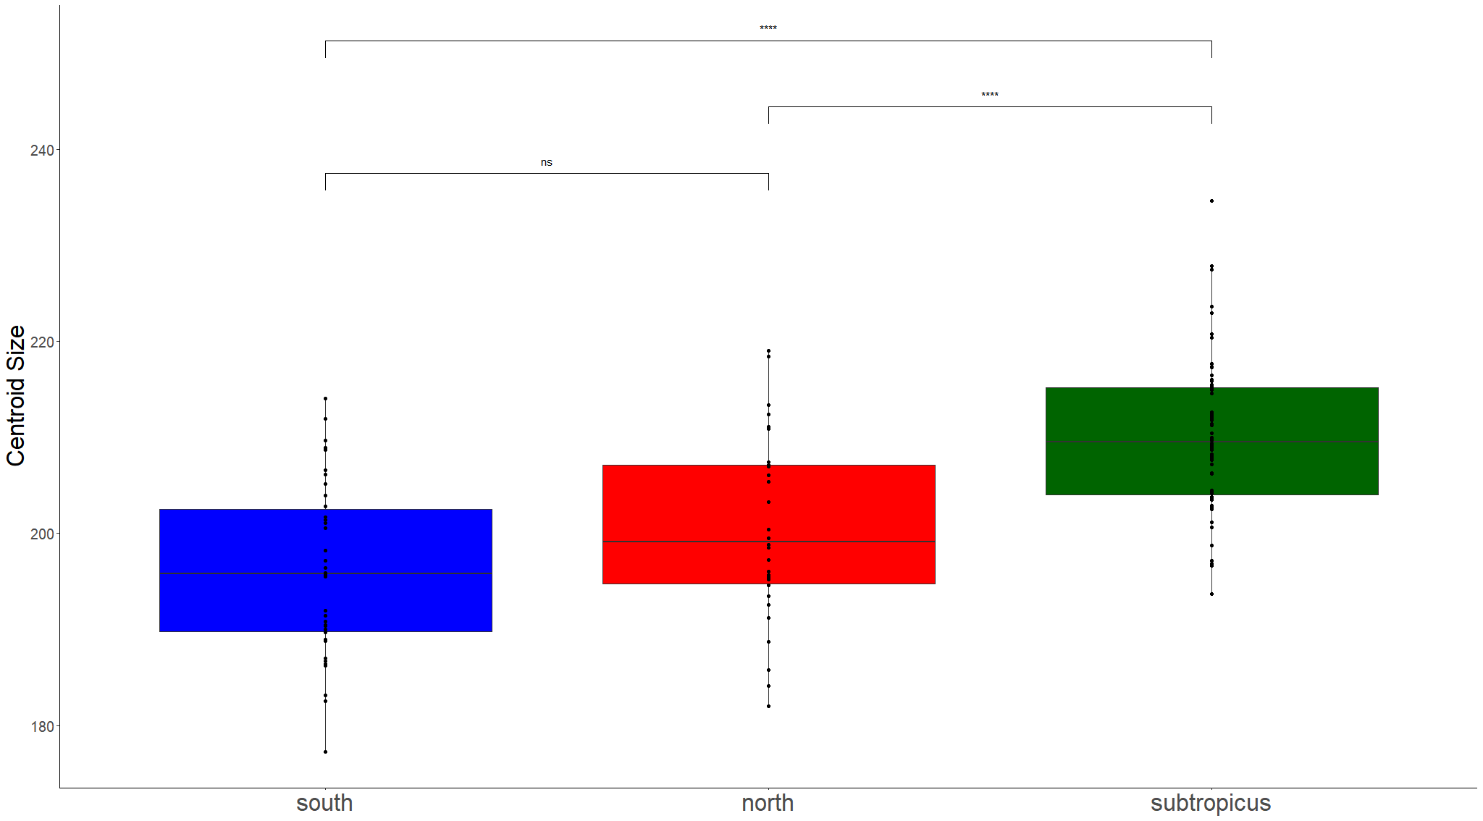
a)
b)

Slide 5
Figure 3. Pairwise comparisons between mean shapes of each clade (A. stuartii south vs A. stuartii north, p = 0.001; A. stuartii north vs A. subtropicus, p = 0.001; A. stuartii south vs A. subtropicus, p = 0.001). The 3D images are the specimen closest to the mean warped correspondingly to the mean shapes of each clade. For each comparison, we label the best differentiator diagnostic; i.e., the size of the major palatine foramina for differentiating A. stuartii south and A. stuartii north, the size of the incisive foramina for differentiating A. stuartii north and A. subtropicus, and the interpalatal difference for differentiating between the three clades. Clades are consistently labelled as per Figure 1.

Slide 6
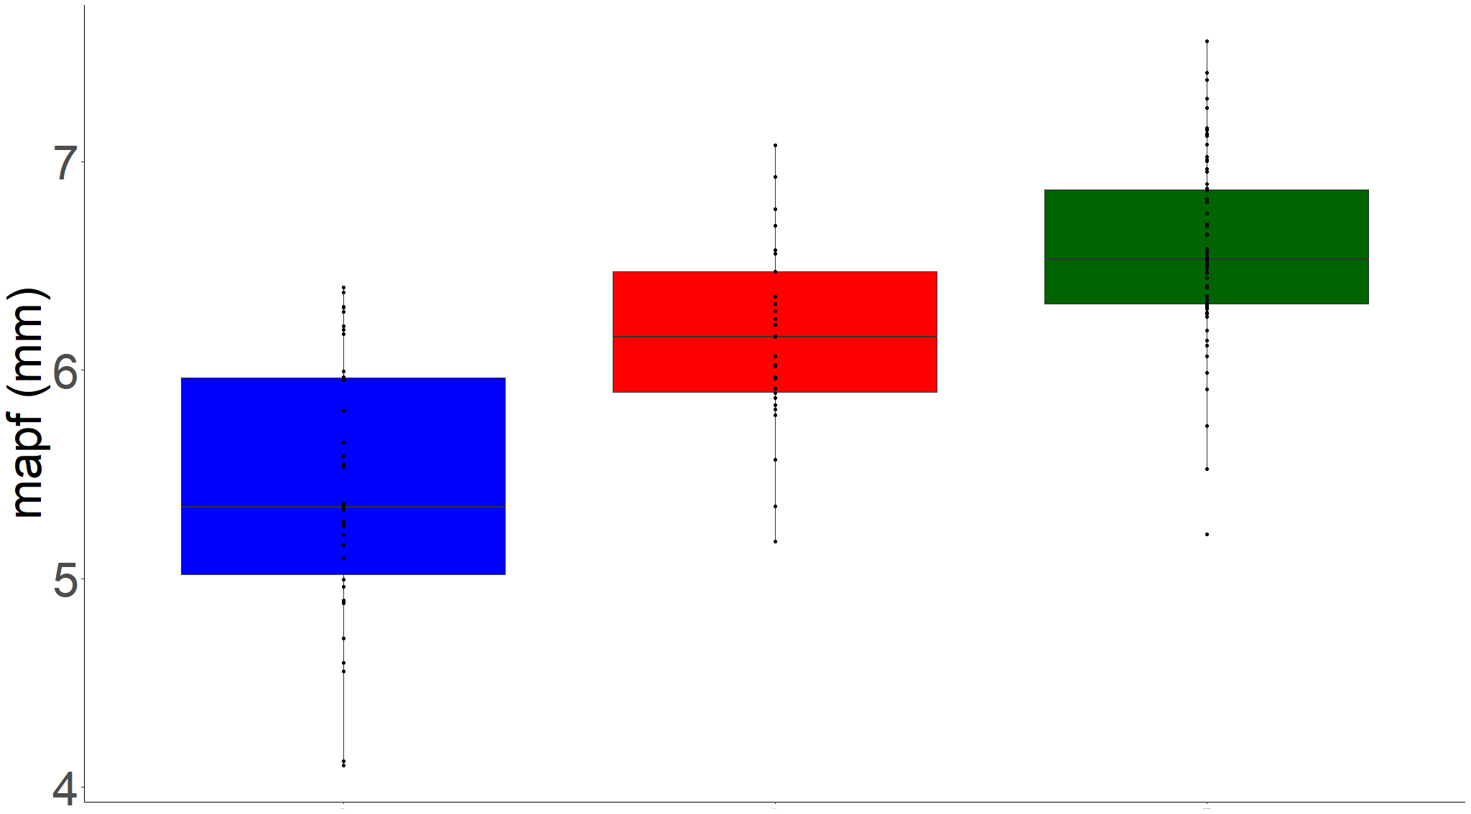
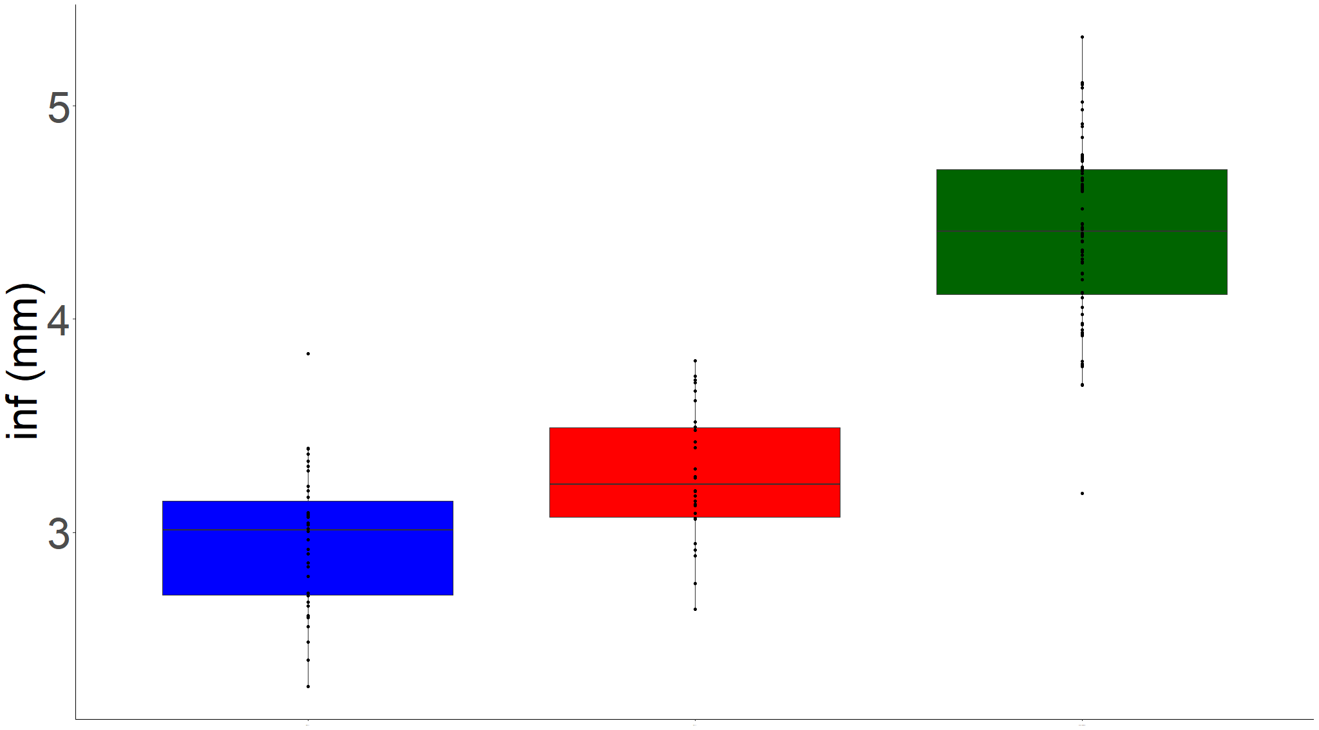
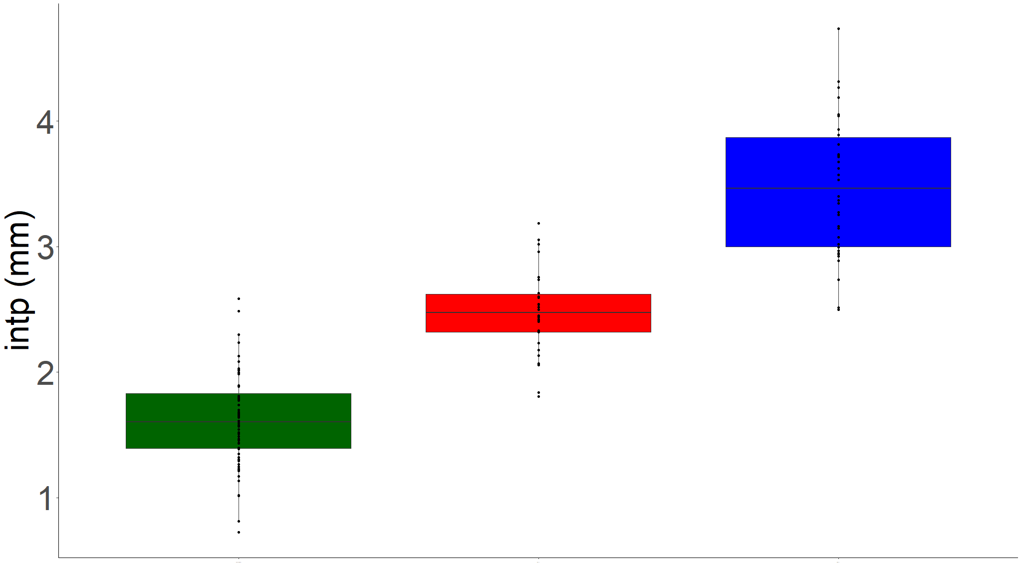
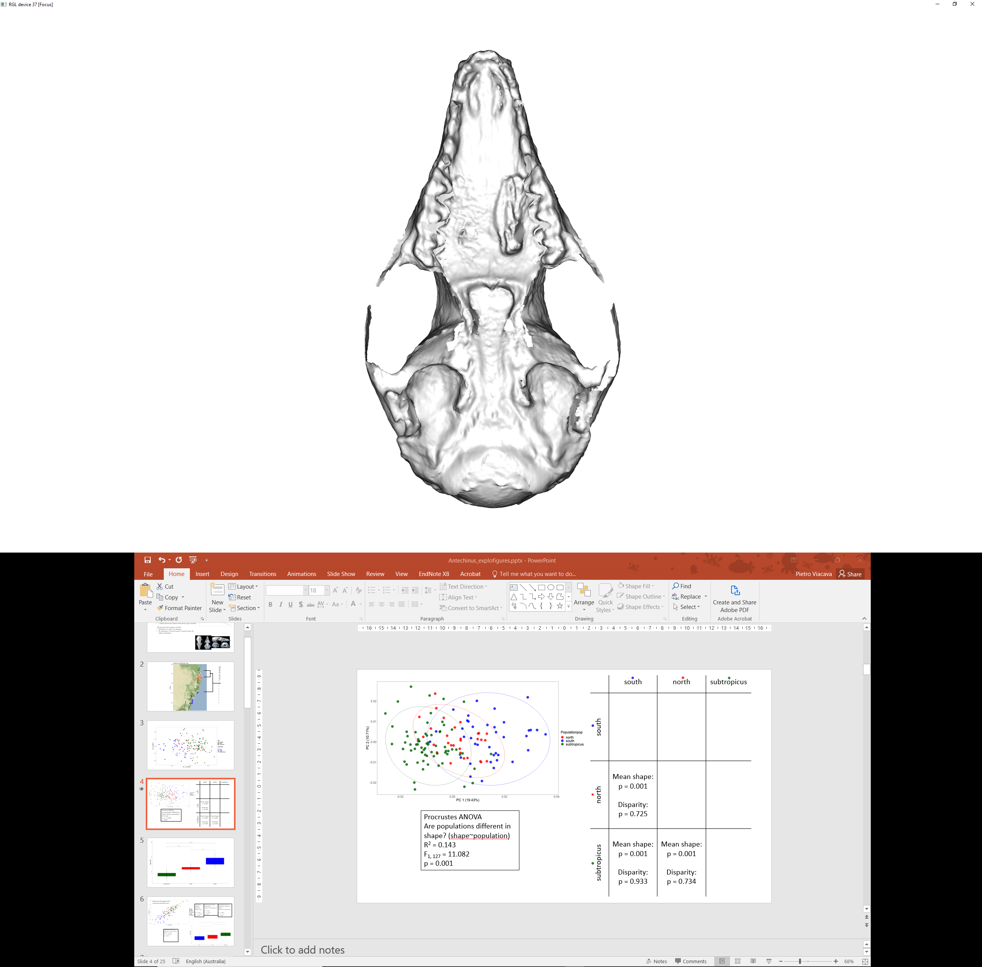
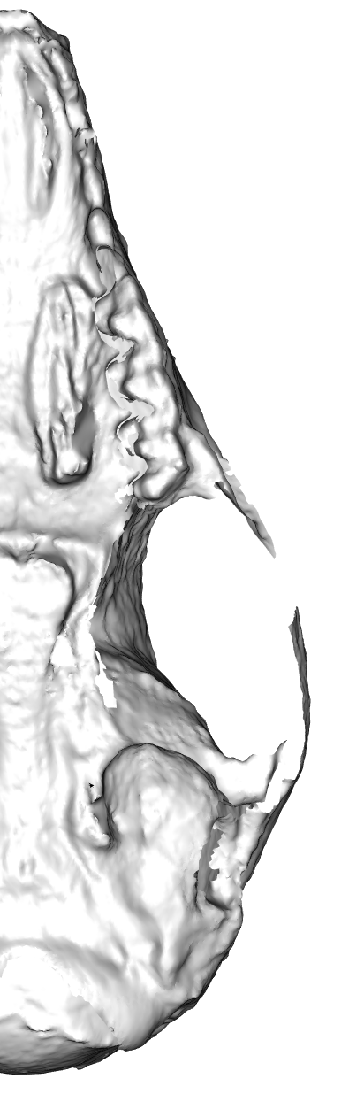
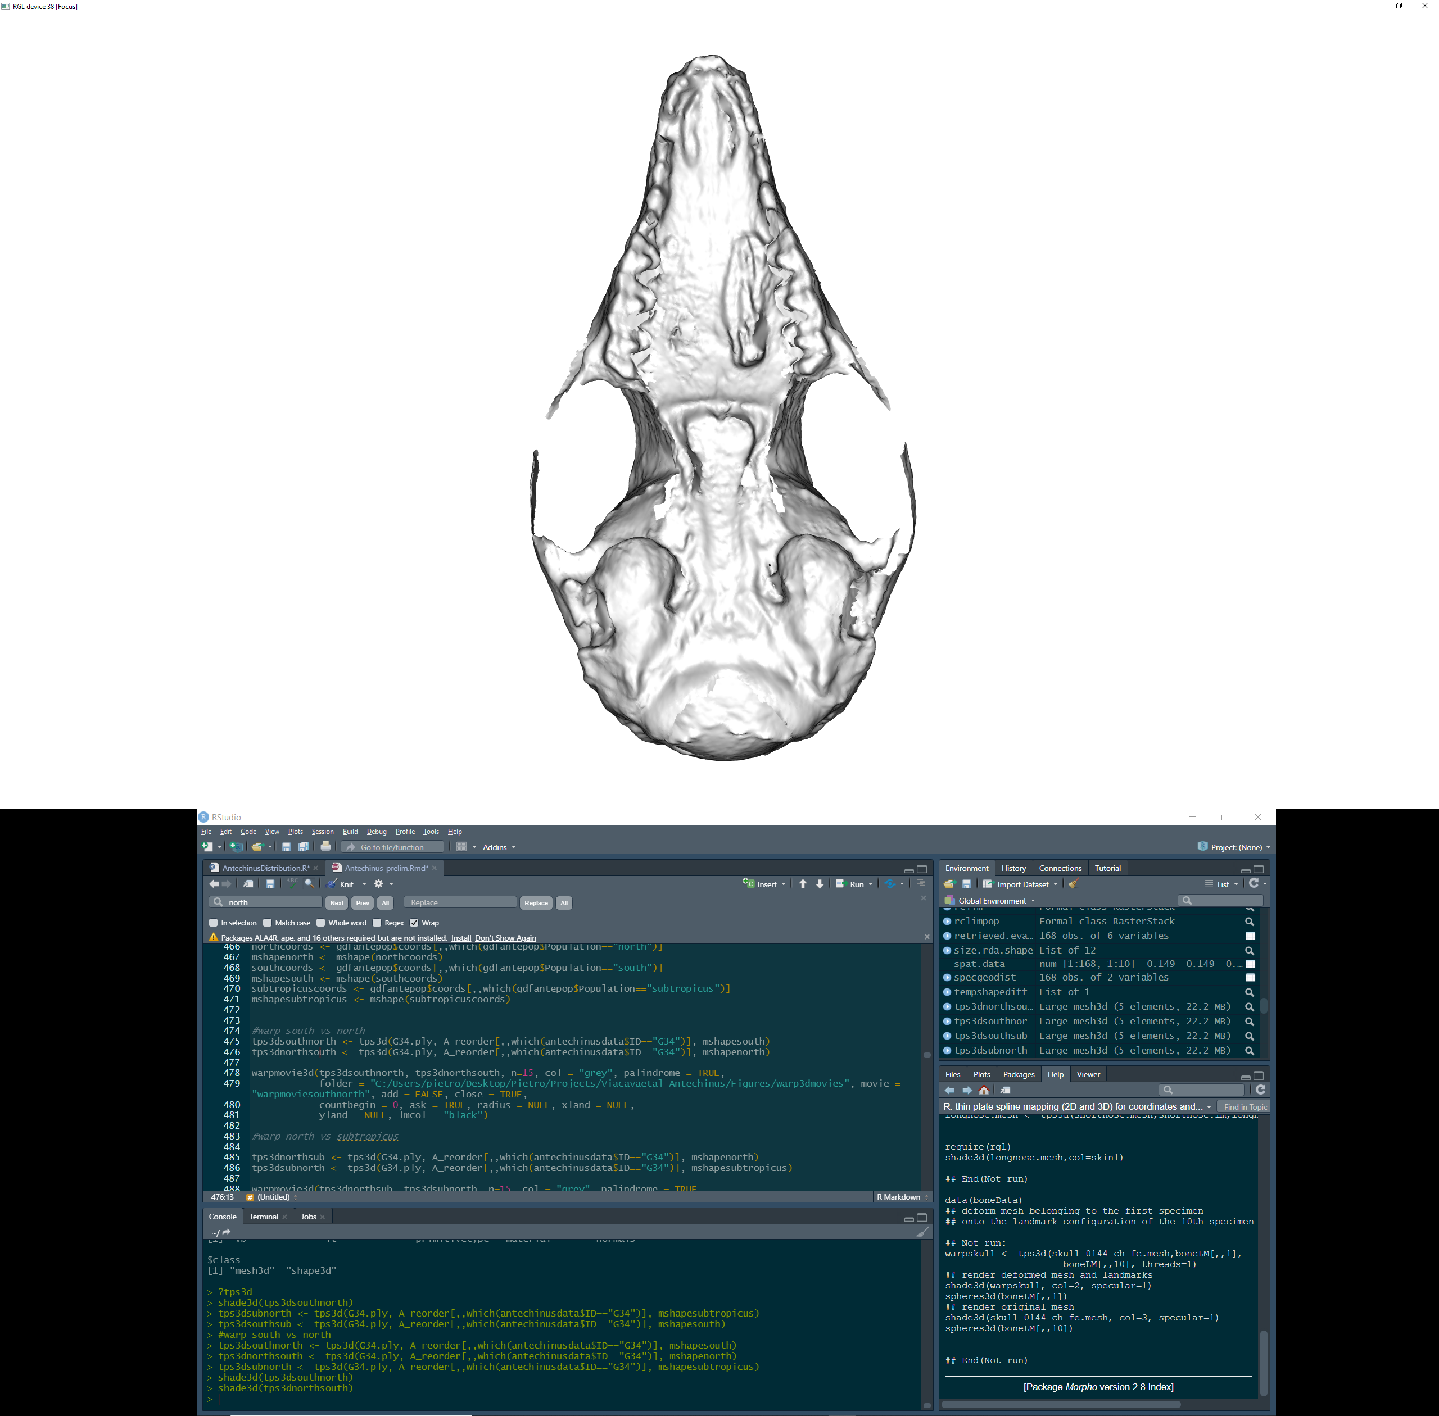
Size of major palatine foramina
Size of incisive foramina
Interpalatal distance
A. stuartii south
A. stuartii north
A. stuartii north
A. subtropicus
A. stuartii south
A. subtropicus

Slide 7
Figure 4. Venn diagrams illustrating variation partitioning analyses. Each individual fraction for each factor contributing to the model is shown in every set. Circle sizes and white space out of the circles representing the unexplained variation are schematic and not to scale.

Slide 8
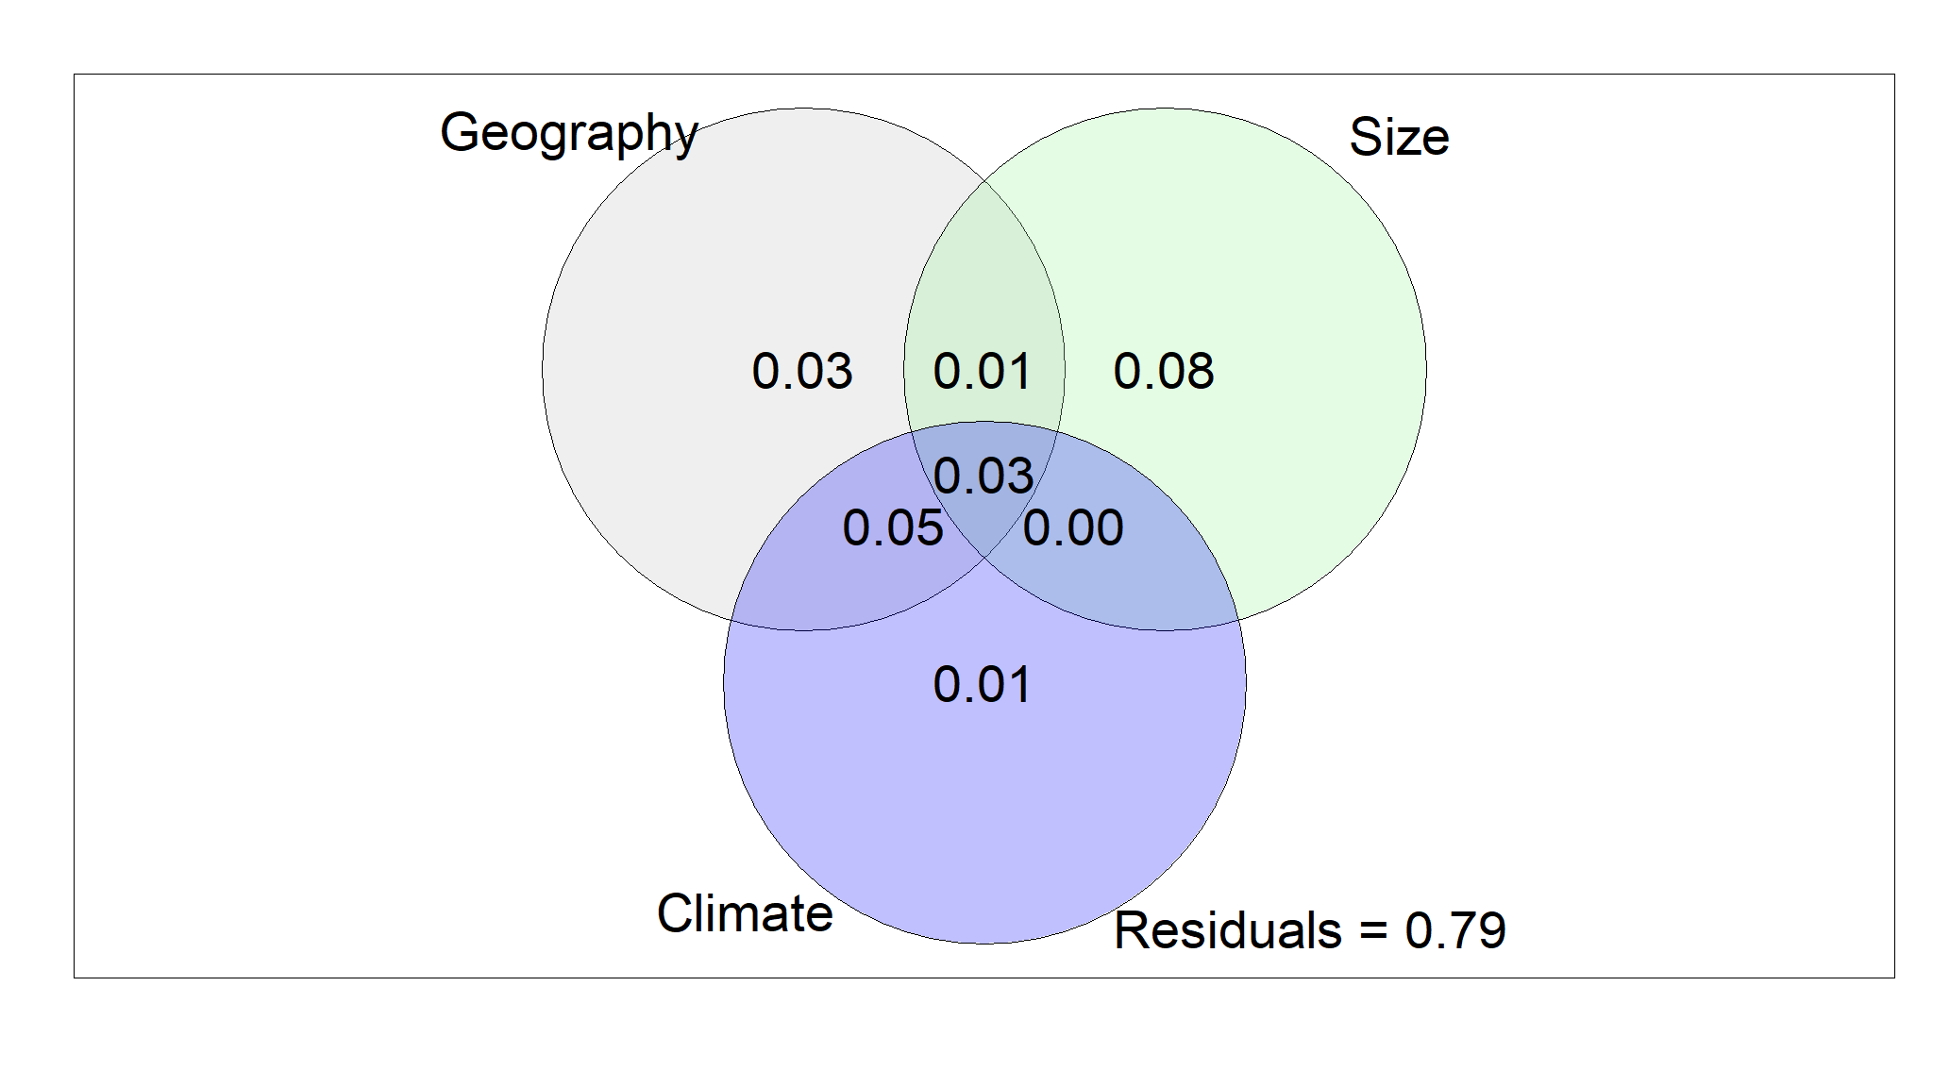
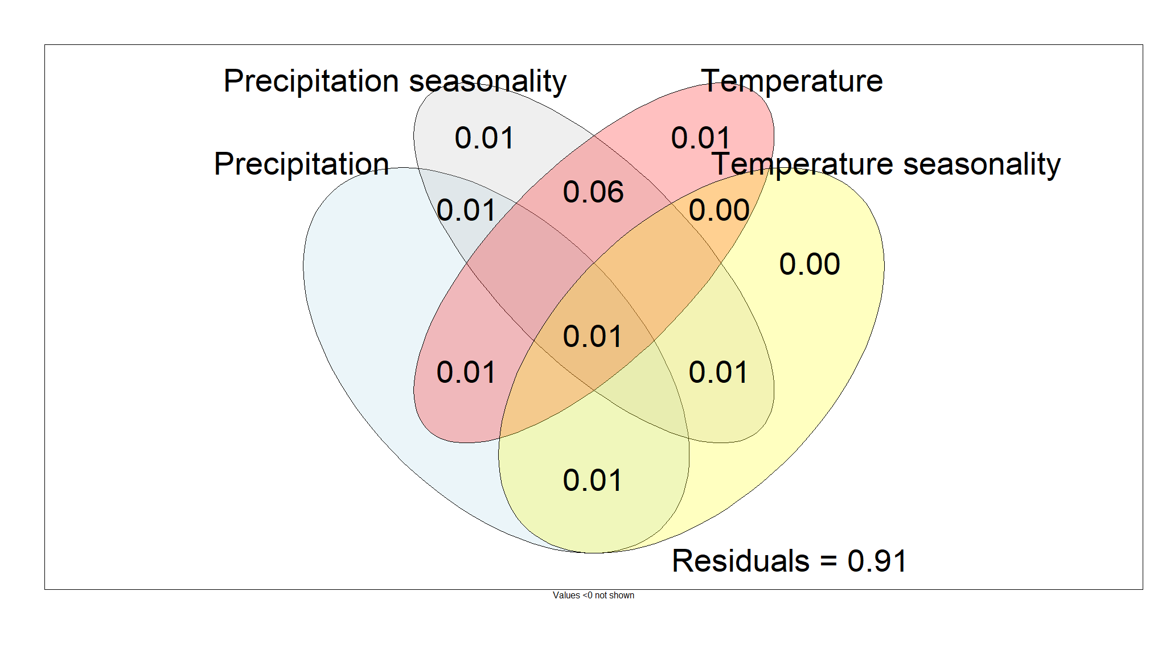

Slide 9
Table 1. ANOVA on predictors of size variation and Procrustes ANOVA on predictors of shape variation.

Slide 10
Response Variable | Predictor Variable | Question | d. f. | SS | R² | F | Pr(>F) | Interpretation
Size | Clade | Are clades different in size? | 2 | 5104.8 | 0.338 | 33.925 | 0.001 | Clear effect.
 | Sex | Are sexes different in size? | 1 | 5184.7 | 0.352 | 71.46 | < 0.001 | Clear effect.
Shape | Clade | Are clades different in shape? | 2 | 0.017 | 0.143 | 11.082 | 0.001 | Clear effect.
 | Size | Is there allometry? | 1 | 0.016 | 0.133 | 20.477 | 0.001 | Clear effect.
 | Sex | Are sexes different in shape? | 1 | 0.004 | 0.038 | 5.051 | 0.001 | Low effect sizes and low variance explained.
 | Size : Sex | As there is sexual dimorphism and allometry, do sexes differ in allometric slopes? | 1 | 0.001 | 0.006 | 0.907 | 0.587 | No clear effect.
 | Size + Sex | Adjusting for size, are sexes different in shape? | 1 | 0.001 | 0.013 | 1.946 | 0.016 | Low effect sizes and low variance explained.
 | Size : Clade | Do clades differ in allometric slopes? | 2 | 0.001 | 0.012 | 1.014 | 0.433 | No clear effect.
 | Size + Clade | Adjusting for size, are clades different in shape? | 2 | 0.01 | 0.085 | 7.175 | 0.001 | Clear effect.

Slide 11
Table 2. Analyses of Variance on geographic sources of size and shape variation of the entire A. stuartii - A. subtropicus species complex and within each clade.

Slide 12
Response variable | Predictor variable | Question | SS | R² | F | Pr (>F) | Interpretation
Size | Latitude | Is latitude covarying with size in this dataset? | 3735.5 | 0.195 | 40.29 | 0.001 | Clear effect.
 | Latitude within each clade | Is latitude covarying with size within each clade? | South: 104.32 North: 303.04 Sub: 4.7 | South: 0.035 North: 0.111 Sub: 0.001 | South: 1.311 North: 1.08 Sub: 0.073 | South: 0.261 North: 0.061 Sub: 0.813 | No clear effect.
 | Longitude | Is longitude covarying with size in this dataset? | 3428.9 | 0.179 | 36.261 | 0.001 | Clear effect.
 | Longitude within each clade | Is longitude covarying with size within each clade? | South: 21.16 North: 485.53 Sub: 31 | South: 0.007 North: 0.178 Sub: 0.007 | South: 0.258 North: 6.07 Sub: 0.478 | South: 0.629 North: 0.027 Sub: 0.461 | No clear effect. North might have a biased sample.
Shape | Latitude | Is latitude covarying with shape in this dataset? | 0.014 | 0.093 | 17.054 | 0.001 | Clear effect
 | Latitude within each clade | Is latitude covarying with shape within each clade? | South: 0.002 North: 0.001 Sub: 0.001 | South: 0.07 North: 0.052 Sub: 0.025 | South: 2.705 North: 1.543 Sub: 1.667 | South: 0.001 North: 0.058 Sub: 0.039 | Only south stuartii is varying latitudinally in shape with low effect.
 | Longitude | Is longitude covarying with shape in this dataset? | 0.012 | 0.081 | 14.645 | 0.001 | Clear effect
 | Longitude within each clade | Is longitude covarying with shape within each clade? | South: 0.002 North: 0.001 Sub: 0.001 | South: 0.066 North: 0.051 Sub: 0.022 | South: 2.554 North: 1.494 Sub: 1.461 | South: 0.003 North: 0.09 Sub: 0.117 | Only south stuartii is varying longitudinally in shape with low effect.

Slide 13
Table 3. ANOVA on climatic predictors of size variation and Procrustes ANOVA on climatic predictors of shape variation.

Slide 14
 |  | Size |  |  |  | Shape
 | d. f. | SS | R² | F | Pr(>F) | SS | R² | F | Pr(>F)
Precipitation | 1 | 731 | 0.032 | 6.596 | 0.011 | 0.002 | 0.013 | 2.135 | 0.012
Precipitation seasonality | 1 | 3193.6 | 0.162 | 33.27 | <0.001 | 0.012 | 0.08 | 14.521 | 0.001
Temperature | 1 | 4550.7 | 0.233 | 51.83 | <0.001 | 0.011 | 0.075 | 13.5 | 0.001
Temperature seasonality | 1 | 1906.7 | 0.094 | 18.38 | <0.001 | 0.002 | 0.016 | 2.69 | 0.004
Elevation | 1 | 390.2 | 0.015 | 3.457 | 0.065 | 0.001 | 0.006 | 1.048 | 0.382

Slide 15
Supplementary Figure 1. Box plot and dot plot of centroid size labelling males and females.

Slide 16
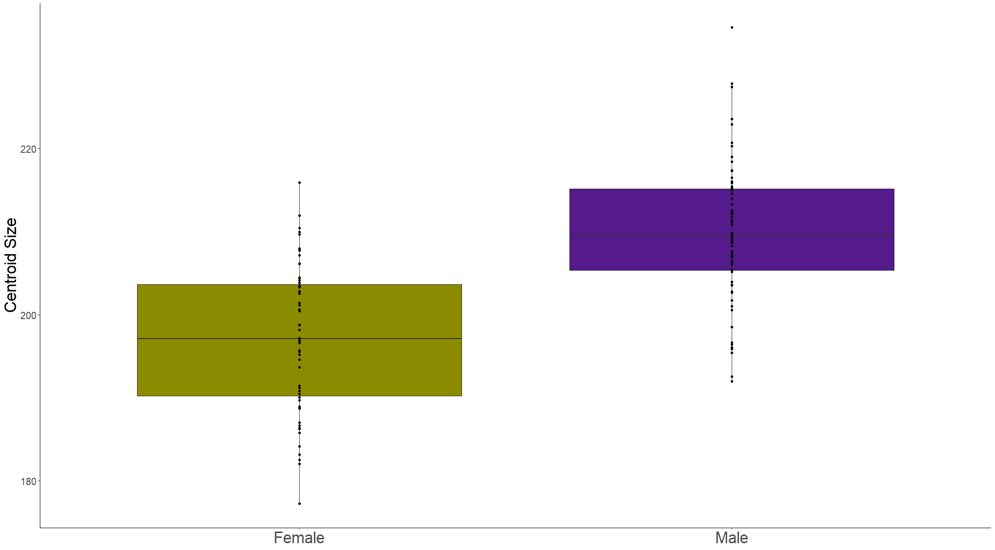

Slide 17
Supplementary Figure 2. Principal Component Analysis on all specimens.

Slide 18
