Slide 1
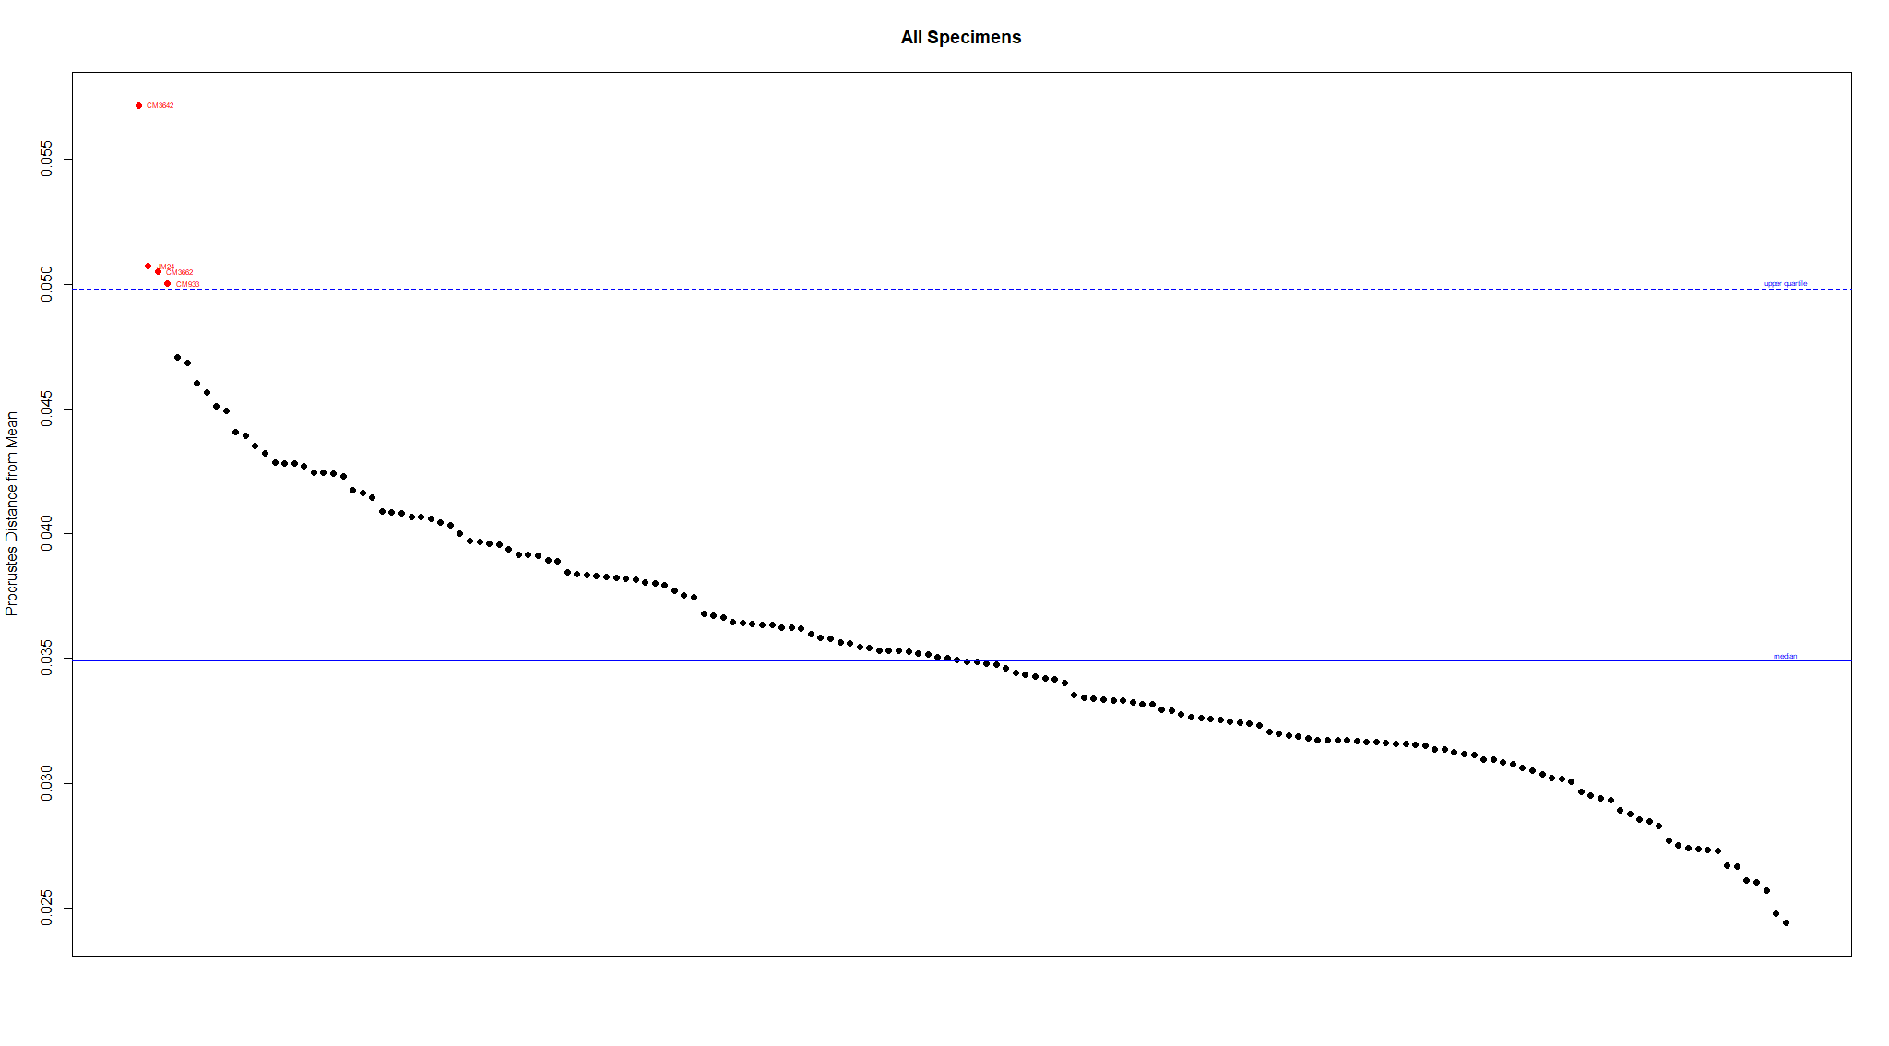
188 specimens scanned, of which:
8 were omitted from landmarking
180 specimens landmarked, of which:
6 were omitted from analysis because were juvenile
4 believed to be other species
1 outlier (Procrustes distance from mean, upper quartile)
169 specimens for analysis, of which:
68 females, 91 males, 10 unknown
67 subtropicus, 39 south stuartii, 23 north stuartii, 40 dubious (holotype)

Slide 2
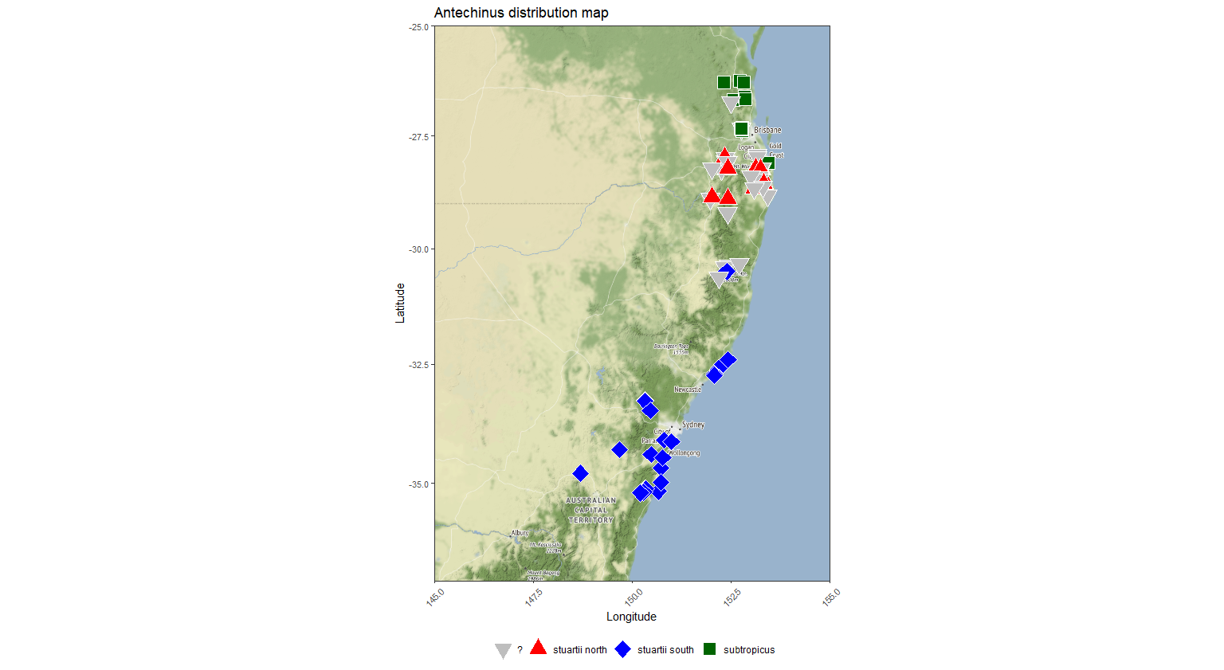

Slide 3
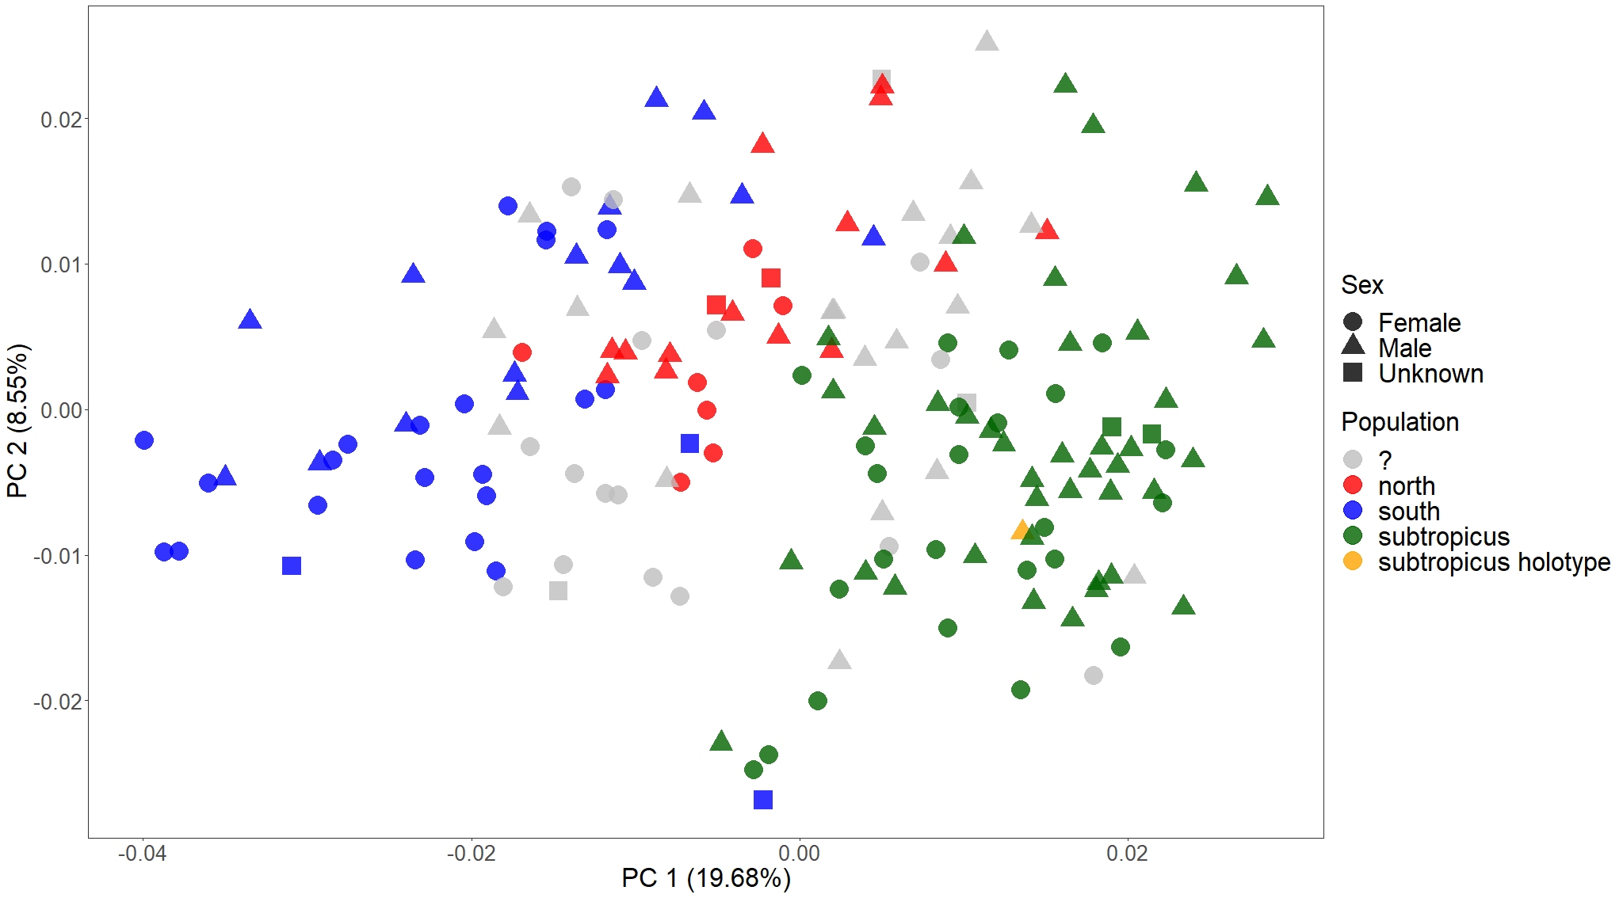
PCA on all specimens, including unknown sex and dubious population identity

Slide 4
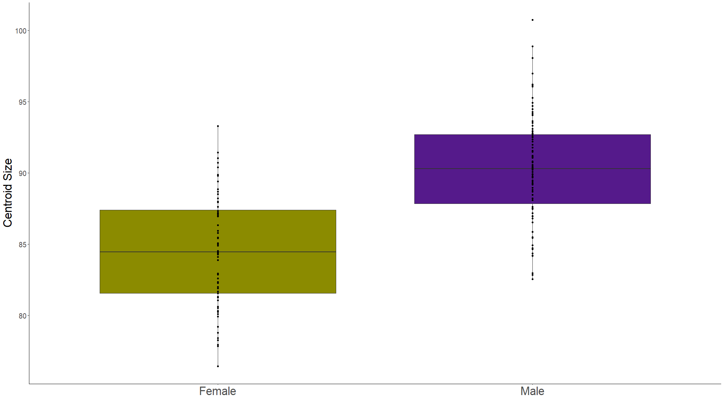
Sex as a predictor of size variation
Adj. R² = 0.355
F_{1,157} = 87.92
p < 0.001

Slide 5
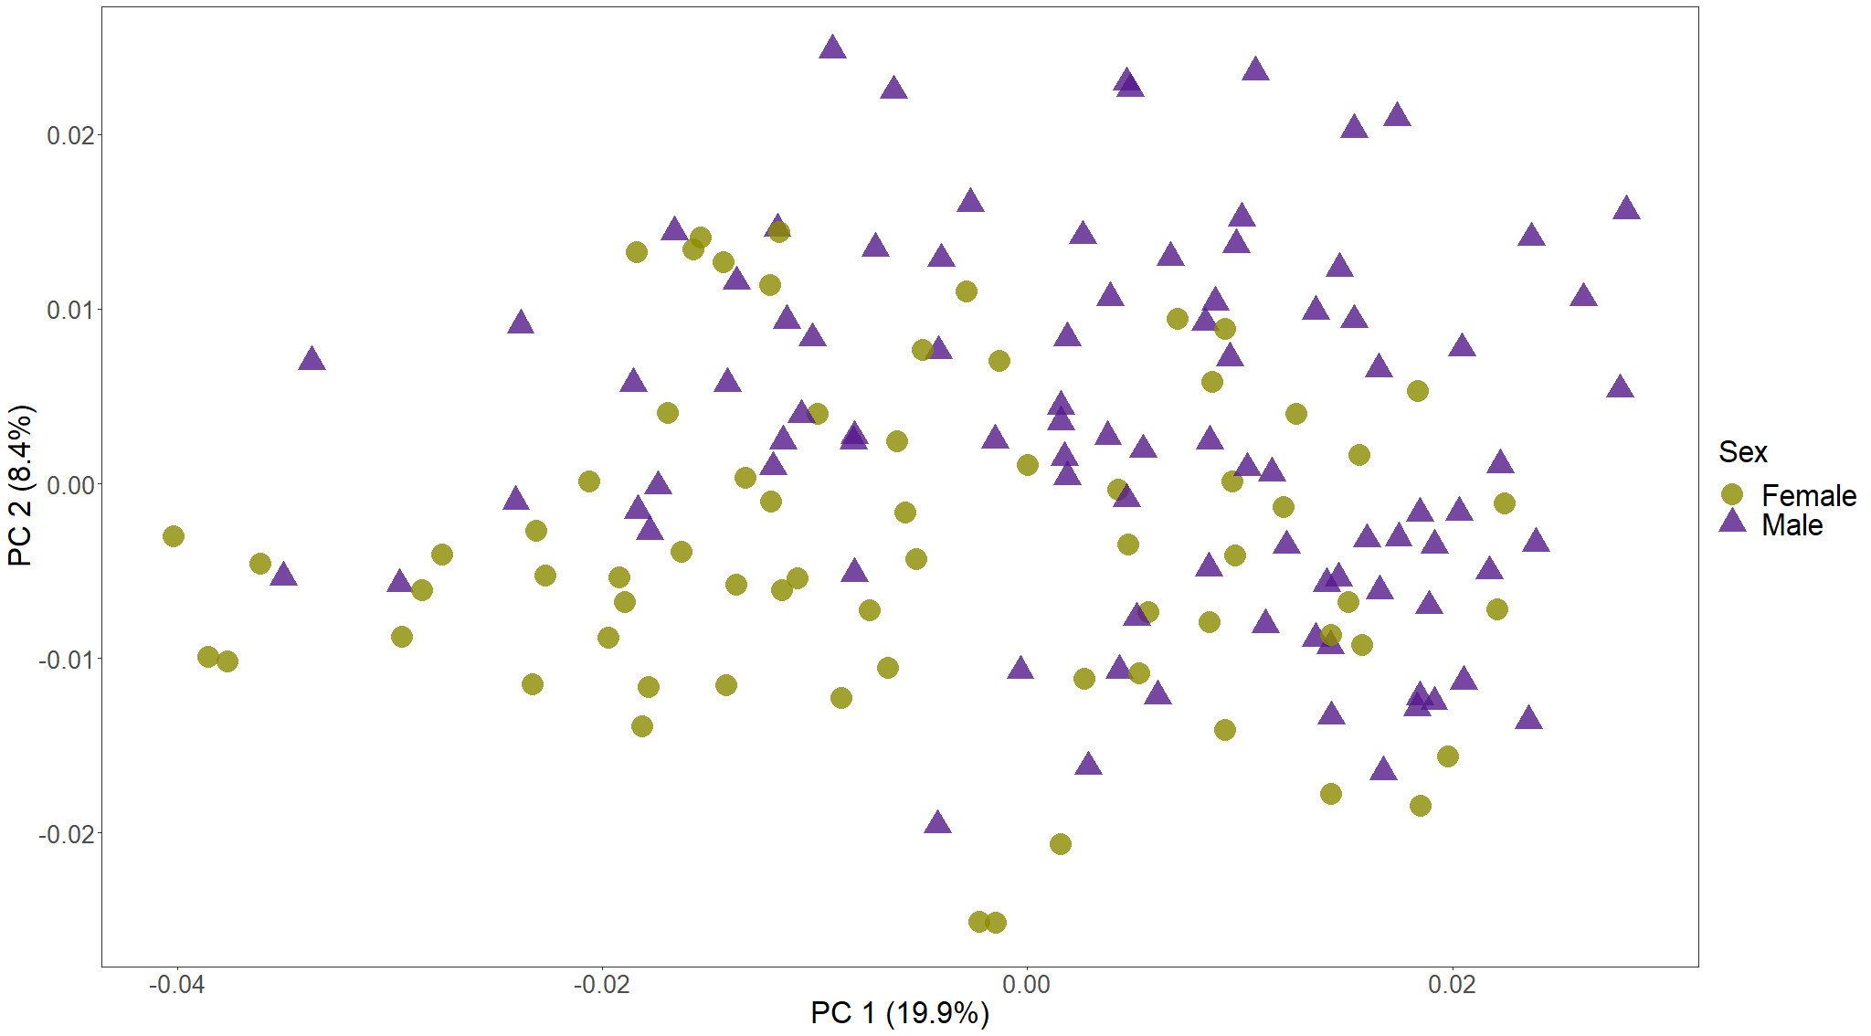
Procrustes ANOVAs
Are sexes different in shape?
(shape~sex)
R² = 0.038
F_{1, 157} = 6.197
p = 0.001
Do they have unique allometries? (shape~size*sex)
R² = 0.005
F_{1, 155} = 0.919
p = 0.556
Adjusting for size, are sexes different in shape? (shape~size+sex)
R² = 0.014
F_{1, 156} = 2.451
p = 0.003
PCA on all specimens, labelling only sex

Slide 6
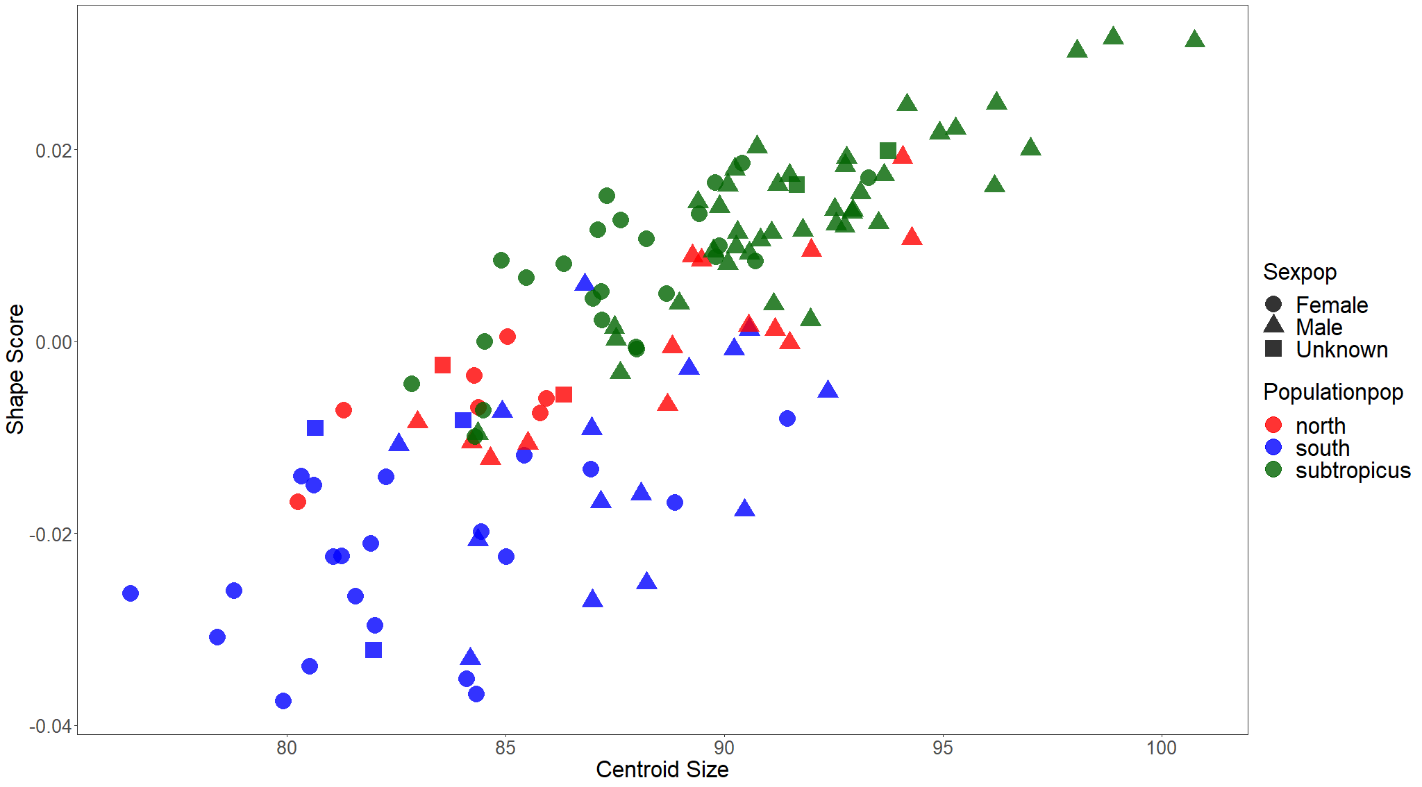
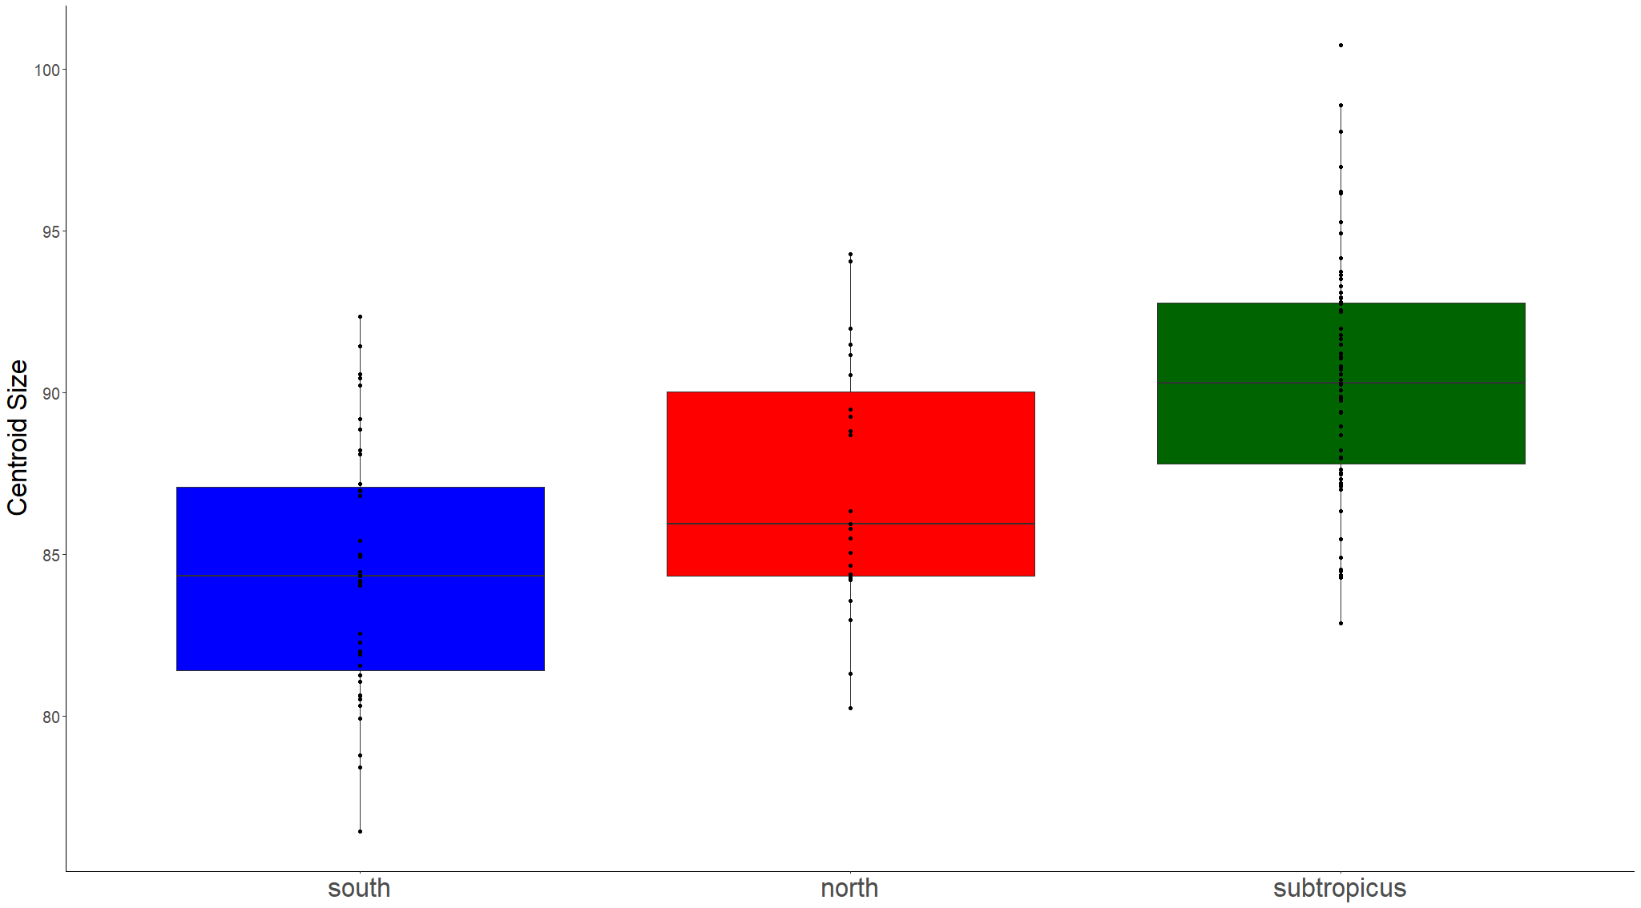
Procrustes ANOVA allometry (shape~size)
R² = 0.137
F_{1, 127} = 20.115
p = 0.001
Do they have unique allometries? (shape~size*population)
R² = 0.013
F_{2, 123} = 1.08
p = 0.267
Adjusting for size, are populations different in shape? (shape~size+population)
R² = 0.125
F_{2, 125} = 10.55
p = 0.001
Population identity as a predictor of size variation
Adj. R² = 0.338
F_{2, 126} = 32.096
p = 0.001

Slide 7
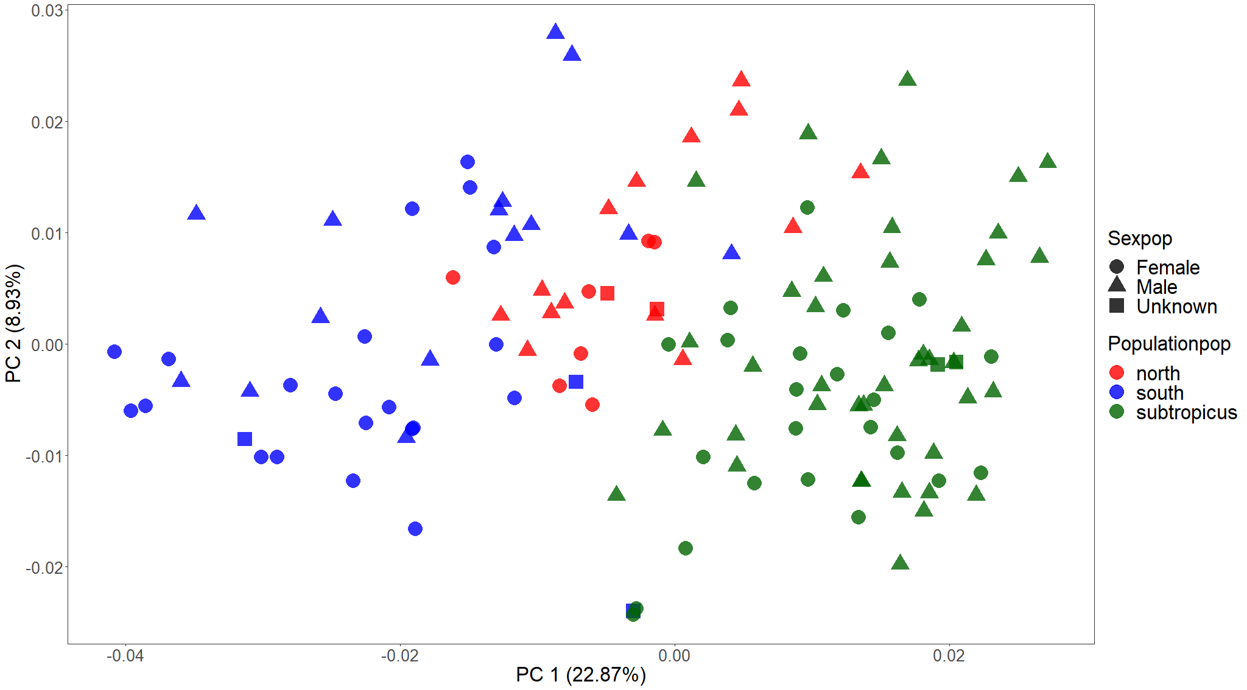
Procrustes ANOVA
Are populations different in shape? (shape~population)
R² = 0.202
F_{1, 127} = 15.9
p = 0.001
Pairwise comparisons
They are all different!
No difference in disparity??

