Slide 1
Project: Effects of soil-borne resources on the structure and dynamics of lowland tropical forests
Principal Investigators:
James Dalling Dept. of Plant Biology, 505 S Goodwin Ave. University of Illinois, Urbana, IL 61801, USA dallingj@life.uiuc.edu | Kyle Harms Dept. of Biological Sciences, Louisiana State University, 202 Life Sciences Bldg., Baton Rouge, LA 70803, USA kharms@lsu.edu | Joseph Yavitt Dept. of Natural Resources, 16 Fernow Hall, Cornell University, Ithaca, NY 14853, USA jby1@cornell.edu | Robert Stallard U.S. Geological Survey-WRD, 3215 Marine Street, Boulder, CO 80303, USA stallard@colorado.edu
Post-doctoral Associate:
Robert John-Chandran Dept. of Plant Biology, 505 S Goodwin Ave. University of Illinois, Urbana, IL 61801, USA robertjc@life.uiuc.edu
For more information about
these data please contact
Jim Dalling
dallingj@life.uiuc.edu

Slide 2
Acknowledgements
Please acknowledge the following agencies that provided funding for the collection and analyses of these data
NSF DEB021104,021115, 0212284,0212818 and OISE 0314581
STRI Soils Initiative and CTFS
Thanks to Paolo Segre and Juan Di Trani for assistance in the field

Slide 3
Table 1. Variogram model fit parameters for soil properties for the BCI 50-ha plot. The measured data values
were first transformed using Box-Cox transformation, and then a polynomial trend surface regression was fitted.
The residuals from the trend surface regression were used to compute empirical variograms, to which variogram
models were fitted. Lambda is the Box-Cox parameter, and trend order indicates the order of the polynomial
regression. Effective range for the Exponential variogram model is estimated at 3 times the fitted range because
the variogram approaches the sill only asymptotically.

Slide 4
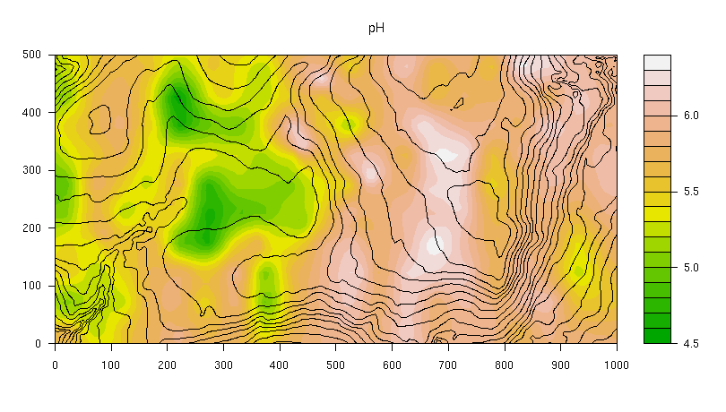
Maps: Filled-contour maps plotted using block average data.
pH

Slide 5
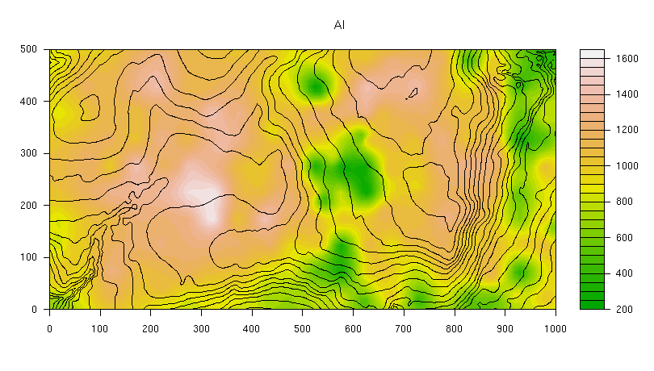
Maps: Filled-contour maps plotted using block average data.
Aluminum (Al): mg / kg of oven-dried soil

Slide 6
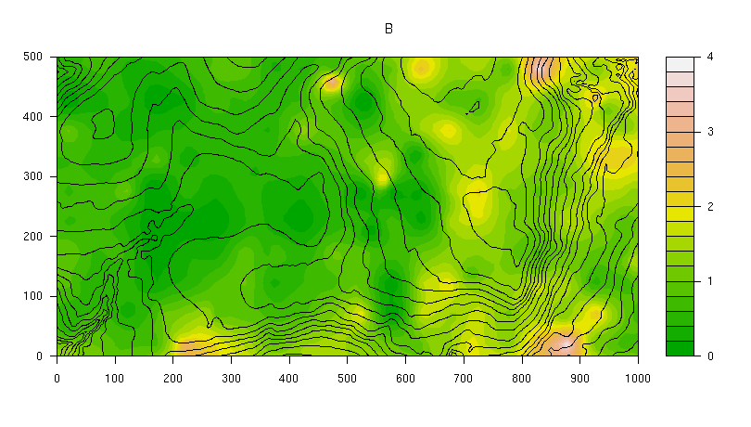
Maps: Filled-contour maps plotted using block average data.
Boron (B): mg / kg of oven-dried soil

Slide 7
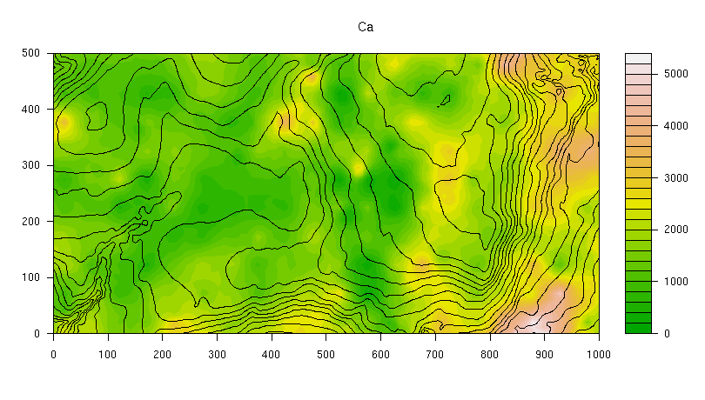
Maps: Filled-contour maps plotted using block average data.
Calcium (Ca): mg / kg of oven-dried soil

Slide 8
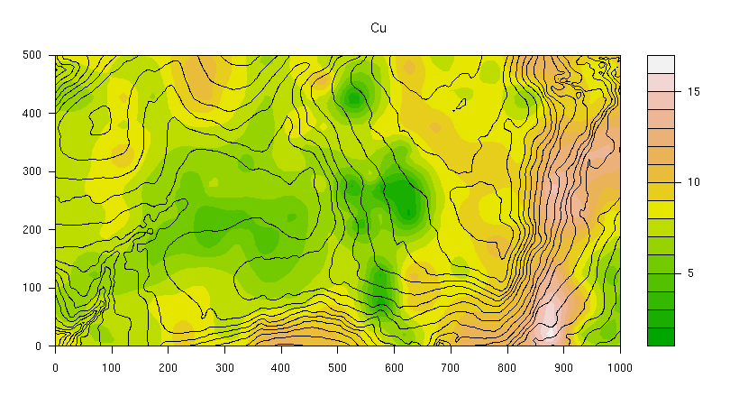
Maps: Filled-contour maps plotted using block average data.
Copper (Cu): mg / kg of oven-dried soil

Slide 9
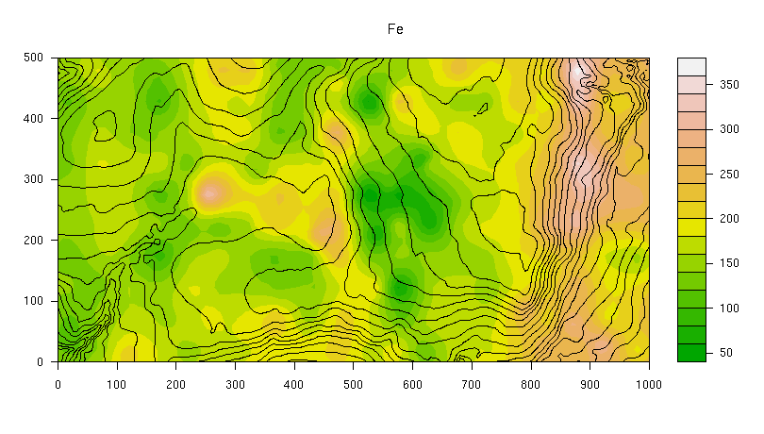
Maps: Filled-contour maps plotted using block average data.
Iron (Fe): mg / kg of oven-dried soil

Slide 10
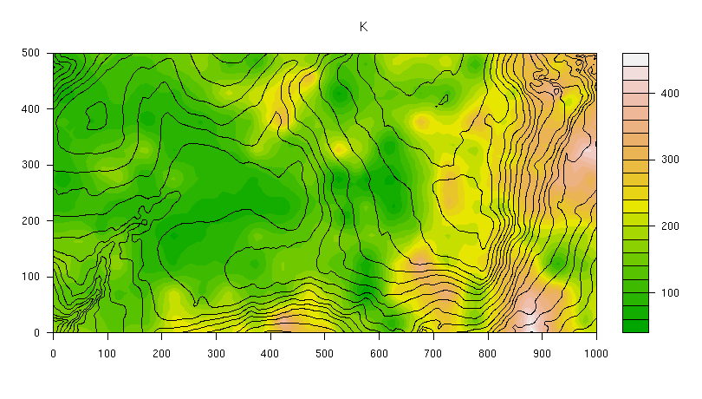
Maps: Filled-contour maps plotted using block average data.
Potassium (K): mg / kg of oven-dried soil

Slide 11
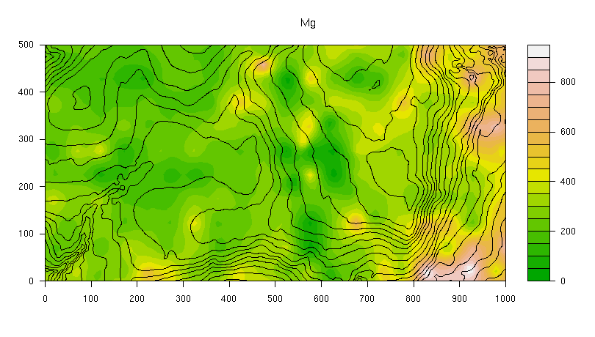
Maps: Filled-contour maps plotted using block average data.
Magnesium (Mg): mg / kg of oven-dried soil

Slide 12
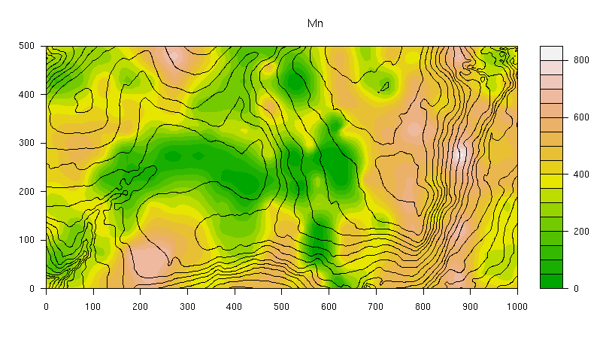
Maps: Filled-contour maps plotted using block average data.
Manganese (Mn): mg / kg of oven-dried soil

Slide 13
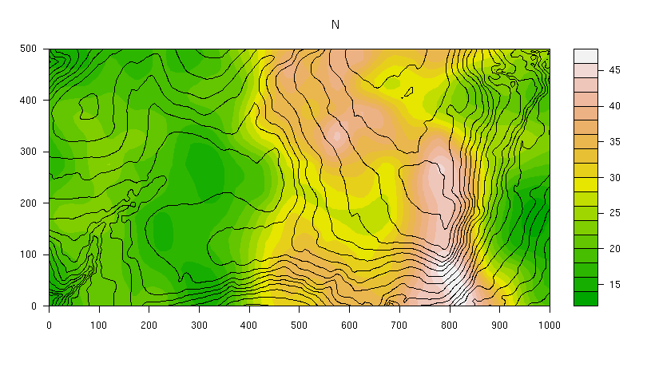
Maps: Filled-contour maps plotted using block average data.
Nitrogen (N): mg / kg of oven-dried soil

Slide 14
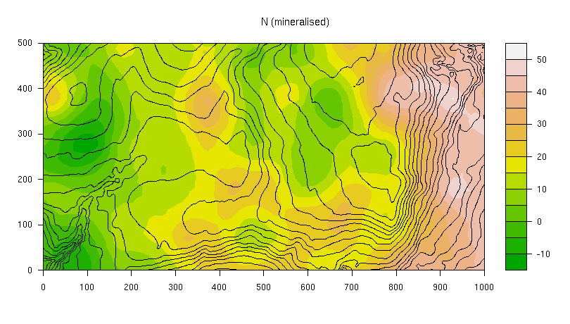
Maps: Filled-contour maps plotted using block average data.
Nitrogen mineralisation: mg / kg of oven-dried soil

Slide 15
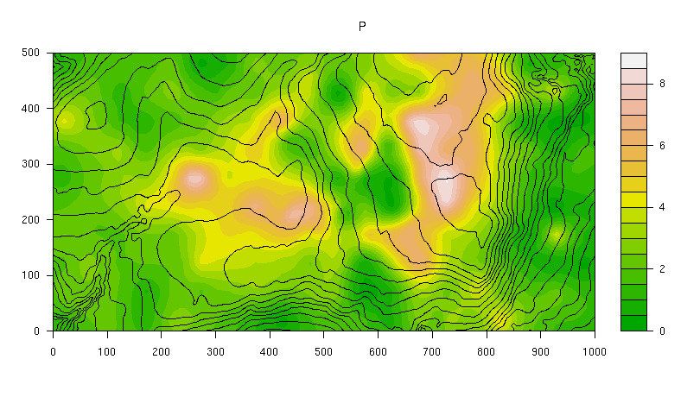
Maps: Filled-contour maps plotted using block average data.
Phosphorus (P): mg / kg of oven-dried soil

Slide 16
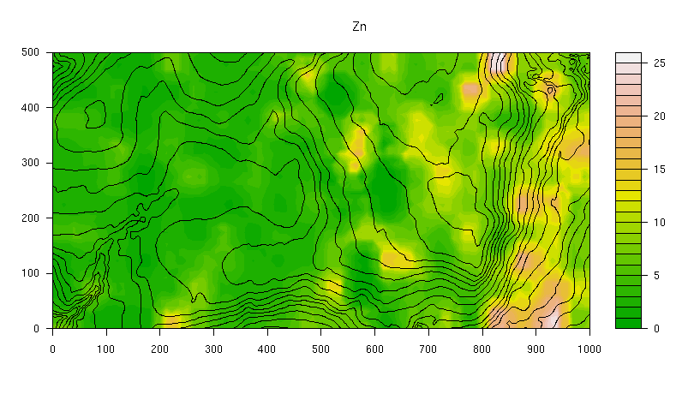
Maps: Filled-contour maps plotted using block average data.
Zinc (Zn): mg / kg of oven-dried soil

