Slide 1

A Smoke Detector

Slide 2
Overview of the Analysis:
Identify the periods where the drawdown is over 10%.
Identify the max drawdown and the period in which this event occurs.
Calculate the Moving Averages (MA).
Implement a cross-over cash-index (COCI) trading strategy.
Compare COCI returns to the base index over the entire period.
Compare COCI volatility to the base index.

Slide 3
Some Assumptions:
There is sufficient liquidity at the close of the first trading session of each month to transfer cash to an index or vice versa.
The portfolio starts in a cash position.

Slide 4
The Data:
We use a 10 month MA.
The MA is calculated on the first trading day of the month, based on the last trading day from the previous month.
The S&P will be the index.
We consider a 90 year time frame and a 30 year time frame.
Prices on the 90 year time frame run from 12/31/1929 to 4/24/2020.
Prices on the 30 year time frame run from 12/29/1989 to 4/24/2020.

Slide 5
The Algorithm:
We use a 10 month MA.
Calculation of the MA occurs on the first trading day of the month.
0.0 is the value of the 10 month MA until the 11th month.
Initially the portfolio is 100% cash in an interest bearing account, and remains cash until at least the 1st MA is calculated.

Slide 6
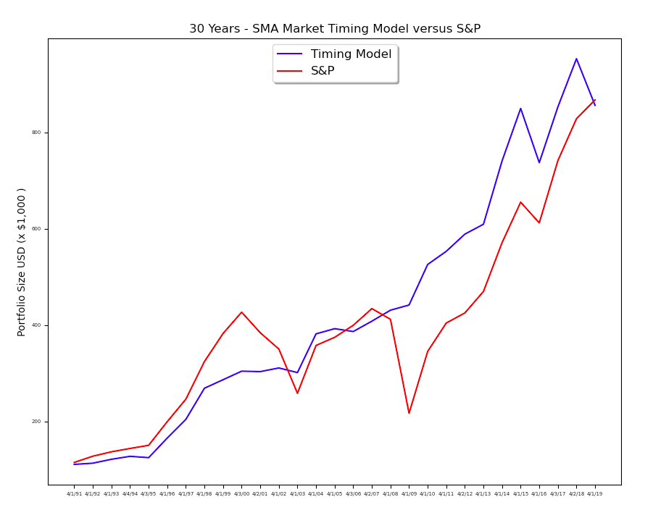

Slide 7
The Results:
30 year model | Timing | Index
Annual Volatility | 9.8% | 17.7%
Annual Yield | 7.3% | 7.5%
Maximum Drawdown | 14.4% | 56.78%
$100,000 | $834,600 | $874,400

Slide 8
The Results:
90 year model | Timing | Index
Annual Volatility | 11.9% | 18.9%
Annual Yield | 5.8% | 5.7%
$100 | $15,860 | $14,410

Slide 9
Reference:
M. Faber, “A Quantitative Approach to Tactical Asset Allocation”,
The Journal of Wealth Management, (2007, 2009, 2013).

