Slide 1
CPE3333 Operating Systems
Dr. Weerapan SAE-DAN
Faculty of Engineering
Ramkhamhaeng University

Slide 2
Today’s Class
Organization Meeting
Course organization & outline
Policies
Prerequisites & course sign-up
Intro to Operating Systems

Slide 3
Organization Information
Contact info
Weerapan.s@rumail.ru.ac.th
Discussion section
18.00 – 21.00 PM, LTB316

Slide 4
Prerequisites and Syllabus
CPE2214: Data Structure and Algorithm
CPE2311: Discrete Mathematics
Textbook: Operating System Concepts (Silberschatz, Galvin, Gagne) 8th or 9th ed.
Course requirements
4-6 written homework (15%)
Class participation & in-class exercises (5%)
3-4 programming projects (40%)
3 exams (40%) – two in-class midterms and a final
Strict late policies and policies on cheating

Slide 5
Course Resources
Accounts in the Lab:30+ Linux-based machines
Discussion section to help you with Lab assignments and course concepts

Slide 6
Course Requirements
Note: Percentages are subject to revision.
Programming projects: 40%
Strict late policy!
In-class exams: 40%
Homework: 15%
Class participation and discussions: 5%

Slide 7
Labs
3-4 Projects
Focus on topics covered in the class
Projects will use primarily C++
May work in groups of 2
Computer Lab accounts or use your own machine
3 late days

Slide 8
Cell Phone and Laptop Policy
Class use policy: Don’t!
Cell phones should be off or silenced
Texting is strictly prohibited in class
Laptops and tablets may NOT be used in class: No email, browsing, Facebook, Twitter during class lectures
Violations may result in penalties

Slide 9
Course Outline & Topics
Processes and Threads
Memory Management
Storage and File Systems
Distributed Systems

Slide 10
What’s An Operating System?
Definition has changed over years
Originally, very bare bones
Now, includes more and more
Operating System (OS)
Interface between the user and the architecture
Implements a virtual machine that is hopefully easier to program than raw hardware

Slide 11
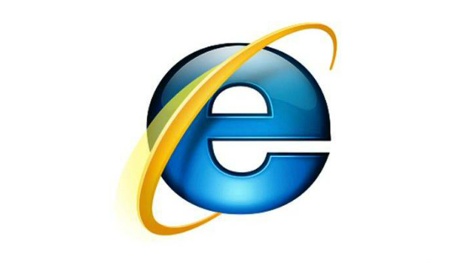
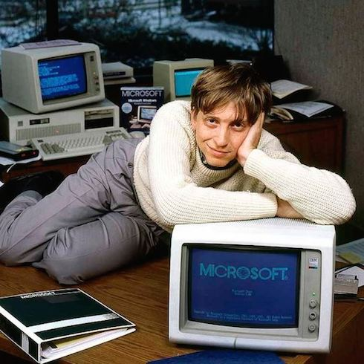
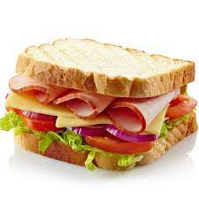
What’s an OS? Bill Gates says…
“even
a ham sandwich” (Steve B.)

Slide 12
OS: Traditional View
Interface between user and architecture
Hides architectural details
Implements virtual machine:
Easier to program than raw hardware
Illusionist
Bigger, faster, reliable
Government
Divides resources
“Taxes” = overhead
User-Level Application
Virtual machine interface
Operating System
physical machine interface
Hardware

Slide 13
New Developments in OS
Operating systems: active field of research
Demands on OS’s growing
New application spaces (Web, Grid, Cloud)
Rapidly evolving hardware
Advent of open-source operating systems
Linux etc.
You can contribute to and develop OS’s!
Excellent research plaporm

Slide 14
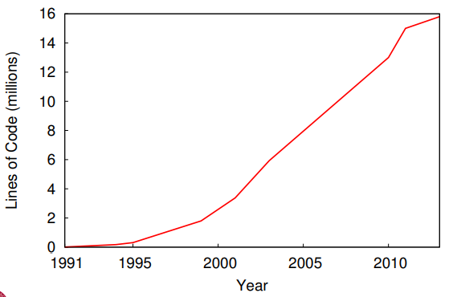
Linux Kernel Size

Slide 15
Operating Sys: Salient Features
Services: The OS provides standard services (the interface) which the hardware implements.
Examples: the file system, virtual memory, networking, CPU scheduling, and time-sharing
Coordination: The OS coordinates multiple applications and users to achieve fairness and efficiency (throughput).
Examples: concurrency, memory protection, networking, and security
Goal: Design an OS so that the machine is convenient to use (a software engineering problem) and efficient (a system and engineering problem).

Slide 16
Why Study Operating Systems?
Abstraction: How to get the OS to give users an illusion of infinite memory, CPUs, resources, world wide computing, etc.
System Design: How to make tradeoffs between
performance and the convenience of OS abstractions
performance and the simplicity of OS design, and
putting functionality in hardware or software.
Basic Understanding: The OS provides the services that allow application programs to work at all.
System Intersection Point: The OS is the point where hardware and software meet.

Slide 17
Why Study Operating Systems?
Not many operating systems are under development, so you are unlikely to get a job building an OS. However, understanding operating systems will enable you to use your computer more effectively. They also serve as an excellent example of system design issues whose results and ideas you will apply elsewhere.
Background: To understand this course you must have a solid basic understanding of hardware (CPU instruction sets, memory hierarchies, I/O systems, etc.) and solid programming skills ( complex data structures, classes as an encapsulation mechanism, etc.)
Obviously, you cannot understand the implications of how components intersect without understanding the components.

Slide 18
Build Large Computer Systems
OS as an example of large system design
Goals: Fast, reliable, large scale
To build these systems, you need to know
Each computer:
Architectural details that matter
C and C++ (nitty gritty & more)
Memory management & locality
Concurrency & scheduling
Disks, network, file systems
Across cluster:
Server architectures
Distributed computing, file systems

Slide 19
History of Operating Systems
And now, for some historical context
From mainframes to web-based systems in nine slides

Slide 20
1. Single User Computers
Hardware: expensive; humans: cheap
One user at a time on console
Interacting with as program runs
Computer executes one function at a time
No overlap: computation & I/O
User must be at console to debug
Multiple users = inefficient use of machine

Slide 21
2.Batch Processing
Execute multiple “jobs” in batch:
Load program
Run
Print results, dump machine state
Repeat
Users submit jobs (on cards or tape)
Human schedules jobs
Operating system loads & runs jobs
More efficient use of machine

Slide 22
3. Overlap I/O and Computation
Before: machine waits for I/O to complete
New approach:
Allow CPU to execute while waiting
Add buffering
Data fills “buffer” and then output
And interrupt handling
I/O events trigger a signal (“interrupt”)
More efficient use of machine
Still one job at a time

Slide 23
4. Multiprogramming
Several programs to run simultaneously
Run one job until I/O
Run another job, etc.
OS manages interactions
Which jobs to run (schedule)
Protects program’s memory from others
Decides which to resume when CPU available

Slide 24
OS Complexity
Increased functionality & complexity
First OS failures
Multics (GE(&(MIT): announced 1963, released 1969
OS/360 released with 1000 known bugs
Need to treat OS design scientifically
Managing complexity becomes key to…

Slide 25
The Renaissance (1970’s)
Hardware: cheap; humans: expensive
Users share system via terminals
The UNIX era
Multics:
Army of programmers, six years
UNIX:
Three guys, two years
“Shell”: composable commands
• No distinction between programs data
But: response time & thrashing

Slide 26
Industrial Revolution (1980’s)
Hardware very cheap
Humans expensive
Widespread use of PCs
IBM PC: 1981, Macintosh: 1984
Simple OS (DOS, MacOS)
No multiprogramming, concurrency, memory protection, virtual memory,…
Later: networking, file-sharing, remote printing…
GUI added to OS (“WIMP”)

Slide 27
The Modern Era (1990’s now)
Hardware cheap; processing demands increasing
“Real” operating systems on PC’s
NT (1991); Mac OS X; Linux
Different modalities:
Real-time: Strict or loose deadlines
Sensor/Embedded: Many small computers
Parallel: Multiple processors, one machine
Distributed: Multiple networked processors
Think P2P, the Web, Google, cloud

Slide 28
Architectural Trends
Big Changes
In 50 years, almost every computer component now 9 orders of magnitude faster, larger, cheaper
example | 1983 | 1999
MIPS | 0.5 | 500
Cost/MIP | $100000 | $5000
memory | 1 MB | 1 GB
network | 10 Mb/s | 1 Gb/s
disk | 1 GB | 1 TB

Slide 29
History Lesson
This degree of change has no counterpart in any other area of business.
Examples:
Transportation -- over the last 200 years, we have gone from horseback (10 miles/hour) to the Concorde (1000(miles/hour) – 2 orders of magnitude.
Communication – at the invention of the telephone (voice), TV (video) and fax (text & pictures), communication went from the speed of transportation to nearly the speed of light - 7 orders of magnitude.

Slide 30
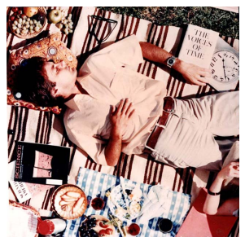
Orders of Magnitude
10^0

Slide 31
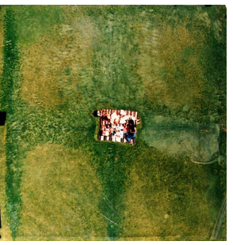
Orders of Magnitude
10^1

Slide 32
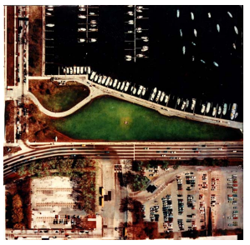
Orders of Magnitude
10^2

Slide 33
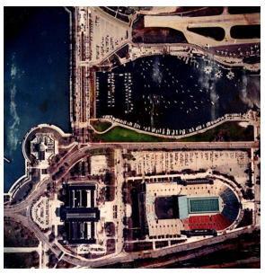
Orders of Magnitude
10^3

Slide 34
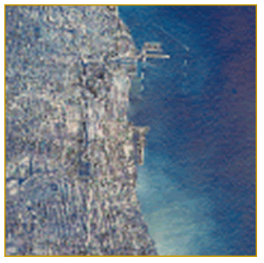
Orders of Magnitude
10^4

Slide 35
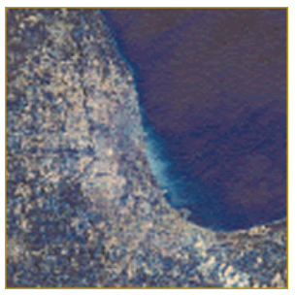
Orders of Magnitude
10^5

Slide 36
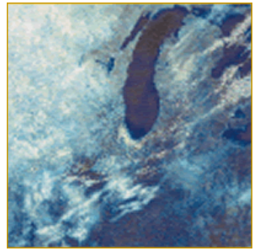
Orders of Magnitude
10^6

Slide 37
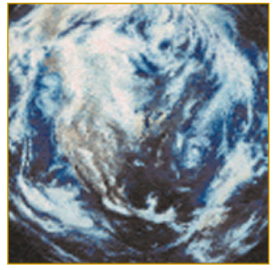
Orders of Magnitude
10^7

Slide 38
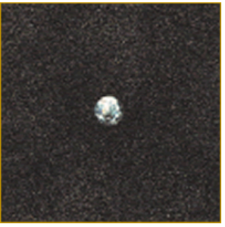
Orders of Magnitude
10^8

Slide 39
Now OS
Moore’s Law – running out of steam
Now “features”
Multiple cores
Unreliable memory
Solid state drives
Serious power/heat constraints
Other tradeoffs possible
Computing power for reliability…

