Slide 1
(a)多通道二维卷积运算
(b)多通道三维卷积运算

Slide 2

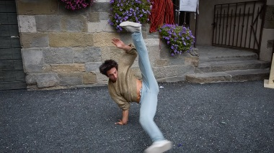
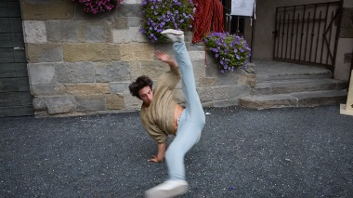

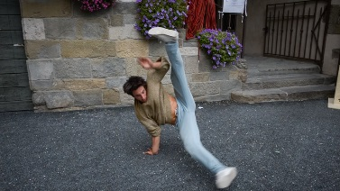
























…
…
Motion Enhancement
ResNeXt + ASPP
Initial Motion Block
$$M_{t+1}$$
c
$$E_{t+1}$$
$$P_{t+1}$$
$$I_{t+1}$$
$$A_{t}$$
Saliency Guided Block
$$I_{t}$$
$$M_{t}$$
c
$$E_{t}$$
$$P_{t}$$
Element-wise Multiplication
$$A_{t−1}$$
Saliency Guided Block
c
Concatenation
$$I_{t−1}$$
Saliency Prediction
Loss Function
c
$$P_{t−1}$$
$$M_{t−1}$$
$$E_{t−1}$$
…
$$A_{t−2}$$
…
New Prediction ($P_{t−1}$)
$$f_{ex}(·)$$
$$f_{sq}(·)$$
c
$$f_{s}(·)$$
Σ
Historical Prediction
($P_{1}, …,P_{t−2}$)
$$P_{1}, …,P_{t−1}$$
$$P_{1}^{′}, …,P_{t−1}^{′}$$
$$A_{t−1}$$

Slide 3
256-d in
256-d in
256, 64, 1×1
256, 4, 1×1
256, 4, 1×1
256, 4, 1×1
Total 32
paths
….
64, 64, 1×1
4, 4, 1×1
4, 4, 1×1
4, 4, 1×1
64, 256, 1×1
4, 256, 1×1
4, 256, 1×1
4, 256, 1×1
256-d out
256-d out
(a) Convolutional Block of ResNet
(b) Convolutional Block of ResNeXt

Slide 4
1×1 Conv
Dilation:1
3×3 Conv
Dilation:6
Atrous Spatial Pyramid Pooling（ASPP）
3×3 Conv
Dilation:12
1×1 Conv
Input
Output
3×3 Conv
Dilation:18
Image Pooling

Slide 5
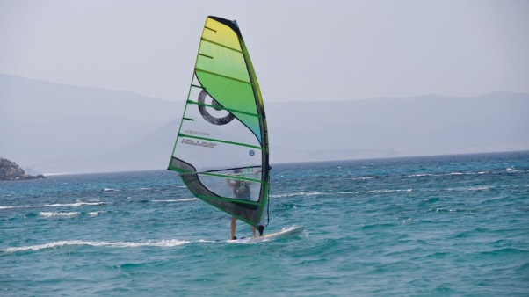

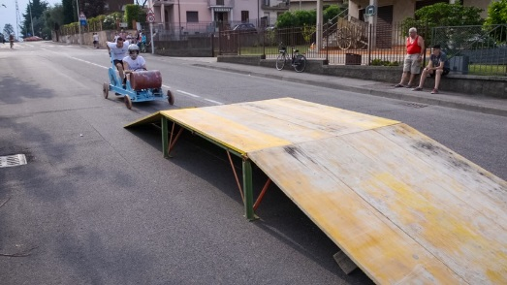
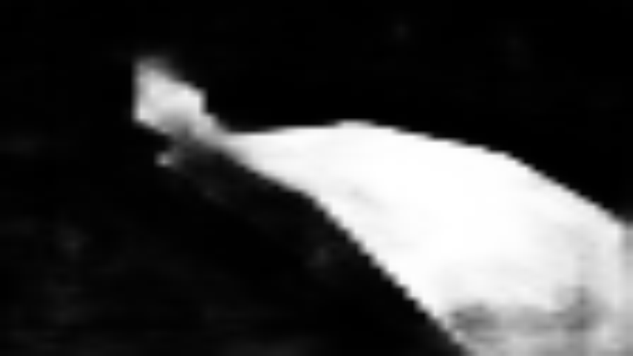
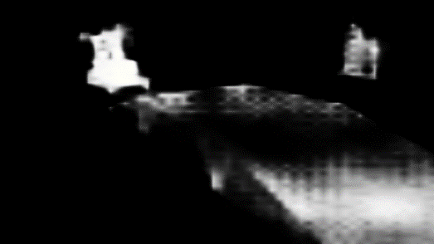
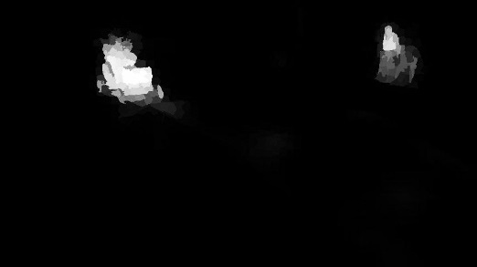
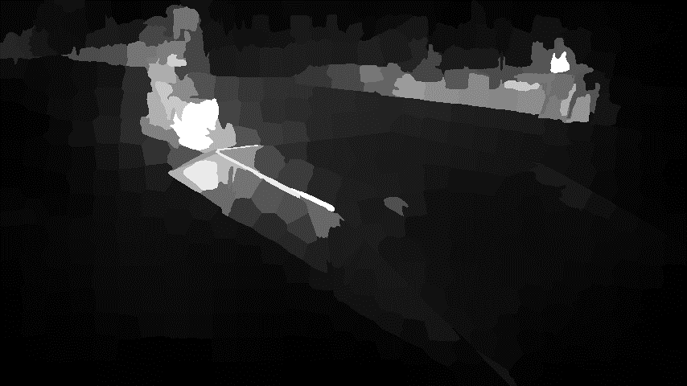
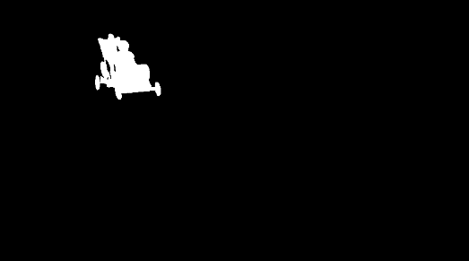
(a)
(b)
Input Frame
DLVS
PDB
SCOM
CG
GT

