Slide 1


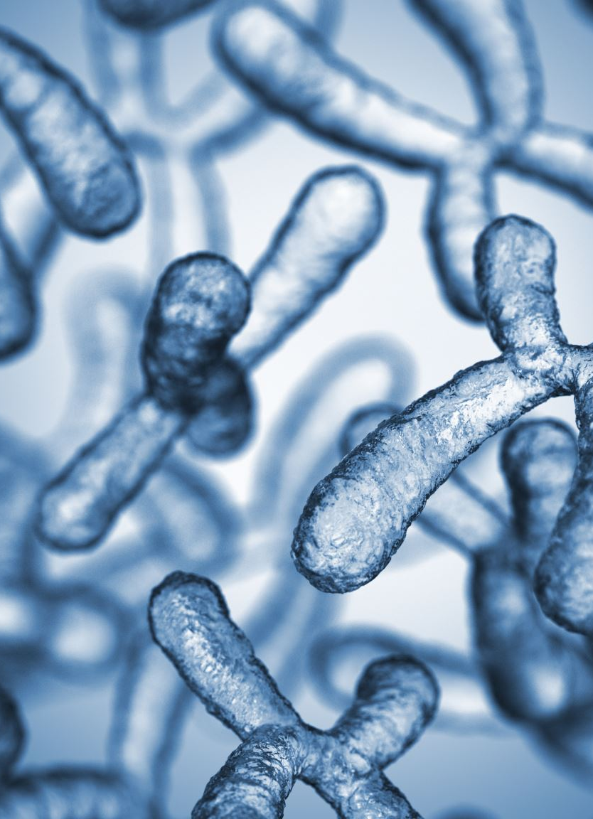



Synoptic Key of Life
La Monte Yarroll
Christopher Murphy
Jennifer Balasi
Shintaro Osuga
Notes:
LeMonte

Slide 2
Table of Contents
Problem Statement
Data
Tools
Methodology
Results
Notes:
LeMonte

Slide 3
Problem
The project addresses the challenge of efficiently accessing and analyzing a large dataset of over 7,000 scientific articles focused on mycelia, collected from leading institutions. These articles are highly structured, with standardized classifications and descriptions in both Latin and English, allowing for advanced data processing.
The team aims to develop an AI-powered tool that enables precise querying and retrieval of relevant articles based on input descriptions. This involves converting unstructured annotated text into a structured format suitable for downstream analysis or modeling. This solution streamlines the search for specific mycelial information, enhancing accessibility and utility for researchers in the field. By organizing and standardizing a complex dataset, the project facilitates sophisticated data-driven insights and query capabilities.
Notes:
LaMonte

Slide 4
Data
The workflow includes:
Data Processing and Standardization:
Parsing annotated text files into paragraphs and mapping annotations to structured data.
Relabeling paragraphs using predefined categories (e.g., "Description," "Nomenclature") or default labels for non-matching entries.
Filtering and normalizing data to retain only relevant content.
Data Organization and Analysis:
Transforming the processed data into a structured pandas DataFrame with detailed metadata, including paragraph labels, filenames, page numbers, and more.
Performing quality checks and statistical summaries to ensure data integrity and readiness for further analysis.
Tool Development:
The resulting dataset supports the development of the AI tool, which leverages the structured information for accurate and efficient retrieval of related articles based on user queries.
Notes:
Shin

Slide 5
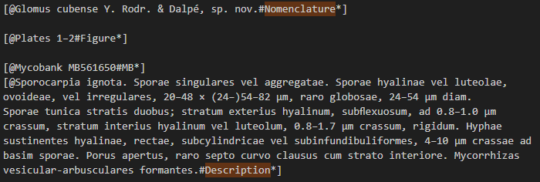
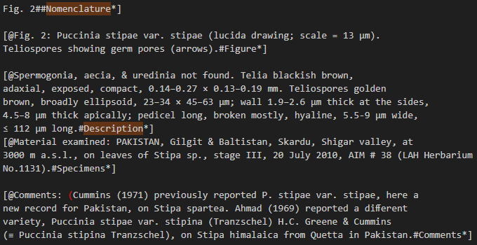
Data In Depth
The YEDDA format segments the text into multiple categories, including but not limited to: Description, Nomenclature, Misc-Exposition, Institution, Type-Collection, and Etymology. For our purposes, we focus specifically on the Nomenclature and Description sections.
Notes:
Shin

Slide 6
Methodology
Data Extraction and Annotation: Extract and standardize relevant sections,
focusing on categories like Nomenclature and Description.
Embedding with Transformer Models: Encode text and literature into
high-dimensional embeddings using transformer-based models to capture semantic relationships.
Cosine Similarity for Matching: Compare input text and dataset embeddings
using cosine similarity, calculating similarity scores.
Top-N Results Retrieval: Rank and retrieve the top N most semantically similar
literature entries based on similarity scores.
Modified Pre-built Search Tool: Adapt an existing literature search tool to integrate
embedding and similarity search processes.
Streamlined Output: Deliver contextually relevant, precise results to help identify
pertinent literature for deeper insights.
Literature Data
Annotate
Embedding Data
Preprocess
Embed Input
Search Embeddings
Compute Cosine Similarity
Return Top N
Notes:
Shin

Slide 7

Key:
User Searching
X
= existing, no change
X
= new code
MycoSearch
1
2
Sentence Transformer
* Search Query
Search Query Embedding
* “pileus campanulate, Lamellae yellow rust-brown”
3
Cosine Similarity between Search Query and Embedded Article Content
4
Returns Top 3 results
Search Results
6
5
Associates Web URL
Notes:
Our project focused on creating a search experience for mycology articles using NLP techniques involving a sentence transformer and text embedding.
MycoSearch is an extension of a pre-existing search application developed by researchers at the Auton Laboratory at Carnegie Mellon University. The codebase was forked to allow for developing and testing the extensions explained here.
Note the key in the upper right-hand corner of the slide that outlines the specific extensions the project team has designed and coded.
The following flow diagram shows the system processing in response to a search query submitted by a user.
1.) User submits a search query. Note example.
2.) Search query is embedded (Pre-trained PyTorch sentence transformer).
3.) Cosine similarity is calculated between query and article embeddings.
4.) Top 3 matches returned with web URLs for the source article.
Most of the project to date has focused on embedding the mycology article content in MycoSearch. So, we created a second visual flow diagram to explain the work done to embed the article content.

Slide 8
Key:
Embedding SKOL Content
X
= existing, no change
X
= new code
Synoptic Key of Life (SKOL)
MycoSearch
1
SKOL Classifier
Exposition,
Description,
Nomenclature
2
Get SKOL Data
Article Annotations
3
SKOL
4
Taxon
5
Associate Nomenclatures with Matching Descriptions
Convert skol data to taxon
6
Return data stream
7
Taxon content is embedded and serialized
Notes:
In addition to MycoSearch, the team extended a second pre-existing application named the “Synoptic Key of Life” or “SKOL”. SKOL was developed by project team member, La Monte Yarroll. This application is responsible for creating annotated representations of mycology research articles using classification algorithms.
Note the key in the upper right-hand corner of the slide that outlines the specific extensions the project team has delivered.
So now we'll walk through the process flow used to integrate these two applications to update the MycoSearch embeddings with SKOL article content.
1.) Pre-existing classifier in the SKOL application. Reads source articles, classifies and creates annotated versions.
The process reads the article paragraph by paragraph and looks for species names. Species names are referred to as nomenclatures.
When it finds a nomenclature, it finds a matching description and annotates.
2.) We extended Mycosearch with a class (get_skol.sh) that retrieves the SKOL annotated content.
3.) A repository of SKOL article references is created in MycoSearch.
4.) Next, we extended the SKOL application with a class that converts article data to Taxons.
In this implementation, a taxon is a species name, its description, and its metadata.
5.) A stream of taxon data for all annotated SKOL articles is returned from SKOL.
5.) Taxon content is embedded into the mycosearch. Again this step uses an existing pre-trained PyTorch sentence transformer.
- Computed embeddings are also serialized to ensure embeddings can be mapped back to the original sentences, and to aid in speed of loading embeddings into memory.

Slide 9
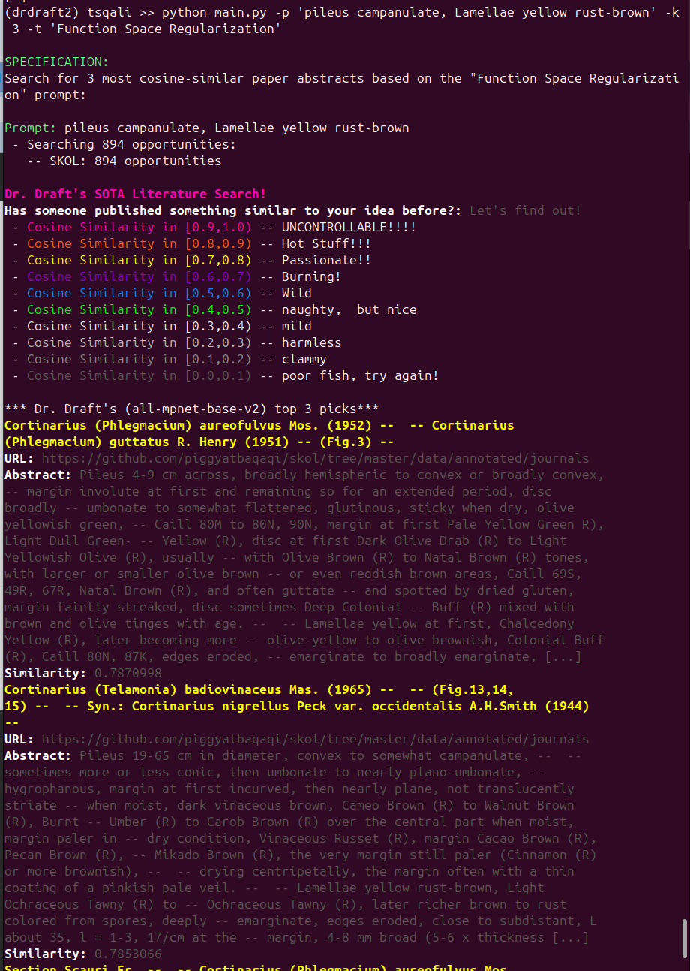
Results
The search query for "pileus campanulate. Lamellae yellow rust-brown" yields three results, each assigned a similarity score. The similarity is visually represented through a color-coded scale applied to the article titles:
Color-Similarity Scale: The scale, detailed in the accompanying table, ranges from grey (indicating the lowest similarity) to pink (indicating the highest similarity).
Result Presentation: The retrieved results are displayed in a structured format, providing the following details for each entry:
Title (color-coded to reflect similarity)
URL (link to the source article)
Species description
Similarity Score (a numerical representation of relevance)
This systematic presentation ensures clarity and facilitates the evaluation of search results based on both qualitative and quantitative indicators.
Notes:
A user can use the search query to find similar results. For example, the search query “pileus campanulate. Lamellae yellow rust-brown” retrieves three results, ranked by similarity scores and visually distinguished using a color-coded scale ranging from grey (low similarity) to pink (high similarity).
Each result includes the article title (color-coded for relevance), a URL link, a species description, and a numerical similarity score. This structured presentation combines visual and quantitative indicators, enabling clear, efficient evaluation of search results.

Slide 10
Next Steps
Improve URL linking
Add more literature to SKOL
Our changes will be pushed back to the main drdrafts project (dr-drafts-sota-search).
Publishing SKOL

