Slide 1
Concept, Approach, and Demonstration
Mar 6, 2006
© 2006. All Rights Reserved.

Slide 2
Introduction 1
What is Evolution Fund (EvoFund)?
  A stock portfolio revision system.
Main features?
  Intelligent
  Adaptive
  Scalable
  Real-time*
Notes:
Intelligent: genetic programming will automatically find the optimal solution
Adaptive: keep tracing the dynamic market trend
Scalable: the quantity method allows the analysis on thousands of stocks, which is impossible to do for financial analysts
Real-time: will be implemented in future

Slide 3
Introduction 2
What can EvoFund do?
  EvoFund predicts the optimized portfolio construction (weights of stock) for maximum earnings with controlled risks for a specified period of time in future.

Slide 4
Basic Components
Data
  Portfolio
  Virtual Portfolio Managers (VPM)
  Virtual Investors (VI)
Processes
  Training
  Analysis
Notes:
Training: force VPM to learn market data, and let VI then learn from VPM’s performance
Analysis: visualize the result and find the winner

Slide 5
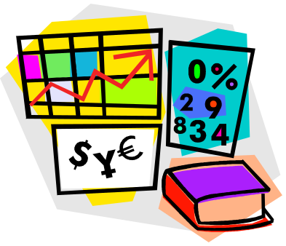
Portfolio
A portfolio is simply expressed as the weights of member stocks
Member Stocks
  should be open quoted
  should have enough historical quotes available

Slide 6

Virtual Portfolio Managers (VPM)
Personalities
  Memory
  Confidence
Learning activities
  Analyze historical data
Decision making
  Find the optimized portfolio

Slide 7
Personalities of VPMs
Memory
  How long period of time a portfolio manager will consider to make investment decisions.
  Short memory may cause the VPM short-sighted.
  Long memory can make the VPM dumb with new market trends.

Slide 8
Personalities of VPMs
Confidence
  For how long period of time a portfolio manager will stick to the previously optimized portfolio structure.
  Strong confidence makes the PM hold for a longer time, which may lose chances of cut-loss.
  Weak confidence leads to more frequent trading and transaction costs as well.

Slide 9
How do VPMs Analyze?
Memory Period
Memory Period
Memory Period
Past
Future
Historical Quotes
Confidence Period
Confidence Period
Optimize Portfolio

Slide 10
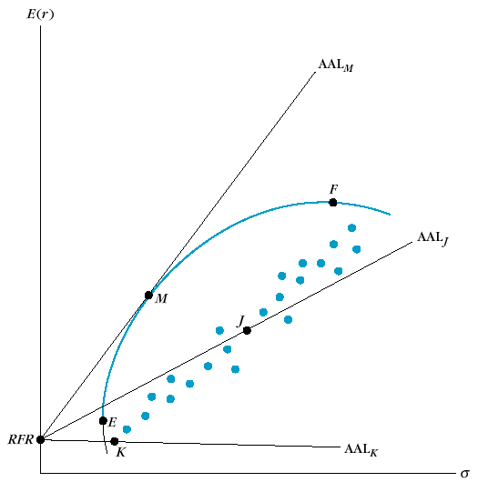
How to Optimize a Portfolio?
Modified Markowitz Portfolio Theory
Return
Optimal Portfolio
Efficient Frontier
Risk-free Rate
Risk (D-SD)
Notes:
Given a certain number of stocks, all kinds of combination of weights of the portfolio can be expressed as a point on the return-risk chart. There’s an upper boundary of these points by MPT called Efficient Frontier. All of the points on Efficient Frontier represent portfolios with the highest possible return at certain risk level. Considering the Risk-free Rate, we can also find an Optimal Portfolio (point M), which basically means the best possible portfolio we can find without saving or borrowing extra cash.

Slide 11

Virtual Investors (VI)
Personalities
  Memory
Performance evaluation
  Evaluate VPMs
  Self-evaluate to find the last winner

Slide 12
Personalities of VIs
Memory
  How long period of time of VPMs’ performance an investor will look at to select a best one.
  Similar properties as the memory of VPMs.

Slide 13
How do VIs Evaluate?
Memory Period
Memory Period
PM Performance
Past
Future
Memory Period
Sticking Period
Inherited from selected VPM’s confidence
Select a best VPM

Slide 14
Basic Components
Data
  Portfolio
  Virtual Portfolio Managers (VPM)
  Virtual Investors (VI)
Processes
  Training
  Analysis
Notes:
Training: genetic programming
Analysis: visualize the result and find the winner

Slide 15
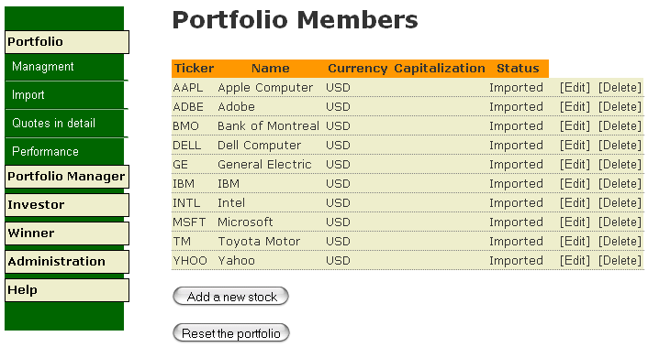
How Things Work Together?
Build a Portfolio
  Select stocks
Notes:
The part will go with software demonstration at the same time

Slide 16
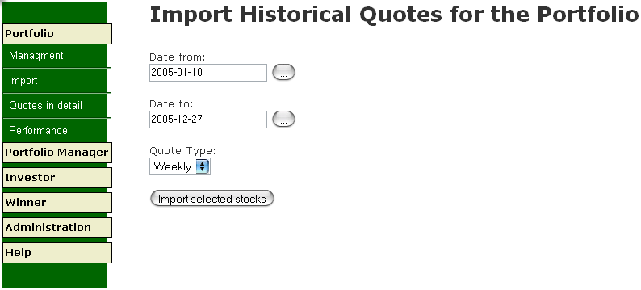
How Things Work Together?
  Select stocks
  Specify the period and type
Notes:
The part will go with software demonstration at the same time

Slide 17
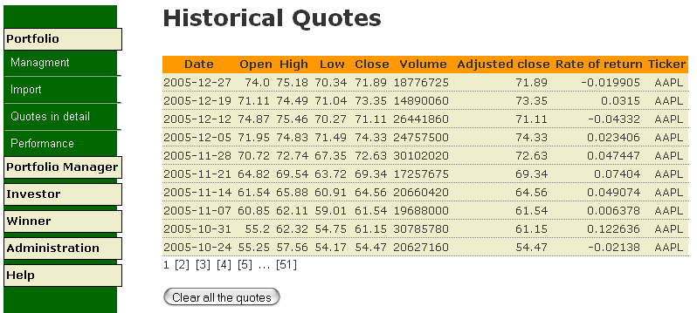
How Things Work Together?
  Select stocks
  Specify the period and type
  Import historical quotes
Notes:
The part will go with software demonstration at the same time

Slide 18
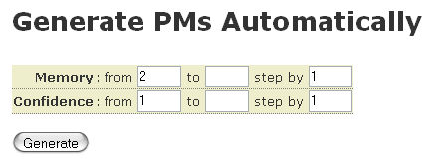
How Things Work Together?
Build a Portfolio
Manage VPMs
  Define ranges for personalities

Slide 19
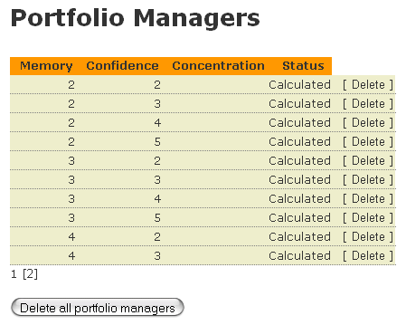
How Things Work Together?
  Define ranges for personalities
  Generate VPMs

Slide 20
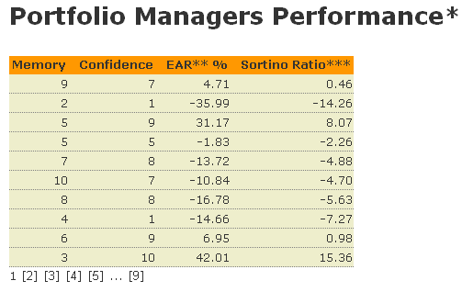
How Things Work Together?
  Define ranges for personalities
  Generate VPMs
  Train VPMs on historical quotes

Slide 21
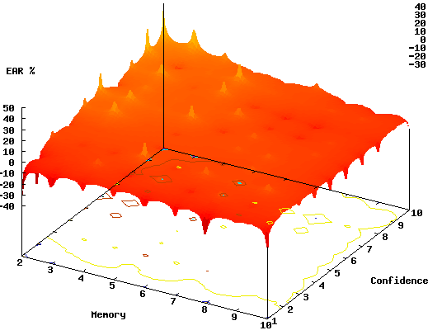
How Things Work Together?
  Define ranges for personalities
  Generate VPMs
  Train VPMs on historical quotes
  Analyze the result: Hotspot chart

Slide 22
How Things Work Together?
Build a Portfolio
Manage VPMs
Manage VIs
  Define ranges for personalities
  Generate VIs
  Train Vis on VPMs’ performance
  Analyze the result: Hotspot chart

Slide 23
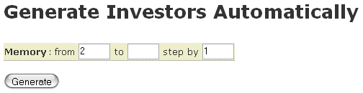
How Things Work Together?
Manage VIs
  Define ranges for personalities

Slide 24
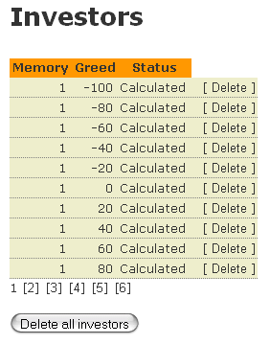
How Things Work Together?
  Define ranges for personalities
  Generate VIs

Slide 25
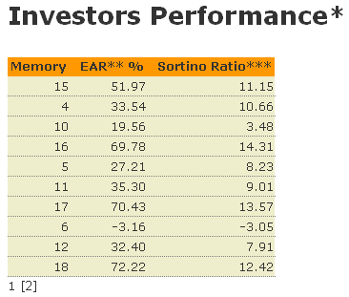
How Things Work Together?
  Define ranges for personalities
  Generate VIs
  Train Vis on VPMs’ performance

Slide 26
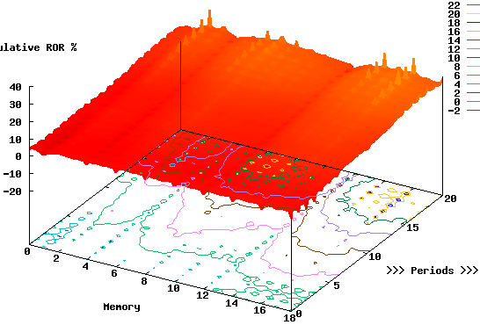
How Things Work Together?
  Define ranges for personalities
  Generate VIs
  Train Vis on VPMs’ performance
  Analyze the result: Timeline chart

Slide 27
How Things Work Together?
Build a Portfolio
Manage VPMs
Manage VIs
Find the Winner
  Winner’s Prediction
  Benchmark vs. Portfolio Average

Slide 28
How Things Work Together?
Find the Winner
  Winner’s Prediction
    Find the best investor from the history

Slide 29
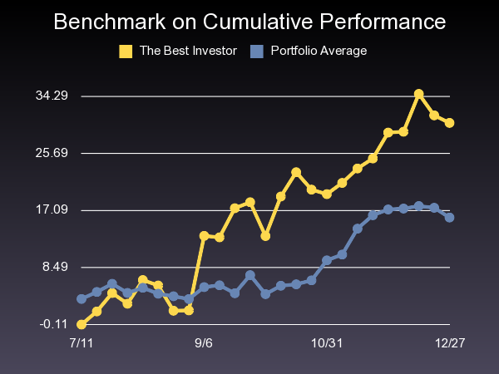
How Things Work Together?
  Winner’s Prediction
  Benchmark vs. Portfolio Average

Slide 30
Test Case
Build a Portfolio
Manage VPMs
Manage VIs
Find the Winner

Slide 31
Sample Portfolio from 2004-2005
Ticker | Name | EAR* %
AAPL | Apple Computer | 150.56
ADBE | Adobe | 35.92
BMO | Bank of Montreal | 19.13
DELL | Dell Computer | -6.30
GE | General Electric | 8.46
IBM | IBM | -4.26
INTL | Intel | -8.29
MSFT | Microsoft | 3.67
TM | Toyota Motor | 23.72
YHOO | Yahoo | 30.01
*Effective Annual Rate

Slide 32
Test Case
Build a Portfolio
Manage VPMs
Manage VIs
Find the Winner

Slide 33
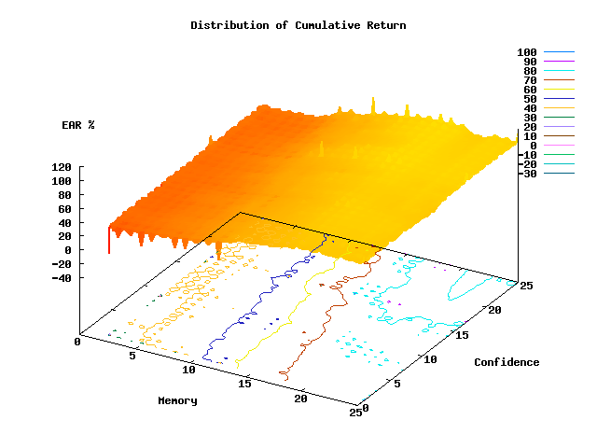
PM Hotspot Chart

Slide 34
Test Case
Build a Portfolio
Manage VPMs
Manage VIs
Find the Winner

Slide 35
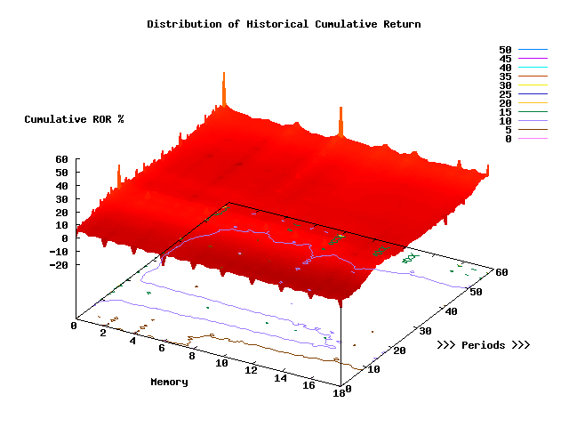
Investor Timeline Chart

Slide 36
Test Case
Build a Portfolio
Manage VPMs
Manage VIs
Find the Winner

Slide 37
Pick a Winner
Best Investor
Selected PM
Memory | EAR* %
2 | 43.65
Memory | Confidence
4 | 25
Winner’s Prediction
Ticker | Company | Weight %
BMO | Bank of Montreal | 100.00
 | Total | 100.00

Slide 38
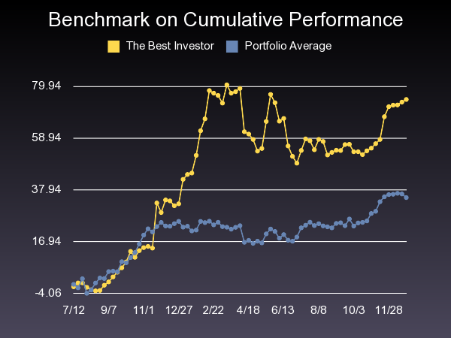
Benchmark
 | The Best Investor | Portfolio Average
HPR* % | 74.68 | 34.83
*Holding Period Return

Slide 39
Appendix
Theoretical Foundation

Slide 40
Investment Philosophy 1
Market is ideally efficient, but the efficiency comes from the fact that every investor keeps seeking out potential opportunities. Therefore, that part of the market can outperform the market average is possible.
EF is aimed to outperform the average.

Slide 41
Investment Philosophy 2
Are passively managed funds really passive?
  Not really. It just transfer the tough missions of portfolio construction and revision into equally tough ones of indices.
  Indices are designed and actively revised, although not so frequently (except S&P 500).
EF tries to optimize the frequency of revision.

Slide 42
Investment Philosophy 3
Under EMH, company info are random, yet prices are not random. Price is driven both by the performance of underlying companies and investors’ psychological behaviors. Together, two forces form out the price behavior with hidden patterns.
Powered by the special algorithm, EF tries to benefit from these patterns.

Slide 43
Investment Philosophy 4
There’re certain unexpected forces outside the market such as policy change, nature disaster, incident, etc. That’s why diversification is important.
EF only try to predict a portfolio rather than the timing of a single stock.

Slide 44
Current Strategies of Portfolio Revision
Static Strategy: Constant Mix
Reactive Strategy: Constant Proportion Portfolio Insurance
Anticipatory Strategy: Tactical Asset Allocation

Slide 45
Tactical Asset Allocation
Definition: managers in this style try to predict potential outperforming equities before the markets move.
Pro: TAA takes advantage of short-term fluctuation from the long-term trend.
Con: market prediction is hard; costs of transactions (commission, tax…) can be high.

Slide 46
Investment from 1926 to 1998
Investment | Compound Annual Return | Ending Value of $1
T-bills | 3.77% | $15
Corporate bonds | 5.8 | 61
S&P 500 | 11.22 | 2,353
Static Mix:
60% stocks, 40% bonds | 9.5 | 754
70% stocks, 30% bills | 9.37 | 693
Optimum monthly shifts | 40.34 | 55,510,318,361
Intuition suggests that even partial accuracy would significantly improve long-run investment performance.

Slide 47
Our Approach
Our algorithm try to predict future movements by learning the past price patterns, which is exactly TAA style.
To overcome the drawback of TAA, EF try to find a balance point between transaction costs and the frequency of revision for portfolio optimization.

Slide 48
Why Evolution?
Genetic Programming
  Realistic simulation of market
Why is GP powerful?
  Nonlinear nature of complexity
  Nature of markets: complex systems
  “The fittest survives.”

Slide 49
Memo on Picking Stocks
Although EF does eliminate some junk stocks from the portfolio temporarily. There’s no guarantee that we can pick stocks just based on price information.
Consisted with the our understanding of the value of stocks, We do think fundamental research study is important. EF is designed only for market side of evaluation, yet we plan to develop functions like stock screening to support part of analysis from fundamental side.

Slide 50
Questions?

