Slide 1
Concept and Demonstration
Mar 29, 2007
© 2007. All Rights Reserved.

Slide 2
Concept
Fundamental belief in AI
  Survival of the Fittest
Evolution Fund
  is a platform to help investors test different models or strategies

Slide 3
Current Model
Virtual portfolio mangers
  who continue predicting future and optimizing portfolios based on classical Markowitz Portfolio Theory
Virtual Investors
  who try to find the best manger
Notes:
Our algorithm try to predict future movements by learning the past price patterns, which is exactly TAA style.
To overcome the drawback of TAA, EF try to find a balance point between transaction costs and the frequency of revision for portfolio optimization.

Slide 4
Virtual Portfolio Managers
Personalities
  Memory
  Confidence
Learning activities
  Analyze historical data
Decision making
  Find the optimized portfolio
Notes:
Memory
How long period of time a portfolio manager will consider to make investment decisions.
Short memory may cause the VPM short-sighted.
Long memory can make the VPM dumb with new market trends.
Confidence
For how long period of time a portfolio manager will stick to the previously optimized portfolio structure.
Strong confidence makes the PM hold for a longer time, which may lose chances of cut-loss.
Weak confidence leads to more frequent trading and transaction costs as well.

Slide 5
How do VPMs Analyze?
Memory Period
Memory Period
Memory Period
Past
Future
Historical Quotes
Confidence Period
Confidence Period
Optimize Portfolio

Slide 6

Virtual Investors
Personalities
  Memory
Performance evaluation
  Evaluate managers
  Self-evaluate to find the last winner
Notes:
Memory
How long period of time of VPMs’ performance an investor will look at to select a best one.
Similar properties as the memory of VPMs.

Slide 7
How do VIs Evaluate?
Memory Period
Memory Period
PM Performance
Past
Future
Memory Period
Sticking Period
Inherited from selected VPM’s confidence
Select a best VPM

Slide 8
Use Case Demonstration

Slide 9
Appendix
Theoretical Foundation

Slide 10
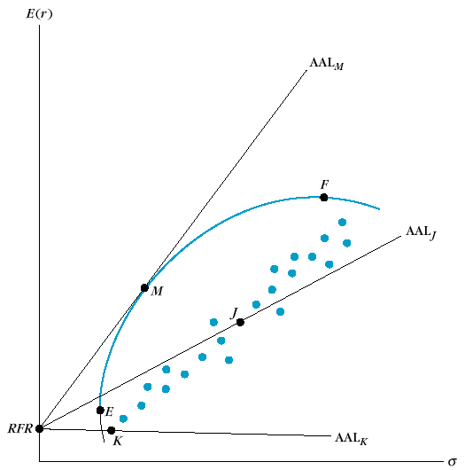
How to Optimize a Portfolio?
Modified Markowitz Portfolio Theory
Return
Optimal Portfolio
Efficient Frontier
Risk-free Rate
Risk (D-SD)
Notes:
Given a certain number of stocks, all kinds of combination of weights of the portfolio can be expressed as a point on the return-risk chart. There’s an upper boundary of these points by MPT called Efficient Frontier. All of the points on Efficient Frontier represent portfolios with the highest possible return at certain risk level. Considering the Risk-free Rate, we can also find an Optimal Portfolio (point M), which basically means the best possible portfolio we can find without saving or borrowing extra cash.

Slide 11
Investment Philosophy 1
Market is ideally efficient, but the efficiency comes from the fact that every investor keeps seeking out potential opportunities. Therefore, that part of the market can outperform the market average is possible.
EF is aimed to outperform the average.

Slide 12
Investment Philosophy 2
Are passively managed funds really passive?
  Not really. It just transfer the tough missions of portfolio construction and revision into equally tough ones of indices.
  Indices are designed and actively revised, although not so frequently (except S&P 500).
EF tries to optimize the frequency of revision.

Slide 13
Investment Philosophy 3
Under EMH, company info are random, yet prices are not random. Price is driven both by the performance of underlying companies and investors’ psychological behaviors. Together, two forces form out the price behavior with hidden patterns.
Powered by the special algorithm, EF tries to benefit from these patterns.

Slide 14
Investment Philosophy 4
There’re certain unexpected forces outside the market such as policy change, nature disaster, incident, etc. That’s why diversification is important.
EF only try to predict a portfolio rather than the timing of a single stock.

Slide 15
Current Strategies of Portfolio Revision
Static Strategy: Constant Mix
Reactive Strategy: Constant Proportion Portfolio Insurance
Anticipatory Strategy: Tactical Asset Allocation

Slide 16
Tactical Asset Allocation
Definition: managers in this style try to predict potential outperforming equities before the markets move.
Pro: TAA takes advantage of short-term fluctuation from the long-term trend.
Con: market prediction is hard; costs of transactions (commission, tax…) can be high.

Slide 17
Investment from 1926 to 1998
Investment | Compound Annual Return | Ending Value of $1
T-bills | 3.77% | $15
Corporate bonds | 5.8 | 61
S&P 500 | 11.22 | 2,353
Static Mix:
60% stocks, 40% bonds | 9.5 | 754
70% stocks, 30% bills | 9.37 | 693
Optimum monthly shifts | 40.34 | 55,510,318,361
Intuition suggests that even partial accuracy would significantly improve long-run investment performance.

Slide 18
Our Approach
Our algorithm try to predict future movements by learning the past price patterns, which is exactly TAA style.
To overcome the drawback of TAA, EF try to find a balance point between transaction costs and the frequency of revision for portfolio optimization.

Slide 19
Why Evolution?
Genetic Programming
  Realistic simulation of market
Why is GP powerful?
  Nonlinear nature of complexity
  Nature of markets: complex systems
  “The fittest survives.”

Slide 20
Memo on Picking Stocks
Although EF does eliminate some junk stocks from the portfolio temporarily. There’s no guarantee that we can pick stocks just based on price information.
Consisted with the our understanding of the value of stocks, We do think fundamental research study is important. EF is designed only for market side of evaluation, yet we plan to develop functions like stock screening to support part of analysis from fundamental side.

