Slide 1

ITS-101
Software Install Hardware Setup

Slide 2
Software Install
Software Install
Install Method :
※ Inner ITS-101's CD with one folder named "Package"
in the folder of Package with another three folder : jdk1.2.2、XClient
Install Method is copy this two folder to disk C , and Double Click \XClient\Xclient.bat is OK
jdk 1.2.2 : include Java Developer's Kit and XClient Program
XClient Path : C:/jdk1.2.2/jre/lib/ext/XClient.zip
(if you need upgrade，just replace XClient.zip )
XClient : includes XClient.bat and the batch for XCLient
path=c:\jdk1.2.2\bin;c:\jdk1.2.2\jre\lib\ext;c:
c:
java com.kCodes.xClient.XClient
(if you install path is not disk C ，then change the path to your installed path)

Slide 3
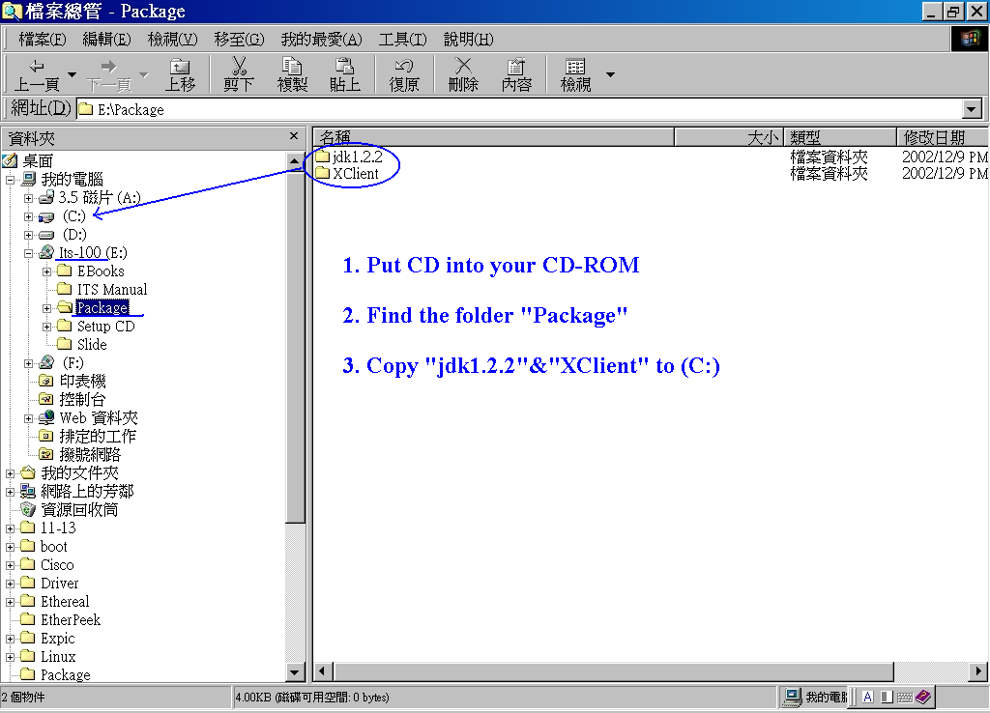

Slide 4
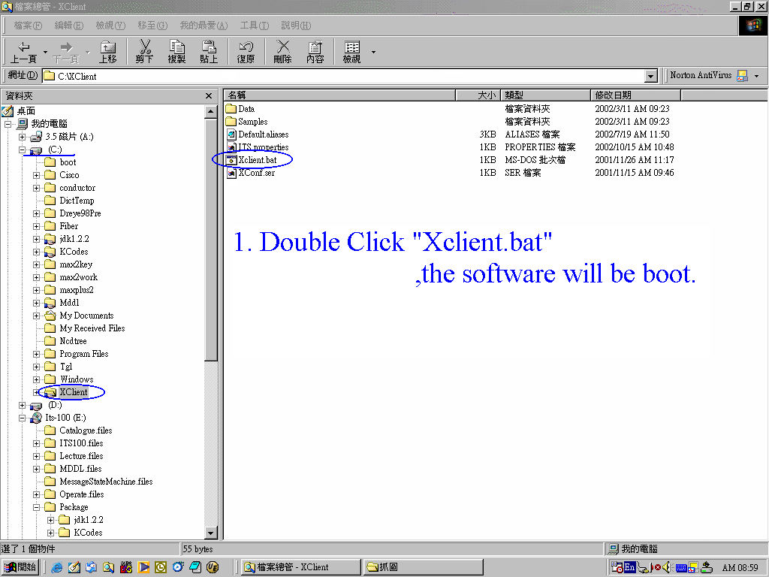

Slide 5
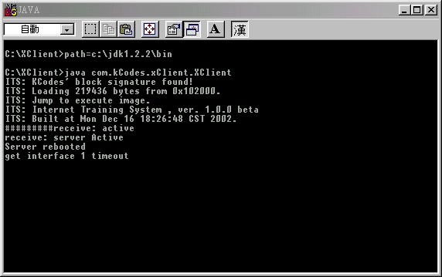

Slide 6
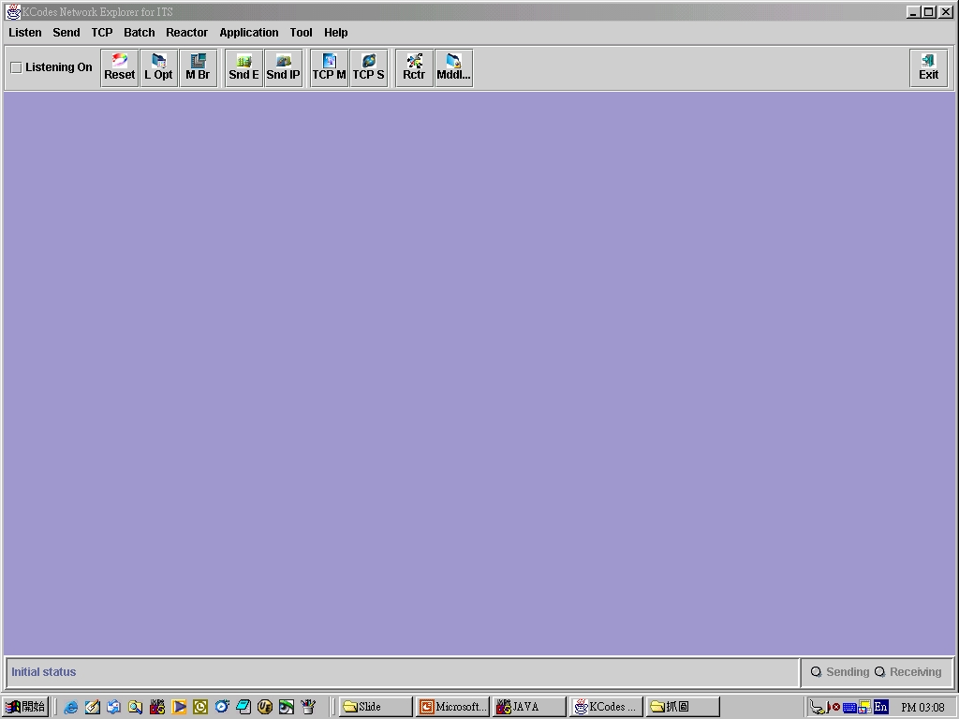
Success

Slide 7
Hardware Setup
Hardware Setup
ITS-101 & HUBOX
※ ITS-101's RS 232 Cable connect to PC's COM 1
※ Please notice UTP Cable Connect to ITS-101's No.，
Suggest user make no. 、First ITS-101's Lan 1
connect to HUBOX's Lan 1

Slide 8
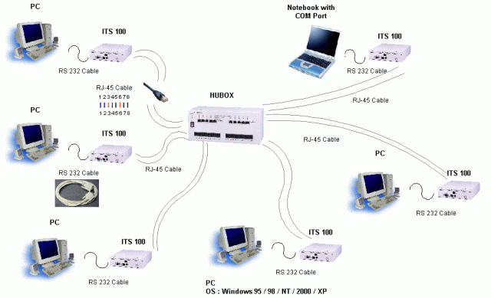

Slide 9
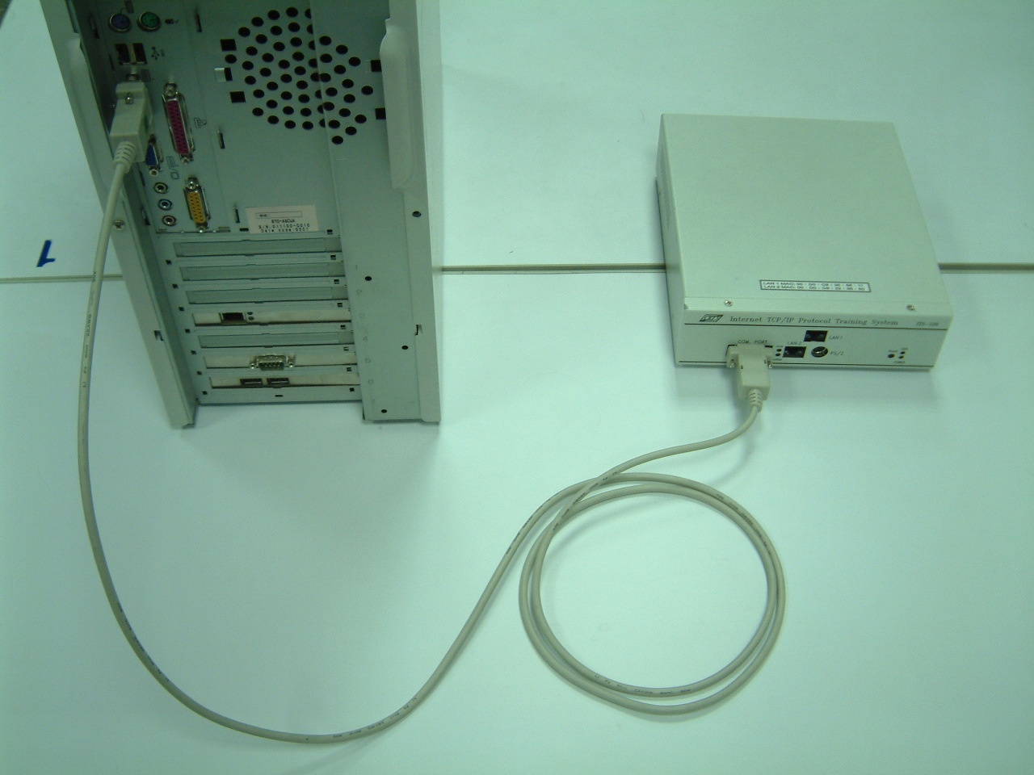
Step1. RS-232 Connect
RS-232

Slide 10
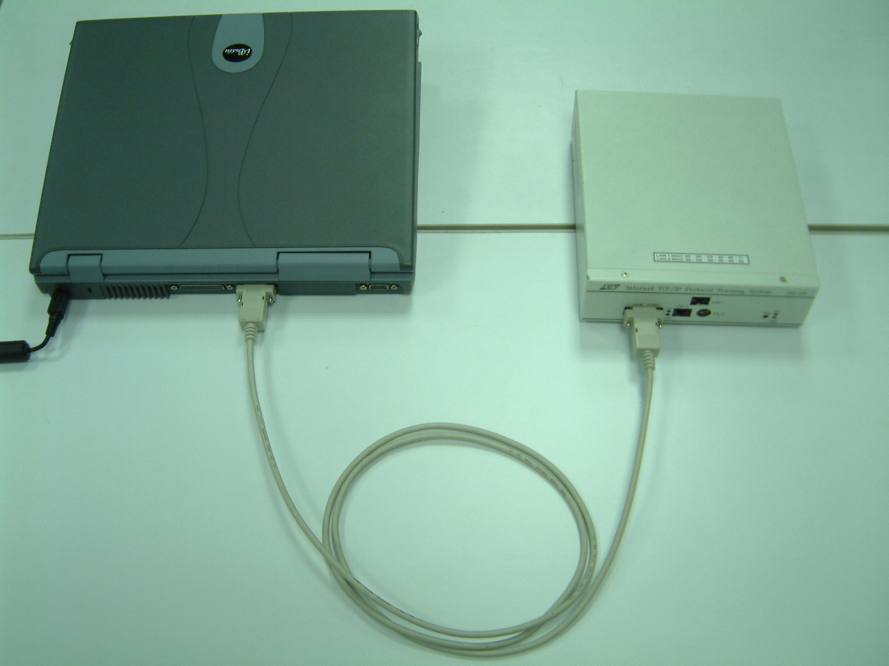
RS-232

Slide 11
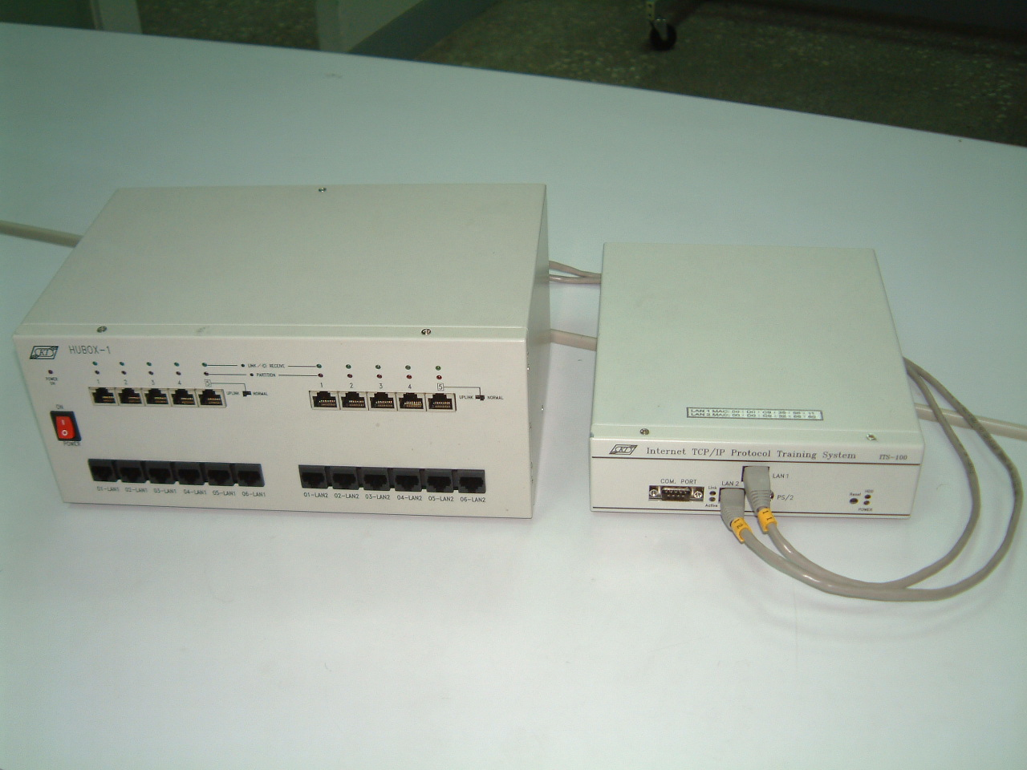
Step2. ITS connect with Hubox
Here
Here

Slide 12
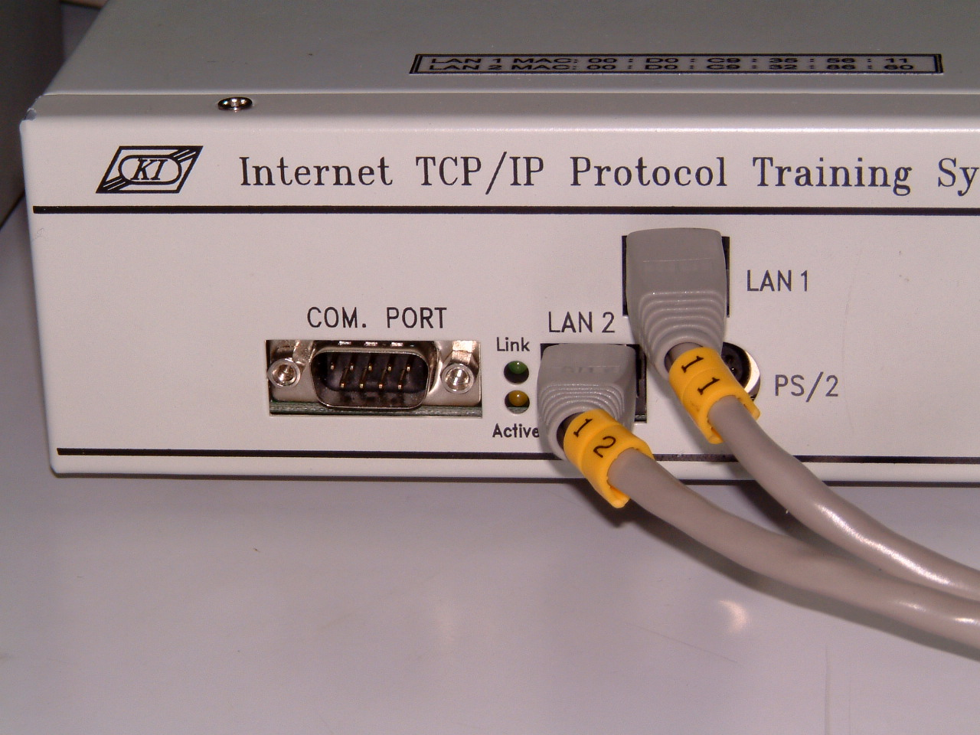
Back
ITS No.
Interface No.
1
ITS No.
Interface1
Interface2

Slide 13
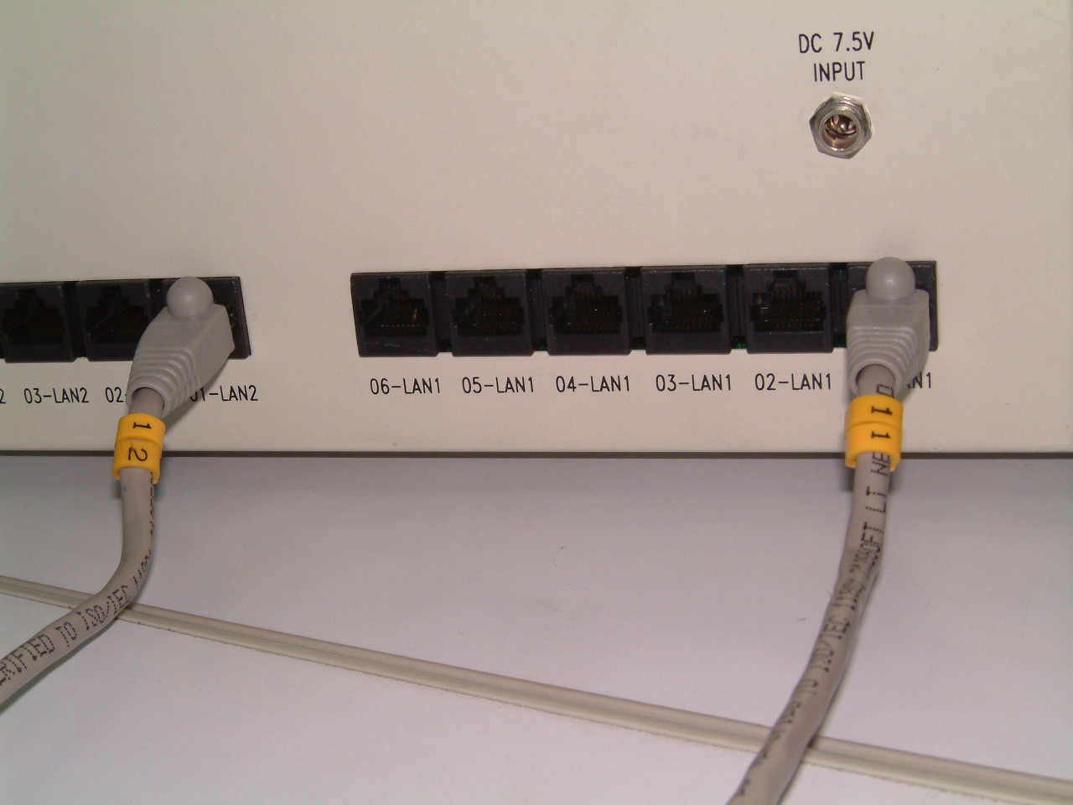
ITS No.
Back
6
5
4
3
2
1
LAN1(Interface1)
ITS No.1 Interface2

Slide 14
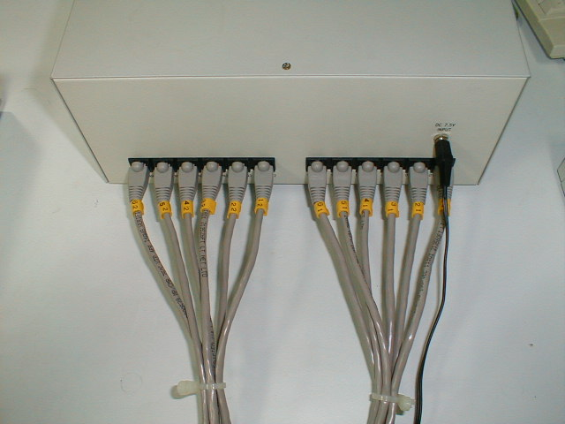
6 units ITS connect with Hubox
LAN2
LAN1
ITS No.
6
1
6
1
Connect to ITS

Slide 15
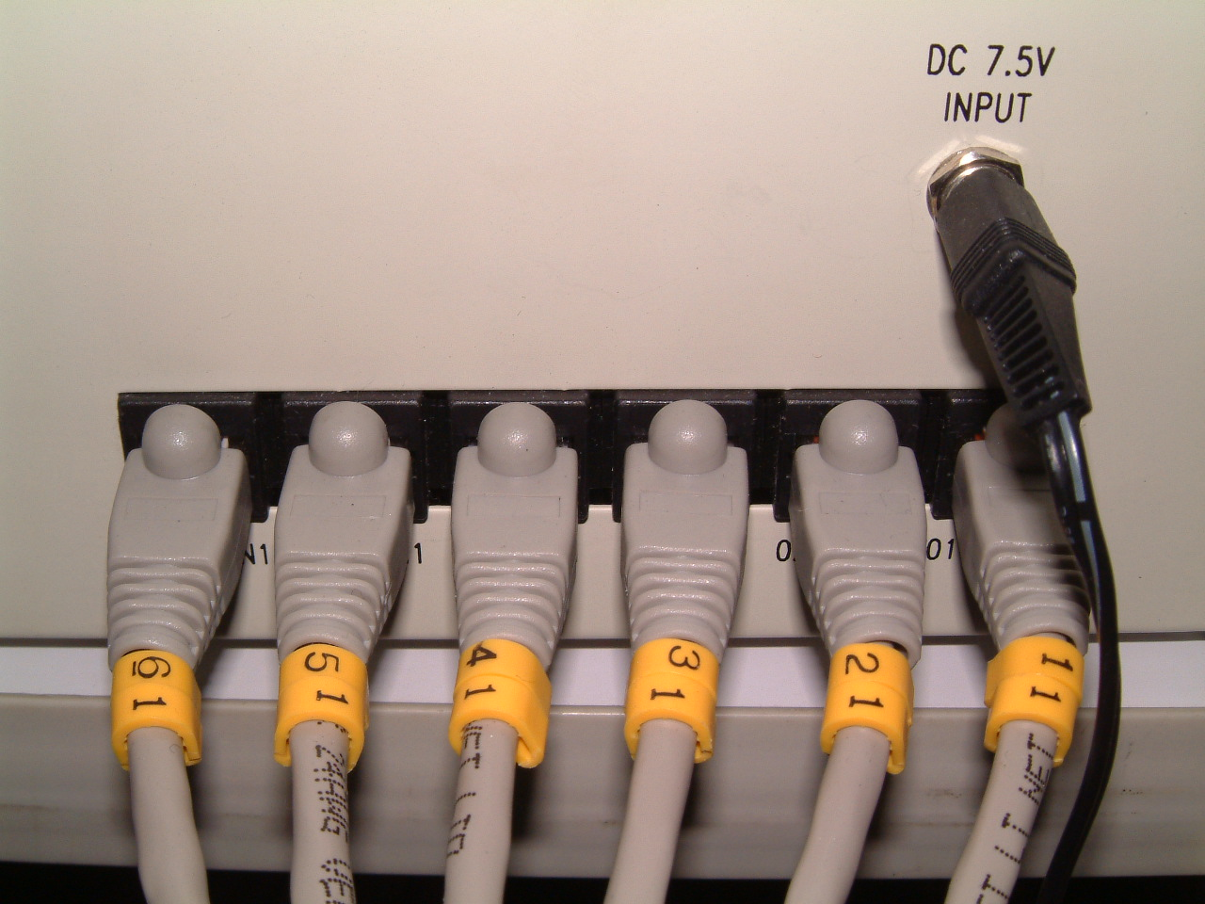
LAN 1 (Interface1)

Slide 16
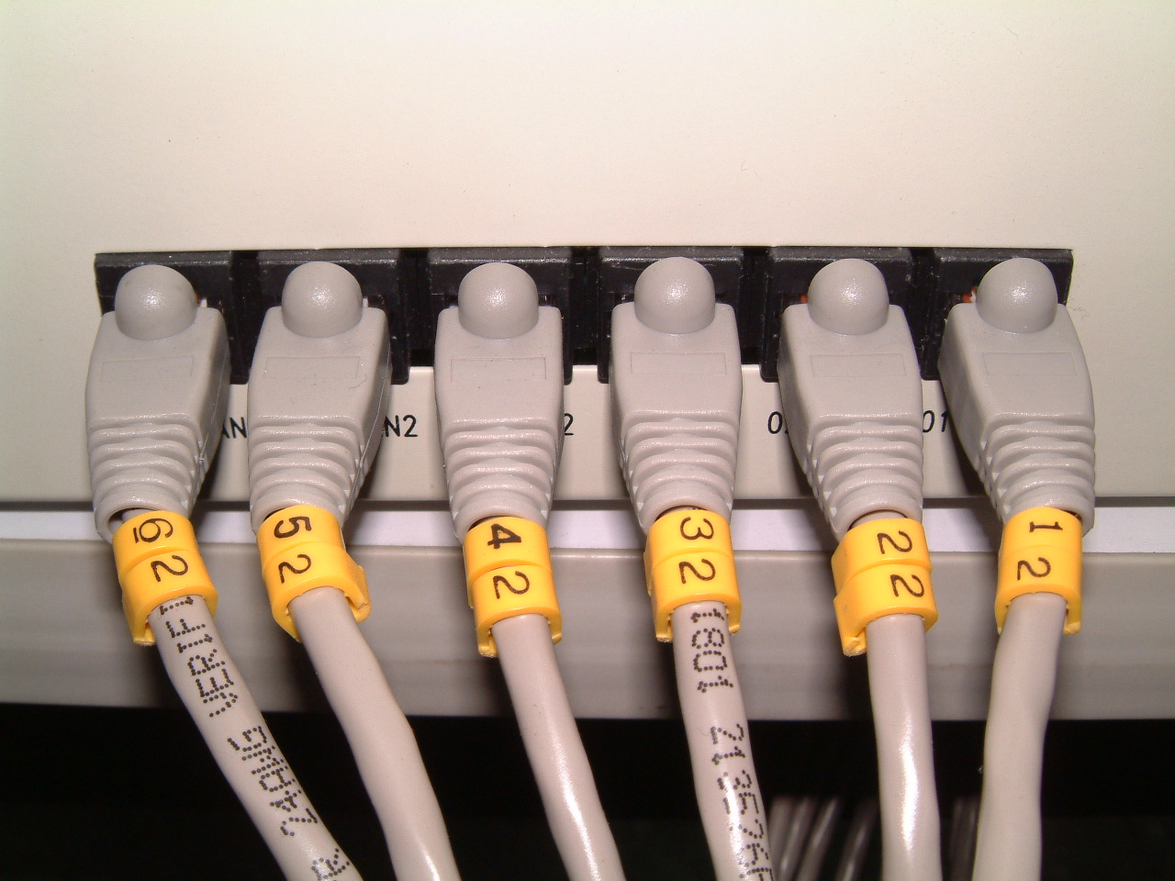
LAN 2 (Interface2)
6
5
4
3
2
1
ITS No.

Slide 17
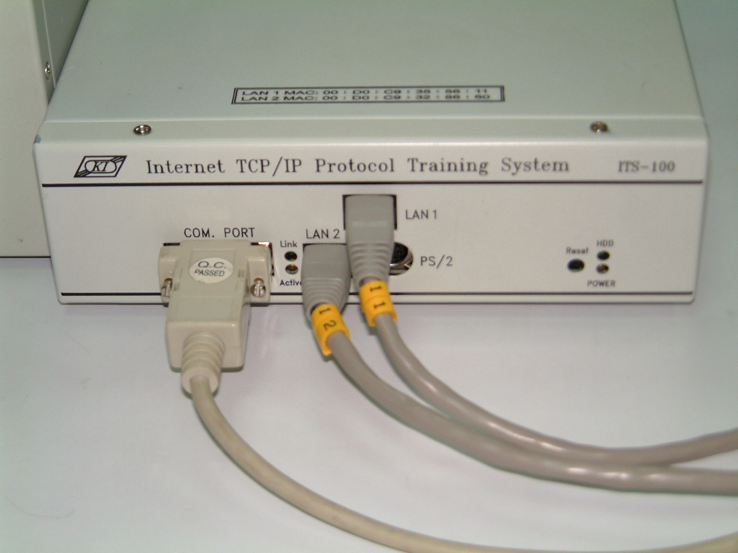

Slide 18
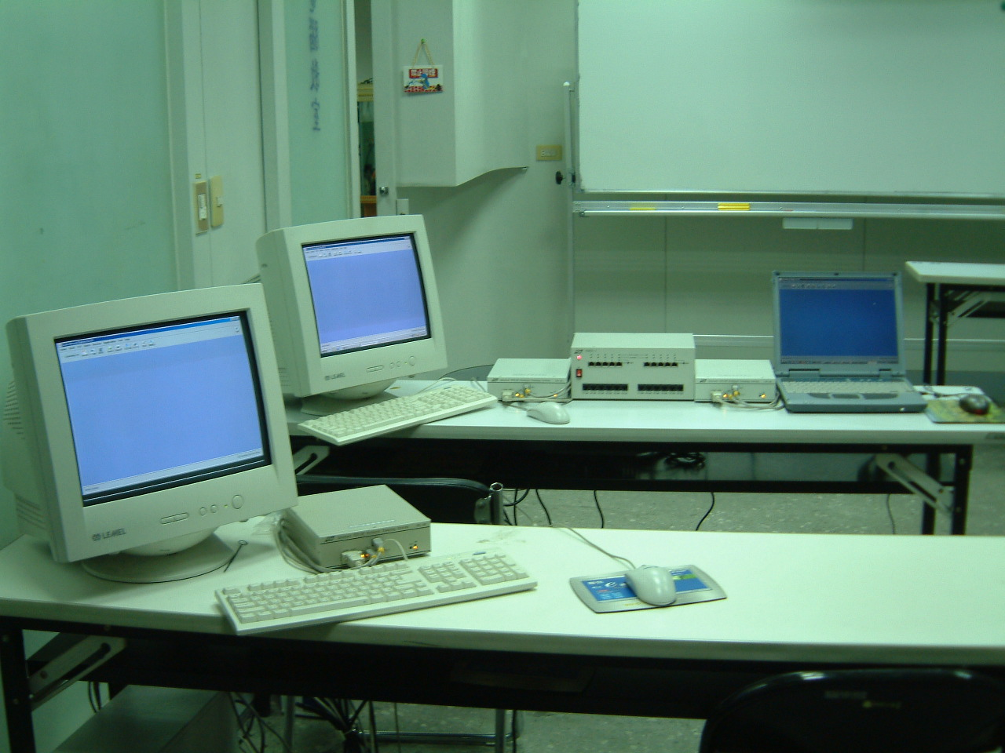
ITS No.
2
1
3

