Slide 1
Logo
Action 1
Action 2
Action3
Action4
Profil

Slide 3
Transport
Cento
Cento2
Add
Data

Slide 4

Transport
Option 1
Cento
Cento2
Data

Slide 5
Data
Transport
Cento
Cento2

Slide 6
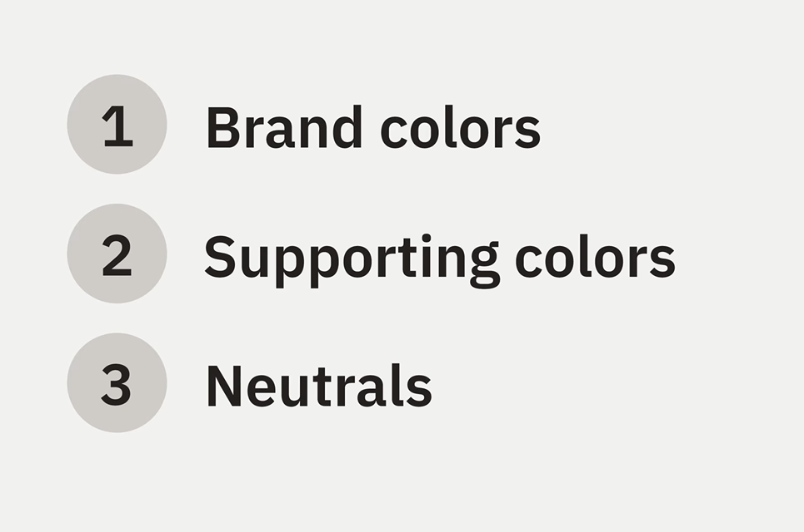
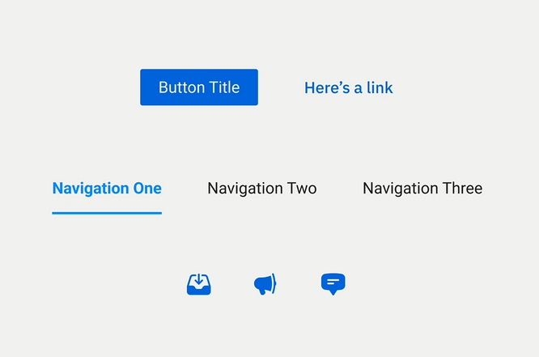
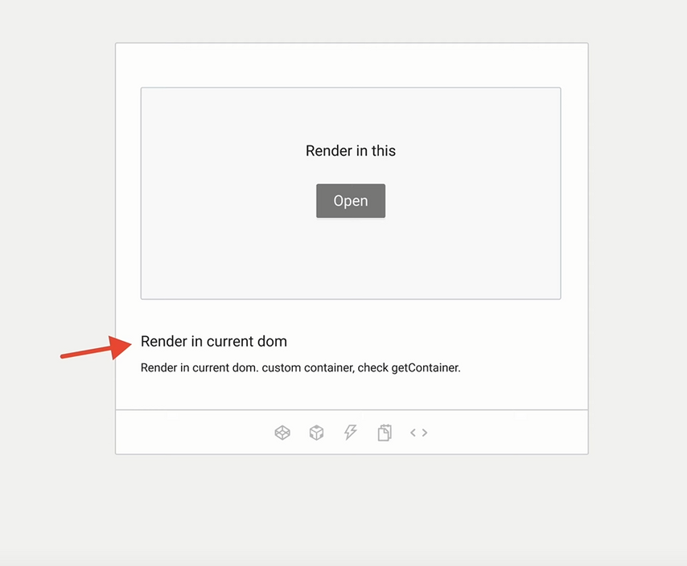
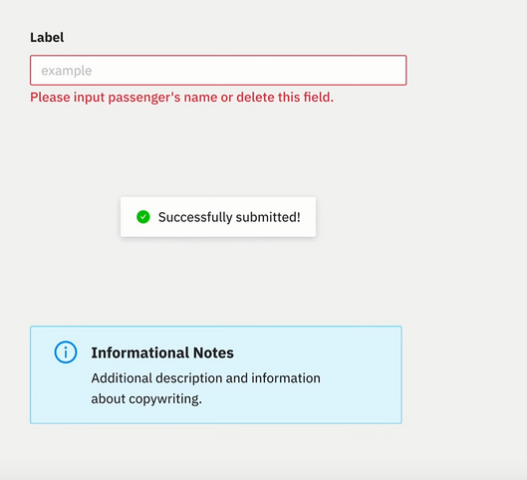
10%
60%
rosu pentru error mesages
verde pentru suceess/confirmation mesages
albastru pentru mesajele de informare

Slide 7
Brand colour 10% : Verde ( hex code) : iconite , hover text,action bar
neutral 60%: ???( hex code):Backgound , unaccesable buttons,cards backgrounds
content 30% : ( hex code)
Support colors : Verde-Mesaje de confirmare( hex code)
Rosu-Mesaje de averttizare/error( hex code)
Albastru-mesaje de info ( hex code)

Slide 9





Iunie 2024
Lun
Mar
Mie
Joi
Vin
Sam
Dum
Lun
12
13
14
15
12
13
14
15
Cabana brazilor
Adress
Website
Catering
Activities
Centotrans
Plecare
07:00 - 07:30
Piata Mihai Viteazul,
oprire 1
07:00 - 07:30
oprire 2
07:00 - 07:30
Cristi
Audi A4
2 locuri
07:00 - 07:30
Centotrans
Plecare
07:00 - 07:30
Piata Mihai Viteazul,
oprire 1
07:00 - 07:30
oprire 2
07:00 - 07:30

Slide 10

Iunie 2024
Lun
Mar
Mie
Joi
Vin
Sam
Dum
Lun
Lun
Mar
Mie
Joi
Vin
Sam
Dum
Lun
12
13
14
15
12
13
14
15
Lun
Mar
Mie
Joi
Vin
Sam
Dum
Lun
12
13
14
15
12
13
14
15
12
13
14
15
12
13
14
15
Cabana brazilor
Cabana brazilor
Adress
Website
Adress
Website
Catering
Catering
Catering
Activities
Activities
Activities
Cristi
CJ40WTF
NrLoc
17:00 -17:30
Centotrans
Plecare
07:00 - 07:30
Cabana brazilor
Centotrans
Plecare
07:00 - 07:30
Piata Mihai Viteazul,
Piata Mihai Viteazul,
oprire 1
07:00 - 07:30
oprire 1
07:00 - 07:30
oprire 2
07:00 - 07:30
oprire 2
07:00 - 07:30
Cristi
17:00 -17:30
Piata Mihai Viteazul,
CJ40WTF
Loc 1
Loc 3
Loc2
Loc 4
Vlad
09:00 - 09:30
Piata Mihai Viteazul,
CJ47BTF
Loc 1
Loc2

Slide 11
Lun
Mar
Mie
Joi
Vin
Sam
Dum
Lun
Lun
Mar
Mie
Joi
Vin
Sam
Dum
Lun
Lun
Mar
Mie
Joi
Vin
Sam
Dum
Lun
12
13
14
15
12
13
14
15
12
13
14
15
12
13
14
15
12
13
14
15
12
13
14
15
Cabana brazilor
Cabana brazilor
Cabana brazilor
Adress
Website
Adress
Website
Adress
Website
Activities
Activities
Activities
Plecare
Piata Mihai Viteazul
07:00 - 07:30
Mic dejun
07:00 - 07:30
Mic dejun
07:00 - 07:30
brake
09:00 - 09:30
Activitatea 1
09:00 - 09:30
Activitatea 1
09:00 - 09:30
Sosire
Cabana brazilor
11:00 - 11:30
Pranz
Ciorba ,piure,prajitura
12:00 - 12:30
Pranz
Ciorba ,piure,prajitura
12:00 - 12:30
plecare
12:00 - 12:30
Activitatea 1
12:00 - 12:30
Activitatea 1
12:00 - 12:30
Oprire 1
Dej
Activitatea 2
Oprire 3
Marasti
Activitatea 2
12:00 - 12:30
Cina
11:00 - 11:30
Oprire 4
floresti
Activitatea 3
12:00 - 12:30

Slide 12

Lun
Mar
Mie
Joi
Vin
Sam
Dum
Lun
12
13
14
15
12
13
14
15
Cabana brazilor
Adress
Website
Catering
Activities

