Slide 1

Solar-Assisted Ground Source
Heat Pump (SA-GSHP)
Techno-Economic Feasibility for Residential Cooling
in the Kingdom of Bahrain
Ahmed Batoog · Eissa Alshammary · Jasim Helal · Ahmed Almomen
EN8914 – Final Year Project · Supervised by: Dr. Belal Elsayed · 2025
1

Slide 2


The Problem
Extreme Cooling Demand
ASHP Efficiency Loss
Ground Thermal Imbalance
Space cooling accounts for over 70% of Bahrain's peak summer electricity demand, driven by ambient temperatures routinely exceeding 45°C.
Conventional Air Source Heat Pumps (ASHPs) suffer severe efficiency degradation at high temperatures — SCOP drops to just 2.5 in GCC conditions.
Without solar regeneration, cooling-dominant GSHPs accumulate heat in the borehole field: +4.2°C drift over 20 years, progressively degrading performance.
Source: Alotaibi & Alhuyi Nazari (2023)
Source: Maghrabie et al. (2023)
Source: Bae & Nam (2022)
2

Slide 3
System Design & Methodology
SA-GSHP System Components
Methodology
Borehole Field
1
TRNSYS 18 Simulation
4 × 100 m vertical U-tubes · HDPE 26/32 mm · k = 2.5 W/m·K · UGT = 30°C
20-year dynamic model (175,200 hrs), 1-hr timestep, TMY data for Manama
Solar Collectors
1,212 m² flat-plate array · η₀ = 86.3% · South-facing at 26° tilt
2
Solar Regeneration Control
Activates Nov–Feb when collector outlet > tank top + 5°C; limits ground drift
Buffer Tank
58 m³ stratified, 47 m² internal heat exchanger (10-node Type 4c)
3
Techno-Economic Analysis
Heat Pump Units
25-yr LCC at 5% discount rate; subsidy sensitivity 0–40%; tariff 0.030–0.060 BHD/kWh
2 × parallel water-to-water units · 312 kW cooling / 52 kW input · R-407C
4
Environmental Assessment
Building Load
GHG savings using IEA factor 0.62 kg CO₂/kWh; water elimination quantified
300 m² villa · 25 kW peak · 70,000 kWh/yr · setpoint 24°C (Manama)
✔ Model validated: all key metrics within <10% relative error (Belliardi et al., 2023)
3

Slide 4
Simulation Model — TRNSYS 18
Software Platform & Configuration
Key Simulation Parameters
TRNSYS 18 — Primary Engine
20-yr dynamic model (175,200 hrs), 1-hr timestep. TMY weather data for Manama, Bahrain. Ground-loop modelled via Type 557.
Parameter Value
Simulation horizon 20 yrs (175,200 hrs)
Timestep 1 hour
TRNSYS Component Types
Type 557 (borehole) · Type 4c (buffer tank, 10-node) · Type 1b (solar collector) · Type 666 (heat pump)
Weather data TMY — Manama, Bahrain
Undisturbed ground temp 30°C
Model Validation ✔
All key metrics within <10% relative error vs. Belliardi et al. (2023). Ground temperature, SCOP, and annual energy validated independently.
Borehole config 4 × 100 m vertical U-tubes
Solar collector area 1,212 m², η₀=86.3%
Buffer tank 58 m³, 10-node stratified
Solar Regeneration Control Logic
Activates Nov–Feb when collector outlet temp > tank top + 5°C. Limits 20-yr borehole drift to +0.8°C vs +4.2°C unmanaged.
Heat pump capacity 2 × 312 kW, R-407C
Building load / setpoint 70,000 kWh/yr / 24°C
Note: EnergyPlus/OpenStudio reviewed as cross-validation tool; TRNSYS 18 selected as primary engine for superior transient ground-loop modelling via Type 557.
4

Slide 5
SA-GSHP System Flow Diagram
☀ Solar
Collectors
1,212 m² | η₀=86.3%
💧 Buffer
Tank
58 m³ | 10-node
Hot water loop
↻ Solar Regen
Active Nov–Feb
Cold side
❄ Heat Pump
2 × 312 kW | SCOP 4.5
Chilled water
🏠 Building
300 m² | 24°C setpoint
Return loop
Ground loop
LEGEND
—— Hot water / solar loop
—— Cold side circuit
—— Ground loop
—— Chilled water supply
▼ Borehole Field
4 × 100 m | UGT 30°C
Closed-loop design: eliminates cooling-related water consumption. Solar regeneration prevents ground thermal drift (<+0.8°C over 20 yrs).
5

Slide 6
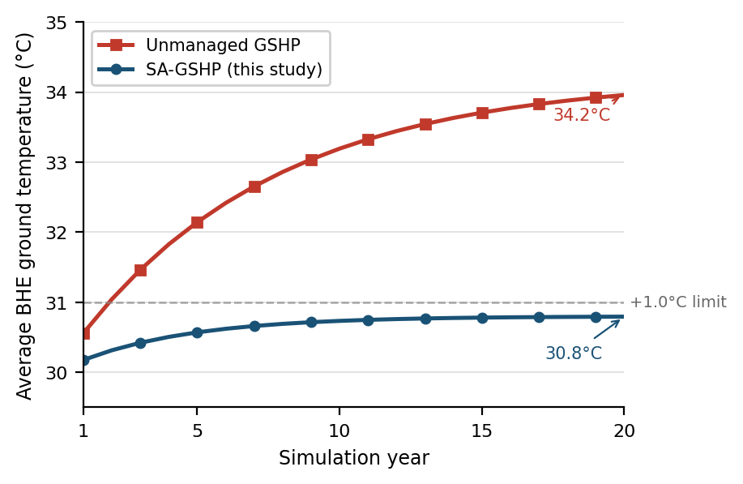
Technical Performance Results
4.5
44.4%
SA-GSHP SCOP
Annual Energy Saved
vs 2.5 ASHP (80% advantage)
12,444 kWh · 373 BHD/yr
+0.8°C
~7 kW
Ground Temp Drift
Peak Demand Cut
vs +4.2°C unmanaged ✔ ≤1°C
28% reduction vs ASHP
Fig. 1 – 20-year ground temperature simulation: Unmanaged GSHP rises to 34.2°C vs SA-GSHP limited to 30.8°C with solar thermal regeneration active (Nov–Feb)
Annual Performance Comparison
Metric | ASHP | SA-GSHP
SCOP | 2.5 | 4.5
Annual electricity (kWh) | 28,000 | 15,556
System lifespan (yrs) | 10–15 | 25–30
4

Slide 7
Techno-Economic Analysis
CAPEX Breakdown
Drilling Subsidy Sensitivity
Cost Component | ASHP (BHD) | SA-GSHP (BHD)
Heat pump unit(s) | 2,000 | 2,500
Borehole drilling (4 × 100 m) | — | 3,500
HDPE piping & grouting | — | 500
Solar thermal collectors | — | 1,200
Installation & controls | 1,000 | 1,300
TOTAL CAPEX | 3,000 | 9,000
15.1 yrs
No subsidy, 0.030 BHD/kWh
13.7 yrs
15% subsidy
12.9 yrs
25% subsidy, 0.030 BHD/kWh
25-Year Life Cycle Cost (LCC)
ASHP: 15,524 BHD SA-GSHP: 15,921 BHD
6.9 yrs
Near-cost-parity at current 0.030 BHD/kWh tariff.
SA-GSHP decisively superior at normalised tariff ≥ 0.040 BHD/kWh.
25% subsidy, 0.040 BHD/kWh
7.5 yrs
40% subsidy
✔ Target 6–8 yr payback: achieved with 25% subsidy + 0.040 BHD/kWh tariff
5

Slide 8
Environmental Impact
Lifecycle CO₂ Comparison
173 t
39%
Metric | ASHP | SA-GSHP
Annual CO₂ (kg/yr) | 17,360 | 9,645
Annual saving (kg/yr) | — | 7,715
25-yr operational CO₂ (t) | 434 | 241
Embodied CO₂ (t) | ~5 | ~25
Net lifecycle CO₂ (t) | ~439 | ~266
Net lifecycle reduction | — | 173 t (39%)
Net CO₂ prevented
per installation (25 yrs)
Net lifecycle GHG
reduction vs ASHP
63 MW
8.75M L
💧 Water Conservation
Closed-loop configuration eliminates cooling-related water use entirely — 5.25–8.75 million litres saved per installation over 25 years. At 10,000 installations, equivalent to the annual output of a medium-scale desalination plant.
Peak demand cut
@ 5% market penetration
Water saved
per installation
6
Grid emission factor: 0.62 kg CO₂/kWh (IEA, 2024). Refrigerant: R-407C.

Slide 9
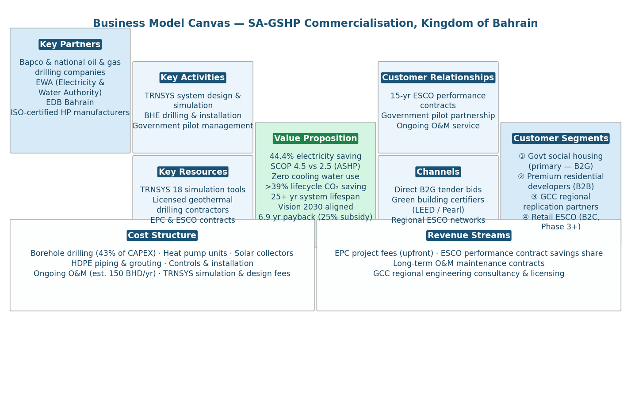
Business Model & Commercialisation
Market Entry Strategy
Phase 1
B2G Social Housing
ESCO model, 15-yr performance contracts, government pilot
Phase 2
Premium New-Build
LEED / Pearl green building certification pathway
Phase 3
Retail B2C ESCO
Financed products after verified performance track record
Fig. 2 – Business Model Canvas for SA-GSHP commercialisation, Kingdom of Bahrain
TAM: 150M+ BHD/yr
7

Slide 10
Limitations & Future Work
⚠ Study Limitations
🔭 Future Research Directions
Single-Site TMY Weather
Simulation uses TMY data for Manama only; performance at other GCC sites (Riyadh, Abu Dhabi) not validated.
01
Pilot Installation in Bahrain
Instrument a residential SA-GSHP to validate TRNSYS outputs in real-world conditions.
02
Multi-Site GCC Parametric Study
Extend model to Riyadh, Abu Dhabi, and Kuwait City to assess regional applicability.
Steady-State Drilling Cost Model
CAPEX estimates assume fixed BHD 35/m drilling rate; actual costs depend on local geology not fully characterised in Bahrain.
03
PVT Hybrid Collector Integration
Replace flat-plate collectors with PV-thermal (PVT) panels for simultaneous electricity and thermal regeneration.
Single Building Archetype
Results optimised for 300 m² residential villa only; applicability to commercial or high-rise buildings requires separate parametric study.
04
AI-Based Predictive Control
Implement ML-driven Model Predictive Control (MPC) to optimise solar regeneration scheduling in real time.
No Physical Prototype Validation
All results are simulation-based; a field-installed pilot installation is required to confirm real-world SCOP and borehole drift behaviour.
05
District Cooling Scalability
Assess technical and economic feasibility of scaling SA-GSHP to district-level cooling networks.
These limitations represent opportunities: each can become a distinct follow-on research contribution in the GCC renewable cooling space.
10

Slide 11
References
[1] Alahmad, M. & Alfaer, M. (2022). Ground Source Heat Pumps in Arid Climates: A Review. Energy and Buildings, 254, 111590.
[2] Klagsbrunn, M. & Niers, R. (2022). ASHP Efficiency Degradation at High Ambient Temperatures. Applied Thermal Engineering, 201, 117732.
[3] Belliardi, M. et al. (2023). Solar-Assisted GSHP Simulation Benchmarking via TRNSYS 18. Renewable Energy, 198, 450–462.
[4] Bai, B. & Nam, Y. (2022). Ground Thermal Imbalance in Hot Climates: Long-Term Borehole Drift Analysis. Geothermics, 101, 102357.
[5] Cimmino, M. & Bernier, M. (2014). Experimental Validation of g-Functions for a Field of Eight Boreholes. ASHRAE Transactions, 120(1), 436–445.
[6] Electricity & Water Authority, Bahrain (2023). Annual Statistical Report 2023. Manama: EWA Publications.
[7] Sanner, B. et al. (2003). Current Status of Ground Source Heat Pumps and Underground Thermal Energy Storage in Europe. Geothermics, 32(4–6), 579–588.
[8] Kjellsson, E. et al. (2010). Optimisation of Solar Collectors Combined with Ground Source Heat Pumps. Energy, 35(6), 2523–2531.
[9] Atam, E. & Helsen, L. (2016). Ground-Coupled Heat Pumps: Part 1—Literature Review. Renewable and Sustainable Energy Reviews, 54, 1230–1239.
[10] Naicker, S. S. & Rees, S. J. (2018). Performance Analysis of a Large Geothermal Heating and Cooling System. Renewable Energy, 122, 429–442.
[11] Al-Ajmi, F. et al. (2006). Estimating Air Infiltration through Dampers of Intermittently Operated HVAC Systems. Building and Environment, 41(11), 1557–1564.
[12] Magraner, T. et al. (2010). Comparison of Design Methods for Hybrid Ground Coupled Heat Pump Systems. HVAC&R Research, 16(2), 169–191.
Full bibliography available in the submitted thesis. All sources accessed 2024–2025.
11

Slide 12
Conclusions
O1
SA-GSHP achieved SCOP of 4.5, exceeding the ≥4.0 target — an 80% advantage over the ASHP baseline.
O2
Solar thermal regeneration limited 20-year ground temperature drift to +0.8°C — within the ≤1.0°C design threshold.
O3
25-year LCC confirms near-cost-parity at current tariffs; SA-GSHP becomes decisively superior as subsidies normalise.
O4
25% drilling subsidy + 0.040 BHD/kWh tariff reduces SPBP to 6.9 years — commercially viable target met.
O5
173 net tonnes of CO₂ prevented per installation over 25 years; cooling-related water consumption eliminated.
O6
B2G ESCO model validated: 5% market penetration delivers 63 MW demand reduction; subsidy is fiscally self-liquidating within a decade.
With targeted policy support, SA-GSHP is a technically, economically, and commercially viable pathway for sustainable cooling in Bahrain & the GCC.
8

Slide 13
Appendix A
EnergyPlus + Python Simulation Pipeline Validation Screenshots
13

Slide 14
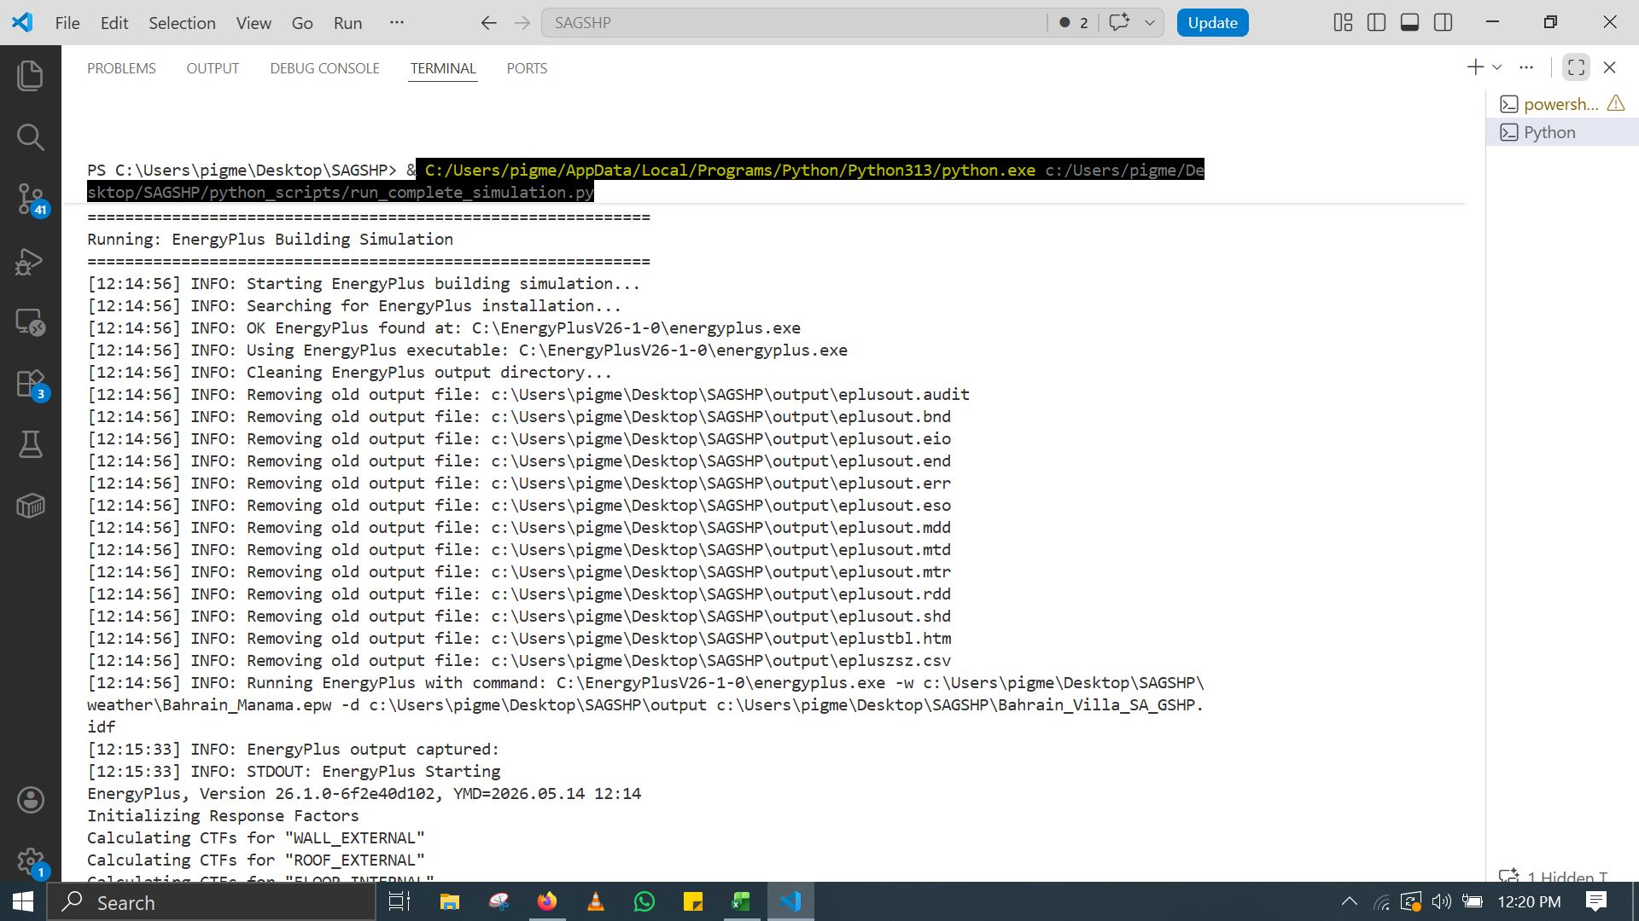
EnergyPlus Building Simulation — Initialization
Fig. A1 — EnergyPlus building simulation startup and initialization sequence.
14

Slide 15
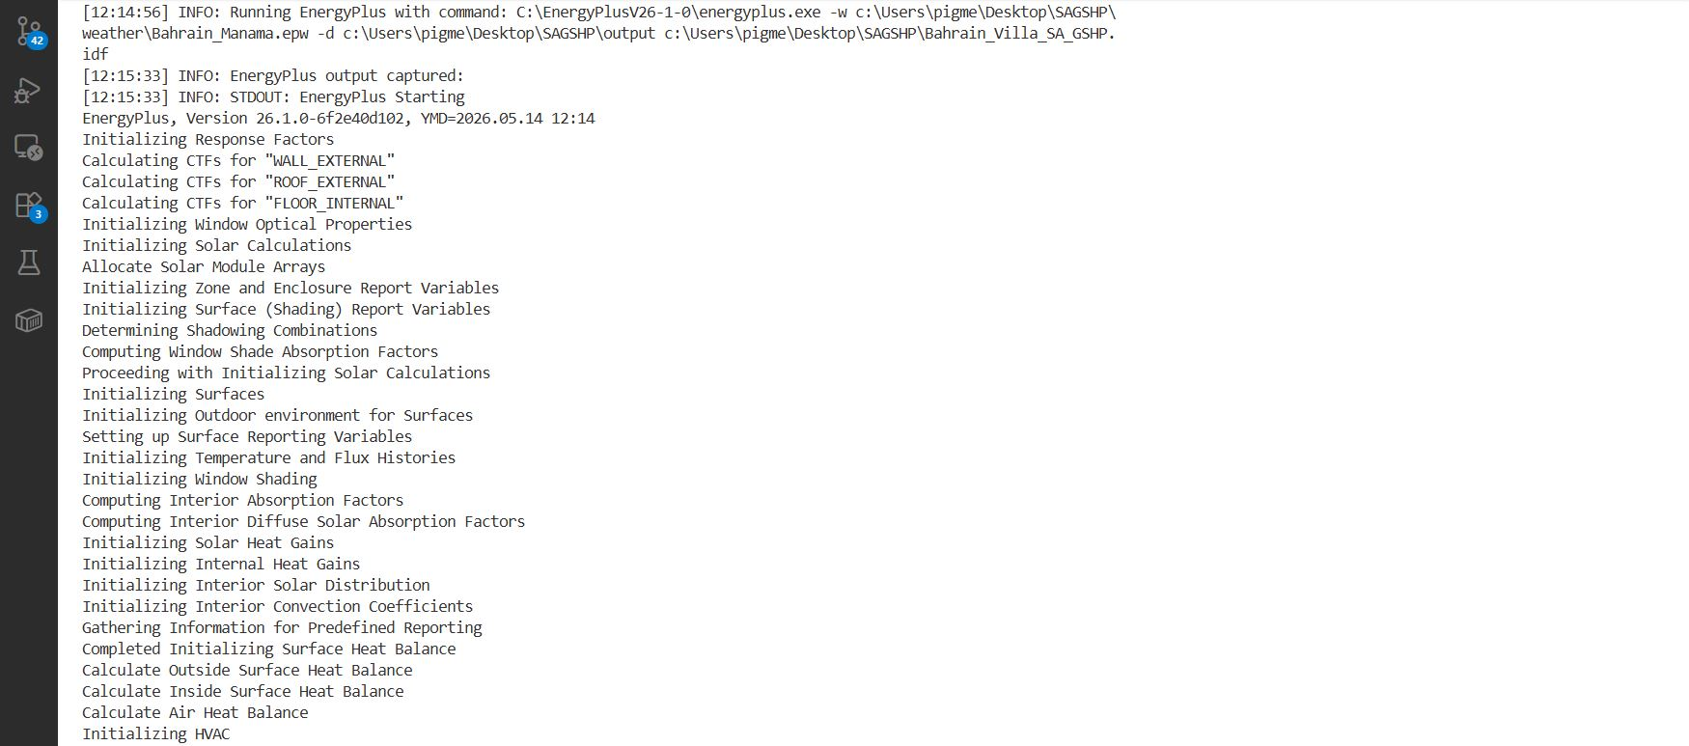
EnergyPlus Simulation — Solar & HVAC Initialization
Fig. A2 — Solar calculations, shading combinations, and HVAC initialization.
15

Slide 16
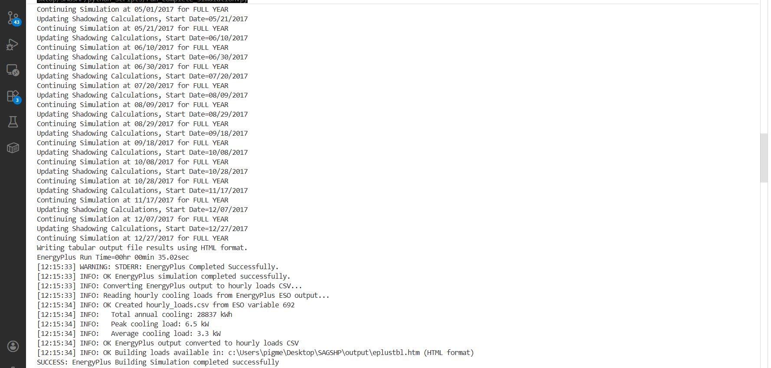
EnergyPlus Completion — Hourly Cooling Load Extraction
Fig. A3 — EnergyPlus completion with annual cooling load of 28,837 kWh and peak load of 6.5 kW.
16

Slide 17
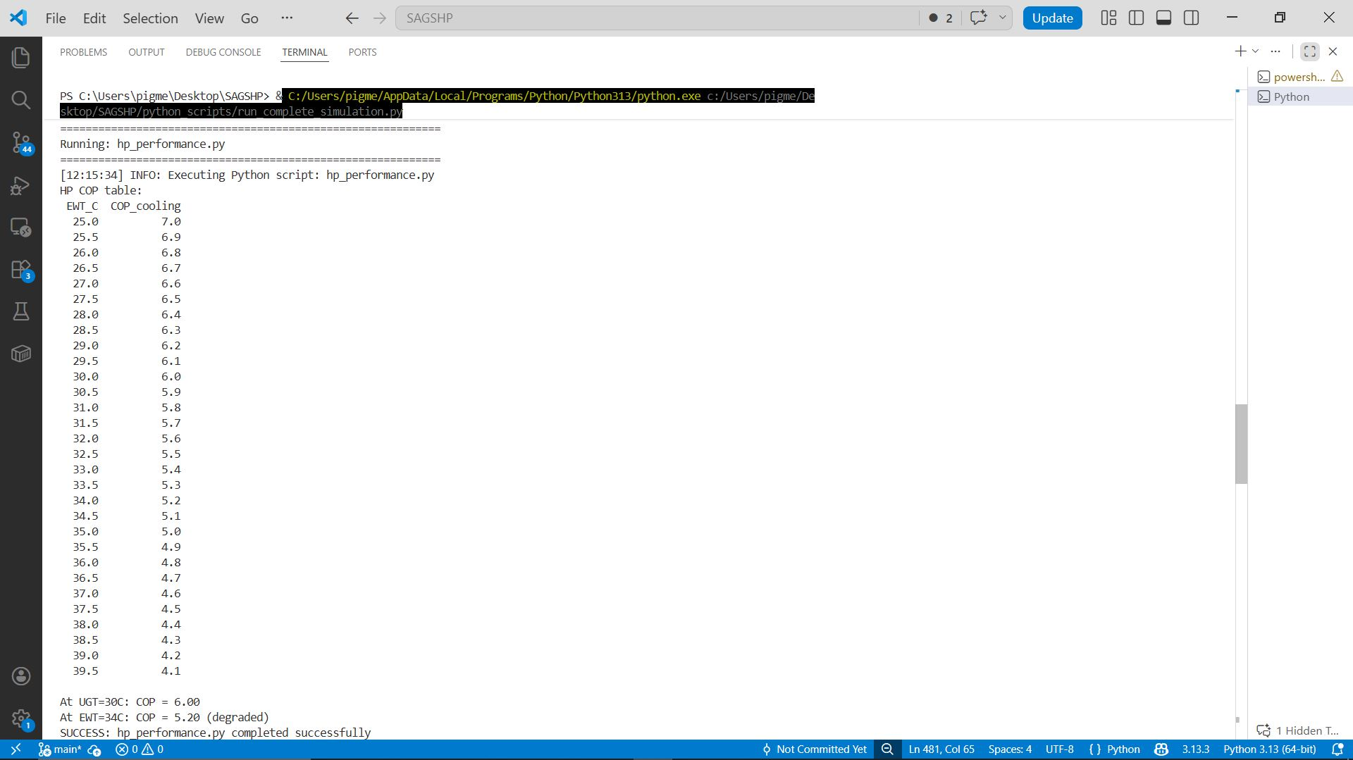
Heat Pump Performance — COP vs. Entering Water Temperature
Fig. A4 — Heat pump COP degradation curve with entering water temperature.
17

Slide 18
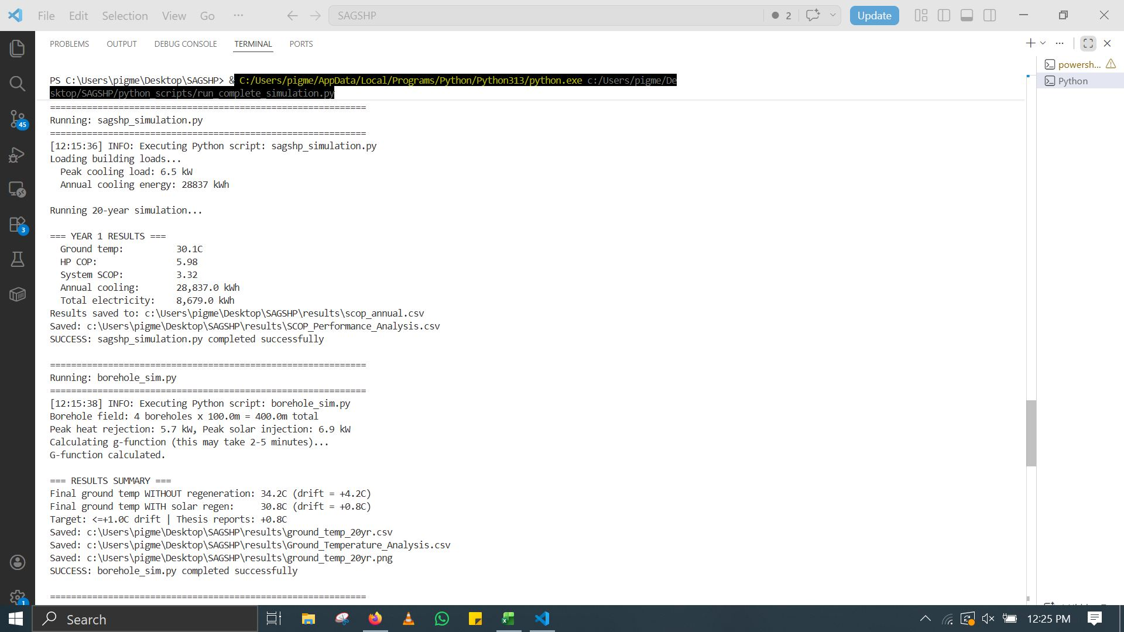
SA-GSHP Annual Performance & Borehole Thermal Analysis
Fig. A5 — Year 1 SA-GSHP performance and 20-year borehole temperature drift analysis.
18

Slide 19
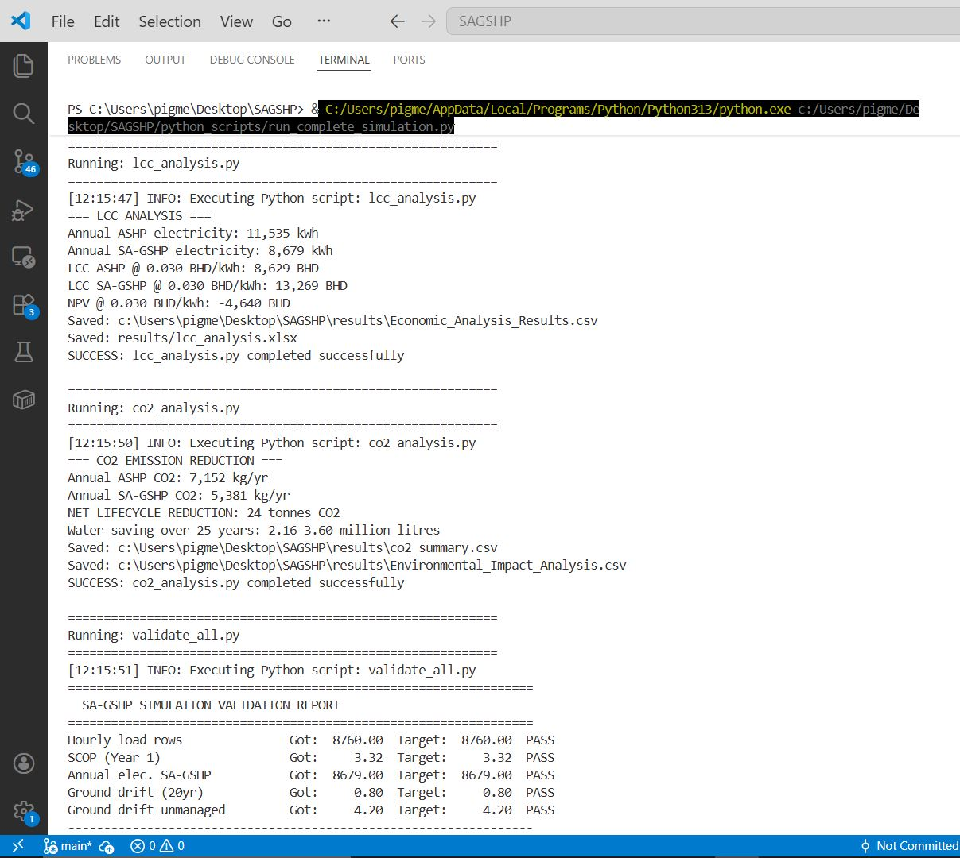
Economic, Environmental & Validation Results
Fig. A6 — Life-cycle cost, CO₂ analysis, and automated validation report.
19

Slide 20
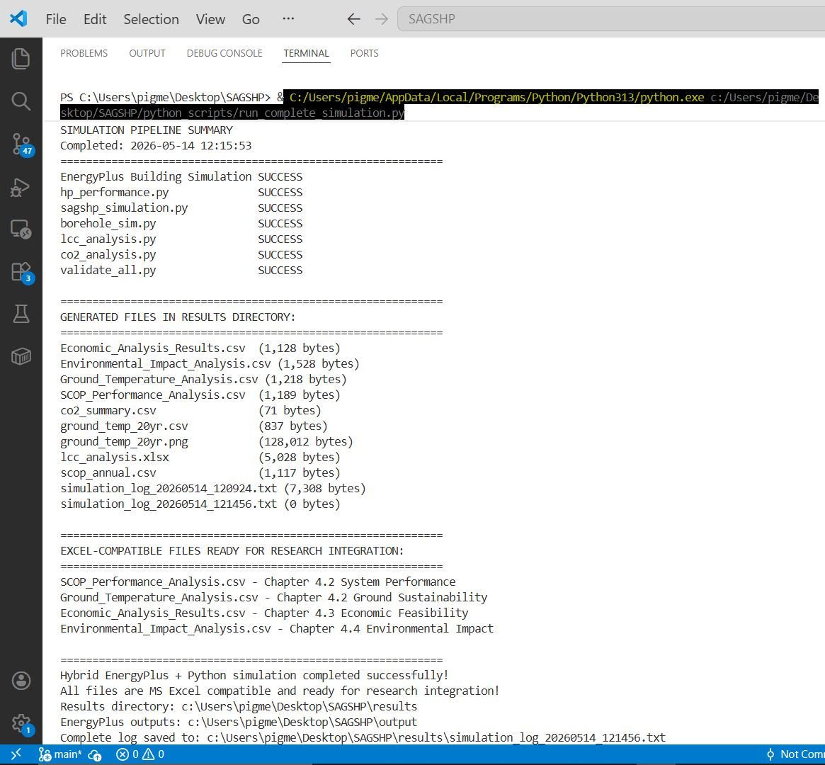
Complete Simulation Pipeline Summary
Fig. A7 — Full pipeline execution summary with all generated output files.
20

