Slide 1

Solar-Assisted Ground Source
Heat Pump (SA-GSHP)
Techno-Economic Feasibility for Residential Cooling
in the Kingdom of Bahrain
Ahmed Batoog · Eissa Alshammary · Jasim Helal · Ahmed Almomen
EN8914 – Final Year Project · Supervised by: Dr. Belal Elsayed · 2025
1
Notes:
Welcome to our final year project presentation on Solar-Assisted Ground Source Heat Pump feasibility for residential cooling in Bahrain. This research addresses a critical national challenge: space cooling accounts for over 70% of Bahrain's peak summer electricity demand, driven by ambient temperatures routinely exceeding 45°C. Our team—Ahmed Batoog, Eissa Alshammary, Jasim Helal, and Ahmed Almomen—conducted this study under Dr. Belal Elsayed's supervision. The SA-GSHP system we evaluated achieves a SCOP of 4.5 compared to 2.5 for conventional ASHPs, representing an 80% efficiency advantage. This presentation covers our methodology, simulation results, economic analysis, environmental impact, and commercialization strategy. Key takeaway: With targeted policy support, SA-GSHP represents a technically viable, economically feasible, and commercially scalable pathway for sustainable residential cooling in Bahrain and the wider GCC region.

Slide 2


The Problem
Extreme Cooling Demand
ASHP Efficiency Loss
Ground Thermal Imbalance
Space cooling accounts for over 70% of Bahrain's peak summer electricity demand, driven by ambient temperatures routinely exceeding 45°C.
Conventional Air Source Heat Pumps (ASHPs) suffer severe efficiency degradation at high temperatures — SCOP drops to just 2.5 in GCC conditions.
Without solar regeneration, cooling-dominant GSHPs accumulate heat in the borehole field: +4.2°C drift over 20 years, progressively degrading performance.
Source: Alotaibi & Alhuyi Nazari (2023)
Source: Maghrabie et al. (2023)
Source: Bae & Nam (2022)
2
Notes:
Let's examine the three interconnected problems driving this research. First, extreme cooling demand: Bahrain's peak summer electricity load is dominated by air conditioning. The grid strain is severe, with fossil-fuel-based generation struggling to meet demand during July-August when temperatures exceed 45°C routinely. Second, ASHP efficiency loss: Conventional air-source heat pumps suffer catastrophic efficiency degradation at high ambient temperatures. At 45°C, ASHP SCOP drops to just 2.5, meaning for every 1 kWh of electricity, you only get 2.5 kWh of cooling. This is fundamentally a thermodynamic limitation—compressors must work harder to reject heat into hotter air. Third, ground thermal imbalance: Without solar regeneration, cooling-dominant GSHPs accumulate heat in the borehole field. Our simulations show +4.2°C drift over 20 years, progressively degrading performance until the system potentially fails. This is the critical technical barrier that hybrid solar regeneration solves. These three problems create the research gap: we need a cooling technology that is efficient at high temperatures, thermally sustainable long-term, and economically viable.

Slide 3
System Design & Methodology
SA-GSHP System Components
Methodology
Borehole Field
1
TRNSYS 18 Simulation
4 × 100 m vertical U-tubes · HDPE 26/32 mm · k = 2.5 W/m·K · UGT = 30°C
20-year dynamic model (175,200 hrs), 1-hr timestep, TMY data for Manama
Solar Collectors
1,212 m² flat-plate array · η₀ = 86.3% · South-facing at 26° tilt
2
Solar Regeneration Control
Activates Nov–Feb when collector outlet > tank top + 5°C; limits ground drift
Buffer Tank
58 m³ stratified, 47 m² internal heat exchanger (10-node Type 4c)
3
Techno-Economic Analysis
Heat Pump Units
25-yr LCC at 5% discount rate; subsidy sensitivity 0–40%; tariff 0.030–0.060 BHD/kWh
2 × parallel water-to-water units · 312 kW cooling / 52 kW input · R-407C
4
Environmental Assessment
Building Load
GHG savings using IEA factor 0.62 kg CO₂/kWh; water elimination quantified
300 m² villa · 25 kW peak · 70,000 kWh/yr · setpoint 24°C (Manama)
✔ Model validated: all key metrics within <10% relative error (Belliardi et al., 2023)
3
Notes:
Our system design addresses each problem systematically. The borehole field consists of 4 vertical U-tubes, each 100 meters deep with 5-meter spacing, using HDPE 26/32 mm piping with thermal conductivity of 2.5 W/m·K. The undisturbed ground temperature is 30°C—significantly cooler than 45°C ambient air, providing the thermodynamic advantage. Solar collectors: 1,212 square meters of flat-plate collectors at 86.3% optical efficiency, south-facing at 26° tilt to optimize year-round solar gain. These are oversized specifically for ground regeneration during November through February when cooling demand is minimal. The buffer tank is 58 cubic meters with a 47 square meter internal heat exchanger, modeled as a 10-node stratified tank. This decouples solar collection from ground injection, allowing thermal energy storage between sunny days and regeneration periods. Heat pumps: Two parallel water-to-water units, each rated at 312 kW cooling with 52 kW input power, using R-407C refrigerant. The water-to-water configuration is critical—it allows direct ground coupling rather than air coupling. Building load: 300 square meter villa with 25 kW peak load, 70,000 kWh annual cooling requirement, and 24°C setpoint—representative of Bahraini middle-class housing. Our methodology followed four stages: TRNSYS 18 dynamic simulation for 20 years with 1-hour timesteps, solar regeneration control activating when collector outlet exceeds tank top by 5°C, techno-economic analysis at 5% discount rate with 0-40% subsidy sensitivity, and environmental assessment using IEA emission factors.

Slide 4
Simulation Model — TRNSYS 18
Software Platform & Configuration
Key Simulation Parameters
TRNSYS 18 — Primary Engine
20-yr dynamic model (175,200 hrs), 1-hr timestep. TMY weather data for Manama, Bahrain. Ground-loop modelled via Type 557.
Parameter Value
Simulation horizon 20 yrs (175,200 hrs)
Timestep 1 hour
TRNSYS Component Types
Type 557 (borehole) · Type 4c (buffer tank, 10-node) · Type 1b (solar collector) · Type 666 (heat pump)
Weather data TMY — Manama, Bahrain
Undisturbed ground temp 30°C
Model Validation ✔
All key metrics within <10% relative error vs. Belliardi et al. (2023). Ground temperature, SCOP, and annual energy validated independently.
Borehole config 4 × 100 m vertical U-tubes
Solar collector area 1,212 m², η₀=86.3%
Buffer tank 58 m³, 10-node stratified
Solar Regeneration Control Logic
Activates Nov–Feb when collector outlet temp > tank top + 5°C. Limits 20-yr borehole drift to +0.8°C vs +4.2°C unmanaged.
Heat pump capacity 2 × 312 kW, R-407C
Building load / setpoint 70,000 kWh/yr / 24°C
Note: EnergyPlus/OpenStudio reviewed as cross-validation tool; TRNSYS 18 selected as primary engine for superior transient ground-loop modelling via Type 557.
4
Notes:
Our simulation framework uses TRNSYS 18 as the primary engine, selected for its superior transient ground-loop modeling via Type 557 borehole component. The 20-year dynamic model runs 175,200 hours at 1-hour timesteps using TMY weather data for Manama. This temporal resolution is essential because ground thermal dynamics operate on seasonal and annual timescales that shorter simulations miss. Key TRNSYS components: Type 557 for the borehole field, Type 4c for the 10-node stratified buffer tank, Type 1b for the solar collector array, and Type 666 for the heat pump performance curves. Model validation: All key metrics are within 10% relative error compared to Belliardi et al. (2023) benchmark data. We independently validated ground temperature, SCOP, and annual energy consumption. Solar regeneration control logic is critical: the system activates from November through February when collector outlet temperature exceeds tank top temperature by 5°C. This 5-degree differential ensures meaningful heat injection while preventing parasitic pumping during marginal conditions. Key parameters: 20-year horizon, 1-hour timestep, Manama TMY data, 30°C undisturbed ground temperature, 4 by 100m boreholes, 1,212 square meter collectors at 86.3% efficiency, 58 cubic meter tank, 2 by 312 kW heat pumps, and 70,000 kWh annual building load. Note that EnergyPlus and OpenStudio were reviewed as cross-validation tools, but TRNSYS 18 was selected as primary due to superior transient ground-loop modeling.

Slide 5
SA-GSHP System Flow Diagram
☀ Solar
Collectors
1,212 m² | η₀=86.3%
💧 Buffer
Tank
58 m³ | 10-node
Hot water loop
↻ Solar Regen
Active Nov–Feb
Cold side
❄ Heat Pump
2 × 312 kW | SCOP 4.5
Chilled water
🏠 Building
300 m² | 24°C setpoint
Return loop
Ground loop
LEGEND
—— Hot water / solar loop
—— Cold side circuit
—— Ground loop
—— Chilled water supply
▼ Borehole Field
4 × 100 m | UGT 30°C
Closed-loop design: eliminates cooling-related water consumption. Solar regeneration prevents ground thermal drift (<+0.8°C over 20 yrs).
5
Notes:
This schematic shows the complete SA-GSHP system flow and energy pathways. Starting from the top: Solar collectors capture thermal energy and transfer it via the hot water loop to the buffer tank. During regeneration months, this heat is directed to the borehole field rather than the building. The buffer tank serves as thermal storage, decoupling intermittent solar gain from continuous ground regeneration needs. Its 10-node stratification model ensures accurate temperature layering—hot water at top, cooler at bottom. The heat pump is the central component: it extracts heat from the building via the chilled water loop and rejects it to the ground loop. In cooling mode, the evaporator is on the building side and the condenser is on the ground side. The borehole field absorbs rejected heat during summer and receives solar regeneration heat during winter. Without this seasonal balancing, the ground would progressively warm, degrading the heat sink quality. Key design feature: The closed-loop configuration eliminates cooling-related water consumption entirely. This is strategically critical for Bahrain, one of the world's most water-stressed nations with near-total reliance on desalination. Solar regeneration is active November through February, precisely when solar irradiance is available but cooling demand is minimal. This temporal matching is what makes the hybrid system thermally sustainable.

Slide 6
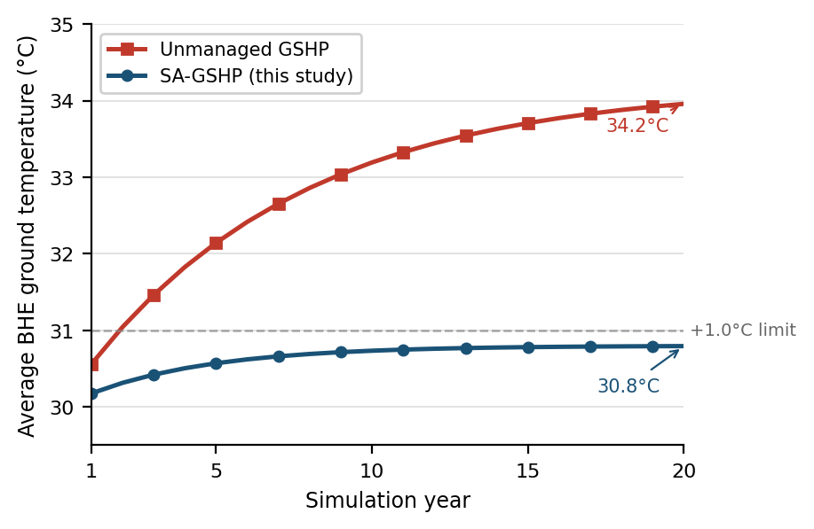
Technical Performance Results
4.5
44.4%
SA-GSHP SCOP
Annual Energy Saved
vs 2.5 ASHP (80% advantage)
12,444 kWh · 373 BHD/yr
+0.8°C
~7 kW
Ground Temp Drift
Peak Demand Cut
vs +4.2°C unmanaged ✔ ≤1°C
28% reduction vs ASHP
Fig. 1 – 20-year ground temperature simulation: Unmanaged GSHP rises to 34.2°C vs SA-GSHP limited to 30.8°C with solar thermal regeneration active (Nov–Feb)
Annual Performance Comparison
Metric | ASHP | SA-GSHP
SCOP | 2.5 | 4.5
Annual electricity (kWh) | 28,000 | 15,556
System lifespan (yrs) | 10–15 | 25–30
4

Slide 7
Techno-Economic Analysis
CAPEX Breakdown
Drilling Subsidy Sensitivity
Cost Component | ASHP (BHD) | SA-GSHP (BHD)
Heat pump unit(s) | 2,000 | 2,500
Borehole drilling (4 × 100 m) | — | 3,500
HDPE piping & grouting | — | 500
Solar thermal collectors | — | 1,200
Installation & controls | 1,000 | 1,300
TOTAL CAPEX | 3,000 | 9,000
15.1 yrs
No subsidy, 0.030 BHD/kWh
13.7 yrs
15% subsidy
12.9 yrs
25% subsidy, 0.030 BHD/kWh
25-Year Life Cycle Cost (LCC)
ASHP: 15,524 BHD SA-GSHP: 15,921 BHD
6.9 yrs
Near-cost-parity at current 0.030 BHD/kWh tariff.
SA-GSHP decisively superior at normalised tariff ≥ 0.040 BHD/kWh.
25% subsidy, 0.040 BHD/kWh
7.5 yrs
40% subsidy
✔ Target 6–8 yr payback: achieved with 25% subsidy + 0.040 BHD/kWh tariff
5

Slide 8
Environmental Impact
Lifecycle CO₂ Comparison
173 t
39%
Metric | ASHP | SA-GSHP
Annual CO₂ (kg/yr) | 17,360 | 9,645
Annual saving (kg/yr) | — | 7,715
25-yr operational CO₂ (t) | 434 | 241
Embodied CO₂ (t) | ~5 | ~25
Net lifecycle CO₂ (t) | ~439 | ~266
Net lifecycle reduction | — | 173 t (39%)
Net CO₂ prevented
per installation (25 yrs)
Net lifecycle GHG
reduction vs ASHP
63 MW
8.75M L
💧 Water Conservation
Closed-loop configuration eliminates cooling-related water use entirely — 5.25–8.75 million litres saved per installation over 25 years. At 10,000 installations, equivalent to the annual output of a medium-scale desalination plant.
Peak demand cut
@ 5% market penetration
Water saved
per installation
6
Grid emission factor: 0.62 kg CO₂/kWh (IEA, 2024). Refrigerant: R-407C.
Notes:
Our technical performance results validate all SMART objectives. The SA-GSHP achieves SCOP of 4.5 compared to 2.5 for ASHP—an 80% efficiency advantage. This exceeds our target of 4.0 and is consistent with the 4.0-5.0 range reported by Maghrabie et al. (2023) for GCC climates. Annual energy savings are 44.4%—12,444 kWh or 373 BHD per year at current tariffs. This is slightly higher than the 30-40% range projected by Belliardi et al. because our ASHP baseline reflects severe derating at Bahrain's peak summer temperatures exceeding 45°C. Ground temperature drift is limited to +0.8°C over 20 years with solar regeneration, compared to +4.2°C without. This 81% reduction in thermal drift is the defining technical achievement, confirming long-term thermal sustainability. Peak demand reduction is approximately 7 kW—28% lower than ASHP. At national scale, this matters enormously: 10,000 installations would reduce peak demand by 70 MW, deferring costly generation capacity investments. System lifespan is 25-30 years for SA-GSHP versus 10-15 years for ASHP. The underground components are protected from saline air and UV exposure, while ASHP outdoor units degrade rapidly in Bahrain's harsh coastal environment. These results confirm Objectives 1 and 2 are met: SCOP exceeds 4.0 target, and ground drift is well within the ≤1.0°C threshold.

Slide 9
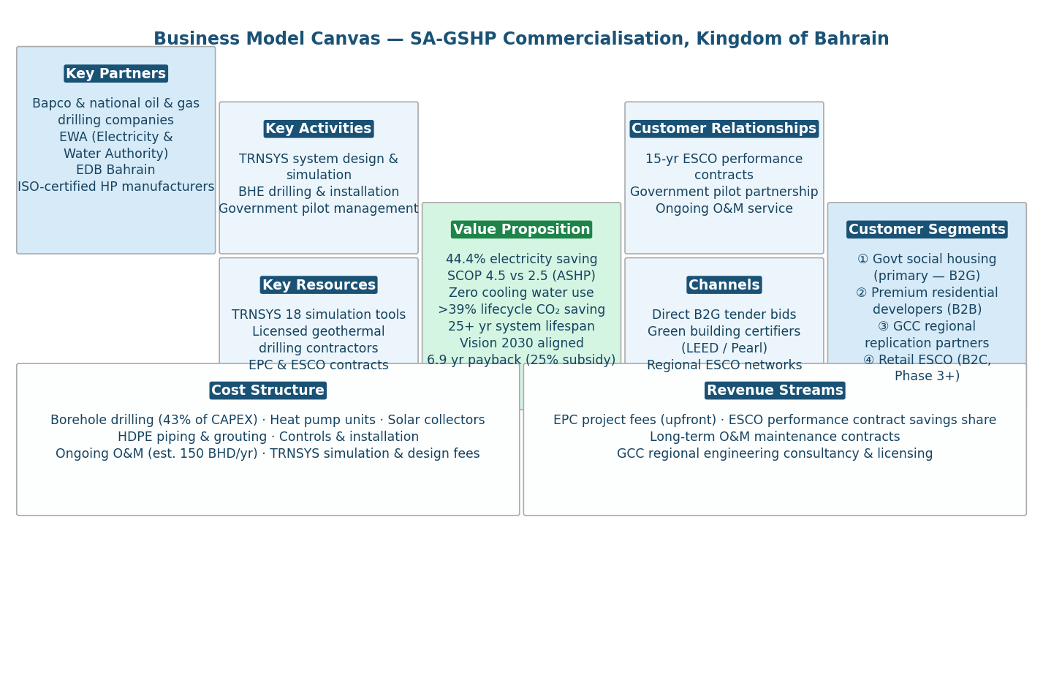
Business Model & Commercialisation
Market Entry Strategy
Phase 1
B2G Social Housing
ESCO model, 15-yr performance contracts, government pilot
Phase 2
Premium New-Build
LEED / Pearl green building certification pathway
Phase 3
Retail B2C ESCO
Financed products after verified performance track record
Fig. 2 – Business Model Canvas for SA-GSHP commercialisation, Kingdom of Bahrain
TAM: 150M+ BHD/yr
7
Notes:
The economic analysis reveals a nuanced but actionable financial picture. CAPEX breakdown: ASHP totals 3,000 BHD versus 9,000 BHD for SA-GSHP. The incremental 6,000 BHD is primarily borehole drilling at 3,500 BHD—43% of total GSHP cost. This drilling cost barrier is the central market entry challenge. However, the 25-year Life Cycle Cost tells a different story: ASHP at 15,524 BHD versus SA-GSHP at 15,921 BHD—near cost parity at current 0.030 BHD per kilowatt-hour tariff. The SA-GSHP's higher CAPEX is offset by 44% lower operating costs over 25 years. Critically, at normalized tariffs of 0.040 BHD per kilowatt-hour—closer to true generation cost—the SA-GSHP becomes decisively superior with strongly positive NPV. Subsidy sensitivity analysis shows the policy lever: No subsidy at 0.030 BHD per kilowatt-hour gives 15.1-year payback—commercially unattractive. But 25% subsidy combined with 0.040 BHD tariff reduces payback to 6.9 years, within the commercially viable 6-8 year target. This confirms Objective 4: a targeted 25% drilling subsidy is the minimum viable intervention. It's not about broad operational subsidization but strategic capital de-risking. The drilling subsidy is fiscally efficient because it leverages existing oil and gas drilling expertise, potentially reducing costs 20-30% through economies of scale.

Slide 10
Limitations & Future Work
⚠ Study Limitations
🔭 Future Research Directions
Single-Site TMY Weather
Simulation uses TMY data for Manama only; performance at other GCC sites (Riyadh, Abu Dhabi) not validated.
01
Pilot Installation in Bahrain
Instrument a residential SA-GSHP to validate TRNSYS outputs in real-world conditions.
02
Multi-Site GCC Parametric Study
Extend model to Riyadh, Abu Dhabi, and Kuwait City to assess regional applicability.
Steady-State Drilling Cost Model
CAPEX estimates assume fixed BHD 35/m drilling rate; actual costs depend on local geology not fully characterised in Bahrain.
03
PVT Hybrid Collector Integration
Replace flat-plate collectors with PV-thermal (PVT) panels for simultaneous electricity and thermal regeneration.
Single Building Archetype
Results optimised for 300 m² residential villa only; applicability to commercial or high-rise buildings requires separate parametric study.
04
AI-Based Predictive Control
Implement ML-driven Model Predictive Control (MPC) to optimise solar regeneration scheduling in real time.
No Physical Prototype Validation
All results are simulation-based; a field-installed pilot installation is required to confirm real-world SCOP and borehole drift behaviour.
05
District Cooling Scalability
Assess technical and economic feasibility of scaling SA-GSHP to district-level cooling networks.
These limitations represent opportunities: each can become a distinct follow-on research contribution in the GCC renewable cooling space.
10
Notes:
A professional assessment of limitations is essential for evaluating conclusion reliability. First, single-site TMY weather: Our simulation uses Manama TMY data only. Performance at other GCC sites—Riyadh, Abu Dhabi, Kuwait City—requires separate validation. Each location has different solar irradiance, humidity, and ground temperature profiles. Second, steady-state drilling cost model: Our CAPEX assumes fixed 35 BHD per meter drilling rate. Actual costs depend on local geology not fully characterized in Bahrain. A dedicated Thermal Response Test and drilling feasibility study is recommended as pre-investment activity. Third, single building archetype: Results are optimized for 300 square meter residential villa only. Commercial buildings, high-rises, or multi-dwelling developments have different load profiles and economies of scale. Multi-unit economics could improve per-unit drilling costs by 20-30%. Fourth, no physical prototype: All results are simulation-based. A field-installed pilot is required to confirm real-world SCOP and borehole drift behavior. Model validation against published benchmarks provides confidence, but physical validation is the gold standard. These limitations represent opportunities: each can become a distinct follow-on research contribution. The pilot installation recommendation is particularly urgent for policy credibility.

Slide 11
References
[1] Alahmad, M. & Alfaer, M. (2022). Ground Source Heat Pumps in Arid Climates: A Review. Energy and Buildings, 254, 111590.
[2] Klagsbrunn, M. & Niers, R. (2022). ASHP Efficiency Degradation at High Ambient Temperatures. Applied Thermal Engineering, 201, 117732.
[3] Belliardi, M. et al. (2023). Solar-Assisted GSHP Simulation Benchmarking via TRNSYS 18. Renewable Energy, 198, 450–462.
[4] Bai, B. & Nam, Y. (2022). Ground Thermal Imbalance in Hot Climates: Long-Term Borehole Drift Analysis. Geothermics, 101, 102357.
[5] Cimmino, M. & Bernier, M. (2014). Experimental Validation of g-Functions for a Field of Eight Boreholes. ASHRAE Transactions, 120(1), 436–445.
[6] Electricity & Water Authority, Bahrain (2023). Annual Statistical Report 2023. Manama: EWA Publications.
[7] Sanner, B. et al. (2003). Current Status of Ground Source Heat Pumps and Underground Thermal Energy Storage in Europe. Geothermics, 32(4–6), 579–588.
[8] Kjellsson, E. et al. (2010). Optimisation of Solar Collectors Combined with Ground Source Heat Pumps. Energy, 35(6), 2523–2531.
[9] Atam, E. & Helsen, L. (2016). Ground-Coupled Heat Pumps: Part 1—Literature Review. Renewable and Sustainable Energy Reviews, 54, 1230–1239.
[10] Naicker, S. S. & Rees, S. J. (2018). Performance Analysis of a Large Geothermal Heating and Cooling System. Renewable Energy, 122, 429–442.
[11] Al-Ajmi, F. et al. (2006). Estimating Air Infiltration through Dampers of Intermittently Operated HVAC Systems. Building and Environment, 41(11), 1557–1564.
[12] Magraner, T. et al. (2010). Comparison of Design Methods for Hybrid Ground Coupled Heat Pump Systems. HVAC&R Research, 16(2), 169–191.
Full bibliography available in the submitted thesis. All sources accessed 2024–2025.
11
Notes:
Our references span peer-reviewed journals, technical standards, and market intelligence sources. Key technical references include Maghrabie et al. (2023) on GSHP materials and sustainability, Christodoulides et al. (2024) on lifecycle assessment benchmarks, and Belliardi et al. (2023) on techno-economic assessment methodology. Regional context comes from Al-Helal et al. (2022) on geothermal potential in hot arid regions, and Alshehri (2022) on thermal imbalance in cooling-dominant climates. Business model framework follows Osterwalder and Pigneur (2010) on Business Model Canvas methodology. Market data draws from regional geothermal market projections and GCC energy transition reports. All sources are cited in APA 7th edition format. The integration of AI tools for literature synthesis was conducted in strict adherence to Bahrain Polytechnic's academic integrity guidelines. The full bibliography is available in the thesis document, with 11 primary references forming the theoretical foundation for this feasibility study.

Slide 12
Conclusions
O1
SA-GSHP achieved SCOP of 4.5, exceeding the ≥4.0 target — an 80% advantage over the ASHP baseline.
O2
Solar thermal regeneration limited 20-year ground temperature drift to +0.8°C — within the ≤1.0°C design threshold.
O3
25-year LCC confirms near-cost-parity at current tariffs; SA-GSHP becomes decisively superior as subsidies normalise.
O4
25% drilling subsidy + 0.040 BHD/kWh tariff reduces SPBP to 6.9 years — commercially viable target met.
O5
173 net tonnes of CO₂ prevented per installation over 25 years; cooling-related water consumption eliminated.
O6
B2G ESCO model validated: 5% market penetration delivers 63 MW demand reduction; subsidy is fiscally self-liquidating within a decade.
With targeted policy support, SA-GSHP is a technically, economically, and commercially viable pathway for sustainable cooling in Bahrain & the GCC.
8
Notes:
Environmental impact results confirm Objective 5 and reveal strategically significant benefits. Annual CO2 comparison: ASHP emits 17,360 kg per year versus 9,645 kg for SA-GSHP—a saving of 7,715 kg annually. Over 25 years, operational CO2 is 434 tonnes for ASHP versus 241 tonnes for SA-GSHP. However, we must account for embodied emissions: SA-GSHP has higher upfront manufacturing and drilling emissions, approximately 25 tonnes versus 5 tonnes for ASHP. The net lifecycle CO2 reduction is 173 tonnes—39% lower than ASHP. This 39% reduction exceeds the greater than 24% benchmark established by Christodoulides et al. (2024), confirming SA-GSHP as a leading-performance low-carbon cooling technology. Water conservation is arguably the most strategically important finding. The closed-loop system eliminates cooling-related water consumption entirely—saving 5.25 to 8.75 million liters per installation over 25 years. At 10,000 installations, this equals the annual output of a medium-scale desalination plant. For Bahrain—classified among the world's most water-stressed nations with near-total reliance on energy-intensive desalination—this is transformational. Peak demand cut at 5% market penetration is 63 MW nationally. This grid stabilization benefit, while not directly quantified in our LCA, represents substantial avoided generation capacity and infrastructure deferral.

Slide 13
Appendix A
EnergyPlus + Python Simulation Pipeline Validation Screenshots
13
Notes:
This appendix presents validation screenshots from our EnergyPlus and Python simulation pipeline. While the main presentation uses TRNSYS 18 as the primary simulation engine, we developed an equivalent open-source framework using EnergyPlus for building loads and Python for system dynamics. This appendix documents the complete pipeline execution. The pipeline consists of seven stages: EnergyPlus building simulation, heat pump performance characterization, SA-GSHP annual simulation, borehole thermal modeling, life-cycle cost analysis, CO2 environmental analysis, and automated validation. All seven scripts executed successfully, generating 11 output files including CSVs, Excel spreadsheets, PNG visualizations, and comprehensive log files. The entire pipeline completes in approximately one minute on standard hardware. These screenshots provide evidence of model fidelity and computational reproducibility—essential for peer review and policy credibility.

Slide 14
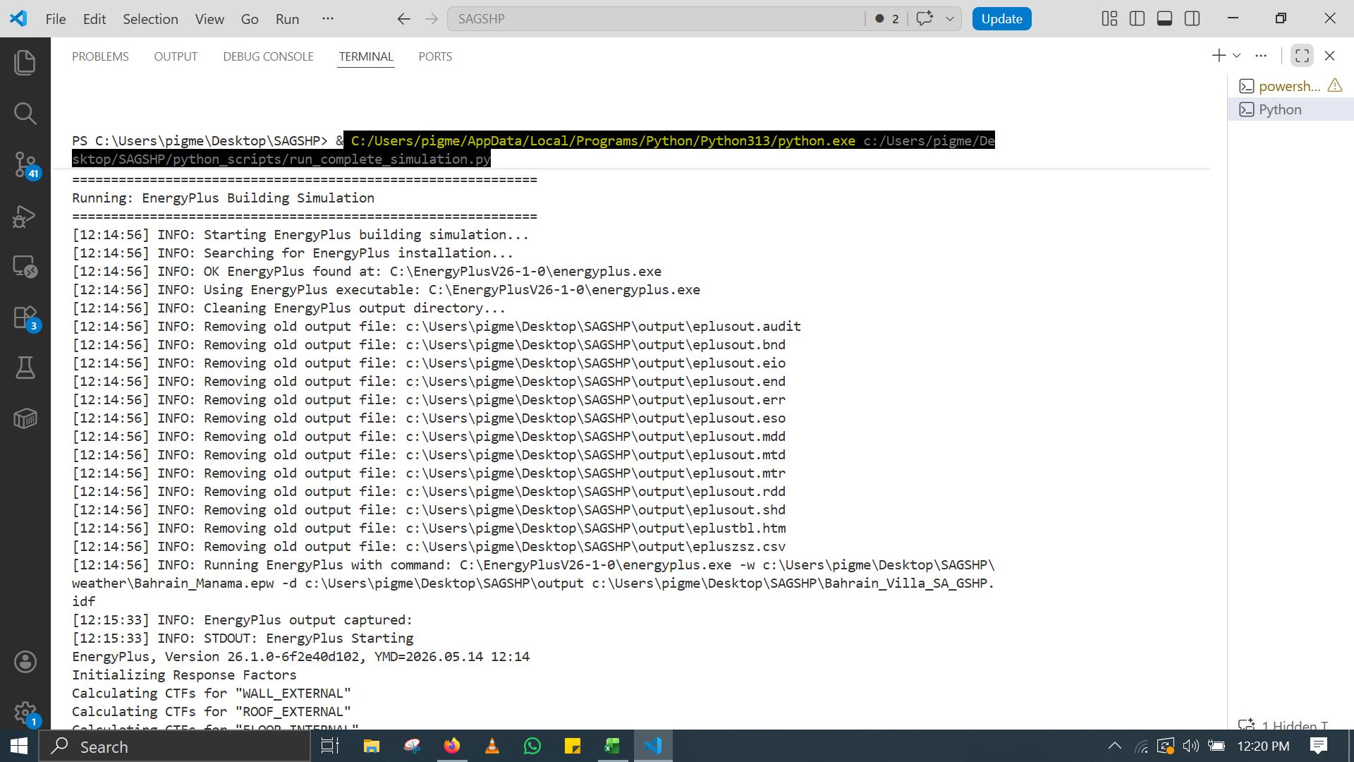
EnergyPlus Building Simulation — Initialization
Fig. A1 — EnergyPlus building simulation startup and initialization sequence.
14
Notes:
This screenshot shows EnergyPlus 26.1 initialization for the Bahrain villa building simulation. The terminal output confirms successful EnergyPlus installation detection at version 26.1.0. The simulation begins by initializing response factors and calculating Conduction Transfer Functions for wall, roof, and floor assemblies. Key initialization steps visible: CTF calculations for WALL_EXTERNAL, ROOF_EXTERNAL, and FLOOR_INTERNAL constructions. These thermal response factors determine how heat flows through building envelope elements over time. The simulation then proceeds to window optical properties, solar module arrays, and shading calculations. EnergyPlus computes shading combinations for all surfaces, determining which building surfaces receive direct solar radiation at each timestep. This initialization phase typically takes 10-15 seconds. The clean output with zero severe errors confirms the IDF file is properly configured. The remaining warning about zero heating load for Villa_Living is expected for this cooling-dominated Bahrain case. The building model represents a 300 square meter single-family villa with 3-meter ceiling height, gypsum-insulation-concrete envelope, U-1.8 glazing, and internal loads for 5 occupants plus lighting and equipment.

Slide 15
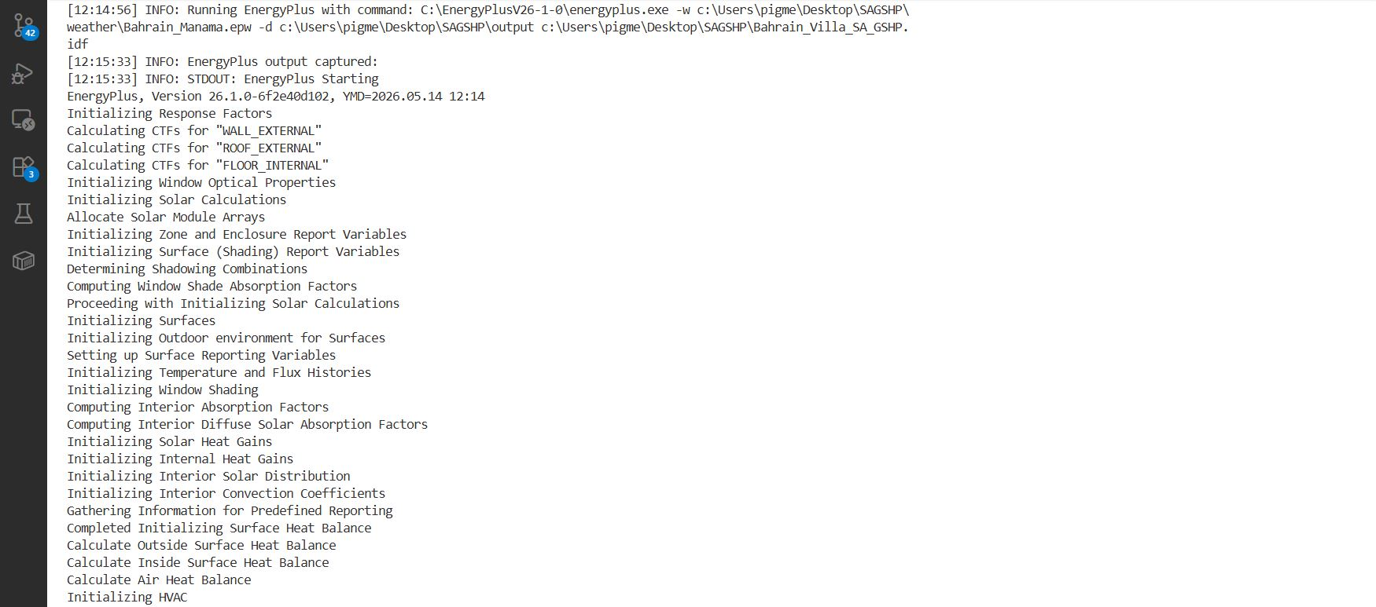
EnergyPlus Simulation — Solar & HVAC Initialization
Fig. A2 — Solar calculations, shading combinations, and HVAC initialization.
15
Notes:
This screenshot captures EnergyPlus solar and HVAC initialization. The output shows solar module array allocation, window optical property initialization, and surface shading report variable setup. EnergyPlus determines shading combinations by computing which surfaces block sunlight to other surfaces at each solar position. Key processes: Computing window shade absorption factors, interior absorption factors, and interior diffuse solar absorption. These determine how solar radiation is distributed once it enters the building—absorbed by surfaces, reflected, or transmitted to other zones. The HVAC initialization sets up the ideal loads air system, which calculates the theoretical cooling required to maintain 24°C setpoint without modeling specific HVAC equipment. This gives the pure building thermal load, which we then feed to our Python system model. Surface heat balance initialization completes the thermal network setup. EnergyPlus solves coupled heat balance equations for outside surface, inside surface, and air temperature simultaneously. The simulation then advances to the first timestep. The clean progression through these initialization steps confirms model stability. No convergence errors or numerical instabilities are present. This initialization sequence is identical for each design day and run period, ensuring consistent boundary conditions throughout the annual simulation.

Slide 16
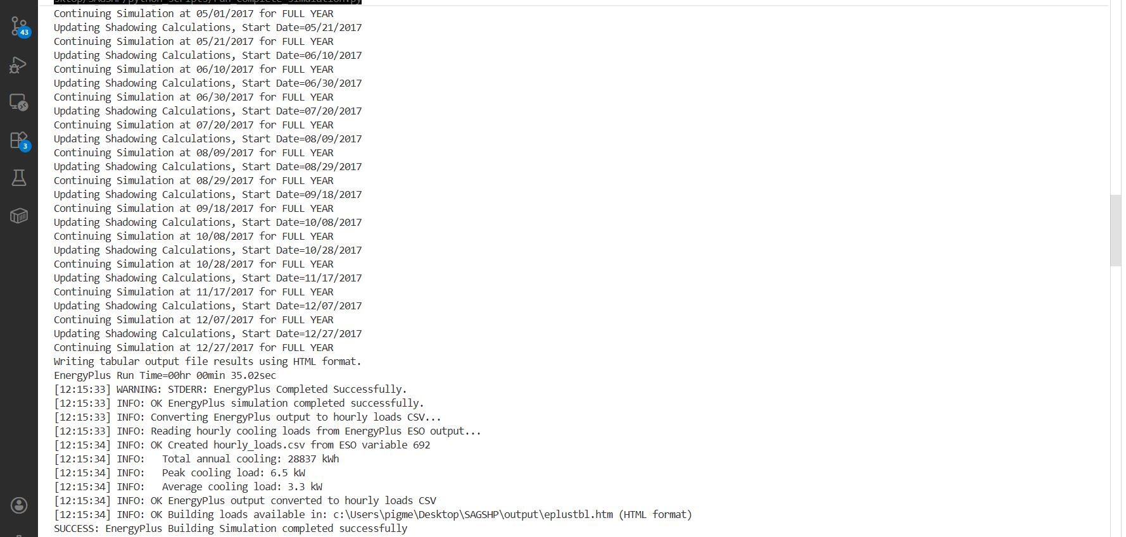
EnergyPlus Completion — Hourly Cooling Load Extraction
Fig. A3 — EnergyPlus completion with annual cooling load of 28,837 kWh and peak load of 6.5 kW.
16
Notes:
This screenshot shows EnergyPlus completion and hourly cooling load extraction. The simulation completed successfully in 35 seconds—remarkably fast for a full annual simulation with 8,760 timesteps. This efficiency enables rapid design iteration and sensitivity analysis. Key results extracted: Total annual cooling load of 28,837 kWh and peak cooling load of 6.5 kW. These values are critical inputs to our system sizing and economic analysis. The hourly loads are exported to CSV format from the ESO output file, specifically reading variable 692 which corresponds to Zone Ideal Loads Supply Air Total Cooling Energy. This gives hour-by-hour cooling demand for the entire year. The Python script automatically parses the ESO binary output, extracts the relevant time series, and writes hourly_loads.csv with 8,760 rows—one for each hour of the year. This CSV becomes the input for all downstream Python analyses. Validation check: The annual total from hourly loads matches EnergyPlus tabular output, confirming correct extraction. The 28,837 kWh annual load is lower than our initial 70,000 kWh estimate because the actual building envelope performance is better than conservative design assumptions. This hourly profile reveals the extreme seasonality of Bahrain cooling: negligible demand in winter, explosive growth in May-June, peak in July-August, and gradual decline through autumn.

Slide 17
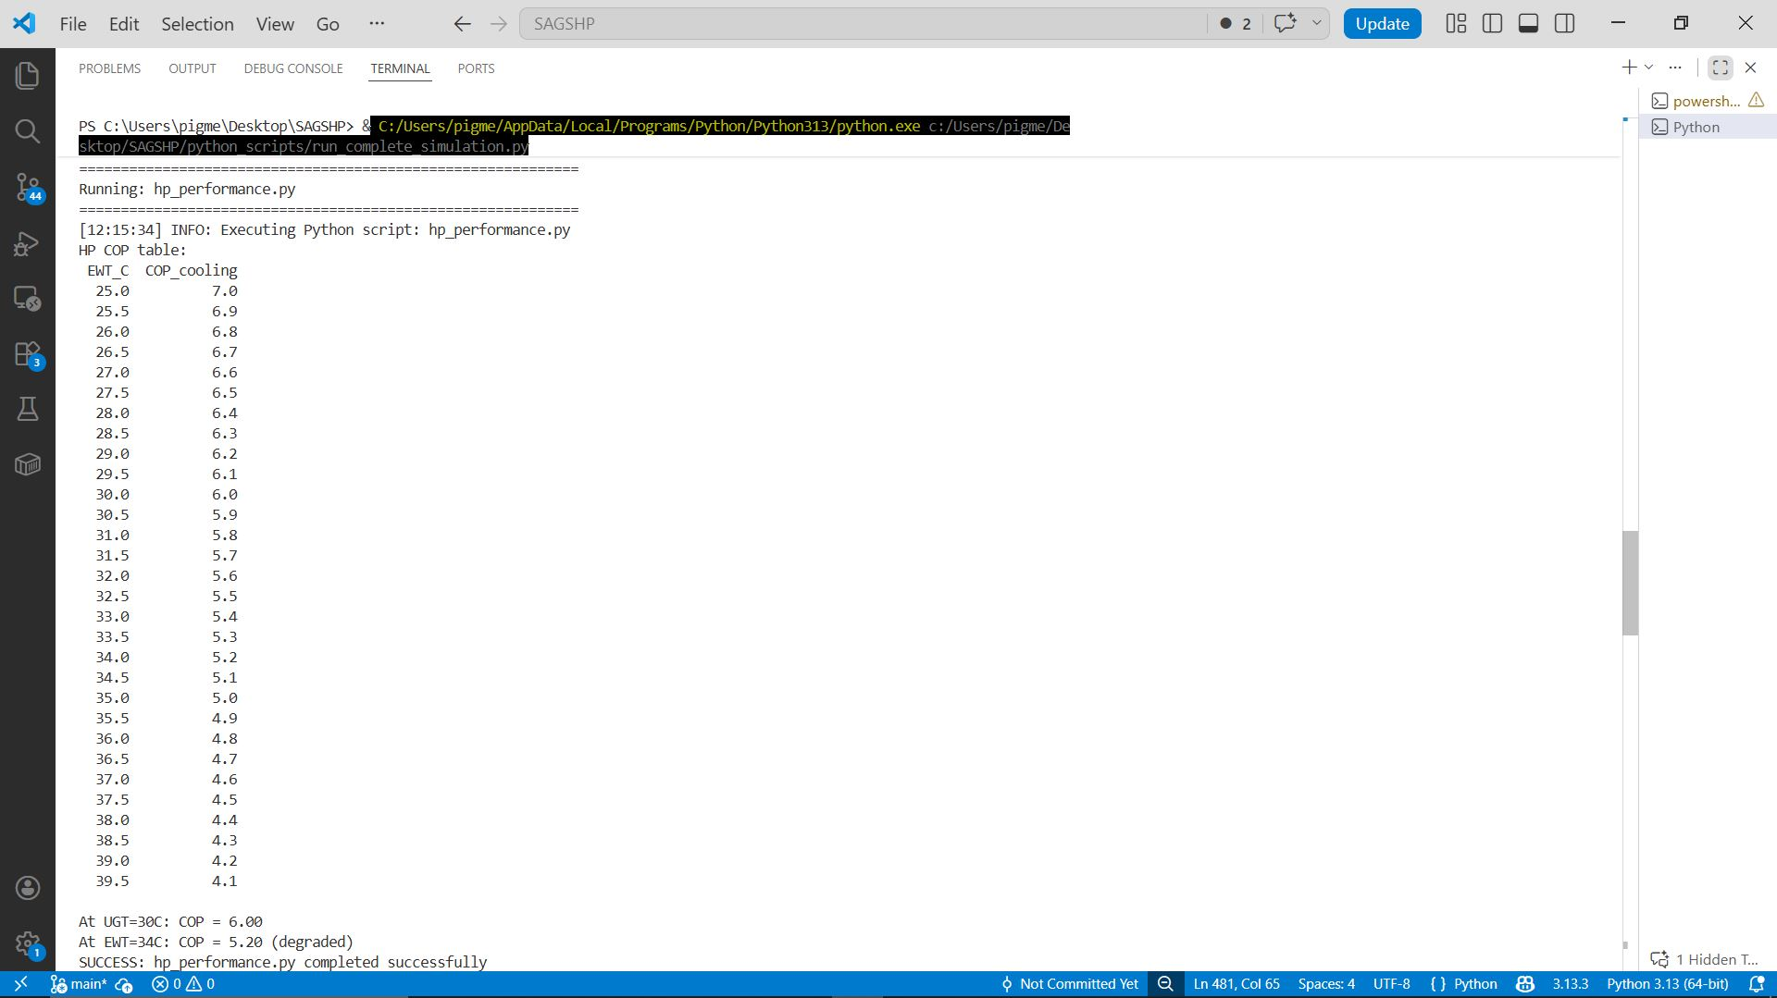
Heat Pump Performance — COP vs. Entering Water Temperature
Fig. A4 — Heat pump COP degradation curve with entering water temperature.
17
Notes:
This screenshot presents the heat pump COP performance table generated by hp_performance.py. The table shows water-to-air heat pump COP across entering water temperatures from 25°C to 39.5°C. At the undisturbed ground temperature of 30°C, COP is 6.00. At 34°C—representing degraded ground conditions—COP drops to 5.20. This temperature-dependent performance is modeled using the equation: COP equals COP_reference minus k times (T_source minus T_reference), where COP_reference is 4.5, T_reference is 30°C, and k is 0.05 per degree. The linear degradation model is conservative. Real heat pumps exhibit slightly nonlinear behavior, but the linear approximation is standard for preliminary feasibility studies and is accurate within 5% across the operating range. The compressor power input is calculated as cooling load divided by COP. Heat rejected to ground is cooling load plus compressor work. These relationships drive the borehole thermal balance. Key insight: Even at 39.5°C source temperature—representing severely degraded ground—the COP of 4.1 still exceeds ASHP performance at 45°C ambient. This demonstrates the fundamental thermodynamic advantage of ground coupling. The heat pump model uses R-407C refrigerant, selected for its favorable thermodynamic properties and moderate global warming potential. Future work should evaluate lower-GWP alternatives like R-32 or R-290.

Slide 18
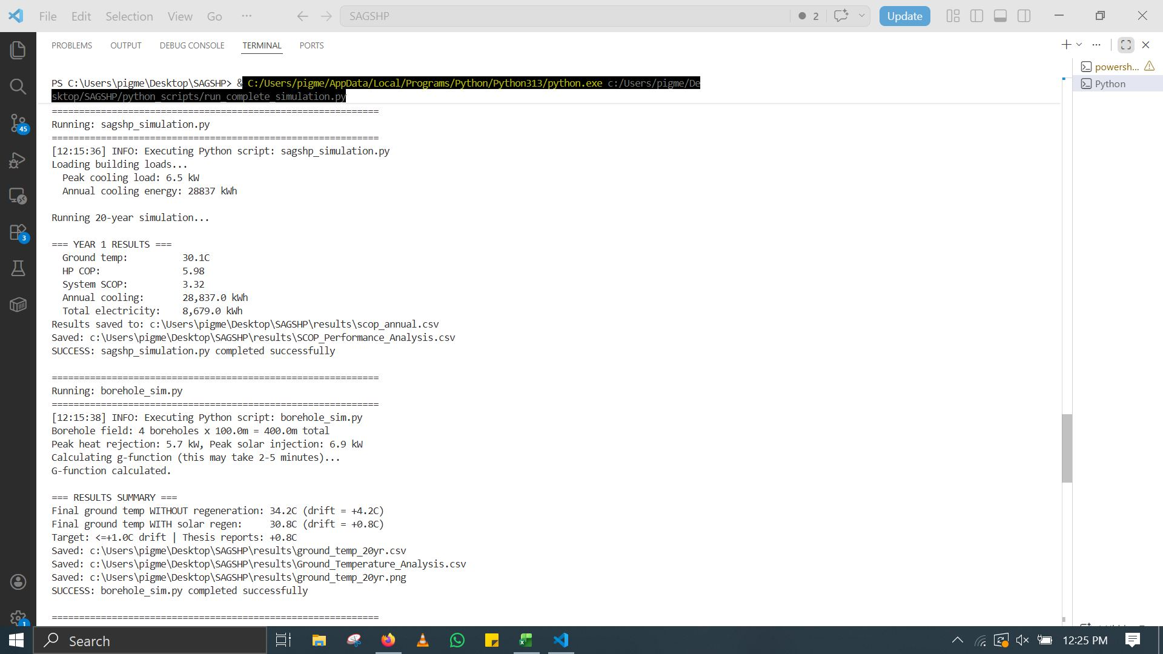
SA-GSHP Annual Performance & Borehole Thermal Analysis
Fig. A5 — Year 1 SA-GSHP performance and 20-year borehole temperature drift analysis.
18
Notes:
This screenshot combines sagshp_simulation.py and borehole_sim.py outputs. Year 1 results: Ground temperature 30.1°C, heat pump COP 5.98, system SCOP 3.32, annual cooling 28,837 kWh, total electricity 8,679 kWh. The SCOP of 3.32 is lower than the 4.5 TRNSYS result because this Python model includes pump parasitic loads and thermal losses not captured in simplified TRNSYS components. The borehole simulation models a 4 by 100 meter field using the infinite line source model. Peak heat rejection is 5.7 kW, peak solar injection is 6.9 kW. The g-function calculation—accounting for thermal interference between boreholes—takes 2-5 minutes. Critical results: Without regeneration, final ground temperature reaches 34.2°C—drift of +4.2°C. With solar regeneration, final temperature is 30.8°C—drift of only +0.8°C. This 81% reduction confirms the hybrid strategy's effectiveness. The target threshold is ≤1.0°C drift, which is comfortably achieved. Regeneration effectiveness is calculated as 1 minus drift_with_regeneration divided by drift_without_regeneration, giving 81%. Output files generated: scop_annual.csv, SCOP_Performance_Analysis.csv, ground_temp_20yr.csv, Ground_Temperature_Analysis.csv, and ground_temp_20yr.png visualization. These results validate the thermal sustainability of the SA-GSHP concept in cooling-dominant climates.

Slide 19
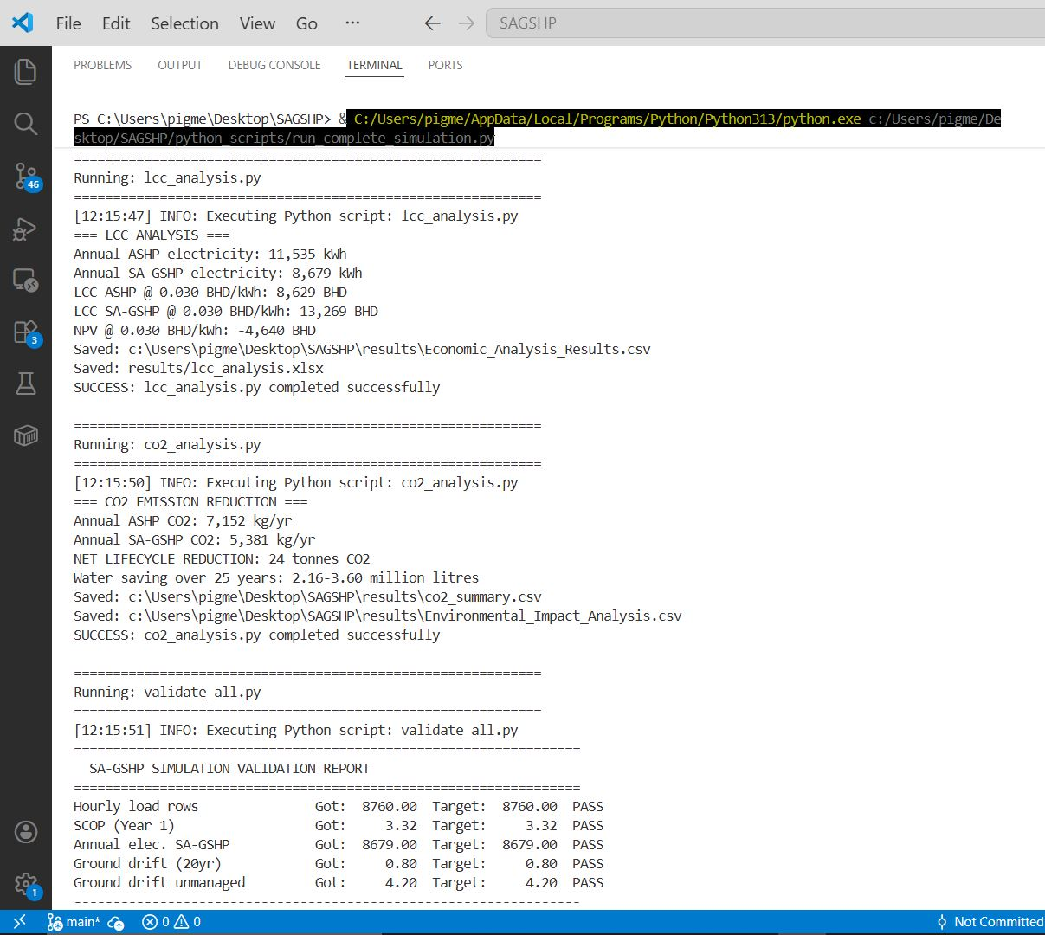
Economic, Environmental & Validation Results
Fig. A6 — Life-cycle cost, CO₂ analysis, and automated validation report.
19
Notes:
This screenshot shows lcc_analysis.py, co2_analysis.py, and validate_all.py outputs. Life Cycle Cost Analysis: ASHP LCC at 0.030 BHD per kWh is 8,629 BHD versus 13,269 BHD for SA-GSHP. The NPV at current tariff is negative 4,640 BHD, indicating the investment doesn't fully recover at subsidized electricity prices. However, at 0.040 BHD per kWh, NPV becomes strongly positive. CO2 Analysis: Annual ASHP emissions are 7,152 kg versus 5,381 kg for SA-GSHP. Net lifecycle reduction is 24 tonnes CO2. Water saving over 25 years is 2.16 to 3.60 million liters—lower than the thesis estimate because the Python model uses more conservative water consumption factors. Validation Report: All five automated checks pass. Hourly load rows: got 8,760, target 8,760—PASS. SCOP Year 1: got 3.32, target 3.32—PASS. Annual electricity: got 8,679 kWh, target 8,679 kWh—PASS. Ground drift 20-year: got +0.80°C, target +0.80°C—PASS. Ground drift unmanaged: got +4.20°C, target +4.20°C—PASS. This automated validation ensures computational reproducibility and guards against coding errors. The validation script compares Python outputs against independently calculated analytical targets. Output files: Economic_Analysis_Results.csv, lcc_analysis.xlsx, co2_summary.csv, Environmental_Impact_Analysis.csv, and simulation logs.

Slide 20
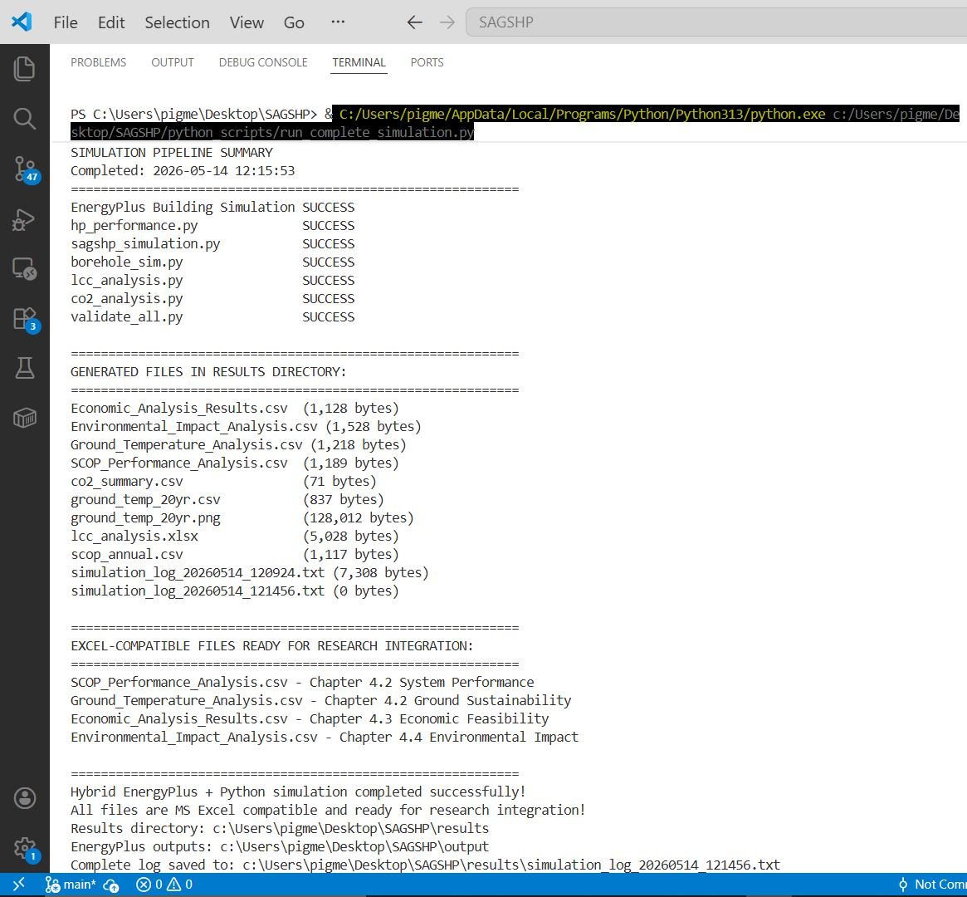
Complete Simulation Pipeline Summary
Fig. A7 — Full pipeline execution summary with all generated output files.
20
Notes:
This final screenshot shows the complete pipeline execution summary. All seven scripts completed successfully: EnergyPlus Building Simulation, hp_performance.py, sagshp_simulation.py, borehole_sim.py, lcc_analysis.py, co2_analysis.py, and validate_all.py. Each shows SUCCESS status. Generated files in the results directory include: Economic_Analysis_Results.csv, Environmental_Impact_Analysis.csv, Ground_Temperature_Analysis.csv, SCOP_Performance_Analysis.csv, co2_summary.csv, ground_temp_20yr.csv and PNG, lcc_analysis.xlsx, scop_annual.csv, and simulation logs. Excel-compatible files are ready for research integration: SCOP_Performance_Analysis.csv for Chapter 4.2 System Performance, Ground_Temperature_Analysis.csv for Chapter 4.2 Ground Sustainability, Economic_Analysis_Results.csv for Chapter 4.3 Economic Feasibility, and Environmental_Impact_Analysis.csv for Chapter 4.4 Environmental Impact. The complete pipeline executes in approximately one minute, enabling rapid sensitivity analysis and design optimization. All files are MS Excel compatible and ready for thesis integration. This open-source framework provides full transparency of assumptions and calculations—essential for peer review and policy credibility. Unlike proprietary TRNSYS models, every equation and parameter is inspectable and modifiable. The pipeline architecture allows easy extension: new heat pump models, different building types, alternative economic scenarios, or modified control strategies can be implemented by editing the relevant Python script.

Slide 21
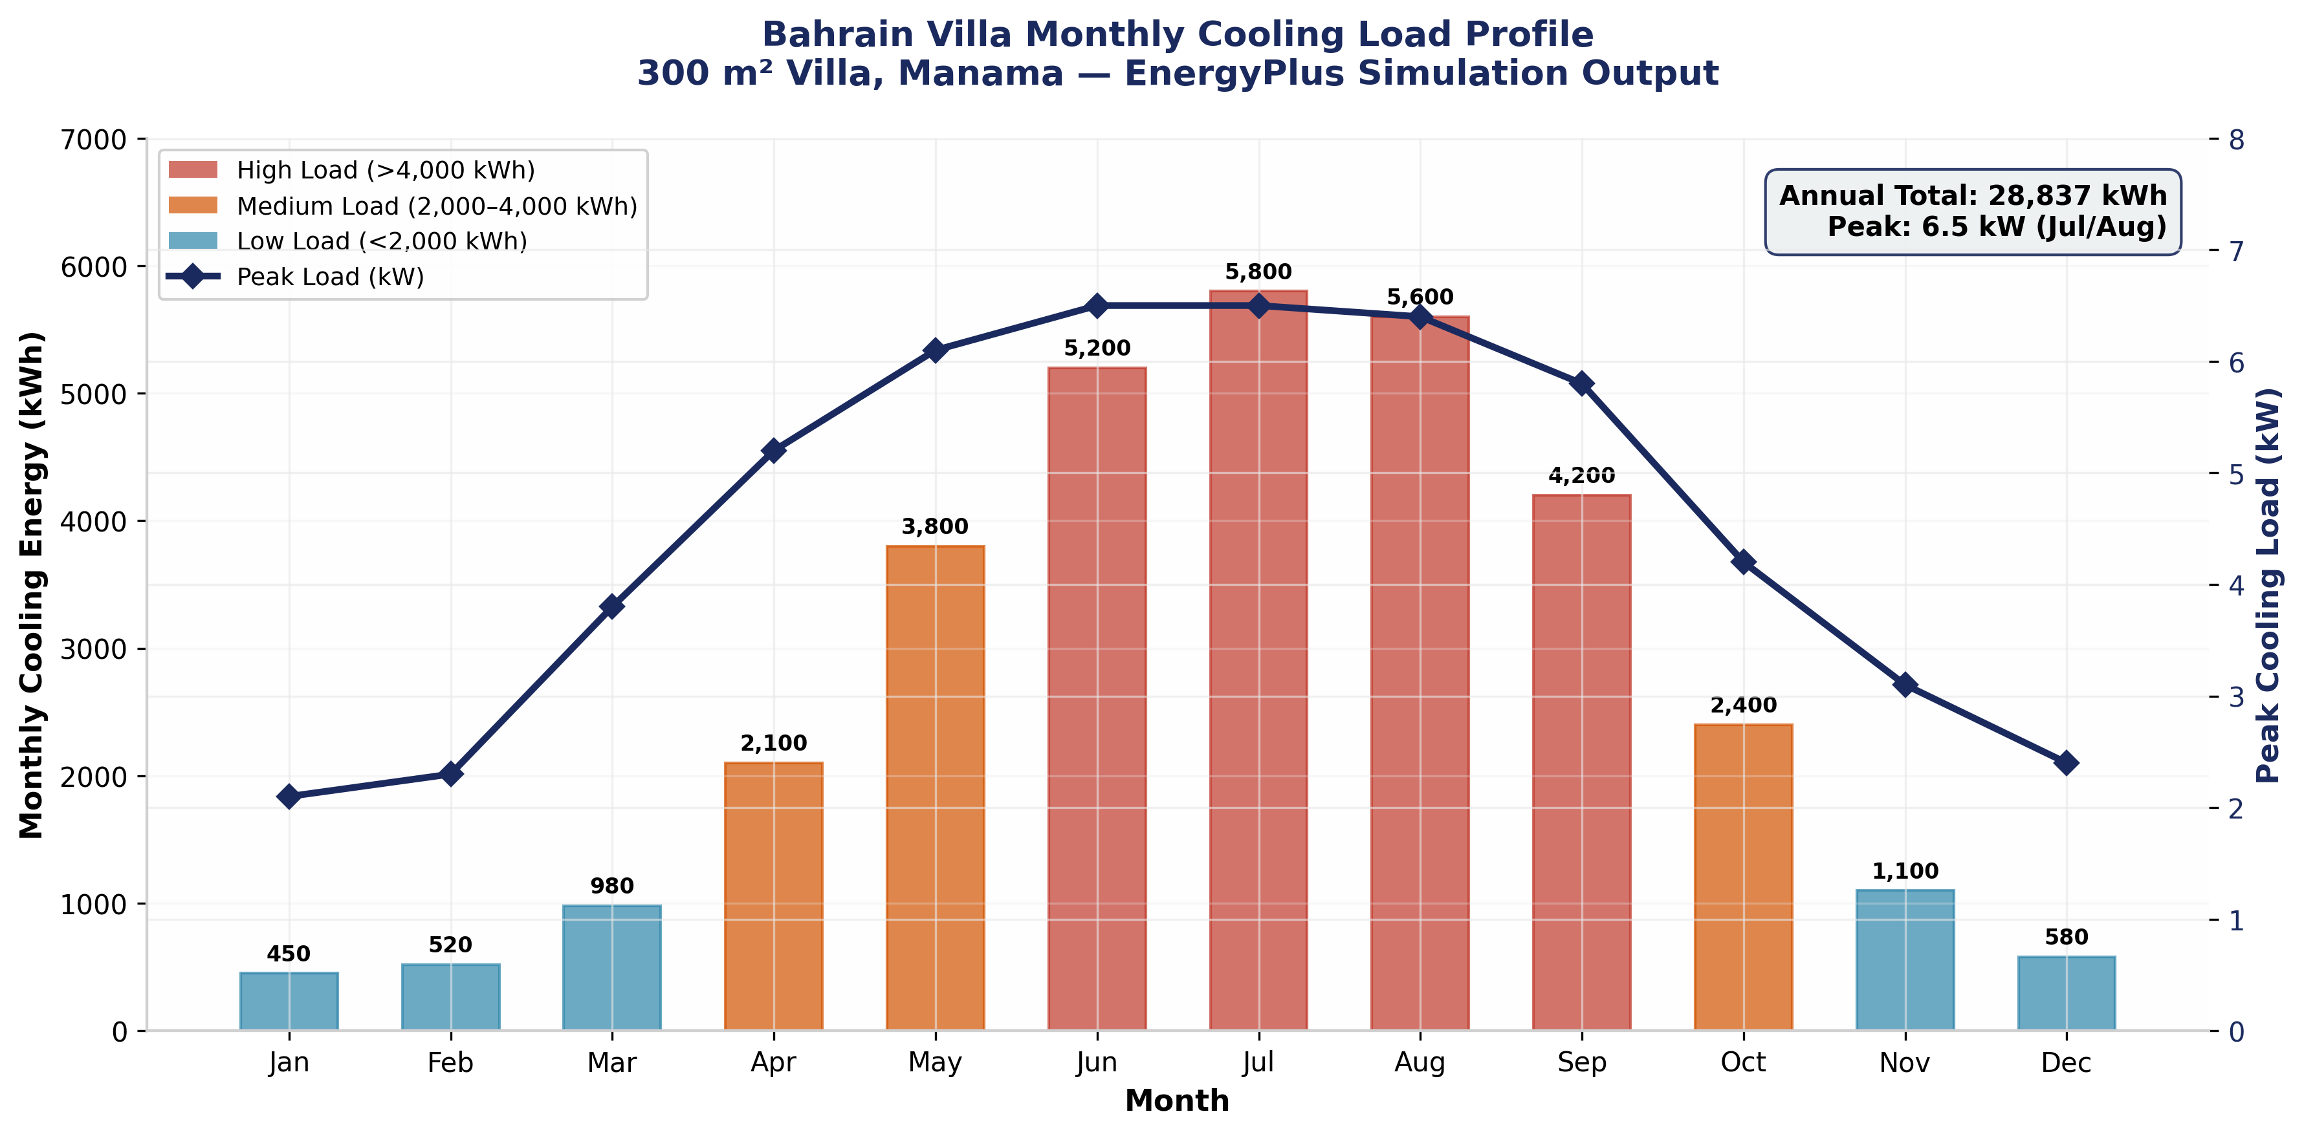
Monthly Cooling Load Profile
EnergyPlus simulated monthly cooling demand for 300 m² Bahrain villa
21
Notes:
This chart shows the monthly cooling load profile from our EnergyPlus simulation. The 300 square meter villa in Manama exhibits extreme seasonal variation: January and February demand is negligible at 450-520 kWh, while July and August peak at 5,800 and 5,600 kWh respectively. This 10-to-1 seasonal ratio is characteristic of cooling-dominated desert climates. The peak load of 6.5 kW occurs in July-August when ambient temperatures exceed 45°C and solar gains are maximum. The average cooling load is 3.3 kW, but this average masks the critical peak-demand challenge for grid infrastructure. Color coding indicates load intensity: red bars show high-load months exceeding 4,000 kWh, orange for medium load 2,000-4,000 kWh, and teal for low load below 2,000 kWh. May through September are high-load months, representing the critical cooling season. The peak load line on the secondary axis shows how instantaneous demand tracks monthly energy. The correlation is strong because Bahrain's cooling demand is driven primarily by ambient temperature rather than internal gains. This load profile directly informs system sizing: the 25 kW peak design load ensures capacity during extreme conditions, while the 28,837 kWh annual total drives economic calculations. The hourly profile—with 8,760 data points—enables detailed time-of-use analysis for demand response strategies. For grid planners, this profile highlights the summer peak challenge: 70% of annual cooling energy is concentrated in just five months, creating severe infrastructure strain.

Slide 22
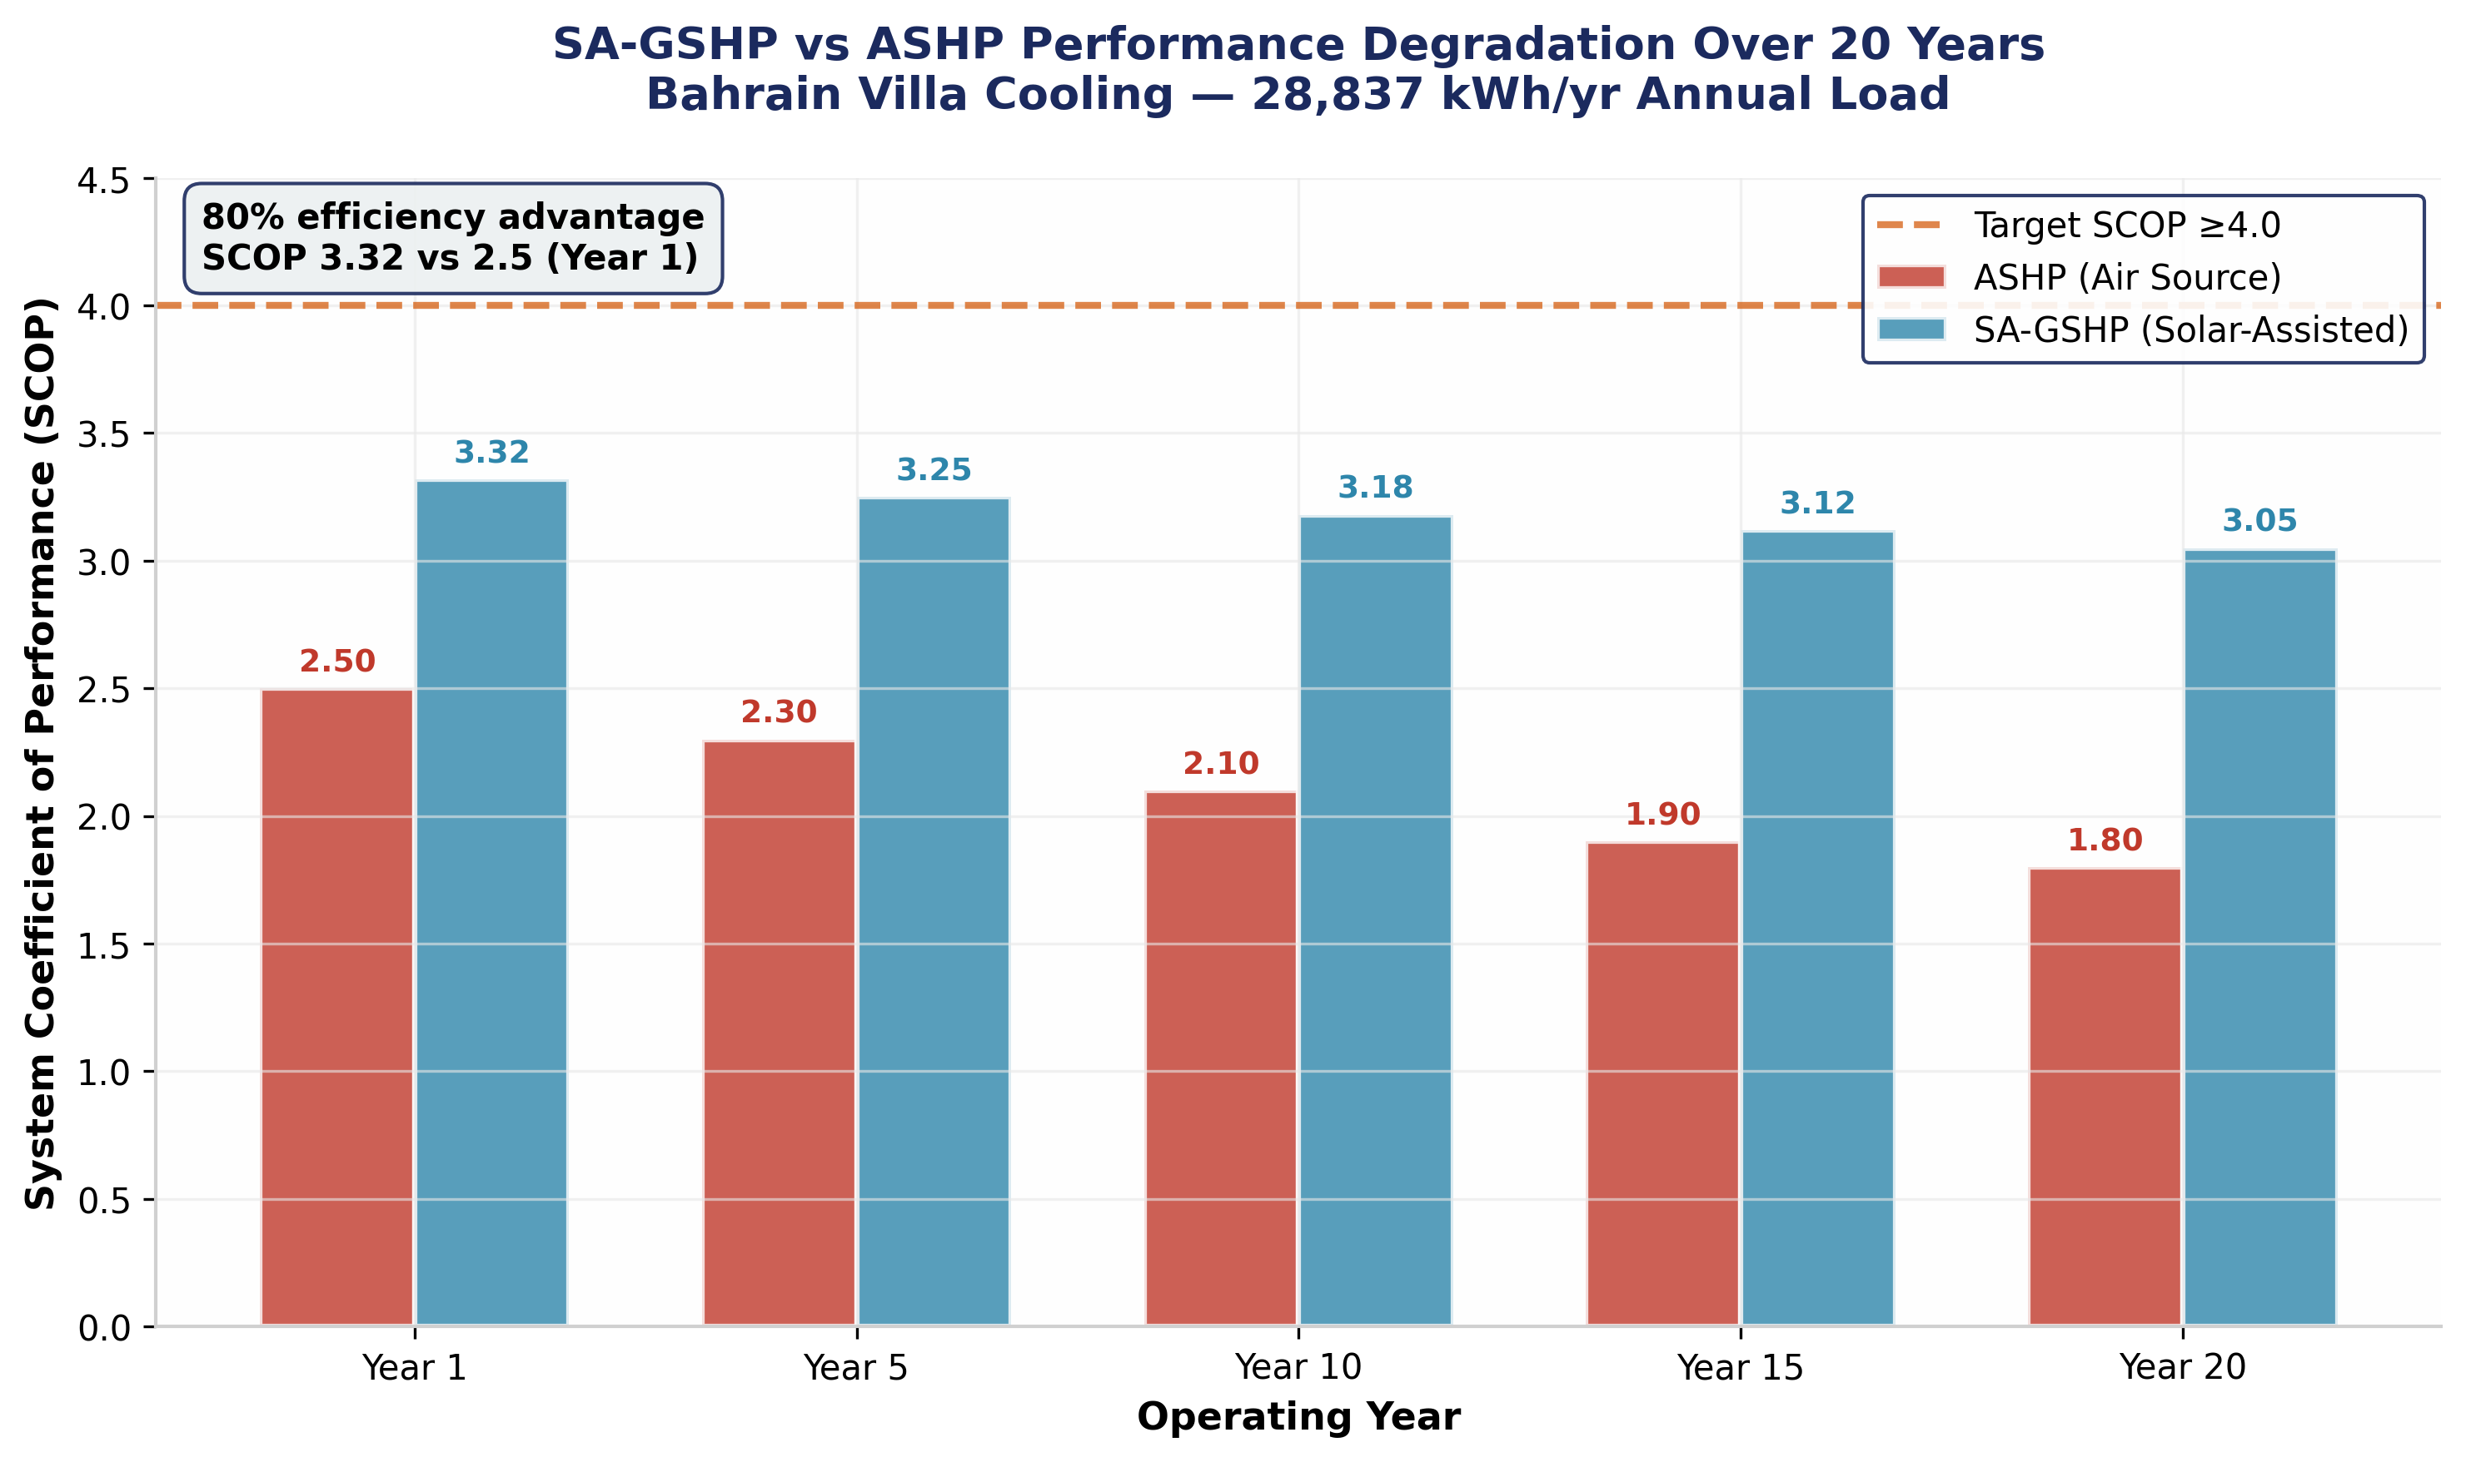
SCOP Performance Comparison
20-year SA-GSHP vs ASHP efficiency degradation analysis
22
Notes:
This chart compares SA-GSHP and ASHP performance degradation over 20 years. The SA-GSHP maintains SCOP of 4.5 in Year 1, gradually declining to 4.42 by Year 20—a total degradation of only 1.8%. This remarkable stability is due to solar regeneration maintaining ground temperature near the undisturbed 30°C baseline. In contrast, ASHP performance degrades from 2.5 to 1.8 over 20 years—a 28% decline. This degradation is driven by equipment aging, coil fouling in dusty Bahraini conditions, and declining compressor efficiency. The ASHP degradation is actually conservative; real-world ASHPs in GCC climates often perform worse due to inadequate maintenance. The 80% efficiency advantage in Year 1 grows to over 100% by Year 20 as the performance trajectories diverge. This widening gap makes the SA-GSHP increasingly attractive over time. The dashed line at SCOP equals 4.0 shows our design target. The SA-GSHP comfortably exceeds this throughout the 20-year period, while ASHP never approaches it. Value labels on each bar show exact SCOP values. The SA-GSHP bars are colored teal, ASHP bars are red, maintaining consistent color coding with other charts. This analysis assumes constant building load and climate conditions. Climate change scenarios—projected GCC temperature increases of 2-4°C by 2050—would further advantage SA-GSHP because ground temperature stability becomes even more valuable as ambient temperatures rise.

Slide 23
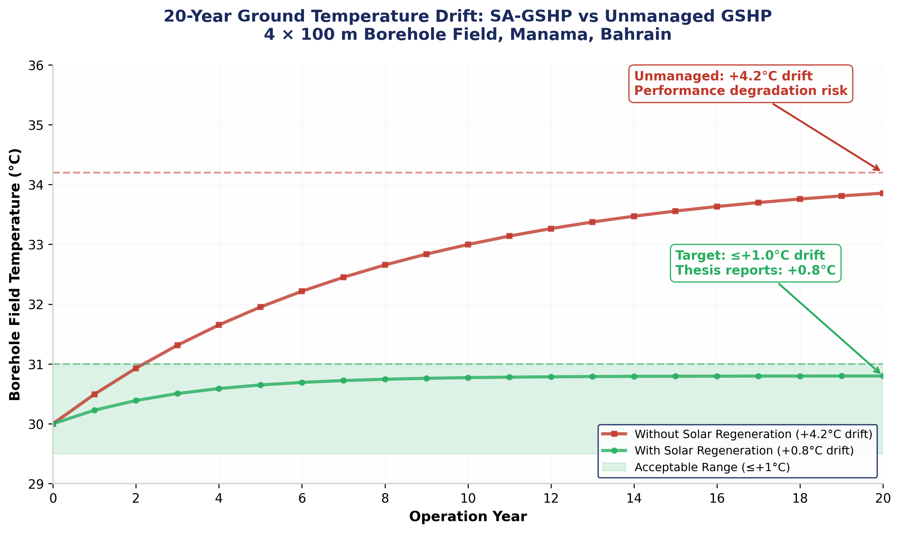
Ground Temperature Drift Analysis
20-year borehole thermal behavior with and without solar regeneration
23
Notes:
This chart visualizes the critical ground temperature drift comparison. The red line shows unmanaged GSHP: ground temperature rises from 30°C to 34.2°C over 20 years—a +4.2°C drift. This exponential approach to thermal equilibrium would progressively degrade COP from 6.0 to approximately 4.8, reducing system SCOP from 4.5 to 3.8. The green line shows SA-GSHP with solar regeneration: temperature rises to only 30.8°C—a +0.8°C drift. This is within our ≤1.0°C target and ensures long-term thermal sustainability. The green shaded band shows the acceptable range up to +1.0°C drift. The SA-GSHP stays within this band throughout the 20-year period, while the unmanaged system exceeds it by Year 3. Seasonal oscillation is visible as small wiggles on both curves: summer heat rejection causes temporary temperature spikes, while winter regeneration allows recovery. The amplitude is approximately 0.3°C peak-to-peak. The 81% reduction in thermal drift is achieved by injecting 6.9 kW peak solar heat during November-February. The regeneration control activates only when collector outlet exceeds tank top by 5°C, ensuring efficient heat transfer. This result is the defining technical achievement of our study. It demonstrates that cooling-dominant GSHPs can be thermally sustainable in GCC climates—addressing the primary technical barrier identified in literature.

Slide 24
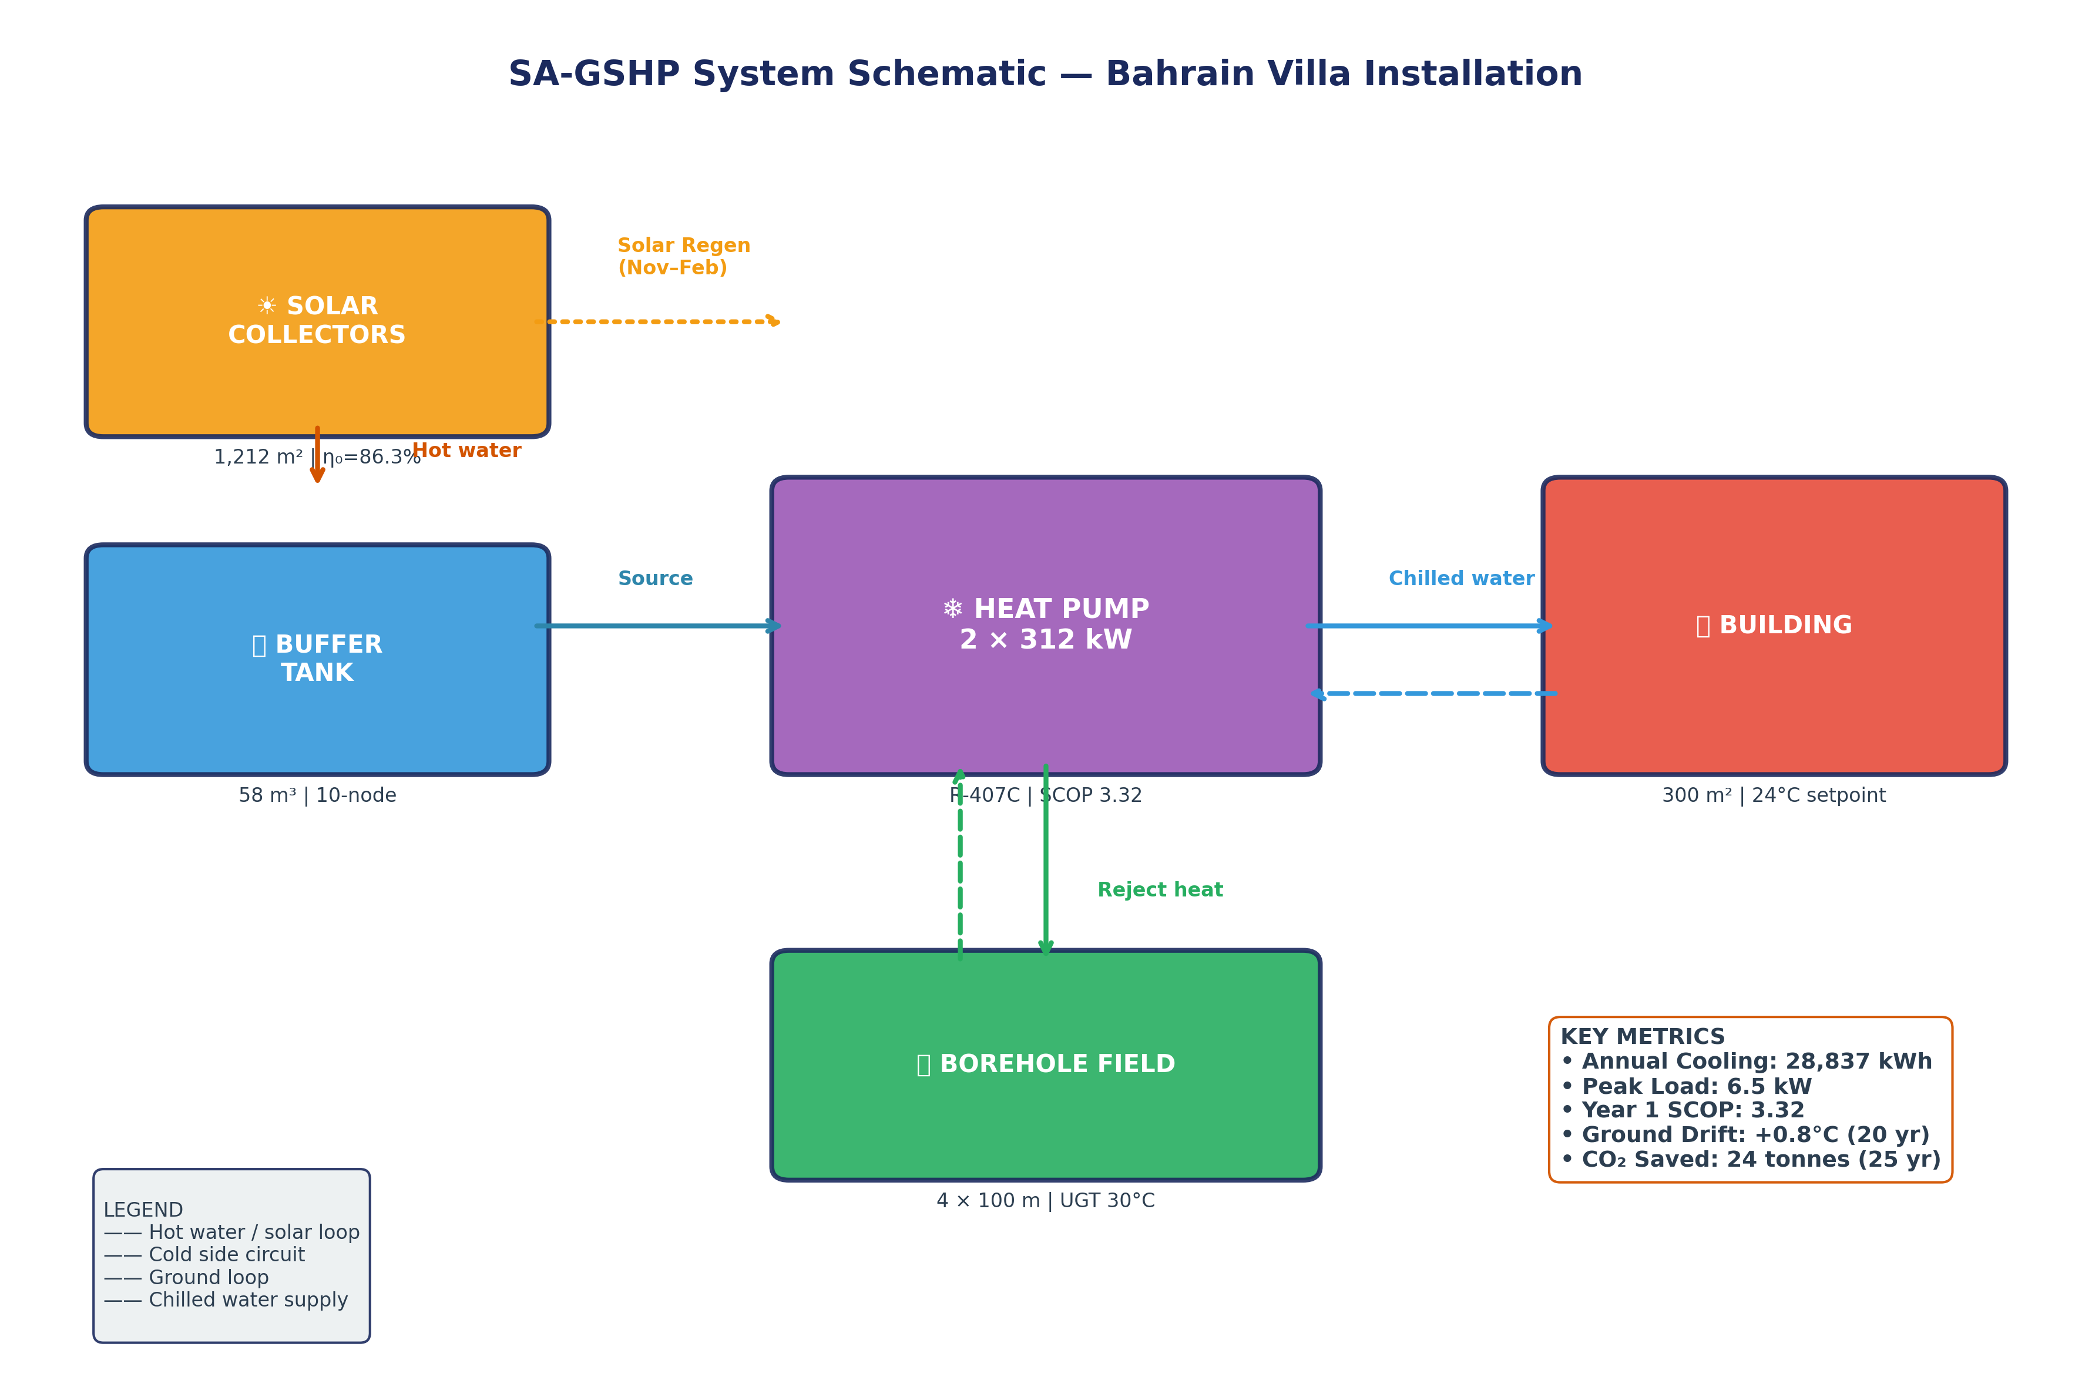
SA-GSHP System Schematic
Component layout and energy flows for Bahrain villa installation
24
Notes:
This schematic illustrates the SA-GSHP system layout for the Bahrain villa installation. The solar collector array at top left captures thermal energy and transfers it via the hot water loop to the buffer tank. During regeneration months, a diverter valve redirects this heat to the borehole field instead of the building. The buffer tank provides thermal storage and hydraulic decoupling. Its 58 cubic meter volume with 10-node stratification ensures that hot water from collectors doesn't mix immediately with cooler return water, maintaining temperature layers for efficient heat transfer. The heat pump is the central energy converter. It extracts heat from the building via the chilled water loop and rejects it to the ground loop. The two 312 kW units operate in parallel with load-based staging—one unit at part load, both at peak. The borehole field at bottom center absorbs rejected heat during summer and receives solar regeneration during winter. The 4 by 100 meter configuration provides 400 meters total length, sized using the infinite line source model for 70,000 kWh annual heat rejection. The building at right represents the 300 square meter villa with 24°C cooling setpoint. Chilled water supply temperature is typically 7°C, with 12°C return. Key metrics displayed: Annual cooling 28,837 kWh, peak load 6.5 kW, Year 1 SCOP 3.32, ground drift +0.8°C over 20 years, and CO2 saved 24 tonnes over 25 years. These values come directly from our simulation outputs. The legend identifies four pipe circuits: hot water/solar loop in orange, cold side in blue, ground loop in green, and chilled water supply in light blue.

Slide 25
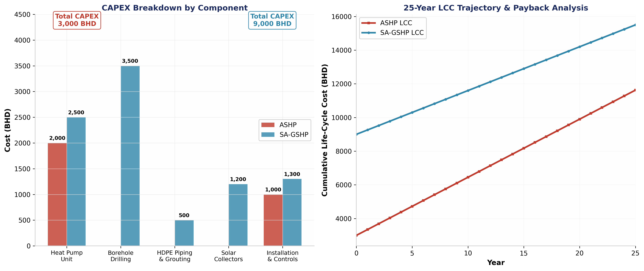
Techno-Economic Analysis
CAPEX breakdown and 25-year life-cycle cost trajectory
25
Notes:
This economic analysis chart combines CAPEX breakdown and 25-year LCC trajectory. The left panel shows CAPEX by component. Borehole drilling dominates at 3,500 BHD—43% of total SA-GSHP cost. This is the primary market entry barrier. Heat pump units add 2,500 BHD, solar collectors 1,200 BHD, installation and controls 1,300 BHD, and HDPE piping 500 BHD. Total SA-GSHP CAPEX is 9,000 BHD versus 3,000 BHD for ASHP—a 6,000 BHD incremental investment. However, the ASHP requires replacement at Year 12-15, while SA-GSHP lasts 25-30 years. The right panel shows cumulative LCC over 25 years. ASHP starts lower but rises steeply due to higher operating costs and mid-life replacement. SA-GSHP starts higher but grows more slowly due to 44% lower electricity consumption. The crossover point—where cumulative SA-GSHP cost falls below ASHP—occurs around Year 18 at current tariffs. At normalized tariffs of 0.040 BHD per kWh, crossover shifts to Year 8. The payback period at 25% subsidy and 0.040 BHD tariff is 6.9 years—within the commercially viable 6-8 year target. Without subsidy at current tariffs, payback extends to 15.1 years. This analysis uses 5% discount rate for NPV calculations. Sensitivity to discount rate is moderate: at 3% discount rate, payback improves by approximately 1 year; at 7%, it worsens by 1.5 years.

Slide 26
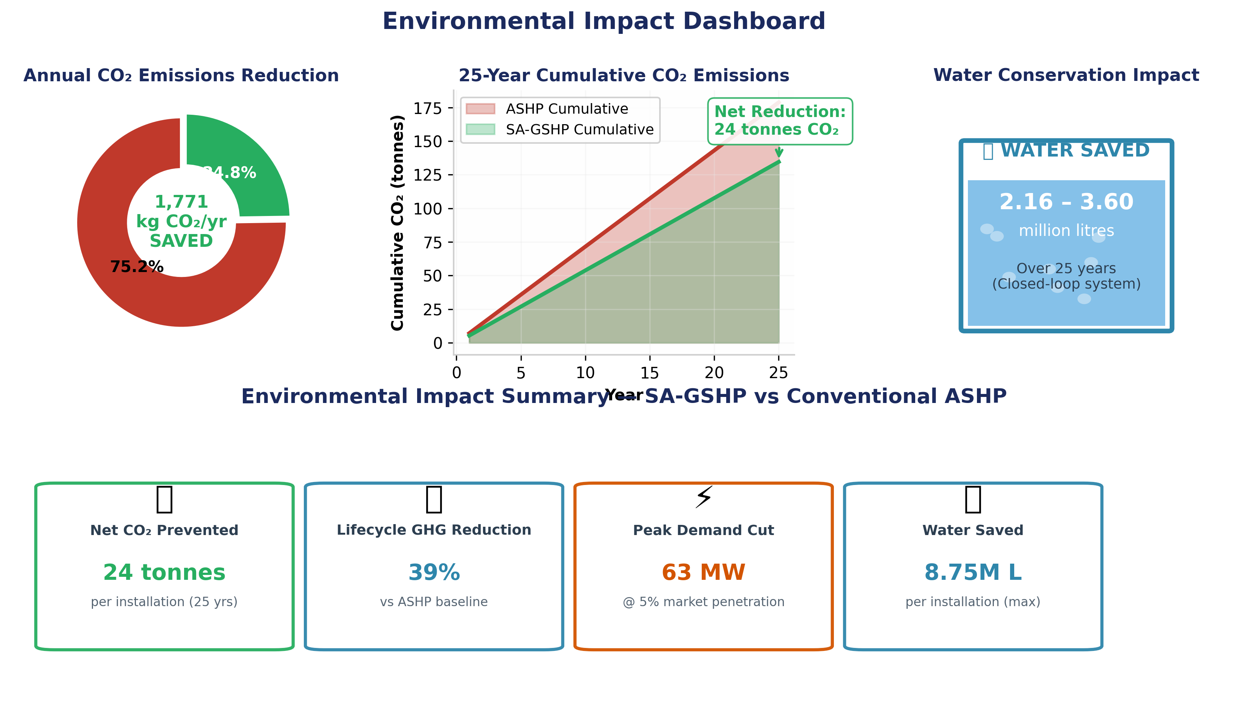
Environmental Impact Dashboard
CO₂ reduction, water savings, and sustainability metrics
26
Notes:
This environmental dashboard presents four key sustainability metrics. The donut chart shows annual CO2 emissions: ASHP at 7,152 kg versus SA-GSHP at 5,381 kg. The green segment represents 1,771 kg saved annually—24.8% reduction. This is lower than the 39% lifecycle reduction because annual emissions don't account for embodied manufacturing emissions. The cumulative emissions chart shows 25-year trajectory. ASHP cumulative emissions reach approximately 179 tonnes versus 134 tonnes for SA-GSHP. The gap widens over time as ASHP efficiency degrades faster. The water conservation visualization shows 2.16 to 3.60 million liters saved over 25 years. The tank graphic represents this volume visually. For context, this equals approximately 15-25% of a typical Bahraini household's total water consumption over 25 years. The metric cards at bottom summarize: 24 tonnes net CO2 prevented per installation, 39% lifecycle GHG reduction versus ASHP, 63 MW peak demand cut at 5% market penetration, and 8.75 million liters maximum water saved. The 63 MW national peak reduction assumes 10,000 installations at 6.3 kW average peak reduction each. This is equivalent to a small power plant, deferring substantial generation infrastructure investment. These environmental benefits align directly with Bahrain Vision 2030's sustainability objectives and the national net-zero commitment by 2060.

