Slide 1
ACM算法与程序设计
第四讲
简单计算题（三）

Slide 2
解最短路问题的基本方法--Floyd算法
二、求任意两顶点间的最短路问题
第一种算法：运用Dijkstra算法变换n次起始点，可求出任意两顶点间的最短路，但对于稠密图，计算量比较大。
Floyd算法(1962年以Floyd提出)，计算量较小，形式简单，易于编程。Floyd算法通常用矩阵实现，也称为矩阵求解法。
为了说明Floyd算法，下面定义几个符号：

Slide 3

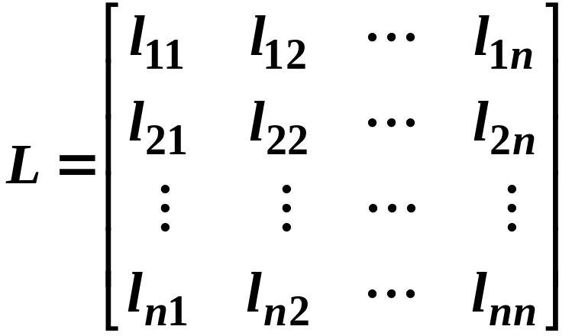
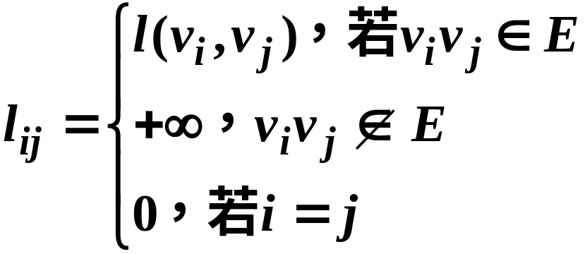
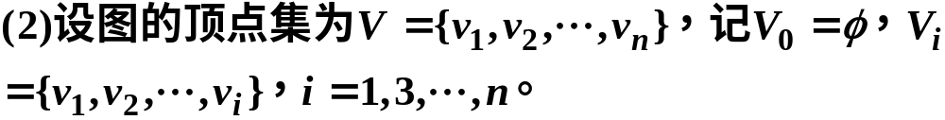
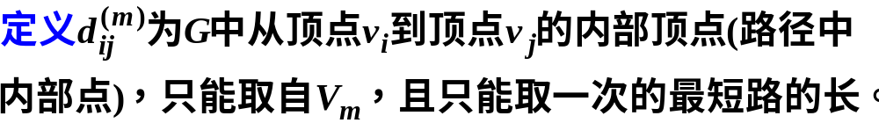
解最短路问题的基本方法--Floyd算法

Slide 4


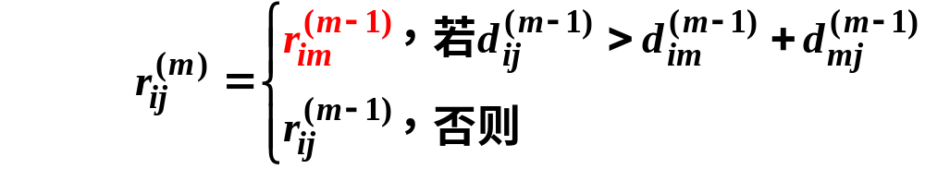

解最短路问题的基本方法--Floyd算法

Slide 5
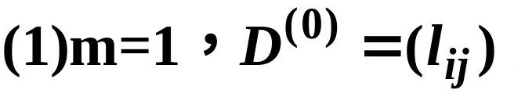

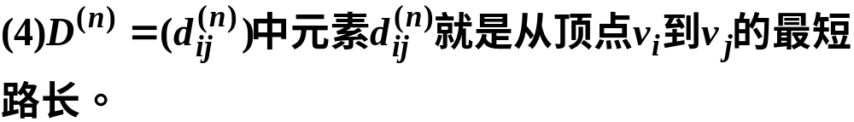
解最短路问题的基本方法--Floyd算法
矩阵算法：

Slide 6
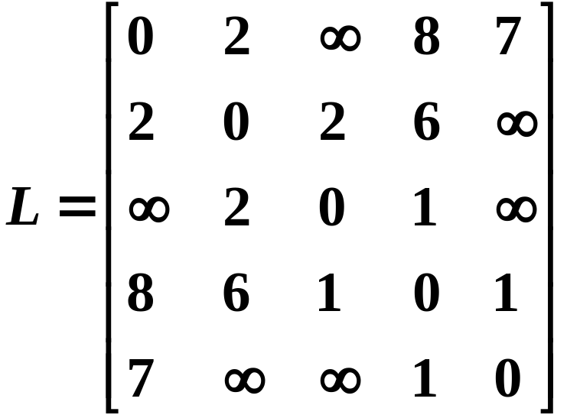
解最短路问题的基本方法--Floyd算法
例 求下图任意两顶点的最短路长。
v₃
2
1
6
v₂
v₄
2
8
1
7
v₁
v₅

Slide 7
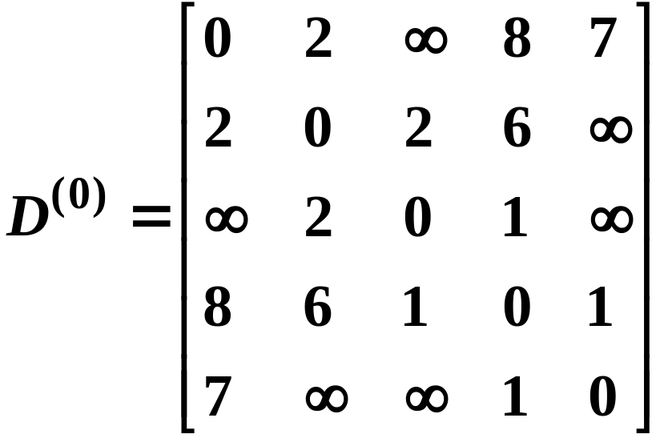
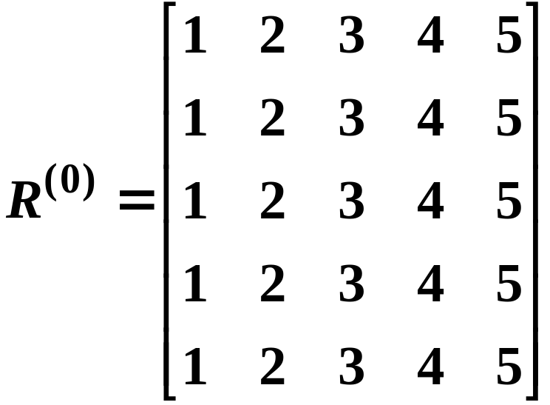
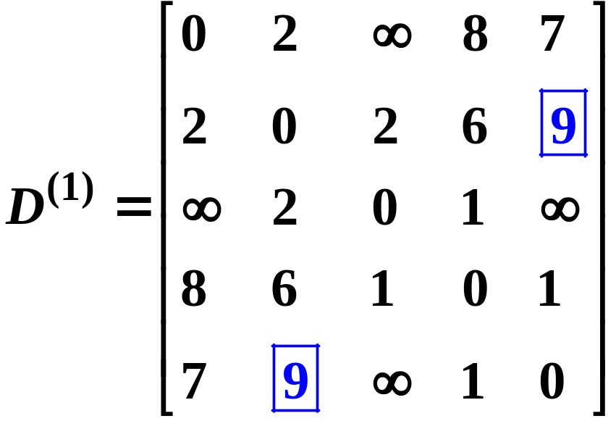
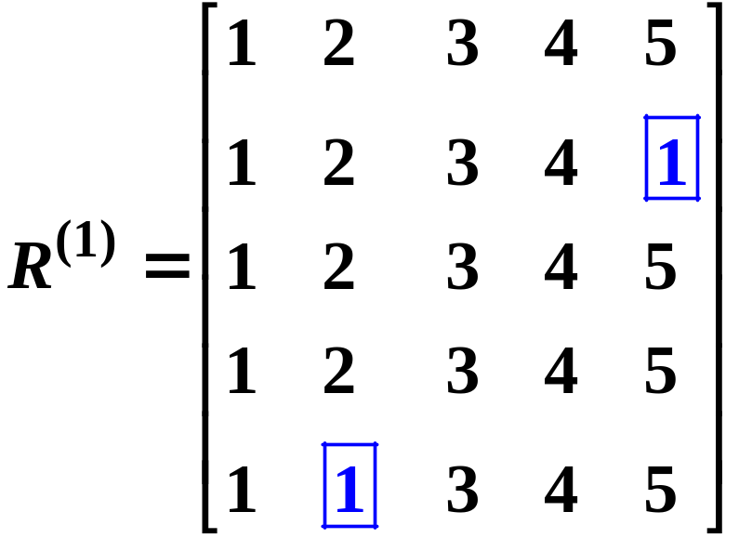
解最短路问题的基本方法--Floyd算法

Slide 8
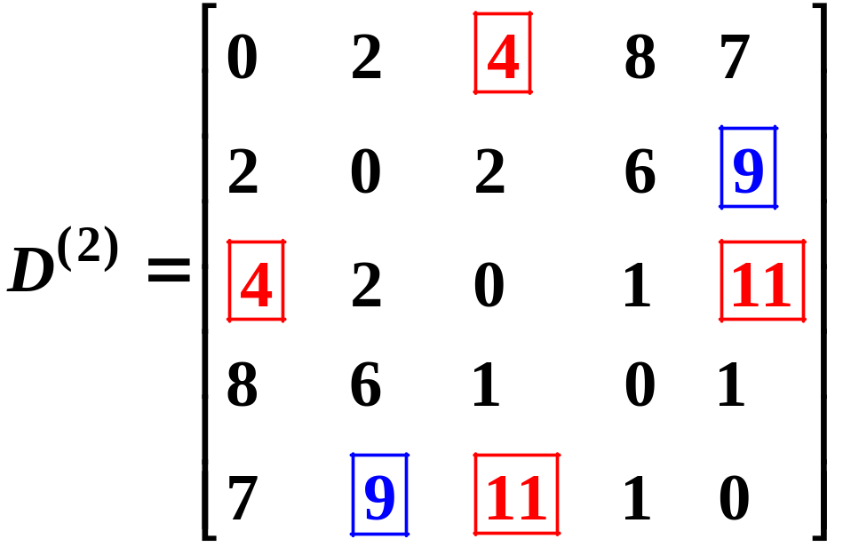
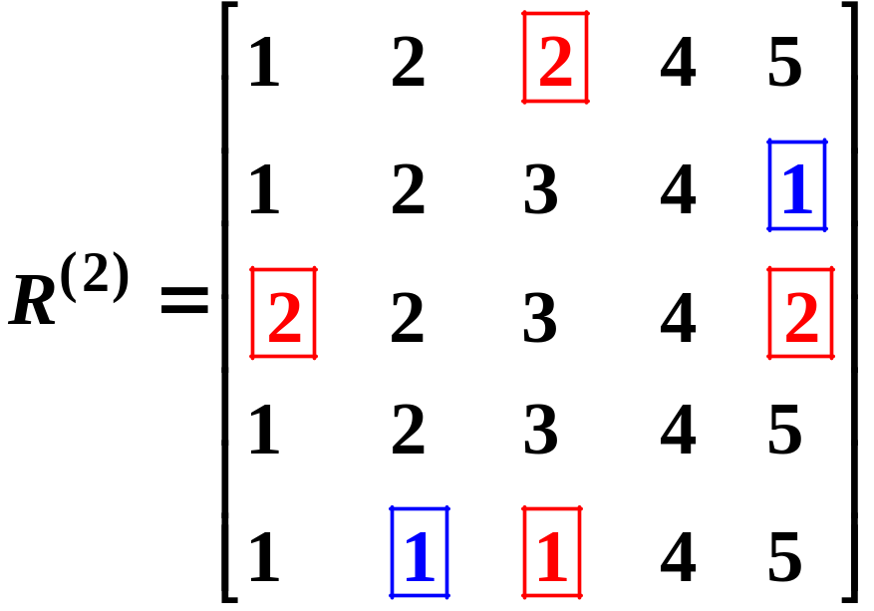
解最短路问题的基本方法--Floyd算法

Slide 9
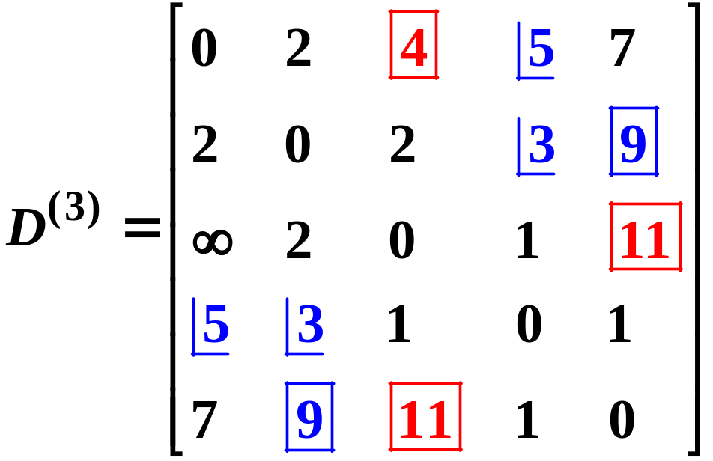
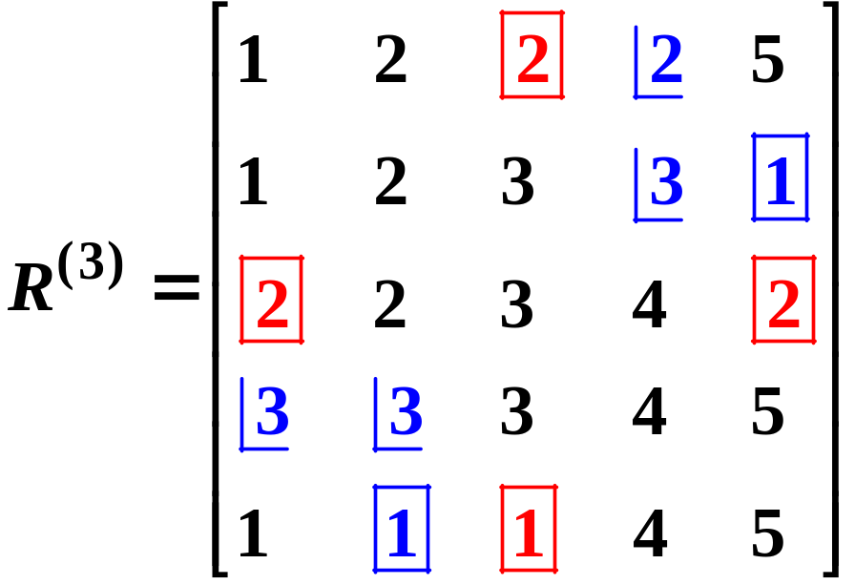

解最短路问题的基本方法--Floyd算法

Slide 10
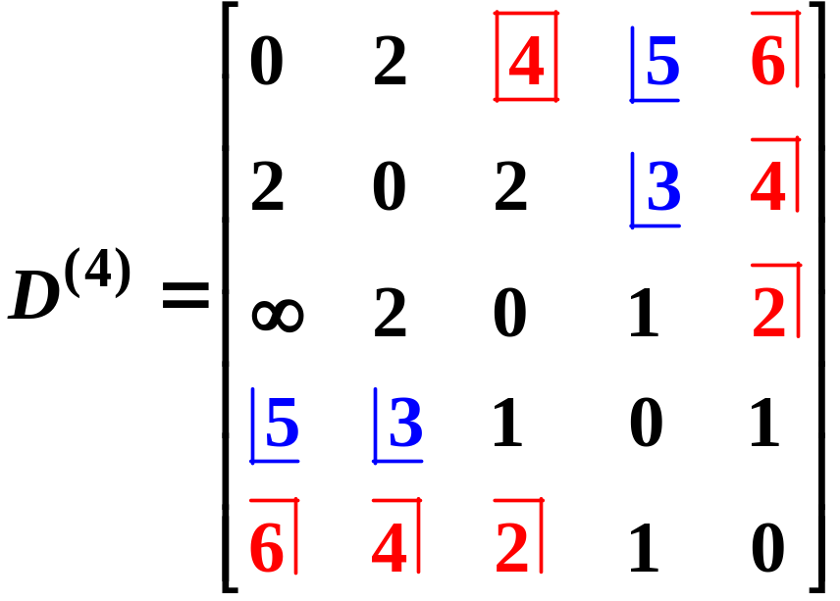
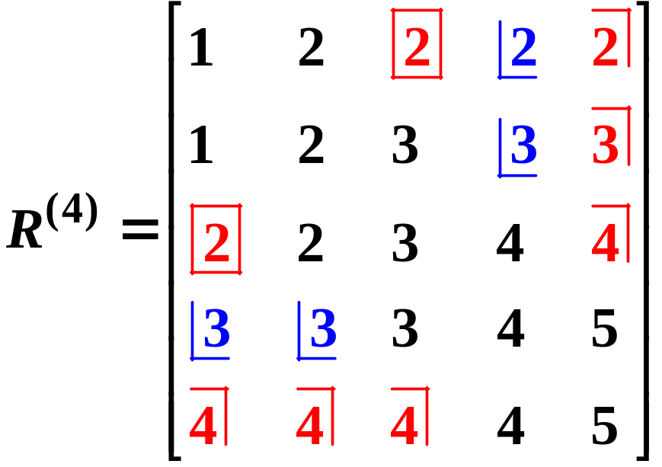
解最短路问题的基本方法--Floyd算法

Slide 11

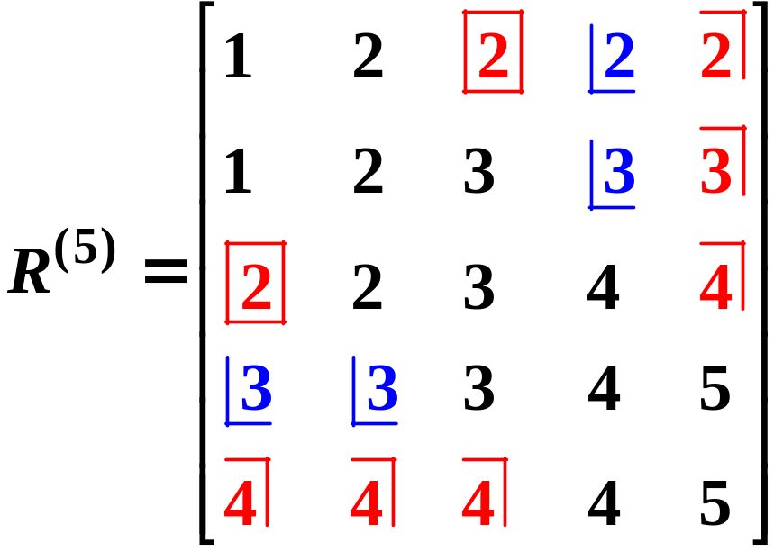
解最短路问题的基本方法--Floyd算法

Slide 12


解最短路问题的基本方法--Floyd算法
容易看到，v₅到v₁的最短距离为6，它们之间的路为：
v₂到v₅的最短距离为4，它们之间的路为：

Slide 13
部分参考代码
#define inf 10000000
class Matrix
{
public:
Matrix(int n);//构造函数
~Matrix();//析构函数
int row;//矩阵行数与列数
int** p;
};
Matrix::Matrix(int n)
{
row=n;
p=(int**)malloc(row*sizeof(int*));
for(int i=0;i<row;i++)
p[i]=(int*)malloc(row*sizeof(int));
for(int i=0;i<n;i++)
for(int j=0;j<n;j++)
p[i][j]=(i==j)?0:inf;
}
Matrix::~Matrix()
{
for(int i=0;i<row;i++)
free(p[i]);
free(p);
}

Slide 14
部分参考代码
void nodes2nodes(Matrix* dis,Matrix* d,Matrix* r)
{
Matrix t(dis->row);
int n=d->row,i,j,m,temp;
for(i=0;i<n;i++) {
for(j=0;j<n;j++) {
d->p[i][j]=dis->p[i][j];
r->p[i][j]=j+1;
}
}
for(m=0;m<n;m++)
{
for(i=0;i<n;i++)
for(j=0;j<n;j++)
t.p[i][j]=d->p[i][j];
for(i=0;i<n;i++)
for(j=0;j<n;j++)
if(i!=j) {
temp=t.p[i][m]+t.p[m][j];
if(temp<t.p[i][j]) {
d->p[i][j]=temp;
r->p[i][j]=r->p[i][m];
}
}
}
}

Slide 15
Battery Charging
Recently, qbwj bought a powerful cellphone which performs even better than most computers. He spent lots of time on it. However, this cellphone has a very strange feature which confused qbwj. There is a battery with infinite capacity in the cellphone. On each day, qbwj has three choices: use the cellphone, charge the battery or do nothing. He cannot do using and charging on the same day. Charging on the k^{th} day adds k units of power to the battery. If qbwj chooses to use the cellphone on the k^{th} day, it would consume k units of power. Note that qbwj can choose to use the cellphone if and only if there are enough units of power in the battery.
Despite of the strengths of the cellphone, qbwj couldn't suffer it any more. So he decides to sell it at the end of T^{th} day. Today is the S^{th} day and the battery is empty now. He wants to know how many days at maximum he can use the cellphone before selling it out.
Note that qbwj can still choose to use the cellphone on both the S^{th} day and T^{th} day.

Slide 16
Input
The first line of the input will be an integer N (N <= 10000) indicating the number of cases.
For each test case, two integers are given on a single line: S T. 1 <= S <= T <= 10⁸.
Output
Print "Case #k: d" in a single line for each test case, in which k represents the case number which starts from 1, and d is the answer.

Slide 17
Sample Input
3
3 6
3 9
1 100000
Sample Output
Case #1: 1
Case #2: 3
Case #3: 49994

Slide 18
1、以后用要花费更多的电量；
2、以后充电比现在充电要得到更多的电量。
简单贪心
第S天电池没电，充完电之后剩余S的电量
第S+1天因为电量不够还需要充电，充完电之后剩下2*S+1的电量
第S+2天使用电池，用完之后剩下S-1的电量，以后重复这样的步骤，也就是说充一天电，使用一天。每进行一次这样的步骤，剩余电量减1。所以S的电量可以进行S次这样的步骤，也就使用了S天。第3*S天，剩余电量为0 。然后第3*S+1天又是相同的问题。因为每次3倍的增长，可直接模拟。

Slide 19
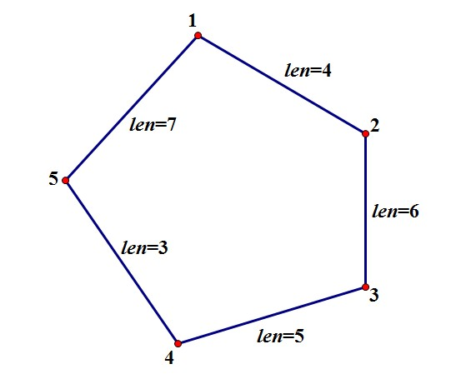
Journey
In Tomb-sweeping Festival, Yangsir and her friends planned to have a journey in a park. The park has N attractions which form a circle and only between adjacent attractions there is a road, so there are N roads in total. On the way to the park, Yangsir and her friends lost their way. After several twists and turns, they arrived at the park but they still didn't know which attraction they are on now.
Looking at the park's map, Yangsir wanted to know that: if they set attraction X as starting point, what is the minimum time they needed to pass all N attractions at least once? They don't need to go back to the starting attraction and the time spend on attractions are ignored.
We number the N attractions from 1 to N clockwise, and the i^{th} road is the road between i^{th} and (i+1)^{th} attraction, except that the N^{th} road is the road between N and 1. The N roads are all undirected.

Slide 20
Input
There are multiple test cases. The first line of the input will be an integer T (T <= 10) indicating the number of test cases. For each test case, the first line is only one integer N (3 <= N <= 1000), representing the number of attractions in the park. In the second line there are N positive integers separated by one space representing the time needed to pass through the i^{th} road. All the integers above are within 1,000,000.
Output
For each test case, print "Case #t: " first, in which t is the number of the test case starting from 1. Then output N integers separated by one space which are the minimum time needed if they start from 1st attraction, 2nd attraction,..., N^{th} attraction.

Slide 21
Sample Input
1
5
4 6 5 3 7
Sample Output
Case #1: 18 19 19 20 18

Slide 22
由于要把N个点都访问一遍，因而最优解必然要经过N-1条边
可以枚举哪条边不走，之后终点必然是这条边的两个端点之一。
假如起点到两个端点的距离分别是S1，S2，则这种方案的最优解是S1+S2+min(S1,S2).以这个 起点的 最优解是min{S1+S2+min(S1,S2)}。
总的复杂度为N^2。

Slide 23
Ants Run!
Description
Professor Yang likes to play with ants when he is free. What? Are you asking why he plays with ants instead of others? Ah, because ant is the only non-plant living thing which can be found in Qingshuihe Campus of UESTC apart from human beings.
This time, Professor Yang caught several ants after finishing his lecture for freshmen. At the beginning of the game, he puts N ants around a plate and numbers them in clockwise order. The ants are so obedient that they run clockwise under the guide of Professor Yang on the boundary of the plate which is a circle. When one ant catches up with its previous ant, the game is over. Knowing the speed of ants, Professor Yang wants you to help him to adjust the distance between adjacent ants to make the game last longer.

Slide 24
Input
The first line of the input is T (no more than 10000), which stands for the number of test cases you need to solve.
Each test case begins with “N R”(without quotes) representing the number of ants participating the game is N and the radius of the circle is R cm. The next line lists N integers and the i-th number is the speed (cm/s) of the i-th ant in clockwise direction. All numbers are positive integer not larger than 20.
Output
If the game can last forever, print “Inf” in a single line, otherwise please output the longest time in seconds each game can last, which should be printed accurately rounded to three decimals.

Slide 25
Sample Input
2
3 1
1 1 1
3 1
3 2 1
Sample Output
Inf
3.142

Slide 26
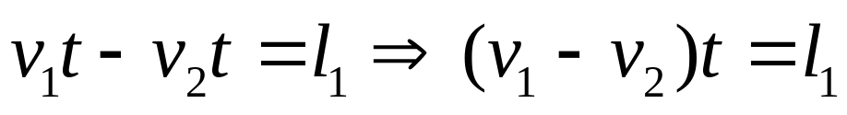
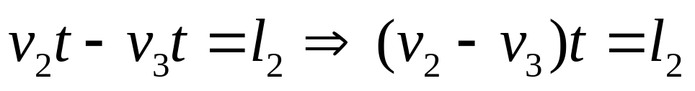
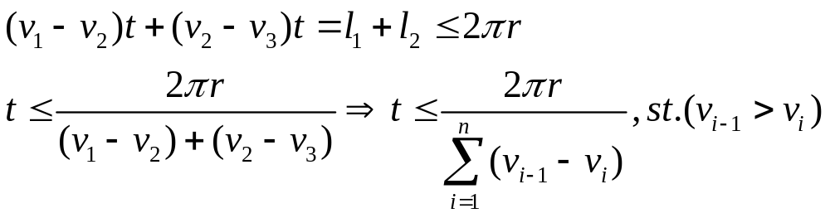
在样例中，3只蚂蚁连环追
第一只追第二只
第二只追第三只
第三只追不上第一只
所有蚂蚁都是相同速度则inf
最最关键的是Pi，如何计算（造成Wrong Answer的主要原因）
acos(-1.0)

Slide 27
#include<stdio.h>
#include<math.h>
double pi=acos(-1.0);
int v[30];
int main()
{
int t,p,n,i;
double r;
scanf("%d",&t);
for (p=1;p<=t;p++)
{
scanf("%d",&n);
scanf("%lf",&r);
for (i=1;i<=n;i++)
scanf("%d",&v[i]);
v[0]=v[n];
int s=0;
for (i=1;i<=n;i++)
if (v[i-1]>v[i]) s=s+v[i-1]-v[i];
if (s==0) printf("Inf\n");
else printf("%.3lf\n",2*pi*r/s);
}
return 0; }

Slide 28
Flagstone Walk
Description
There is a long flagstone walk on the way from the dormitory to the main hall. This flagstone walk has N lines and four flagstones arranged in each line. Hongshu always start from rightmost flagstone of the first line. In order to make this walk funny, he would always step onto the left or right flagstone in the next line if there is. For example, if Hongshu stands at the second rightmost flagstone of the third line, he would choose to step to the first or third rightmost one of the forth line. Note that Hongshu has only one choice when he is at the corner of one line.

Slide 29
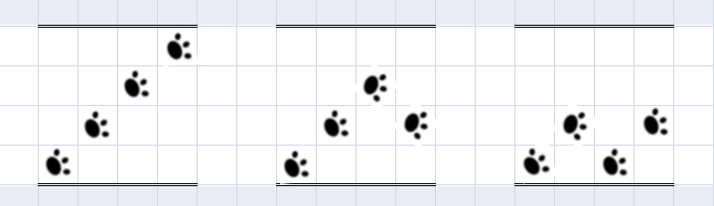
Because Hongshu has to go to the main hall every day, he wants to know how many different ways to step across the flagstone walk. Can you help him?

Slide 30
Input
The first line of the input is an integer T (T <= 20), which stands for the number of test cases you need to solve.
Each case consists of an integer N (1 <= N <= 20) on a single line, which stands for the length of the walk.
Output
For each case, print the number of ways on a single line.

Slide 31
Sample Input
3
2
3
4
Sample Output
1
2
3

Slide 32
1
1
1
2
1
1
1
DP[1][1]=1
DP[2][2]=DP[3][1]+DP[1][1]= 1
DP[3][3]=DP[4][2]+DP[2][2]=1
DP[1][3]=DP[2][2]=1
DP[4][4]=DP[3][3]=1
DP[2][4]=DP[3][3]+DP[1][3]=2
DP[1][1]=1
DP[ 1 ][ i ] = DP[ 2 ] [ i – 1 ]
DP[ 2 ][ i ] = DP[ 1 ] [ i – 1 ] + DP[ 3 ] [ i – 1 ]
DP[ 3 ][ i ] = DP[ 2 ] [ i – 1 ] + DP[ 4 ] [ i – 1 ]
DP[ 4 ][ i ] = DP[ 3 ] [ i – 1 ]

Slide 33
#include<stdio.h>
int main(){
int i,j,k,n,m,tot,a[21][21];
scanf("%d",&n);
for (i=1;i<=n;i++){
scanf("%d",&m);
memset(a,0,sizeof(a));
a[1][1]=1;tot=0;
for (j=2;j<=m-1;j++)
for (k=1;k<=4;k++){
if (k>1) a[j][k]=a[j-1][k-1];
if (k<m) a[j][k]+=a[j-1][k+1];
}
for (k=1;k<=4;k++){
if (k>1) a[m][k]=a[m-1][k-1];
if (k<m) a[m][k]+=a[m-1][k+1];
tot+=a[m][k];
}
printf("%d\n",tot); }
}
思考：此题的输出结果有没有什么规律

Slide 34
Fly Through
Description
The home of flower fairies is being devastated by a monster called Littlefatcat. They have to leave the place where their generations lived with no other choices. CC, the greatest investigator of flower fairies, found a paradise in the west and will lead all the flower fairies there. This paradise is full of flowers and safe from attack of Littlefatcat. However, there are lots of huge rocks on the way to the paradise.

Slide 35

Flower fairies are of different levels which are determined by their power. Fairies of higher level will fly higher. A fairy will persist in flying at the height corresponding to his or her level for honor and self-respect. Also, rocks on the way have specific height. When the route of a fairy hit a rock, the fairy will have to use magic to fly through the rock.
Being aware of the height of all rocks and the specific height each fairy can fly at, CC want to know how many rocks each fairy will fly through.
fly through

Slide 36
Input
The first line will be “N M”(without quotes), representing for the numbers of rocks and fairies.
The following line will give N numbers, giving the height of the rocks from the east to west.
Then M lines followed. On the i-th line, a number representing the specific height of fairy numbered i can fly at will be given.
All numbers are positive and not bigger than 100000.
Output
Please output the number of rocks each fairy has to fly through in order to get to the paradise in a single line.

Slide 37
Sample Input
5 3
1 2 3 4 5
2
4
6
Sample Output
4
2
0

Slide 38
这个问题相当于问在一组数中有多少个是大于等于i的。
All numbers are positive and not bigger than 100000.
Time Limit:1000ms.
普通的方法可能会导致Time Limit Exceed，时间复杂度应该控制在O(nlogn)。
方法：先排序，再二分法找插入位置
STL。。。
看看专业队员的编程

Slide 39
#include <iostream>
#include <sstream>
#include <iomanip>
#include <vector>
#include <deque>
#include <list>
#include <set>
#include <map>
#include <stack>
#include <queue>
#include <bitset>
#include <string>
#include <numeric>
#include <algorithm>
#include <functional>
#include <iterator>
#include <cstdio>
#include <cstring>
#include <cmath>
#include <cstdlib>
#include <cctype>
#include <complex>
#include <ctime>
这就是专业级别的事先准备工作

Slide 40
using namespace std;
int data[100005];
int main() //全程STL
{
int n, m;
while (scanf("%d%d", &n, &m) == 2)
{
for (int i = 0; i < n; ++i) scanf("%d", data+i);
sort(data, data+n); //STL 快排
while (m--)
{
int v;scanf("%d", &v);
int where = lower_bound(data, data+n, v) - data;
printf(“%d\n”, n - where); //
}
}
return 0; }
The lower_bound() algorithm compares a supplied value to elements in a sorted sequence and returns the first position in the container at which value can be inserted without violating the container's ordering.

Slide 41
再来看看哈希的实现
#include<stdio.h>
#include <string.h>
int a[100001],b[100001];
int main(){
int n,m,i,j;
memset(b,0,10001*sizeof(int));
scanf("%d%d",&n,&m);
for (i=1;i<=n;i++){
scanf("%d",&a[i]);
b[a[i]]++; //把数作为下标，然后进行计数
}
for (i=99999;i>=1;i--)
b[i]+=b[i+1]; //找出大于等于b[i]的个数
for (i=1;i<=m;i++){
scanf("%d",&j);
printf("%d\n",b[j]); }
}

Slide 42
人见人爱A^B
求A^B的最后三位数表示的整数（1<=A,B<=10000）
2 3
12 6
8
984

Slide 43
快速求幂
3 ^ 999 = 3 * 3 * 3 * … * 3
3 ^ 2 = 3 * 3
3 ^ 4 = (3 ^ 2) * (3 ^ 2)
3 ^ 8 = (3 ^ 4) * (3 ^ 4)
3 ^ 16 = (3 ^ 8) * (3 ^ 8)
3 ^ 32 = (3 ^ 16) * (3 ^ 16)
3 ^ 64 = (3 ^ 32) * (3 ^ 32)
3 ^ 128 = (3 ^ 64) * (3 ^ 64)
3 ^ 256 = (3 ^ 128) * (3 ^ 128)
3 ^ 512 = (3 ^ 256) * (3 ^ 256)

Slide 44
3 ^ 999
= 3 ^ (512 + 256 + 128 + 64 + 32 + 4 + 2 + 1)
= (3 ^ 512) * (3 ^ 256) * (3 ^ 128) * (3 ^ 64) * (3 ^ 32) * (3 ^ 4) * (3 ^ 2) * 3
惊人的发现：999对应的2进制数：1111100111

Slide 45
http://acm.uestc.edu.cn/#/problem/show/167
参考程序：
int modexp(int a, int b, int n)
{
int t=1;
while(b!=0)
{
if(b%2==1) //if(b&1)
t=(t*a);
a=(a*a);
b/=2; //b>>=1;
}
return t;
}
http://acm.pku.edu.cn/JudgeOnline/problem?id=3134

Slide 46
求a^b mod n的值
1、问题描述
求a^b mod n，即a^b求的余数。
2、输入数据
第一行是一个正整数N，表示测试数据的组数，下面依次是n行测试数据，每行由3个数a、b、n组成，之间用一个空格隔开。
3、输出数据
对应每行输入，输出一行a^b mod n的值。

Slide 47
求a^b mod n的值
4、输入样例
1
23 25 7
5、输出样例
2

Slide 48

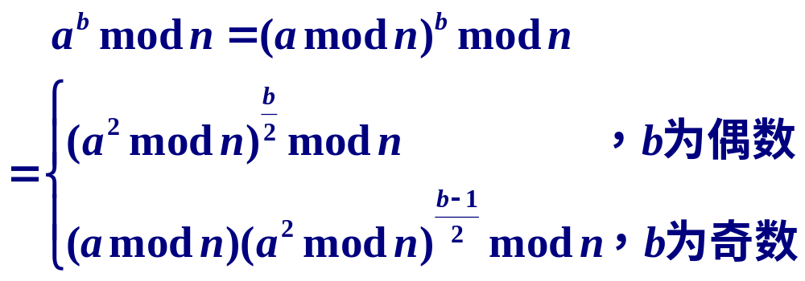
分析

Slide 49

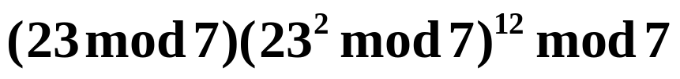

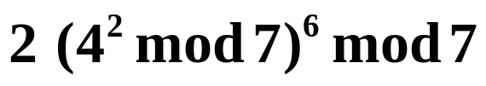

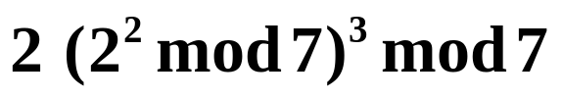

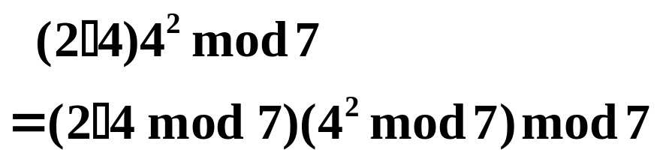

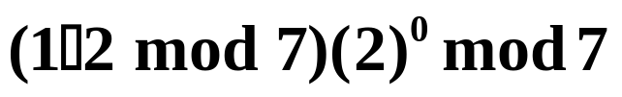
比如，求
表达式
结果
2

Slide 50
部分参考程序
参考程序：
int modexp(int a, int b, int n)
{
int t=1;
while(b!=0)
{
if(b%2==1) //if(b&1)
t=(t*a)%n;
a=(a*a)%n;
b/=2; //b>>=1;
}
return t;
}

Slide 51
H1N1's Problem http://cs.scu.edu.cn/soj/contest/problem.action?cid=215&alias=I
Description
H1N1 like to solve acm problems.But they are very busy, one day they meet a problem. Given three intergers a,b,c, the task is to compute a^(b^c))%317000011. 1412, ziyuan and qu317058542 don't have time to solve it, so the turn to you for help.

Slide 52
Input
The first line contains an integer T which stands for the number of test cases. Each case consists of three integer a, b, c seperated by a space in a single line. 1 <= a,b,c <= 100000
Output
For each case, print a^(b^c)%317000011 in a single line.

Slide 53
Sample Input
2 1 1 1 2 2 2
Sample Output
1 16
费马小定理 a^(p-1) mod p=1

Slide 54
解最短路问题的基本方法
从v_{i}到v_{j}的最短路是指： v_{i}到v_{j}间权和最小的路。
最短路问题有以下几种类型：
两个指定顶点间的最短路
图中各对顶点间的最短路
两个指定顶点间通过某些指定顶点的最短路
第二、第三、…、第k条最短路

Slide 55
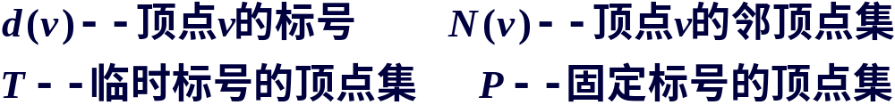
解最短路问题的基本方法
一、从一个始点v₁到一个终点v_{n}的最短路问题
解决该问题一个比较好的算法是由Dijkstra于1959年提出的。该算法不仅能求出v₁到v_{n}的最短路，也能求出v₁到其他顶点的最短路。
Dijkstra算法是一种标号算法。赋权图上每个顶点给出一个标号---临时标号(T标号)或固定标号(P标号)，P标号表示始点到该顶点的最短距离，T标号存储到始点的路长数据(中间结果，不一定是最短距离)，便于计算，减少运算量。

Slide 56
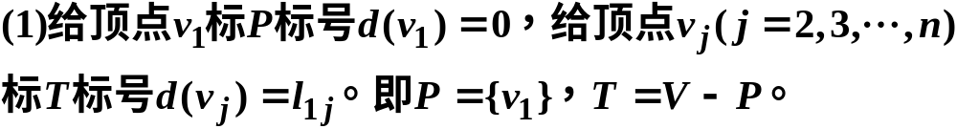
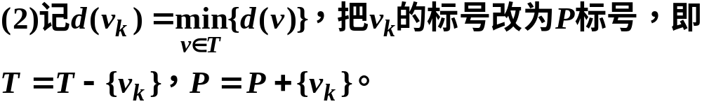

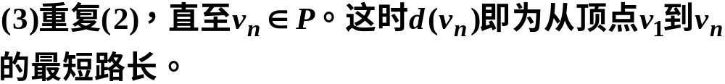
解最短路问题的基本方法--Dijkstra算法
Dijkstra算法步骤：

Slide 57
5.1 解最短路问题的基本方法--Dijkstra算法
v₂
1
v₅
2
v₈
2
5
9
9
6
3
7
v₁
8
1
6
2
v₃
v₆
v₉
v₁₁
2
3
1
7
4
1
4
v₄
9
v₇
1
v₁₀
3₂
---固定编号，下标表示前趋顶点
8₁
---临时编号，下标表示前趋顶点

Slide 58
v₂
1
∞
v₅
2
∞
v₈
2₁
2
5
9
7
9
6
3
8₁
1
∞
6
∞
∞
v₁
8
2
0
v₃
v₆
v₉
v₁₁
2
3
1
7
4
1
4
1₁
v₄
9
v₇
1
v₁₀
∞
∞
v₂
1
∞
v₅
2
∞
v₈
2₁
2
5
9
7
9
6
3
8₁
1
∞
6
∞
∞
v₁
8
2
0
v₃
v₆
v₉
v₁₁
2
3
1
7
4
1
4
1₁
v₄
9
v₇
1
v₁₀
10₄
∞

Slide 59
v₂
1
3₂
v₅
2
∞
v₈
2₁
2
5
9
7
9
6
3
8₁
1
∞
6
∞
∞
v₁
8
2
0
v₃
v₆
v₉
v₁₁
2
3
1
7
4
1
4
1₁
v₄
9
v₇
1
v₁₀
10₄
∞
v₂
v₅
5₅
v₈
2₁
1
3₂
2
2
5
9
7
9
6
3
8₁
1
6₅
6
12₅
∞
v₁
8
2
0
v₃
v₆
v₉
v₁₁
2
3
1
7
4
1
4
1₁
v₄
9
v₇
1
v₁₀
10₄
∞

Slide 60
v₂
v₅
5₅
v₈
2₁
1
3₂
2
2
5
9
7
9
6
3
8₁
1
6₅
6
12₅
14₈
v₁
8
2
0
v₃
v₆
v₉
v₁₁
2
3
1
7
4
1
4
1₁
v₄
9
v₇
1
v₁₀
10₄
∞
v₂
v₅
5₅
v₈
2₁
1
3₂
2
2
5
9
7
9
6
3
7₆
1
6₅
6
12₅
14₈
v₁
8
2
0
v₃
v₆
v₉
v₁₁
2
3
1
7
4
1
4
1₁
v₄
9
v₇
1
v₁₀
10₄
∞

Slide 61
v₂
v₅
5₅
v₈
2₁
1
3₂
2
2
5
9
7
9
6
3
7₆
1
6₅
6
12₅
14₈
v₁
8
2
0
v₃
v₆
v₉
v₁₁
2
3
1
7
4
1
4
1₁
v₄
9
v₇
1
v₁₀
9₃
∞
v₂
v₅
5₅
v₈
2₁
1
3₂
2
2
5
9
7
9
6
3
7₆
1
6₅
6
12₅
14₈
v₁
8
2
0
v₃
v₆
v₉
v₁₁
2
3
1
7
4
1
4
1₁
v₄
9
v₇
1
v₁₀
9₃
10₇

Slide 62
v₂
v₅
5₅
v₈
2₁
1
3₂
2
2
5
9
7
9
6
3
7₆
1
6₅
6
11₁₀
14₈
v₁
8
2
0
v₃
v₆
v₉
v₁₁
2
3
1
7
4
1
4
1₁
v₄
9
v₇
1
v₁₀
9₃
10₇
v₂
v₅
5₅
v₈
2₁
1
3₂
2
2
5
9
7
9
6
3
7₆
1
6₅
6
11₁₀
13₉
v₁
8
2
0
v₃
v₆
v₉
v₁₁
2
3
1
7
4
1
4
1₁
v₄
9
v₇
1
v₁₀
9₃
10₇

Slide 63
v₂
v₅
5₅
v₈
2₁
1
3₂
2
2
5
9
7
9
6
3
7₆
1
6₅
6
11₁₀
13₉
v₁
8
2
0
v₃
v₆
v₉
v₁₁
2
3
1
7
4
1
4
1₁
v₄
9
v₇
1
v₁₀
9₃
10₇
v₂
v₅
5₅
v₈
2₁
1
3₂
2
2
5
9
7
9
6
3
7₆
1
6₅
6
11₁₀
13₉
v₁
8
2
0
v₃
v₆
v₉
v₁₁
2
3
1
7
4
1
4
1₁
v₄
9
v₇
1
v₁₀
9₃
10₇

Slide 64
解最短路问题的基本方法--Dijkstra算法
把以顶点及其前趋顶点作为端点的边作为一个集合，该边集导出的子图是一个生成树。
v₂
v₅
5₅
v₈
2₁
1
3₂
2
2
3
7₆
1
6₅
11₁₀
13₉
v₁
2
0
v₃
v₆
v₉
v₁₁
2
1
1
1₁
v₄
v₇
1
v₁₀
9₃
10₇
该生成树是否是最小生成树？

