Slide 1
Electrical Load Forecasting Case study: Energyville
Pieter-Jan Inghelbrecht
Master of Artificial Intelligence
Daily supervisor: Mahtab Kaffash
Promotor: Prof. Geert Deconinck
Notes:
Good morning everybody and welcome! My name is Pieter-Jan and I study the Master of Artificial Intelligence. Previously I studied statistics and economics at Ghent University. So, I am going to speak a little bit about the progress of my thesis which is about load forecasting. It a in cooperation with Emeryville, which is a company that performs research to sustainable energy and intelligent systems.

Slide 2
Table of contents
Problem and motivation
Aim of the thesis
Literature Review
Progress
Data cleaning
Exploratory Data Analysis
Point Forecasting
To do
Notes:
So what’s on the menu for today, first I am going to introduce the problem and motivate the thesis and also describe the aims of the thesis. Then I will focus on what’s been done in the literature.
Next, I will go to the actual data analysis part and finally I will end with discussing planning for the upcoming weeks/months

Slide 3
Problem and motivation
Load forecasting has been a fundamental issue in the planning and operation of power systems.
The energy industry has been going through a significant modernization process over the last decade ➔ infrastructure is being upgraded rapidly
In this competitive and dynamic environment decision-making processes rely on probabilistic forecasts to quantify the uncertain future
Past research was heavily focused on point load forecasting
Research interest in probabilistic energy forecasting research has taken off rapidly in recent years
Notes:
So What is the motivation?
Load forecasting has been a fundamental issue in the planning and operation of power systems. Having accurate point forecast places a company at competitive advantage. Though, in this competitive environment, point forecast are not enough anymore. Often in many operational and planning tasks, probabilistic forecasts are needed. This is also reflected in the literature, focus in the past has mainly been on point forecasting, but in recent years research on probabilistic forecasting has taken off rapidly.

Slide 4
Aims of The Thesis
Data cleaning
Analyze the data in terms of quality and quantity
Exploratory data analysis
Forecasting:
Develop a point forecasting model
Develop a probabilistic forecasting model
Identity important predictors
Notes:
The goal of the thesis is in a first stage to analyze the data in terms of quality and quantity. Secondly, perform some data exploration and try to visualize interesting behavior. Finally, prediction: first try to develop a point forecasting models and then also a model that generates probabilistic forecasts.

Slide 5
Literature Review
Global Energy Forecasting Competitions (GEFComp)
2012: Point forecasting
2014: Probabilistic forecasting
Methods of the top 3 performance teams are discussed
Important features
Point forecasting techniques
Probabilistic forecasting techniques
Summary tables
Notes:
For the literature review I focused largely on the global energy forecasting. There have been 3 of them: on 2012, 2014 and 2017. One of the goals of these competitions was to gap the bridge between academic research and industry practices. Participants were asked to document their methodology in a small report. An the reports of the best performing are published. I focused on the first two competitions, 2012 was on point forecasting and 2014 was on probabilistic forecasting. I have summarized for each of these competitions the techniques used by the top 3 performing teams in three different tables: One tables focuses on feature engineering and important features, the second focuses on point forecasting and the last one focuses on probabilistic forecasting.
I found these competitions a fun way to explore the field of load forecasting

Slide 6
Important features
Time specific features
e.g. hour, day, holidays, season …
Lagged consumption
Rolling summary statistics such as mean, min, max, std.
Temperature data
Not used during this thesis
Raw input
Feature engineering
Feature selection
Input features

Slide 7
Data cleaning
Data from Fifthplay and Fluvius
Fluvius data used as a kind of “control set”
Fifthplay:
PV generation
Injection: transformer 1 and transformer 2
Consumption: transformer 1 and transformer 2
Fluvius:
PV generation
Injection
Consumption
Notes:
So let’s now move on to the more fun part.
I obtained data from Fifthplay and Fluvius . The Fifthplay dataset are the data measured by Energyville themself. The dataset from Fluvius is used as sort of control set to validate the data of Fifthplay. For both datasets I obtained data for PV generation, injection and consumption

Slide 8
Data cleaning
Total consumption building (t) = PV generation (t) – injection (t) + consumption grid (t)
Fifthplay:
Injection = Injection Transformer 1 + Injection Transformer 2
Consumption = Consumption Transformer 1 + Consumption Transformer 2
Resolution: 15 minute periods: 1 day = 96 observations
Period: from 2017-05-31 till 2020-02-05
Notes:
The total consumption of the building was then calculated as follow: PV generation minus injection + consumption. The resolution of the data was 15 minutes, so 96 observations equals one day. The data started as early as end of may 2017 till the beginning of 2020.

Slide 9
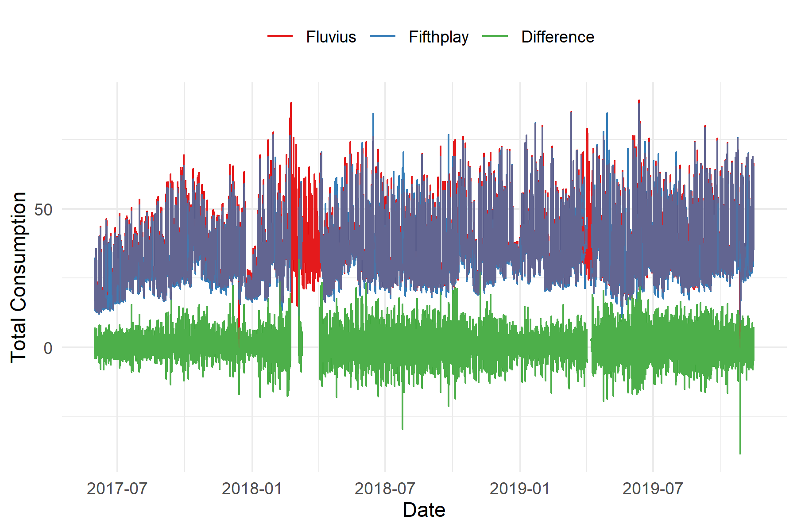
Data Cleaning
Some minor problems:
E.g. 2018-03-09 13:15:00 is followed by 2018-04-03 09:15:00
Almost 1 month between next data point
Imputation using data from Fluvius
Final dataset:
2017-05-31 13:00:00 -- 2019-11-15 00:00:00
Notes:
In general the data was pretty clean, there were some minor problems such as a gap of almost one month in the beginning of 2018. Then I used the data from Fluvius to impute. The figure here shows the consumption of Fluvius and Fithplay and the difference between the two. The difference is not exactly zero and this is expected because the measurement systems of fluvius and fifthplay are not on the same place.

Slide 10
Exploratory Data Analysis
First split data into train, validation, test data set (60%, 20%, 20%)
Chronological splits to preserve temporal behavior
Exploratory Data Analysis (EDA) performed on the training data
Create time and lag covariates
Notes:
The first thing I did was splitting data in a training, validation and test set (60 %, 20%, 20%). The splits were done chronologically to preserve the temporal structure in the data. The EDA was performed on the training data.

Slide 11
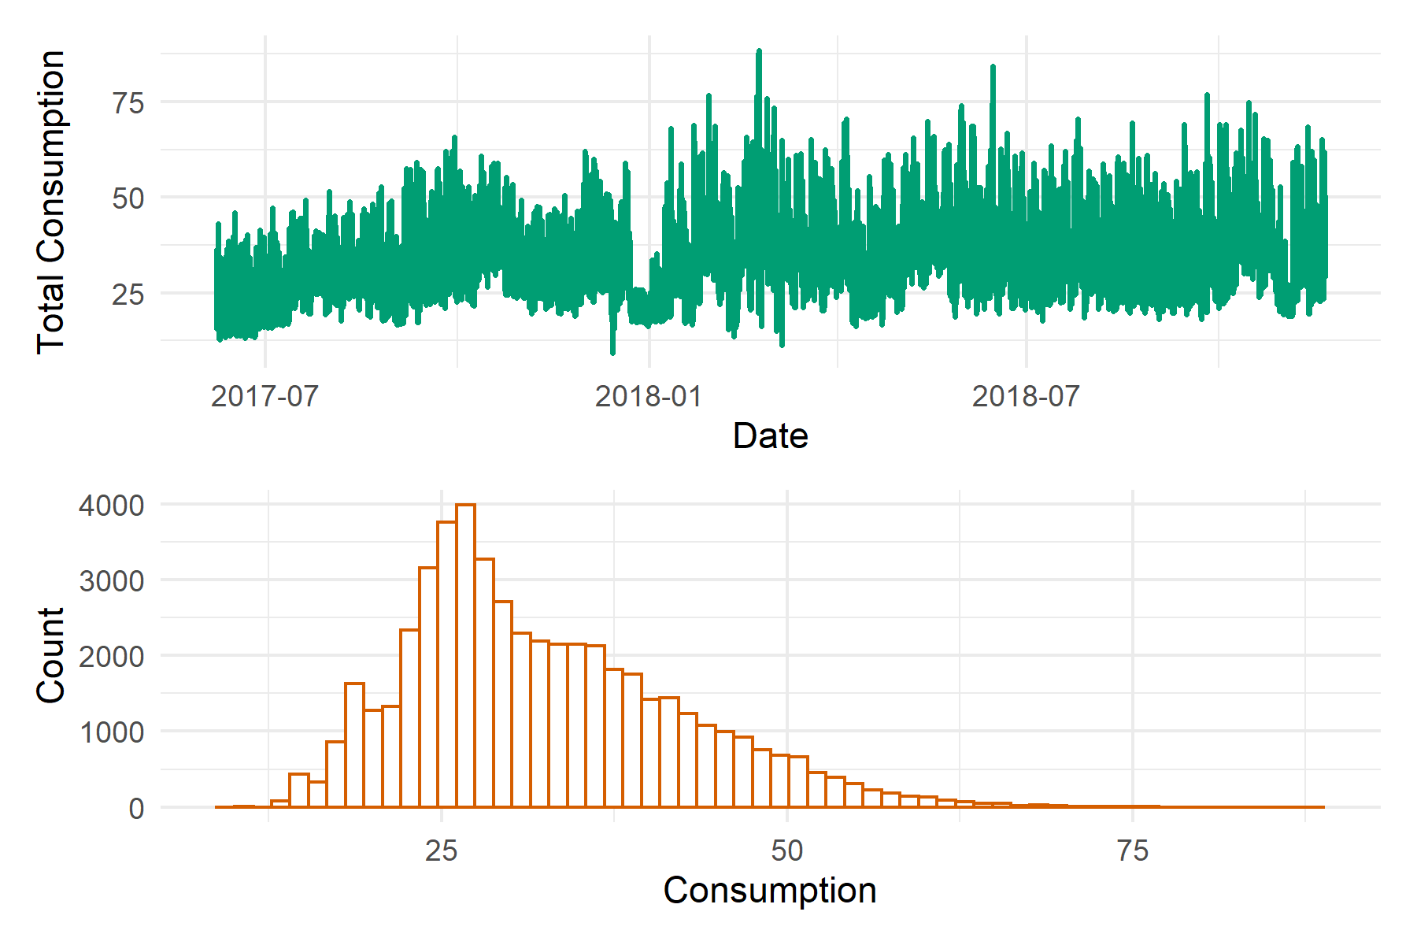
Exploratory Data Analysis
Total consumption over time
Trend?
Right skewed
Multiple distributions?
Notes:
The top figure show the consumption over time and the figure below shows the distribution of the consumption. You might see a small increasing trend, certainly in the beginning, but then it stabilizes. Also the distribution is positively skewed, but that’s mainly because the behavior of the consumption between day and night and week and weekend is different

Slide 12
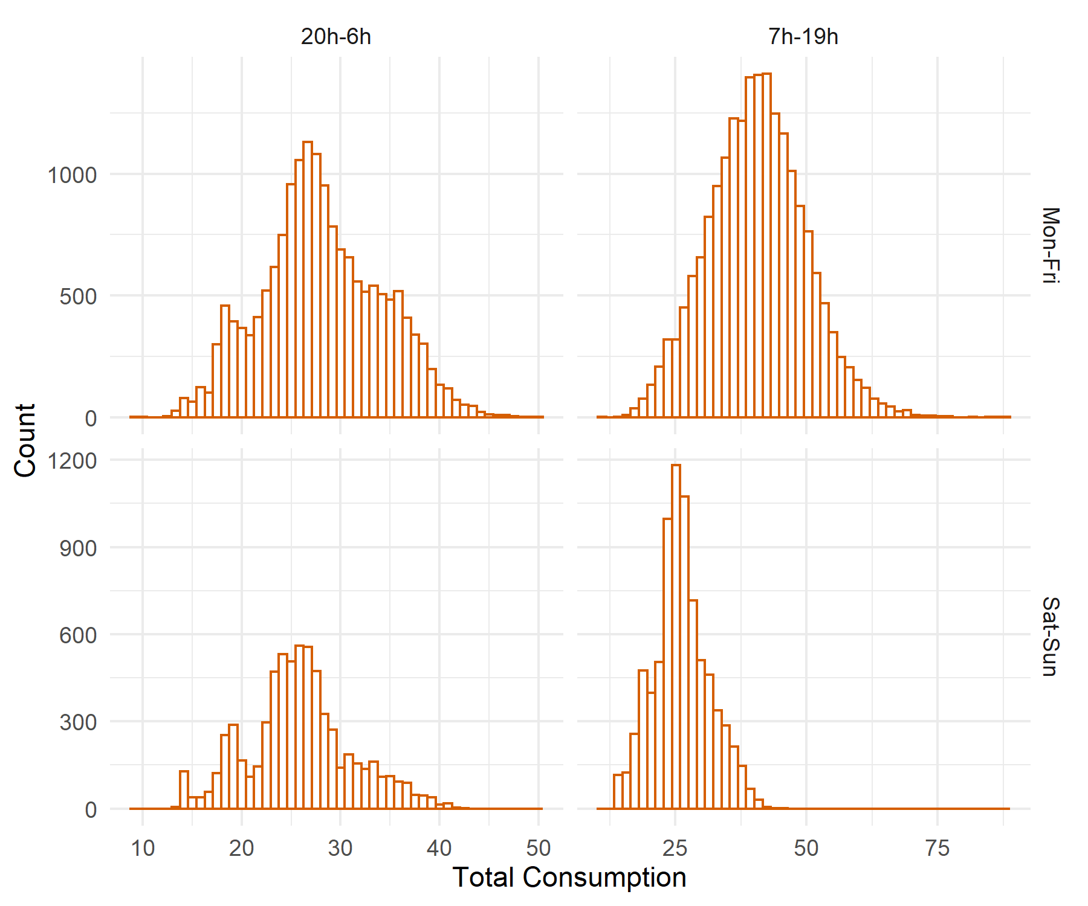
Exploratory Data Analysis
Condition on day and hour

Slide 13
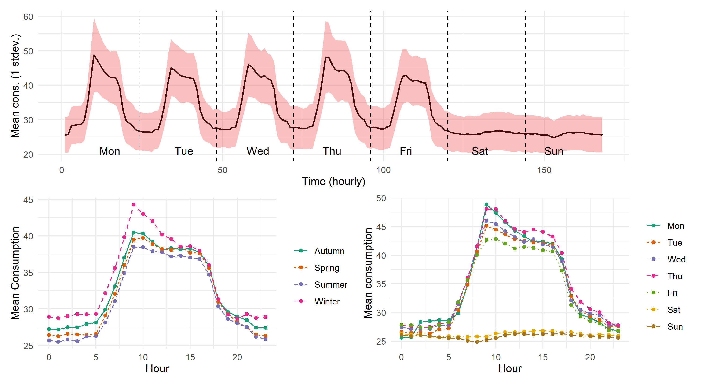
Exploratory Data Analysis
Notes:
Then I looked at some profile plots. So the figure on top shows the mean consumption where the red shaded area is the 1 standard deviation. The figure in the upper lower corner shows the mean consumption throughout different seasons. So the highest consumption is during Winter and the lowest consumption is during Summer which seems reasonable. Then the plot on right is zoomed in version of the plot on top.

Slide 14
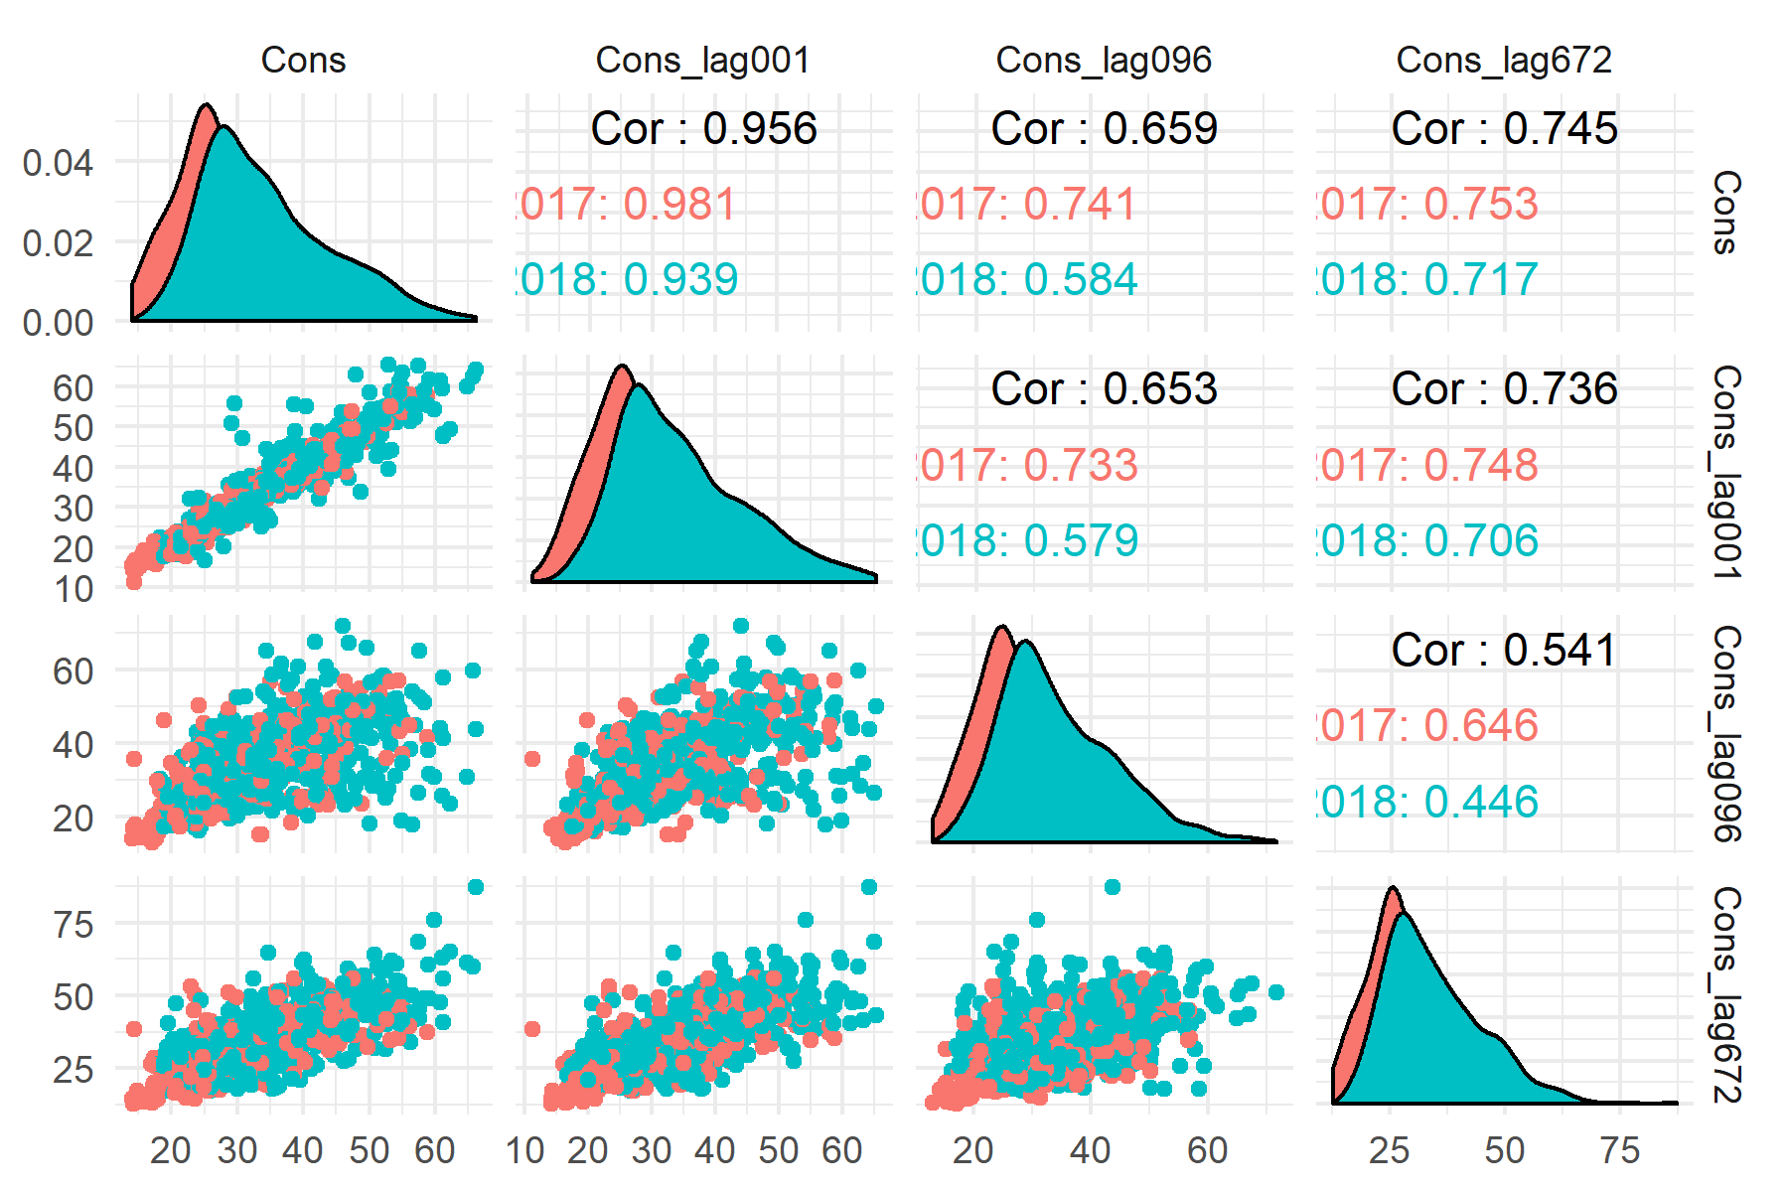
Exploratory Data Analysis
Consumption
Lag 1 (15 min ago)
Lag 96 (1 day ago)
Lag 672 (1 week ago)
Distribution shifts over time
Linear relationship
Notes:
Next, you see relation between the consumption and lagged consumption for lag 1 (15 minutes ago), lag 96 (1 day) and lag 672 (1 week). The relationship seems quite linear, furthermore the distributions seems to shift over time.

Slide 15
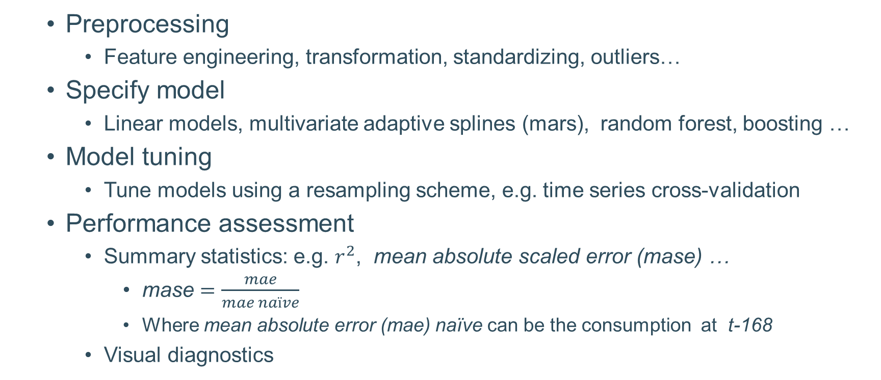
Point forecasting: preliminary results
Preprocessing
Feature engineering, transformation, standardizing, outliers…
Specify model
Linear models, multivariate adaptive splines (mars), random forest, boosting …
Model tuning
Tune models using a resampling scheme, e.g. time series cross-validation
Performance assessment
Summary statistics: e.g. $r^{2}$, mean absolute scaled error (mase) …
mase $=\frac{mae}{mae naïve}$
Where mean absolute error (mae) naïve can be the consumption at t-168
Visual diagnostics
Notes:
I have some preliminary results on the point forecasting. But first I am quickly describe the pipeline. So first I perform some preprocessing which consist out of feature engineering, transformations, standardizing and handling outliers. Then I specify the model and tune the tuning parameters using a resampling scheme which I will discuss on the next slide. Finally to assess the model I look at some summary statistics but also try to visualize performance. One summary statistic I really like is the mean absolute scaled error (mase), it’s mean absolute error of your forecasting model against the mean absolute scaled error of a naïve model such as the consumption of the previous week.

Slide 16
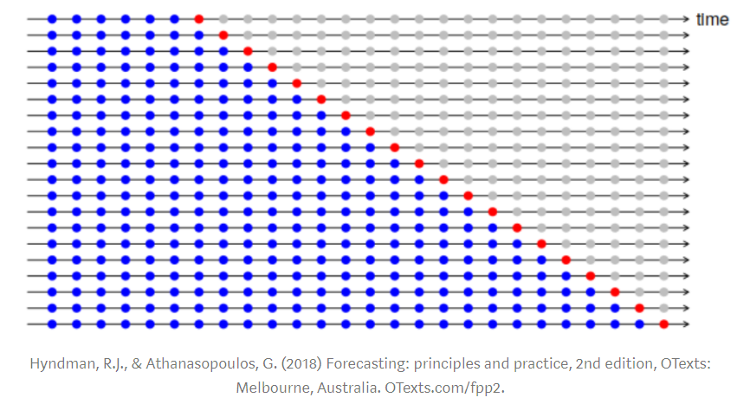
Point forecasting: preliminary results
Resampling scheme to tune parameters
Time series cross-validation
Preserve temporal structure in the data
Notes:
This slide is to give you an idea of the resampling scheme. It’s called time series cross-validation or some people name it walk forward testing and it’s used to preserve the temporal structure in the data

Slide 17
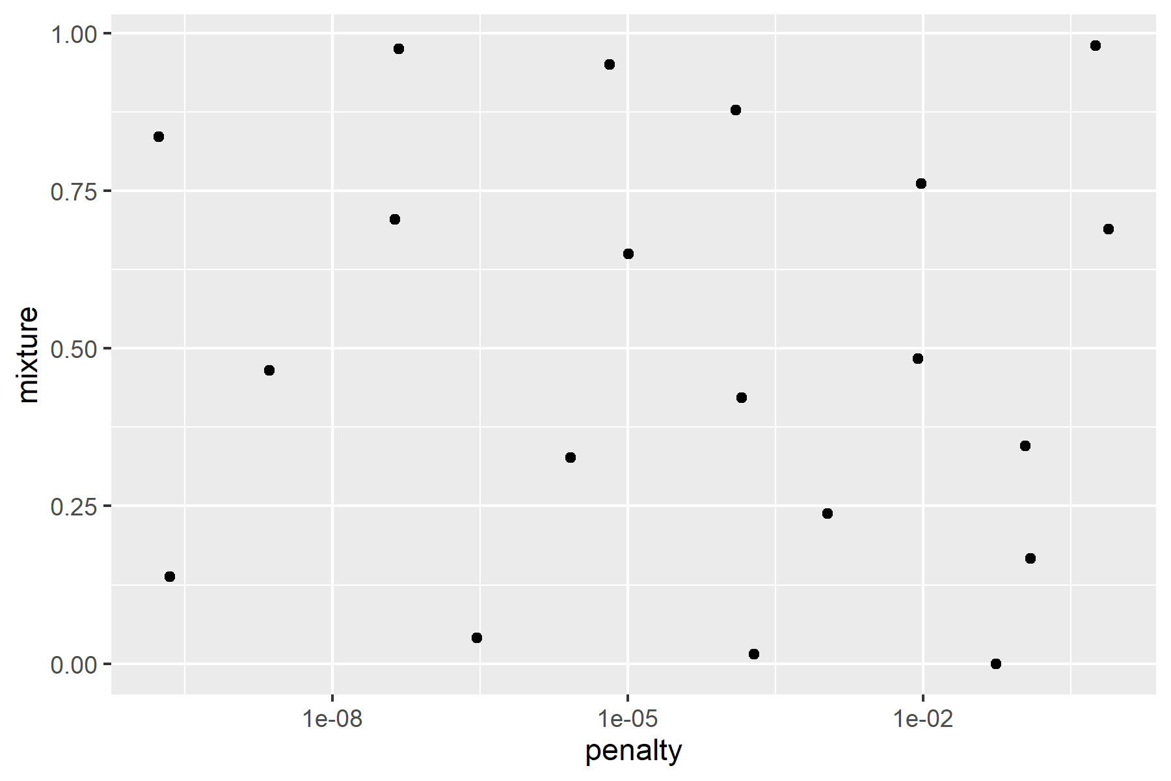
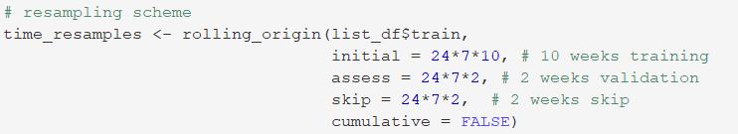
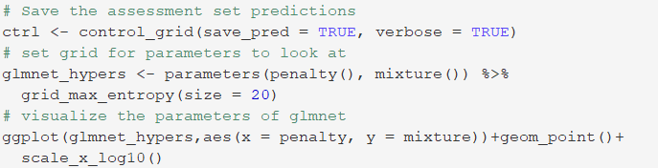
Point forecasting: preliminary results
Model and tuning parameters
Total of 7 x 20 models (runtime around 1 min)
Example with penalized regression (lasso, ridge, elastic net)

Slide 18
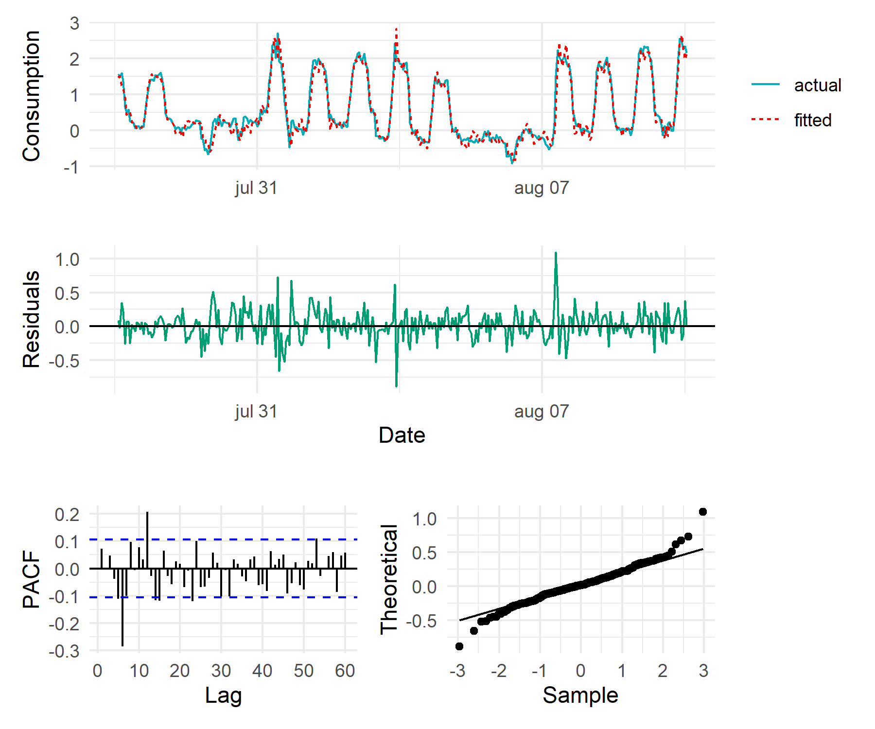
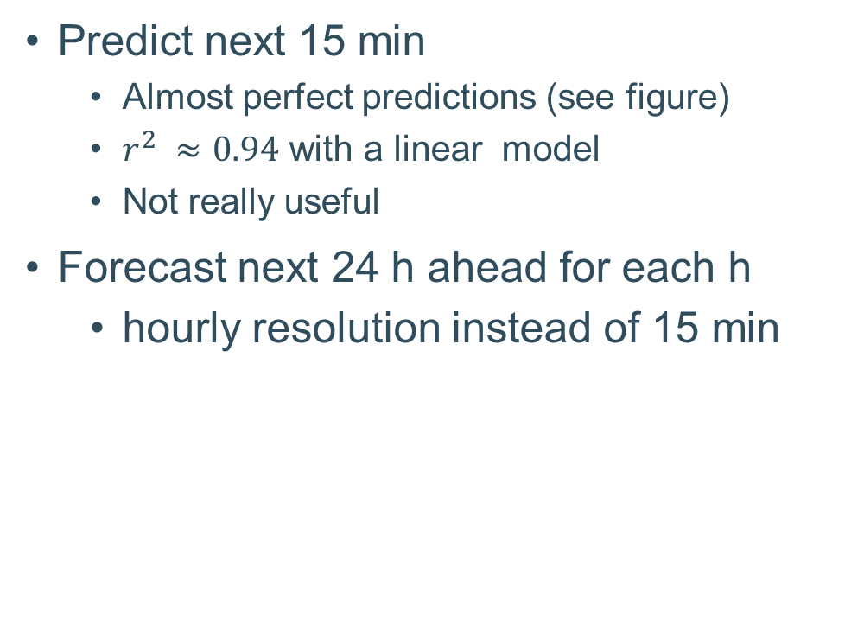
Point forecasting: preliminary results
Predict next 15 min
Almost perfect predictions (see figure)
$r^{2} ≈0.94$ with a linear model
Not really useful
Forecast next 24 h ahead for each h
hourly resolution instead of 15 min
Notes:
A first thing I did was predicting the next 15 minutes, you get almost perfect predictions as you can see on the figure and this was with a linear model. Though this is not really useful since I am only predicting the next 15 minutes. A next, I focused on predicting 24h ahead for each and I used hourly resolution instead of 15 minutes mainly to speed up things.

Slide 19
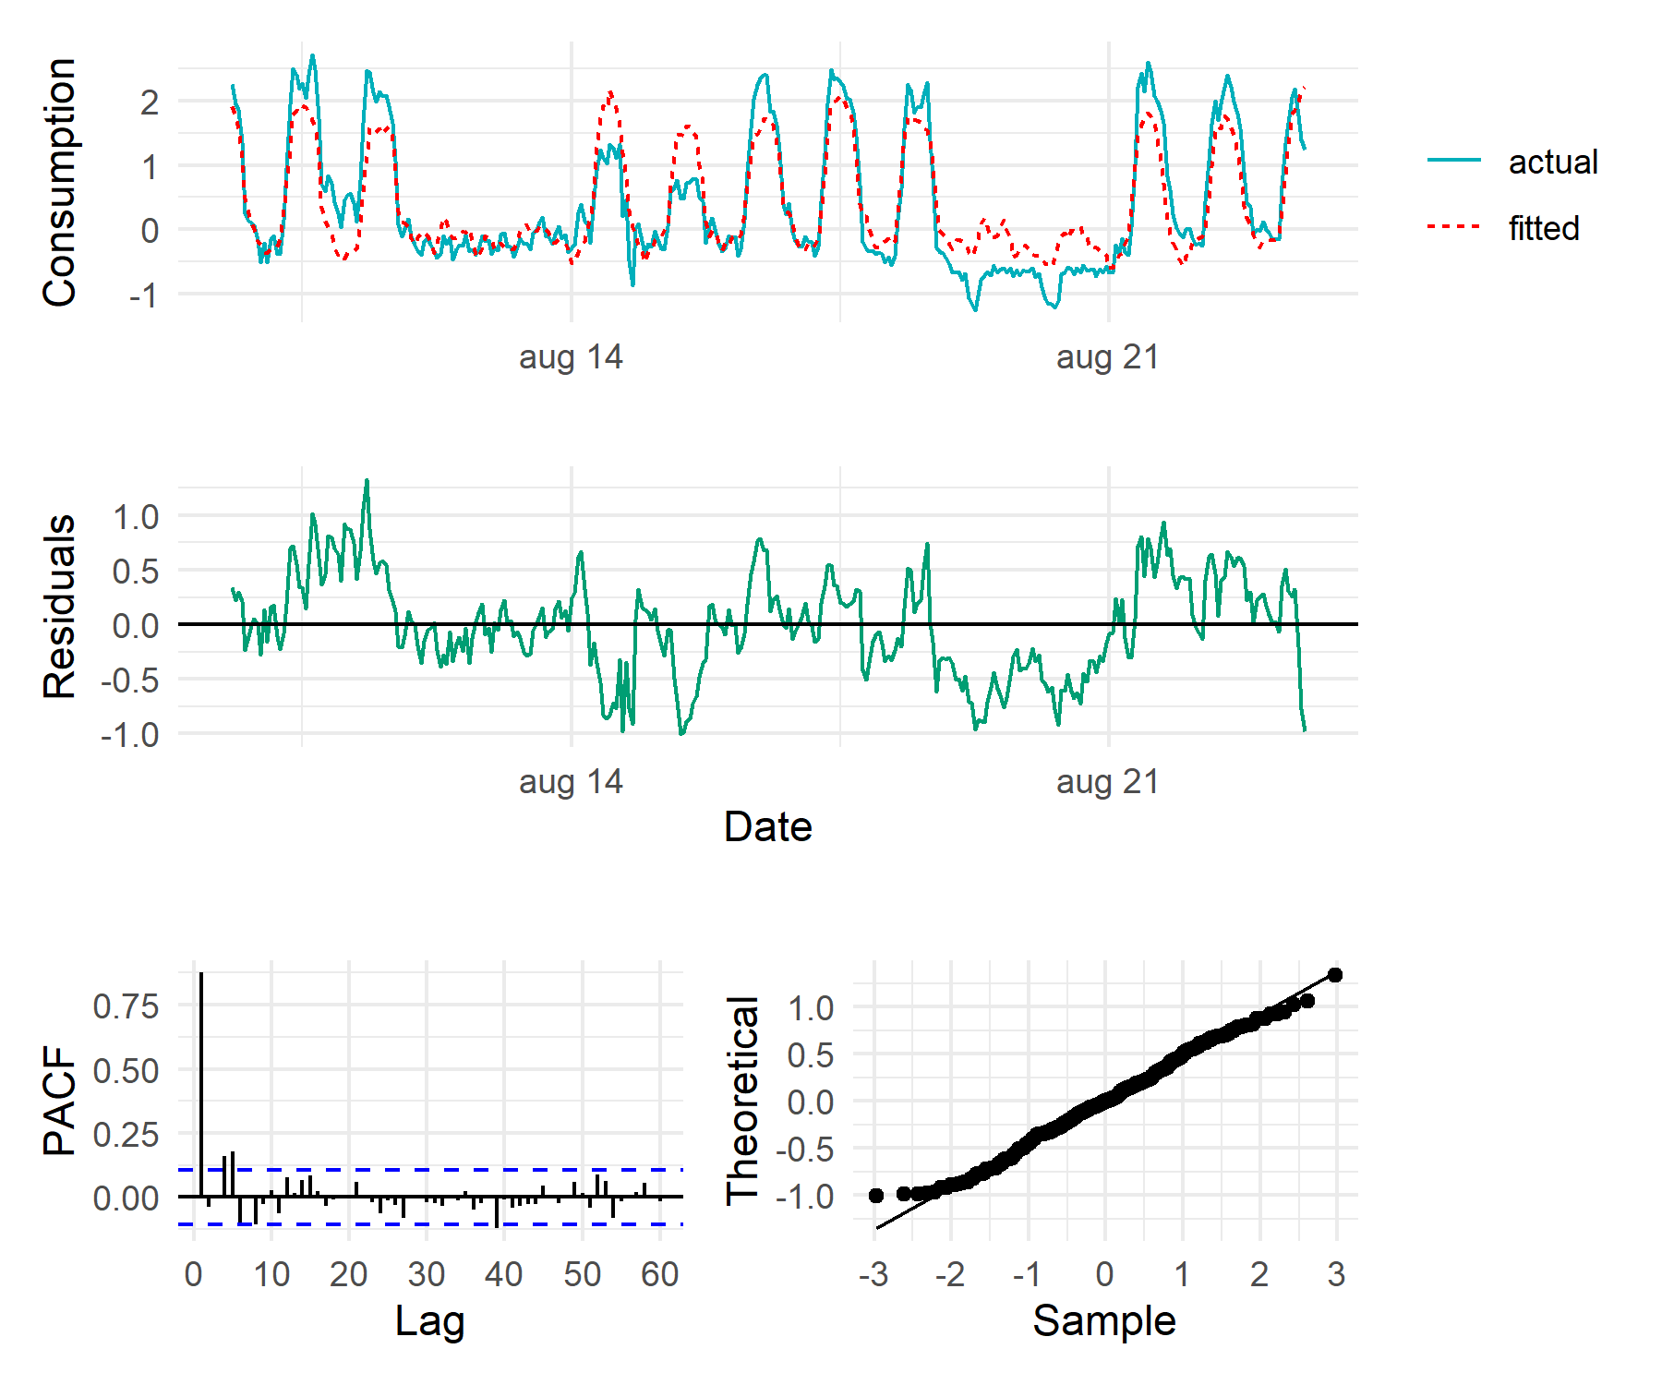
Point forecasting: preliminary results
Linear model predicting 24h ahead
Visual inspection of fitted values
Residuals
Patterns?
Partial autocorrelation
Normally distributed?
Notes:
Here you see the results for the 24h ahead predictions. There are not bad in general but there is clear difference with the predictions from the previous slide. Also a use this figures to kind of inspect my results.

Slide 20
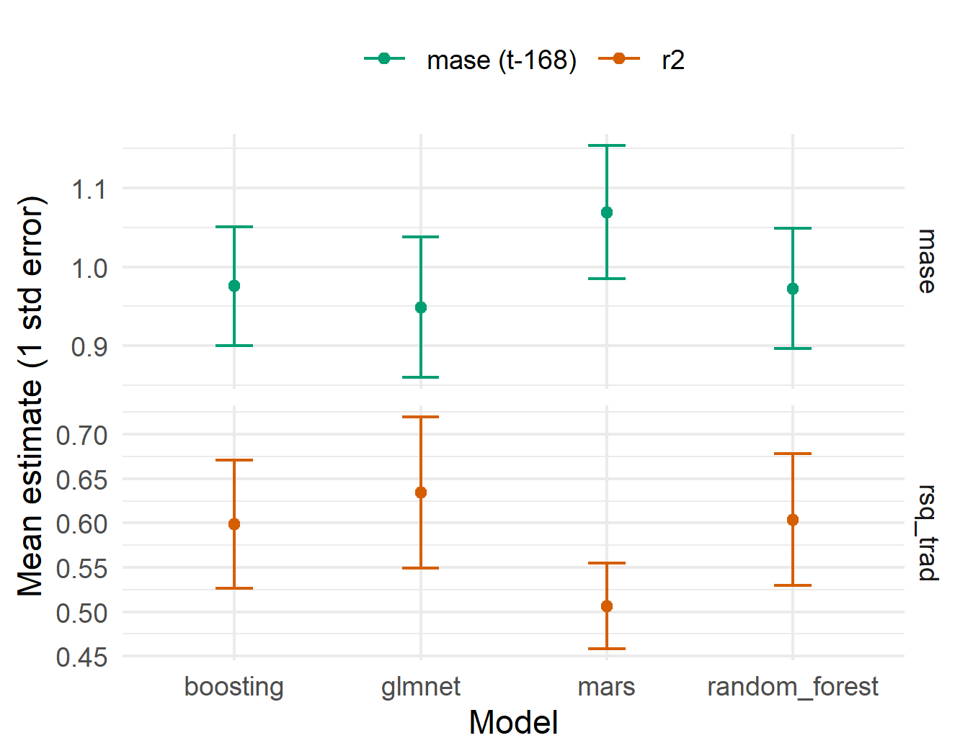
Point forecasting: preliminary results
Model performance
Linear regression (glmnet)
Multivariate Adaptive Splines (mars)
Random forest
Boosting
Notes:
Here you see the performance of the four models I tested. On top you see the mase using as a naïve forecast the prediction of the week ago and below you have the R-squared. So when the mase is below 1 you are outperforming the naïve model. So in this case only the multivariate adaptive splines are not outperforming the naïve forecast. Also the linear model performs best so far.

Slide 21
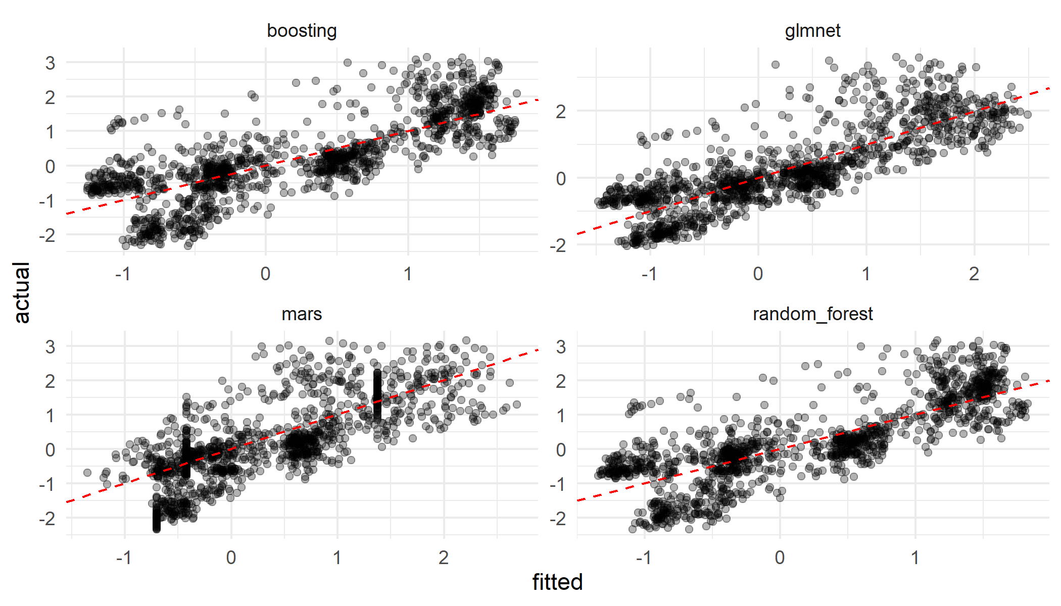
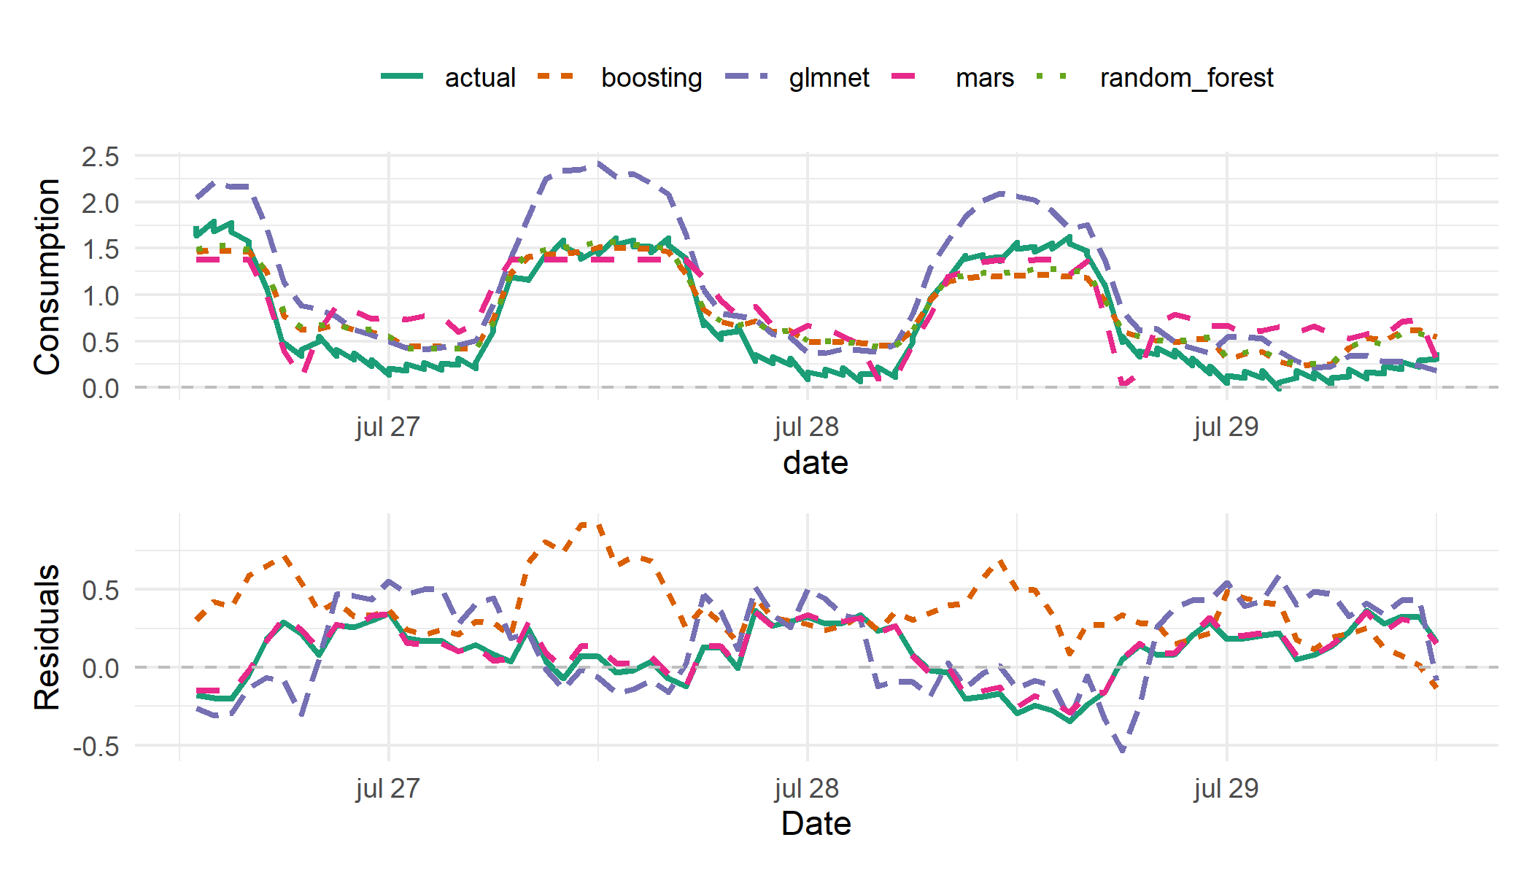
Point forecasting: preliminary results
Notes:
Here is another figure showing the predictions (fitted values) against the actual values. So when all points are on the red line you have perfect predictions.

Slide 22
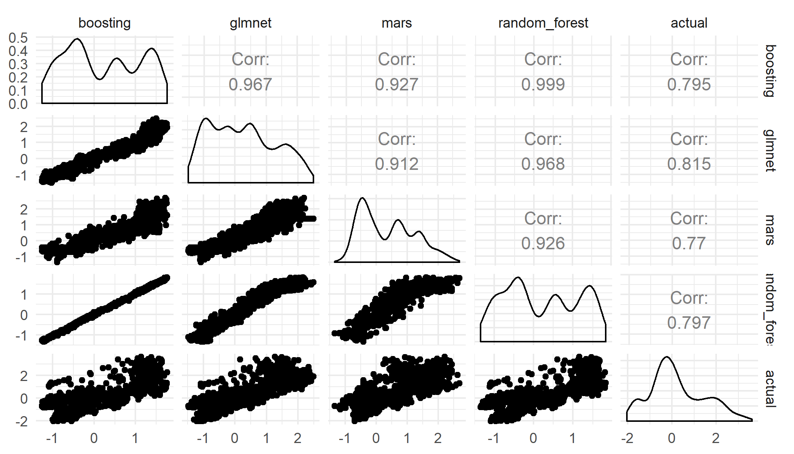
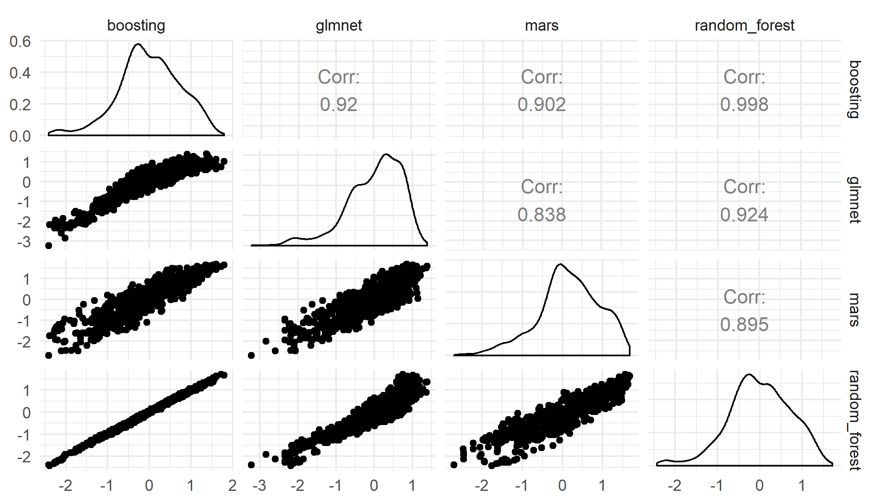
Point forecasting: preliminary results
Predictions
Residuals
Notes:
Here you see the relationship of residuals for the different models. In the end I would like to build an ensemble model so its useful to look at how correlated the residuals are.

Slide 23
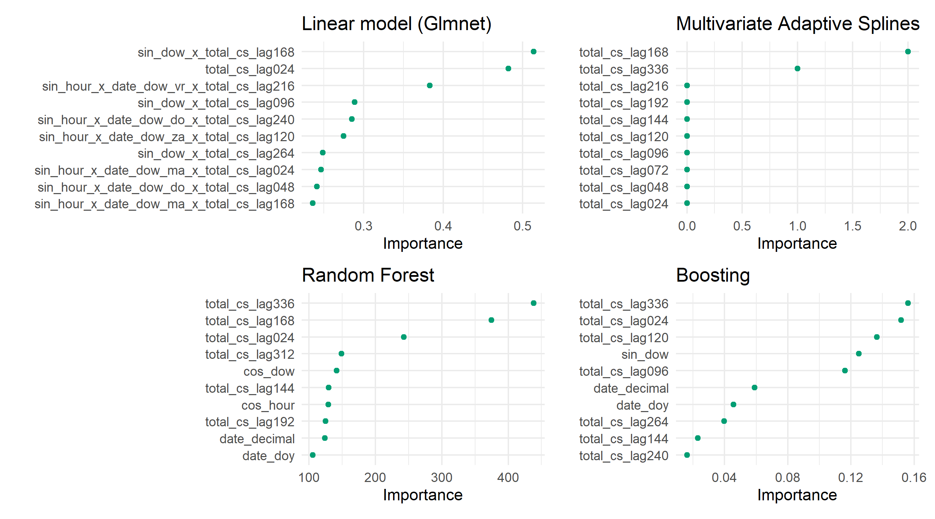
Point forecasting: preliminary results
Notes:
Here you see the variable importance figures for different models. This gives me an idea as whether the feature engineering was any successful

Slide 24
What’s next?
Finish point forecasting part (deadline: 11/03/2020)
Preprocessing: e.g. remove the trend in the data and work on the remainder
Different forecast horizons
Deep learning (if time permits)
Ensemble model
Probabilistic forecasting (deadline: 25/04/2020)
Finish literature review
Build framework to obtain probabilistic forecasts
Writing part (deadline: 25/05/2020)

Slide 25
Thank you for your attention! Feedback welcome
Pieter-Jan Inghelbrecht
Master of Artificial Intelligence
Daily supervisor: Mahtab Kaffash
Promotor: Prof. Geert Deconinck

Slide 26
Questions
Forecast horizon
Figure about data cleaning daily resolution or 15 min?
Figuur profile plots eigenlijk zit er een dubbele plot in ➔ new years and end of the year
Deep learning: Depends on forecast error
1h step to 24h
Labels of plots if you use normalized data
Relative error, compare performance with other papers
Mention the unit of the consumption (like Kwh or so)

Slide 27
Questions
Time resolution 15 minutes or hourly resolution? If I do the data exploration on 15 minute data it does not make sense to do the rest of the analysis on hourly data ➔ 15 minutes for data cleaning and EDA, the modelling can be in hourly resolution, but clearly specify
What is the exact unit of the measurement, is it kilowatt-hour (Kwh)? For the fluvius data I had to divide by 4 ➔ Kilowatt-hour per 15 minutes

