Slide 1
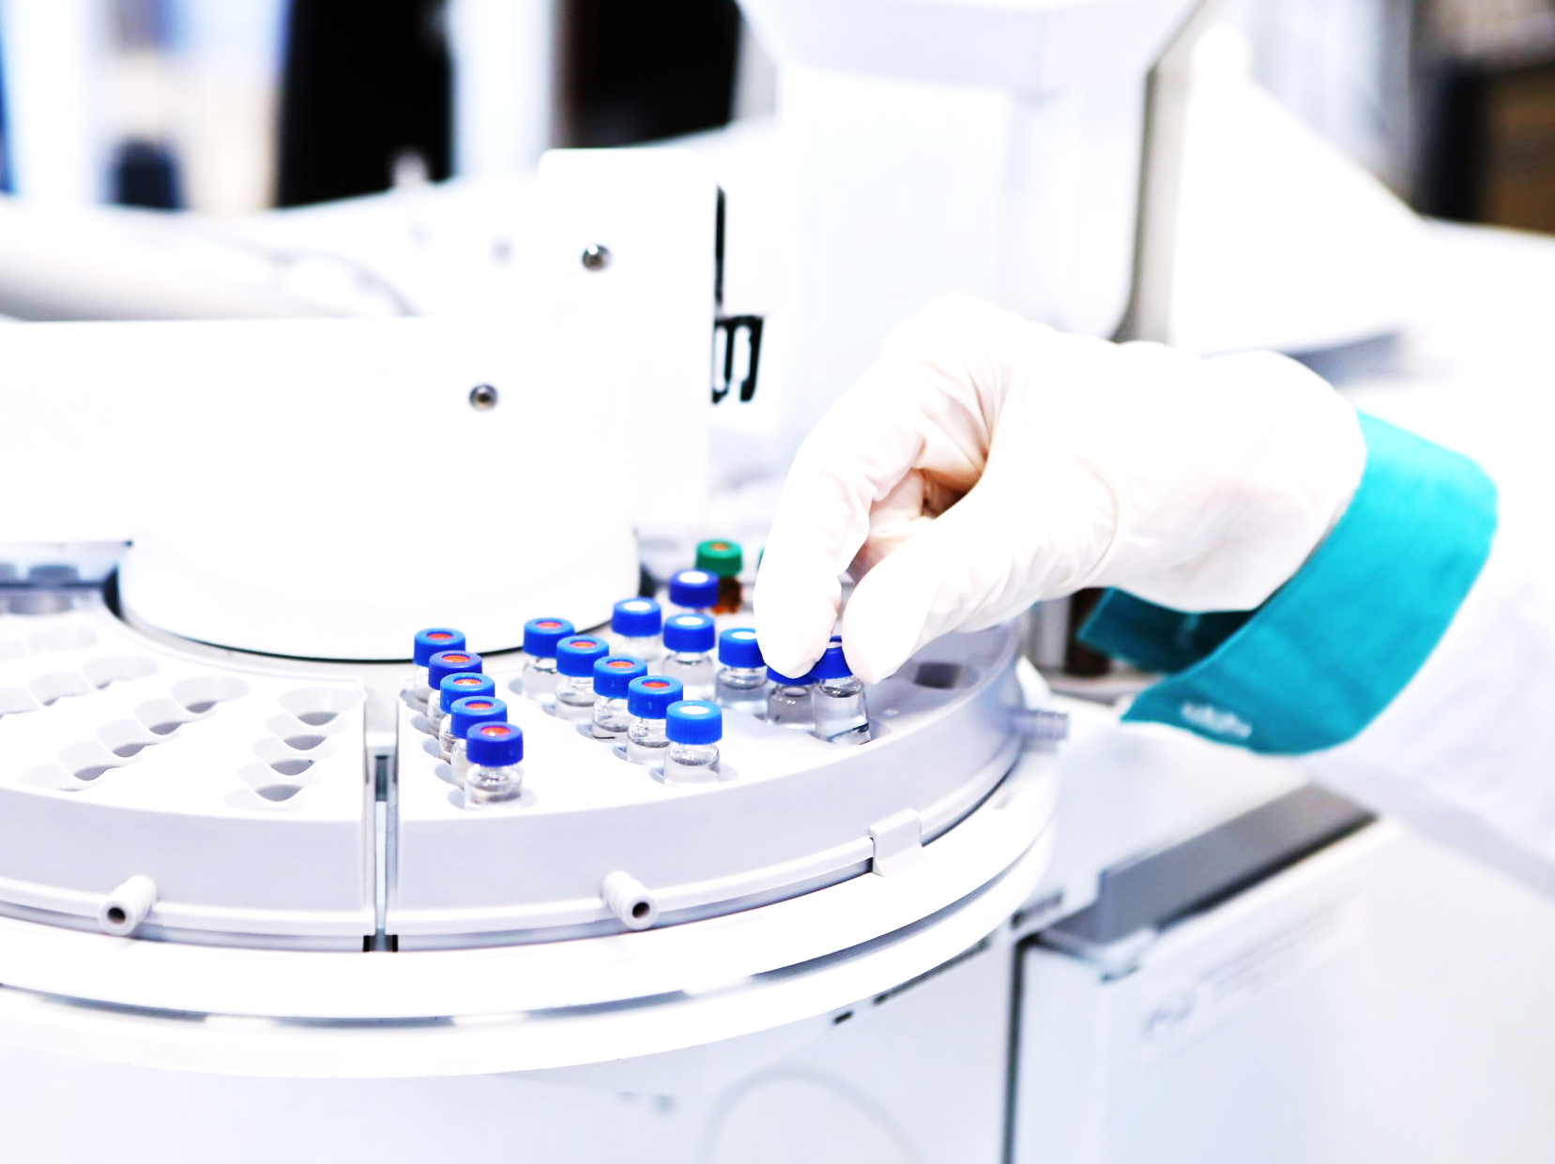
Predicting Diabetes Using Machine Learning Models
Project 2, Group 3:
Michael Leston and Giselle Gomez

Slide 2
Agenda
Executive Summary
Data Collection, Cleaning and transformation
Exploratory Data Analysis & Visualizations
Approach
Model Implementation
Model Optimization and Final Performance
Results and Conclusions
Future Considerations
Resources

Slide 3
Executive Summary
Problem: Predict whether a patient has diabetes based on medical and demographic data.
Objective: Develop a machine learning model to achieve high classification accuracy (75%+).

Slide 4
Data Collection and Cleaning
Source: 100,000 entries of medical and demographic data.
Key Variables: Age, BMI, HbA1c levels, race, gender, smoking history.
Cleaning Process: No missing values, categorical encoding for model readiness.

Slide 5
Exploratory Data Analysis (EDA)
Key Insights:
- Distribution of age, BMI, HbA1c, and blood glucose levels.
- Correlations between variables and target outcome (diabetes presence).
- Visualizations used: histograms, correlation matrix.

Slide 6
Visualizations
Key Insights:
- Distribution of age, BMI, HbA1c, and blood glucose levels.
- Correlations between variables and target outcome (diabetes presence).
- Visualizations used: histograms, correlation matrix.

Slide 7
Approach
approach that your group took in achieving the project goals

Slide 8
Model Implementation
Model Used: RandomForest Classifier.
Preprocessing: OneHotEncoder for categorical variables.
Data Split: Training and testing sets for evaluation.

Slide 9
Model Optimization
Process: Iterative tuning of hyperparameters (e.g., number of estimators, max depth).
Evaluation Metrics: Accuracy, confusion matrix.
Results: Each iteration improved accuracy and precision.

Slide 10
Final Model Performance
Accuracy: Achieved accuracy of [insert value].
Metrics: Confusion matrix, classification report (precision, recall, F1-score).
Conclusion: Model performance met the target criteria of 75%+ accuracy.

Slide 11
Conclusions
Summary: Successfully built a RandomForest model to predict diabetes with over 75% accuracy.
Model Insight: Important features identified: age, BMI, and HbA1c levels.
Takeaway: Results show that machine learning can provide accurate predictions for diabetes risk.

Slide 12
Future Considerations
Improvements: Explore more complex models like XGBoost or neural networks.
Data: Use additional features or external datasets to improve prediction accuracy.
Next Steps: Test the model on different populations to assess generalizability.

Slide 13

Thank You!
Resources and more info in:
https://github.com/piiop/group-project-2
Questions?

