Slide 1


SUSTIANABLE DEVLOPMENT

Slide 2

Learning Objectives
Understanding Energy around us
Datasets about different energy resources (Wind, Solar, Thermal)
Visualization of data i.e diagrammatic representations about energy utilization
Learning usage about juypter notebook using python
GOAL
Source :
www.freepik.com/

Slide 3
Tools and Technology used
Juypter Notebook
Python
Python Libraries
Machine learning

Slide 4
Methodology
Problem Definition
Data collection
Data preprocessing and cleaning
Exploratory Data analysis

Slide 5
Problem Statement:
How can AI/ML predict the data of present, so future generation could live longer.

Slide 6
Solution:
We used AI/ML for analysis of energy data, ongoing situations and CO₂ The solution help for future generation live long

Slide 7
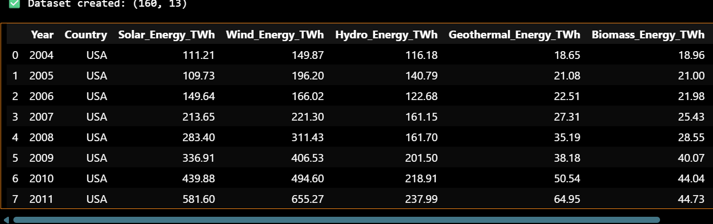
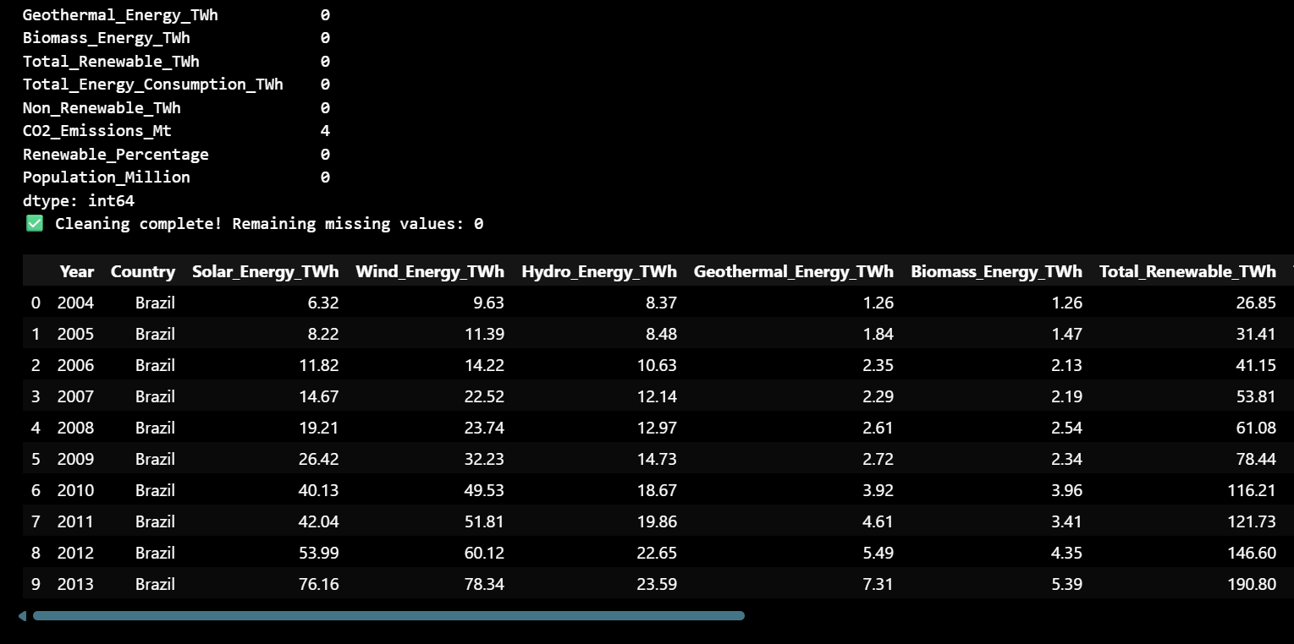
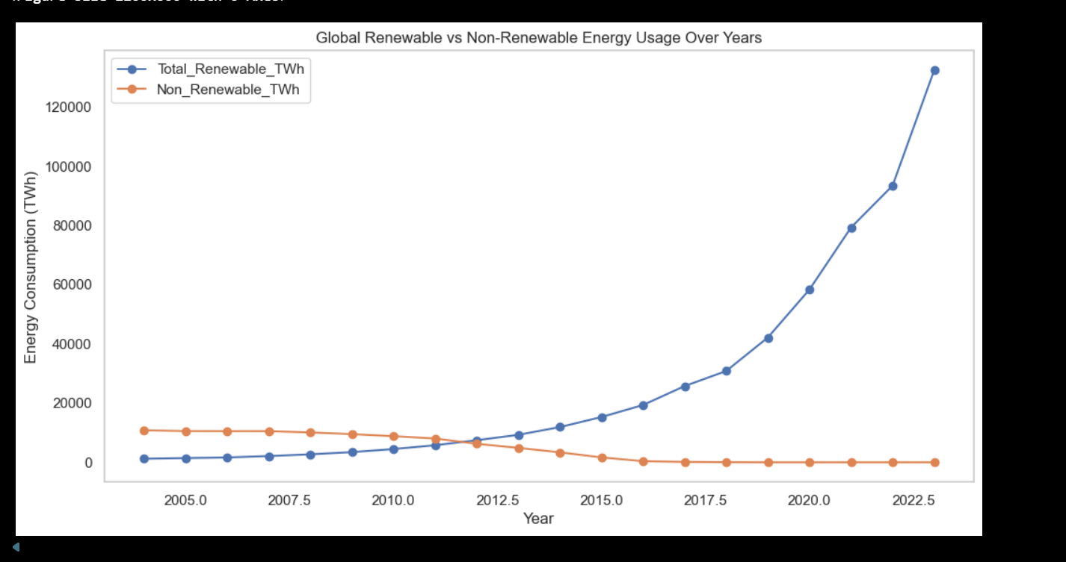
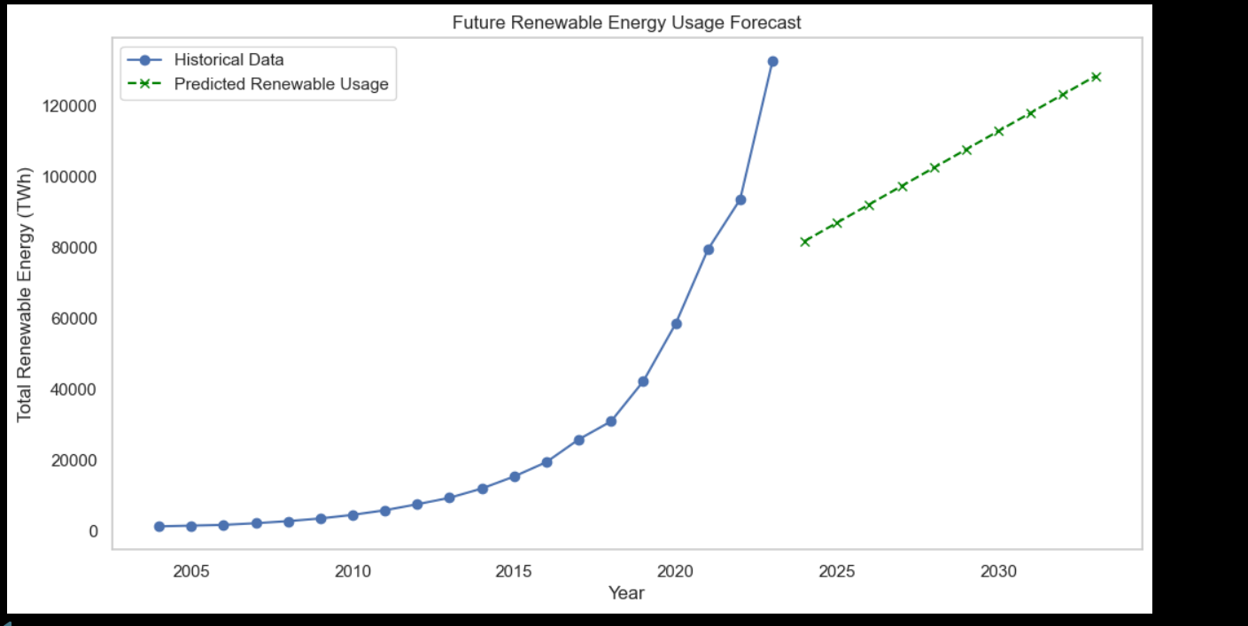
Screenshot of Output:

Slide 8
Conclusion:
In the end I would like to conclude that AI can not be predictable. Sometimes it makes mistakes and that mistakes could be dangerous to humankind. We should always rely to humans regarding decision making. But AI could provide the data about the environment.

