Slide 1



Sub-Linear
Lattice-Based
Zero-Knowledge Arguments for Arithmetic Circuits
Carsten Baum, Jonathan Bootle, Andrea Cerulli, Rafael del Pino, Jens Groth and Vadim Lyubashevsky
Notes:
Start by talking about lattice assumption on which protocol is based

Slide 2
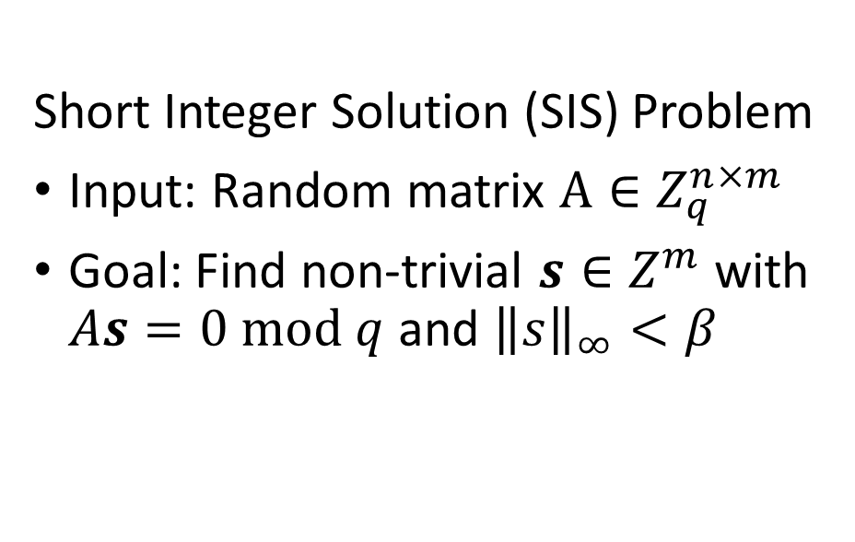
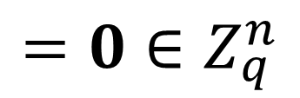


Lattice-Based
Zero-Knowledge Arguments for Arithmetic Circuits
Short Integer Solution (SIS) Problem
Input: Random matrix $A∈Z_{q}^{n×m}$
Goal: Find non-trivial $s∈Z^{m}$ with $As=0 mod q$ and ${\left\|s\right\|}_{∞}<β$
$$A$$
$$s$$
$$=0∈Z_{q}^{n}$$
Notes:
Mention quantum resistance, worst-case-to-average-case reductions

Slide 3


Lattice-Based
Zero-Knowledge Arguments for Arithmetic Circuits
Commitment/hash from SIS:
Binding/collision resistant by SIS
Hiding by Leftover Hash Lemma
Homomorphic
Compressing [A96]
$$A$$
$$s$$
=
$$t$$
Notes:
Use SIS hash function
Failure of binding -> collision -> SIS solution
Sample few inputs with sufficient entropy -> hiding by LHL
Compressing/succinct commits (important for sublinear size)
Use homomorphic property
POK as discussed earlier

Slide 4
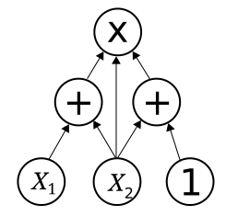



Lattice-Based
Zero-Knowledge Arguments for Arithmetic Circuits
Statement
Witness
Prover
Verifier

Slide 5

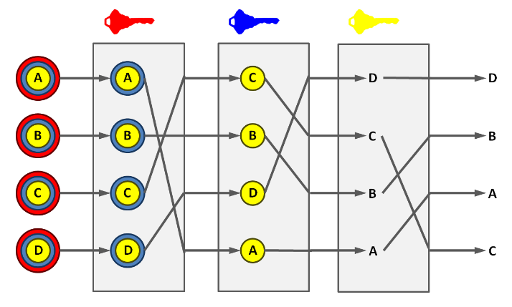



Lattice-Based
Zero-Knowledge Arguments for Arithmetic Circuits
Statement
Witness
Prover
Verifier

Slide 6
Lattice-Based
Zero-Knowledge Arguments for Arithmetic Circuits
Statement
Completeness:
An honest prover convinces the verifier.
Prover
Verifier

Slide 7
Lattice-Based
Zero-Knowledge Arguments for Arithmetic Circuits
Statement
Soundness:
A dishonest prover never convinces the verifier.
Computational guarantee
-> argument
Completeness:
An honest prover convinces the verifier.
Prover
Verifier
Notes:
Grey out, include all text and position different properties?

Slide 8

Lattice-Based
Zero-Knowledge Arguments for Arithmetic Circuits
Statement
Knowledge Soundness:
The prover must know a witness to convince the verifier.
-> Proof/argument
of knowledge
Completeness:
An honest prover convinces the verifier.
Prover
Verifier
Notes:
Grey out, include all text and position different properties?

Slide 9
Lattice-Based
Zero-Knowledge Arguments for Arithmetic Circuits
Statement
Witness
Knowledge Soundness:
The prover must know a witness to convince the verifier.
-> Proof/argument
of knowledge
Completeness:
An honest prover convinces the verifier.
Prover
Verifier
Zero-knowledge:
Nothing but the truth of the statement is revealed.
Notes:
Grey out, include all text and position different properties?

Slide 10

Lattice-Based
Zero-Knowledge Arguments for Arithmetic Circuits
3
Why arithmetic circuits?
C to circuit compilers
Models cryptographic computations
Witness existence? NP-Complete
$$Z_{p}$$
Statement
Witness
Notes:
Restricted C to arithmetic circuit compiler
Much cryptography takes place over finite fields
Do valid inputs exist? NP-Complete

Slide 11
Lattice-Based
Zero-Knowledge Arguments for Arithmetic Circuits
Statement
Interaction
Prover Computation
Verifier Computation
Communication
Prover
Verifier
Cryptographic Assumption
Notes:
Want sublinear proofs in statement size
Want lattice assumption: leading to post-quantum protocol.
Want general statement, expressive proof-system.
Framed as interactive proofs, but make NI using FS transform, hashes replace verifier messages
Prover and verifier computation efficient.

Slide 12
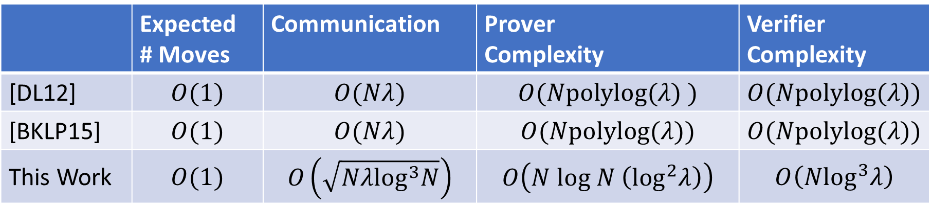


Results Table
 | Expected # Moves | Communication | Prover Complexity | Verifier Complexity
[DL12] | $$O(1)$$ | $$O(Nλ)$$ | $$O(Npolylog(λ) )$$ | $$O(Npolylog(λ))$$
[BKLP15] | $$O(1)$$ | $$O(Nλ)$$ | $$O(Npolylog(λ))$$ | $$O(Npolylog(λ))$$
This Work | $$O(1)$$ | $$O\left(\sqrt{Nλ\log^{3}N}\right)$$ | $$O\left(N log N \left(\log^{2}λ\right)\right)$$ | $$O\left(N\log^{3}λ\right)$$
$N$ gates
Security parameter $λ$
Notes:
Circuit with N gates, proof sizes close to sqrt. Previous works linear.

Slide 13
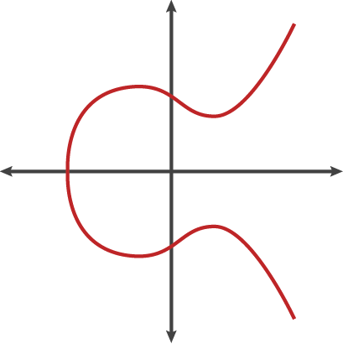
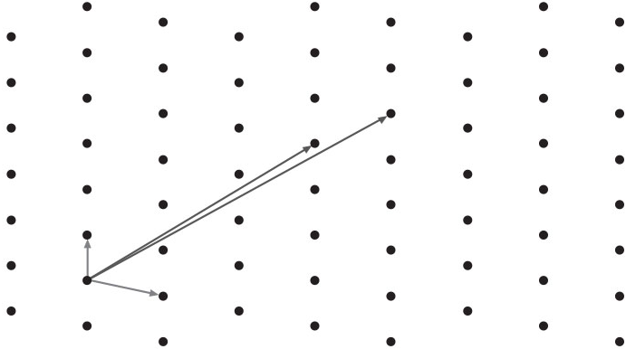
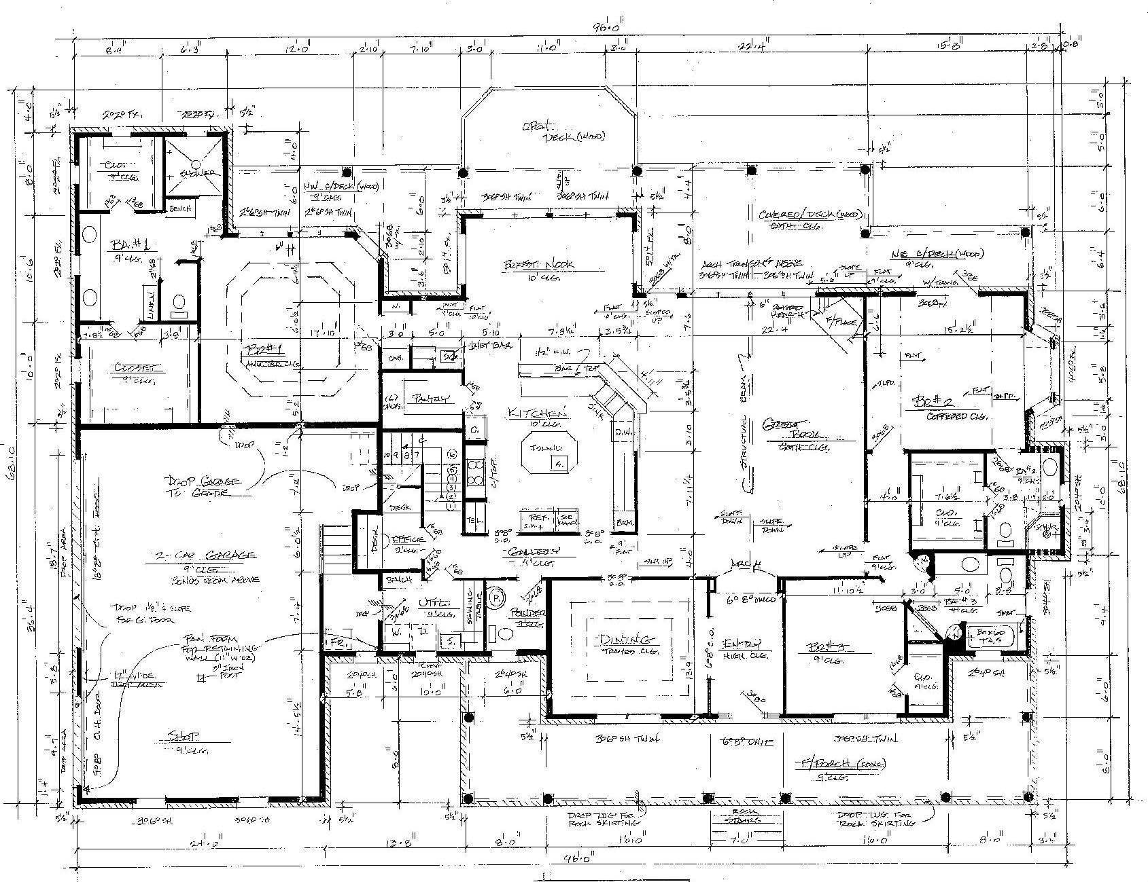
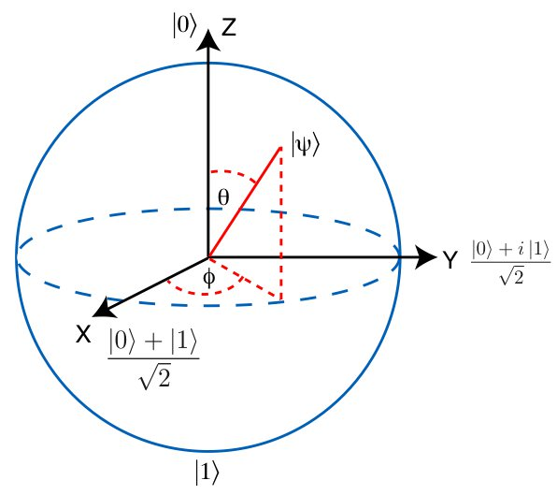
Arithmetic
Circuit
Argument
Arithmetic Circuits
Featured in prior works
DLOG Protocols
Information Theoretic Proofs
Matrix Equations
The interesting parts
Extension Fields
Polynomials
This work
Proof of Knowledge
Commitments
Rejection Sampling
Protocol
Notes:
Circuits->Matrix Equations->Polynomials->Commits->Protocol
Circuits,matrices,polys is a common approach followed by many protocols
Translate the protocol DLOG to SIS setting, needs extra ingredients like POK, extension fields. The interesting bits
POK better than previous ones in its own right.
ILC, LPCP models etc
All models for proofs where prover commits, verifier creates challenges, prover uses challenges to send linear combinations of commitment openings to verifier
Lots of proofs use this
Groth’16 blueprint, lattice instantiation, but problems to overcome
Old proofs over fields, no size bounds, solving linear equations of commitments guarantees openings. Openings non-trivial here. POK solves problem, but still have to be aware of sizes, rejection sampling for ZK, etc.
Old proofs use poly-id testing over field, but too-low soundness due to small primes used for lattice work. Want good soundness without parallel reps

Slide 14



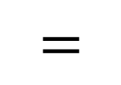
Proof of Knowledge
Statement
$$A$$
$$s$$
$$=$$
$$t$$
Witness

Slide 15

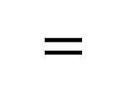
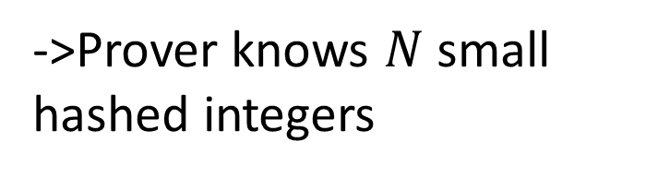







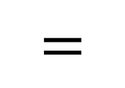


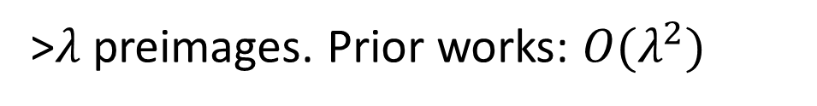

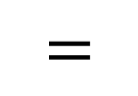

Proof of Knowledge
$$A$$
$$s_{1}$$
$$=$$
$$t_{1}$$
$$A$$
$$s_{2}$$
$$=$$
$$t_{2}$$
…
$$A$$
$$s_{m}$$
$$=$$
$$t_{m}$$
$$m≈\sqrt{N}$$
>$λ$ preimages. Prior works: $O(λ^{2})$
$$s_{1}$$
$$≈\sqrt{N}$$
->Prover knows $N$ small hashed integers
Notes:
Can see as proof of knowledge of many hash preimages, better efficiency than previously known protocols.
Or can see as proof of knowledge of N integers, to serve AC argument.
Prior works required lambda^2 preimages to get good asymptotic results. We require only lambda

Slide 16






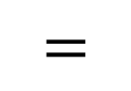


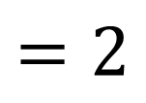

Typical Proofs of Knowledge
Completeness:
$$A$$
$$s$$
$$=$$
$$t$$
$${\left\|s\right\|}_{∞}<β$$
Knowledge Soundness:
$$A$$
$$s$$
$$t$$
$$=2$$
$${\left\|s\right\|}_{∞}<Kβ$$
Soundness Slack
None for us*
We get $O(λ)$
Proving $m$ statements requires $O(m)$-sized proofs
Notes:
POK of S such that AS=T, public matrices A and T
Really: POK of many SIS hash preimages for A
Diagram
Sample blinder, hash, send
Verifier picks challenges (binary, hint at RSIS version)

Slide 17


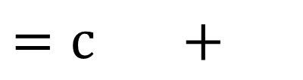





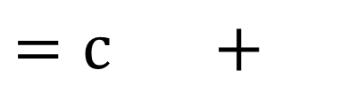

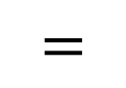




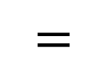





Simplistic Protocol
$$A$$
$$s$$
$$=$$
$$t$$
P
V
$$A$$
$$y$$
$$=$$
$$w$$
$$w$$
$$c∈\{0,1\}$$
$$z$$
$$s$$
$$y$$
$$z$$
$$=c +$$
Check: ${\left\|z\right\|}_{∞}<B$
$$A$$
$$z$$
$$=c +$$
$$t$$
$$w$$
Rejection Sampling
Notes:
Y chosen randomly and large enough to hide s when added together.
Completeness, HVZK easy to see from Fiat-Shamir with aborts framework, similar to many signatures e.g. BLISS, and follow from facts about rejection sampling of Gaussians (or something else)

Slide 18










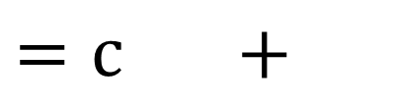
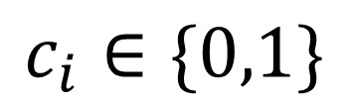


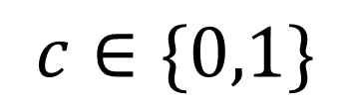


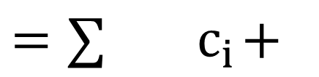


Our Protocol
$$z$$
$$s$$
$$z$$
$$s_{1}$$
$$s_{i}$$
$$y$$
$$y$$
$$y$$
$$s_{2}$$
$$s_{m}$$
$$= + { c}_{2}…+ c_{m}+$$
$$=c +$$
$$c_{i}∈\{0,1\}$$
$$=∑{ c}_{i}+$$
$$c∈\{0,1\}$$
$$z′$$
$$s_{2}$$
$$s_{m}$$
$$y$$
$$= + { c}_{2}…+ c_{m}+$$
Extraction with probability $≈pr−1/2$ for prover with success probability $pr$
Notes:
Extend the simplistic protocol in the obvious way: use many bits to decide whether to include particular vectors or not
Extraction guaranteed by ‘heavy rows’ probabilistic averaging argument
Knowledge extractor to make POK: run extractor_i many times until an accepting Z is obtained. Now replay prover with the same first message, and only change challenges i to get new Z
Decent success probability by ‘heavy rows’ argument i.e. if prover success probability is larger than a given quantity, then there must be a decent number of fixed j\neq i challenges for which replaying will succeed with probability bounded below. If not, the prover success probability must have been less.
Subtract Zs to get exact opening. Some expansion in norm (slack) no multiple

Slide 19

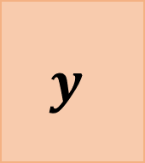
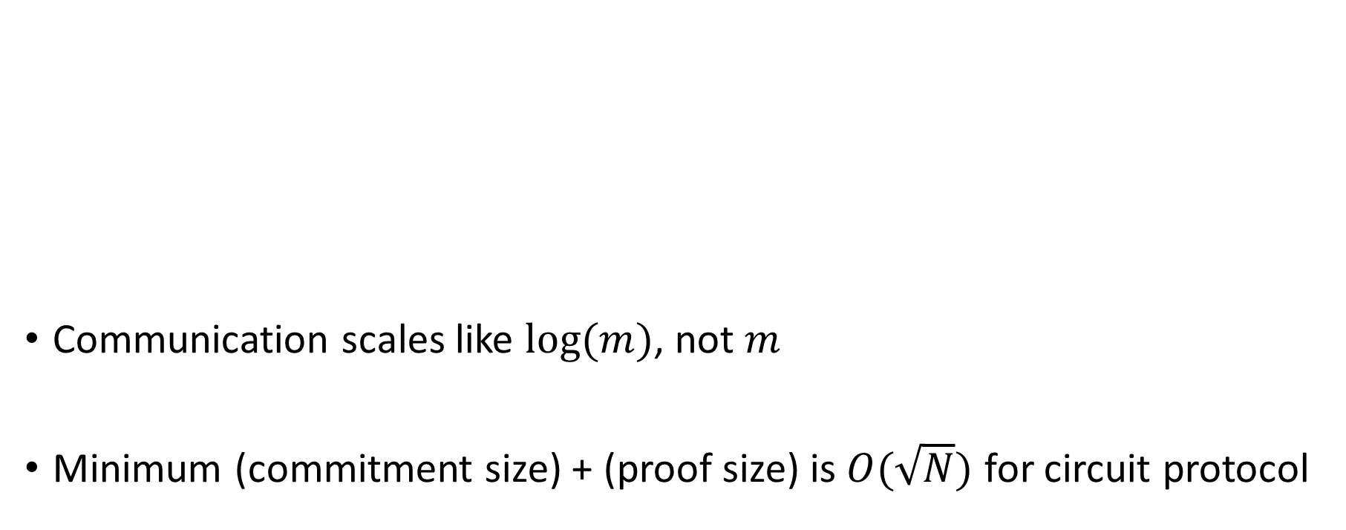



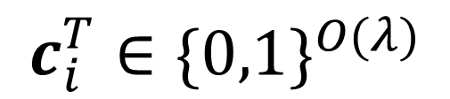

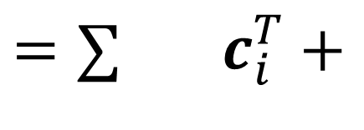
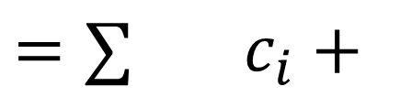
Our Protocol
Communication scales like $log(m)$, not $m$
Minimum (commitment size) + (proof size) is $O(\sqrt{N})$ for circuit protocol
$$z$$
$$z$$
$$s_{i}$$
$$y$$
$$y$$
$$c_{i}^{T}∈\{0,1\}^{O(λ)}$$
$=∑$ $c_{i}^{T}+$
$$c_{i}∈\{0,1\}$$
$=∑$ $c_{i}+$
Extraction with probability $≈pr−1/2^{λ}$ for $λ$ parallel repetitions

Slide 20
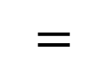
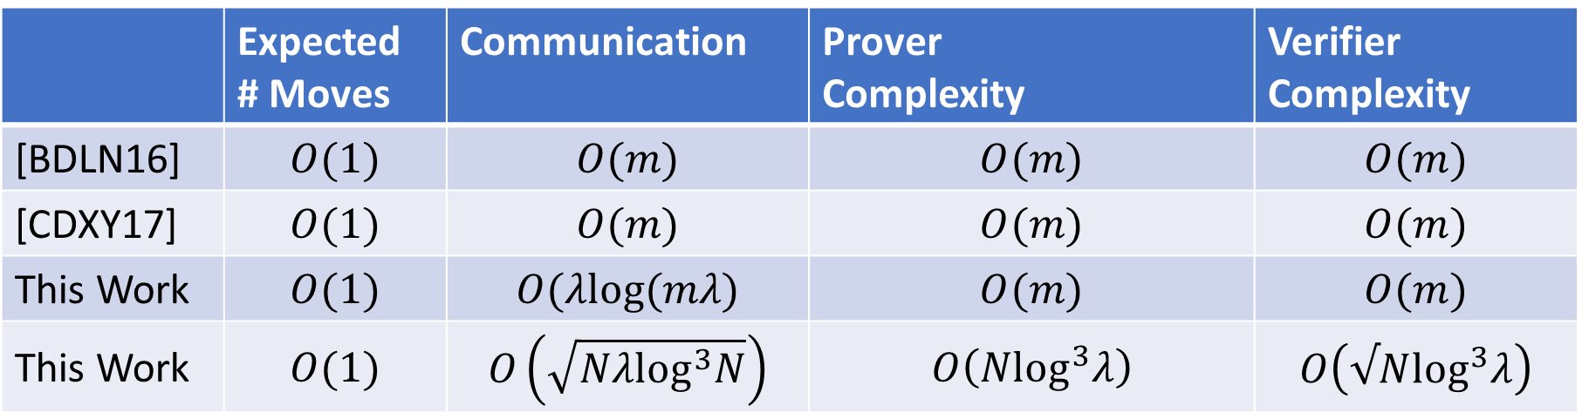


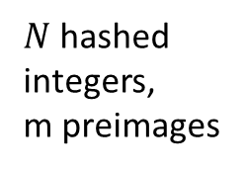

Proof-of-Knowledge Performance
 | Expected # Moves | Communication | Prover Complexity | Verifier Complexity
[BDLN16] | $$O(1)$$ | $$O(m)$$ | $$O(m)$$ | $$O(m)$$
[CDXY17] | $$O(1)$$ | $$O(m)$$ | $$O(m)$$ | $$O(m)$$
This Work | $$O(1)$$ | $$O(λlog(mλ)$$ | $$O(m)$$ | $$O(m)$$
This Work | $$O(1)$$ | $$O\left(\sqrt{Nλ\log^{3}N}\right)$$ | $$O\left(N\log^{3}λ\right)$$ | $$O\left(√N\log^{3}λ\right)$$
$$A$$
$$s$$
$$=$$
$$t$$
$N$ hashed integers,
m preimages
Security parameter $λ$
Notes:
Communication sqrt( N polylog(lambda)) by choosing dimensions of matrices accordingly
Computation O(lambda N) mults for prover and verifier
Ring variant- different challenge space, multiple of 2, but better soundness/slack
Damgaard buckets
Damgaard expander buckets
Lyubashevsky low weight challenge paper
Powers of X paper
Stern Protocols
Recent Damgaard Oechsner low weight?

Slide 21
Arithmetic
Circuit
Argument
Arithmetic Circuits
Matrix Equations
Extension Fields
Polynomials
Proof of Knowledge
Commitments
Rejection Sampling
Protocol
Notes:
Now talk about the arithmetic circuit argument, which uses the new proof of knowledge as a component.

Slide 22



High Level Structure
L
R
O
3
15
5
12
15
180
5
7
O
=
$$×3$$
$$+$$
15
12
$$×$$
5
7
12
+
=
180
Notes:
Arrange wire values into L, R and O. Top matrix for addition gates, and bot. for mult. gates
Check product of 2 top matrices is the 3rd to check mult. gates.
Check sum of 2 bot. matrices is the 3rd to check addition gates.
Also, outputs of some gates feed into inputs of others, and some wires are split in two. Need to check some wire values are equal.
Do this by showing that if the two equal wire values were swapped, then the matrices remain the same. Reduces to computations using a public permutation matrix.
Also need to check that some publicly-known wire values from multiplication-by-constant gates are the correct values.
Show the matrices for the small example circuit here.

Slide 23
High Level Structure
L
R
O
3
15
5
12
15
180
5
7
O
=
$$×3$$
$$+$$
15
12
$$×$$
5
7
12
+
=
180
Notes:
Arrange wire values into L, R and O. Top matrix for addition gates, and bot. for mult. gates
Check product of 2 top matrices is the 3rd to check mult. gates.
Check sum of 2 bot. matrices is the 3rd to check addition gates.
Also, outputs of some gates feed into inputs of others, and some wires are split in two. Need to check some wire values are equal.
Do this by showing that if the two equal wire values were swapped, then the matrices remain the same. Reduces to computations using a public permutation matrix.
Also need to check that some publicly-known wire values from multiplication-by-constant gates are the correct values.
Show the matrices for the small example circuit here.

Slide 24
High Level Structure
L
R
O
O
=
+
=
Notes:
For larger circuits, the same idea, just with larger matrices.

Slide 25
High Level Structure
L
R
O
O
=
+
=
Notes:
For larger circuits, the same idea, just with larger matrices.

Slide 26
Matrix Dimensions
~√N
~√N
~√N
~√N
Notes:
To get optimal communication efficiency, arrange the values into matrices of roughly sqrt(N) x sqrt(N)

Slide 27
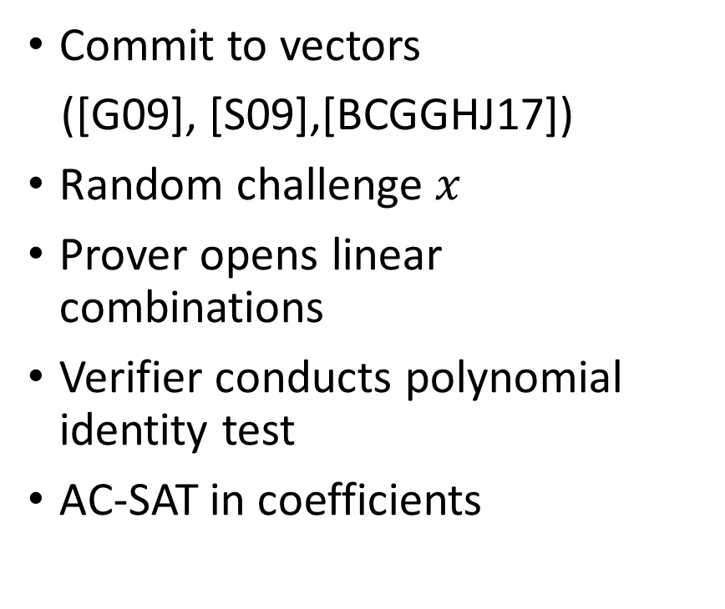
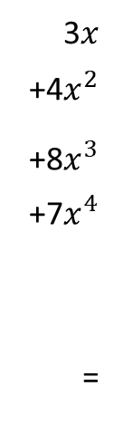
Paradigm from Previous Arguments
Commit to vectors
([G09], [S09],[BCGGHJ17])
Random challenge $x$
Prover opens linear combinations
Verifier conducts polynomial identity test
AC-SAT in coefficients
3$x$
+4$x^{2}$
+8$x^{3}$
+7$x^{4}$ =
2 | 6 | 6 | 2 | 0 | 1 | 9 | 2 | 7 | 4
5 | 3 | 7 | 2 | 8 | 3 | 6 | 1 | 6 | 9
5 | 7 | 6 | 7 | 1 | 4 | 2 | 6 | 8 | 3
6 | 3 | 7 | 2 | 7 | 5 | 3 | 2 | 4 | 7
5 | 2 | 8 | 7 | 3 | 1 | 0 | 4 | 7 | 3
Notes:
Previous protocols commit to rows of each matrix. Verifier sends a random challenge x to the prover. Prover releases linear combinations of rows using challenge.
Allows verifier to build polynomials with arithmetic circuit satisfiability embedded into coefficients, to check.
Verifier needs to check that linear combinations are correctly formed from commitments to rows. These works use homomorphic commitments to each row, so easy to produce commitment to linear combination and then check against vector.

Slide 28




Protocol Flow
1. Commit to wire values
P
V
$y←$C
2. Commit to polynomial coefficients
$x←$C
3. Commit to mod p correction factors
Check size bounds and linear combinations
$z←$C
4. Compute linear combinations, do rejection sampling, proof of knowledge
, Proof of Knowledge
Notes:
Want to verify arithmetic circuit satisfiability modulo p. But SIS based commitments are for small elements. Computations on small elements treated like integer computations, no modular reduction. To check that the correct conditions hold modulo p, we need to include these correction factors.
POK absolutely essential. In other settings, sending linear combinations almost guarantees that the prover knows openings. Solve linear equations in security proof. When working with lattices, additional constraints such as short solutions prevent the same proof techniques. We need the POK to fix this.

Slide 29

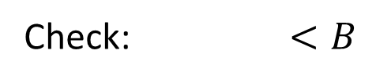
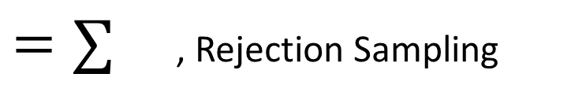
Protocol Flow
√N
√N
P
V
√N
$y←$C
√N
O(1)
$x←$C
√N
O(1)
Check: $<B$
$z←$C
$=∑$ , Rejection Sampling
com( )$=∑$
, Proof of Knowledge

Slide 30
Parameter Choice
q, modulus for SIS
binding space for SIS commitments
Polynomial-sized gap
maximum size of openings from knowledge-extractor
maximum size of honest prover committed values
p, arithmetic circuits modulo p
Notes:
What determines parameters?
Need SIS hard
Lots of linear combinations of openings and calculations on linear combinations of openings. Need binding space large enough to accommodate this
Size diagram of different bounds involved?

Slide 31

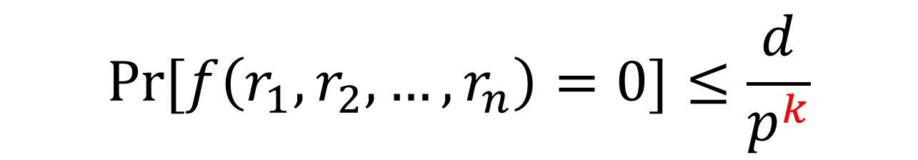


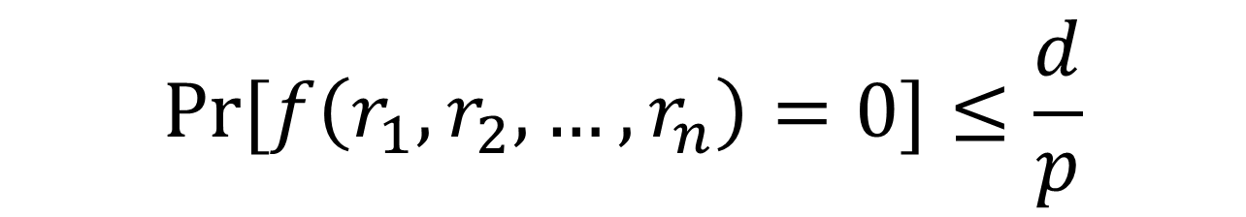

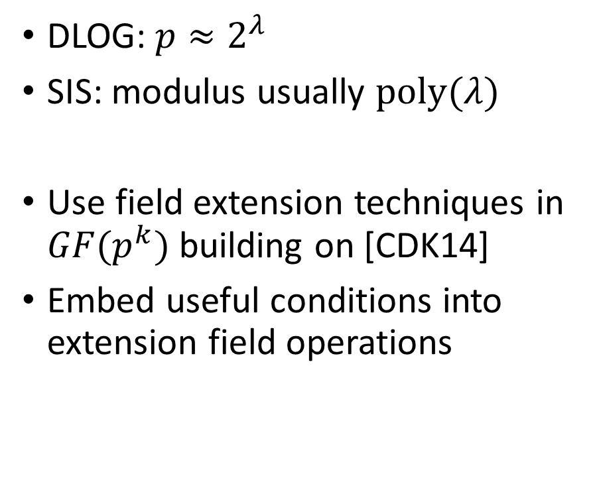

Additional Issues
DLOG: $p≈2^{λ}$
SIS: modulus usually $poly(λ)$
Use field extension techniques in $GF(p^{k})$ building on [CDK14]
Embed useful conditions into extension field operations
Schwarz-Zippel Lemma:
$$Pr[f\left(r_{1},r_{2},…,r_{n}\right)=0]≤\frac{d}{p^{k}}$$
$$Pr[f\left(r_{1},r_{2},…,r_{n}\right)=0]≤\frac{d}{p}$$
Negligible!
Not negligible!
Empty
Empty
Rubbish
$a$
$$b$$
$$a⋅b$$
$$×$$
$$=$$
Rubbish
Notes:
$GF\left(p^{k}\right)$ a vector space over $GF\left(p\right)$
$GF\left(p^{k}\right)$-multiplications are linear maps on $GF\left(p\right)$
Homomorphic commitments
View $k$ commitments as a homomorphic commitment to a $GF(p^{k})$ element!
Run protocol over $GF\left(p^{k}\right)$ (extends [CDK14])
Used in [CDK14] for linear relations

Slide 32
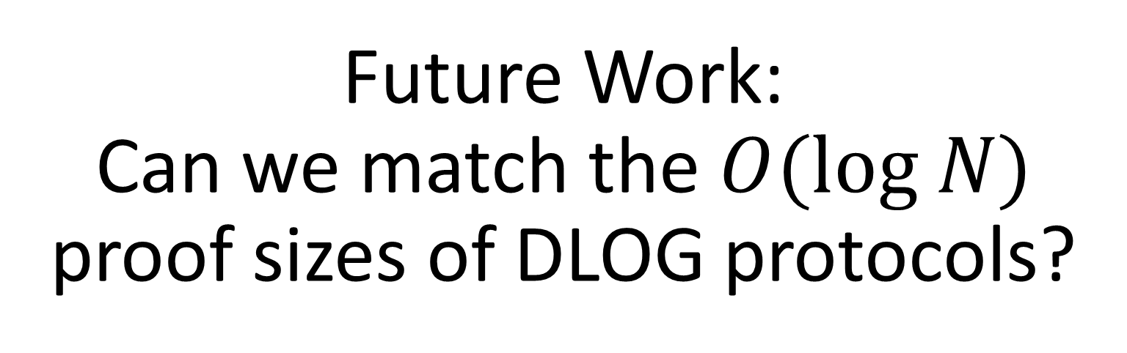
Future Work:
Can we match the $O(log N)$ proof sizes of DLOG protocols?

Slide 33
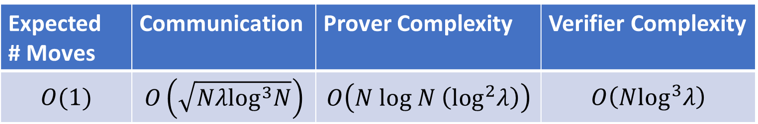


Thanks!
Expected # Moves | Communication | Prover Complexity | Verifier Complexity
$$O(1)$$ | $$O\left(\sqrt{Nλ\log^{3}N}\right)$$ | $$O\left(N log N \left(\log^{2}λ\right)\right)$$ | $$O\left(N\log^{3}λ\right)$$
General Statements
Sub-linear proofs
Relies on SIS
$N$ gates
Security parameter $λ$

