Slide 1
Drivable Area Segmentation and Lane Detection
Team Members:
Bal Narendra Sapa
Ajay Kumar Jagu

Slide 2
Content
01. Dataset Preprocessing
02. Method (Architecture, Loss)
03. Experiments

Slide 3
Dataset Preprocessing
We have used stable diffusion to generate the samples.
Number of Samples: 200
Image Size: 640x360
Annotation:
LabelMe tool was used to annotate the samples.
Each Image is annotated twice one for Drivable Area Segmentation and another for Lane Detection
Dataset Partitioning:
Training: 80% (160 Samples)
Validation: 10% (20 Samples)
Testing: 10% (20 Samples)

Slide 4
Dataset Preprocessing
Transformations: Randomly given below methods are chosen to make the model more robust
Random Perspective Transformation: Random Rotation, Translation
HSV Color Augmentation: This changes the hue, saturation, and value of the image.
Image Resizing: If the input image is not in 640x360 size, it will be resized to this size.
Label Preprocessing: The label images are thresholded to create binary masks.
The output is a binary mask.

Slide 5
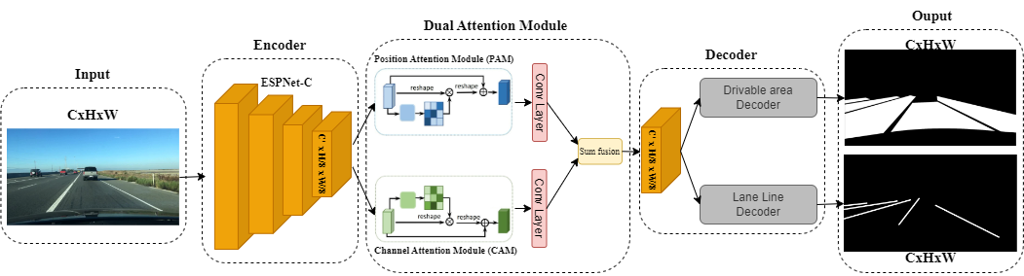
Method – Architecture, Loss

Slide 6
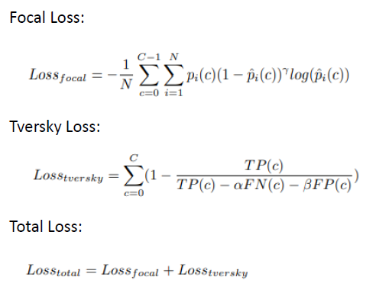
Method – Architecture, Loss
Tversky loss and Focal loss are used here. Total loss = Focal Loss + Tversky Loss

Slide 7
Experiments
Number of Epochs: 8
Learning Rate:
Initial Learning Rate: 5e-4
A polynomial Learning Rate Scheduler is used to dynamically decreases the learning rate across the epochs
Optimization Algorithm: Adam Optimizer
Learning Rate Decay: 5e-4
Hyper-Parameter Search:
Higher epochs(15 Epochs were tested initially) results in increase in validation loss. Hence 8 is chosen.
Performance Metric:
Pixel Accuracy, IoU(Intersection over Union)

Slide 8
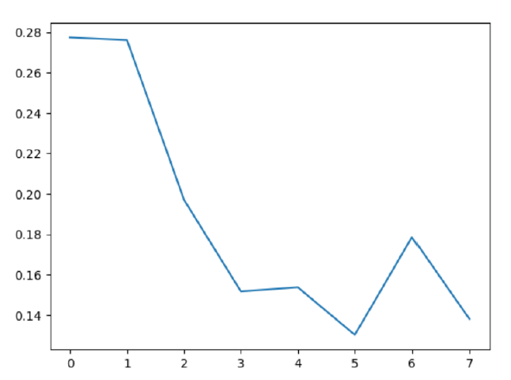
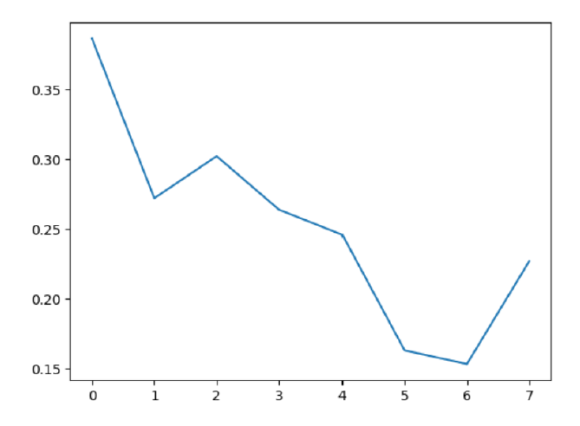
Experiments
Training Loss: Validation Loss:

Slide 9
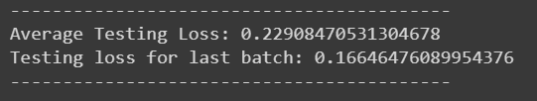
Experiments
Testing Loss:
Pixel Accuracy and Intersection over Union:

