Slide 1
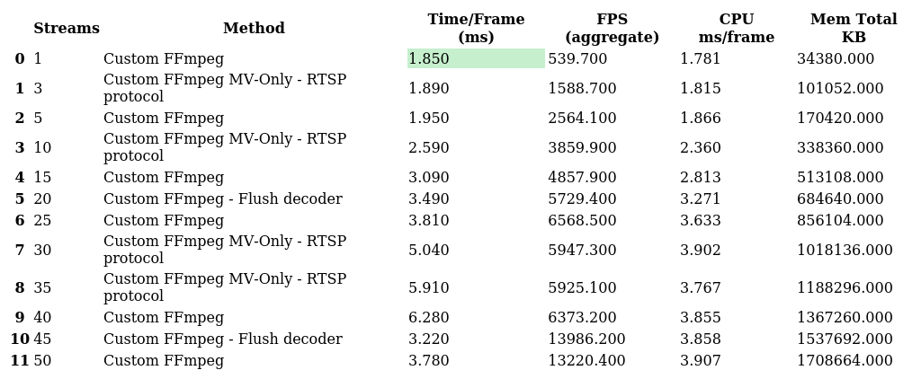
Fastest Methods
Best (lowest time/frame) method at each streams value

Slide 2
Speedup Analysis
All metrics normalised so >1.0 = improvement over baseline

Slide 3
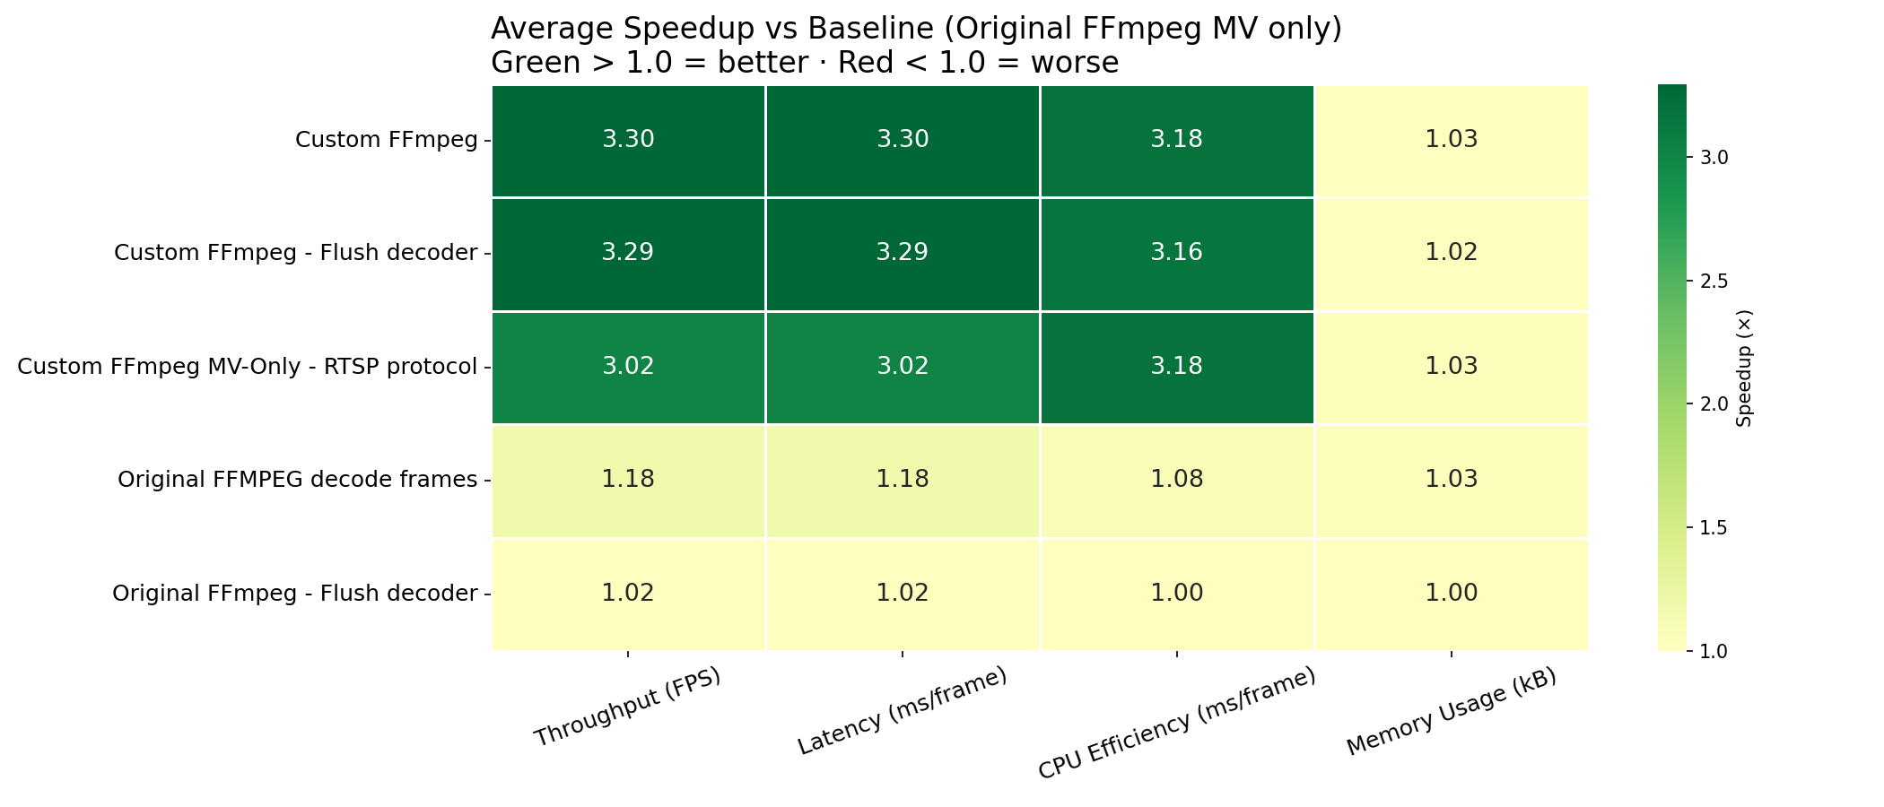
Speedup Heatmap vs Baseline (Original FFmpeg MV only)
Average speedup across all stream counts — green = better, red = worse (Original FFmpeg MV only = 1.0)

Slide 4
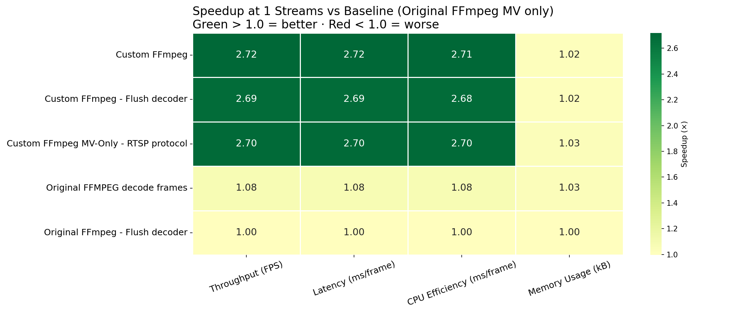
Speedup Heatmap at 1 Streams (Original FFmpeg MV only)
Speedup at 1 streams — green = better, red = worse (Original FFmpeg MV only = 1.0)

Slide 5

Speedup Heatmap at 3 Streams (Original FFmpeg MV only)
Speedup at 3 streams — green = better, red = worse (Original FFmpeg MV only = 1.0)

Slide 6
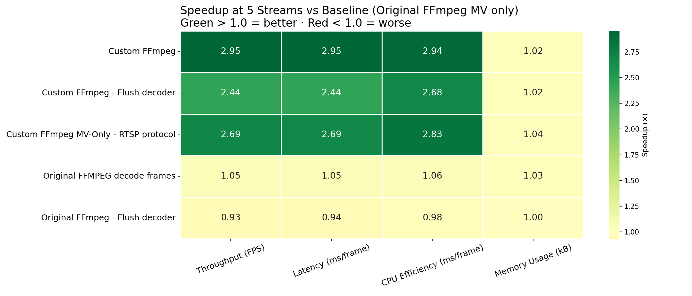
Speedup Heatmap at 5 Streams (Original FFmpeg MV only)
Speedup at 5 streams — green = better, red = worse (Original FFmpeg MV only = 1.0)

Slide 7
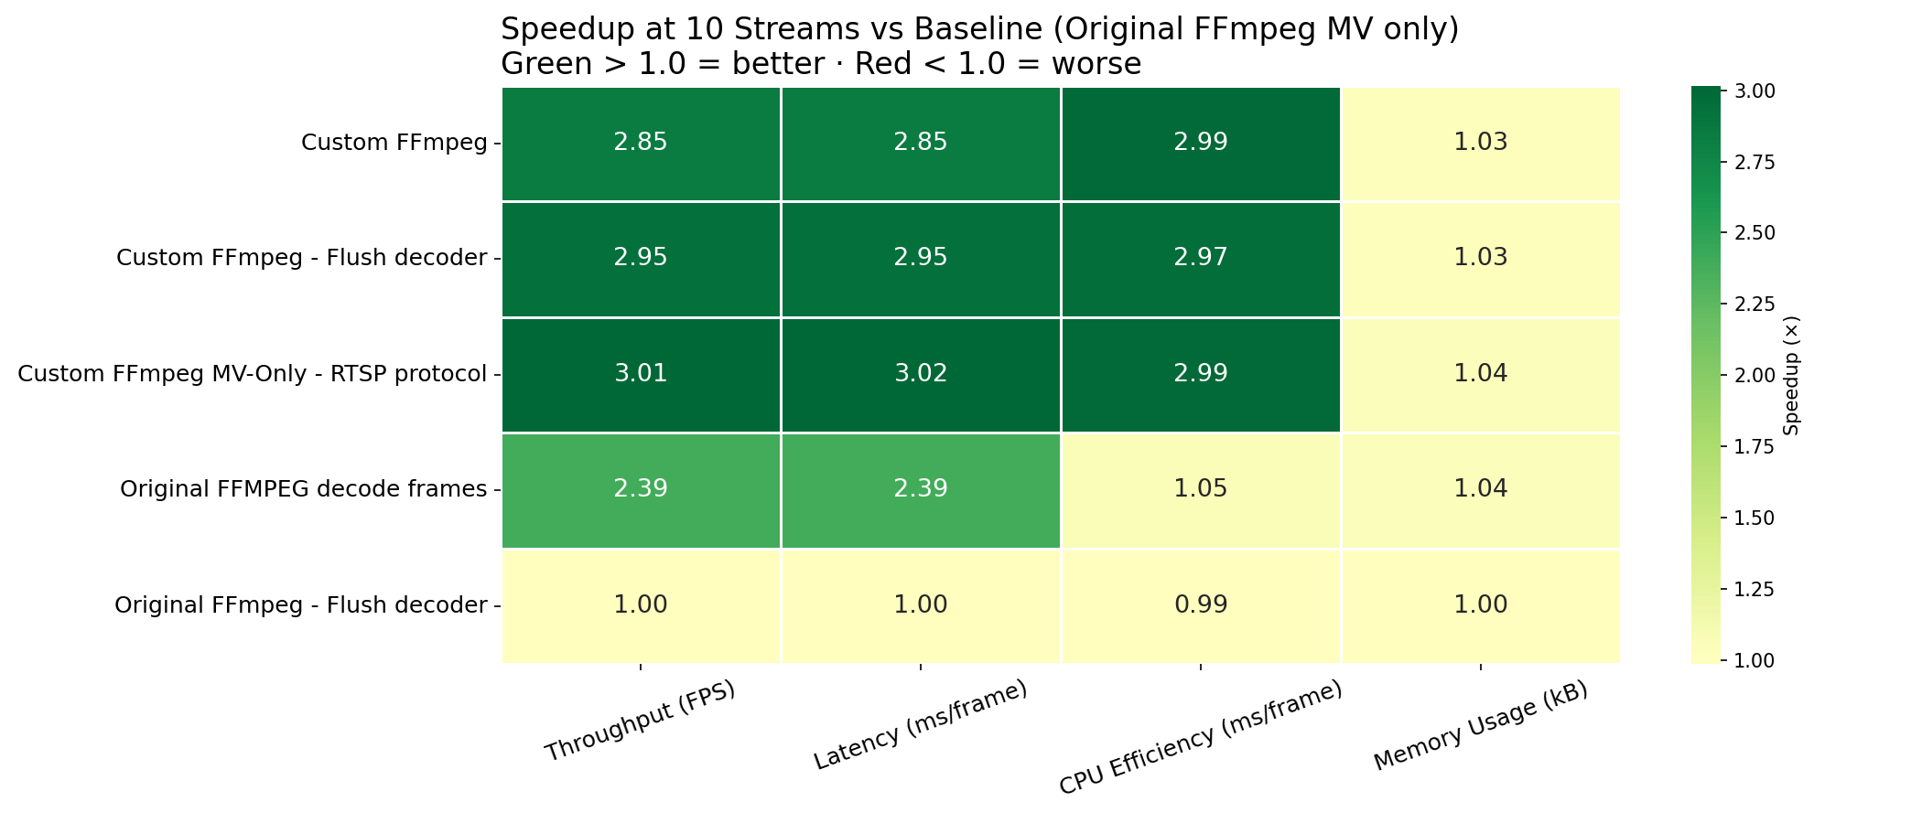
Speedup Heatmap at 10 Streams (Original FFmpeg MV only)
Speedup at 10 streams — green = better, red = worse (Original FFmpeg MV only = 1.0)

Slide 8
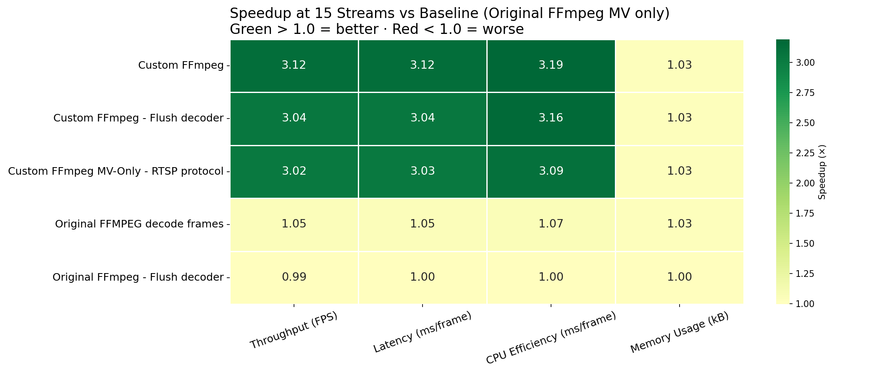
Speedup Heatmap at 15 Streams (Original FFmpeg MV only)
Speedup at 15 streams — green = better, red = worse (Original FFmpeg MV only = 1.0)

Slide 9

Speedup Heatmap at 20 Streams (Original FFmpeg MV only)
Speedup at 20 streams — green = better, red = worse (Original FFmpeg MV only = 1.0)

Slide 10
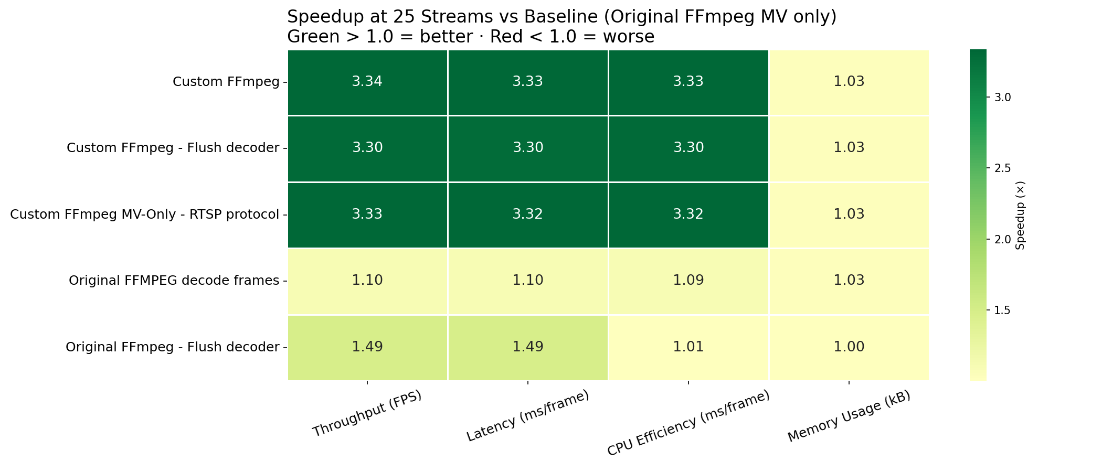
Speedup Heatmap at 25 Streams (Original FFmpeg MV only)
Speedup at 25 streams — green = better, red = worse (Original FFmpeg MV only = 1.0)

Slide 11
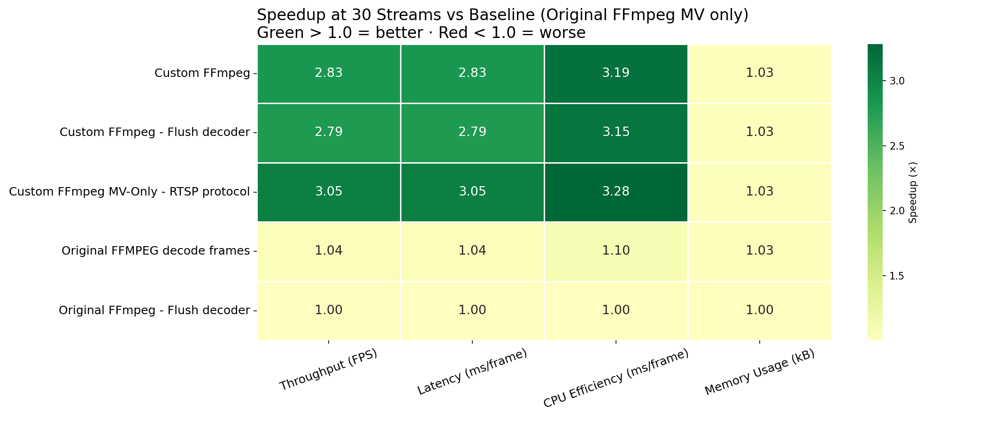
Speedup Heatmap at 30 Streams (Original FFmpeg MV only)
Speedup at 30 streams — green = better, red = worse (Original FFmpeg MV only = 1.0)

Slide 12
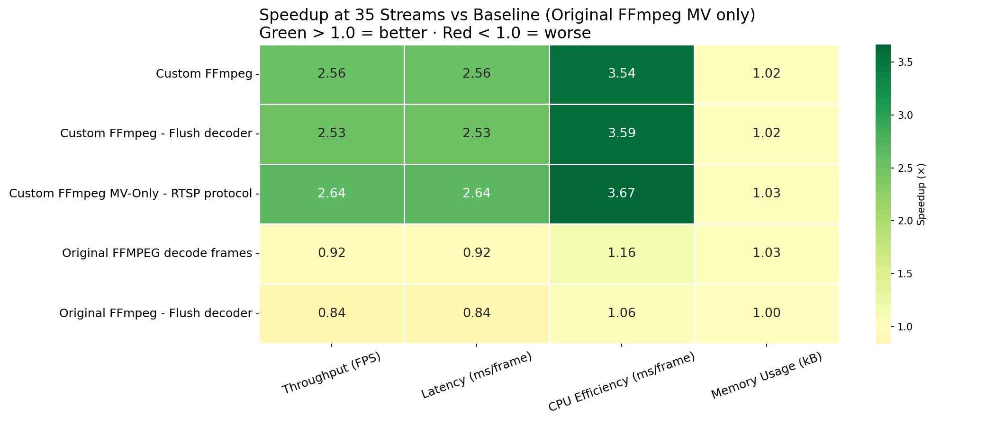
Speedup Heatmap at 35 Streams (Original FFmpeg MV only)
Speedup at 35 streams — green = better, red = worse (Original FFmpeg MV only = 1.0)

Slide 13
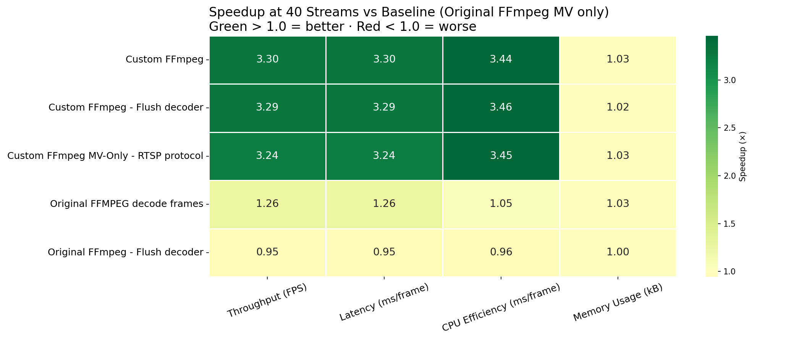
Speedup Heatmap at 40 Streams (Original FFmpeg MV only)
Speedup at 40 streams — green = better, red = worse (Original FFmpeg MV only = 1.0)

Slide 14
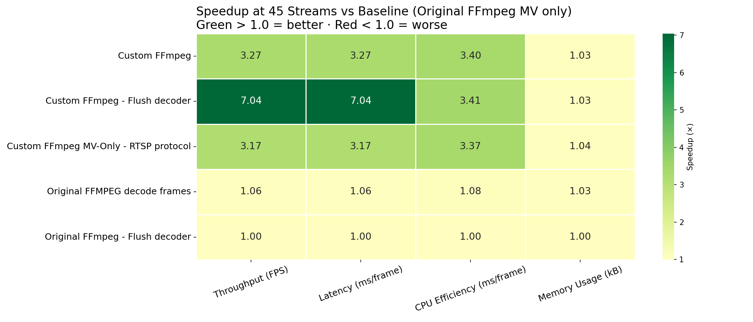
Speedup Heatmap at 45 Streams (Original FFmpeg MV only)
Speedup at 45 streams — green = better, red = worse (Original FFmpeg MV only = 1.0)

Slide 15
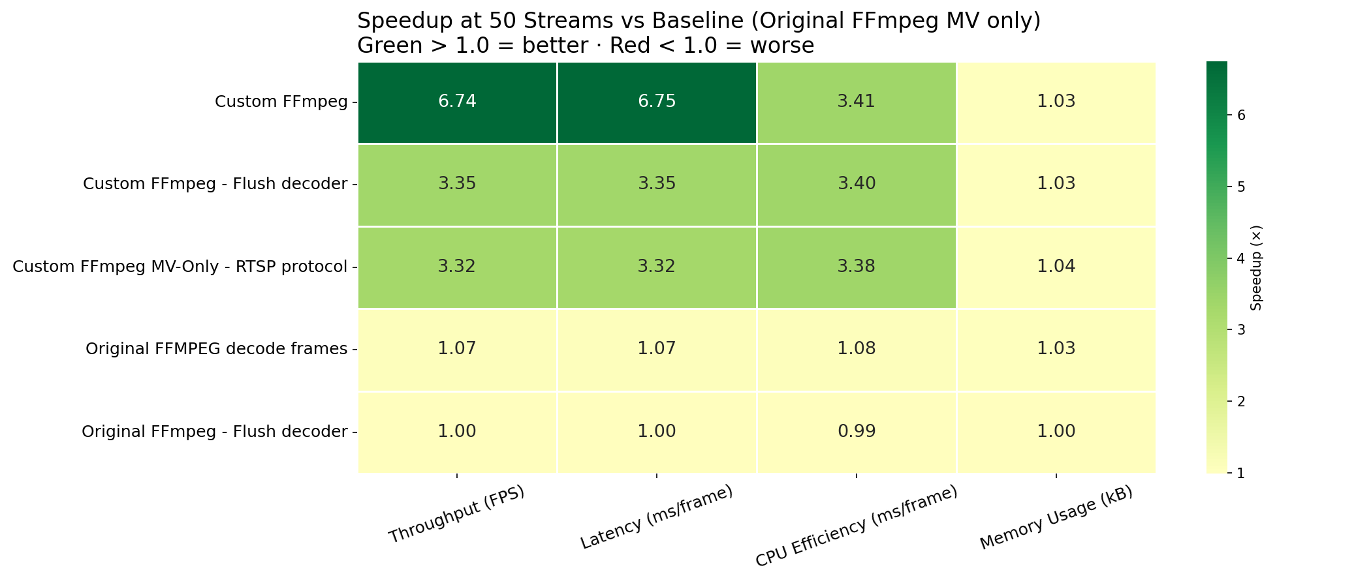
Speedup Heatmap at 50 Streams (Original FFmpeg MV only)
Speedup at 50 streams — green = better, red = worse (Original FFmpeg MV only = 1.0)

Slide 16
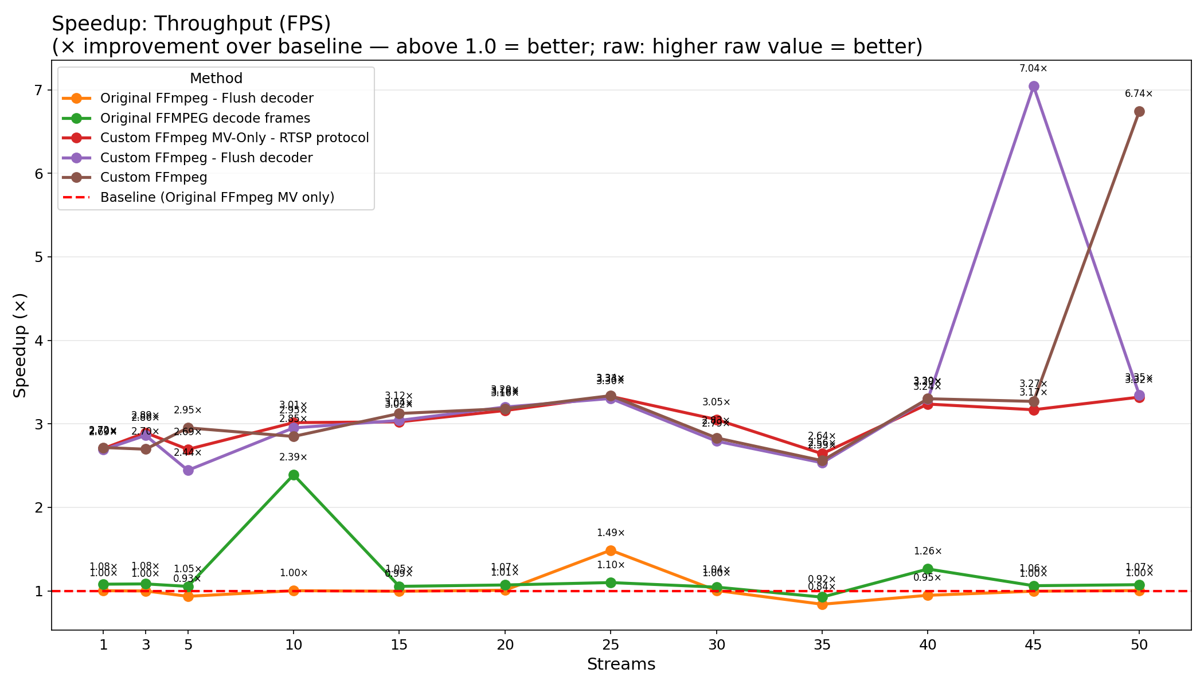
Throughput Speedup vs Baseline (Original FFmpeg MV only)
FPS ratio: method / baseline — values > 1.0 = higher throughput

Slide 17
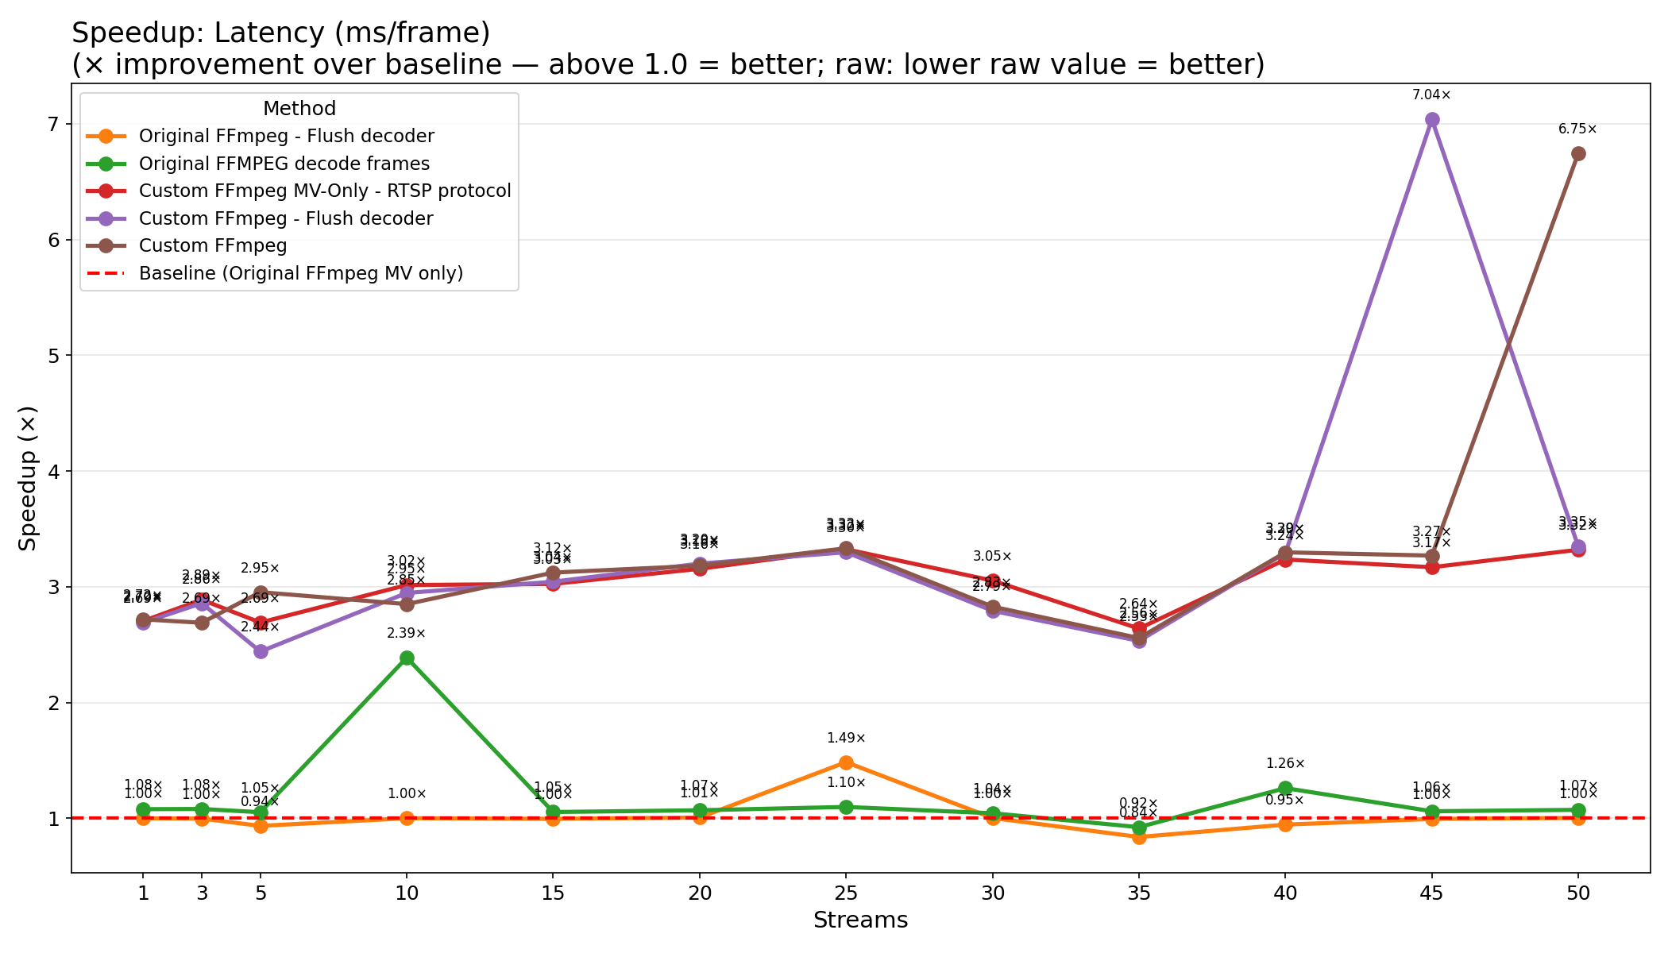
Latency Speedup vs Baseline (Original FFmpeg MV only)
Time/frame ratio: baseline / method — values > 1.0 = lower latency

Slide 18
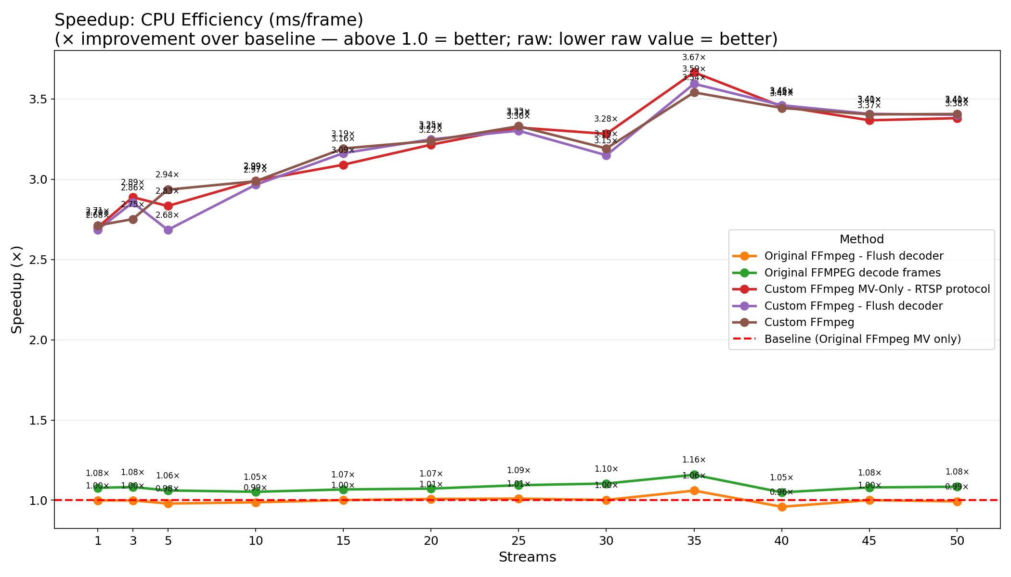
CPU Efficiency Speedup vs Baseline (Original FFmpeg MV only)
CPU ms/frame ratio: baseline / method — values > 1.0 = less CPU work

Slide 19
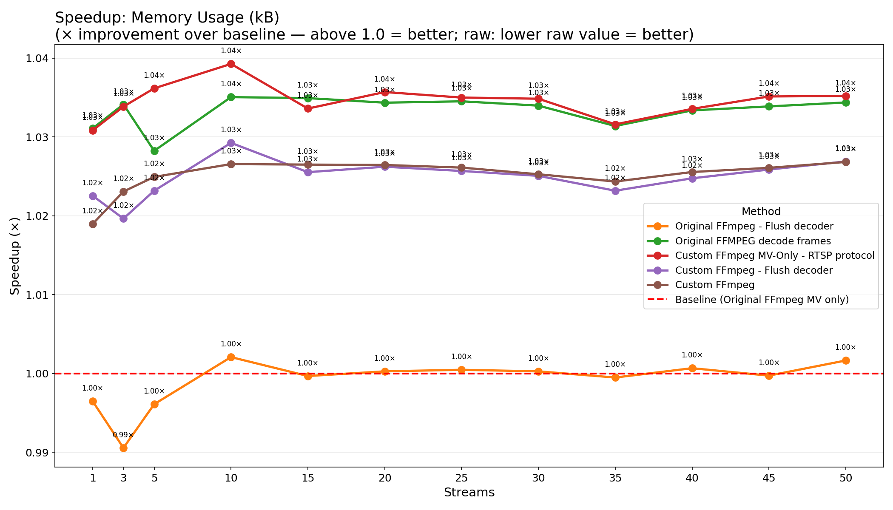
Memory Usage Speedup vs Baseline (Original FFmpeg MV only)
Memory ratio: baseline / method — values > 1.0 = less memory

Slide 20
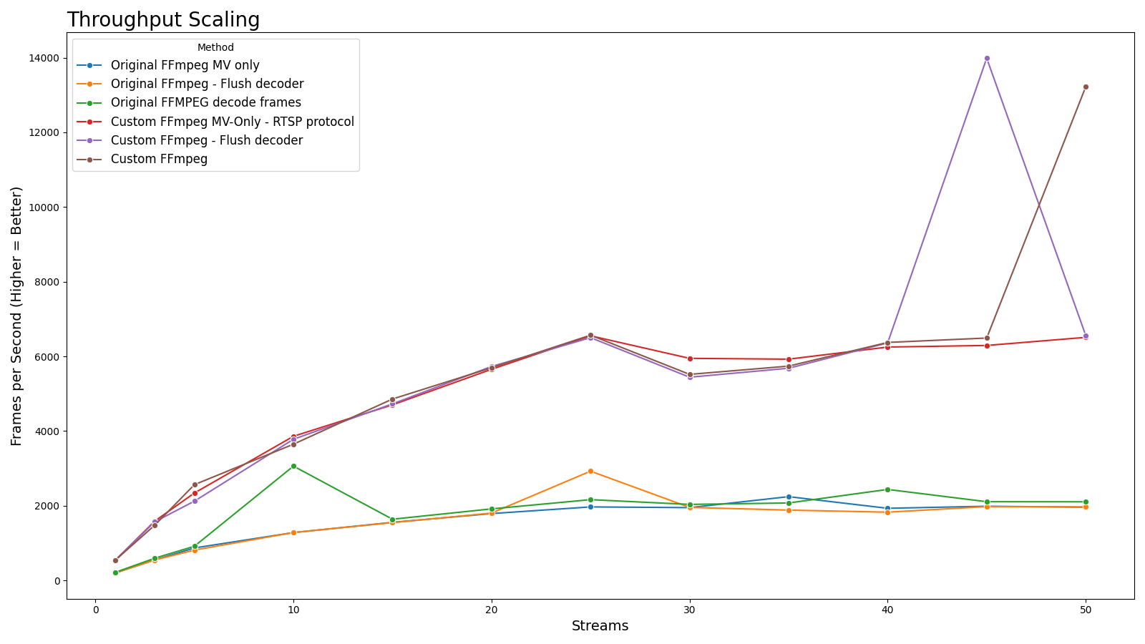
Throughput Scaling
High Profile Methods: FPS vs Streams

Slide 21
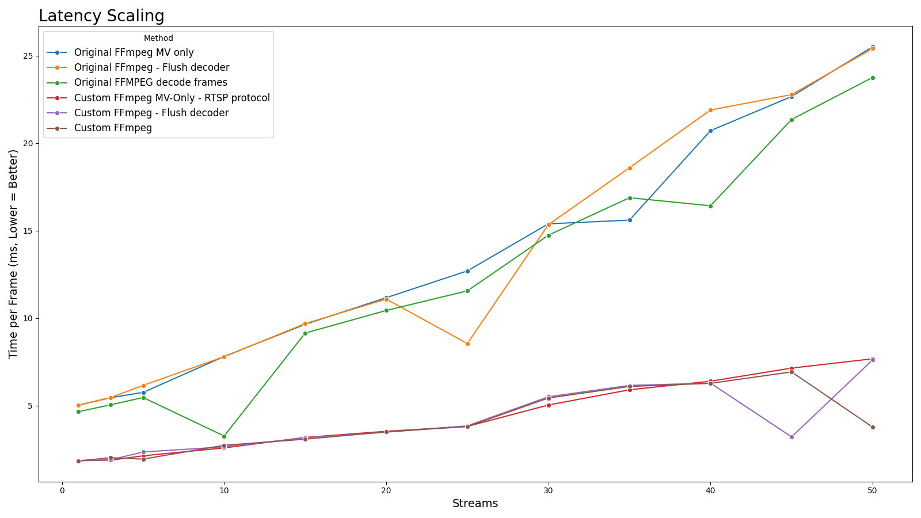
Latency Scaling
High Profile Methods: Time per Frame vs Streams

Slide 22
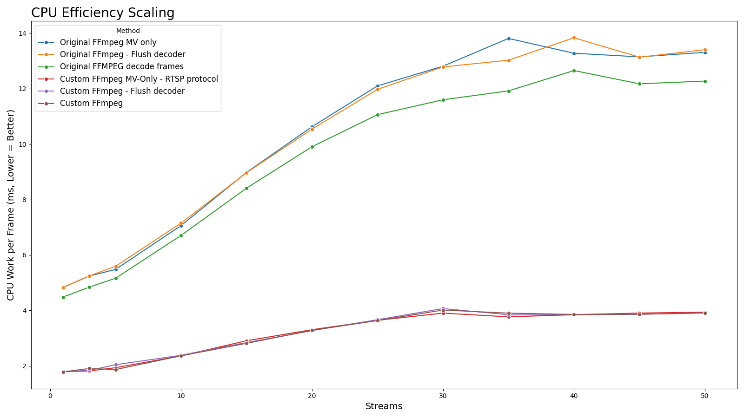
CPU Efficiency Scaling
High Profile Methods: CPU ms/frame vs Streams

Slide 23
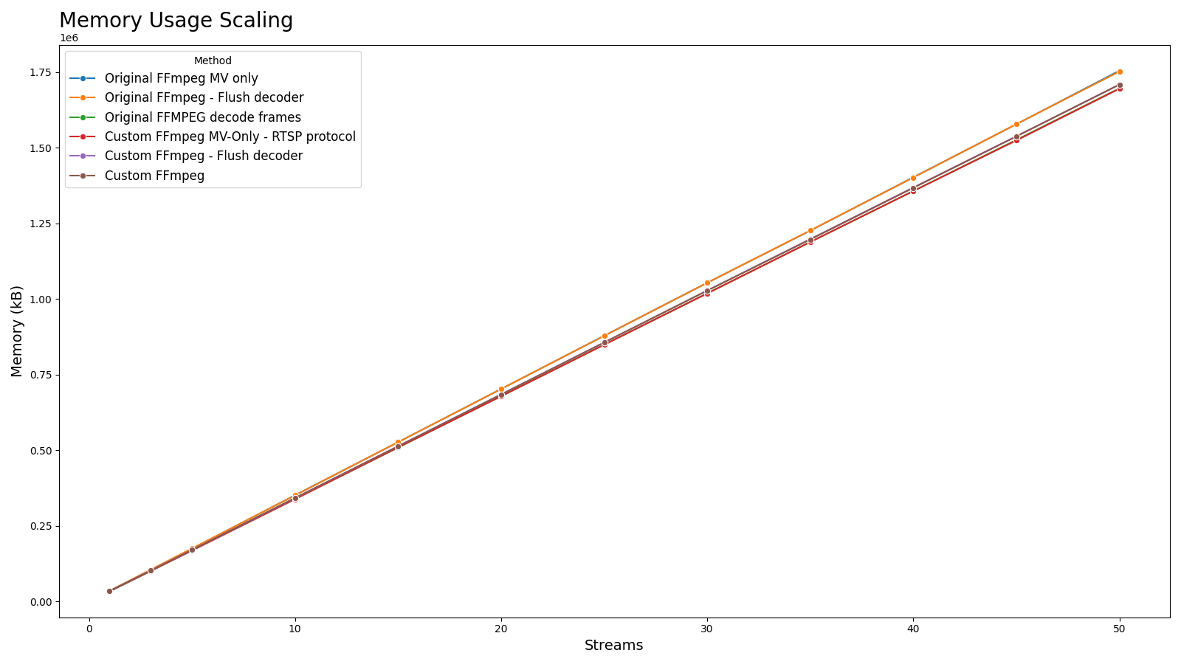
Memory Usage Scaling
High Profile Methods: Memory Usage (kB) vs Streams

Slide 24
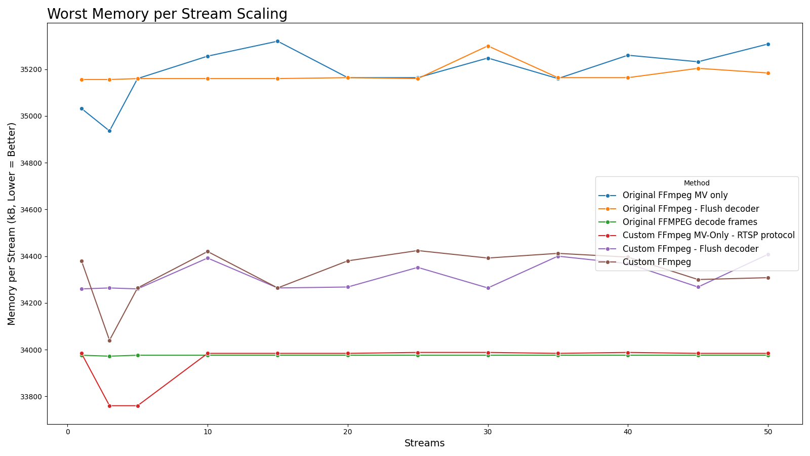
Worst Memory per Stream Scaling
High Profile Methods: Worst Memory/Stream (kB) vs Streams

Slide 25
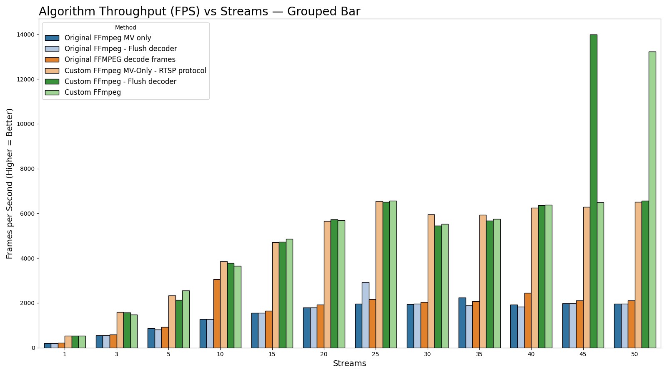
Grouped FPS Comparison (All Streams)
All High Profile Methods: FPS per Streams, Grouped Bar Chart

Slide 26
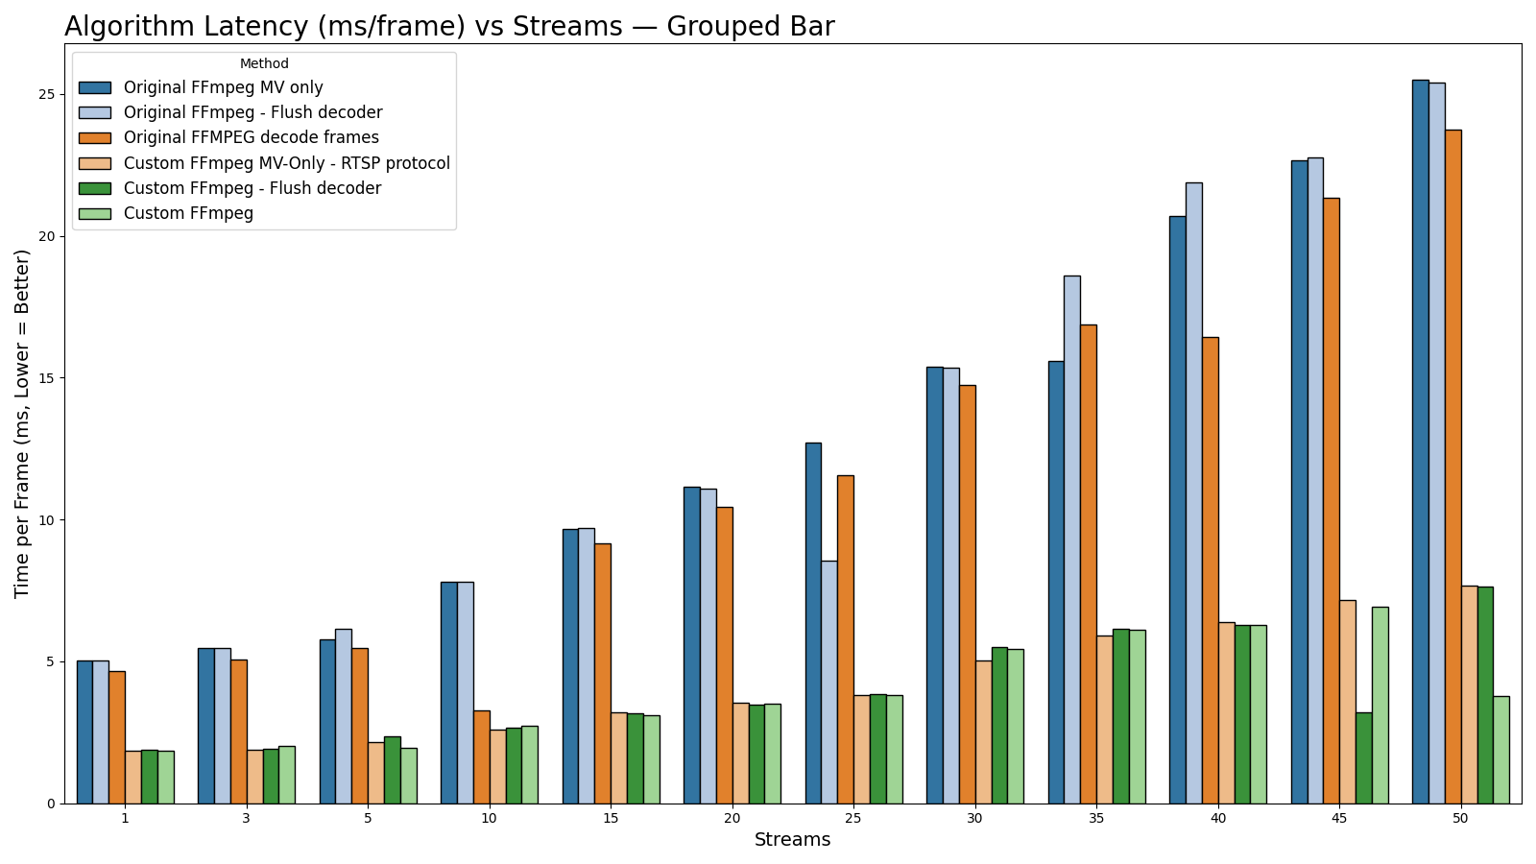
Grouped Latency Comparison (All Streams)
All High Profile Methods: Latency (ms/frame) per Streams, Grouped Bar Chart

Slide 27
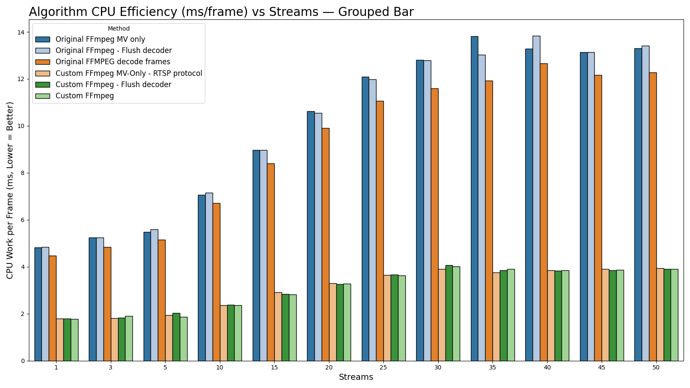
Grouped CPU Efficiency Comparison (All Streams)
All High Profile Methods: CPU ms/frame per Streams, Grouped Bar Chart

Slide 28
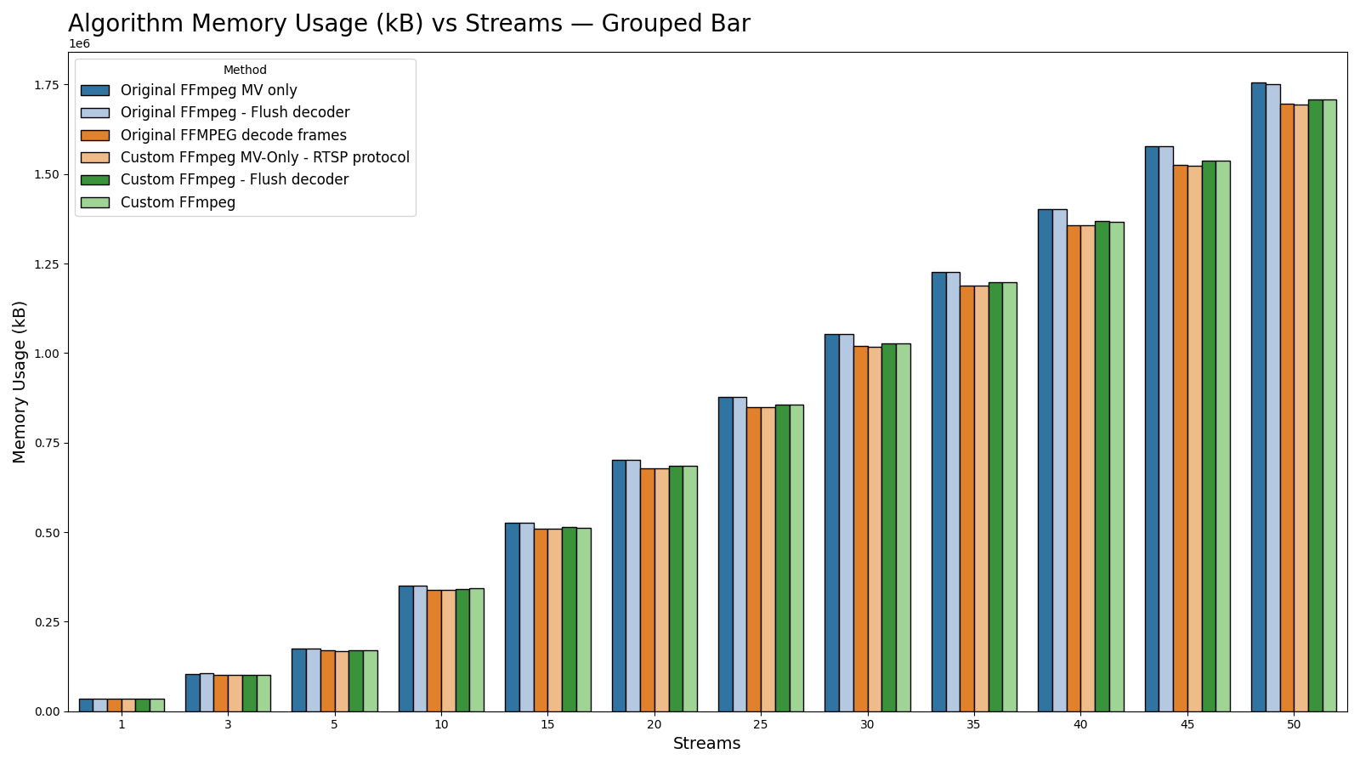
Grouped Memory Usage Comparison (All Streams)
All High Profile Methods: Memory Usage per Streams, Grouped Bar Chart

Slide 29
Detailed Tables
Full Per-Streams Benchmark Results

Slide 30
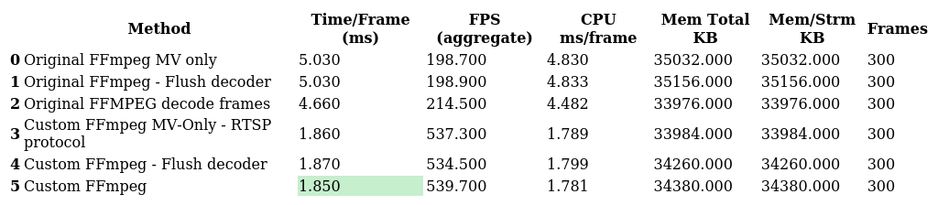
Detailed Table: Streams=1
All metrics for high-profile methods, streams=1

Slide 31
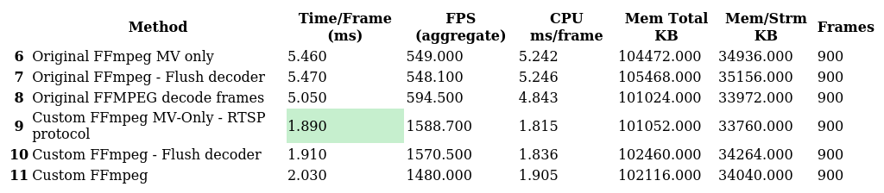
Detailed Table: Streams=3
All metrics for high-profile methods, streams=3

Slide 32
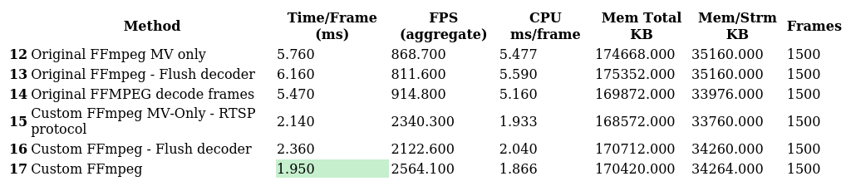
Detailed Table: Streams=5
All metrics for high-profile methods, streams=5

Slide 33
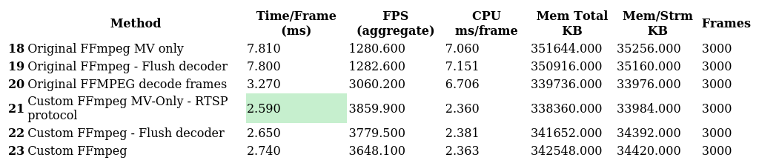
Detailed Table: Streams=10
All metrics for high-profile methods, streams=10

Slide 34
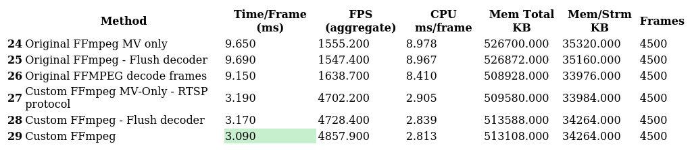
Detailed Table: Streams=15
All metrics for high-profile methods, streams=15

Slide 35
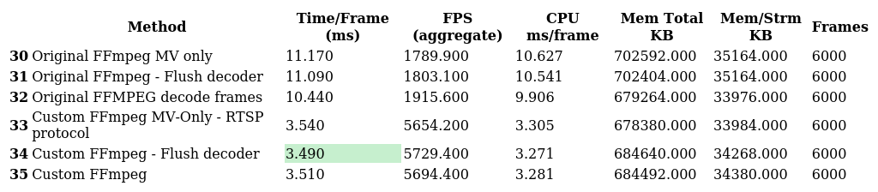
Detailed Table: Streams=20
All metrics for high-profile methods, streams=20

Slide 36
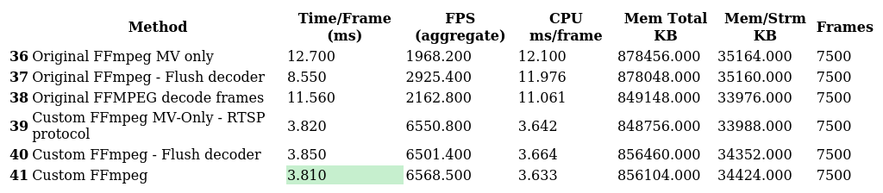
Detailed Table: Streams=25
All metrics for high-profile methods, streams=25

Slide 37

Detailed Table: Streams=30
All metrics for high-profile methods, streams=30

Slide 38
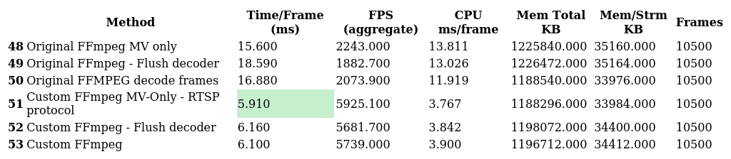
Detailed Table: Streams=35
All metrics for high-profile methods, streams=35

Slide 39
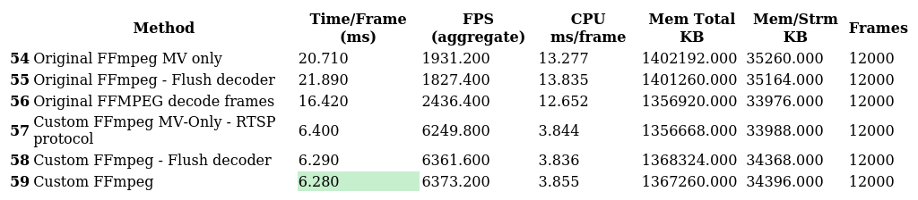
Detailed Table: Streams=40
All metrics for high-profile methods, streams=40

Slide 40

Detailed Table: Streams=45
All metrics for high-profile methods, streams=45

Slide 41
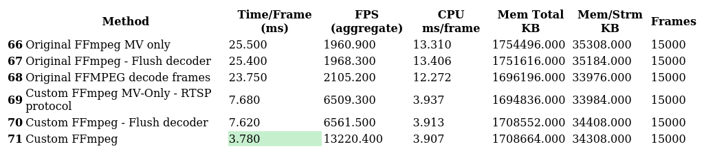
Detailed Table: Streams=50
All metrics for high-profile methods, streams=50

Slide 42
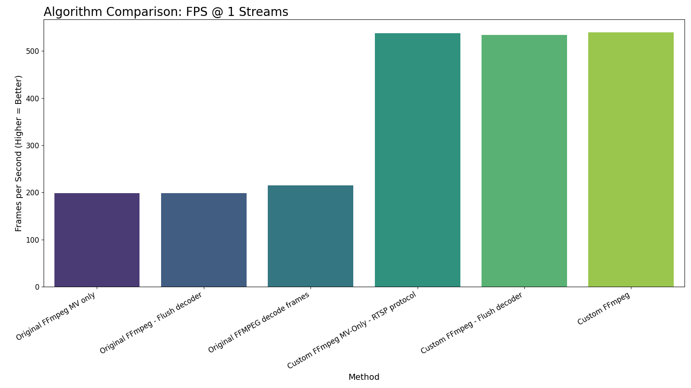
Algorithm FPS Comparison (1 Streams)
Throughput (FPS) by High Profile Method at 1 Streams

Slide 43
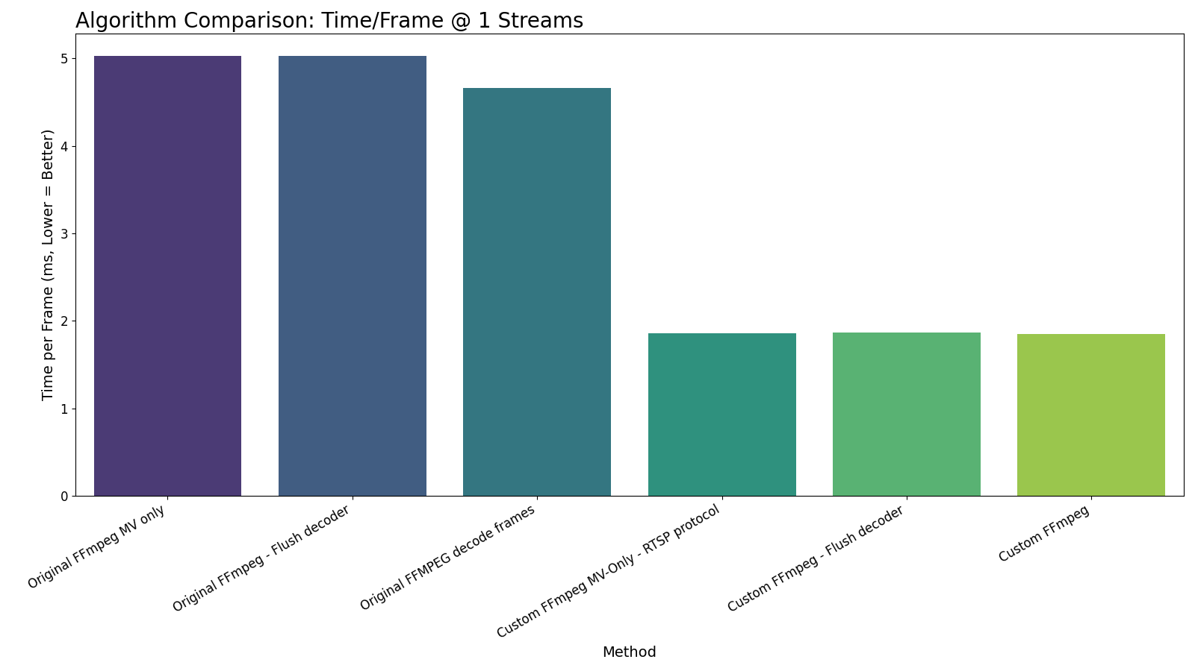
Algorithm Latency Comparison (1 Streams)
Time per Frame (ms) by High Profile Method at 1 Streams

Slide 44

Algorithm CPU Efficiency Comparison (1 Streams)
CPU ms/frame by High Profile Method at 1 Streams

Slide 45
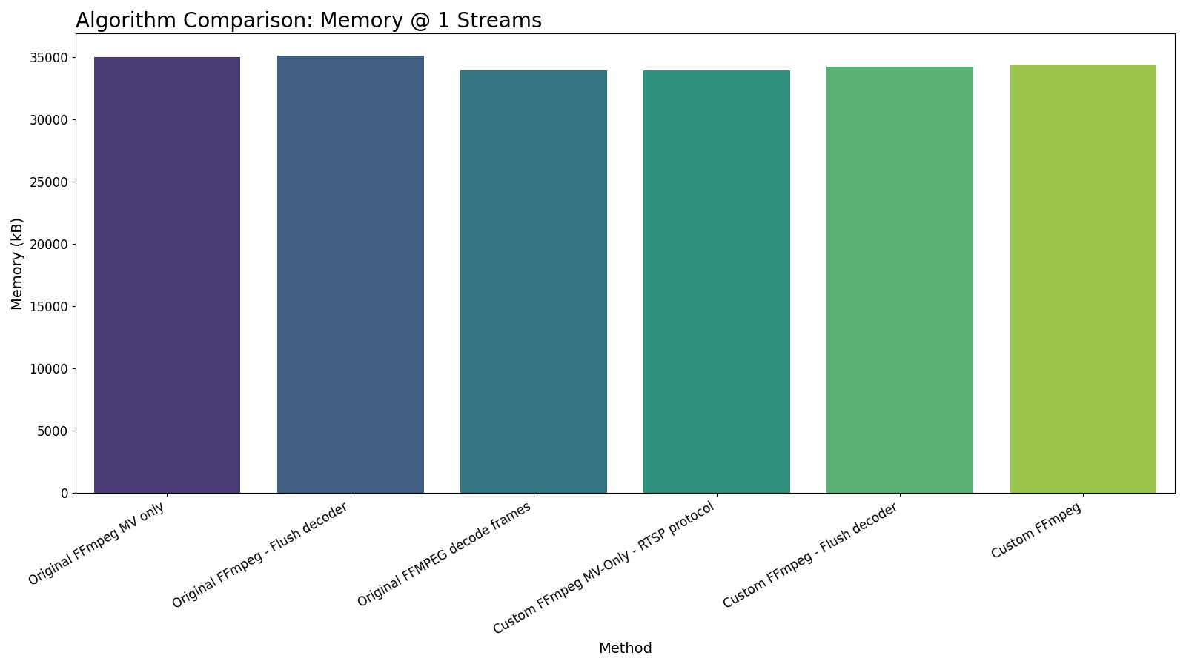
Algorithm Memory Usage Comparison (1 Streams)
Memory Peak (kB) by High Profile Method at 1 Streams

Slide 46
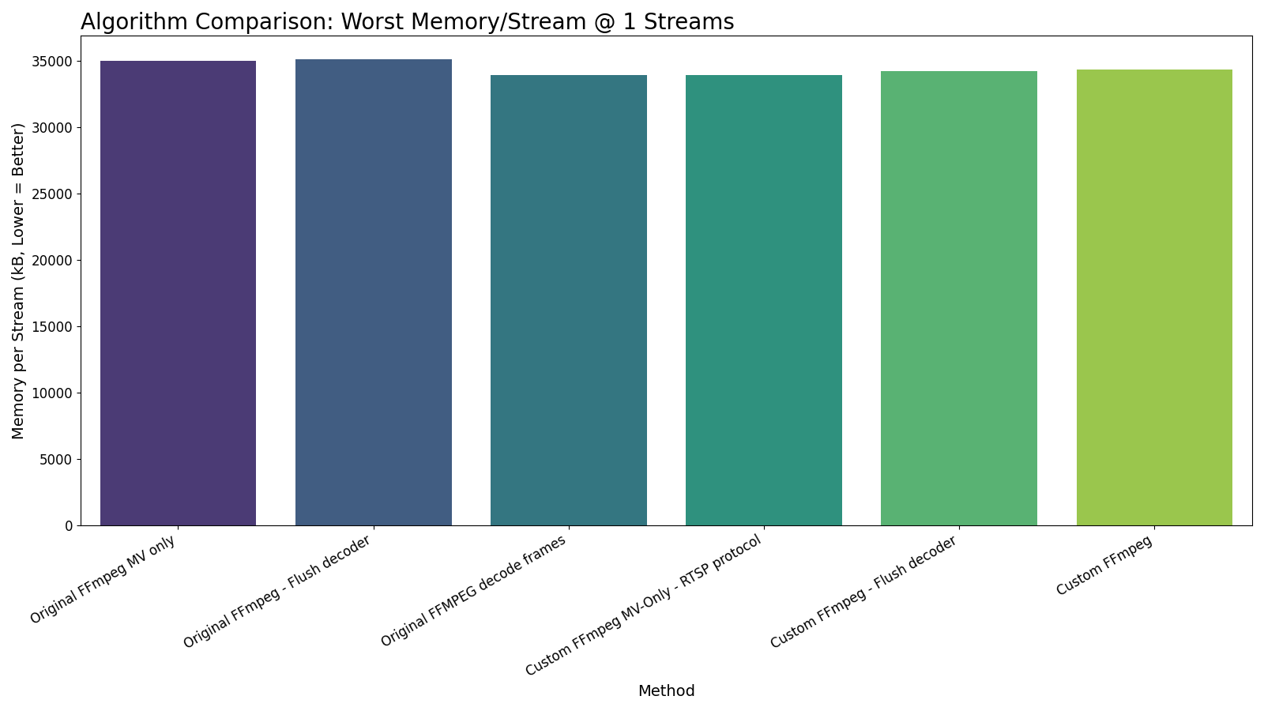
Algorithm Worst Memory/Stream Comparison (1 Streams)
Worst Memory per Stream (kB) by High Profile Method at 1 Streams

Slide 47
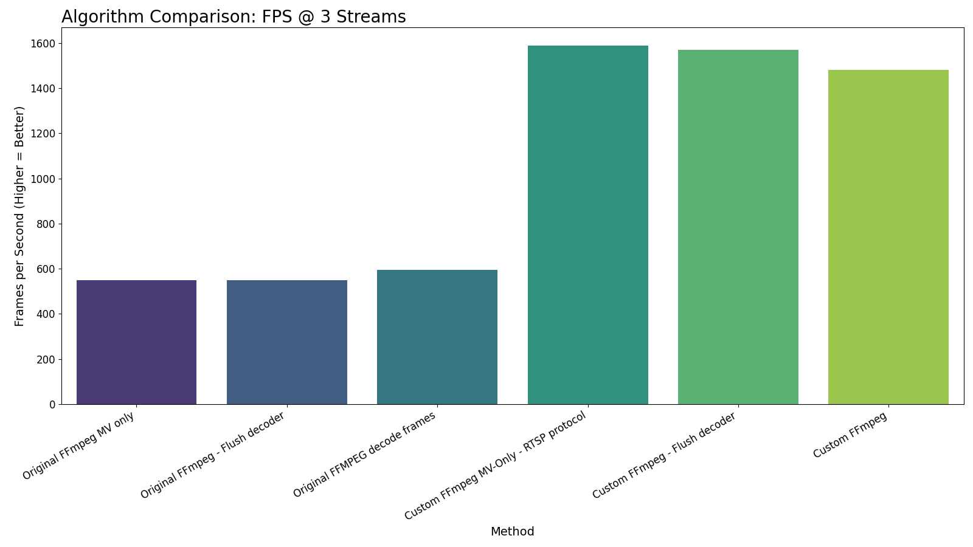
Algorithm FPS Comparison (3 Streams)
Throughput (FPS) by High Profile Method at 3 Streams

Slide 48
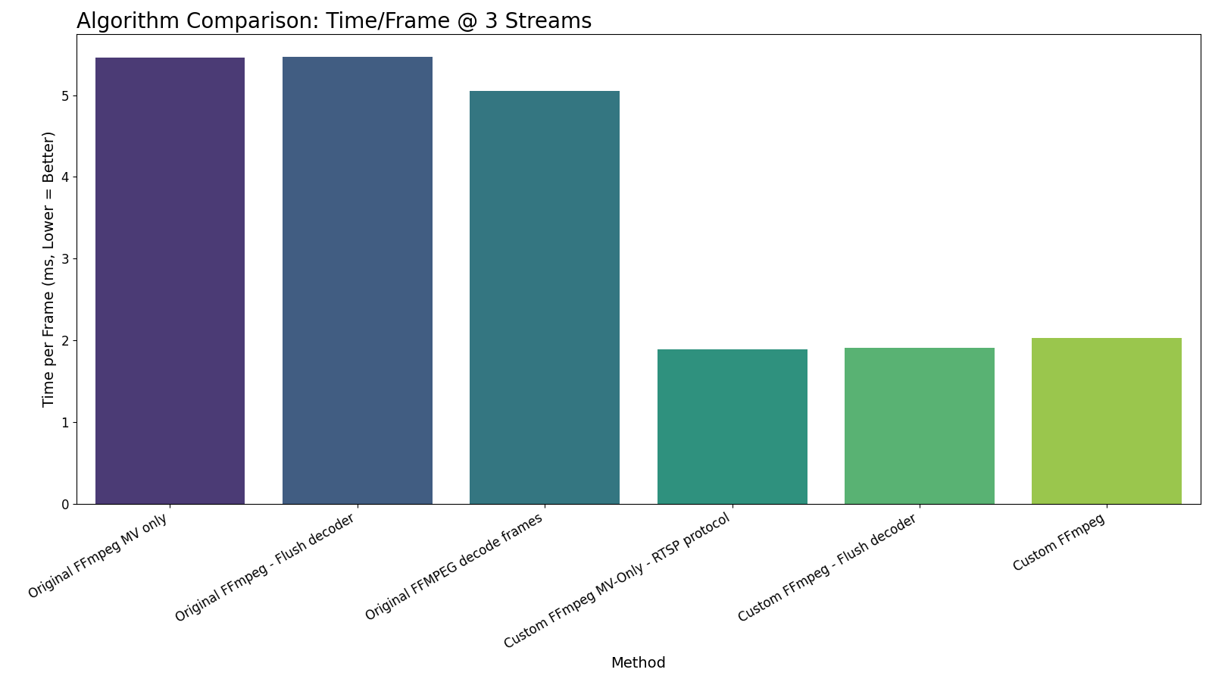
Algorithm Latency Comparison (3 Streams)
Time per Frame (ms) by High Profile Method at 3 Streams

Slide 49
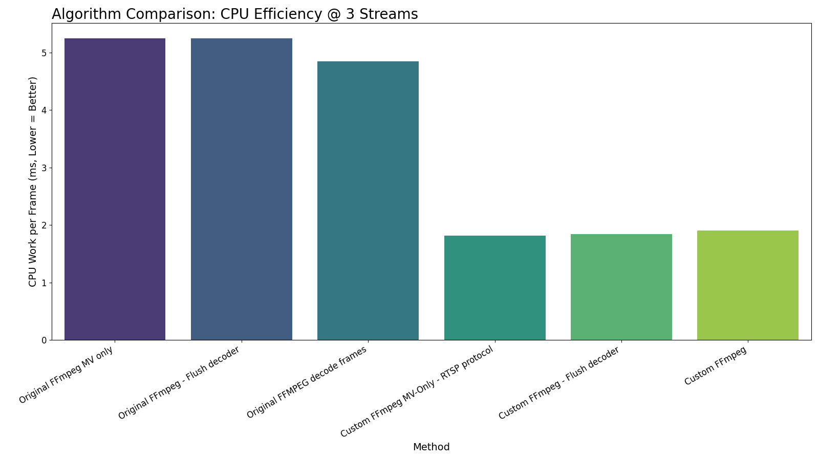
Algorithm CPU Efficiency Comparison (3 Streams)
CPU ms/frame by High Profile Method at 3 Streams

Slide 50
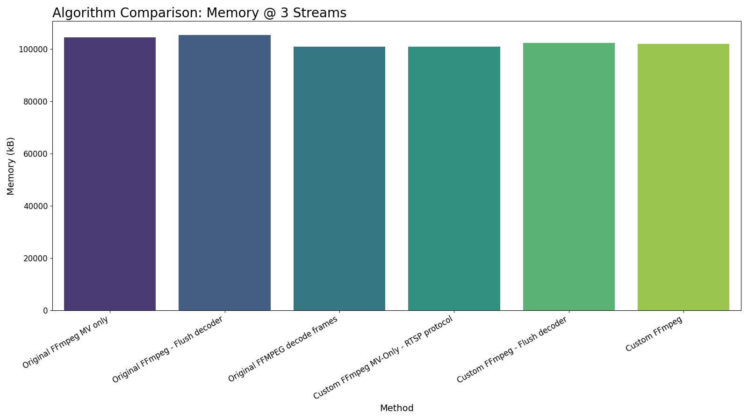
Algorithm Memory Usage Comparison (3 Streams)
Memory Peak (kB) by High Profile Method at 3 Streams

Slide 51

Algorithm Worst Memory/Stream Comparison (3 Streams)
Worst Memory per Stream (kB) by High Profile Method at 3 Streams

Slide 52
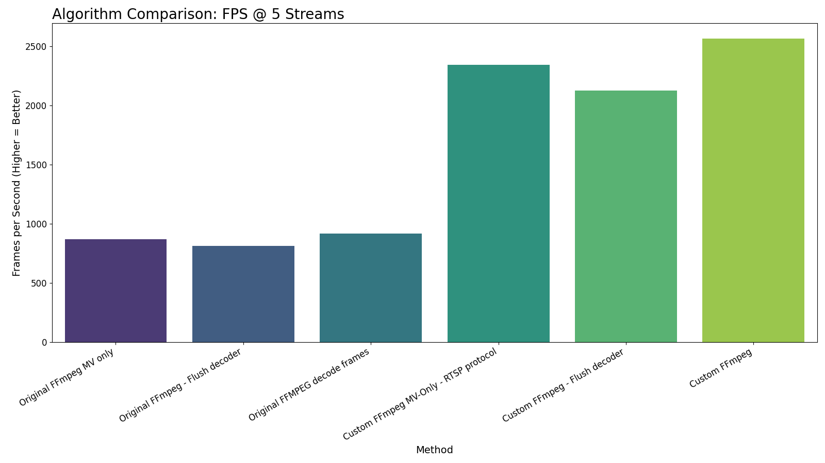
Algorithm FPS Comparison (5 Streams)
Throughput (FPS) by High Profile Method at 5 Streams

Slide 53
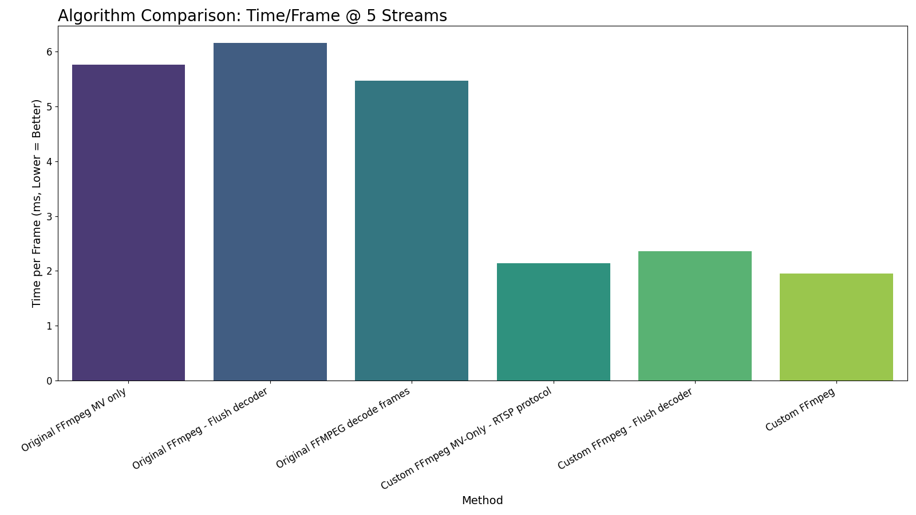
Algorithm Latency Comparison (5 Streams)
Time per Frame (ms) by High Profile Method at 5 Streams

Slide 54
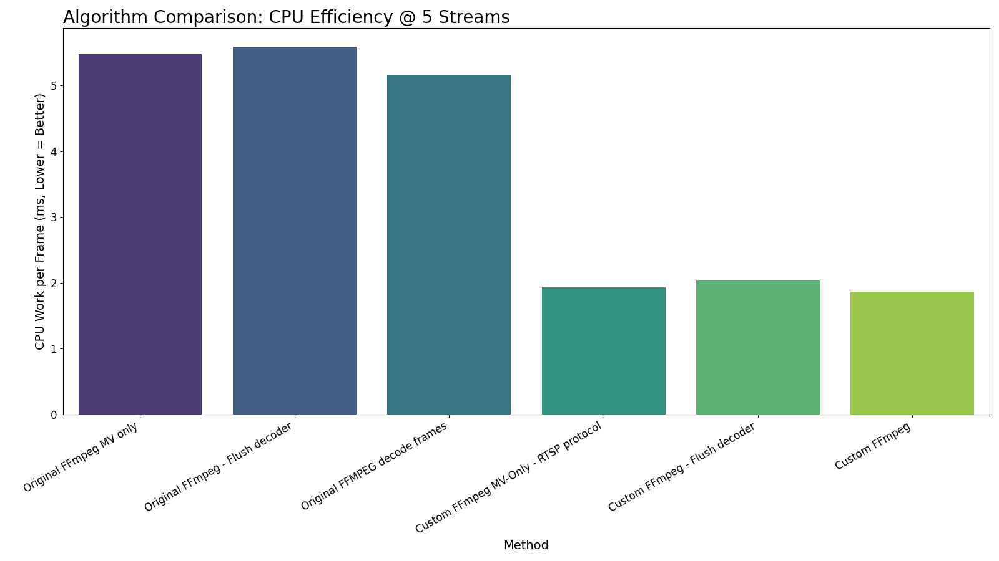
Algorithm CPU Efficiency Comparison (5 Streams)
CPU ms/frame by High Profile Method at 5 Streams

Slide 55

Algorithm Memory Usage Comparison (5 Streams)
Memory Peak (kB) by High Profile Method at 5 Streams

Slide 56

Algorithm Worst Memory/Stream Comparison (5 Streams)
Worst Memory per Stream (kB) by High Profile Method at 5 Streams

Slide 57
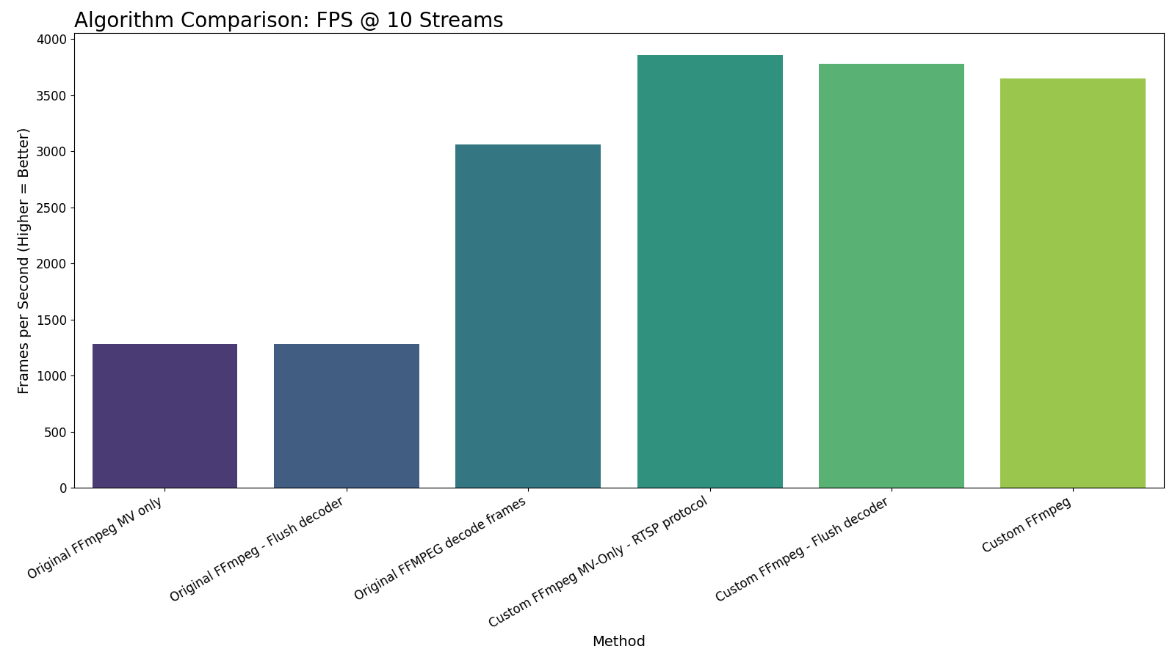
Algorithm FPS Comparison (10 Streams)
Throughput (FPS) by High Profile Method at 10 Streams

Slide 58
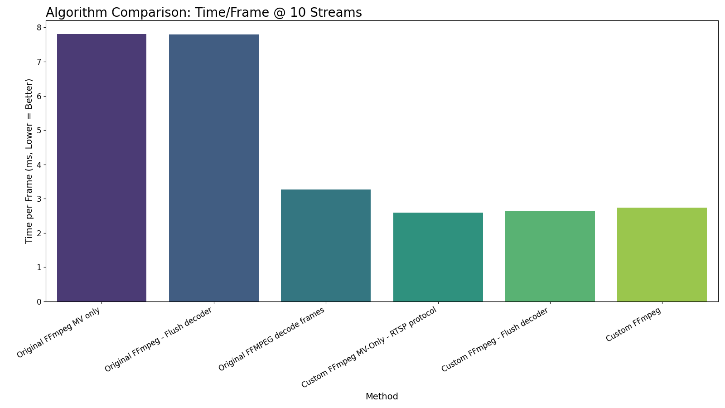
Algorithm Latency Comparison (10 Streams)
Time per Frame (ms) by High Profile Method at 10 Streams

Slide 59
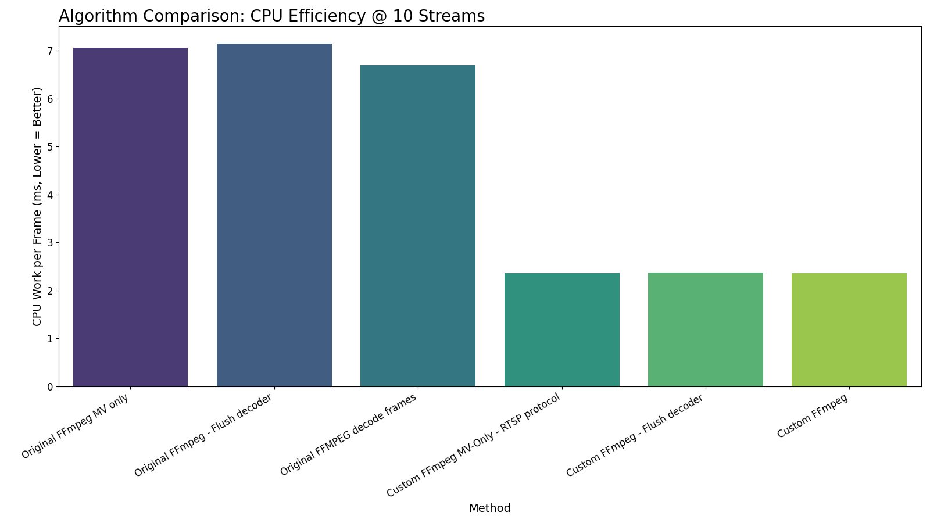
Algorithm CPU Efficiency Comparison (10 Streams)
CPU ms/frame by High Profile Method at 10 Streams

Slide 60

Algorithm Memory Usage Comparison (10 Streams)
Memory Peak (kB) by High Profile Method at 10 Streams

Slide 61

Algorithm Worst Memory/Stream Comparison (10 Streams)
Worst Memory per Stream (kB) by High Profile Method at 10 Streams

Slide 62
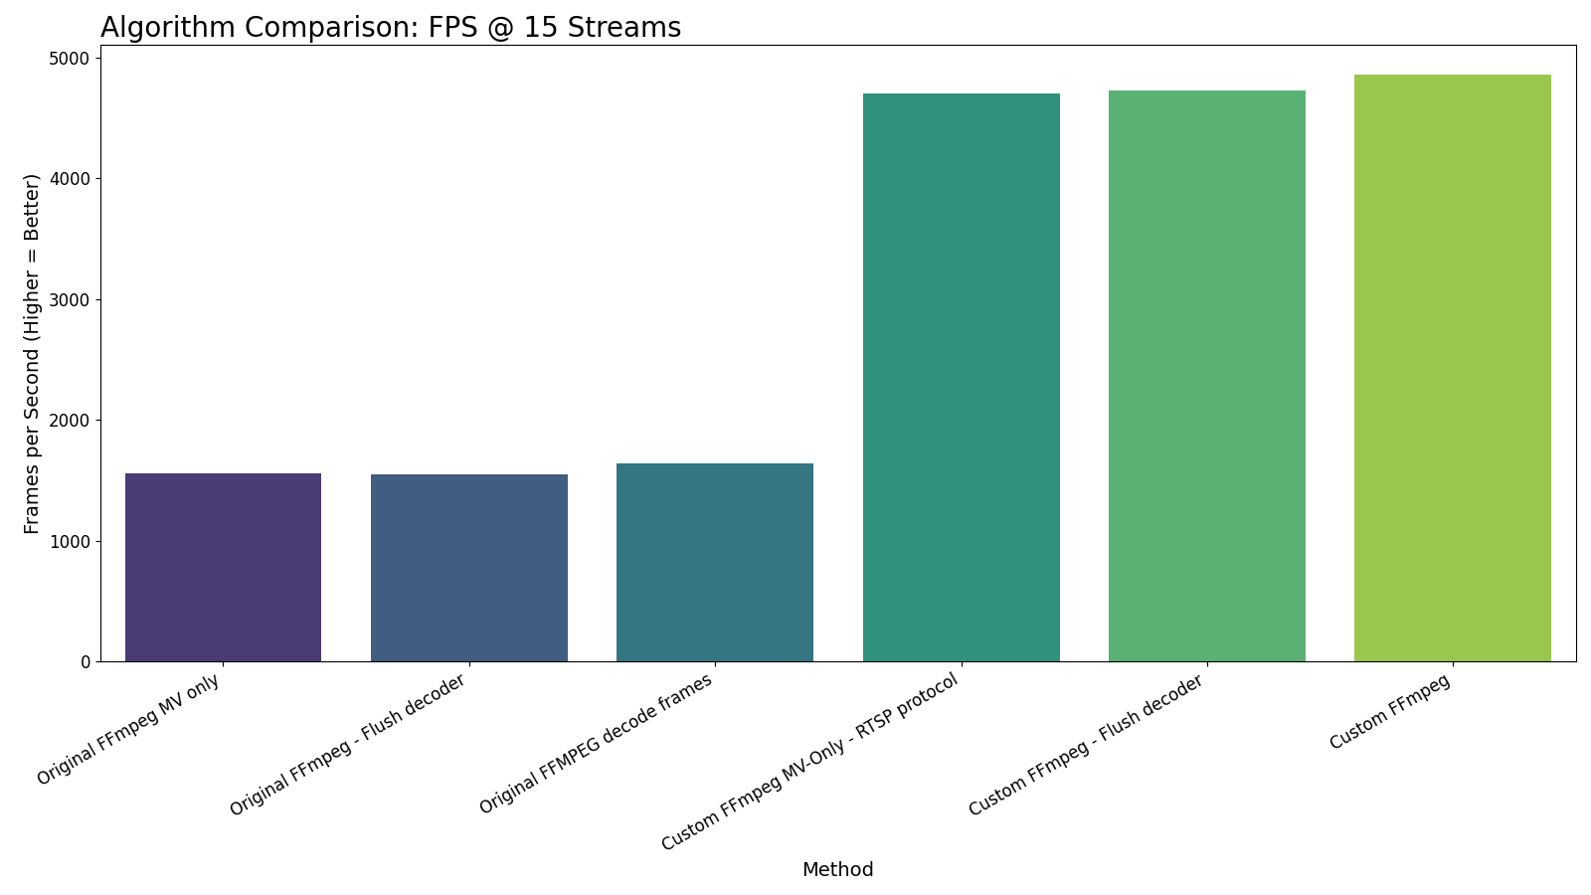
Algorithm FPS Comparison (15 Streams)
Throughput (FPS) by High Profile Method at 15 Streams

Slide 63

Algorithm Latency Comparison (15 Streams)
Time per Frame (ms) by High Profile Method at 15 Streams

Slide 64

Algorithm CPU Efficiency Comparison (15 Streams)
CPU ms/frame by High Profile Method at 15 Streams

Slide 65

Algorithm Memory Usage Comparison (15 Streams)
Memory Peak (kB) by High Profile Method at 15 Streams

Slide 66

Algorithm Worst Memory/Stream Comparison (15 Streams)
Worst Memory per Stream (kB) by High Profile Method at 15 Streams

Slide 67

Algorithm FPS Comparison (20 Streams)
Throughput (FPS) by High Profile Method at 20 Streams

Slide 68

Algorithm Latency Comparison (20 Streams)
Time per Frame (ms) by High Profile Method at 20 Streams

Slide 69

Algorithm CPU Efficiency Comparison (20 Streams)
CPU ms/frame by High Profile Method at 20 Streams

Slide 70

Algorithm Memory Usage Comparison (20 Streams)
Memory Peak (kB) by High Profile Method at 20 Streams

Slide 71

Algorithm Worst Memory/Stream Comparison (20 Streams)
Worst Memory per Stream (kB) by High Profile Method at 20 Streams

Slide 72

Algorithm FPS Comparison (25 Streams)
Throughput (FPS) by High Profile Method at 25 Streams

Slide 73

Algorithm Latency Comparison (25 Streams)
Time per Frame (ms) by High Profile Method at 25 Streams

Slide 74

Algorithm CPU Efficiency Comparison (25 Streams)
CPU ms/frame by High Profile Method at 25 Streams

Slide 75

Algorithm Memory Usage Comparison (25 Streams)
Memory Peak (kB) by High Profile Method at 25 Streams

Slide 76

Algorithm Worst Memory/Stream Comparison (25 Streams)
Worst Memory per Stream (kB) by High Profile Method at 25 Streams

Slide 77

Algorithm FPS Comparison (30 Streams)
Throughput (FPS) by High Profile Method at 30 Streams

Slide 78

Algorithm Latency Comparison (30 Streams)
Time per Frame (ms) by High Profile Method at 30 Streams

Slide 79

Algorithm CPU Efficiency Comparison (30 Streams)
CPU ms/frame by High Profile Method at 30 Streams

Slide 80

Algorithm Memory Usage Comparison (30 Streams)
Memory Peak (kB) by High Profile Method at 30 Streams

Slide 81

Algorithm Worst Memory/Stream Comparison (30 Streams)
Worst Memory per Stream (kB) by High Profile Method at 30 Streams

Slide 82

Algorithm FPS Comparison (35 Streams)
Throughput (FPS) by High Profile Method at 35 Streams

Slide 83

Algorithm Latency Comparison (35 Streams)
Time per Frame (ms) by High Profile Method at 35 Streams

Slide 84

Algorithm CPU Efficiency Comparison (35 Streams)
CPU ms/frame by High Profile Method at 35 Streams

Slide 85

Algorithm Memory Usage Comparison (35 Streams)
Memory Peak (kB) by High Profile Method at 35 Streams

Slide 86

Algorithm Worst Memory/Stream Comparison (35 Streams)
Worst Memory per Stream (kB) by High Profile Method at 35 Streams

Slide 87

Algorithm FPS Comparison (40 Streams)
Throughput (FPS) by High Profile Method at 40 Streams

Slide 88

Algorithm Latency Comparison (40 Streams)
Time per Frame (ms) by High Profile Method at 40 Streams

Slide 89

Algorithm CPU Efficiency Comparison (40 Streams)
CPU ms/frame by High Profile Method at 40 Streams

Slide 90

Algorithm Memory Usage Comparison (40 Streams)
Memory Peak (kB) by High Profile Method at 40 Streams

Slide 91

Algorithm Worst Memory/Stream Comparison (40 Streams)
Worst Memory per Stream (kB) by High Profile Method at 40 Streams

Slide 92

Algorithm FPS Comparison (45 Streams)
Throughput (FPS) by High Profile Method at 45 Streams

Slide 93

Algorithm Latency Comparison (45 Streams)
Time per Frame (ms) by High Profile Method at 45 Streams

Slide 94

Algorithm CPU Efficiency Comparison (45 Streams)
CPU ms/frame by High Profile Method at 45 Streams

Slide 95

Algorithm Memory Usage Comparison (45 Streams)
Memory Peak (kB) by High Profile Method at 45 Streams

Slide 96

Algorithm Worst Memory/Stream Comparison (45 Streams)
Worst Memory per Stream (kB) by High Profile Method at 45 Streams

Slide 97

Algorithm FPS Comparison (50 Streams)
Throughput (FPS) by High Profile Method at 50 Streams

Slide 98

Algorithm Latency Comparison (50 Streams)
Time per Frame (ms) by High Profile Method at 50 Streams

Slide 99

Algorithm CPU Efficiency Comparison (50 Streams)
CPU ms/frame by High Profile Method at 50 Streams

Slide 100

Algorithm Memory Usage Comparison (50 Streams)
Memory Peak (kB) by High Profile Method at 50 Streams

Slide 101

Algorithm Worst Memory/Stream Comparison (50 Streams)
Worst Memory per Stream (kB) by High Profile Method at 50 Streams

