Slide 1

Recommendation Systems for Insurance

Slide 2


What are Recommendation Systems
Ever wondered how Amazon recommends products to users to buy online?
How Netflix recommends movies to its subscribers to watch?
How Spotify recommends music to its users to listen?
There is no magic, they use Recommendation systems to make this happen. Recommendation system exploits user preferences and traits to prioritize and recommend items which the users would like.
2

Slide 3
What are Recommendation Systems
“Recommendation systems are systems that help users discover items which they may like”
2

Slide 4
Recommendation Systems - Applications
Recommendation systems are utilized in a variety of areas including
movies
music
news
books
research articles
search queries
social tags
and products in general.
There are also recommendation systems for experts, collaborators, jokes, restaurants, garments, financial services, life insurance, romantic partners (online dating), and Twitter pages.
2

Slide 5
Do Recommendation Systems make any impact ?
Mckinsey analysts estimated that
35% of AMAZON revenue and
75% of what they watch on NETFLIX came from product recommendations.
2

Slide 6
February 2019
TYPES OF RECOMMENDATION SYSTEMS

Slide 7
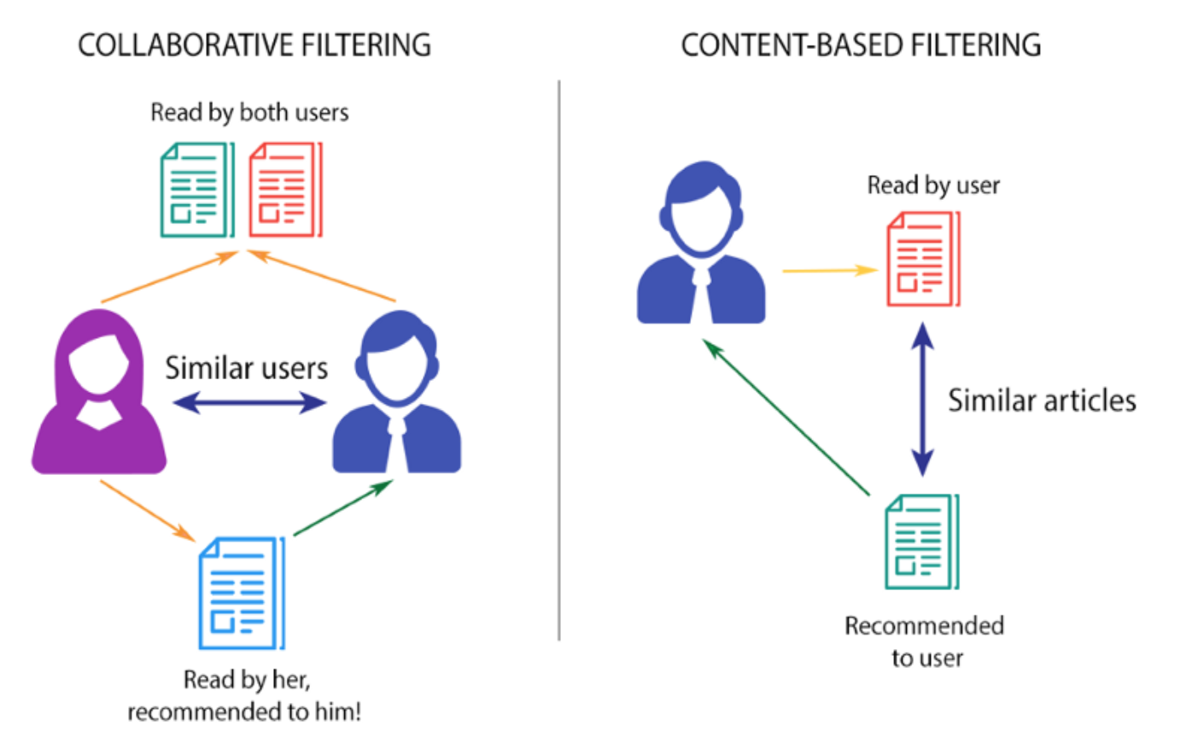
Types of Recommendation Systems
3

Slide 8
February 2019
EDA Practice

Slide 9
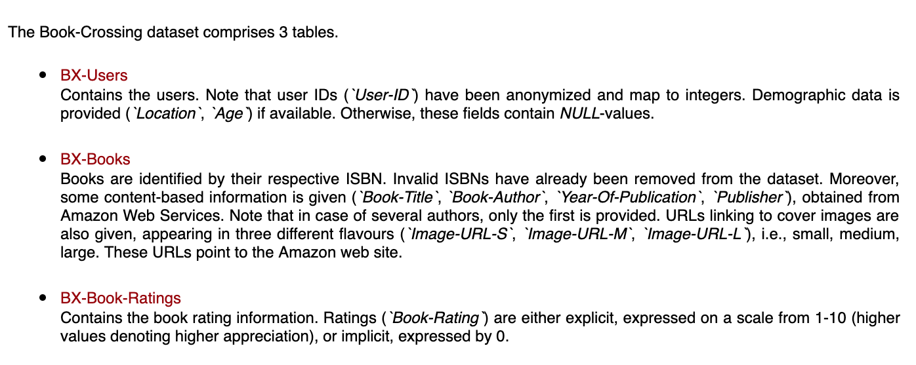
Application to Book Crossing DataSet
http://www2.informatik.uni-freiburg.de/~cziegler/BX/
2

Slide 10
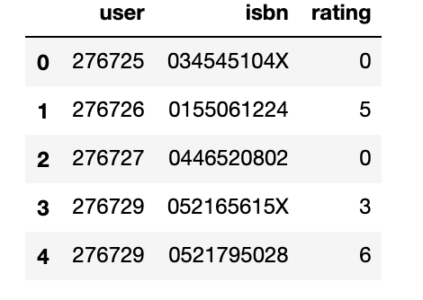

DataSet – BOOK CROSSING
BX-BOOK-RATINGS
BX-BOOKS
2

Slide 11
DataSet – BOOK CROSSING – EDA EXERCISE
Download the Book Crossing Dataset and load into pandas. Do some EDA to find
How many user ratings are present
Data of how many books is there
Find the ratings of a particular user, say 276747
Find the ratings of user 276747 and sort them in descending order of number of ratings
Find the highest 5 ratings of user 276747
Find the title and author of the favorite 5 books of user
Find the number of books (isbns) rated per user
Find the number of users who have rated each book(isbn)
2

Slide 12
February 2019
Recommendation Systems
Collaborative Filtering

Slide 13

CONCEPT

Slide 14
N Nearest Neighbour Collaborative Filtering
We know what books a User likes,
Then give him recommendations of top N books
Dataset from
https://www.bookcrossing.com/
2

Slide 15
DataSet – Ratings Matrix
 | Book 1 | Book 2 | Book 3 | Book 4
User 1 | 5 | ? | 4 | 2
User 2 | 4 | 4 | ? | 2
User 3 | 1 | ? | 2 | 5
User 4 | 4 | 3 | 4 | 2
To find the ratings of User 1 for Book 2 , Find the Users nearest to User 4 by using a distance metric
2
Notes:
User 2 is more similar to User 1
User 4 is less similar to User 1

Slide 16
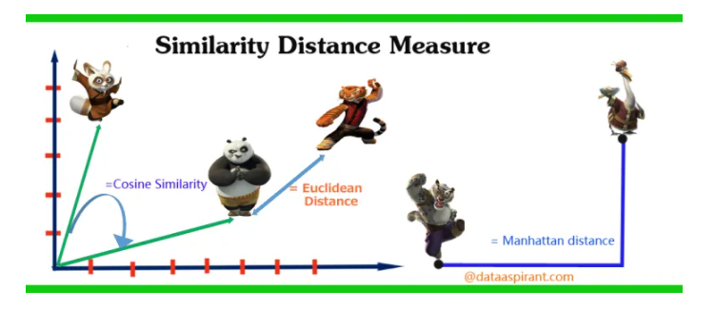
DataSet – Finding Nearest Neighbours
Source:
https://dataaspirant.com/five-most-popular-similarity-measures-implementation-in-python/
There are many measures to find the nearest neighbours, which is the shortest distance.
Popular measures are:
Euclidean Distance
Manhattan Distance
Cosine Similarity
Hamming Distance
2
Notes:
User 2 is more similar to User 1
User 4 is less similar to User 1

Slide 17
DataSet – Finding Nearest Neighbours by Hamming Distance
We will use Hamming distance today for our first recommendation system.
Hamming distance is a metric for comparing two binary data strings. While comparing two binary strings of equal length, Hamming distance is the number of bit positions in which the two bits are different.
2
Notes:
User 2 is more similar to User 1
User 4 is less similar to User 1

Slide 18
PROCEDURE

Slide 19

Procedure
EDA
- When we have data, 1st thing is to do EDA
Data Cleaning
- only retain values from books-rating that actually have books meta data
- drop books that don’t have many ratings
- drop users that have not rated many books
Create User-item-rating-matrix (The rating matrix)
 | Book 1 | Book 2 | Book 3 | Book 4
User 1 | 5 | ? | 4 | 2
User 2 | 4 | 4 | ? | 2
User 3 | 1 | ? | 2 | 5
User 4 | 4 | 3 | 4 | 2
 | ISBNs
User IDs | Ratings
19￼

Slide 20
Procedure
Find K Nearest Neighbor by Hamming Distance
- From User-item-rating-matrix, create a data frame contains all user except the active user
- Add a column to the data frame which contains the hamming distance between active user and each users
- short list of k-nearest (the k smallest hamming distance) users for the data frame
Return top N Recommendations to active user
- after getting k-nearest neighbor, find average rating of each book rated by k-nearest neighbor
- drop books that active users already read
- list out the ISBN by rating in descending order and take the top N ISBN
- also print out the title and author
20￼

Slide 21

DEMO

Slide 22
CONTENT-BASED
RECOMMENDATION

Slide 23
CONCEPT

Slide 24
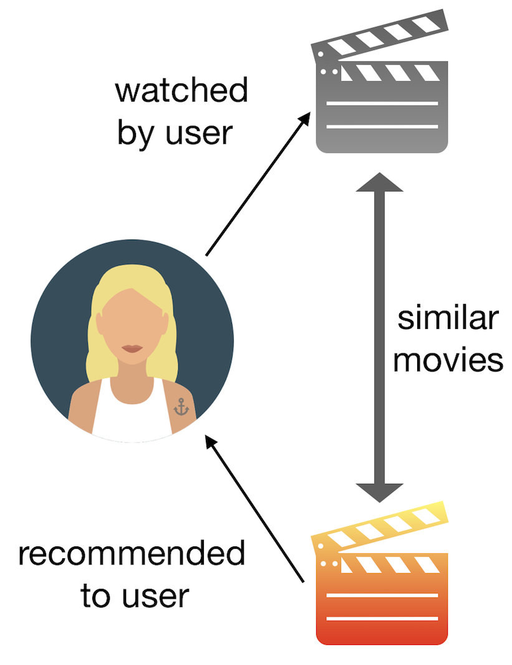
CONTENT-BASED RECOMMENDATION
This type of filter does not involve other users if not ourselves. Based on what we like, the algorithm will simply pick items with similar content to recommend us.
Image source: https://towardsdatascience.com/how-to-build-from-scratch-a-content-based-movie-recommender-with-natural-language-processing-25ad400eb243
24￼

Slide 25
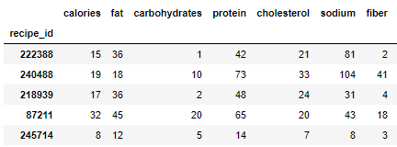
DataSet – Nutrition Matrix
When users search for one recipe, give them some recipes that have similar nutritions
2
Notes:
User 2 is more similar to User 1
User 4 is less similar to User 1

Slide 26
DataSet – Similarity Distance Measure
Source:
https://dataaspirant.com/five-most-popular-similarity-measures-implementation-in-python/
There are many distance measures to find the most similar recipe.
We covered that Hamming Distance.
We will cover:
Euclidean Distance
Manhattan Distance
Cosine Similarity
2
Notes:
User 2 is more similar to User 1
User 4 is less similar to User 1

Slide 27
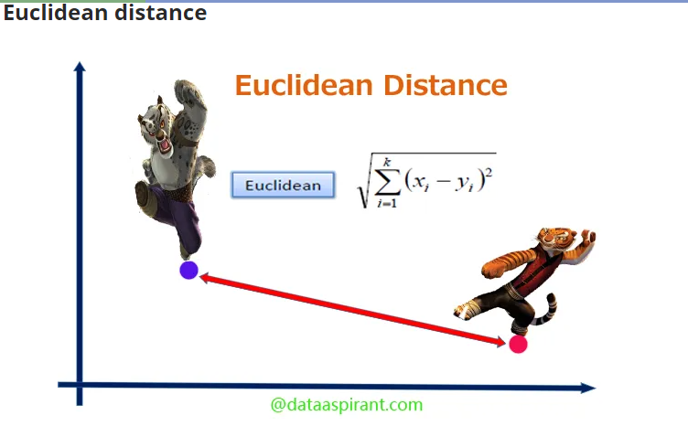
Euclidean Distance
Source:
https://dataaspirant.com/five-most-popular-similarity-measures-implementation-in-python/
Euclidean distance is also known as simply distance.
The Euclidean distance between two points is the length of the path connecting them. The Pythagorean theorem gives this distance between two points.
The smaller distance, the more similarity
2
Notes:
User 2 is more similar to User 1
User 4 is less similar to User 1

Slide 28
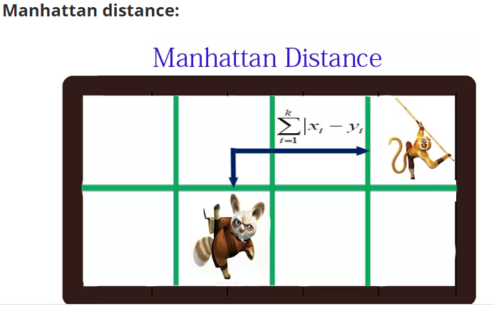
Manhattan Distance
Source:
https://dataaspirant.com/five-most-popular-similarity-measures-implementation-in-python/
Manhattan distance is a metric in which the distance between two points is calculated as the sum of the absolute differences of their Cartesian coordinates. In a simple way of saying it is the total sum of the difference between the x-coordinates and y-coordinates. The smaller distance, the more similarity
2
Notes:
User 2 is more similar to User 1
User 4 is less similar to User 1

Slide 29
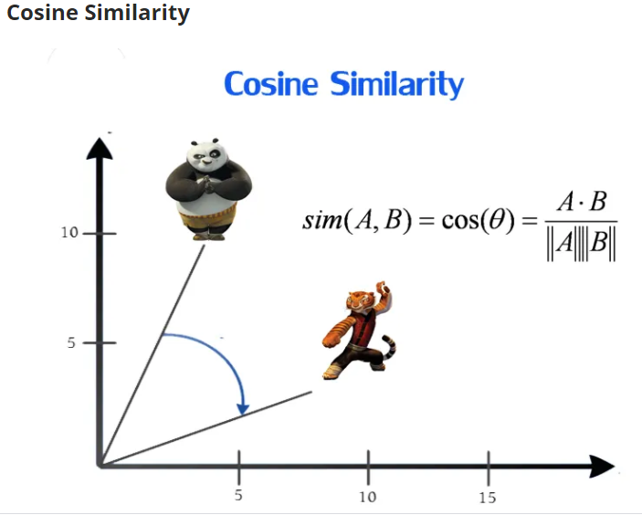
Cosine Similarity
Source:
https://dataaspirant.com/five-most-popular-similarity-measures-implementation-in-python/
The cosine similarity metric finds the normalized dot product of the two attributes. By determining the cosine similarity, we would effectively try to find the cosine of the angle between the two objects. The cosine of 0 is 1, and it is less than 1 for any other angle. Say cos(10) =0.98, which is very similar because the degree is so small.
As degree is larger, the cosine value will be smaller, and it becomes less similar.
2
Notes:
User 2 is more similar to User 1
User 4 is less similar to User 1

Slide 30
Calculate Distance in Python
euclidean
vector1=[1,0,0]
vector2=[0,1,0]
#Euclidean
from scipy.spatial.distance import Euclidean
Euclidean(vector1,vector2)
#Manhattan
from scipy.spatial.distance import Cityblcok
Cityblock(vector1,vector2)
#Cosine
from scipy.spatial.distance import Cosine
Cosine(vector1,vector2)
2
Notes:
User 2 is more similar to User 1
User 4 is less similar to User 1

Slide 31
PROCEDURE

Slide 32
Procedure
EDA
- When we have data, 1st thing is to do EDA
Data Cleaning
- only retain values from books-rating that actually have books meta data
- drop books that don’t have many ratings
- drop users that have not rated many books
Create Nutrition matrix
32￼

Slide 33
Procedure
Find K Nearest Neighbor by Euclidean Distance
- From nutrition matrix, create a data frame contains all recipe except the active recipe
- Add a column to the data frame which contains the Euclidean distance between scaled active recipe and each scaled recipes
- short list of k-nearest (the k smallest Euclidean distance) recipes for the data frame
Return top N Recommendations to active recipe
- return the top N recommendations from the dataframe
- you can also provide recipe, recipe nutrition, and recipe photo also.
33￼

Slide 34
DEMO

Slide 35
DATASET
Food recipes dataset taken from: https://www.kaggle.com/elisaxxygao/foodrecsysv1
Modified to only include the nutritional values (nutritions.csv) and the recipe names (names.csv)
Names dataset
Recipe ID
Recipe name
Nutritions dataset
Recipe ID
Calories
Fat
Carbohydrates
Protein
Cholesterol
Sodium
Fiber
35￼

Slide 36
GOAL
Given a recipe, recommend recipes that have the closest nutritional value as the given recipe.
36￼

Slide 37
February 2019
Policy Recommendation System for Insurance

Slide 38



Policy Recommendation System for Insurance
A recommendation system uses customer characteristics and portfolio data to help customers choose insurance that best covers their needs.

Slide 39
Policy Recommendation System for Insurance
How it works?
Recommender system are based on collaborative filtering technique or content based system, which mainly focuses on finding relations between products and customers through machine learning techniques.
They recommend products without concerning the users' personalized requirement. The recommender system takes users' current need in account and recommends most suitable policy to them.

Slide 40
Kaggle Insurance Dataset
https://www.kaggle.com/uciml/caravan-insurance-challenge/version/1

Slide 41
Insurance Recommendation System
Demo

