Slide 1
Computation methods
Samir Devkota

Slide 2
Computation Methods:
Gauss Elimination Method
x - y + z = 4
-3y + z = 4
8z = 12

Slide 3
DEFINITION OF:
DEFINITION OF GAUSS ELIMINATION: Gaussian elimination(named after the German mathematician Carl Friedrich Gauss), is a method used in linear algebra to solve systems of linear equations and find the solutions to unknown variables.
Example:
x−y+z=8 ---------(1)
2x+3y−z=-2 --------(2)
3x−2y−9z=9 -------(3)

Slide 4
Types of Solution in Elimination Method
If a''13≠0, then the solution is unique.
If a''13=0,r≠0, then there is no solution.
If a''13=0,r=0,then there is infinite solution.

Slide 5
Example of Gauss Elimination Method
x−y+z=8 ---------(1)
2x+3y−z=-2 --------(2)
3x−2y−9z=9 -------(3)
By eliminating equation (2) by 2*equation (1) we get,
5y-3z=-18 --------(4)
and 2*equation (3) by 3*equation (2) we get,
13y+15z=-24 ---------(5)
Again, by eliminating equation(4) and (5) we get,
Z=1 ---------(6)
Now, By Gauss Elimination method,
x−y+z=8
5y-3z=-18
Z=1
Using back-substitution, we obtain the solution as (4,−3,1).

Slide 6
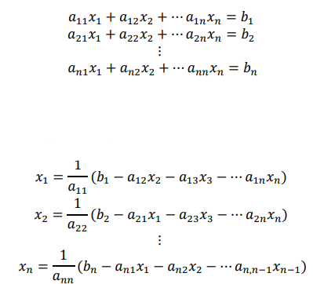
2. Gauss-Seidel Method
Gauss–Seidel method (developed by Carl Gustav Jacob Jacobi and Philipp Ludwig von Seidel), also known as the method of successive displacement, is an iterative method used to solve a system of linear equation.

Slide 7
1. Initially we have the solution (x1,x2,x3)=(0,0,0)
Use x2=0 and x3=0 in equation (1) to get new value of x1.
Use x3 and new x1 in equation (2) to get new value of x2.
Use new x1 and x2 in equation (3) to get new value of x3.
2.Now, continue the process in Step 1, with new values of x1, x2 and x3.

Slide 8
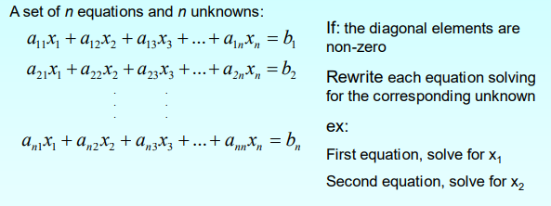
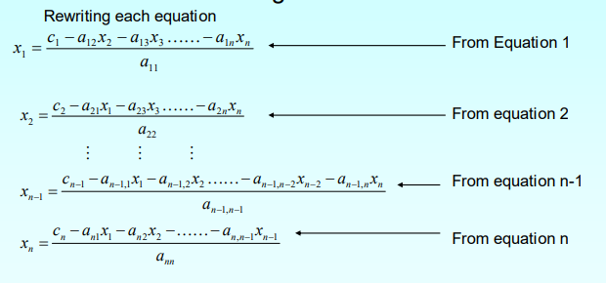
Example of Gauss-Seidel Method

Slide 9

Thank You !!!

