Slide 1

AT&T Cybersecurity
High Tech Day 2018
Microbit Program

Slide 2
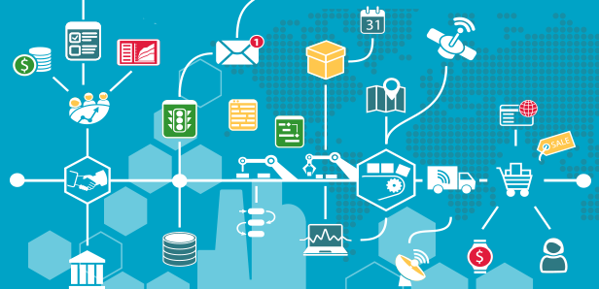
AT&T Connecting and Securing Your World
Notes:
AT&T is a leader in cybersecurity to secure our network and ensure our customers can go about their daily lives safely. Cybersecurity spans nearly every digital transaction you think of from personal transaction between you and your bank and also securing your smart home.

Slide 3
What is Microbit?
<Hello World!/>
Microbit is a 5x5 LED Pocket Sized computer
Microbit can be used to create games, robots or even control your Spotify playlist.
Coding
No additional Software needed
Coding can be done from any browser
Can also deploy on Android, iPhone and Microsoft
Blocks, Javascript, Python and more!
Features
Wireless Communication (Radio and Bluetooth)
Accelerometer for board gesture detection
Magnetometer
Light Sensors
Temperature Sensing
GPIO Pins
2 User Buttons
Notes:
https://www.microbit.co.uk/create-code

Slide 4
Concepts Covered
Programming Logic
Methods/Functions
Inputs
Variables
For Loop
Encryption (Caesar Cipher)
Radio Technology

Slide 5
Scenario #1
Write a program on your Microbit that
Allows the user to send a message to another party
Allows the user to receive a message from another party
Hello!
Hey!

Slide 6
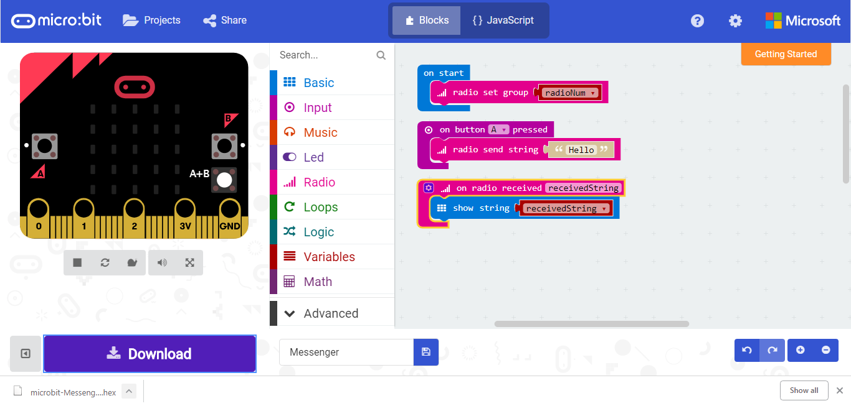
Navigating the Block Editor
1
Open block editor: https://makecode.microbit.org/#
5
Drag .hex file from file location to
microbit in “My Computer”
to install. It will say “Copying” and
then disappear on microbit.
2
Drag blocks from menu to editing area
3
Name file and download .hex file
*Note: Step 5 not shown
4
Click the arrow and select show in folder
1
2
3
4
Messenger

Slide 7
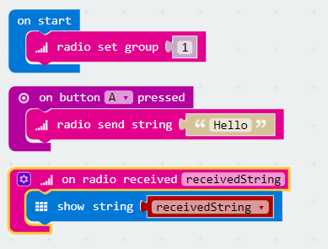
Example 1: Basic Radio Code
Notes:
This basic radio code will allow two microbits to communicate with each other when using the same radio group.
Basic coding blocks:
On start – this block will perform the tasks within it when the Microbit first starts
When the microbit starts, it will set the radio group to 1 (varies by table)
On button A pressed – this block will perform the tasks within it when the user presses button A
When button A is pressed, the microbit will send the string “Hello” via radio to other microbits on the same channel
On radio received receivedString – this block will perform the tasks within it when it receives a radio signal
When a radio signal is received on channel 1, the string being transmitted will be shown.

Slide 8
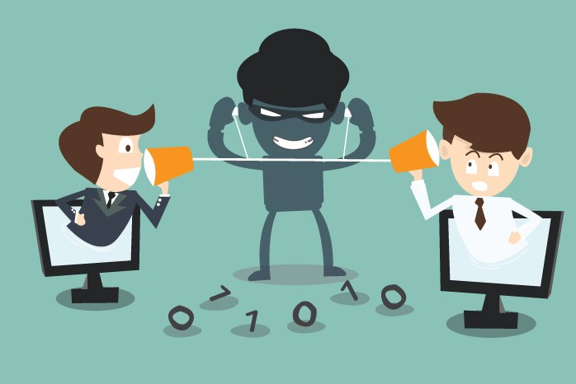
“Man-in-the-Middle” Attack

Slide 9
Terminology
Encryption
The process of encoding a message or information in such a way that only authorized parties can access it and those who are not authorized cannot.
The process DOES NOT itself prevent interference but denies the intelligible content to a would-be interceptor.
Decryption
The conversion of encrypted data into its original form.
Caesar Shift
A method of encryption that replaces each letter in the original message with a different one a fixed number of places down the alphabet.

Slide 10
Scenario #2
Upload encrypted messaging program on your Microbit that
Allows the user to send/receive a message to another party
Allows the user to encrypt/decrypt a message to another party
GFMMP!
IFZ!
???

Slide 11
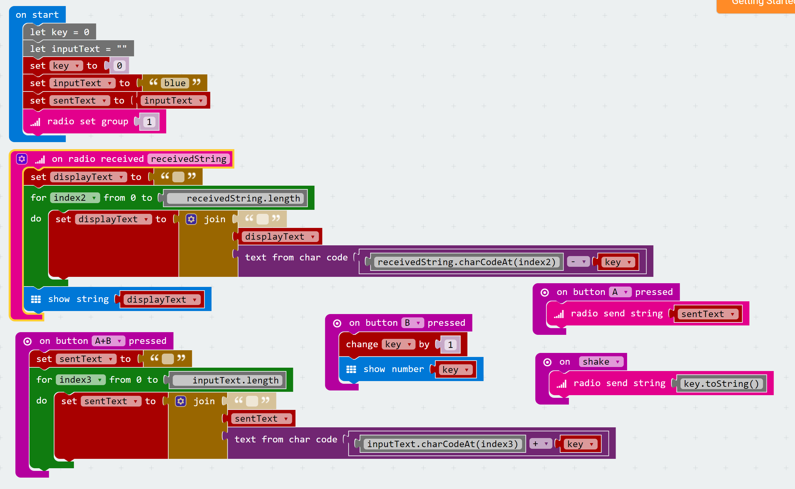
Scenario #2 Codeblocks
Notes:
This encrypted messaging radio code will allow two microbits to communicate with each other with encrypted messages using a technique called Caesar Shift when using the same radio group.
Basic coding blocks:
On start – this block will perform the tasks within it when the Microbit first starts
Initialize and set key to 0
Clear text
Set input text to be transmitted to blue
Set the radio group to 1 (varies by table)
On radio received receivedString – this block will perform the tasks within it when it receives a radio signal
When a radio signal is received on channel 1, the string being transmitted will be shown.
On button A pressed – this block will perform the tasks within it when the user presses button A
When button A is pressed, the microbit will send the string “Hello” via radio to other microbits on the same channel
On button B pressed – this block will perform the tasks within it when the user presses button B
When button B is pressed, the microbit will increase key value by 1 (e.g. change key from 1 to 2)
On button A+B pressed – this block will perform the tasks within it when the user presses buttons A+B simultaneously
When A+B pressed, encrypt the message
When microbit is shaken – this block will perform the tasks within it when the user shakes microbit
When microbit is shaken, the microbit will send the key value via radio to other microbits on the same channel

Slide 12
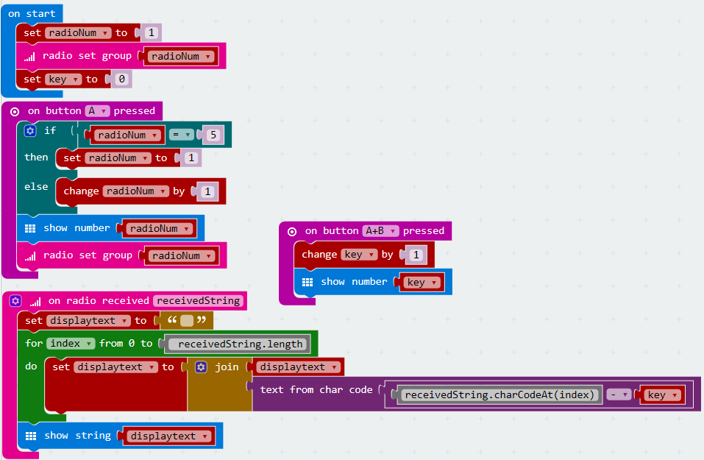
Man-in-Middle Codeblocks

Slide 13
Discussion Questions
How do you think you can establish a more secure connection?
How do you know your message is coming from the correct person?
Can you think of how secure communication may be useful in your everyday life?

Slide 14
Resources
Visual Code Blocks:
https://makecode.microbit.org/#
IDE:
http://python.microbit.org/v/1
IDE Reference:
https://python-editor-1-0-0.microbit.org/help.html
MicroPython Reference Guide:
http://microbit-micropython.readthedocs.io/en/latest/tutorials/hello.html

