Slide 1

SMART STREET LIGHT SYSTEM
USING ARDUINO
Presented by: Pratik Gupta (39/CSE/16027-183)
Abhishek Mishra(39/CSE/16146-136)

Slide 2
What we talked about:
What is Smart Street Light System?
Why Smart Street Light?
How it’ll be implemented.

Slide 3
What we’ll be talking about:
What has been done?
What can be done on a large scale?
How will it be done and its cost.

Slide 4
About Smart Street
Light System
Currently, in the whole world, enormous electricity is consumed by the street lights, which are controlled by means of embedded brightness sensors.
They are automatically turned off when its bright and automatically turned on when its dark. This is a huge waste of energy and this system needs to be changed.
We propose an autonomous light distribution system in which the initial street light is always on when its dark, but with a low intensity.
When it senses an object, it’ll increase its intensity to full and also light up 2 more street lights in front of it. After the object has gone by, the light changes back to its initial state, i.e. the first street light will be at a dim brightness and the rest that were on will be turned off.

Slide 5
Why go smart?
Need to save power
Need to save money
Take seasonal changes into account
Lessen dependency on manual controls

Slide 6
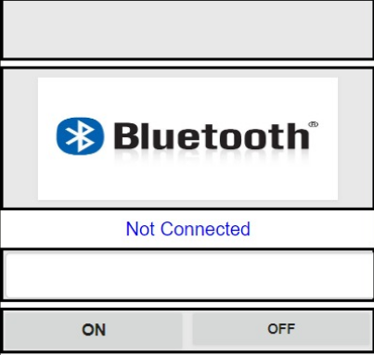
Implementation
We’re making a prototype of a Smart Street LED System.
Lights will be off during daytime.
As it gets dark, except the first LED lamp all will be turned off.
The LED lamps will turn on as it detects any movement passing by.
The speed sensor will detect the speed of the object moving by and accordingly light the next in-line lamps*.
I’ve also designed an app, which will turn on/off any street lamp based on its position or serial number.
But to connect an Arduino to a phone, we’ll need Bluetooth module.
* The LM393 speed sensor checks the rotation of wheels per second and calculates speed. So, a network can be created in which the speed will be shared with the nearest lamp and the lamp will light next in-line lamps accordingly.

Slide 7
Components Used
LDR – Light Dependent Resistors
IR – Infrared Sensors
LED – Light Emitting Diode
Arduino
Breadboard and wires
LM393 Speed Sensor

Slide 8
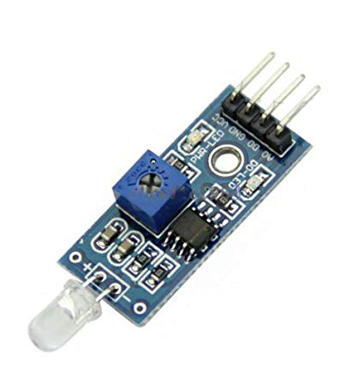
LM393 Speed Sensor
This is a speed sensor, which calculates speed on the basis of rotations per second. The wheel is put between
the space given in the sensor, and as the wheel rotates it detects the number of rotations and calculates the
speed accordingly.

Slide 9
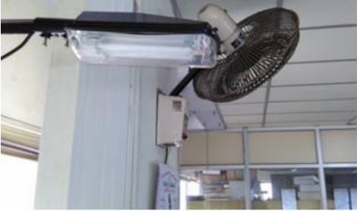
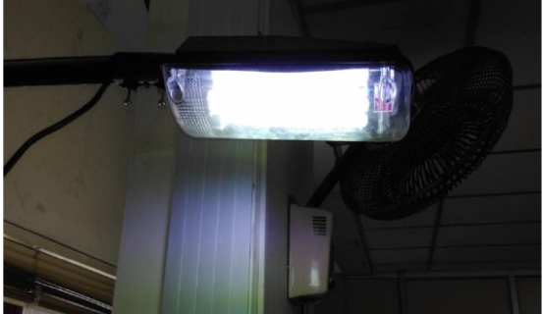
Some Implementations:

Slide 10
Where have been these systems implemented ?
Chicago
2. Paris
Los Angeles
Oslo
Norway
6. Illinois Institute of Technology

Slide 11
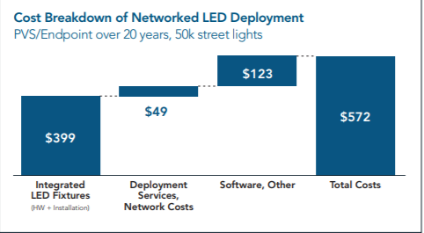
Energy Saving Techniques
Low Wattage
Dimming
Reduced burn time
Cost
A typical operator will spend approximately
$572 per light to deploy, operate and maintain
their networked LEDs.

Slide 12
Business Model
Street lighting has emerged as a leading smart city application. By replacing existing street lights with LED-based lamps, utilities and other street light operators can cut energy and operations costs by 50 percent or more.
Networking those LEDs delivers an even faster return on investment (ROI).
Advantage of networked LED’s:
Have longer life span as compared to sodium and mercury street lamps.
New energy efficient LED-based street lights have a life span of up to 20 years, enabling lower energy and operations costs

Slide 13
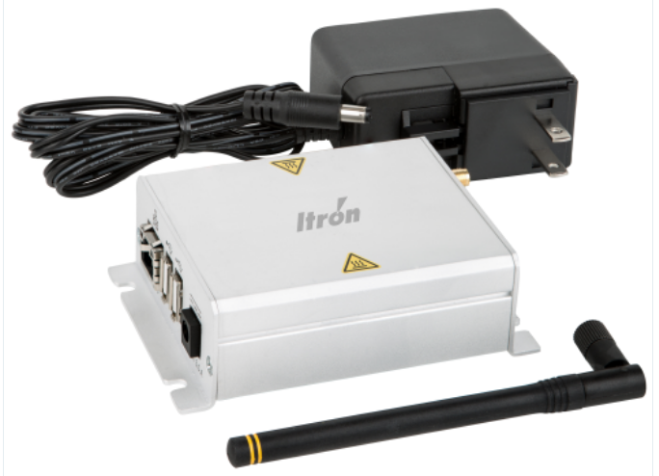
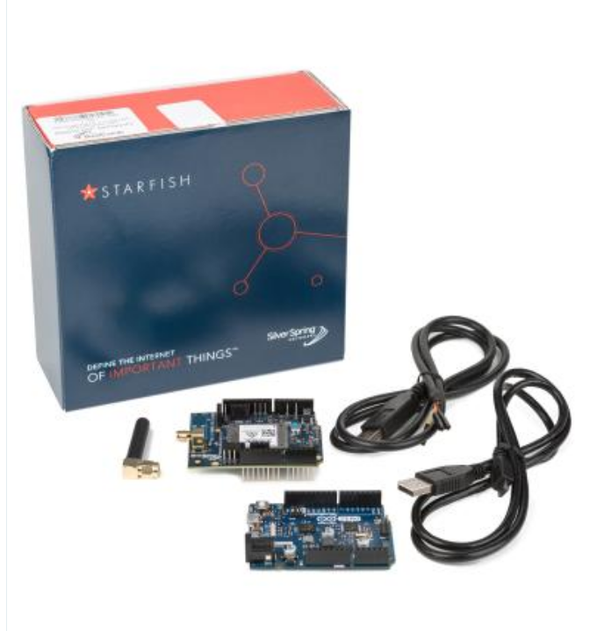
HARDWARE REQUIREMENTS FOR A NETWORKED LED LAMP SYSTEM:
PIC16F877A MICROCONTROLLER
Intel Galileo Gen2
Relays
Current Sensor
Wi-Fi Module
EDGE ROUTER

Slide 14
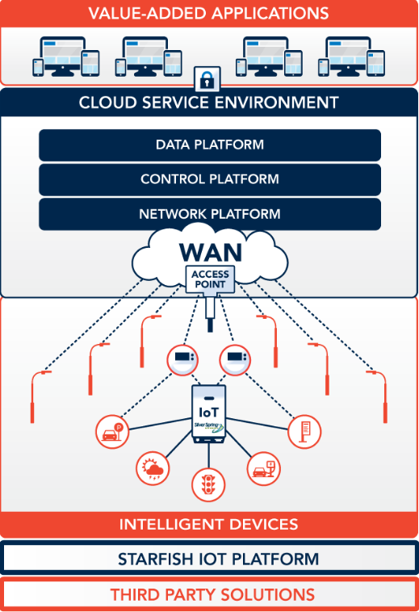
FUTURE GOALS:
Create a network of LED lamps using something like GSM.
2. This network can be controlled frim a control room.
3. We’ll need , PIC16F877A microcontroller, Relay, UART
and Wi-Fi Module.
4. Sharing this data with multiple stakeholders.
Itron Networks Platform proposed network

Slide 15
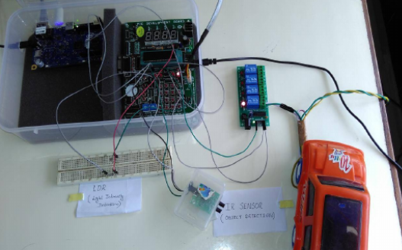
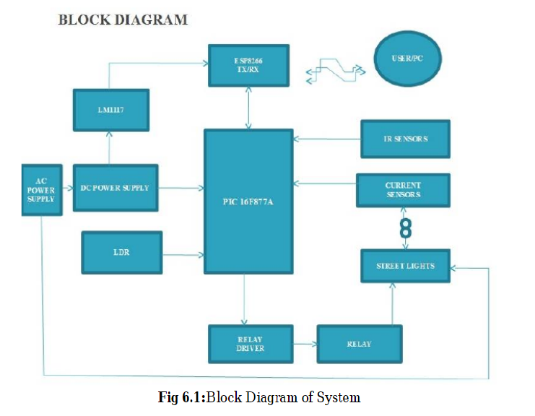
Working Principle:
The system architecture of the intelligent street light system consists of IR sensors, LDR,PIC16F877A microcontroller, Relay, UART and Wi-Fi Module. LDR‟s are light dependent devices whose resistance decreases when light falls on them and increases in the dark. When a light dependent resistor is kept in dark, its resistance is very high. The vehicle which passes by the street light is detected by IR sensor. Relay are used as a switch to switch on/off the street light bulb.
A UART (Universal Asynchronous Receiver/Transmitter) is the microchip with programming that controls a
computer's interface to its attached street light system

Slide 16
THANK YOU

