Slide 1
Optimal Binary Search Tree
M.B.Chandak
hodcs@rknec.edu
www.mbchandak.com

Slide 2

Optimal Binary Search Tree - Construction

Slide 3
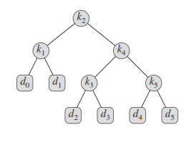
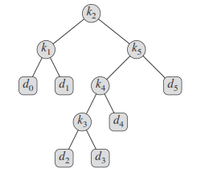
Why construction logic is required
Possibility of randomness in selecting the node during construction will generate multiple trees
For Example
(a) (b)

Slide 4
Question-Which tree should be selected
Answer- Tree with minimum cost
How to find the cost of tree
Two types of nodes :
Nodes for successful search = K
Nodes for unsuccessful search = D
Depth of the node in the tree is important
For cost finding = Depth is added with 1 [to include the contribution, otherwise contribution of root will be zero {as depth of root is zero}]

Slide 5
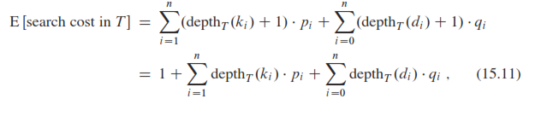
Formula
The depth of root node is ZERO, and any value of probability multiple by ZERO will result in ZERO
To avoid, the Depth of each node including ROOT is added with constant “1”
Depth is calculated assuming ROOT node at Depth = 1

Slide 6
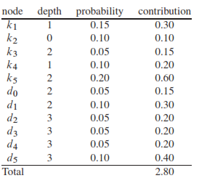
Using the formula – Cost of tree [a]
…

Slide 7
Apply the same formula find the cost of tree
Cost of tree
K2 x 1 + (k1+k5) x 2 + (do+d1+k4+d5)x3 + (k3+d4)x4
+ (d2+d3) x 5
Refer above table and find the values of “k” and “d” terms
“K” terms for successful probability [pi] and “d” terms for
Unsuccessful probability [qi]
Cost =
0.10 x 1 + (0.15+0.20)x2 + (0.05+0.10+0.10+0.10)x3
+ (0.05+0.05)x4 + (0.05+0.05)x5
= 0.10 + 0.70 + 1.05 + 0.4+0.5= 2.75

Slide 8
Selection Logic – Fixing Randomness
Construction of matrices
“P” – probability matrix
“E” – Evolution matrix
“R” – Root matrix
Check dimensions
For further calculations refer the tutorial presentation already mailed.

