Slide 1
Chapter 4: Threads

Slide 2
Chapter 4: Threads
Overview
Multicore Programming
Multithreading Models
Thread Libraries
Implicit Threading
Threading Issues
Operating System Examples

Slide 3
Threads
A thread is a basic unit of CPU utilization;
It comprises a thread ID, a program counter, a register set, and a stack.
It shares with other threads belonging to the same process its code section, data section, and other operating-system resources, such as open files and signals.
A traditional (or heavyweight) process has a single thread of control.
If a process has multiple threads of control, it can perform more than one task at a time

Slide 4
Motivation
Most modern applications are multithreaded
Threads run within application
Multiple tasks with the application can be implemented by separate threads
  Update display
  Fetch data
  Spell checking
  Answer a network request
Process creation is heavy-weight while thread creation is light-weight
Can simplify code, increase efficiency
Kernels are generally multithreaded

Slide 5

Multithreaded Server Architecture

Slide 6
Benefits
Responsiveness – may allow continued execution if part of process is blocked, especially important for user interfaces
(Web browser could allow user interaction in one thread while an image was being loaded in another thread)
Resource Sharing – threads share resources of process, easier than shared memory or message passing
(The benefit of sharing code and data is that it allows an application to have several different threads of activity within the same address space)
Economy – cheaper than process creation, thread switching lower overhead than context switching
  (In Solaris for example, creating a process is about thirty times slower than is creating a thread, and context switching is about five times slower.)
Scalability – process can take advantage of multiprocessor architectures ( A single-threaded process can only run on one processor, regardless how many are available. Multithreading on a multi CPU machine increases parallelism)

Slide 7

Single and Multithreaded Processes

Slide 8
User Threads and Kernel Threads
User threads - management done by user-level threads library
Three primary thread libraries:
  POSIX Pthreads
  Windows threads
  Java threads
Kernel threads - Supported by the Kernel
Examples – virtually all general purpose operating systems, including:
  Windows
  Solaris
  Linux
  Tru64 UNIX
  Mac OS X

Slide 9
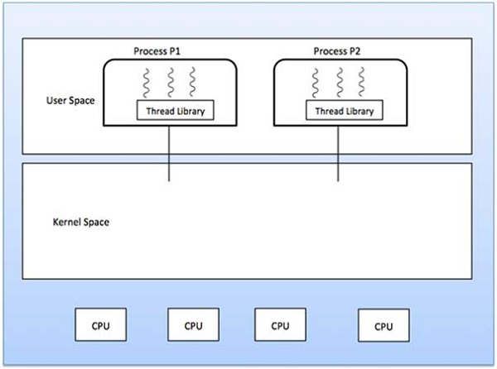
User Threads and Kernel Threads

Slide 10
User Threads and Kernel Threads
User threads -
The thread management kernel is not aware of the existence of threads. The thread library contains code for creating and destroying threads, for passing message and data between threads, for scheduling thread execution and for saving and restoring thread contexts.
Advantages
Thread switching does not require Kernel mode privileges.
User level thread can run on any operating system.
Scheduling can be application specific in the user level thread.
User level threads are fast to create and manage.
Disadvantages
In a typical operating system, most system calls are blocking.
Multithreaded application cannot take advantage of multiprocessing.

Slide 11
User Threads and Kernel Threads
Kernel threads -
Thread management is done by the Kernel. There is no thread management code in the application area. Kernel threads are supported directly by the operating system. Any application can be programmed to be multithreaded. All of the threads within an application are supported within a single process.
The Kernel maintains context information for the process as a whole and for individuals threads within the process. Scheduling by the Kernel is done on a thread basis. The Kernel performs thread creation, scheduling and management in Kernel space. Kernel threads are generally slower to create and manage than the user threads.

Slide 12
User Threads and Kernel Threads
Advantages
Kernel can simultaneously schedule multiple threads from the same process on multiple processors.
If one thread in a process is blocked, the Kernel can schedule another thread of the same process.
Kernel routines themselves can be multithreaded.
Disadvantages
Kernel threads are generally slower to create and manage than the user threads.
Transfer of control from one thread to another within the same process requires a mode switch to the Kernel.

Slide 13
User Threads and Kernel Threads
User level thread | Kernel level thread
User thread are implemented by users. | kernel threads are implemented by OS.
OS doesn’t recognized user level threads. | Kernel threads are recognized by OS.
Implementation of User threads is easy. | Implementation of Kernel thread is complicated.
Context switch time is less. | Context switch time is more.
Context switch requires no hardware support. | Hardware support is needed.
If one user level thread perform blocking operation then entire process will be blocked. | If one kernel thread perform blocking operation then another thread can continue execution.
User level threads are designed as dependent threads. | Kernel level threads are designed as independent threads.
Example : Java thread, POSIX threads. | Example : Window Solaris.

Slide 14
Multithreading Models
Some operating system provide a combined user level thread and Kernel level thread facility.
Solaris is a good example of this combined approach. In a combined system, multiple threads within the same application can run in parallel on multiple processors and a blocking system call need not block the entire process. Multithreading models are three types
Many-to-One
One-to-One
Many-to-Many

Slide 15

Many-to-One
Many user-level threads mapped to single kernel thread
Thread management is done in user space by the thread library.
When thread makes a blocking system call, the entire process will be blocked.
Only one thread can access the Kernel at a time, so multiple threads are unable to run in parallel on multiprocessors.
Few systems currently use this model
Examples:
  Solaris Green Threads
  GNU Portable Threads

Slide 16

One-to-One
Each user-level thread maps to kernel thread
Creating a user-level thread creates a kernel thread
More concurrency than many-to-one
It supports multiple threads to execute in parallel on microprocessors.
Number of threads per process sometimes restricted due to overhead
Examples
  Windows NT
  Linux
  Solaris 9 and later
  Disadvantage of this model is that creating user thread requires the corresponding Kernel thread

Slide 17

Many-to-Many Model
Allows many user level threads to be mapped to many kernel threads
The many-to-many model multiplexes any number of user threads onto an equal or smaller number of kernel threads.
In this model, developers can create as many user threads as necessary and the corresponding Kernel threads can run in parallel on a multiprocessor machine.
Allows the operating system to create a sufficient number of kernel threads
This model provides the best accuracy on concurrency and when a thread performs a blocking system call, the kernel can schedule another thread for execution.
Solaris prior to version 9
Windows with the ThreadFiber package

Slide 18

Two-level Model
Similar to M:M, except that it allows a user thread to be bound to kernel thread
Examples
  IRIX
  HP-UX
  Tru64 UNIX
  Solaris 8 and earlier

Slide 19
Thread Libraries
Thread library provides programmer with API for creating and managing threads
Two primary ways of implementing
  Library entirely in user space
  Kernel-level library supported by the OS

Slide 20
Pthreads
May be provided either as user-level or kernel-level
A POSIX standard (IEEE 1003.1c) API for thread creation and synchronization
Specification, not implementation
API specifies behavior of the thread library, implementation is up to development of the library
Common in UNIX operating systems (Solaris, Linux, Mac OS X)

Slide 21
Command Line Arguments
The arguments passed from command line are called command line arguments. These arguments are handled by main() function.
To support command line argument, you need to change the structure of main() function as given below.
int main(int argc, char *argv[] )
Here, argc counts the number of arguments. It counts the file name as the first argument.
The argv[] contains the total number of arguments. The first argument is the file name always.

Slide 22
Command Line Arguments
#include <stdio.h>
void main(int argc, char *argv[] ) {
printf("Program name is: %s\n", argv[0]);
if(argc < 2){
printf("No argument passed through command line.\n");
}
else{
printf("First argument is: %s\n", argv[1]);
}
}

Slide 23
Command Line Arguments
gcc program.c –a program
./program hello
Output is:
Program name is: program
First argument is:hello

Slide 24
Pthreads Example
The C program shown demonstrates the basic Pthreads API for
constructing a multithreaded program that calculates the summation of a nonnegative integer in a separate thread.
In a Pthreads program, separate threads begin execution in a specified function.
When this program begins, a single thread of control begins in main (). After some initialization, main () creates a second thread that begins control in the runner () function. Both threads share the global data sum
All Pthreads programs must include the pthread. h header file.
The statement pthread_tid declares the identifier for the thread we will create
Each thread has a set of attributes, including stack size and scheduling information
The pthread_attr declaration represents the attributes for the thread.

Slide 25
Pthreads Example
We set the attributes in the function call pthread_attr_init (&attr). Because we did not explicitly set any attributes, we use the default attributes provided
A separate thread is created with the pthread_create () function call.
In addition to passing the thread identifier and the attributes for the thread, we also pass the name of the function where the new thread will begin execution-in this case, the runner () function. Last, we pass the integer parameter that was provided on the command line, argv [1].
The program has two threads: the initial (or parent) thread in main() and the summation (or child) thread performing the summation operation in the runner() function
After creating the summation thread the parent thread will wait for it to complete by calling the pthread_join () function. The summation thread will complete when it calls the function pthread_exit ().
Once the summation thread has returned the parent thread will output the value of the shared data sum.

Slide 26

Pthreads Example

Slide 27
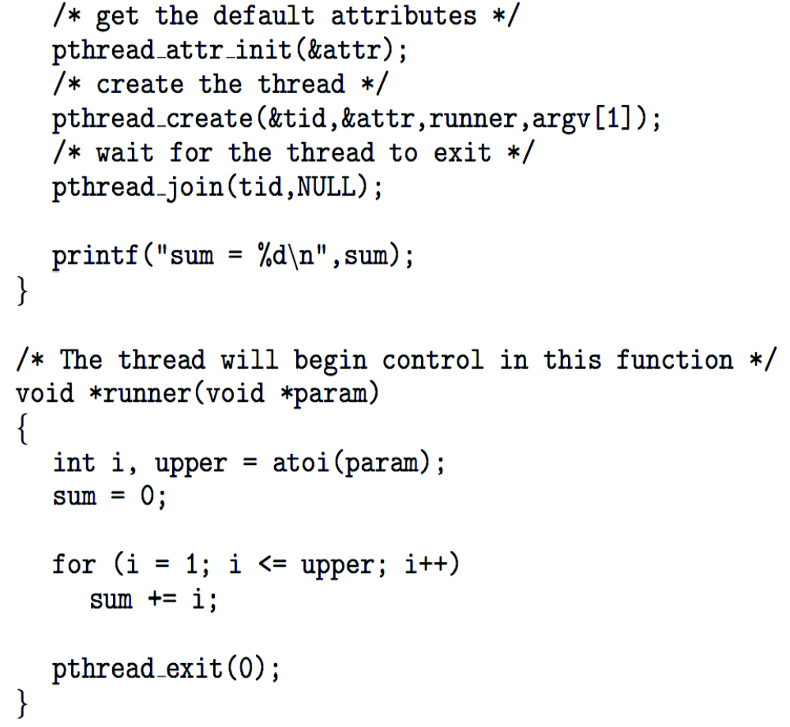
Pthreads Example (Cont.)

Slide 28
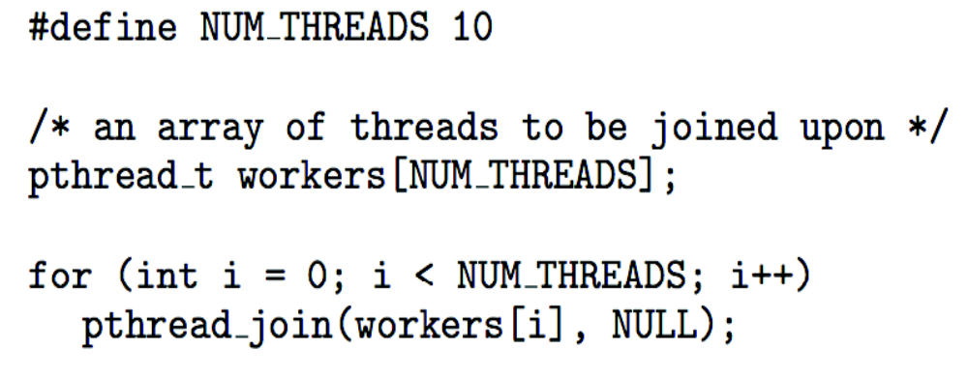
Pthreads Code for Joining 10 Threads

Slide 29
End of Chapter 4

