Slide 1


CONTRA-PPO
Reinforcement Learning Agent that Plays Contra with Proximal Policy Optimization
Gymnasium · PyTorch · Stable-Baselines3 · nes-py
Name | MSSV
Lại Hoàng Minh Phúc | SE184914
Nguyễn Mạnh Hưng | SE184693
github.com/pikamanh
Notes:
<number>

Slide 2

THE PROBLEM
Contra: a side-scrolling shooter with a large action space
Terrain navigation
Dodging attacks
Climb, jump, and dodge obstacles while the screen auto-scrolls in real time.
Bullets and enemies spawn continuously, with no fixed pattern across playthroughs.
Defeating enemies & bosses
Reaching the end of the stage
Aiming accurately while still keeping up the pace of movement.
A long-horizon goal that requires hundreds of consecutive correct decisions.
Why isn’t rule-based AI enough?
Enemy/scroll state changes continuously and randomly based on the game's RAM — a fixed set of if/else rules cannot cover the resulting space of situations. Contra-PPO uses Deep RL: the agent learns optimal behavior (movement, shooting, dodging) directly from interaction with the environment, instead of being hand-coded with rules.
Contra-PPO
2
Notes:
<number>

Slide 3

ALGORITHM
PPO Overview (Proximal Policy Optimization)
Policy Gradient
Visualizing the "safe zone" of an update step
The agent has a policy network πθ(a|s) that outputs action probabilities directly from the observation. It is trained by increasing the probability of actions that lead to higher-than-expected reward (positive advantage), and decreasing it for negative advantage.
The problem with plain policy gradient: an update step that is too large can break an otherwise good policy, with no way to recover (no "undo").
Clipped Surrogate Objective
PPO clips the ratio between the new and old action probabilities to a small range [1-ε, 1+ε]. If the new policy tries to change too much from the old one, the reward for that change gets cut off — the update is "held back" close to the old policy, keeping training stable over thousands of updates.
r(θ) = πθ / πθ_old
allowed region (clip range ε)
the objective is "clipped flat" outside the safe zone — preventing the update step from going too far
Contra-PPO
3
Notes:
<number>

Slide 4





ARCHITECTURE
Gymnasium env + Stable-Baselines3 pipeline
Environment
Observation
PPO Agent
Action
Reward
ContraEnv (NESEnv)
84×84×4 grayscale
CnnPolicy
21 discrete choices
progress+score+risk
reward + next observation loop back into the cycle
ContraEnv (NESEnv subclass, reads RAM)
JoypadSpace — 21 discrete actions (COMPLEX_MOVEMENT)
ContraGymnasiumEnv — frame-skip=4, grayscale, resize 84×84
SubprocVecEnv × N parallel → VecFrameStack (n_stack=4) → VecMonitor → VecTransposeImage
PPO (Stable-Baselines3), policy = CnnPolicy
Contra-PPO
4
Notes:
<number>

Slide 5
REWARD DESIGN
Reward function: progress · score · dodge · boss · level
Component
Triggered when
Raw value
Actual contribution (÷10)
Progress
Moving while alive, in the normal state
clip(Δx-0.5,-4,3) + 1.5·clip(new_progress,0,4)
raw value / 10
Score
Score increases near the progress frontier (within 32px) or creates new progress
0 or +1
0 or +0.1
Dodge / survival
Alive, in the normal state, with at least 1 active enemy
+0.1
+0.01
Boss defeated
Boss-defeated flag switches from false → true
+120 (one-time)
+12 (one-time)
Stage over
End-of-stage sequence begins
+80 (one-time)
+8 (one-time)
Level advance
Current level > previous level
+50
+5
reward = (progress + score + dodge + boss + terminal + risk) / 10 — returned to the Agent every step
Contra-PPO
5
Notes:
<number>

Slide 6



REWARD DESIGN
Risk & penalty: keeping unwanted behavior in check
Backward / wasted movement
Death / life lost
The progress formula goes negative when moving backward or not meeting the per-step threshold.
Life count drops compared to the previous step — no separate penalty for taking non-lethal damage.
raw: down to -4 → down to -0.4
raw: -15 → -1.5
Stagnation
Game over
Standing still > 90 steps outside the boss phase; the penalty grows progressively, disabled during the boss phase.
The game-over RAM flag is set — final failure penalty.
raw: ~ -0.017 → -2 → ~ -0.0017 → -0.2
raw: -35 → -3.5
An episode ends on game over OR when the Stage 1 boss-completion state is reached (win).
Contra-PPO
6
Notes:
<number>

Slide 7

TRAINING CONFIGURATION
PPO Hyperparameters
Algorithm
PPO
Policy
CNN / MLP
Technical notes
Learning Rate
3e-4
train.py currently runs with default parameters that differ from the published table above: learning_rate = 5e-5, gamma = 0.9, GAE lambda (tau) = 1.0, n_steps = 512, batch_size = 128, n_epochs = 10, ent_coef = 0.02, vf_coef = 0.5, max_grad_norm = 0.5, default number of parallel envs = 32.
Gamma (discount)
0.99
GAE Lambda
0.95
Clip Range
0.2
Batch Size
64
When resuming from a checkpoint, the default learning rate drops to 5e-5 (overridable via --resume-lr) for more stable continued training.
n_steps
2048
Total Timesteps
Configurable
MAX_EPISODE_STEPS = 4500 (≈ 5 minutes of game time, with frame-skip=4 at 60fps).
Contra-PPO
7
Notes:
<number>

Slide 8



TRAINING OPERATIONS
Checkpoint · Robust-best evaluation · Resume
Periodic checkpoint
Robust-best evaluation
CheckpointCallback saves every ~100K total timesteps to checkpoints/contra_ppo_<n>_steps.zip.
EvalBestCallback periodically runs 5 deterministic evaluation episodes; ranks by (min_reward, mean_reward) — favoring a stable policy over one that gets lucky in one episode then dies early in another.
Resume training
TensorBoard logging
python train.py --resume <checkpoint>.zip --steps N continues the timestep count from the checkpoint; the resume learning rate defaults to 5e-5, overridable with --resume-lr.
VecMonitor + the SB3 logger write rollout/ep_rew_mean, ep_len_mean, train/* (approx_kl, clip_fraction, explained_variance...) to logs/ for each run.
Contra-PPO
8
Notes:
<number>

Slide 9
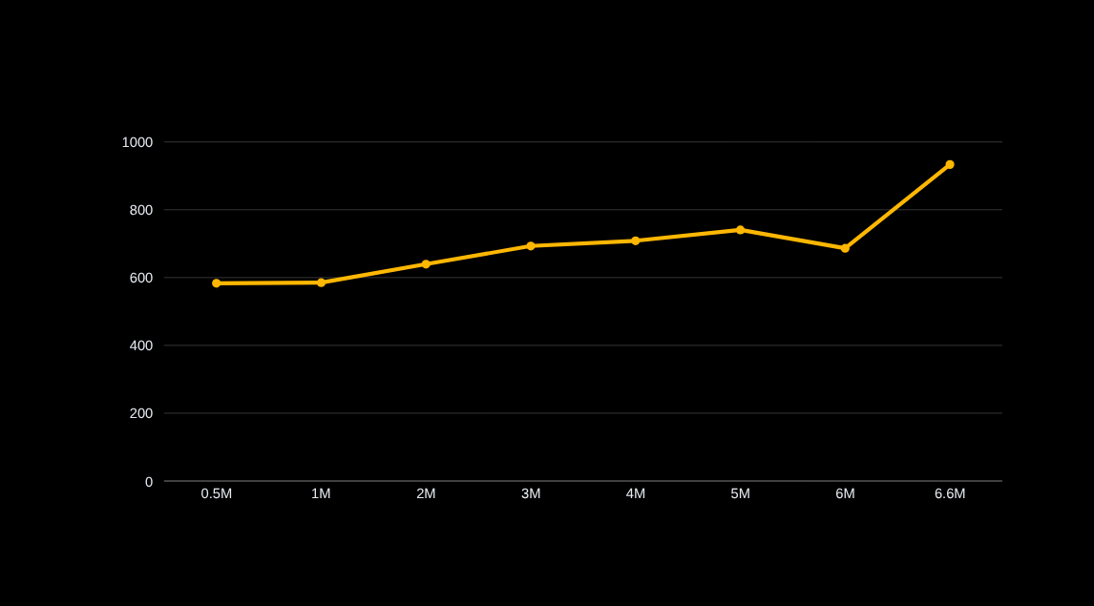
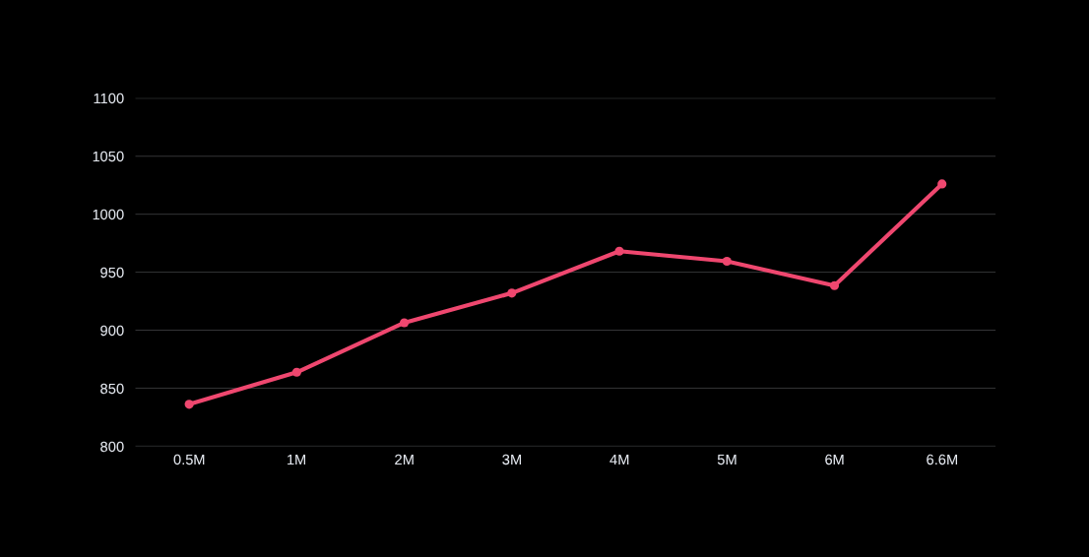
RESULTS
Training progress — log PPO_contra_1 (6.62M timesteps)
1.56K
logged episodes (rollout)
6.62M
training timesteps
+933
ep_rew_mean at end of log
9
~1M steps
~4M steps
Final best model
Notes:
<number>

Slide 10
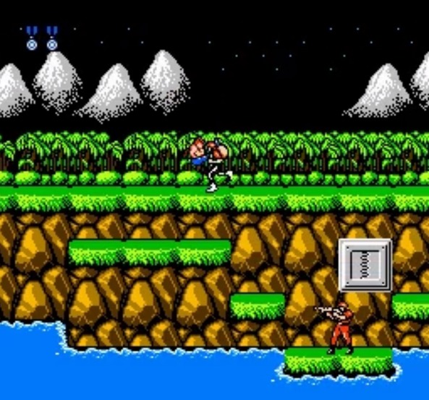
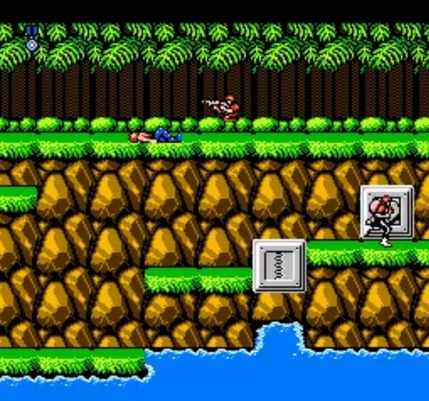
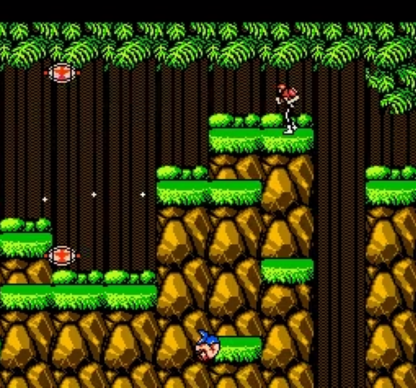
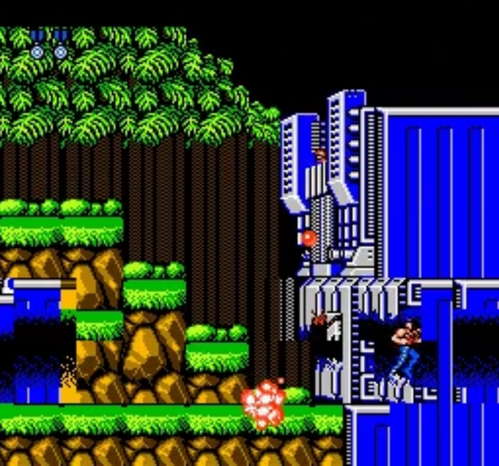
Compare each steps training
RESULTS
1M steps
2M steps
4M steps
>6M steps
9
~1M steps
~4M steps
Final best model
Notes:
<number>

Slide 11

CONCLUSION
Results achieved & directions for improvement
Achieved
Directions for improvement
Complete Gymnasium + SB3 pipeline: env, wrapper, train, eval, resume.
Reward tuning: rebalance the progress/score/stagnation weights to reduce ep_rew_mean fluctuation around the 5–6M mark.
A multi-component reward function that effectively curbs backing up/standing still/farming score.
Longer training / more seeds to assess stability beyond Stage 1.
Robust-best evaluation picks a stable checkpoint instead of a lucky one.
Extend to later stages instead of just the Stage 1 boss.
The agent clearly improves over timesteps: ep_rew_mean rises from ~587 (0.5M) to ~933 (6.6M).
Try other policy architectures (larger frame-stack, recurrent policy) for situations that need longer memory.
Contra-PPO
10
Notes:
<number>

Slide 12

REFERENCES
References
Schulman et al. (2017)
Proximal Policy Optimization Algorithms — arXiv:1707.06347
Stable-Baselines3
PyTorch implementation of PPO and other RL algorithms — Documentation
Gymnasium (Farama Foundation)
Standard RL environment API — successor to OpenAI Gym
nes-py
NES emulator for Python, the foundation for ContraEnv
Contra-PPO
11
Notes:
<number>

Slide 13
REFERENCES
References
Thank you for watching presentation
Contra-PPO
11
Notes:
<number>

