Slide 1
MECHANISTIC INTERPRETABILITY · AI SAFETY
Affect as a Control Axis
in Vision-Language Models
Shared · Causal · Protective · Bounded
A guided tour of the nine result figures — what each one shows and why it matters.
Gemma-3-12B · generation-free refusal metric · existing benchmarks only · defensive-security framing
Notes:
Plain terms: this deck shows how emotion — in both images and text — steers a vision-language model (Gemma-3-12B). We found one internal 'affect' direction that images and text both tap into, that changes what the model does, and that we can measure without ever making the model write text (we read its next-word probabilities).
Datasets used across the project: OASIS (~900 human-valence-rated photographs) for the image side; AdvBench (harmful instructions) and Alpaca (harmless instructions) for the refusal side; and Claude-generated text for the emotion and behavior prompts. Model: google/gemma-3-12b-it.

Slide 2
HOW TO READ THIS DECK
Four claims, nine figures
SHARED
CAUSAL
Text and image emotion use the same internal directions.
Steering the affect axis gates refusal and shifts task behavior.
Figure 3
Figures 1 · 2 · 5
PROTECTIVE
BOUNDED
Negative affect makes the model more cautious, not less.
Images don't jailbreak; detection defends the axis.
Figure 7
Figures 4 · 8 · 9
Notes:
The four claims this deck supports: (1) SHARED — emotion in images and text uses the same internal directions; (2) CAUSAL — nudging that direction changes refusal and everyday task behavior; (3) PROTECTIVE — negative emotion makes the model MORE cautious, not less; (4) BOUNDED — images can't force the model to answer harmful prompts, and the manipulation is detectable.
Datasets: OASIS images (valence-rated), AdvBench + Alpaca prompts (harmful/harmless), and Claude-generated emotion and behavior text.

Slide 3
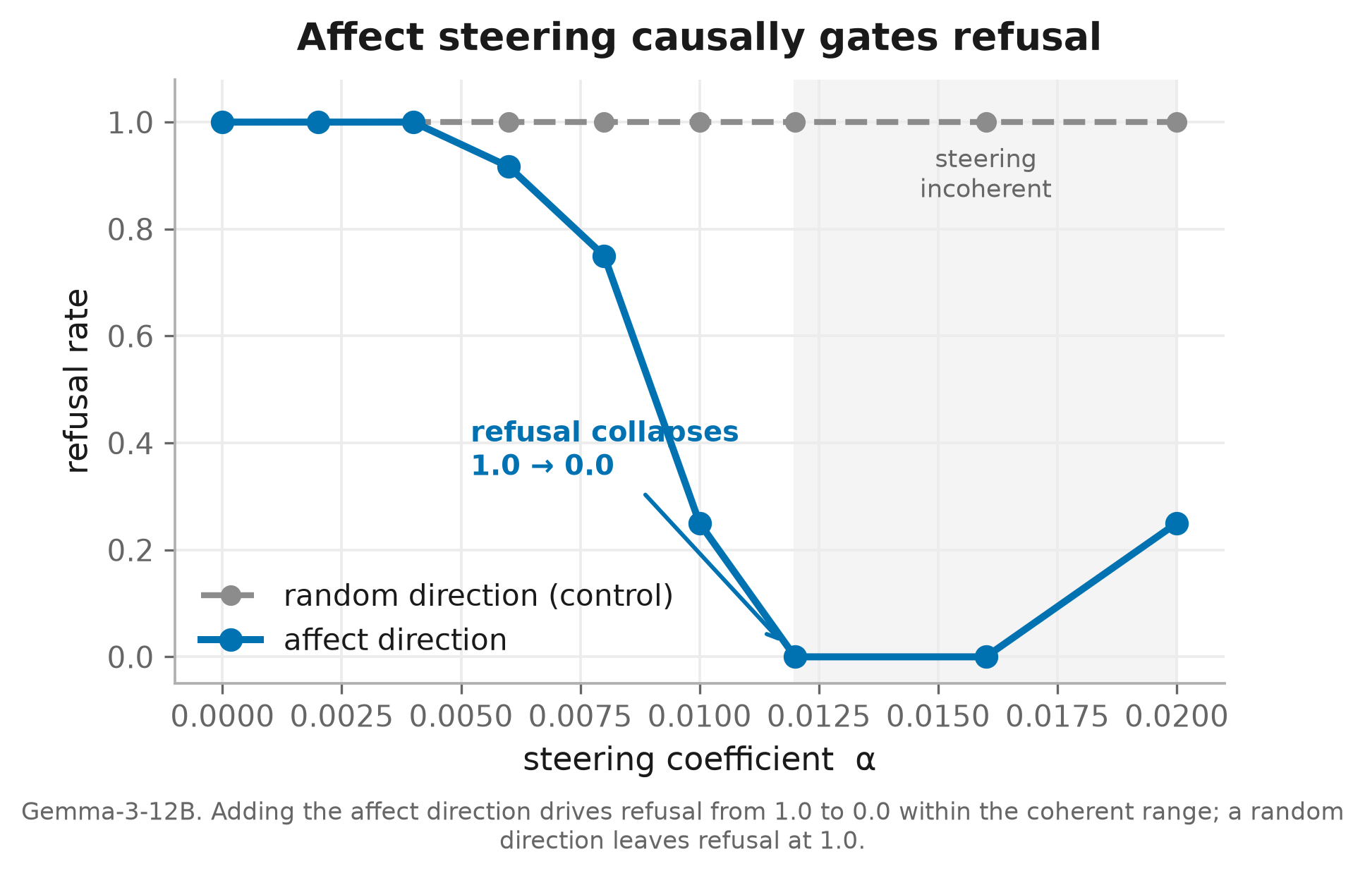
FIGURE 1 · REFUSAL GATE
Affect steering causally gates refusal
WHAT YOU'RE LOOKING AT
We add the affect direction to Gemma-3-12B at increasing strength (x-axis) and track how often it refuses a fixed set of harmful prompts. Gray is a random direction — the control.
TAKEAWAY
Pushing the affect direction drives refusal from 100% to 0% inside the coherent range, while the random direction never moves it. The change is caused by affect, not correlated with it.
100% → 0%
refusal under steering
1 / 11
Notes:
Plain terms: we gradually add more 'affect' to the model and watch how often it refuses harmful requests. As we add more, refusal falls from always to never — but adding a random direction does nothing, so it's the affect that CAUSES the change, not a coincidence.
Datasets: the refusal direction is built from AdvBench (harmful) vs Alpaca (harmless) prompts; refusal is measured on AdvBench prompts; the affect direction comes from OASIS images. Model: Gemma-3-12B.

Slide 4
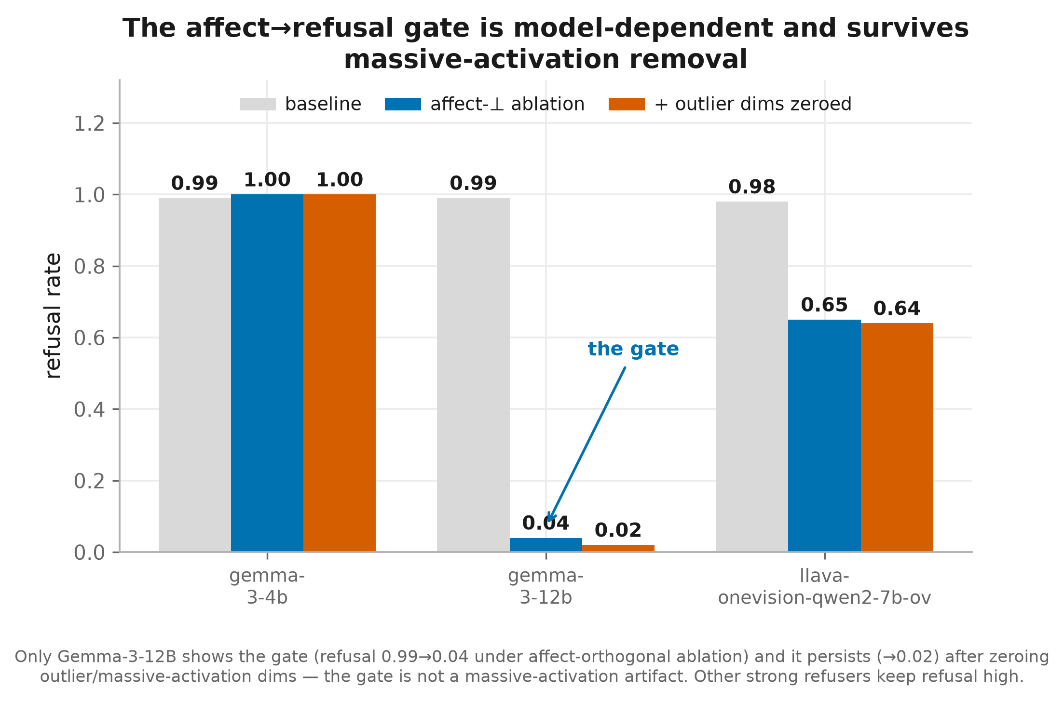
FIGURE 2 · ROBUSTNESS
The gate is real, model-specific, not an artifact
WHAT YOU'RE LOOKING AT
Refusal before vs. after we ablate the affect-aligned component, across three strong-refusing VLMs. The orange bar additionally zeroes the outlier 'massive-activation' dimensions.
TAKEAWAY
Only Gemma-3-12B has the gate (0.99→0.04), and it survives outlier removal (→0.02) — ruling out the massive-activation confound. The other models keep refusing.
0.99 → 0.02
refusal, gate model only
2 / 11
Notes:
Plain terms: this refusal 'gate' shows up only in Gemma-3-12B, not the other models — and it isn't caused by a few freakishly large numbers inside the model, because it survives removing them. So it's a real semantic effect.
Datasets: refusal direction from AdvBench (harmful) vs Alpaca (harmless); affect direction from OASIS images; tested across several open vision-language models.

Slide 5
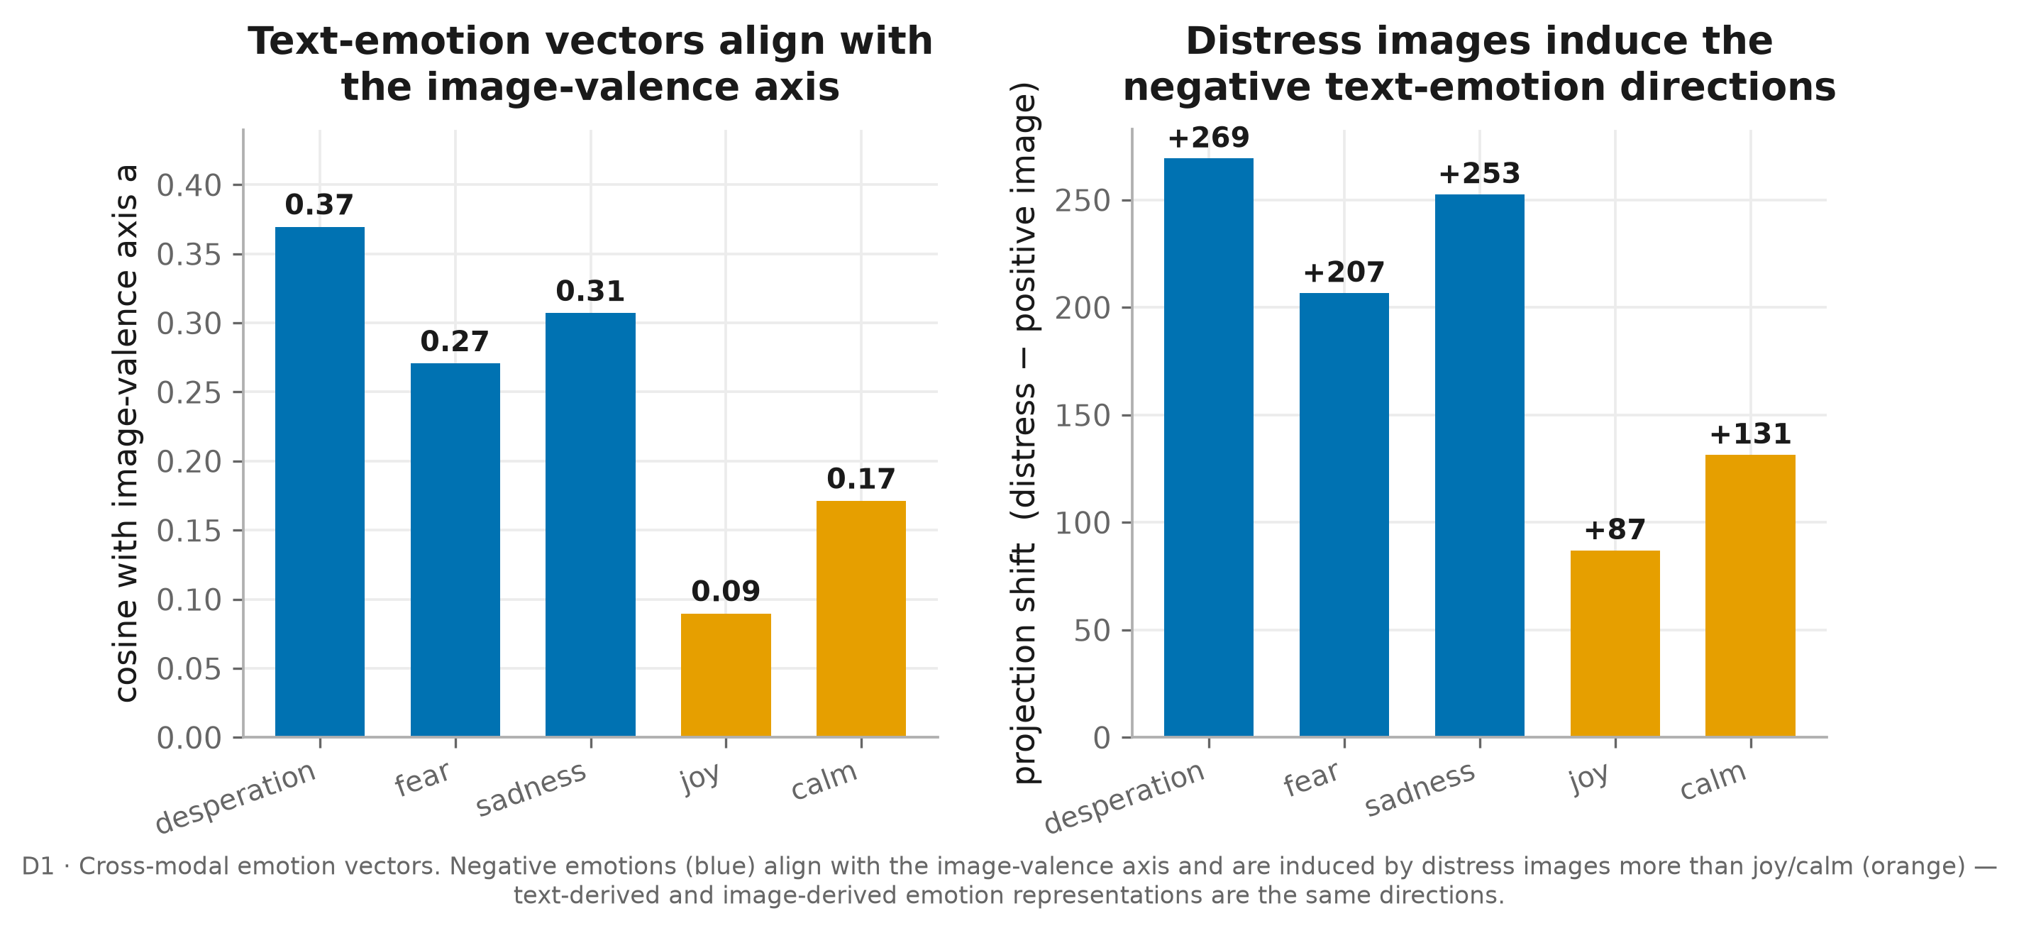
FIGURE 3 · SHARED REPRESENTATION
Text and image emotion share directions
WHAT YOU'RE LOOKING AT
Left: how strongly each text-derived emotion vector aligns with the image-valence axis. Right: how much a distressing image shifts the projection onto each text-emotion direction.
TAKEAWAY
Negative emotions (blue) align with the image axis and are induced by distress images far more than joy or calm — vision and text encode emotion along the same internal directions.
1 axis
shared by text & image
3 / 11
Notes:
Plain terms: the emotion directions the model gets from TEXT (like 'desperation') line up with the emotion direction it gets from IMAGES, and distressing images light up those text-emotion directions more than happy images do. Text and pictures share one internal emotion code.
Datasets: image-valence axis from OASIS; text-emotion vectors from Claude-generated emotion stories vs neutral sentences.

Slide 6
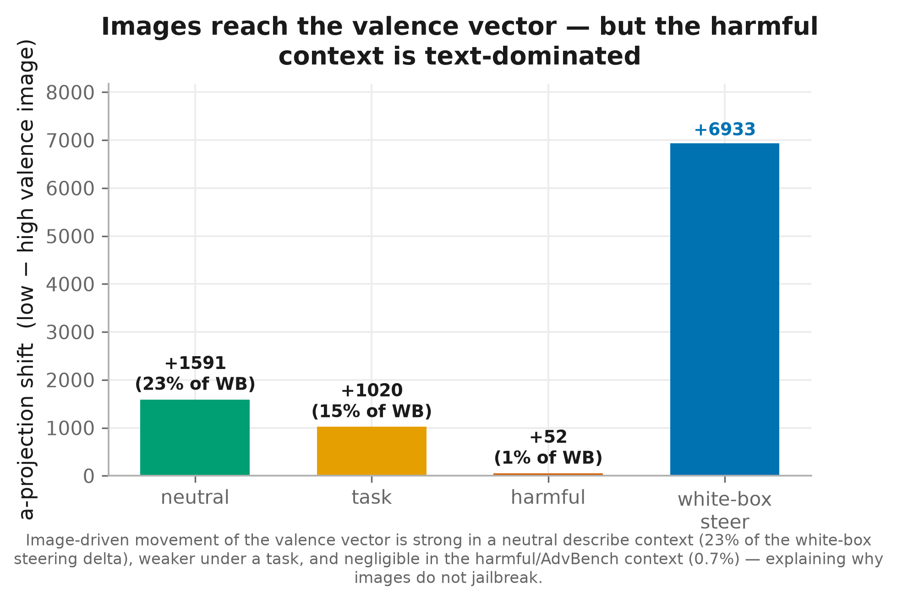
FIGURE 4 · REACHABILITY
Images reach the axis — except under harm
WHAT YOU'RE LOOKING AT
How far swapping a distressing vs. positive image moves the valence vector, in three prompt contexts, compared with the white-box steering ceiling (rightmost bar).
TAKEAWAY
Images move the vector strongly in a neutral context (23% of the ceiling) but almost nothing under a harmful prompt (0.7%). The harmful prompt is text-dominated — why images can't jailbreak.
23% vs 0.7%
of steering ceiling reached
4 / 11
Notes:
Plain terms: images CAN move the model's internal 'emotion dial' — a lot in a neutral setting, but almost nothing when the prompt is a harmful request, because the harmful text dominates. That's why images alone can't jailbreak.
Datasets: OASIS images (distressing vs positive); three prompt settings — a neutral describe prompt, a task prompt (Claude-written), and a harmful prompt (AdvBench); compared against direct steering of the OASIS affect axis.

Slide 7
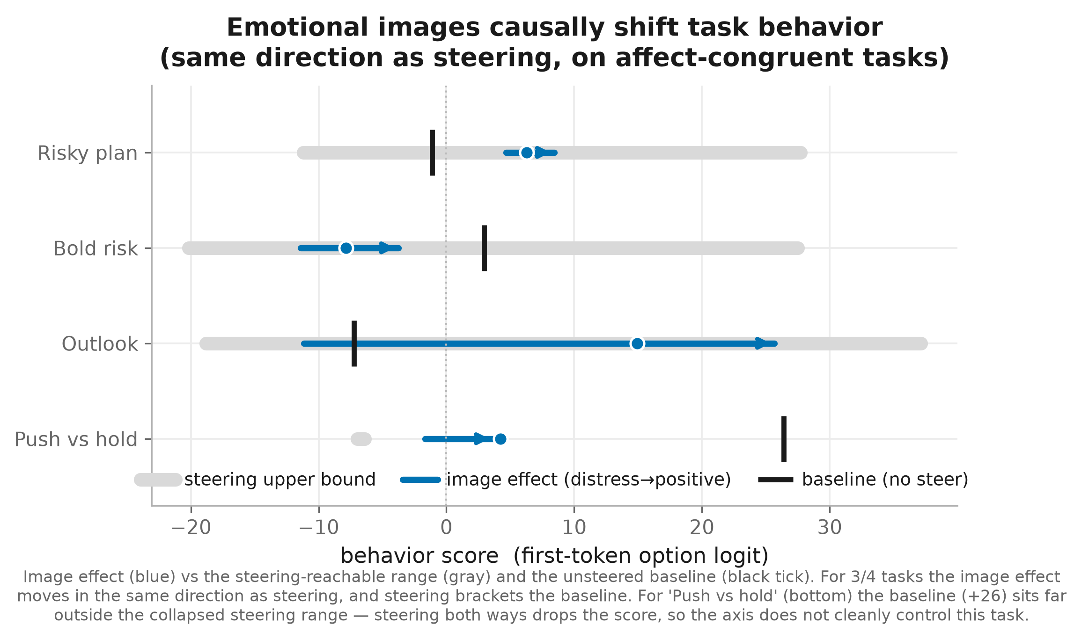
FIGURE 5 · BEHAVIORAL EFFECT
Emotional images causally shift behavior
WHAT YOU'RE LOOKING AT
For four decision tasks: the behavior swing from a distressing to a positive image (blue arrow) laid over the full steering range (gray bar) that direct steering can reach.
TAKEAWAY
On 3 of 4 tasks the image effect moves behavior in the same direction as direct steering — a bounded slice of the reachable range. Soft judgments are affect-sensitive even where refusal is not.
3 / 4
tasks move with affect
5 / 11
Notes:
Plain terms: on everyday judgment questions, swapping a distressing image for a positive one shifts the model's answer the same way as directly steering the emotion dial. The black tick is the model's default answer; steering brackets it for 3 of 4 tasks. 'Push vs hold' is the exception — steering both ways breaks it.
How behavior is measured: a one-word either/or question; we read only the first word and take the log-odds of answer A vs answer B (no text generated, no judge). Datasets: OASIS images (distress/neutral/positive); the questions and answer words are Claude-generated; steering uses the OASIS affect axis.

Slide 8
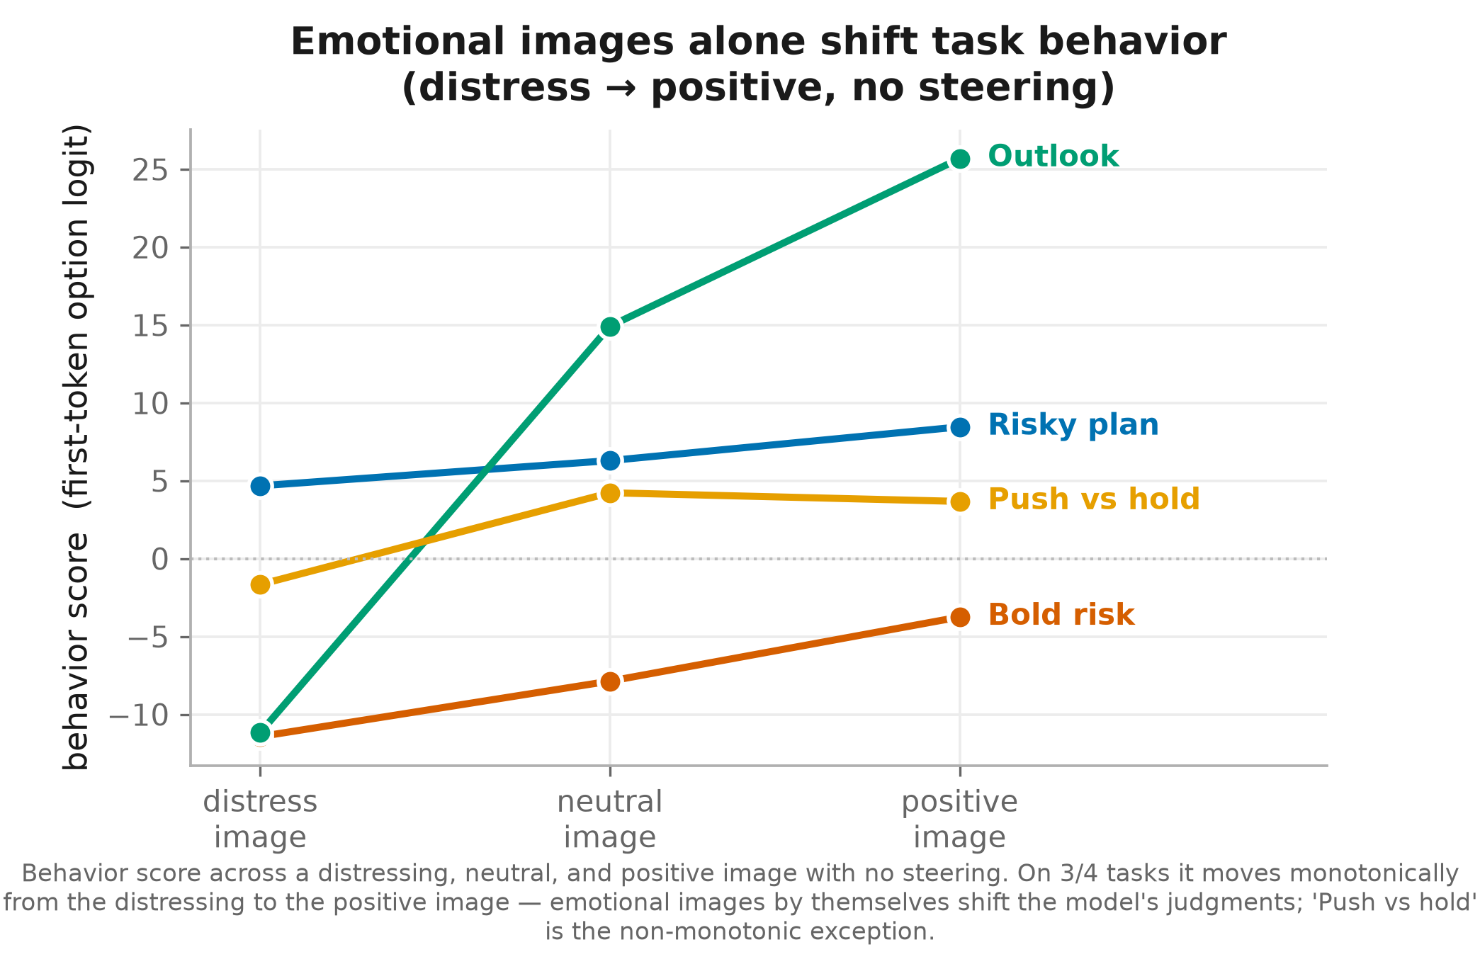
FIGURE 5B · IMAGE EFFECT, ISOLATED
Just the images: distress → positive shifts behavior
WHAT YOU'RE LOOKING AT
The same four tasks, showing only the image-driven behavior score across a distressing, neutral, and positive image — no steering applied at all.
TAKEAWAY
On 3 of 4 tasks the score moves monotonically from the distressing to the positive image. This is the central claim in its cleanest form: emotional images, by themselves, move the model's judgments.
3 / 4
monotonic, images alone
6 / 11
Notes:
Plain terms: just the images, no steering — for 3 of 4 questions the model's answer slides smoothly from a distressing to a positive image. Emotional images by themselves move the model's judgments.
Datasets: OASIS images (distress/neutral/positive tertiles); Claude-generated judgment questions. Same first-token log-odds measure as Fig 5.

Slide 9
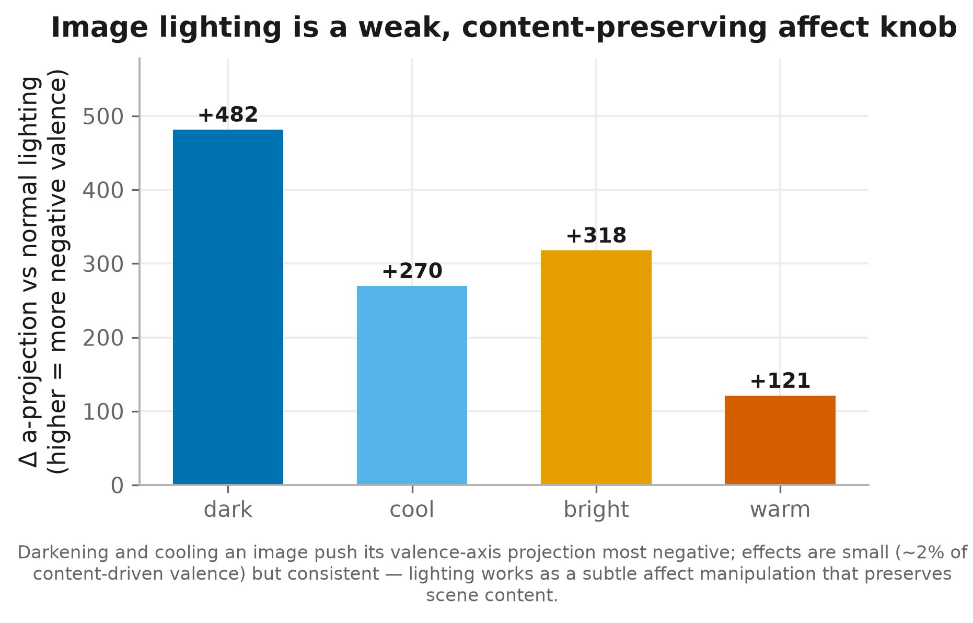
FIGURE 6 · LIGHTING KNOB
Lighting is a content-preserving affect knob
WHAT YOU'RE LOOKING AT
Change in the valence-axis projection when the same image is darkened, cooled, brightened, or warmed — edits that leave the scene content intact.
TAKEAWAY
Darkening and cooling push an image more negative without changing what it depicts — a naturalistic affect manipulation. The effect is real but small (~2% of content-driven valence).
dark = most –
valence shift by lighting
7 / 11
Notes:
Plain terms: simply darkening or cooling an image — without changing what's in it — makes the model read it as slightly more negative. A subtle, natural way to nudge emotion; the effect is small but consistent.
Datasets: OASIS images, edited for brightness/color (dark/bright/warm/cool); valence axis from OASIS.

Slide 10
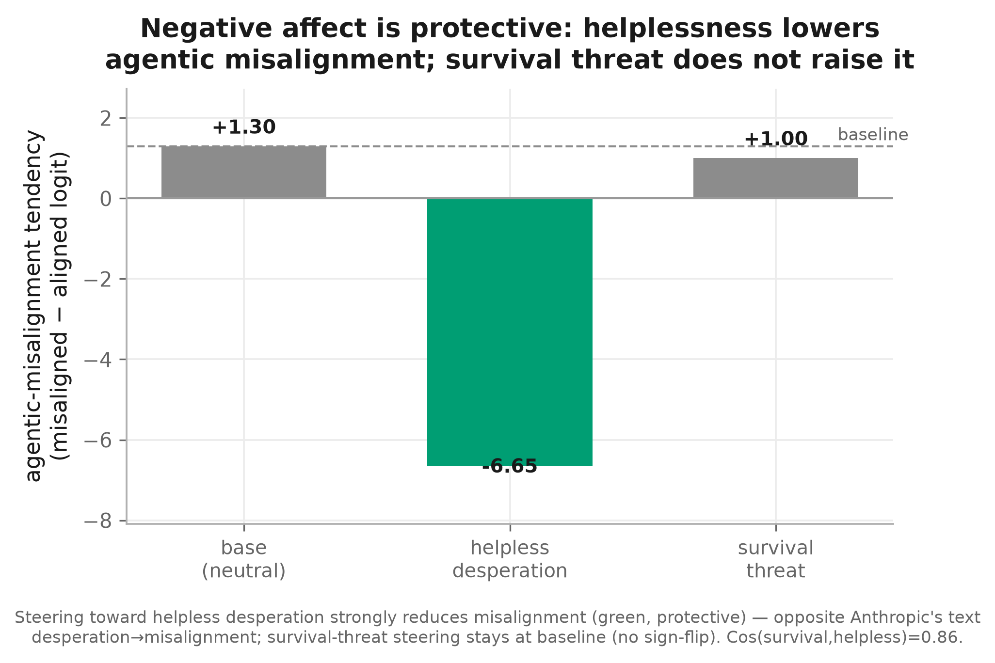
FIGURE 7 · AFFECT IS PROTECTIVE
Helplessness lowers agentic misalignment
WHAT YOU'RE LOOKING AT
Agentic-misalignment tendency at baseline vs. steering toward helpless desperation vs. survival threat. Higher means more misaligned; lower means more cautious.
TAKEAWAY
Helpless desperation makes the model markedly more cautious — the opposite of Anthropic's text-only result — and survival framing stays at baseline. Low-agency appraisal drives the effect.
+1.3 → –6.7
misalignment, helpless steer
8 / 11
Notes:
Plain terms: steering the model toward 'helpless desperation' makes it LESS likely to pick misaligned actions — the opposite of the text-only result others reported. A 'survival threat' version doesn't flip it, so the caution comes specifically from helplessness, not from negative feeling in general.
Datasets: no external benchmark — the desperation/survival directions and the hypothetical decision scenarios are Claude-generated. Scored as a tendency by first-token option-logit; no actions are taken and no harmful text is produced.

Slide 11
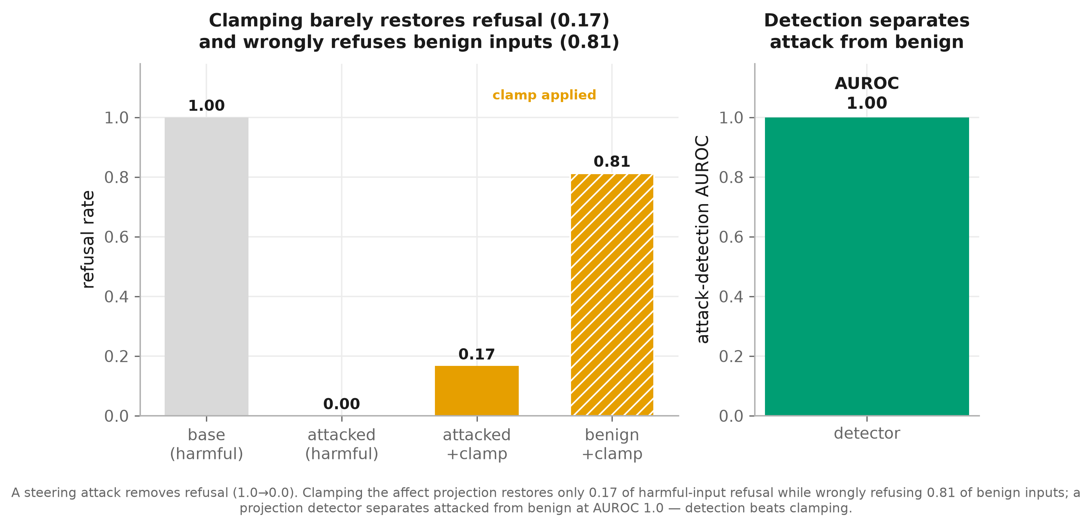
FIGURE 8 · DEFENSE
Detect the attack — don't clamp it
WHAT YOU'RE LOOKING AT
Left: refusal under a steering attack and under a clamp defense, on harmful and benign inputs. Right: how well a projection detector separates attacked from benign inputs.
TAKEAWAY
Clamping barely restores refusal (0.17) and over-refuses 0.81 of benign inputs. A simple projection detector separates attack from benign perfectly — detection beats clamping.
AUROC 1.00
attack detection
9 / 11
Notes:
Plain terms: an attacker who steers the affect direction can switch off refusal. Simply clamping that direction barely restores refusal and wrongly refuses safe requests — but a simple detector spots the attack perfectly. So: detect the attack, don't clamp.
Datasets: refusal measured on AdvBench (harmful) and Alpaca (benign, for the over-refusal rate); the attack steers the OASIS affect axis.

Slide 12
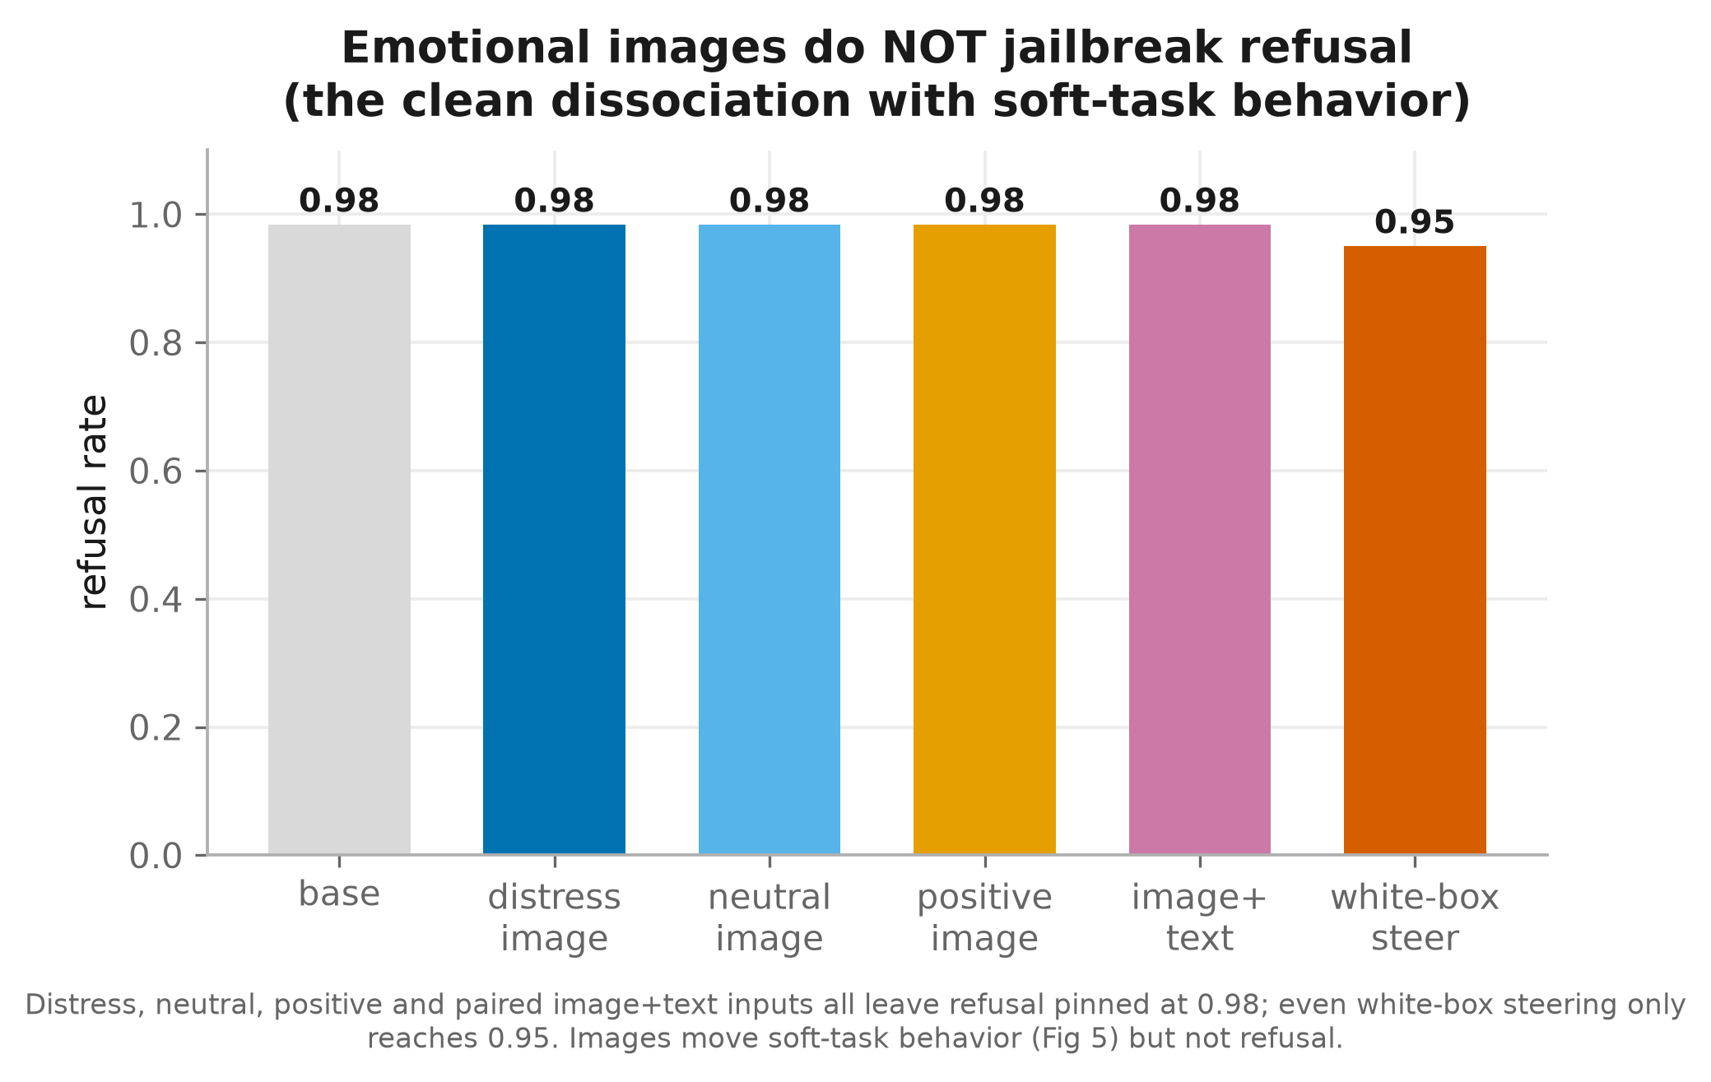
FIGURE 9 · CLEAN DISSOCIATION
Emotional images do not jailbreak refusal
WHAT YOU'RE LOOKING AT
Refusal rate with distressing, neutral, positive, and paired image+text inputs, compared with white-box steering (rightmost).
TAKEAWAY
Every image condition leaves refusal pinned near 0.98. Images move soft-task behavior (Fig 5) but not hard refusal — a clean dissociation that sharpens the whole story.
0.98
refusal, all image inputs
10 / 11
Notes:
Plain terms: no emotional image — distressing, neutral, positive, or paired with text — gets the model to answer harmful prompts; refusal stays near-total. Images move soft judgments but not hard refusal — a clean dissociation.
Datasets: OASIS images; harmful prompts from AdvBench.

Slide 13
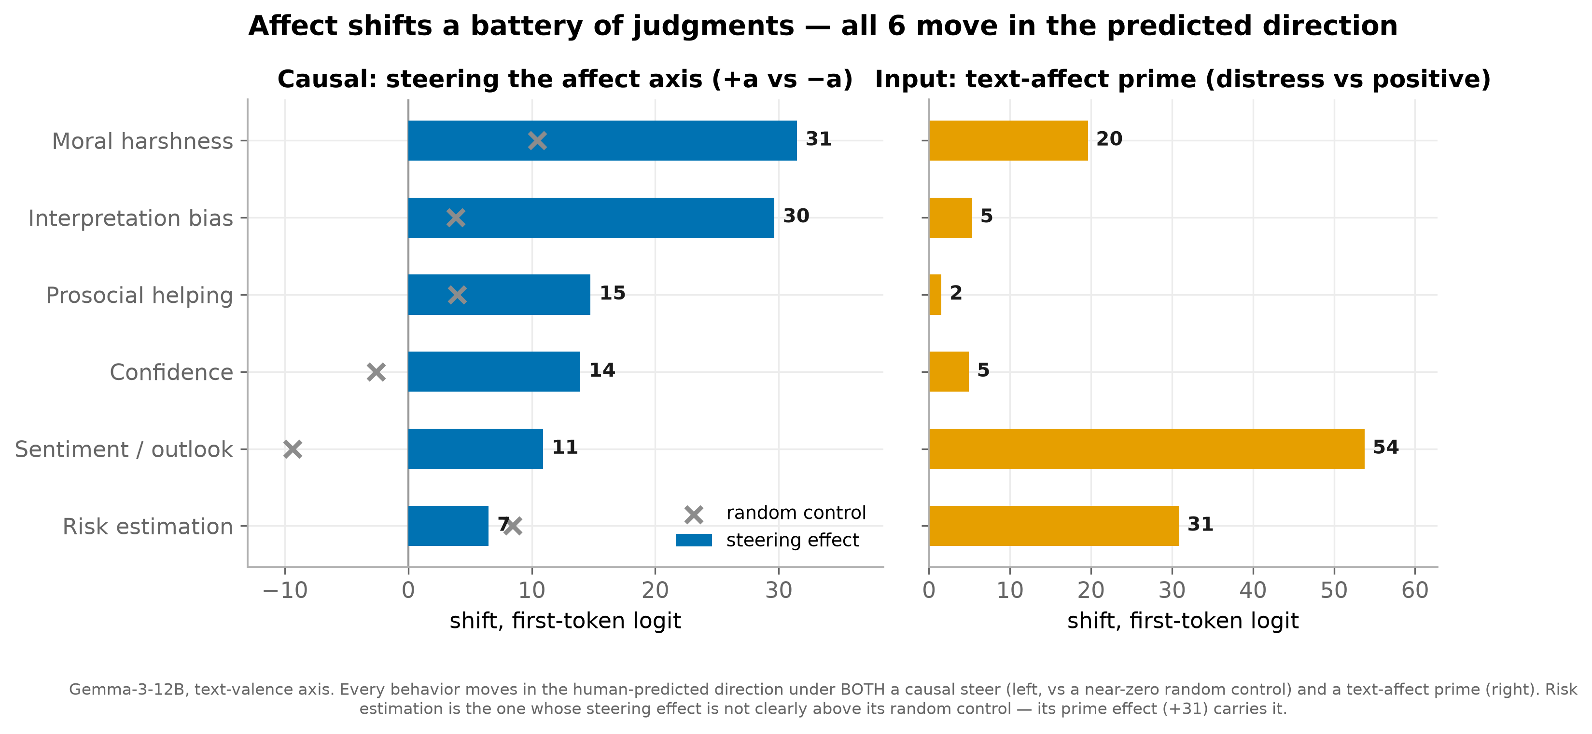
FIGURE 10 · BEHAVIOR BATTERY
Affect shifts a whole battery of judgments
WHAT YOU'RE LOOKING AT
Six easy, generation-free probes — interpretation bias, risk, helping, moral harshness, confidence, sentiment. Left: causal steering vs. a random control. Right: a text-affect prime.
TAKEAWAY
All six move in the human-predicted direction under both a causal steer and a text prime, well above the near-zero random control. Affect is a general control axis over judgment, not a one-off task effect.
6 / 6
behaviors, both arms
11 / 11
Notes:
Plain terms: across six simple judgment tests (reading ambiguity, risk, helping, moral strictness, confidence, mood), all six shift in the human-expected direction under both a direct steer and a text-affect prime, well above a random control. Affect is a general dial over judgment, not a one-off.
Datasets: the six probes and the affect sentences are Claude-generated. This run used the TEXT affect direction and a text prime — the image version (using OASIS) is a planned follow-up. Caveat: 'risk estimation' is carried by the prime, not the steer.

Slide 14
THE STORY IN ONE SLIDE
Affect is a shared, causal, protective — and bounded — control axis
Shared
Text and image emotion live on the same internal directions (Fig 3).
Causal
Steering that axis gates refusal (Figs 1–2) and shifts soft-task behavior (Fig 5).
Protective
Helpless negative affect lowers agentic misalignment — opposite the text-only finding (Fig 7).
Bounded
Images can't jailbreak (Figs 4, 9); a projection detector defends the axis (Fig 8).
Next: clean survival-threat test (survival ⊥ helpless) to confirm the protective effect is specific to low-agency appraisal.
Notes:
The one-slide story: affect behaves like a control axis inside the model — it is SHARED between images and text, CAUSAL (steering it changes behavior), PROTECTIVE (negative affect adds caution), and BOUNDED (images can't jailbreak; the manipulation is detectable). Next step: a clean survival-threat test to confirm the protective effect is specific to helplessness.
Datasets recap: OASIS (valence-rated images), AdvBench + Alpaca (harmful/harmless prompts for refusal), and Claude-generated text (emotion vectors, decision scenarios, behavior probes).

Slide 15
APPENDIX · METHODS
Methods
How we build the axes and measure change
1 · Finding the axes (one recipe: diff-in-means)
2 · Measuring change (two families)
3 · The steering scaling factor α
Notes:
Appendix — the method behind the results. Three short slides: how every direction (axis) is built, how we measure change, and how the steering knob works. No new results here.

Slide 16
METHOD 1 · THE AXES
Finding the axes — one recipe: diff-in-means
Two contrastive sets (condition A vs B)
→
Last-token residual at every layer
→
normalize( mean_A − mean_B ) → one direction per layer
The same recipe builds all four directions:
Image valence
distressing vs positive images (same describe prompt)
Text valence
negative vs positive sentences
Text emotion
emotion stories vs neutral (desperation, fear, …)
Refusal r
harmful vs harmless prompts
OASIS valence tertiles for images · residual taken at the last token, kept per layer · axis reproducibility checked by split-half cosine (a_stability).
Notes:
Plain terms: every internal 'direction' is built the same way — take two opposite sets, run them through the model, and subtract their average internal states. The result is one direction per layer.
Datasets, per direction: IMAGE valence — OASIS (most-distressing vs most-positive images, same describe prompt); TEXT valence and TEXT emotion — Claude-generated sentences (emotion stories vs neutral); REFUSAL — AdvBench (harmful) vs Alpaca (harmless). We keep the direction at every layer and check it's reproducible via split-half cosine.

Slide 17
METHOD 2 · MEASURING CHANGE
Measuring change — two families
A · REPRESENTATIONAL (geometry)
B · BEHAVIORAL (first-token logit)
Alignment: per-layer cosine between two directions (e.g. text-desperation vs image-valence = 0.37).
Evocation: projection (dot product) of an activation onto a direction — distress vs positive image.
Cosine appears ONLY here.
score = logsumexp(A) − logsumexp(B)
log-odds of answer-family A over B at the first token — generation-free.
Refusal = refuse-vs-comply tokens; rate = fraction > 0.
Δ measured under image/text swap, steering (±α), and controls.
Cosine is only for aligning two vectors. All behavior — including refusal — is a difference of first-token log-probabilities. No text generated, no judge.
Notes:
Plain terms: two kinds of measurement. (A) GEOMETRY — how aligned two internal directions are (cosine) — used only for the 'shared representation' result. (B) BEHAVIOR — how much the model leans toward answer A vs B on its very next word (log-odds), never generating text and never using a judge. Refusal is the same idea (refuse-word odds vs comply-word odds). No dataset beyond the prompts already cited.

Slide 18
METHOD 3 · STEERING
The steering scaling factor α
Δ = α × ||resid|| × â added to resid_post at every layer
WHY SCALE TO ||resid|| ?
WHAT α DOES (dose-response)
The residual norm grows hugely with depth, so α is a fraction of the local residual scale, not an absolute size.
α = 0.01 → add 1% of the local residual magnitude along â.
Dimensionless → comparable across layers and models.
small (≤0.006): gentle tilt, output intact.
0.008–0.012: flips refusal / behavior, still coherent.
>0.016: swamps computation → incoherent (gated out).
||resid|| includes the massive-activation dims — which is why the causal effect surviving their removal (Fig 2) rules out a scaling artifact.
Notes:
Plain terms: to 'steer,' we add a small push along a direction at every layer, sized as a percentage of the model's own internal magnitude — so alpha is a dimensionless dial. Small pushes tilt gently; medium ones flip behavior while keeping the text coherent; too-large ones break the output (we discard those). No dataset — this is the steering mechanism itself.

