Slide 1
SMARTPRICE INDIA
Real-Time Price Comparison Platform
Amazon India & Flipkart Scraper with Intelligent Relevancy Matching

Slide 2
THE RELEVANCY CHALLENGES
01. Query Pollution
Searching for premium devices (e.g. S24 Ultra) pulls in dozens of low-cost accessories (cases, screen protectors, chargers) in search pages.
02. Cross-Model Matches
Standard fuzzy string matching frequently pairs different product generations (e.g. Galaxy S25 with S24) due to overlapping character lengths.
03. Scraper Reliability
Frequent anti-bot blocking (CAPTCHAs, IP blocks) and slow concurrent execution times degrade real-time UX.

Slide 3
SYSTEM ARCHITECTURE DIAGRAM
FRONTEND (React + Vite)
• Dashboard UI (App.jsx) • Filters (Matches, Sort, Pages) • API Client (Axios Service)
BACKEND CORE (FastAPI)
• Endpoints (/api/search, clear) • Scrape Controller (Threading) • Matcher Engine (Fuzzy + Specs) • Model Generation Validator • Comparator Savings Analysis
WEBSITES SCRAPED
• Amazon India - Selenium Driver - Accessory keyword filter • Flipkart Web - Selenium Driver - Container class resolver
DATABASE LAYER (SQLite)
• Search History & Result Cache

Slide 4
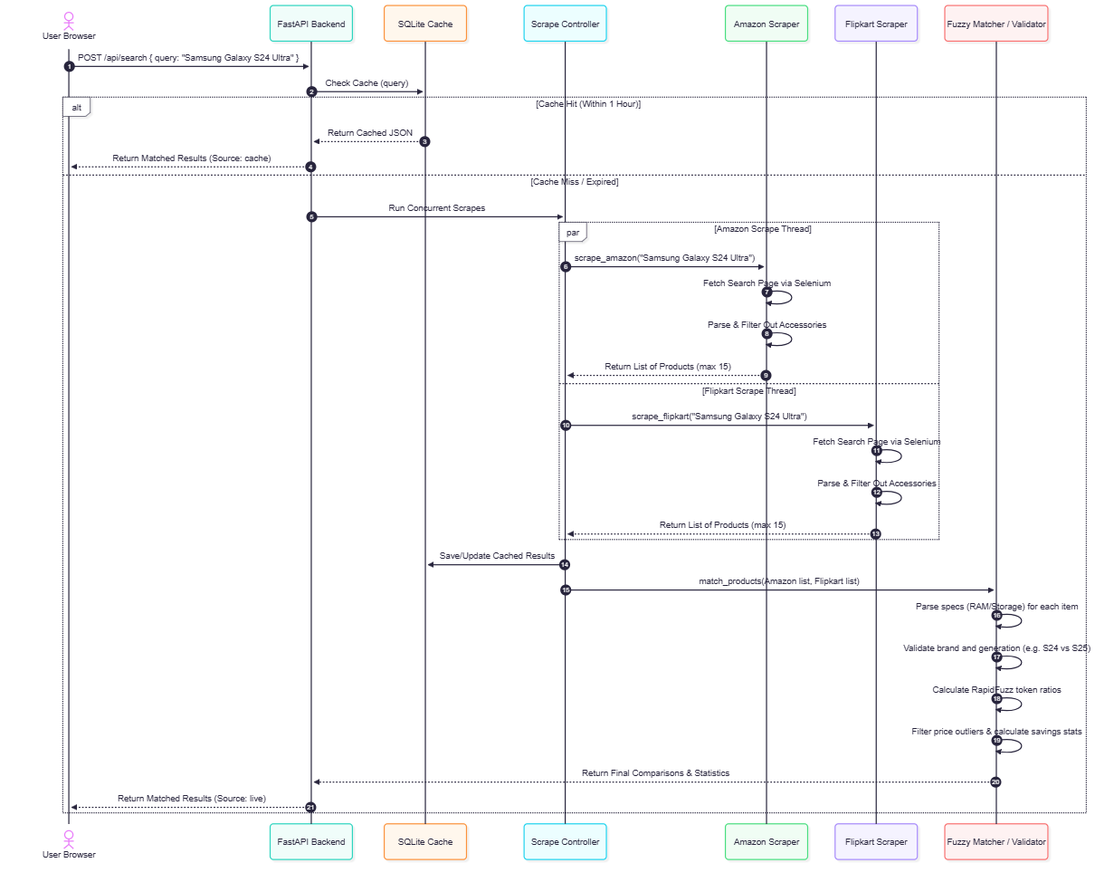
DATA FLOW & SEQUENCE DIAGRAM

Slide 5
SCRAPER FILTERS & OUTLIER GUARD
Smart Accessory Filter
Filter list includes cases, chargers, tempered glass, straps, screen guards, film, and cables. - Query Bypass: If search query explicitly mentions an accessory (e.g. 'S24 charger'), filtering is bypassed. - Bundle Exception: Expensive main device bundles (e.g. 'Galaxy S24 Ultra with Charger' > Rs. 8,000) are protected from deletion.
Dynamic Price Outlier Rejection
Analyzes price distribution dynamically upon scrape completion. - Detection Threshold: Active when high-value items (priced > Rs. 15,000) are found. - Outlier Rule: Automatically rejects any scraped result priced below 12% of the maximum price AND under Rs. 8,000. - Result: Keeps results clean, eliminating cheap accessories and unrelated items.

Slide 6
PRECISION MATCHING ENGINE
RAM & Storage Extraction
Independent parsing of RAM (e.g. 8GB vs 12GB) and storage capacity (128GB vs 256GB vs 1TB). Rule: Matches are strictly rejected if either RAM or Storage specs differ, ensuring different sub-configurations are compared separately.
Generational Model Validation
Specific regex checks targeting model families (e.g. S24 vs S25, iPhone 15 vs 16, OnePlus 11R vs 12R). Rule: Mismatches block pairs with high string similarity from matching, solving cross-generational false positive comparisons.

Slide 7
TECHNOLOGY STACK
Frontend
React (v18) Tailwind CSS (v3) Vite (v5) Axios Client
Backend Core
FastAPI Server Python 3.11+ Uvicorn Reloader Pydantic Settings
Database / Cache
SQLite database SQLAlchemy ORM Query History logging JSON cache strings
Scraping & Match
Selenium WebDriver BeautifulSoup4 RapidFuzz matching Anti-bot rotation

