Slide 1
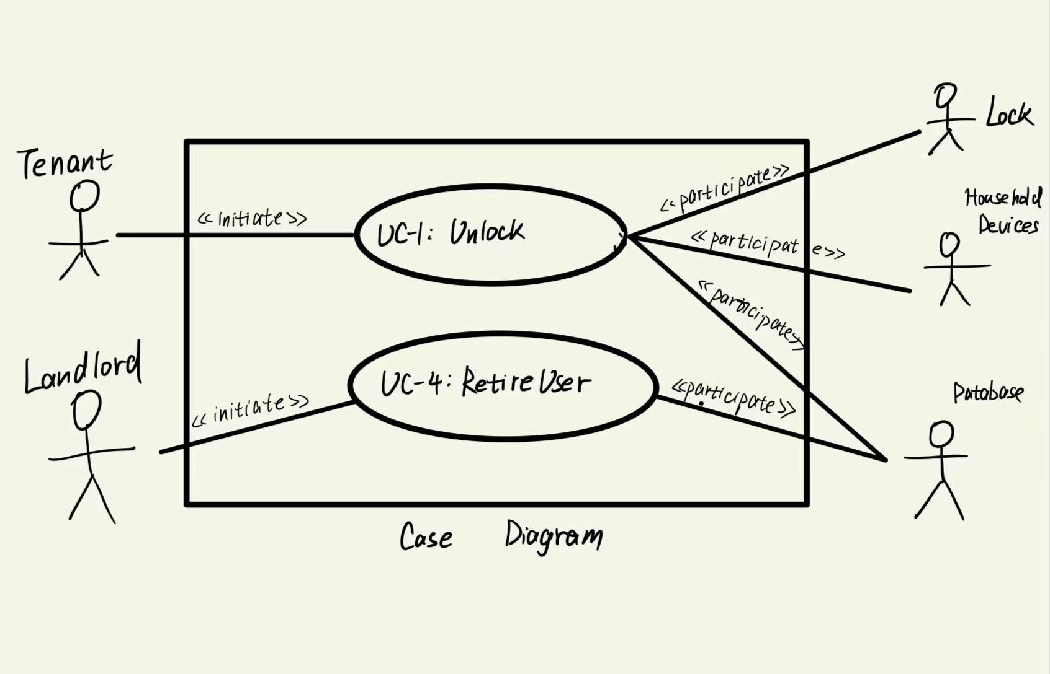
1.use case diagram

Slide 2
2.use case schemas of UC-1 and UC-4

Slide 3
Use Case UC-1: |  | Unlock
RelatedRequirements: |  | REQ-1, REQ-2, REQ-3, REQ-4, REQ-5
Initiating Actor: |  | Any of: Tenant, Landlord
Actor’s Goal: |  | To disarm the lock and enter,and air conditioner turns on automatically
Participating Actors: |  | Lock, Household Devices, Database
Preconditions: |  | The set of valid keys stored in the system database is non-empty.The system displays the menu of available functions; at the door keypad the menu choices are “Lock” and “Unlock.”Automatically turn on air conditioning
Postconditions: |  | Start automatic lock timer.The door is unlocked.
Flow of Events for Main Success Scenario:
→← | Tenant/Landlordarrives at the door and selects the menu item “Unlock”Systemsignals to the Tenantthe lock status and logs the entry in the database.
← | System validates the request by checking the mobile keysin the database.
← | System turns on the air conditioner
→ | Tenant/Landlordopens the door, enters the home [and shuts the door and locks]
Flow of Events for Extensions (Alternate Scenarios):
←1.System (a) signals a warning that the door is open, and (b) signal to Timer to start the alarm counter
→2.Tenant/Landlord closes the door
←3.LockDevice to arm the lock, (d) signal to Timer to reset the auto-lock counter, and (e) signal to Timer to reset the alarm counter
2a. Tenant/Landlord enters an invalid identification key
← | 1. | System (a) detects error, (b) marks a failed attempt, and (c) signals to the actor
← |  | 1.a | System (a) detects that the count of failed attempts exceeds the maximum allowed number, (b) signals to sound AlarmBell, and (c) notifies the Police actor of a possible break-in
→ | 2. | Tenant/Landlord supplies a valid identification key
 | 3. | Same as in Step 3 above

Slide 4
Use Case UC-4: |  |  | RetireUser
Related Requirements: |  |  | REQ-3 REQ-7
Initiating Actor: |  |  | Landlord
Actor’s Goal: |  |  | Retire an existing user account and disable access.
Participating Actors: |  |  | Tenant, Database
Preconditions: |  |  | The user’s account is removed from the database. The devices associated with the users cannot unlock the door..
Postconditions: |  |  | • The specified data is deleted from the database.
Flow of Events for Main Success Scenario:
→ | 1. | 1.Landlord started the Database management system and selects a user account to retire.
← | 2. | System validates the request and checks if the user account exists.
→ | 3. | Landlord deletes a user’s account and update the database.
Flow of Events for Extensions (Alternate Scenarios):
→ | 2a. System detects a login failure
← | 1. System notifies the user to check whether id and password is correct and retry
→ | 5b. System obtains no specific user information from database
← | 1. System (a) signals to the actor, (b) notifies the actor to retry

Slide 5
3.the acceptance tests for UC-1 and UC-4

Slide 6
Test-case Identifier: | TC-1
Use Case Tested: | UC-1
Pass/fail Criteria: | The test passes if the Tenant successfully unlocks the door via the mobile application within the legal number of attempts
Input Data: | Numeric keycode, door identifier
Test Procedure: |  | Expected Result:
Step 1. Type in an incorrect keycode and a valid door identifier |  | System beeps to indicate failure; records unsuccessful attempt in the database; prompts the user to try again
Step 2. Type in the correct keycode and door identifier |  | System flashes a green light to indicate success; records successful access in the database; disarms the lock device

Slide 7
Test-case Identifier: | TC-2
Use Case Tested: | UC-4
Pass/fail Criteria: | The test passes if the owner retires an existing user account and the devices associated with the user cannot unlock the door.
Input Data: | Computer operation
Test Procedure: |  | Expected Result:
Step 1. Use an existing user account to retire |  | The user account is removed from or disabled in the database.
Step 2. Use the retired account to open the door. |  | System warnsto indicate failure;records unsuccessful attempt in the database;prompts the user to try again.
Step 3. Use a non-existent user account to retire |  | System returns an error message indicating the user account doesn't exist.

