Slide 1
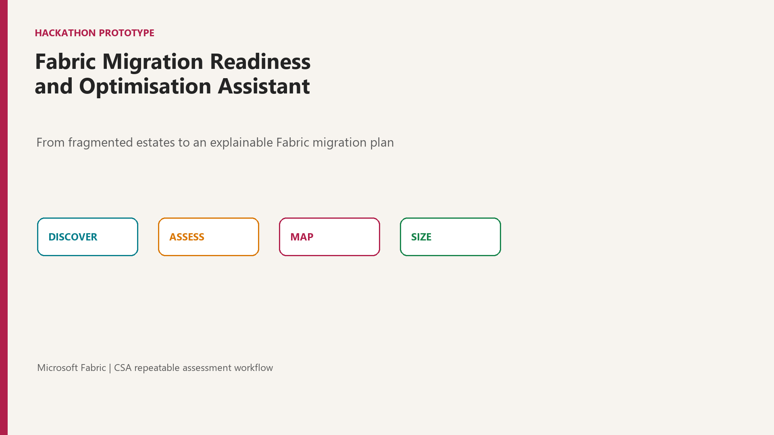
Notes:
Introduce the prototype and the outcome: a repeatable Fabric migration assessment.

Slide 2
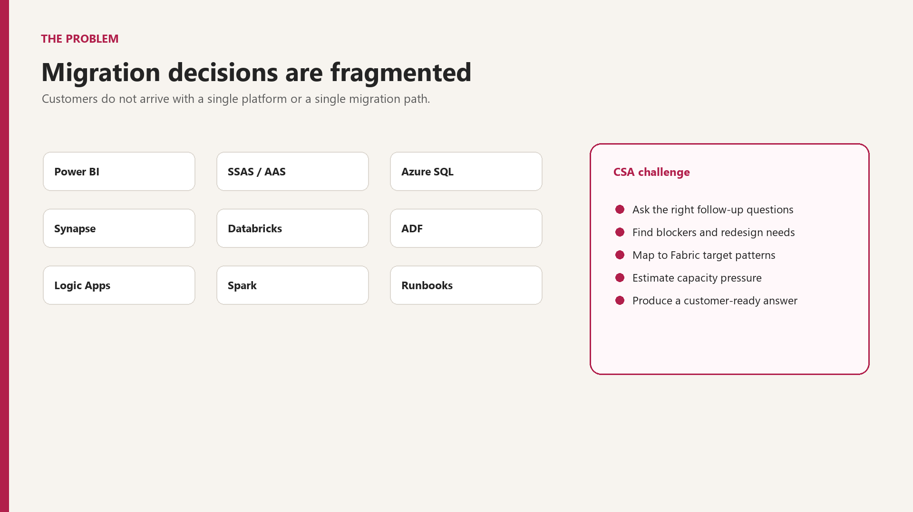
Notes:
Explain the fragmented estate and why ad hoc assessment is slow and inconsistent.

Slide 3
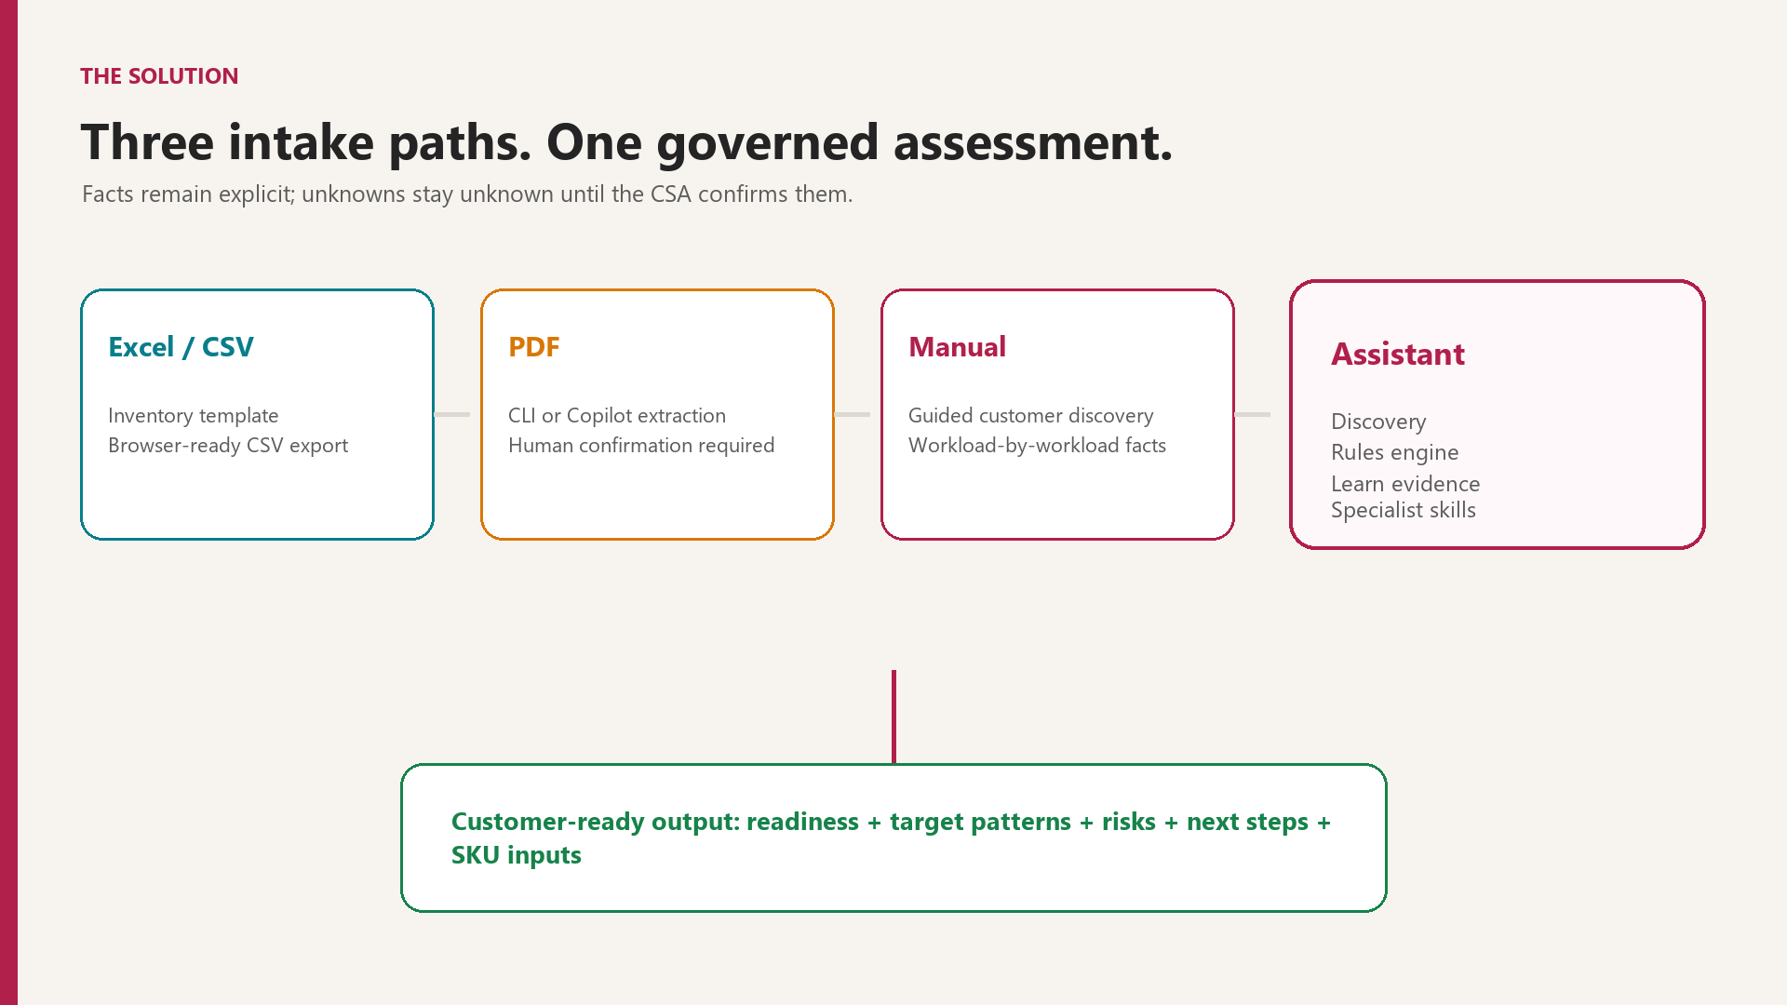
Notes:
Show the three supported intake routes and the governed assessment flow.

Slide 4
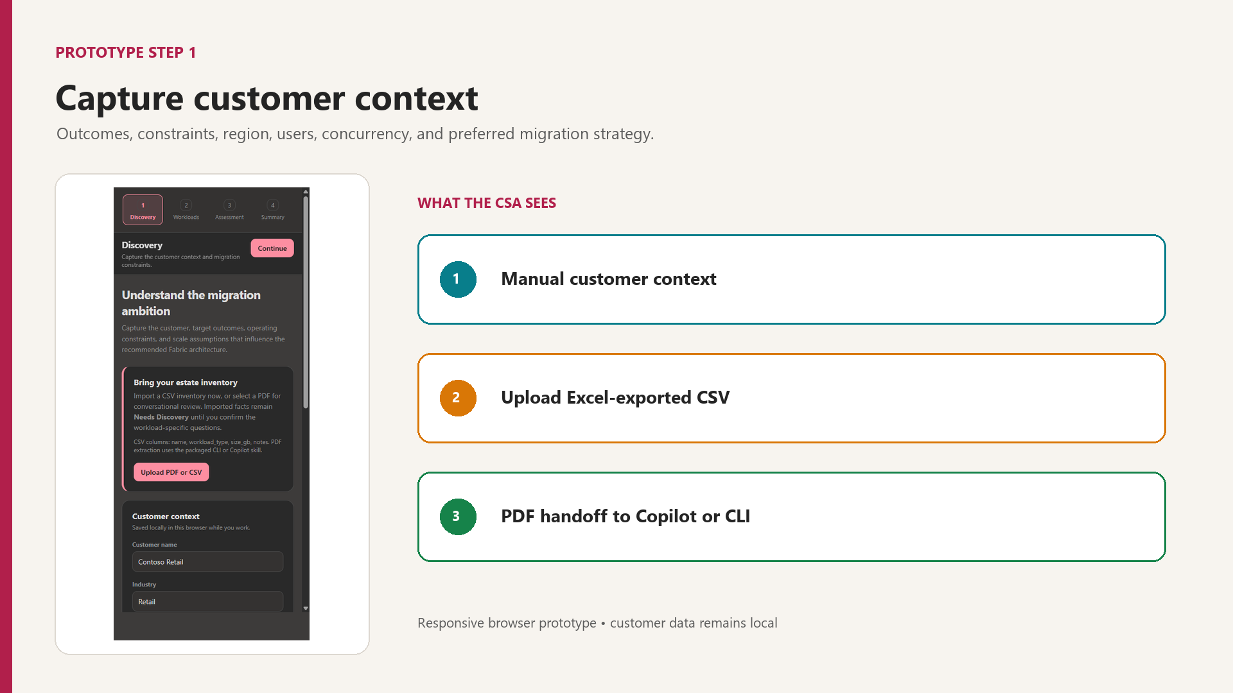
Notes:
The discovery screen captures business context and measurable workload pressure.

Slide 5
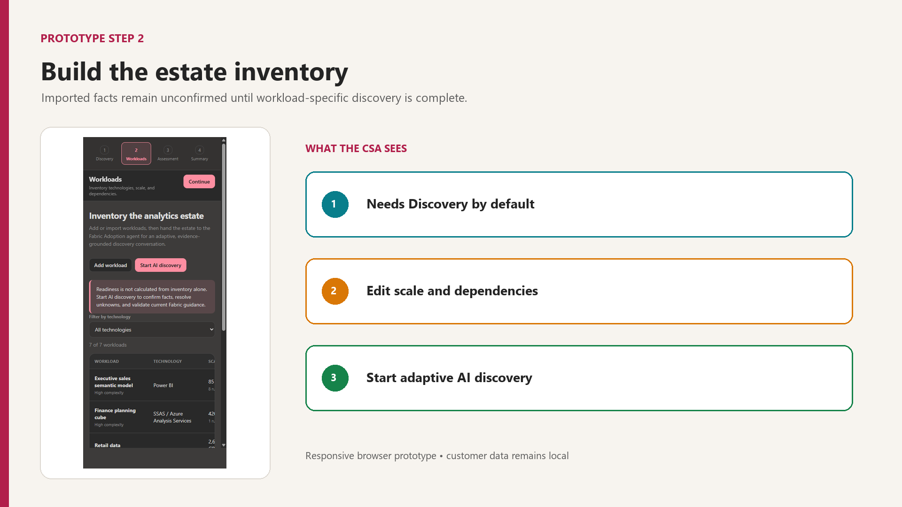
Notes:
Spreadsheet inventory is saved as CSV for browser upload; PDF uses Copilot or CLI; manual entry is available.

Slide 6
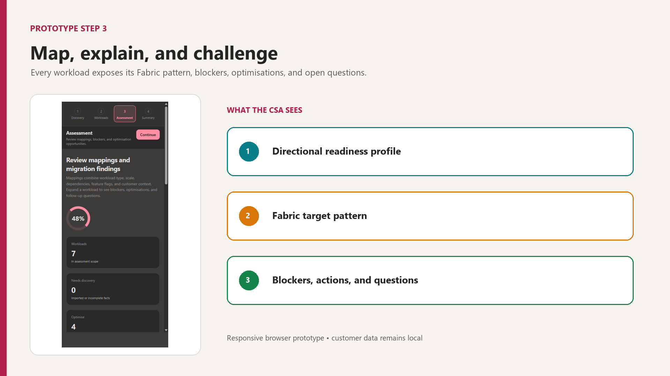
Notes:
The engine maps workloads and explains blockers, optimisation actions, and open questions.

Slide 7
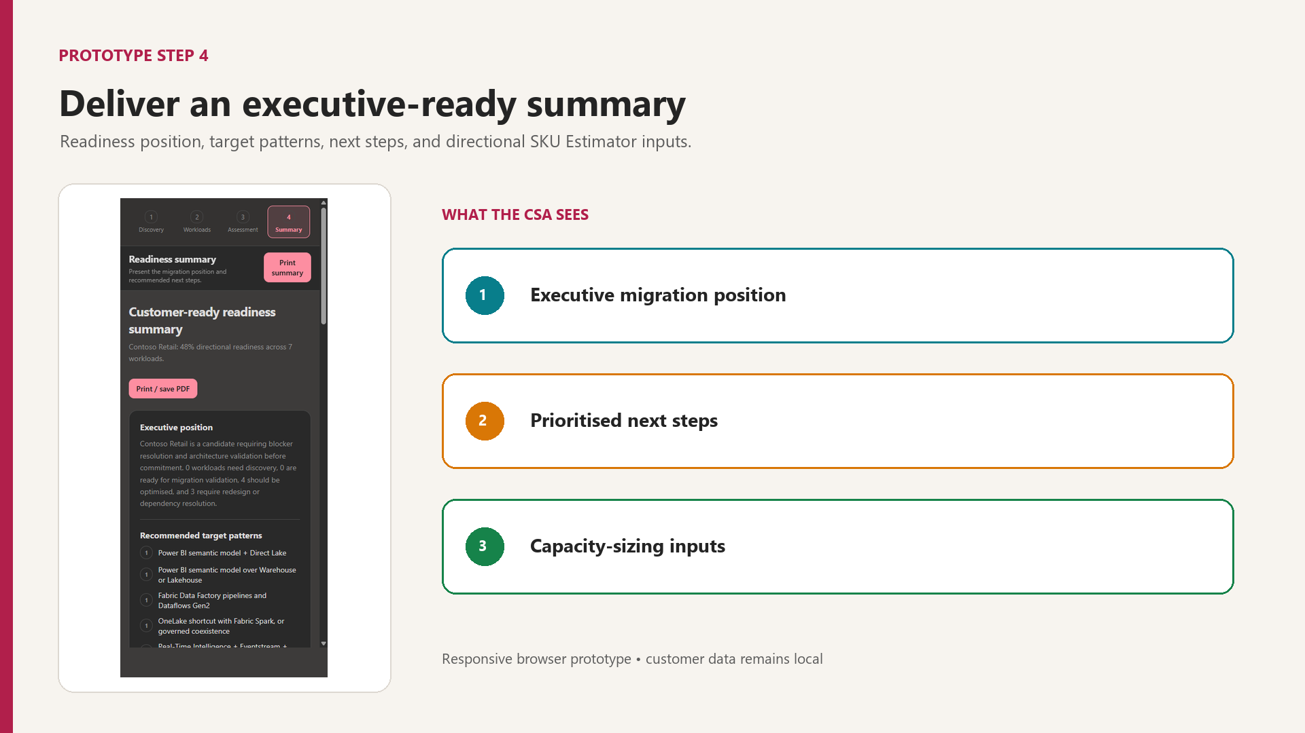
Notes:
The summary is customer-ready and includes directional inputs for the SKU Estimator, not a capacity quote.

Slide 8
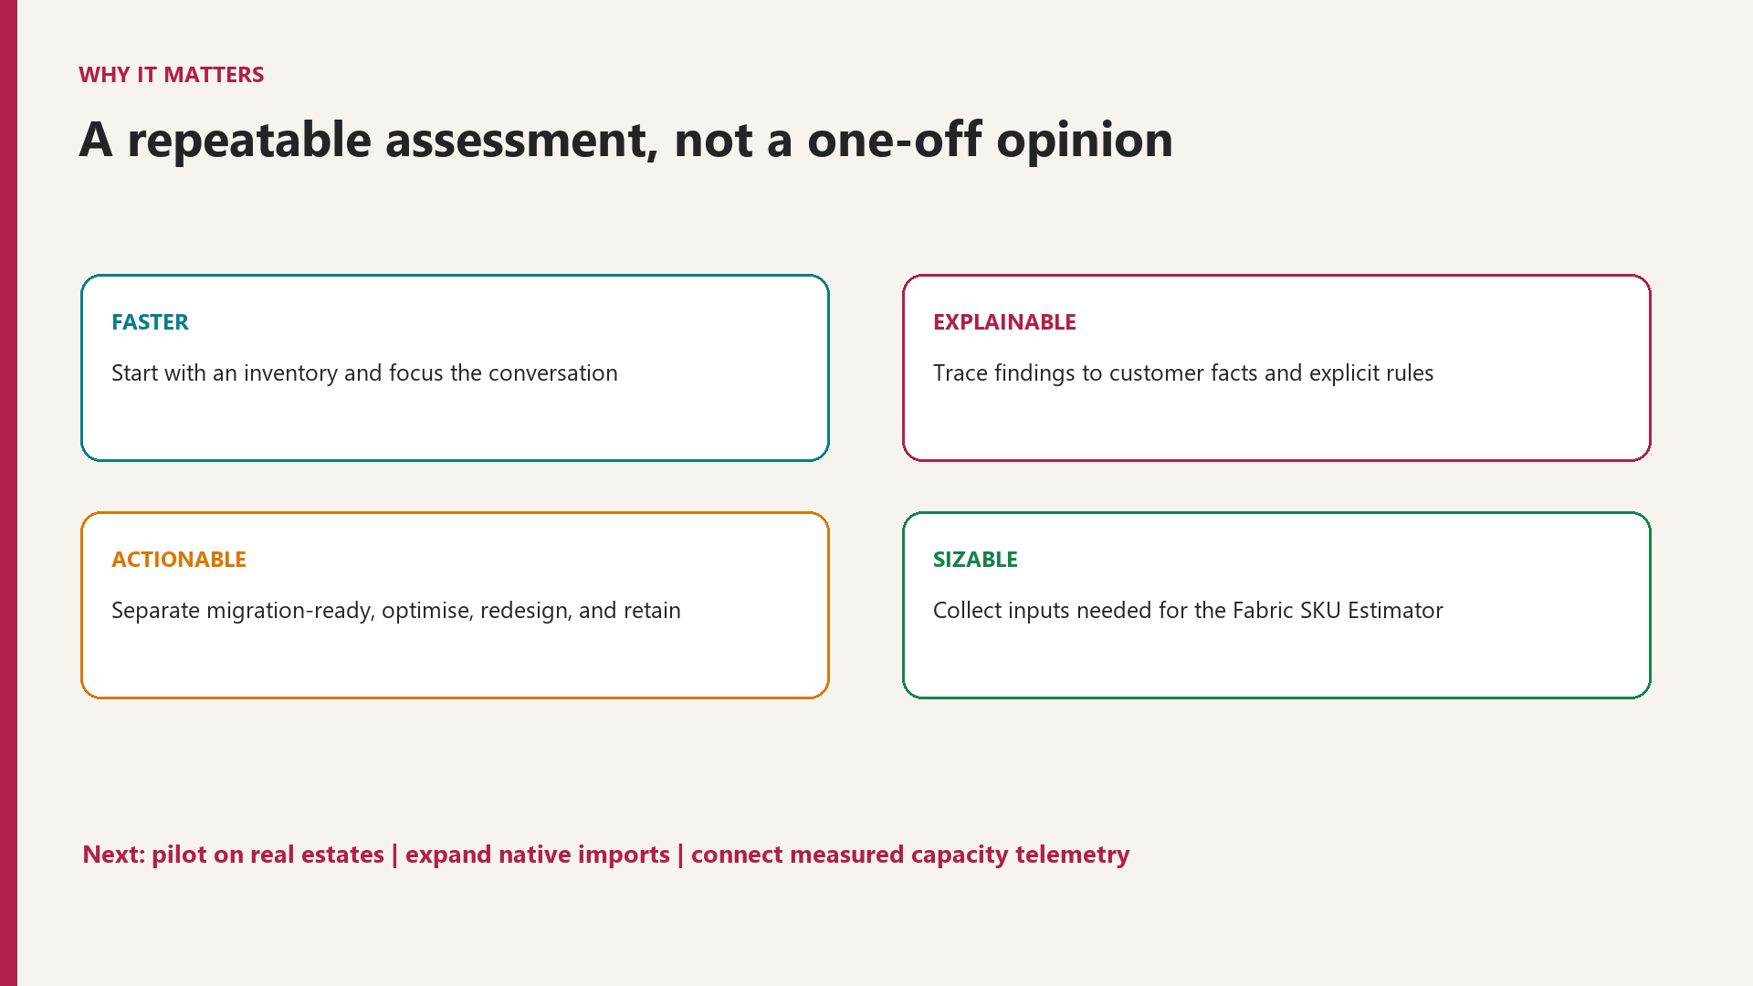
Notes:
Close on impact and the path from hackathon prototype to a validated engagement tool.

