Slide 1

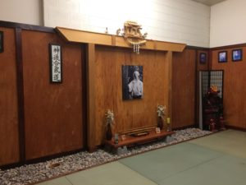
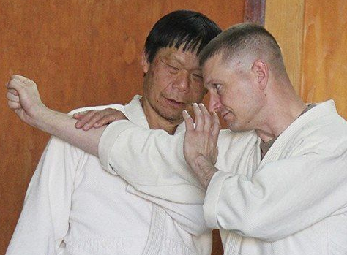
3425 Van Teylingen Dr.
Colorado Springs, CO 80917
(719) 574-7420
pikespeakaikido@gmail.com
3425 Van Teylingen Dr.
Colorado Springs, CO 80917
(719) 574-7420
pikespeakaikido@gmail.com
Aikido is a modern Japanese martial art that employs joint locks, pins, and throws
Focuses on diffusing conflict
An effective form of self-defense
Taught in a cooperative environment based on students’ physical capabilities
No tournaments, competitions, or contests
Can be an effective form of exercise, improving flexibility and reducing stress
Aikido is a modern Japanese martial art that employs joint locks, pins, and throws
Focuses on diffusing conflict
An effective form of self-defense
Taught in a cooperative environment based on students’ physical capabilities
No tournaments, competitions, or contests
Can be an effective form of exercise, improving flexibility and reducing stress
Beginner’s Special: $140
(3 months + uniform — 50% off )
Beginner’s Special: $140
(3 months + uniform — 50% off )
Pikes Peak Aikido is the oldest continually operating Aikido dojo in the Colorado Springs area. We’re affiliated with Aikido World Headquarters as a member of Aikido Shimbokukai. We teach traditional Aikido, as developed by Morihei Ueshiba.
Visitors are always welcome.
Pikes Peak Aikido is the oldest continually operating Aikido dojo in the Colorado Springs area. We’re affiliated with Aikido World Headquarters as a member of Aikido Shimbokukai. We teach traditional Aikido, as developed by Morihei Ueshiba.
Visitors are always welcome.
www.pikespeakaikido.org
www.pikespeakaikido.org
Pikes Peak Aikido
(719) 574-7420
pikespeakaikido@gmail.com
www.pikespeakaikido.org
Pikes Peak Aikido
(719) 574-7420
pikespeakaikido@gmail.com
www.pikespeakaikido.org
Pikes Peak Aikido
(719) 574-7420
pikespeakaikido@gmail.com
www.pikespeakaikido.org
Pikes Peak Aikido
(719) 574-7420
pikespeakaikido@gmail.com
www.pikespeakaikido.org
Pikes Peak Aikido
(719) 574-7420
pikespeakaikido@gmail.com
www.pikespeakaikido.org
Pikes Peak Aikido
(719) 574-7420
pikespeakaikido@gmail.com
www.pikespeakaikido.org
Pikes Peak Aikido
(719) 574-7420
pikespeakaikido@gmail.com
www.pikespeakaikido.org
Pikes Peak Aikido
(719) 574-7420
pikespeakaikido@gmail.com
www.pikespeakaikido.org
Pikes Peak Aikido
(719) 574-7420
pikespeakaikido@gmail.com
www.pikespeakaikido.org
Pikes Peak Aikido
(719) 574-7420
pikespeakaikido@gmail.com
www.pikespeakaikido.org

