Slide 1

Love Cafe – Webpage Project
A cozy café webpage using HTML & CSS

Slide 2

Project Overview
Objective:
To create a visually appealing and responsive website for a local café using HTML and CSS.
Tools Used:
- HTML5
- CSS3

Slide 3

Website Structure
Sections Included:
- Header with Navigation
- Hero Section
- About Us
- Menu
- Contact
- Footer

Slide 4

HTML Code Highlights
Header + Navigation:
<header>
<h1>Love Cafe</h1>
<nav>
<a href="#about">About</a>
<a href="#menu">Menu</a>
<a href="#contact">Contact</a>
</nav>
</header>
Semantic HTML for clear structure

Slide 5

Hero Section
HTML Structure:
<section class="hero">
<div class="hero-text">
<h2>Welcome to Love Cafe</h2>
<p>Your favorite spot for coffee and comfort.</p>
</div>
</section>
Uses background image and overlay

Slide 6
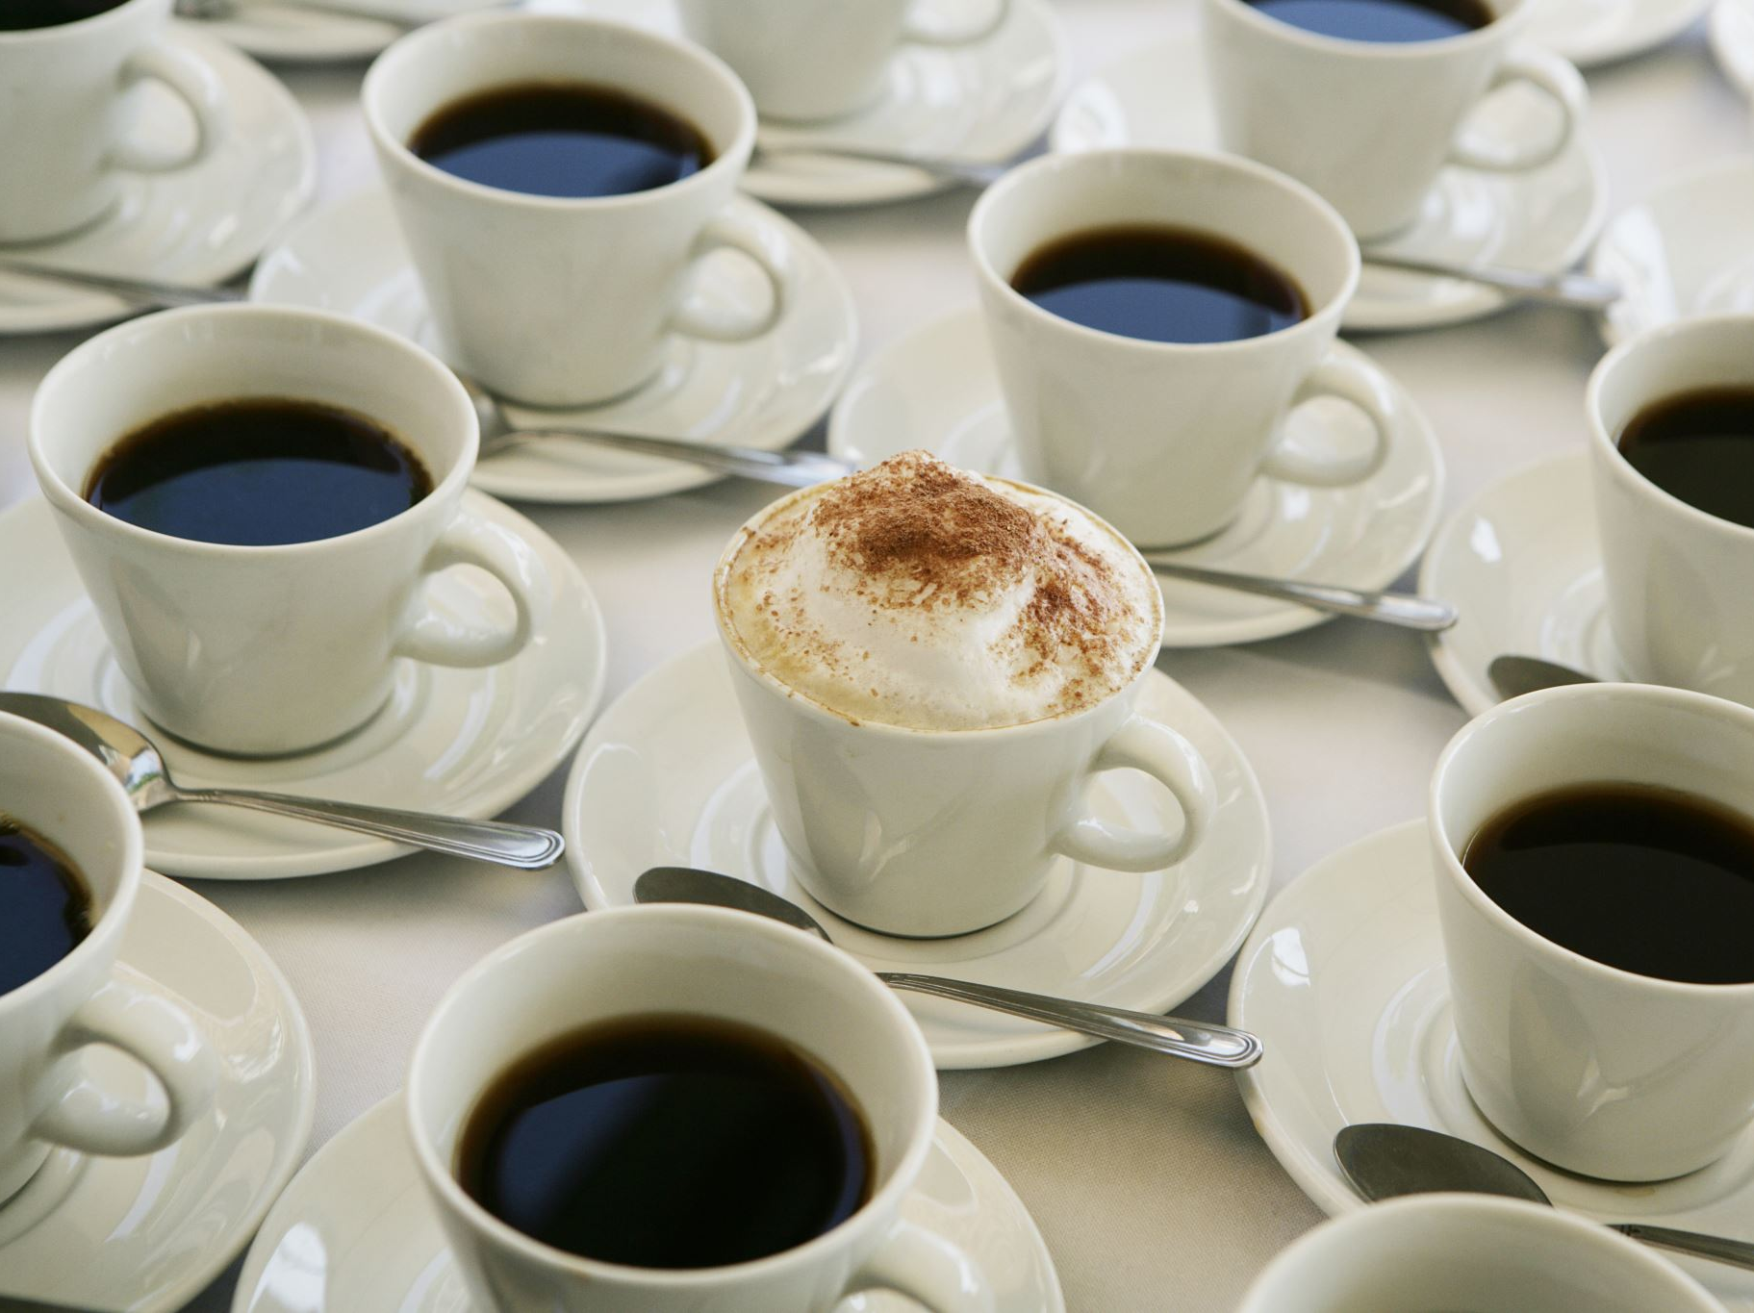
About & Menu Sections
About Us paragraph using <section>
Menu items using <ul> and <li>:
<li><strong>Espresso</strong> - ₹300</li>

Slide 7
Contact & Footer
Contact info:
- Email, phone, and location
Footer snippet:
<footer>
<p>© 2025 Love Cafe. All rights reserved.</p>
</footer>

Slide 8

CSS Styling Overview
Warm color palette: #8b5e3c, #fff8f0
Responsive layout with Flexbox
Hero image with text overlay
Font: Segoe UI

Slide 9
CSS Styling Highlights
body {
font-family: 'Segoe UI';
background-color: #fff8f0;
color: #4b2e2e;
}
header {
background-color: #8b5e3c;
color: white;
}
Clean spacing, soft tones

Slide 10
Final Preview
Screenshot of full homepage
Highlight sections: Hero, Menu, Contact

Slide 11
Future Improvements
Add responsive hamburger menu
Include contact form
Light/Dark mode toggle
Add interactivity with JavaScript

Slide 12
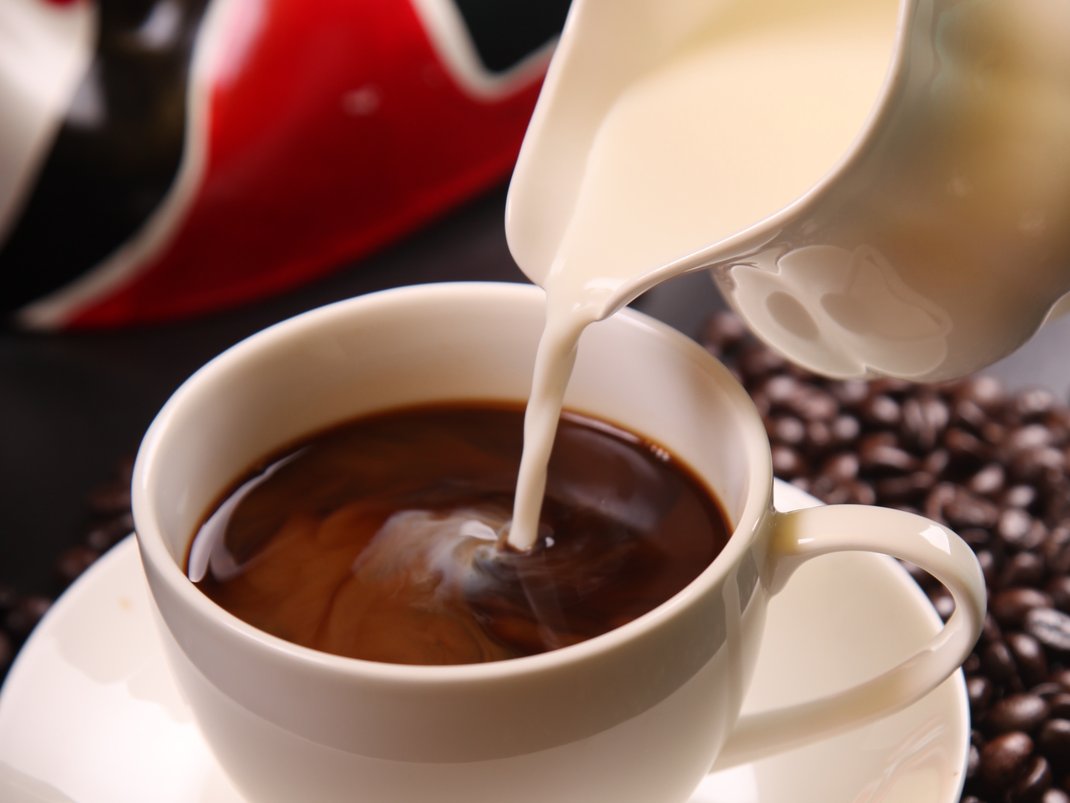
Thank You NAME – LOVE KUMAR UID – 24BCA10146

