Slide 1
Multi-agent Cooperative Patrolling of Designated Points on Graphs
The University of Tokyo
Akitoshi Kawamura, Hideaki Noshiro
Notes:
Thank you for chairperson.
I'm Hideaki Noshiro. Today I'd like to talk about "Multi-agent Cooperative Patrolling
of Designated Points on Graphs".

Slide 2
What is “Patrolling Problem” ?
In patrolling problem,
one or more agents
move around a given terrain to defend or supervise it
by visiting designated places in the terrain with sufficient frequency.
Examples of problems on Guarding
Art Gallery Problem : stable, infinite visibility
Patrolling Problem : mobile agents, zero visibility
Fence Patrolling (patrol whole line segments or circuit) : continuous
Patrol vertices of graphs : discrete
Notes:
At the beginning, I'd like to introduce “patrolling problem”.
In patrolling problem, one or more agents move around a given terrain to defend or supervise it by visiting designated places in the terrain with sufficient frequency.
There many related problems on guarding.
One example is Art Gallery Problem.
In this problem we optimize the positions of cameras and minimize the number of them.
In this situation, camera doesn’t move but has infinite visibility.
Another example is Patrolling problem.
In this problem, agents move around a given terrain and we optimize the movements of agents.
In this situation, agents have zero visibility.
Art Gallery Problem is known to be NP-hard
and patrolling problem seems to be more difficult than it,
so the terrain is often restricted to some simple shape.
There are many different settings for patrolling problem.
One is “Fence Patrolling”, in which agents move on the line segments or circuit and patrol whole of it.
The other is to patrol vertices of graphs, in which we only have to patrol the vertices but the graph is more complex.
I’d like to talk about this setting.

Slide 3
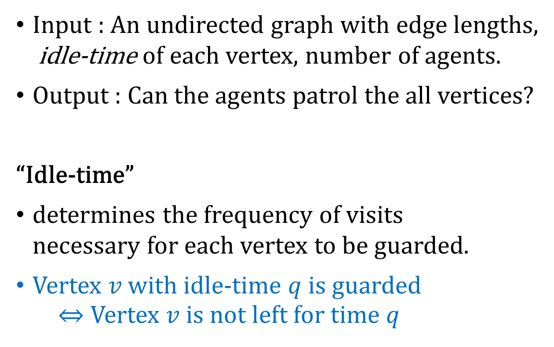






Cooperative Patrolling Problem
Speed = 1
$$1$$
$$1$$
Idle-time
$$4$$
$$2$$
$$5$$
Input : An undirected graph with edge lengths, idle-time of each vertex, number of agents.
Output : Can the agents patrol the all vertices?
“Idle-time”
determines the frequency of visits necessary for each vertex to be guarded.
Vertex $v$ with idle-time $q$ is guarded ⇔ Vertex $v$ is not left for time $q$
$$4$$
time
Notes:
Especially, our theme is cooperative patrolling problem.
In this setting, ~ are given as input and answer whether agents can guard all vertices.
“Idle-time” determines ~~.
Vertex $v$ with idle-time $q$ is guarded if and only if $v$ is not left for time $q$.
For example, if a graph with 3 vertices is given and idle-times are specified as shown in figure, one scheduling for this by 1 agent is move like this.
We assume that all agents move at speed 1.

Slide 4
Left side : the case of uniform idle-times Right side : arbitrary idle-times
One agent
General graph
NP-hard / NP-hard
Trees
P / NP-hard
Lines
P / P
Stars
P / NP-hard
[1] : S. Coene, F.C.R. Spieksma, and G.J. Woeginger. Charlemagne's challenge: the periodic latency problem. Operations Research, 59(3), pp. 674–683, 2011.
Notes:
This is a result by Coene of the case of 1 agent.
Because the case of General graph is NP-hard even if all idle-times are equal, several special shapes are considered.
Lines and Stars are graphs like this.(figure)
In Tree and Stars, if idle-times are uniform it is in P, but is NP-hard if idle-times are general.
Lines are solvable in polynomial time even if idle-times are general.

Slide 5
Left side : the case of uniform idle-times Right side : arbitrary idle-times
Any number of agents, uncooperative
General graph
NP-hard / NP-hard
Trees
NP-hard / NP-hard
Lines
P / P
Stars
NP-hard / NP-hard
[1] : S. Coene, F.C.R. Spieksma, and G.J. Woeginger. Charlemagne's challenge: the periodic latency problem. Operations Research, 59(3), pp. 674–683, 2011.
Notes:
Coene studied the case for multiple agents, too,
but they assumed that all agents don’t cooperate with each other.
I will explain this meaning later.
~~
The difference between one agent and multiple agents is the case of uniform idle-times in Trees and Stars.

Slide 6














Uncooperative / Cooperative patrolling
$$2$$
$$1$$
$$2$$
Idle-time
$$2$$
$$1$$
$$2$$
$$6$$
$$2$$
$$2$$
$$6$$
$$6$$
$$2$$
$$2$$
$$6$$
Uncooperative patrolling problem
Cooperative patrolling problem
Notes:
“Uncooperative” means that each vertex must be guarded by exactly 1 agent.
If agents can’t cooperate, 3 agents are necessary for this graph.
On the other hand, if agents cooperate, there is a good scheduling like this and only 2 agents are enough.
The left figure is an optimal solution for uncooperative patrolling problem,
And the right figure is for cooperative patrolling problem.

Slide 7
Left side : the case of uniform idle-times Right side : arbitrary idle-times
One agent
General graph
NP-hard / NP-hard
Trees
P / NP-hard
Lines
P / P
Stars
P / NP-hard
[1] : S. Coene, F.C.R. Spieksma, and G.J. Woeginger. Charlemagne's challenge: the periodic latency problem. Operations Research, 59(3), pp. 674–683, 2011.
Notes:
This is a slide of the case of 1 agent mentioned before.
When there is only 1 agent, uncooperative patrolling and cooperative patrolling come to the same thing
and cooperative patrolling problem is NP-hard if the case is NP-hard even for 1 agent.

Slide 8
Left side : the case of uniform idle-times Right side : arbitrary idle-times
Any number of agents, cooperative
General graph
NP-hard / NP-hard
Trees
? / NP-hard
Lines
? / ?
Stars
? / NP-hard
Notes:
Our purpose is to study these unsolved cases in cooperative patrolling problem.

Slide 9



Left side : the case of uniform idle-times Right side : arbitrary idle-times
Any number of agents, cooperative
General graph
NP-hard / NP-hard
Trees
? / NP-hard
Lines
? / ?
Unit
? / ?
Stars
? / NP-hard
$$d$$
$$d$$
$$d/2$$
Clique with uniform edge length
Notes:
We also deal with unit-length clique.
This was useful for proving NP-hardness of some situation.
The class of Unit-length clique is positioned into Stars
because unit-length clique can be represented by half-unit-length star.
We assume that the center vertex of a star is not subject to guard.

Slide 10
Left side : the case of uniform idle-times Right side : arbitrary idle-times
Any number of agents, cooperative
General graph
NP-hard / NP-hard
Trees
? / NP-hard
Lines
P / ?
Unit
P / ?
Stars
P / NP-hard
Notes:
Here is a part of our results.
We proved that the case of Lines, Units and Stars are in P if idle-times are uniform.

Slide 11
Left side : the case of uniform idle-times Right side : arbitrary idle-times
Any number of agents, cooperative
General graph
NP-hard / NP-hard
Trees
? / NP-hard
Lines
P / ?
Unit
P / ?
Stars
P / NP-hard
Notes:
In this presentation, I’d like to talk about the case of Lines.

Slide 12
Lines
Because the maximum speed of the agents are uniform, agents may turn back to each other instead of passing each other.
⇒ All agents may move keeping the order of initial placement. (= “Order-keeping Movements”)

Slide 13



Lines with uniform idle-times
Idle-time = 1
We will show that arbitrary movements can be converted to Back-and-Forth Movements.
Assume that the given movements is Order-keeping movements w.l.g.
$$1/2$$
$$1$$
$$1/2$$
time
Notes:
First, let me talk about the case of Lines with uniform idle-times.
Let's think about an example like this.
Idle-times of vertices are 1.

Slide 14


Lines with uniform idle-times
Leftmost vertex is guarded by → is not present in $x>1/2$ .
$$1/2$$
$$1$$
$$1/2$$
$$1$$
time
Notes:
First, Let’s focus on the leftmost vertex of this line.
Because agents always keep order, the leftmost agent can’t be present in the gray area.

Slide 15

Lines with uniform idle-times
Leftmost vertex is guarded by → is not present in $x>1/2$ .
An optimum movement for is to go back and forth in $[0,1/2]$.
$$1/2$$
$$1$$
$$1/2$$
$$1$$
time

Slide 16

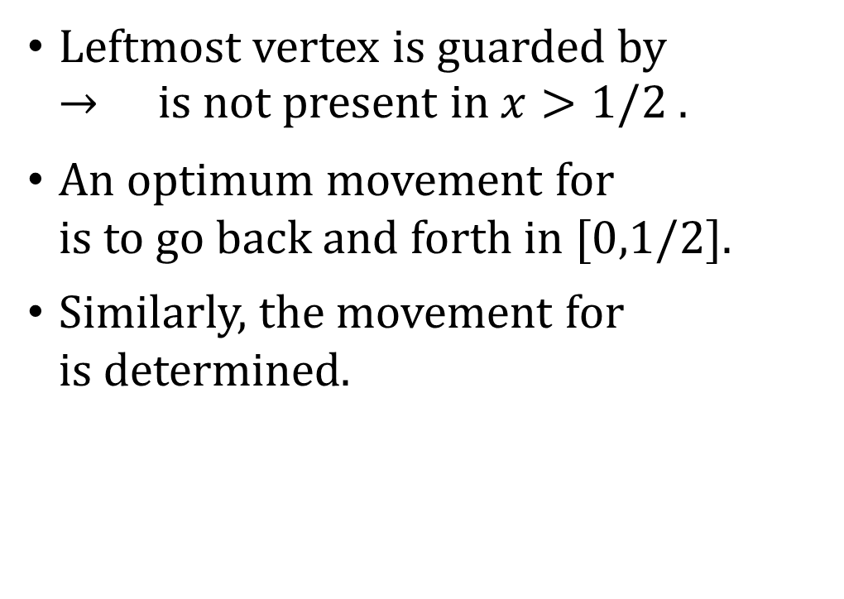
Lines with uniform idle-times
Leftmost vertex is guarded by → is not present in $x>1/2$ .
An optimum movement for is to go back and forth in $[0,1/2]$.
Similarly, the movement for is determined.
$$1/2$$
$$1$$
$$1/2$$
$$1$$
time

Slide 17
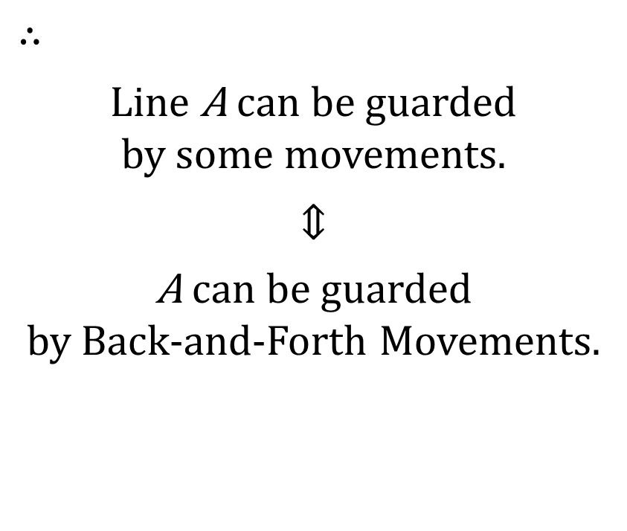
Lines with uniform idle-times
$$∴$$ Line A can be guarded by some movements.
⇕
A can be guarded by Back-and-Forth Movements.
$$1/2$$
$$1$$
$$1/2$$
Solvable in polynomial time
time
Notes:
Therefore, if some Line A can be guarded by some movements,
we can convert the movements to Back-and-Forth Movements
and

Slide 18
Lines with arbitrary idle-times
Because agents do not need to cooperate, the case of uniform idle-times was easy to solve.
The case of arbitrary idle-times is not as easy. There is an example that
multiple agents need to cooperate
and it seems to be difficult to determine mechanically their movements.
Notes:
Now, I’d like to move on to the case of arbitrary idle-times.
Up to here, I have spoken about the case of uniform idle-time.

Slide 19











Failure
Success
$$8$$
$$2$$
$$2$$
$$3$$
$$6$$
$$8$$
$$2$$
$$2$$
$$3$$
$$6$$
Failure goes to the right to help until can return to the leftmost vertex in its idle-time.
Success and go back and forth in time of 6 cycle.
$$>6$$
Notes:
Lets take a look at this example.
The left figure is a failure example.

Slide 20
(each 〇 must be visited by at least 1 agent)
$$8$$
$$2$$
$$2$$
$$3$$
$$6$$
$$8$$
$$2$$
$$2$$
$$3$$
$$6$$
If exact times are specified instead of idle-times, 2 agents are not enough to guard all points.
It is best to go help on the right side as much as possible. ⇒ We can determine the movement of the agents from the left side(proof is omitted).

Slide 21
Conclusion
We considered patrolling problems with cooperating agents.
Lines/Stars/Units with uniform idle-times are easily solvable because agents don’t need to cooperate or cooperation is simple.
The case of arbitrary idle-times is unsolved. → We considered exact time instead of idle-times.
Lines : We can determine the movements greedily from left side.
Units : Profit maximization is NP-hard even for 1 agent.
Future works : Trees; on the condition of exact time; …
Notes:
Let me summarize the point of our presentation.

