Slide 1
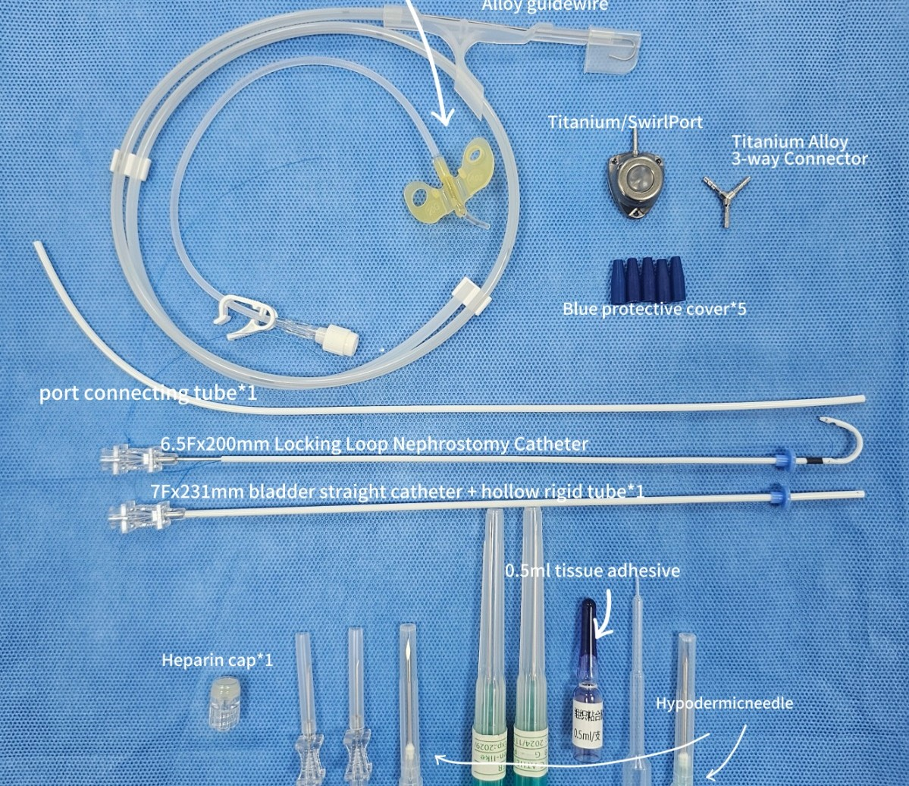
Feline SUB System
Subcutaneous Ureteral Bypass
for Feline Ureteral Obstruction
Notes:
Today we introduce the Subcutaneous Ureteral Bypass (SUB) system for cats with ureteral obstruction. It creates a bypass from the renal pelvis to the bladder under the skin and restores urine flow.

Slide 2
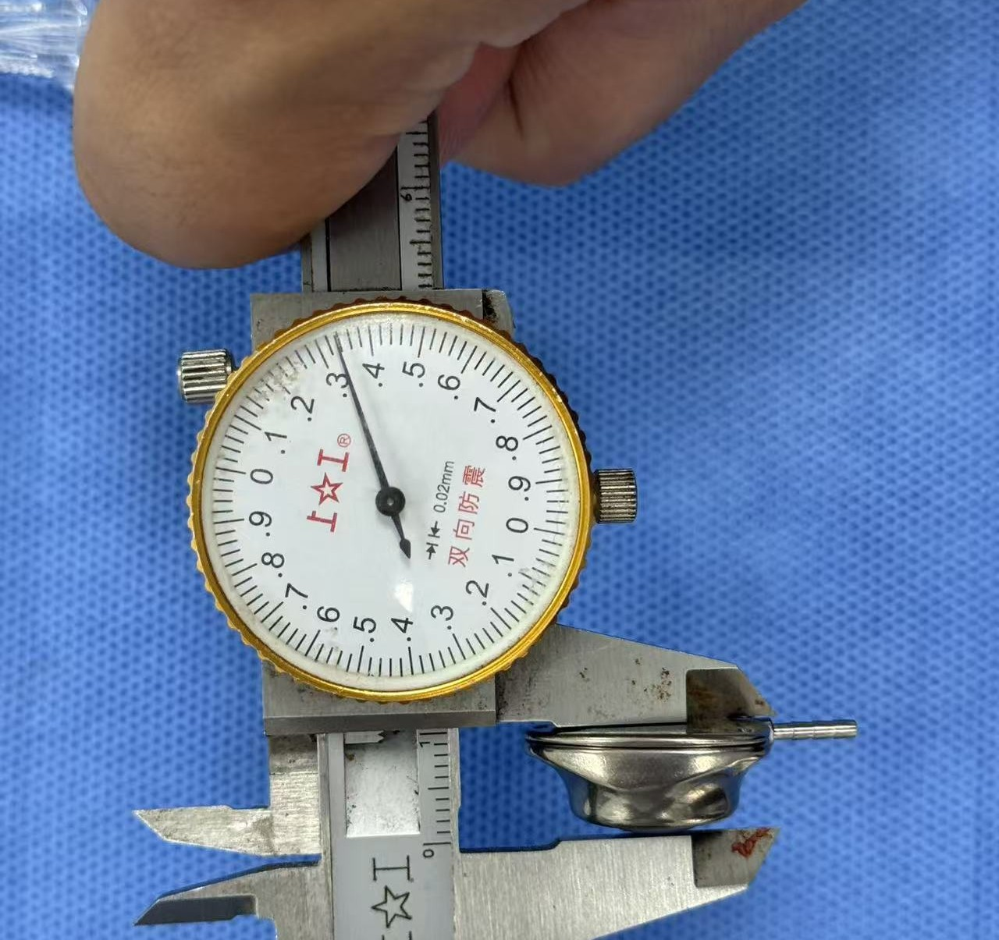
Contents
I. Clinical Background
II. Product Overview & Models
III. Kit Components & Key Features
IV. Surgical Procedure & Aftercare
V. FAQ
Notes:
Five parts: clinical background, product and models, kit and features, surgery and aftercare, and common questions.

Slide 3
I. Clinical Background 1. Feline Ureteral Obstruction
Common causes
Calcium oxalate ureteroliths, the most common cause; stones are often small and multiple
Ureteral stricture, with or without stones
Solidified blood stones and other debris in the ureter
Published outcome
Wuillemin et al., J Vet Intern Med, 2021
Multicentre study, 81 cats treated with SUB
Hospital discharge rate: 94% (76/81)
Clinical consequences
Why SUB: the device bypasses the ureter completely, so the result does not depend on the number or position of stones, or on whether a stricture is present.
Hydronephrosis, azotemia, acute kidney injury
Bilateral obstruction, or obstruction of a single functioning kidney, is life-threatening
Medical management alone often fails; the kidney needs to be decompressed within days
Notes:
Ureteral obstruction in cats is mostly caused by calcium oxalate stones, often together with strictures. The kidney is damaged quickly, so the obstruction has to be relieved. A 2021 multicentre study of 81 cats reported a 94 percent discharge rate after SUB placement.

Slide 4
I. Clinical Background 2. Treatment Options Compared
 | Medical management | Traditional surgery (ureterotomy / reimplantation) | Ureteral stent | SUB system
Approach | IV fluids, diuretics, alpha-blockers | Open surgery on the ureter | Double-pigtail stent inside the ureter | Bypass from renal pelvis to bladder under the skin
Multiple stones / strictures | Often fails | Technically difficult, risk of re-obstruction | Possible, but placement can be difficult in small feline ureters | Not affected, the ureter is bypassed
Surgical skill required | None | Microsurgery | High, usually needs fluoroscopy | Standardised steps, video available
Patency maintenance | Not applicable | Not possible | Not possible | Port allows routine flushing (SUB-B / SUB-C)
Follow-up imaging | Ultrasound | Ultrasound | X-ray / ultrasound | Plain X-ray with radiopaque rings, plus ultrasound
Notes:
Medical management alone often fails. Traditional ureteral surgery is microsurgery and multiple stones or strictures make it difficult. Stents are hard to place in small feline ureters. The SUB bypasses the ureter, follows standardised steps, and with a port it can be flushed.

Slide 5
I. Clinical Background 3. Indications & Model Selection
Indications
Which model to choose
Ureteral obstruction caused by ureteroliths, single or multiple
Ureteral stricture, proximal or distal
Obstruction not resolved after 24 to 72 h of medical management
Bilateral obstruction, or obstruction of a single functioning kidney
Case | Recommended model
Unilateral obstruction, long-term management | SUB-B
Bilateral obstruction | SUB-C
Short-term, palliative or budget-limited case | SUB-A
Notes:
Typical indications are stones, strictures, obstruction that does not respond to medical management, and bilateral obstruction. SUB-B for unilateral long-term cases, SUB-C for bilateral, SUB-A for short-term or budget-limited cases.

Slide 6
II. Product Overview 1. How the SUB System Works
Kidney
renal pelvis
Nephrostomy catheter
6.5Fr locking-loop
Subcutaneous port
TC titanium
Bladder catheter
7Fr straight
Bladder
Urine drains from the renal pelvis through the nephrostomy catheter, the port and the bladder catheter into the bladder, bypassing the obstructed ureter.
The port sits under the skin on the body wall. It is accessed with a Huber needle to flush the system and to collect urine for culture.
Both catheters carry a radiopaque ring, so their position can be checked on a plain X-ray.
SUB-A has no port: the two catheters are connected directly and the system cannot be flushed.
Notes:
A catheter in the renal pelvis, a catheter in the bladder, and a subcutaneous port in between. Urine bypasses the blocked ureter. The port is used for flushing and urine sampling.

Slide 7
II. Product Overview 2. Three Model Options
Feature | SUB-A | SUB-B | SUB-C
Configuration | Economy / Portless | Unilateral with port | Bilateral with port
Subcutaneous port | None | TC titanium | TC titanium
Flushing | Not possible | Via port | Via port
Indwelling period | Up to 6 months | Long-term, with routine flushing | Long-term, with routine flushing
Best for | Short-term palliative, cost-sensitive cases | Unilateral obstruction | Bilateral obstruction
Notes:
SUB-A is the portless economy option, up to six months, cannot be flushed. SUB-B is unilateral with a titanium port. SUB-C is bilateral.

Slide 8
III. Kit Components
Item | Specification
Nephrostomy catheter | 6.5Fr x 200 mm, locking loop
Bladder catheter | 7Fr x 231 mm, straight
Subcutaneous port | TC titanium (SUB-B / SUB-C)
Connector | Titanium alloy, 3-way / 4-way
Guidewire | 0.035 inch, J-tip
Port needles | 22G Huber needles, 20G port needle
IV catheters | 18G x 2
Tissue adhesive | With applicator
Others | Heparin cap, protective covers x 5, scalpel, connecting tube
Notes:
This is the complete kit. Everything needed for the surgery is in one box.

Slide 9
III. Key Features 1. Slim TC Titanium Port
Parameter | Value
Material | TC titanium alloy
Height | 10.3 mm
Access needle | 22G Huber needle
Fixation | Sutured to rectus abdominis sheath
Clinical benefit
Lower profile under the skin, less tension on the skin over the port; useful in small or thin cats
Light and strong, sits stably on the body wall
Easy to palpate for routine flushing
Port height measured with caliper: 10.3 mm
Notes:
The port is TC titanium alloy and 10.3 mm high. Low profile means less skin tension, which matters in small cats. It is easy to feel under the skin for flushing.

Slide 10
III. Key Features 2. Radiopaque Ring Catheters
Both catheters are soft silicone with an integrated radiopaque ring. The ring shows on a plain X-ray without contrast.
 | Catheter without marker | Catheter with radiopaque ring
Post-op position check | Often needs contrast or ultrasound | Plain AP and lateral X-ray
Follow-up re-checks | Migration or kinking harder to see | Ring position visible on every film
Extra cost and time | Contrast agent, longer procedure | None
Material | Varies | Medical silicone, flexible for long-term implantation
Notes:
Both catheters have a radiopaque ring. A standard X-ray confirms where they are, right after surgery and at every re-check, without contrast.

Slide 11
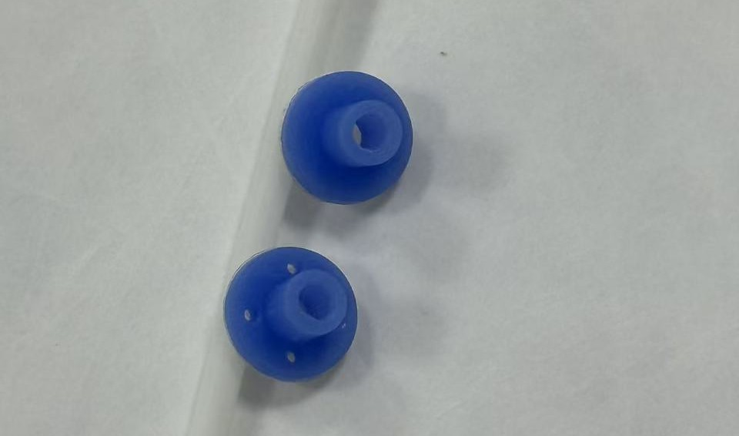
III. Key Features 3. Pre-Punched Suture Holes on Both Cuffs
 | Adhesive only | Pre-punched cuff + suture
Fixation | Depends on adhesive bond | Suture plus adhesive
Leakage at entry site | Higher risk if the bond fails | Reduced by mechanical fixation
Catheter dislodgement | Possible when the cat moves | Cuff held by sutures
In surgery | Surgeon has to pierce the cuff | Holes ready, saves time
Nephrostomy and cystostomy cuffs with pre-punched suture holes
The nephrostomy cuff is sutured to the renal capsule and the cystostomy cuff to the bladder wall through the pre-punched holes. Tissue adhesive is then used as a second seal, instead of being the only fixation.
Notes:
Both cuffs have pre-punched suture holes, so the cuff can be sutured directly to the kidney capsule and bladder wall. Adhesive becomes a second seal. Less leakage, less dislodgement, quicker surgery.

Slide 12
III. Key Features 4. All-Inclusive Kit
General surgical consumables are included, so the clinic does not have to source them separately on the day of surgery.
Included item | Used for
18G IV catheters x 2 | Puncture of renal pelvis and bladder
0.035-inch J-tip guidewire | Guiding the nephrostomy catheter into the renal pelvis
Tissue adhesive with applicator | Sealing the cuffs at the kidney and bladder
Scalpel | Skin incision and port pocket
22G Huber needles, 20G port needle | Patency check in surgery and later flushing
Heparin cap, protective covers | Closing and protecting catheter ends
Notes:
Besides the implant, the kit includes IV catheters, guidewire, adhesive, scalpel, Huber needles, heparin cap and covers. Nothing extra to buy, nothing forgotten, and a clear cost per case.

Slide 13
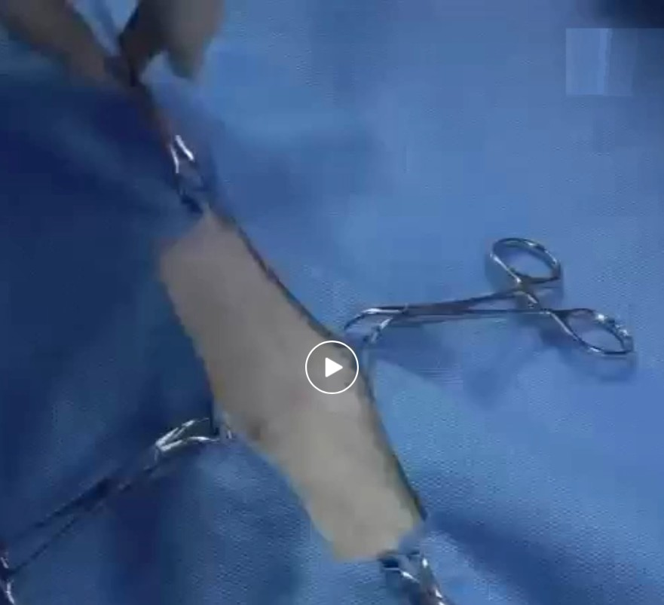
IV. Surgery & Aftercare 1. Surgical Procedure
1. Pre-op preparation
Fast 12 h food, 4 h water; IV antibiotics; ultrasound localization
2. Nephrostomy catheter placement
Puncture renal pelvis with 18G, insert J-guidewire, advance catheter, suture cuff
3. Cystostomy catheter placement
Purse-string at bladder apex, electrocautery puncture, insert catheter, suture cuff
4. System connection and patency check
Connect via connector; angiography confirms flow through the system
5. Port fixation and closure
Click to watch the full surgical video
Fix port to rectus abdominis sheath; close abdomen; post-op AP and lateral X-ray
Notes:
Five core steps: preparation, nephrostomy catheter, cystostomy catheter, connection and patency check, port fixation and closure. Click the image to open the full surgical video.

Slide 14
IV. Surgery & Aftercare 2. Post-op Care & Flushing
Reference follow-up schedule
Flushing steps (SUB-B / SUB-C)
Time | What to do
Day 0 | AP and lateral X-ray, confirm catheter position
Before discharge | Ultrasound, renal values, flush
About 1 week | Re-check, flush, urinalysis and culture
About 1 month | Re-check, flush, ultrasound
Every 3 months | Routine flush and check-up
Clip and aseptically prepare the skin over the port
Insert the 22G Huber needle into the port
Aspirate urine for culture
Flush slowly with sterile saline (or the clinic's flushing solution) under ultrasound guidance
Confirm fluid enters the renal pelvis and the bladder
Check for resistance or leakage; record the result
Reference only; the attending vet adjusts the schedule for each patient.
Notes:
After surgery, X-rays confirm catheter position. The port is flushed before discharge, at about one week, one month, and every three months after that. Each flush gives a urine sample for culture. SUB-A has no port and cannot be flushed.

Slide 15
IV. Surgery & Aftercare 3. Possible Complications & Management
Complication | What to look for | Prevention / management
Urine leakage | Fluid in abdomen, rising renal values after surgery | Suture cuffs through pre-punched holes; check patency before closure
Catheter kinking or migration | Reduced flow on flushing, position change on X-ray | Correct catheter length and route; X-ray follow-up
Blockage / mineralisation | Resistance during flushing, hydronephrosis returns | Routine flushing via port; replace if needed
Urinary tract infection | Positive urine culture from port sample | Aseptic technique; culture at each flush; antibiotics per culture
Dysuria / cystitis | Straining, frequent urination after surgery | Usually managed medically; monitor at re-checks
Port site problems | Swelling, seroma, discomfort | Fix port to rectus sheath; aseptic access
Notes:
Main complications: leakage, kinking or migration, blockage, infection, cystitis-like signs and port site problems, with how to prevent or manage each.

Slide 16
V. FAQ
Q: Can SUB-A be flushed?
Q: Does the clinic need to buy anything else?
A: No. SUB-A has no port. It is for short-term or palliative use, up to 6 months.
A: No general supplies needed. Adhesive, scalpel, heparin cap and IV catheters are included.
Q: How is placement confirmed after surgery?
Q: What is the difference between SUB-B and SUB-C?
A: Plain AP and lateral X-ray. The radiopaque rings show catheter position without contrast.
A: SUB-B treats one side. SUB-C is for cats with obstruction on both sides.
Q: Which needle is used to access the port?
Q: Is there training material?
A: 22G Huber needle, included in the kit together with a 20G port needle.
A: A full surgical video is available, from patient preparation to closure.
Notes:
Common questions from vets. Add more as customer questions come in.

Slide 17
Thank You
Contact us for samples, pricing
and distribution.

