Slide 1
VETERINARY IMPLANT DEVICE
Feline SUB System
Subcutaneous Ureteral Bypass for Feline Ureteral Obstruction
ISO 13485 Certified
Notes:
Welcome to the Feline SUB System training. This device provides a subcutaneous bypass for cats with ureteral obstruction, restoring urine flow without repeated urethral catheterization. We will cover our advantages, system components, surgical procedure, and quality certifications.

Slide 2
Key Advantages vs Leading Brand
Feature | Our System | Leading Brand
Slimmer TC titanium port | 1.03 mm height, lighter profile, lower subcutaneous bulge | 1.25 mm height, bulkier profile
Nephrostomy fixation | Pre-punched suture holes on nephrostomy cuff; suture or tissue adhesive | Nephrostomy cuff secured with tissue adhesive only
Complete kit contents | Tissue adhesive, scalpel, dilator, heparin cap included; 2 x 18G IV catheters | General supplies sold separately
Portless configuration (SUB-A) | Complete kit, connector included | Portless kit requires separate connector purchase
Radiopaque visualization | Radiopaque body + ring; plain X-ray confirms position, migration, kinking | Requires contrast for clear visualization
Notes:
Our system offers five key advantages: a slimmer titanium port at 1.03mm vs 1.25mm, pre-punched suture holes on the nephrostomy cuff allowing suture or adhesive fixation, a complete kit with all general supplies included, a fully integrated portless option, and radiopaque catheters visible on plain X-ray without contrast.

Slide 3
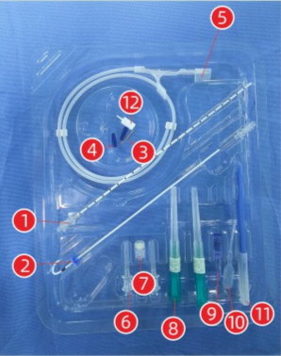
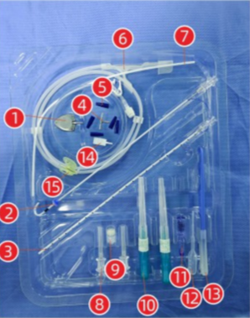
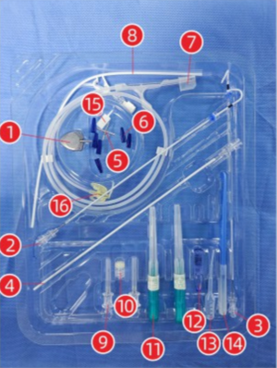
Three Model Options
Feature | SUB-A | SUB-B | SUB-C
Configuration | Portless economy | Unilateral + port | Bilateral + port
Flushing | Not possible | Via port | Via port
Indwelling | Up to 6 months | Long-term | Long-term
Best for | Short-term | Unilateral | Bilateral
SUB-A — Economy
SUB-B — Unilateral
SUB-C — Bilateral
Notes:
Three models: SUB-A is portless economy for up to 6 months; SUB-B is unilateral with titanium port for long-term flushing; SUB-C is bilateral for obstruction on both sides. The photos show actual kit contents for each model.

Slide 4
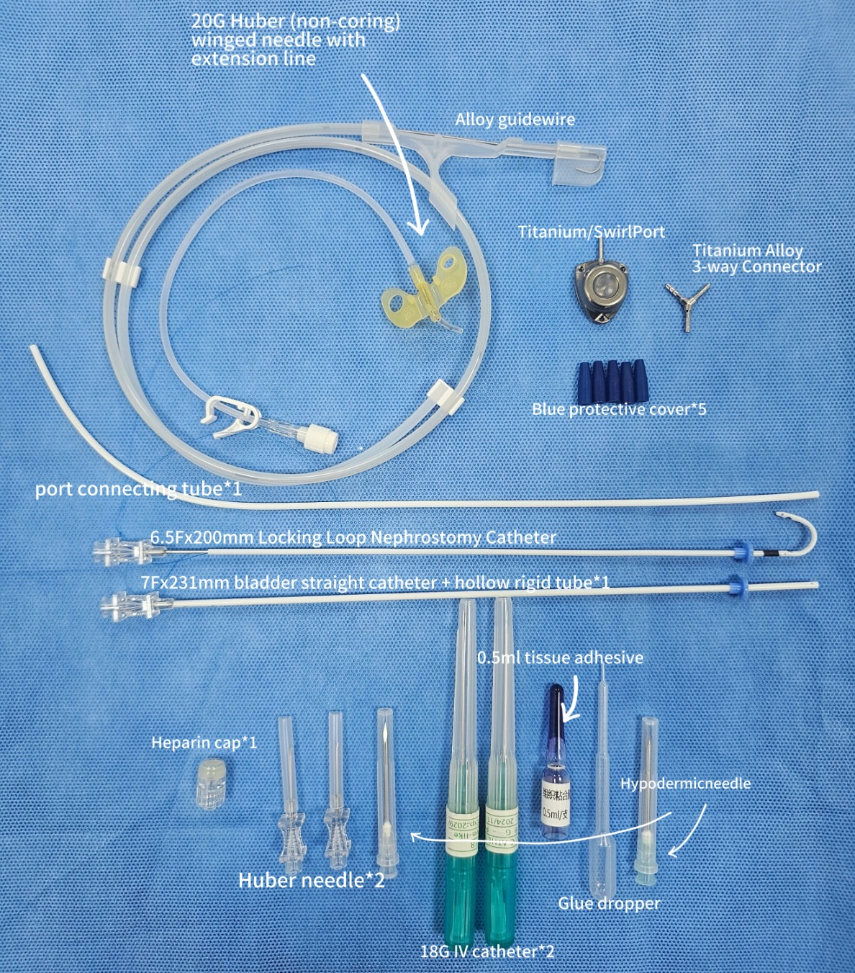
System Components
1. J-shaped nephrostomy catheter (6.5Fr × 200 mm)
2. Straight bladder catheter (7Fr × 231 mm)
3. TC titanium subcutaneous port (SUB-B / C)
4. Titanium connector: straight / 3-way / 4-way
5. Port connection tube (SUB-B / C)
6. Blue protective covers
7. J-tip guidewire, 0.035 inch, ≥ 80 cm
8. 18G IV catheters × 2
9. 22G Huber needle / 20G port needle
10. Dilator / trocar
11. Scalpel
12. Tissue adhesive 0.25 mL + applicator
13. Heparin cap
14. Stiffening cannula
Notes:
Component guide:
1. J-shaped nephrostomy catheter: inserted into renal pelvis, locking ring secures position. Radiopaque with marker rings. Pre-punched suture holes on cuff.
2. Straight bladder catheter: inserted from bladder apex. Radiopaque. Cuff has pre-punched holes, secured with 3 sutures.
3. TC titanium subcutaneous port: fixed to rectus sheath, self-sealing septum for flushing.
4. Titanium connector: straight for SUB-A, 3-way for SUB-B, 4-way for SUB-C.
5. Port connection tube: connects connector to subcutaneous port.
6. Blue protective covers: seal all connections, prevent urine leakage.
7. J-tip guidewire: after 18G puncture of renal pelvis, guidewire is coiled in pelvis, catheter advanced over it.
8. 18G IV catheters: puncture renal pelvis, confirm position with contrast before guidewire.
9. Huber / port needle: non-coring needle for port access, used for flushing and contrast.
10. Dilator: enlarges puncture tract.
11. Scalpel: skin and tissue incision.
12. Tissue adhesive: seals and reinforces catheter fixation, used with sutures.
13. Heparin cap: temporary tube closure, allows injection through rubber septum.
14. Stiffening cannula: inserted inside catheter to increase stiffness for placement.

Slide 5
Component Guide — What Each Part Does
1. J-shaped nephrostomy catheter (6.5Fr × 200 mm)
Inserted into renal pelvis; locking ring secures position. Radiopaque with marker rings. Cuff has pre-punched holes for suturing or tissue adhesive.
2. Straight bladder catheter (7Fr × 231 mm)
Inserted from bladder apex. Radiopaque. Cuff has pre-punched holes, secured with 3 sutures to bladder wall.
3. TC titanium connector
Straight for SUB-A; 3-way for SUB-B; 4-way for SUB-C. Connects catheters and port tube.
4. Subcutaneous port (SUB-B / C)
Fixed to rectus sheath. Self-sealing septum allows flushing from outside the skin.
5. Port connecting tube
One end connects to connector, the other passes through abdominal wall to the port.
6. Blue protective caps
Seal all connection points to prevent urine leakage.
7. J-tip guidewire (0.035", ≥ 80 cm)
After 18G puncture of renal pelvis, guidewire is coiled in pelvis; catheter is advanced over it.
8. 18G IV catheters × 2
Puncture renal pelvis; confirm position with contrast before guidewire insertion.
9. 22G Huber needle / 20G port needle
Non-coring needle for port access; used for flushing and contrast. Does not damage the septum.
10. Stiffening cannula
Inserted inside catheter to increase stiffness and ease placement.
11. Tissue adhesive 0.25 mL + applicator
Seals and reinforces catheter fixation; used together with sutures.
12. Scalpel
Skin and tissue incision.
13. Dilator
Enlarges the puncture tract.
14. Heparin cap
Temporarily seals tube opening; allows injection through rubber septum.
Notes:
This page explains what each component in the kit does. Catheters are radiopaque and have pre-punched suture holes. The titanium connector varies by model. All general surgical supplies are included in every kit.

Slide 6
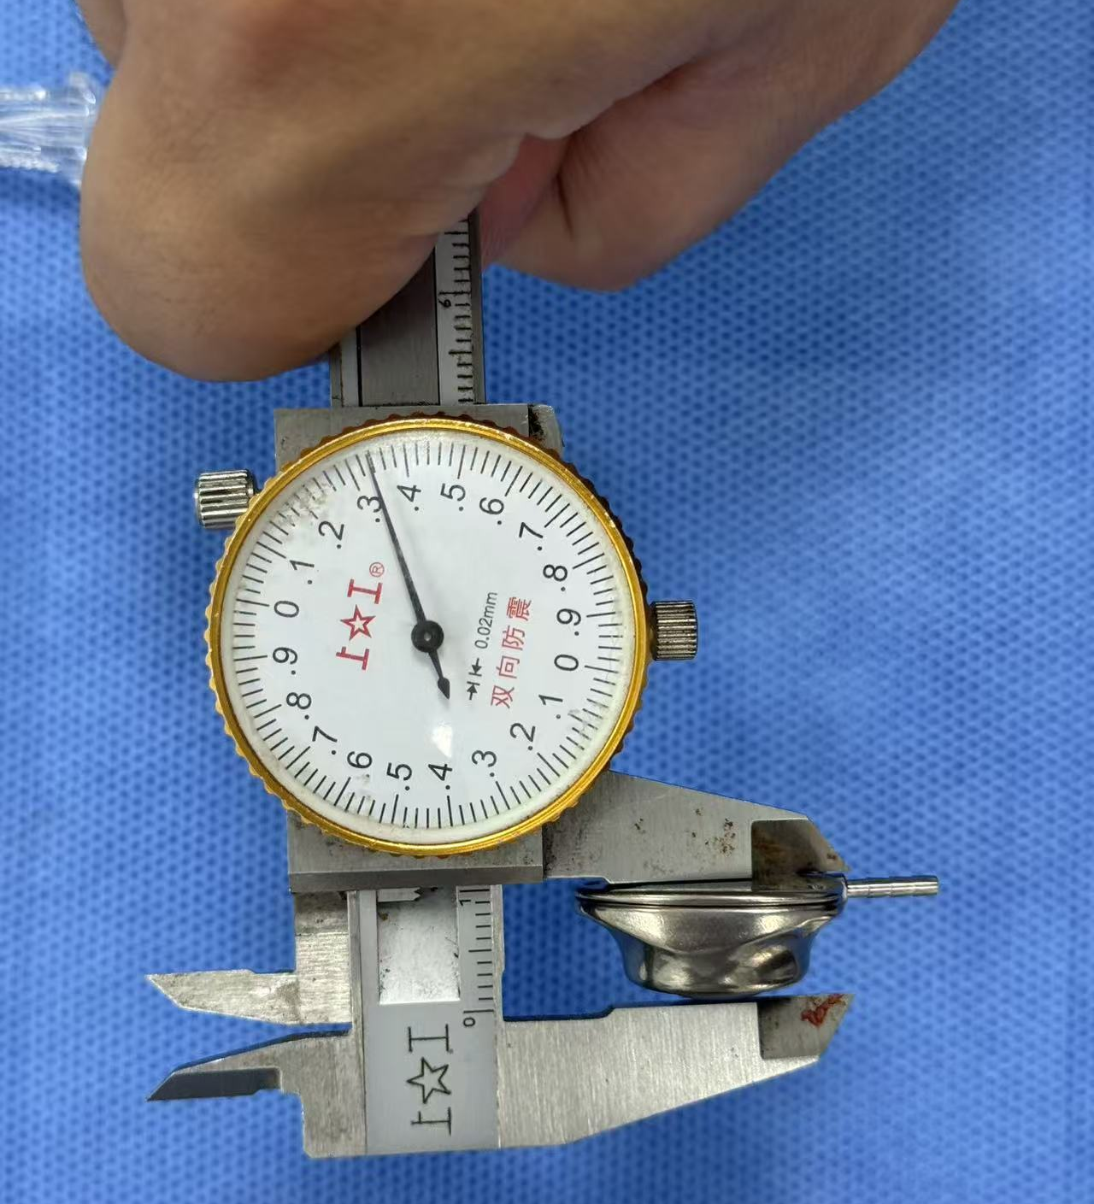
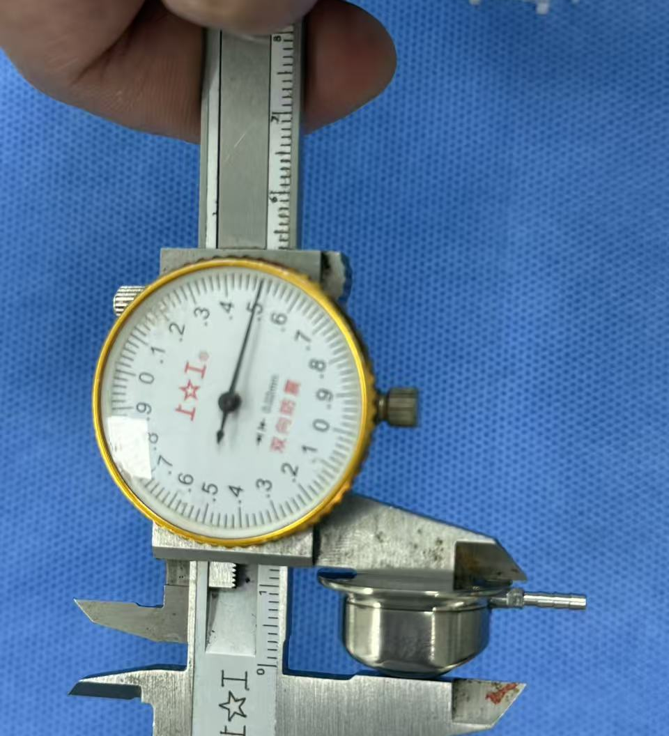
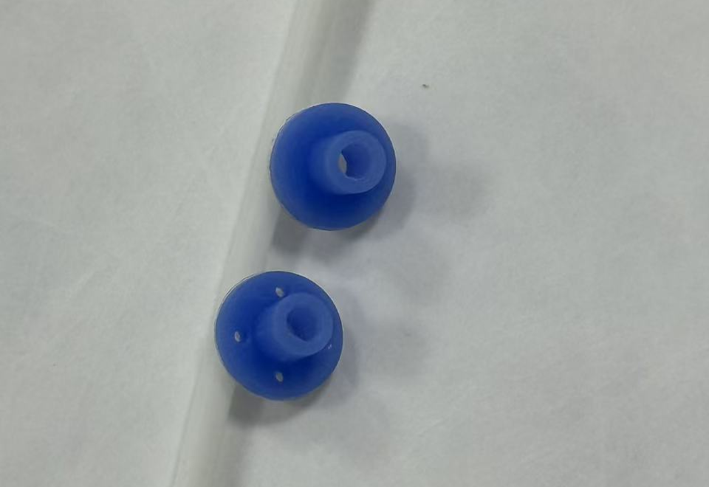
Design Details
Slim TC titanium port
Pre-punched suture holes
Radiopaque system
1.03 mm height vs 1.25 mm leading brand. Lower profile, reduced subcutaneous bulge.
Nephrostomy and cystostomy cuffs have pre-punched holes for direct suturing.
Catheter body + marker rings visible on plain X-ray, no contrast needed.
Our port: 1.03 mm
Leading brand: 1.25 mm
Blue protective caps with pre-punched suture holes
Notes:
Measured side by side: our titanium port is only 1.03 mm high vs 1.25 mm on the leading brand. Both cuffs have pre-punched suture holes for direct fixation, and the entire radiopaque system is visible on plain X-ray without contrast media.

Slide 7
Surgical Procedure
1
Pre-op preparation
Fast 12h food, 4h water; perioperative IV antibiotics; flush all SUB components to wet them and confirm patency
2
Nephrostomy catheter placement
Surgical Demo Video
Expose caudal pole; 18G puncture into renal pelvis under fluoroscopy or ultrasound; pass J-guidewire, advance catheter over it, lock pigtail; fix cuff to capsule
Full SUB implantation procedure from prep to closure
3
Cystostomy catheter placement
Purse-string at bladder apex; puncture with No. 11 blade or electrocautery; insert catheter, tie purse-string; suture cuff and seal with tissue adhesive
4
System connection and leak test
Watch the Surgical Procedure →
Push kidney catheter onto first barb ridge, cut locking string flush, push fully on; connect bladder and port tubes; leak test via Huber needle; fit blue covers
5
Port fixation and closure
Lay catheters without kinks; suture port to rectus sheath through its 3 holes; close abdomen; post-op plain AP + lateral X-ray
This summary is for reference only. Procedures should be performed by professional veterinarians in accordance with the IFU and the surgical video.
Notes:
The procedure has five steps. Pre-op: fasting, antibiotics, and flushing all components. Nephrostomy: 18G puncture into the renal pelvis through the caudal pole, guided by fluoroscopy or ultrasound, then guidewire, catheter, pigtail lock and cuff fixation. Cystostomy: purse-string at the bladder apex, insert catheter, suture and glue the cuff. Connection: seat the kidney catheter on the first barb ridge, cut the locking string flush, push fully on, connect the other tubes, leak test with a Huber needle and fit the blue covers. Finally, lay the catheters without kinks, suture the port to the rectus sheath, close and take post-op X-rays. A full surgical video is available.

Slide 8
Thank You
Bypass the obstruction. Restore the flow.
ISO 13485 Certified · Veterinary Implant Device
Notes:
Thank you for your attention. We look forward to partnering with you to bring this SUB system to your clinic. Product samples, detailed IFU, and surgical video are available on request.

