Slide 1
Feline SUB System Introduction
VETERINARY IMPLANT DEVICE
Subcutaneous Ureteral Bypass for Feline Ureteral Obstruction
Notes:
Welcome. Today we present the PURETAI Subcutaneous Ureteral Bypass (SUB) system, an implantable device for cats with ureteral obstruction. It creates a subcutaneous bypass from the renal pelvis to the bladder and restores urine flow. We will cover the clinical background, the product and its three models, the key design features, the surgical and post-op protocol, and ordering information.

Slide 2
Agenda
CONTENTS
01
Company & Quality
02
Clinical Background
Who we are, certifications
Feline ureteral obstruction and treatment options
03
Product Overview
04
Kit & Key Features
How the SUB works, three model options
Components, port, catheters, cuffs, kit
05
Surgery & Aftercare
06
Ordering & FAQ
Procedure, flushing protocol, complications
Model selection and common questions
Notes:
Six parts: company and quality, the clinical problem, the product and its models, the kit and its key design features, surgery and aftercare, and finally ordering and FAQ.

Slide 3




Xinxiang Purtai Medical Co., Ltd.
01 · COMPANY & QUALITY
A medical device manufacturer focused on veterinary implant devices. The PURETAI SUB system is designed, produced and quality-controlled under an ISO 13485 certified quality management system.
ISO 13485 Certified
Medical-Grade Materials
Ready-to-Use Kit
Clinical Support
Quality management system certified to ISO 13485, the international standard for medical device manufacturers.
TC titanium alloy port and connectors, medical silicone catheters with integrated radiopaque markers.
One kit contains the implant plus the surgical consumables needed on the day of surgery.
Full surgical demonstration video and product support available for partner clinics.
Notes:
Brief company introduction. Key point for distributors: the device is produced under an ISO 13485 certified quality system. Certificate scans can be added to this slide.

Slide 4
Feline Ureteral Obstruction
02 · CLINICAL BACKGROUND
What causes it
Calcium oxalate ureteroliths: the most common cause; stones are often multiple and small
Ureteral strictures, which may be present with or without stones
Solidified blood stones and other intraluminal debris
94%
of cats discharged from hospital after SUB placement
Why it is urgent
Obstruction causes hydronephrosis, azotemia and acute kidney injury
Bilateral obstruction, or obstruction of a single functioning kidney, is life-threatening
Medical management alone often fails; decompression is needed within days to save renal function
Multicentre study, 81 cats (Wuillemin et al., JVIM 2021)
The SUB bypasses the ureter entirely, so it works regardless of stone number, location or stricture.
Notes:
Ureteral obstruction is a common and serious problem in cats, most often caused by calcium oxalate stones, frequently combined with strictures. The kidney is quickly damaged, so the obstruction has to be relieved. Published multicentre data show around 94 percent of cats are discharged after SUB placement. Because the SUB bypasses the ureter completely, it does not matter how many stones there are or where they sit.

Slide 5
Treatment Options Compared
02 · CLINICAL BACKGROUND
 | Medical management | Traditional surgery (ureterotomy / reimplantation) | Ureteral stent | SUB system
Approach | IV fluids, diuretics, alpha-blockers | Open surgery on the ureter | Double-pigtail stent inside the ureter | Bypass from renal pelvis to bladder under the skin
Multiple stones / strictures | Often fails | Technically difficult, risk of re-obstruction | Possible, but stent placement can be difficult in small feline ureters | Not affected: ureter is bypassed
Surgical skill required | None | Microsurgery | High, usually needs fluoroscopy | Standardised steps, video available
Patency maintenance | Not applicable | Not possible | Not possible | Port allows routine flushing (SUB-B / SUB-C)
Follow-up imaging | Ultrasound | Ultrasound | X-ray / ultrasound | Plain X-ray with radiopaque rings, plus ultrasound
Notes:
This is how the SUB compares to the alternatives. Medical management alone often fails. Traditional ureteral surgery is microsurgery and multiple stones or strictures make it difficult. Stents are hard to place in small feline ureters. The SUB bypasses the ureter, follows standardised steps, and with a port it can be flushed to keep it patent.

Slide 6

Indications & Patient Selection
02 · CLINICAL BACKGROUND
Indications
Which model?
Ureteral obstruction caused by ureteroliths, single or multiple
Unilateral obstruction, long-term
SUB-B
Ureteral stricture, proximal or distal
Bilateral obstruction
SUB-C
Obstruction not resolved by 24 to 72 h of medical management
Bilateral obstruction or obstruction of a single functioning kidney
Short-term, palliative or budget-limited case
SUB-A
Notes:
Typical indications are ureteroliths, strictures, obstruction that does not respond to medical management, and bilateral obstruction. Model selection is simple: SUB-B for unilateral long-term cases, SUB-C for bilateral, and SUB-A for short-term, palliative or budget-limited cases.

Slide 7
How the SUB System Works
03 · PRODUCT OVERVIEW
Kidney
Nephrostomy catheter
Subcutaneous port
Bladder catheter
Bladder
Renal pelvis
6.5Fr locking-loop
TC titanium, flushable
7Fr straight
Urine flow restored
Bypass
Flush
Monitor
Urine drains from the renal pelvis through the catheters to the bladder, completely bypassing the obstructed ureter.
The port sits under the skin and is accessed with a Huber needle to flush the system and keep it patent.
Radiopaque rings on the catheters show position on plain X-ray; the port also allows urine sampling for culture.
Notes:
The principle is simple: a catheter in the renal pelvis, a catheter in the bladder, and a subcutaneous port in between. Urine bypasses the blocked ureter. The port is used for flushing and for collecting urine samples, and the radiopaque rings make it easy to check catheter position on X-ray.

Slide 8
Three Model Options
03 · PRODUCT OVERVIEW
Choose the configuration that matches your patient and clinical need.
Feature | SUB-A | SUB-B | SUB-C
Configuration | Economy / Portless | Unilateral with Port | Bilateral with Port
Subcutaneous Port | None | TC Titanium | TC Titanium
Flushing | Not possible | Via port access | Via port access
Indwelling Period | Up to 6 months | Long-term, with routine flushing | Long-term, with routine flushing
Best For | Short-term palliative, cost-sensitive cases | Unilateral obstruction | Bilateral obstruction
Notes:
SUB-A is the economy portless option for short-term palliative use, up to six months, and cannot be flushed. SUB-B is unilateral with a titanium port for long-term management with periodic flushing. SUB-C is the bilateral version for cats with obstruction on both sides.

Slide 9
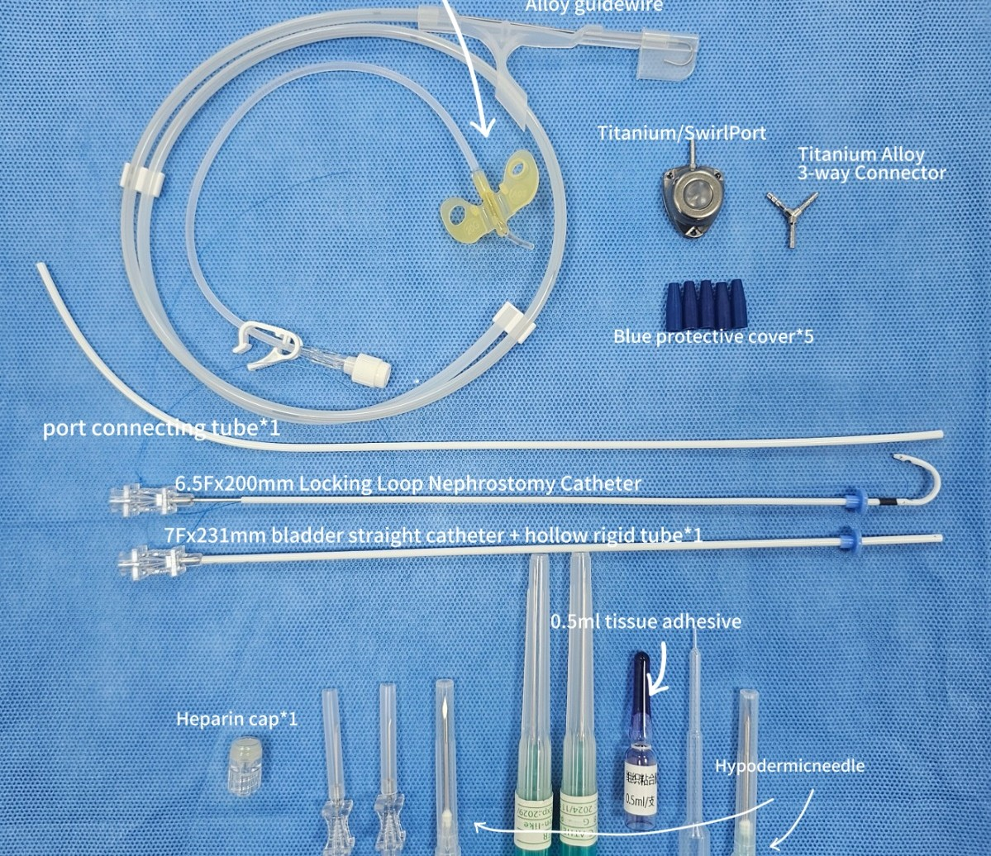
System Components
04 · KIT & KEY FEATURES
Implant
6.5Fr x 200 mm locking-loop nephrostomy catheter
7Fr x 231 mm straight bladder catheter
TC titanium subcutaneous port (SUB-B / SUB-C)
Titanium alloy 3-way / 4-way connector, port connecting tube
Placement & access
0.035-inch J-tip alloy guidewire
18G IV catheters x 2, hypodermic needles
22G Huber needles and 20G port needle
Fixation & closure
Tissue adhesive with applicator
Heparin cap, blue protective covers x 5
Scalpel
Notes:
This is the complete kit. Implant parts: the J-shaped locking-loop nephrostomy catheter, the straight bladder catheter, the titanium port and the connector. Placement and access: guidewire, IV catheters and Huber needles. Fixation: tissue adhesive, heparin cap and covers. Everything needed for the surgery is in one box.

Slide 10
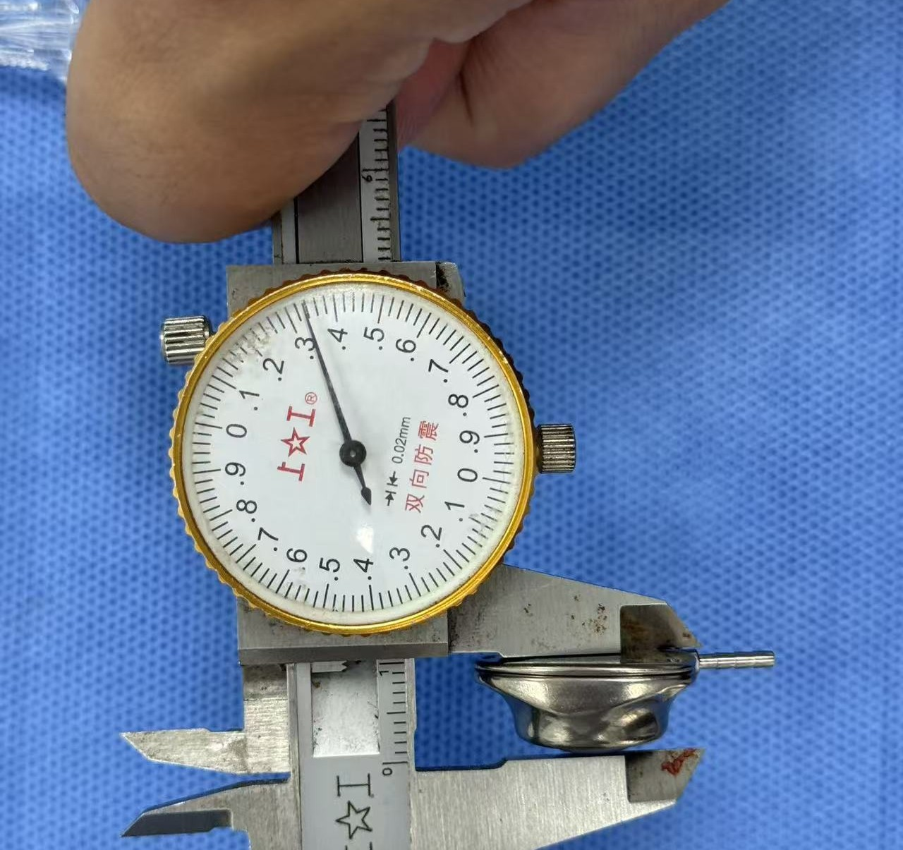
Slim TC Titanium Port
04 · KEY FEATURE 1
10.3 mm
port height, measured with caliper
Lower subcutaneous profile
Lighter weight
Less skin tension over the port and a smaller subcutaneous pocket, which matters in small or thin cats.
TC titanium alloy gives strength with low weight, so the port sits stably on the body wall.
Easy to locate and access
Secure fixation
Firm titanium body is easy to palpate under the skin for routine flushing with a 22G Huber needle.
Port is fixed to the rectus abdominis sheath, keeping it in place for long-term use.
Notes:
Our port is made of TC titanium alloy and is only 10.3 millimetres high. A lower profile means less skin tension and a smaller pocket, which is important in small cats. It is easy to feel under the skin, so flushing is straightforward.

Slide 11



Radiopaque Ring Catheters
04 · KEY FEATURE 2
Silicone catheters with an integrated radiopaque ring, visible on a plain X-ray without contrast.
Post-op confirmation
Follow-up visits
Soft silicone
Check catheter position on routine AP and lateral X-rays right after surgery.
Detect catheter migration or kinking at re-checks without contrast studies.
Flexible, biocompatible silicone suited to long-term implantation.
 | Catheter without radiopaque marker | PURETAI radiopaque ring catheter
Position check | Often needs contrast or ultrasound | Plain X-ray is enough
Extra cost and time | Contrast agent, longer procedure | None
Migration / kinking detection | Harder to see | Ring position shows on every film
Notes:
Both catheters have an integrated radiopaque ring. On a standard X-ray, without contrast, you can confirm where the catheters are, right after surgery and at every check-up. That saves time and contrast, and makes migration or kinking easier to spot.

Slide 12
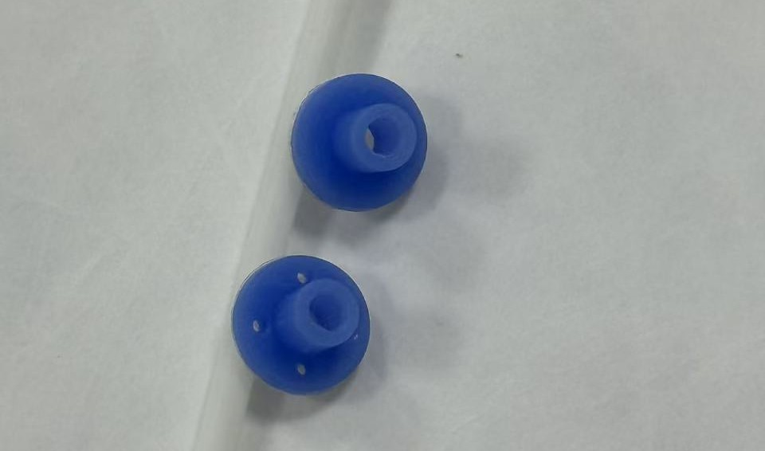
Pre-Punched Suture Holes on Both Cuffs
04 · KEY FEATURE 3
 | Adhesive-only fixation | PURETAI pre-punched cuffs
Fixation strength | Depends on adhesive bond | Suture plus adhesive
Leakage risk at entry site | Higher if bond fails | Reduced by mechanical fixation
Catheter dislodgement | Possible when cat moves | Cuff held by sutures
Operator ease | Must pierce cuff during surgery | Holes ready, saves time
Direct suturing through the pre-punched holes fixes the nephrostomy cuff to the renal capsule and the cystostomy cuff to the bladder wall, instead of relying on tissue adhesive alone.
Notes:
Both cuffs have pre-punched suture holes. The surgeon sutures the cuff directly to the kidney capsule and the bladder wall. This gives mechanical fixation on top of the adhesive, which reduces leakage and dislodgement and saves time in surgery.

Slide 13





All-Inclusive Kit
04 · KEY FEATURE 4
No additional general supplies to source on the day of surgery: open one box and start.
Tissue adhesive
Huber needles
Connector
with applicator
22G, plus 20G port needle
3-way / 4-way titanium
Heparin cap
18G IV catheters
Guidewire
and 5 protective covers
x 2, for renal and bladder puncture
0.035-inch J-tip
Saves preparation time
Fewer missing items
Clear cost per case
No need to collect parts from different suppliers.
Everything packed together, nothing forgotten in theatre.
One kit price for budgeting and client quotes.
Notes:
The kit is all-inclusive: tissue adhesive, Huber needles, connector, heparin cap and covers, IV catheters, guidewire and scalpel are all in the box. The clinic does not need to source extra items, nothing gets forgotten, and the cost per case is clear.

Slide 14
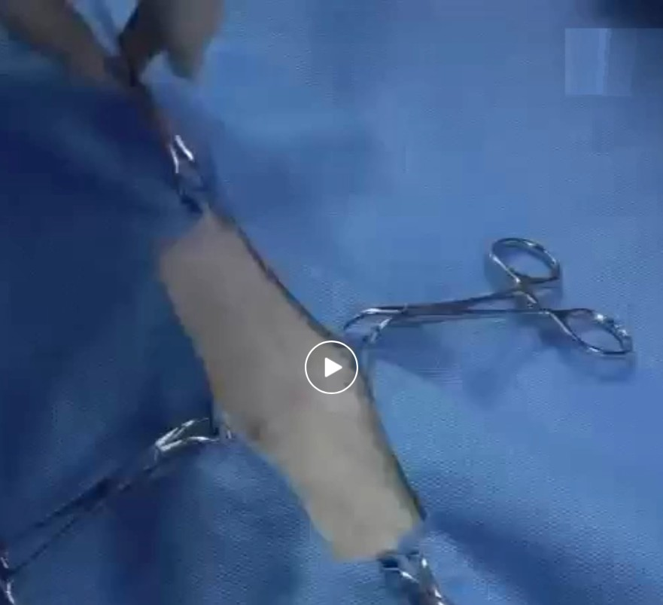
Surgical Procedure
05 · SURGERY & AFTERCARE
1
Pre-op preparation
Fast 12 h food, 4 h water; IV antibiotics; ultrasound localization
2
Nephrostomy catheter placement
Puncture renal pelvis with 18G, insert J-guidewire, advance catheter, suture cuff
3
Cystostomy catheter placement
Purse-string at bladder apex, electrocautery puncture, insert catheter, suture cuff
4
System connection and patency check
Connect via 3-way connector; DSA angiography confirms flow through the system
5
Port fixation and closure
Watch the full surgical video
Fix port to rectus abdominis sheath; close abdomen; post-op AP and lateral X-ray
Notes:
The procedure follows five core steps: preparation, nephrostomy catheter, cystostomy catheter, connection with patency check, and port fixation with closure. Click the image or button to open the full surgical demonstration video.

Slide 15
Post-op Care & Flushing Protocol
05 · SURGERY & AFTERCARE
Day 0
Before discharge
~1 week
~1 month
Every 3 months
Post-op AP and lateral X-ray to confirm catheter position
Ultrasound and renal values; first flush via port
Re-check, flush, urinalysis and urine culture
Re-check, flush, ultrasound
Routine flush and check-up, long-term
How to flush (SUB-B / SUB-C)
Clip and aseptically prepare the skin over the port
Insert the 22G Huber needle into the port; aspirate urine for culture
Flush slowly with sterile saline (or the clinic's flushing solution) under ultrasound guidance
Confirm flow: fluid seen entering the renal pelvis and the bladder
Check for resistance or leakage at the port or catheter sites
Record date and findings; schedule the next flush
Schedule shown is a commonly used reference protocol; the attending veterinarian adjusts it to each patient.
Notes:
After surgery, X-rays confirm catheter position. The port is then flushed at regular intervals: before discharge, at about one week, one month, and every three months after that. Each flush also gives a urine sample for culture. This schedule is a reference; the vet adapts it to each cat. SUB-A has no port and cannot be flushed.

Slide 16
Possible Complications & Management
05 · SURGERY & AFTERCARE
Complication | What to look for | Prevention / management
Urine leakage | Fluid in abdomen, rising renal values after surgery | Secure cuff suturing through pre-punched holes; check patency before closure
Catheter kinking or migration | Reduced flow on flushing, catheter position change on X-ray | Correct catheter length and route; radiopaque rings for X-ray follow-up
Blockage / mineralisation | Resistance during flushing, recurrence of hydronephrosis | Routine flushing via port (SUB-B / SUB-C); replace if needed
Urinary tract infection | Positive urine culture from port sample | Aseptic technique; culture at each flush; antibiotics per culture
Dysuria / cystitis | Straining, frequent urination after surgery | Usually managed medically; monitor at re-checks
Port site problems | Swelling, seroma, discomfort | Slim port, fixation to rectus sheath, aseptic access
Notes:
As with any implant, complications can occur. The main ones are leakage, kinking or migration, blockage, infection, cystitis-like signs and port site problems. Several of our design choices target these directly: sutured cuffs against leakage, radiopaque rings for follow-up, the port for flushing and the slim port profile.

Slide 17

Frequently Asked Questions
06 · ORDERING & FAQ
Can SUB-A be flushed?
How do I confirm placement after surgery?
No. SUB-A has no port. It is for short-term or palliative use, up to 6 months.
Plain AP and lateral X-ray. The radiopaque rings show catheter position without contrast.
Which needle accesses the port?
Do I need to buy anything else?
22G Huber needle, included in the kit together with a 20G port needle.
No general supplies needed. Adhesive, scalpel, heparin cap and IV catheters are included.
What is the difference between SUB-B and SUB-C?
Is surgical training available?
SUB-B treats one side. SUB-C is the bilateral version for cats with obstruction on both sides.
A full surgical demonstration video is available, from patient prep to closure.
Notes:
Common questions from vets and distributors. These answers can be adjusted as we collect more customer questions.

Slide 18
Thank You
PARTNER WITH US
Bypass the obstruction. Restore the flow.
Contact us for samples, pricing and distribution opportunities.
Notes:
Thank you. Please contact us for samples, pricing, a product demo or distribution opportunities.

