Slide 1
PROJECT TITLE
District wise crimes committed against women between 2001 to 2012
Notes:
District wise crimes committed against women between 2001 to 2012

Slide 2
GROUP DETAIL
IN OUR GROUP THERE IS 2 MEMBERS
1 Priyank Lad
2 Zeel Surti

Slide 3
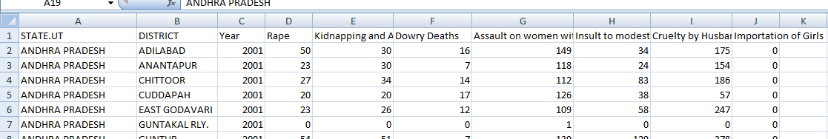
DATASET IN DATA SCIENCE PROJECT

Slide 4
QUESTIONS OF ANALYSIS
1 description of dataset
2 which is the highest crime??
3 crime wise report for all state.
4 district wise all crime report.
5 year wise crime report.
6 growth of the crime year by year.

Slide 5
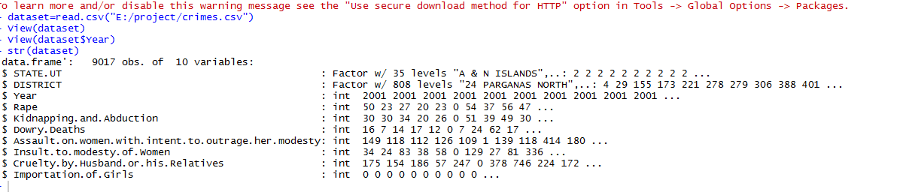
1 description of dataset
dataset=read.csv("E:/project/crimes.csv")
View(dataset)
View(dataset$Year)
str(dataset)

Slide 6
2 which is the highest crime??
#====================treemap plot of all crimes in #india==================================
library(treemap)
table=read.csv("E:/project/crimes.csv")
rap_crime=table %>% summarise(rap_crime = sum(Rape))
kidnap_crime=table %>% summarise(kidnap_crime = sum(Kidnapping.and.Abduction))
dowry_crime=table %>% summarise(dowry_crime = sum(Dowry.Deaths))
assult_crime=table %>% summarise(assult_crime = sum(Assault.on.women.with.intent.to.outrage.her.modesty))
insult_crime=table %>% summarise(insult_crime = sum(Insult.to.modesty.of.Women))
by_rel_crime=table %>% summarise(by_rel_crime = sum(Cruelty.by.Husband.or.his.Relatives))
imp_crime=table %>% summarise(imp_crime = sum(Importation.of.Girls))
all_crimes=c(rap_crime,kidnap_crime,dowry_crime,assult_crime,insult_crime,by_rel_crime,imp_crime)
tr_crimes=as.numeric(paste(all_crimes))
header=c("Rape","Kidnapping.and.Abduction","Dowry.Deaths","Assault.on.women.with.intent.to.outrage.her.modesty","Insult.to.modesty.of.Women","cruelty.by.Husband.or.his.Relatives","Importation")
my_tree=cbind(header,tr_crimes)
df=data.frame(header,tr_crimes)
str(df)
transform(df,all_crimes=as.numeric(all_crimes))
str(df)
print(df)
treemap(df,index = "header",vSize = "tr_crimes",type = "index",fontface.labels = 6,bg.labels = "transparent",title = "treemap about all crimes",title.legend = "tr_crimes")

Slide 7
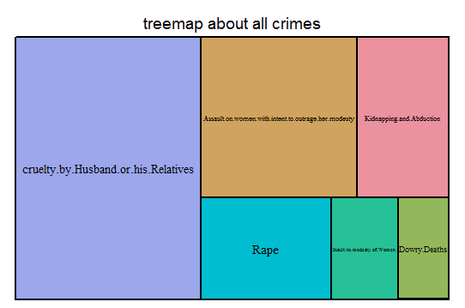
2 which is the highest crime??

Slide 8
3 crime wise report for all state.
library(dplyr)
library(ggplot2)
table=read.csv("E:/project/crimes.csv")
View(table)
number_of_rapes=table %>% summarise(number_of_rapes = sum(Rape))
head(number_of_rapes)
data2=table %>% group_by(STATE.UT) %>% summarise(number_of_rapes = sum(Rape))
View(data2)
#========================ggplot of the data which is grouped by #STATES for Rape case.=======================
IrisPlot <- ggplot(data2, aes(data2$number_of_rapes,data2$STATE.UT,label=data2$number_of_rapes)) + geom_point() +geom_text(hjust=0.1,vjust=1)
print(IrisPlot)

Slide 9
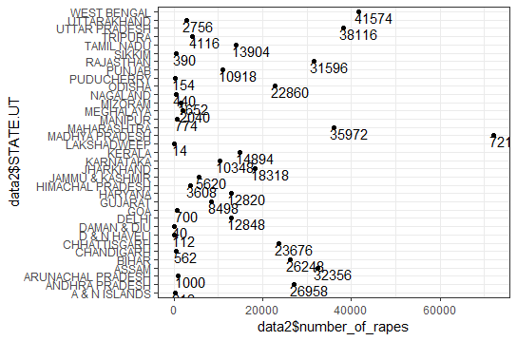
3 crime wise report for all state.
This report having 7 files for all type of crimes.

Slide 10
4 district wise all crime report.
#========================normlized crime in AANDHRA PARDESH=====================
library(ggplot2)
theme_set(theme_bw())
library(dplyr)
library(ggplot2)
table=read.csv("E:/project/crimes.csv")
data2=table %>% group_by(DISTRICT) %>% filter(STATE.UT== "ANDHRA PRADESH") %>% summarise(all_crimes=sum(Rape,Kidnapping.and.Abduction,Dowry.Deaths,Assault.on.women.with.intent.to.outrage.her.modesty,Insult.to.modesty.of.Women,Cruelty.by.Husband.or.his.Relatives,Importation.of.Girls))
View(data2)
print(all_crimes)
data=data.frame(data2)
print(data2)
data$avg = round((data$all_crimes - mean(data$all_crimes))/sd(data$all_crimes),2)
data$chart_type = ifelse(data$avg < 0,"below","above")
data=data[order(data$avg),]
ggplot(data,aes(x=DISTRICT,y=avg))+
geom_bar(stat = 'identity',aes(fill=chart_type),width = 0.5)+
scale_fill_manual(name="crimes",labels=c("above avg","below avg"),
values = c("above"="#00ba38","below"="#f8766d"))+
labs(subtitle = "normlized crimes in ANDHRA PRADESH",
title = "DIverging Bars")+
coord_flip()

Slide 11
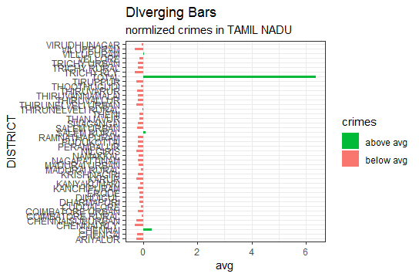
4 district wise all crime report.
This report having 35 files for all District.

Slide 12
5 year wise crime report.
table=read.csv("E:/project/crimes.csv")
rap_crime=table %>% filter(Year==2001) %>% summarise(rap_crime = sum(Rape))
kidnap_crime=table %>% filter(Year==2001) %>% summarise(kidnap_crime = sum(Kidnapping.and.Abduction))
dowry_crime=table %>% filter(Year==2001) %>% summarise(dowry_crime = sum(Dowry.Deaths))
assult_crime=table %>% filter(Year==2001) %>% summarise(assult_crime = sum(Assault.on.women.with.intent.to.outrage.her.modesty))
insult_crime=table %>% filter(Year==2001) %>% summarise(insult_crime = sum(Insult.to.modesty.of.Women))
by_rel_crime=table %>% filter(Year==2001) %>% summarise(by_rel_crime = sum(Cruelty.by.Husband.or.his.Relatives))
imp_crime=table %>% filter(Year==2001) %>% summarise(imp_crime = sum(Importation.of.Girls))
all_crimes=c(rap_crime,kidnap_crime,dowry_crime,assult_crime,insult_crime,by_rel_crime,imp_crime)
tr_crimes=as.numeric(paste(all_crimes))
header=c("Rape","Kidnapping.and.Abduction","Dowry.Deaths","Assault.on.women.with.intent.to.outrage.her.modesty","Insult.to.modesty.of.Women","cruelty.by.Husband.or.his.Relatives","Importation.of.Girls")
my_tree=cbind(header,tr_crimes)
df=data.frame(header,tr_crimes)
str(df)
transform(df,all_crimes=as.numeric(all_crimes))
str(df)
print(df)
print(all_crimes)
x <- df$tr_crimes
labels <- df$header
piepercent<- round(100*x/sum(x), 1)
# Plot the chart.
pie(x, labels =paste(df$header,piepercent,"%"), main = "Crime in 2001 pie chart",col = rainbow(length(x)))
legend("topright", df$header, cex = 0.8,fill = rainbow(length(x)))

Slide 13
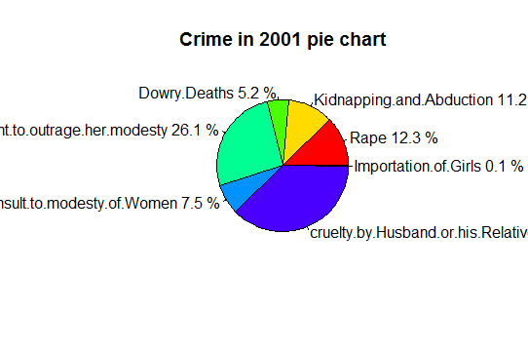
5 year wise crime report.
This report having 12 files for all year.

Slide 14
6 growth of the crime year by year.
table=read.csv("E:/project/crimes.csv")
data2=table %>% group_by(Year) %>% summarise(all_crimes=sum(Rape,Kidnapping.and.Abduction,Dowry.Deaths,Assault.on.women.with.intent.to.outrage.her.modesty,Insult.to.modesty.of.Women,Cruelty.by.Husband.or.his.Relatives,Importation.of.Girls))
#View(data2)
data=data.frame(data2)
print(data2)
x=(data2$Year)
y=(data2$all_crimes)
plot(x,y,type = "o",col="red",xlab = "YEAR",ylab = "CRIMES",main = "CHART ABOUT YEARLY CRIME REPORT")

Slide 15
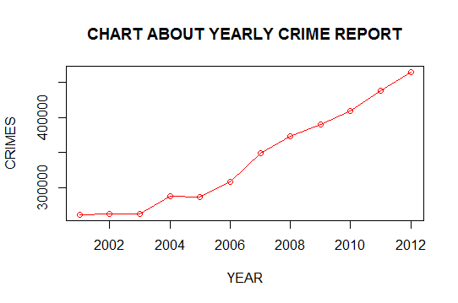
6 growth of the crime year by year.

Slide 16
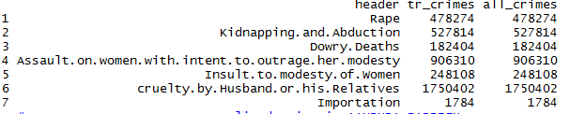
PREDUCTION THROUGH ANALYSIS OF DATASET
1 all crimes are increse day by day for all resons.
2 the crime is highestly occur is cruelty by Husband or his Relatives.

Slide 17
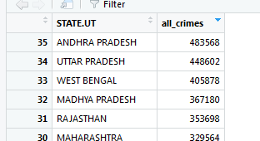
PREDUCTION THROUGH ANALYSIS OF DATASET
3 in anadhra pradesh the maximum crime is occur.

Slide 18
THANK YOU!

