Slide 1
Twitter Sentiment Analysis
Project By : Priyank Lad & Zeel Surti

Slide 2
Twitter Sentiment Analysis using R & Shiny WebApp
A Simple Approach to Twitter Sentiment Analysis in R Programming Language
This project is on “Twitter Sentiment Analysis using R” is a sentiment analysis project based on big data analytics. This project will help us to analyse sentiment from Twitter generated text data. Which will be able to show the sentimental state for a person or a specific topic or whatever we want.
The aim for this project is to build up an application which will be able to connect nontechnical people to the field of data mining. Where using simple user interface they will be able to create a report based on their search keyword. This application is very simple and easy to use. So it will be comfortable for everyone to use it.

Slide 3
Shiny
This project was built using Shiny WebApp. Shiny is an R package that makes it easy to build interactive web apps straight from R. You can host standalone apps on a webpage or embed them in R Markdown documents or build dashboards. You can also extend your Shiny apps with CSS themes, HTML widgets, and JavaScript actions.
In Shiny App, there are 2 types of creating GUI Based Web Applications :
Single-file (app.R)
Multi-file (ui.R,server.R)
This project is Multi-file type, which contains 2 separate files for Front-End & Back-End Development. ui.R is for Front-End & server.R is for Back-End.

Slide 4
Prerequisites
Twitter API
R Binary
An IDE for R Programming (RStudio)
Shiny & Plotrix (R Libraries)
Positive & Negative Words List (To compare Tweets for Sentiment)

Slide 5
Project Content
Search input & Location Selection (By default location is set to Worldwide)
Word Cloud Formation
Plotting Histogram of Sentiments
Pie Chart for Sentiment Percentage
Table of Analysed Tweets associated with the searched Hashtag
Barplot of Top 20 Users who used that Hashtag
Twitter Handle Analysis (Hashtag Frequencies by a particular User)

Slide 6
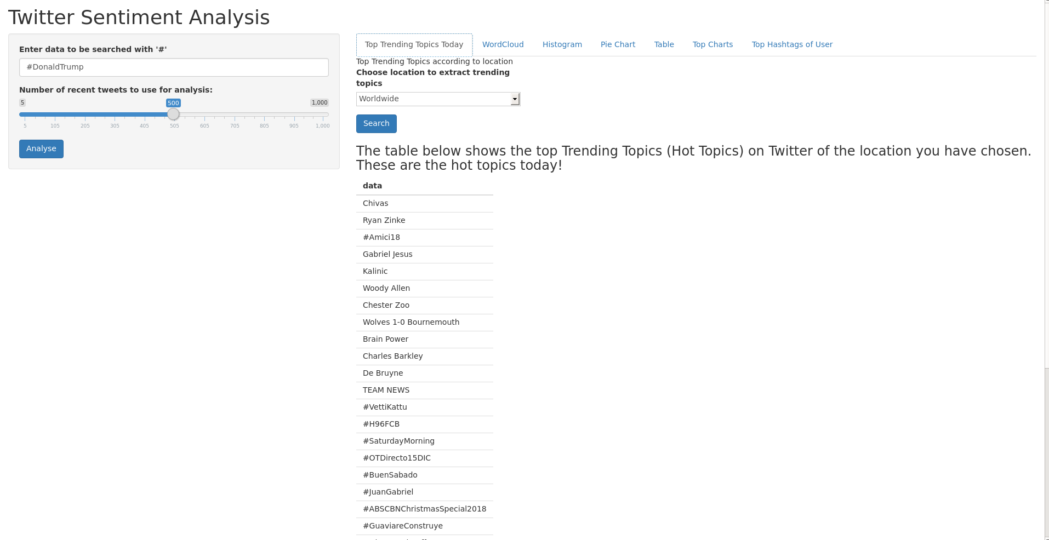
1. Search input & Location Selection (By default location is set to Worldwide)

Slide 7
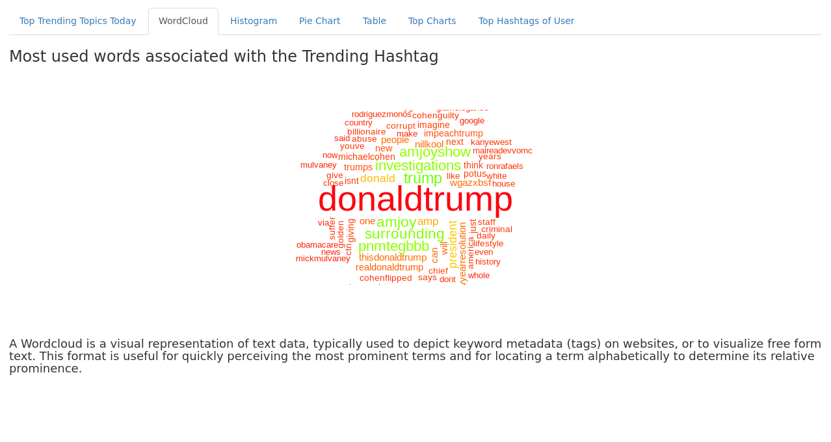
2. Word Cloud Formation

Slide 8
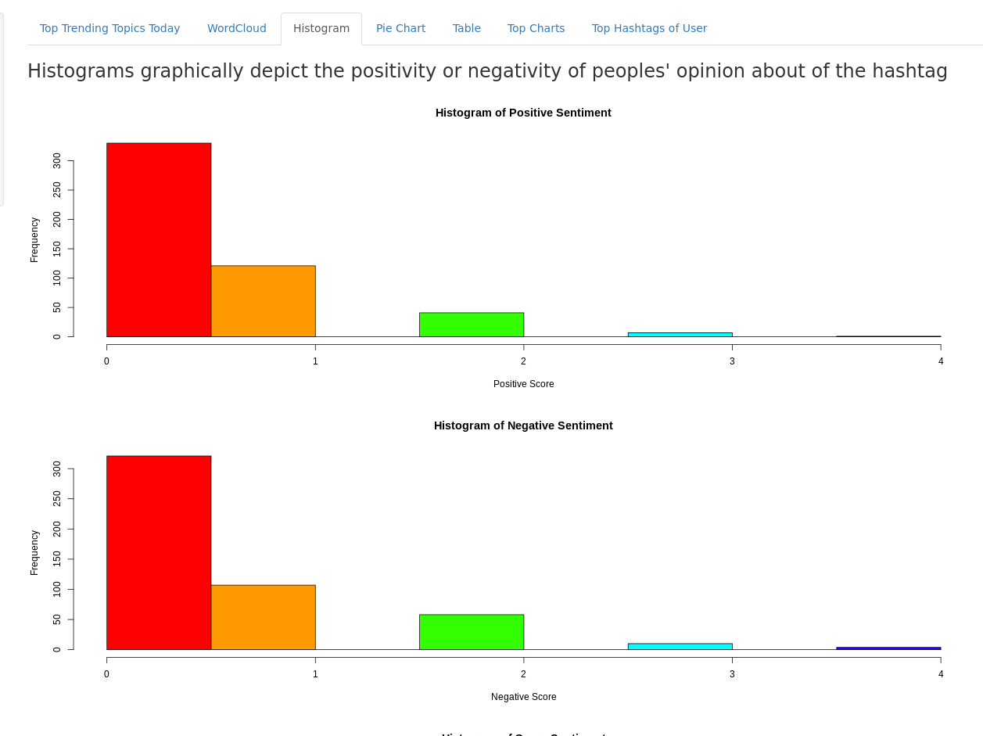
3. Plotting Histogram of Sentiments

Slide 9
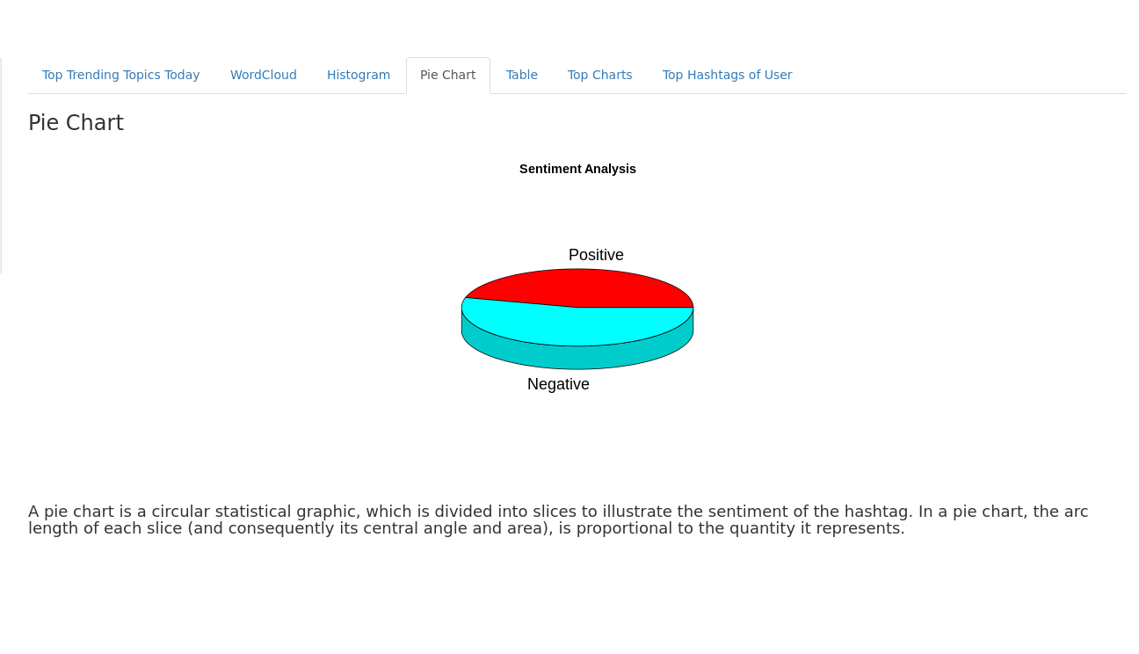
4. Pie Chart for Sentiment Percentage

Slide 10
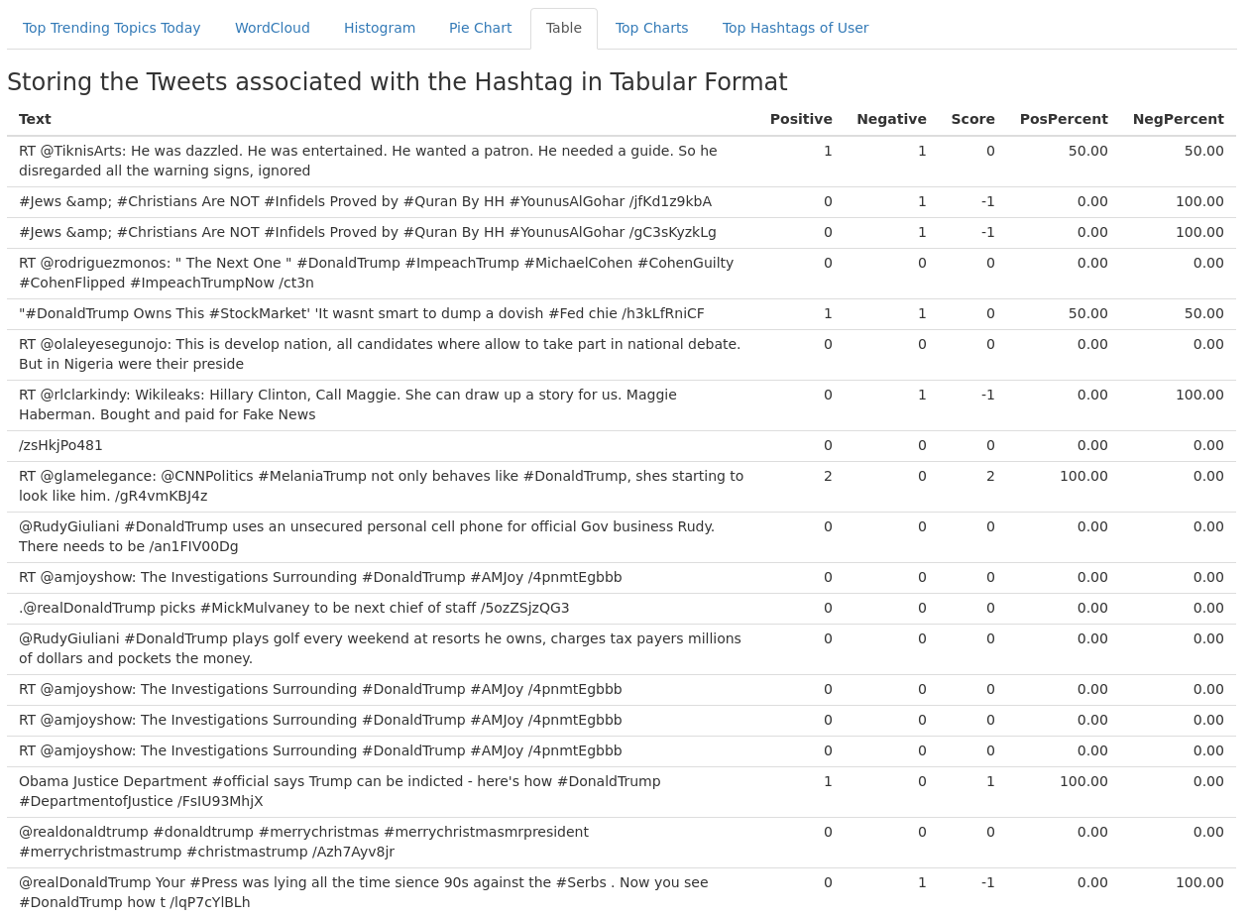
5. Table of Analysed Tweets associated with the searched Hashtag

Slide 11
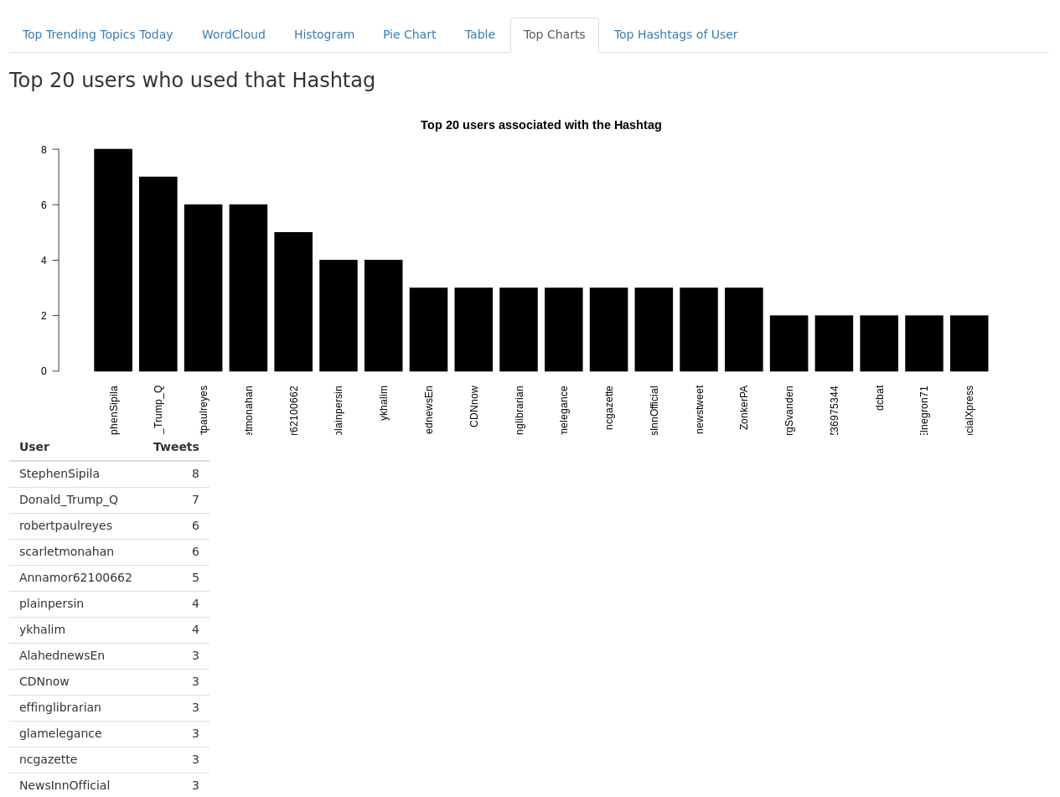
6. Barplot of Top 20 Users who used that Hashtag

Slide 12
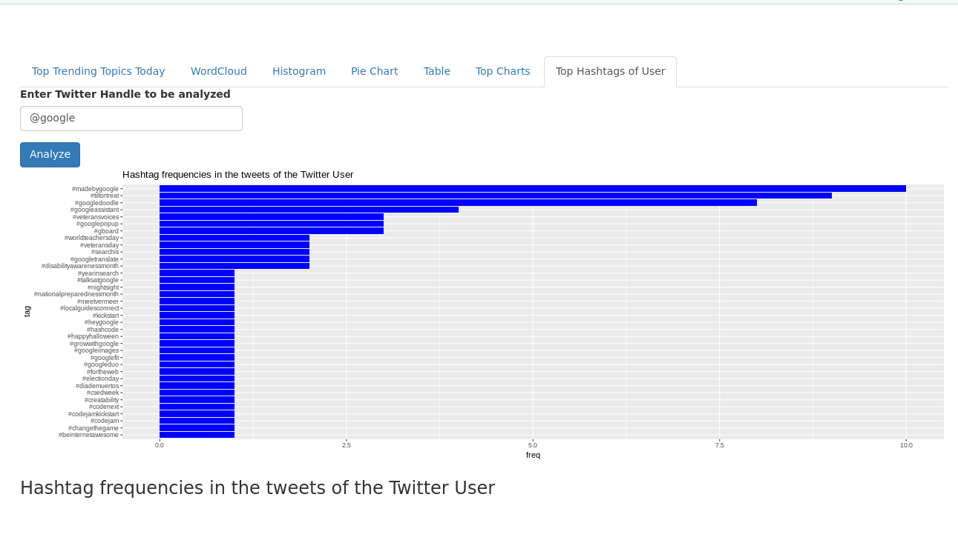
7. Twitter Handle Analysis (Hashtag Frequencies by a particular User)

